Slide 1
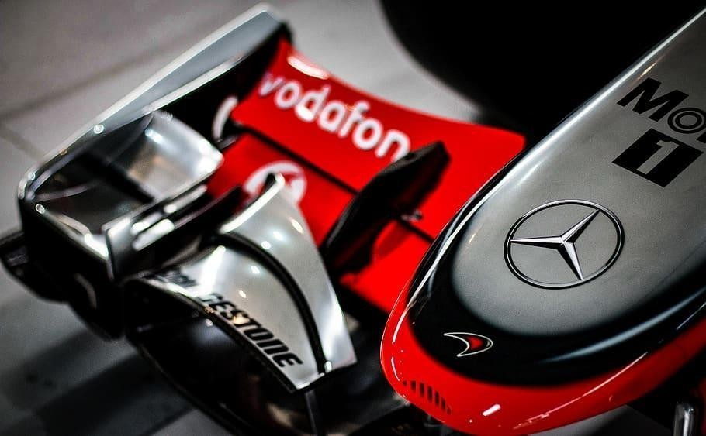
F1 Fan Club
Team:
Sarath Chandra Kunisetty Venu Linga
Avinash Reddy Thiyyagura
Dharma Teja Konidena

Slide 2
Introduction
Formula One is the pinnacle of technological achievement in all of racing. F1 racing is the most popular racing sport across the world. Its popularity is growing exponentially very year. For the F1 2022 the viewership was over a million views per race on ESPN. It's also the world's wealthiest, most intense, most challenging, most charged, and international racing competition. Formula One is very serious about its place at the top of the motorsport tree.
There are many racing fans who are very enthusiastic on auto racing, who wants to make themselves updated with all the information about the sport, teams, drivers which had become the our motive here to provide a one-stop place for all of the racing fans, where they can get access to information/updates about F1 sport, favorite drivers, rankings, upcoming races/events, etc. and that is “Formula One (F1) Fan Club”.

Slide 3
Features/Components
Access to latest news, upcoming races and events:
Users will be able to find the information related to latest news in the F1 field, upcoming races and sport/fan events happening in future. Users will be able to book tickets to the upcoming races, RSVP to the upcoming events and view/share the news on Facebook.
F1-Store:
Logged-in users will be able to browse/shop for their favourite types of merchandise in our store like jerseys, collectables, watches etc. They can filter the available options based on size, price, and category.
User Tier System:
Logged-in users will be able to earn loyalty points based on their interactive activities performed in our application like booking a ticket to an upcoming race, purchasing any item from F1-Store, etc.

Slide 4
Features/Components contd.
Below are the type of activities and number of points that each user gets for respective activities.
Based on the number of points accumulated by the user they are categorized in to 3 tiers
Activity | Points
Sharing F1 club News | 5
Booking Upcoming race ticket | 10
Attend Events & Meetups | 10
Purchase F1 Merchandise | 10
User points | User Tier
0 to 100
100 to 500
500

Slide 5
Features/Components contd.
F1 History and Statistics:
All users will be able to obtain the statistics regarding their favourite teams, drivers and circuits in our application. Also they can access the past history of F1 racing the way it reached to its stage right now and the previous history of the F1 racing seasons starting from 1950, where they can get the details of the rounds that happened in that seasons, winners, circuits etc.
User Profile:
We have certain user interactive options where users have to be registered in to our application in order to access those features. Below are those features
Booking a ticket to an upcoming race
Purchasing any merchandize in F1-store
Sharing news online
RSVP to F1 events
Once the user registers and logs into the application they can view their personal Information, order and booking history

Slide 6
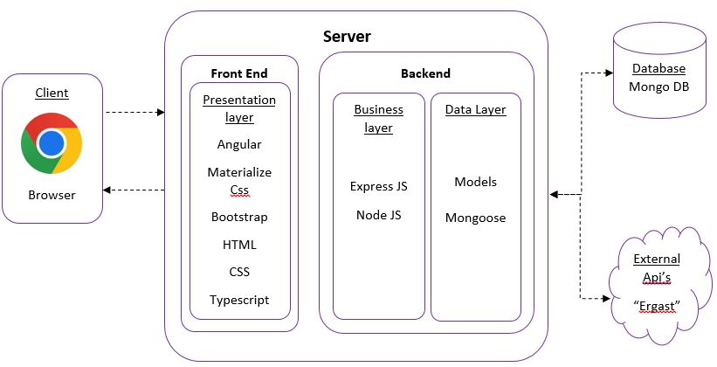
Architecture

Slide 7
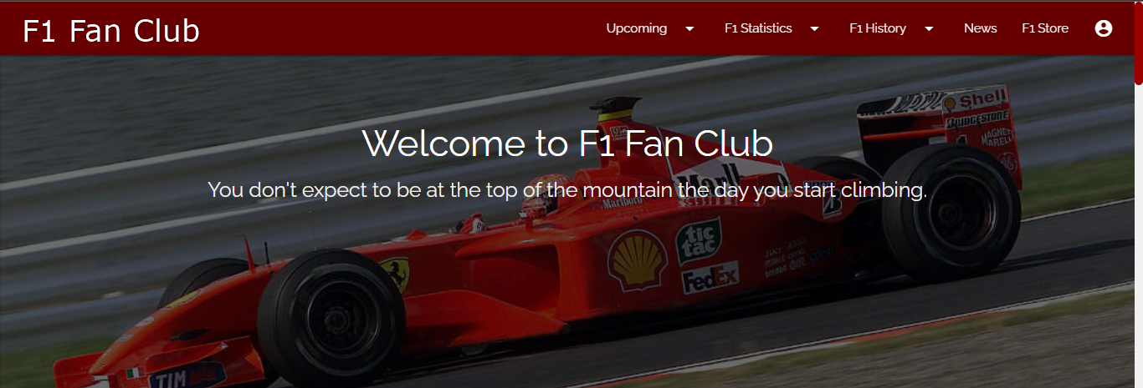
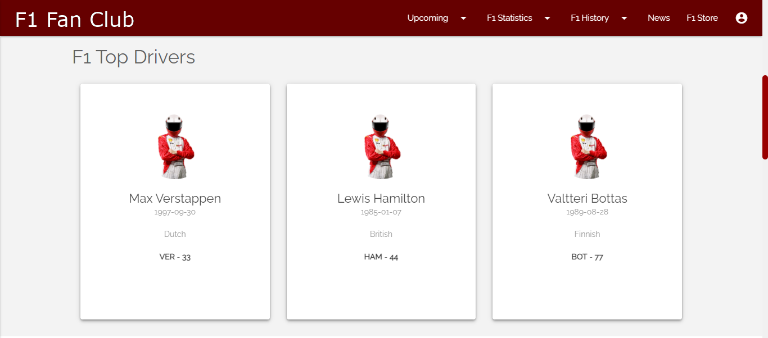
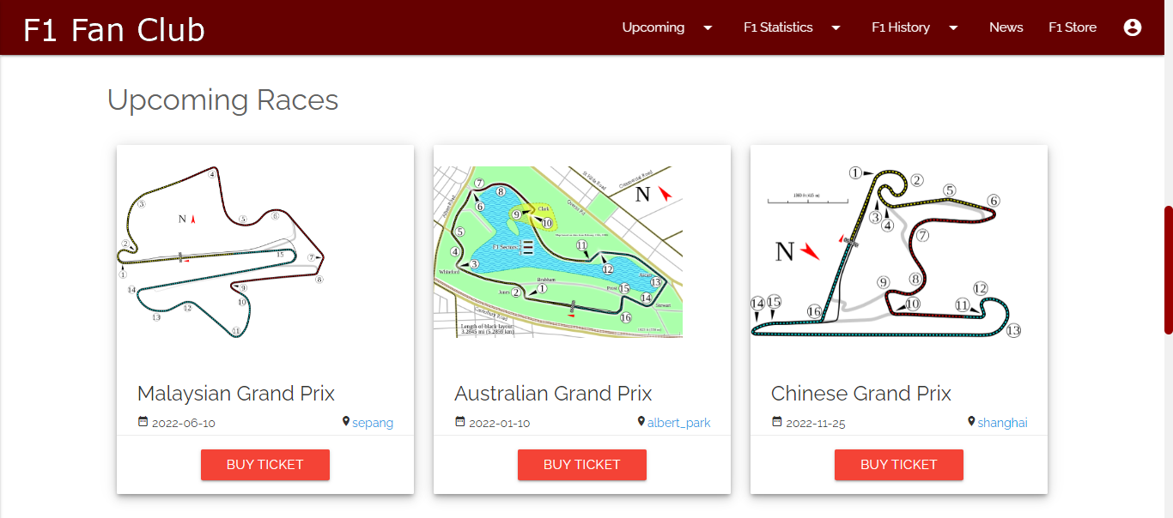
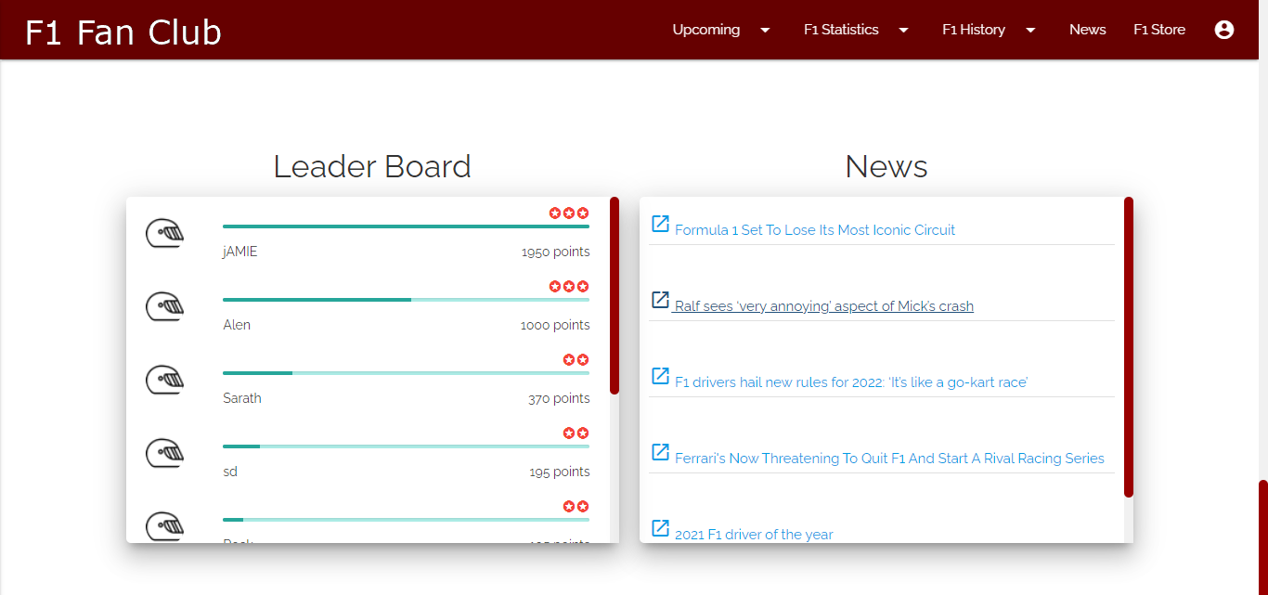
Home Page

Slide 8
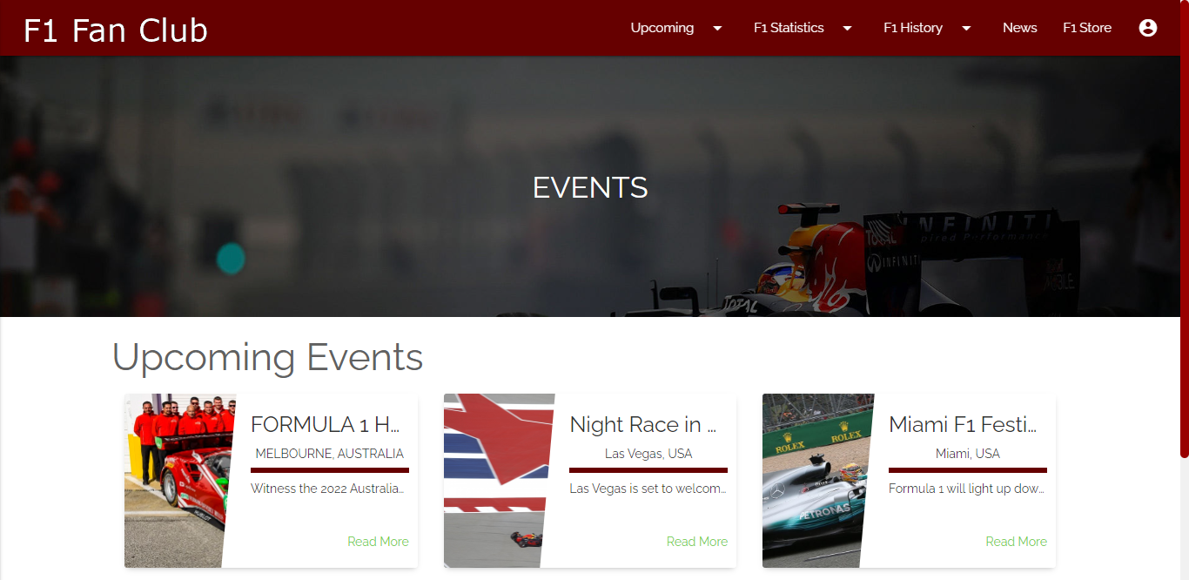
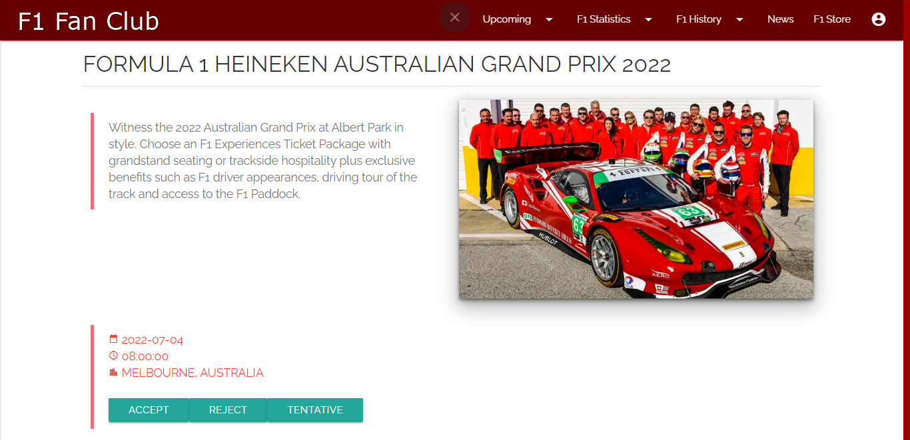
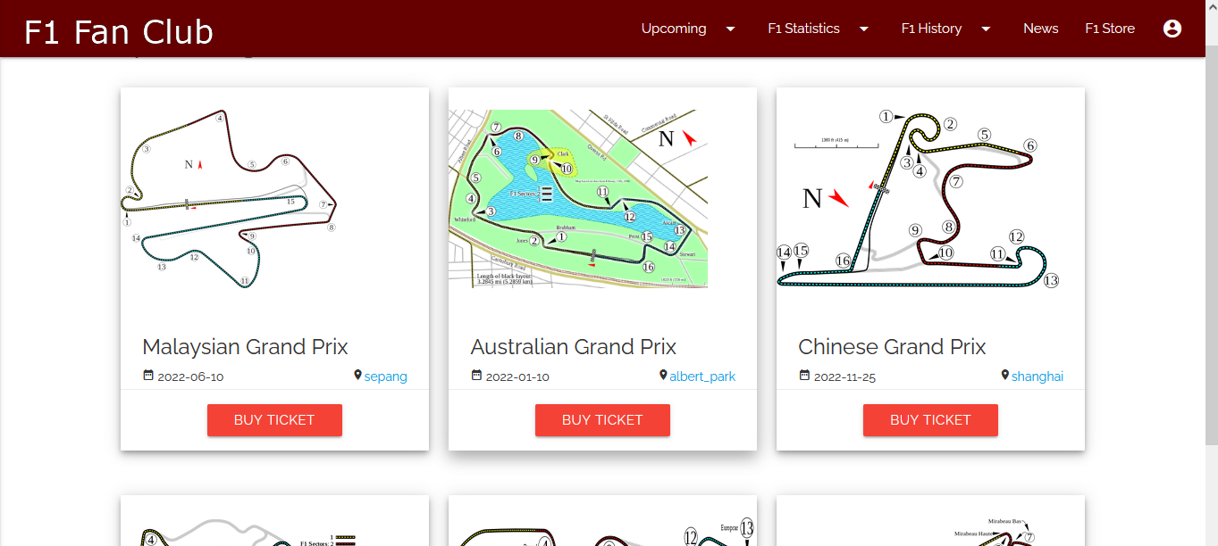
Upcoming Races and Events

Slide 9
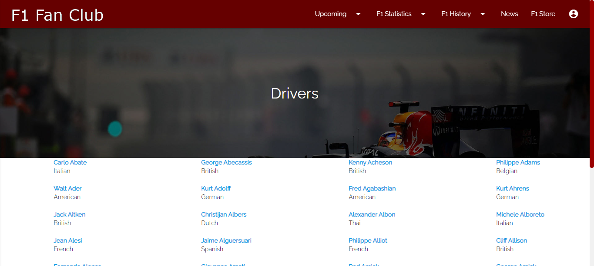
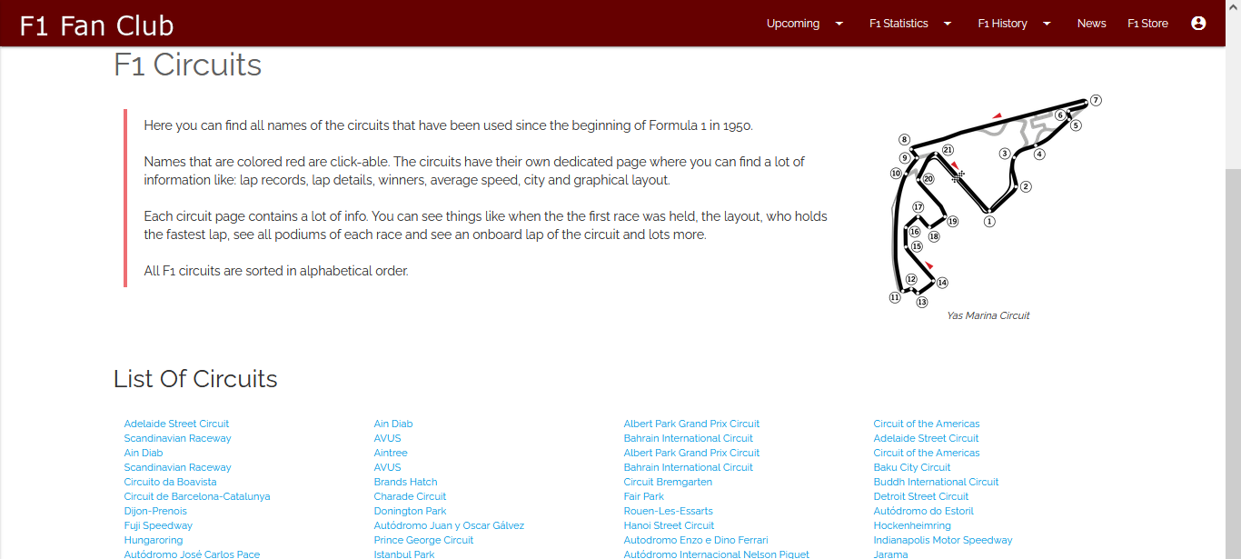
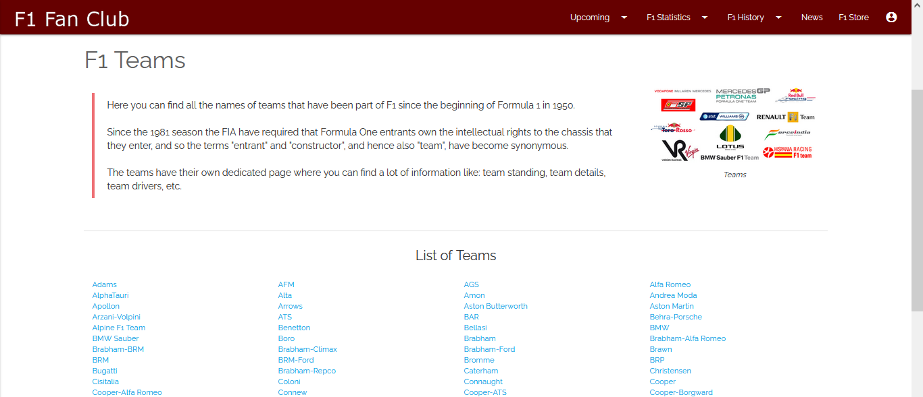
F1 Statistics

Slide 10
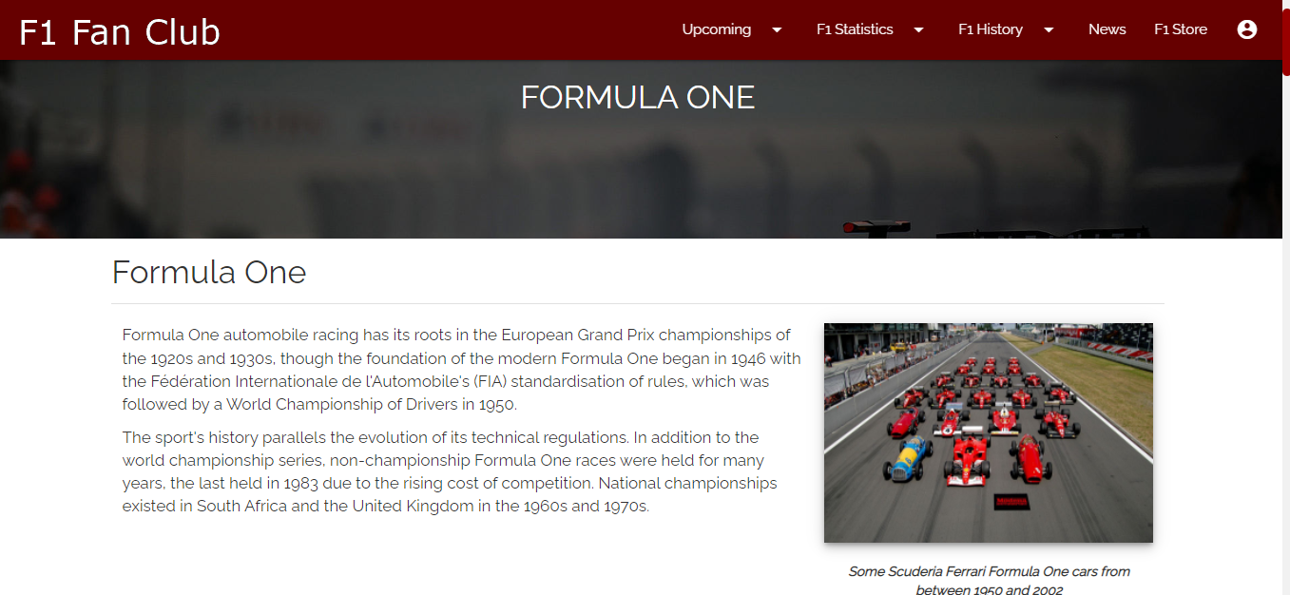
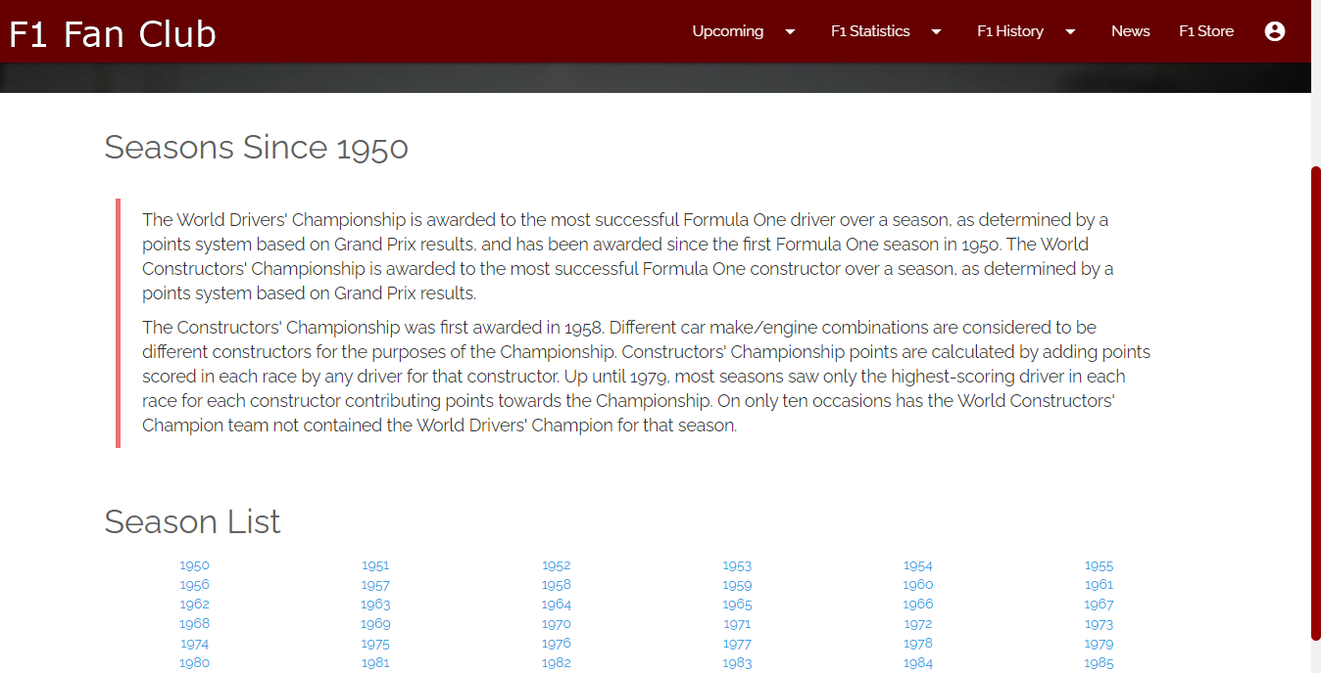
F1 History
In this section the users will be able to view the previous history of how F1 has emerged to the current stage it is right now along with all the that happened in the F1 history starting from 1950.

Slide 11
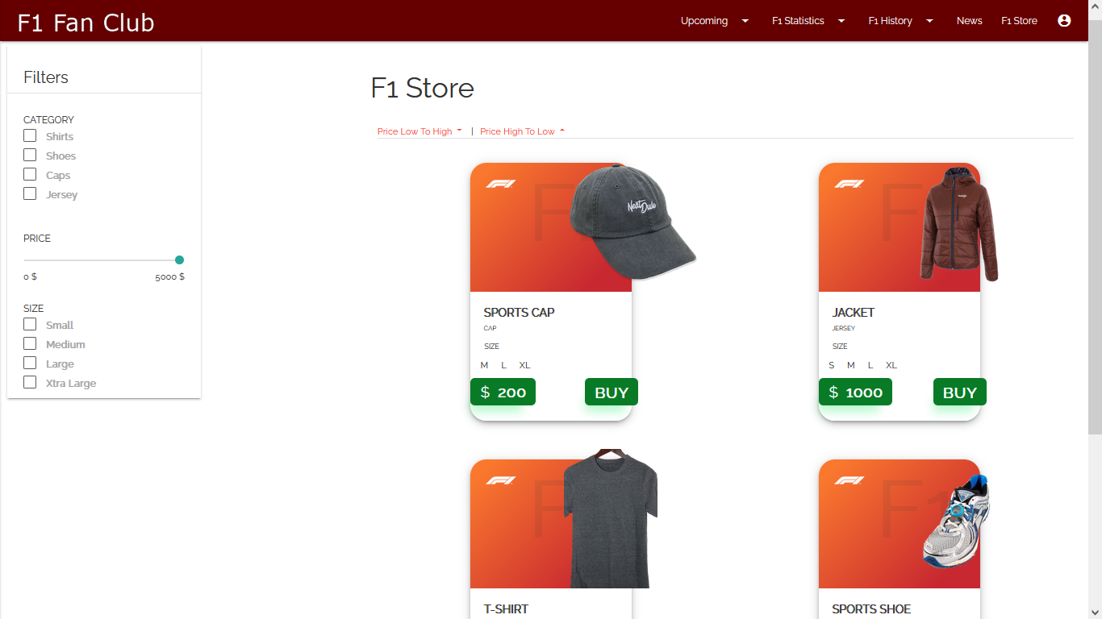
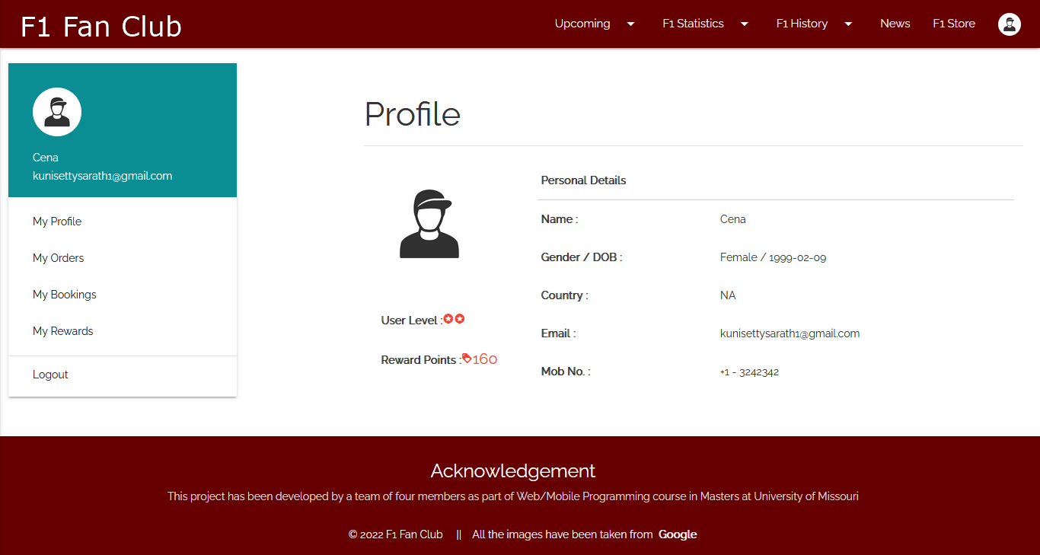
F1 Store & User Profile

Slide 12
Thank You

