Slide 1

Group 19
Prepared for the final project of IT314

Slide 2
Task Allocations:
202201275 - Kunj Bhuva
Project Lead / Frontend Developer
202201315 - Jal Dani
Backend Developer
202201281 - Sakshi Shah
Frontend Developer
202201354 - Ram Kulkarni
Backend Developer
202201292 - Devamm Patel
Backend Developer
202201362 - Tanay Kewalramani
Unit Tester
202201303 - Ansh Pandya
Backend Developer
202201264 - Alpeshkumar Yadav
Documentation
202201363 - Harsh Mangukiya
Documentation
202201271 - Rishabh Jain
Prototyping

Slide 3






Objective # 1
Connecting prospective donors with individuals and organizations in need of donations.
Objectives
Objective # 2
Ensuring the safety of donors by explicitly verifying NGO credentials before onboarding onto platform.
for our Ekta Fund platform
Objective # 3
Providing complete transparency to donors by maintaining records of donations and their usage allocations.

Slide 4

Milestone # 1 - Non-technical
Establishing clear requirements in the form of user stories, analyzing functional and non-functional requirements, and designing various diagrams to bring the said requirements to life followed by sprint planning.
Milestone # 2 - Core technical
Milestones
Actual implementation of all the functionalities. Includes GUI design, backend, and frontend, and designing low redundancy databases followed by final deployment.
we crossed in our journey
Milestone # 3 - Refinements
Testing various aspects of the software. Includes black-box testing, white-box testing, GUI testing, mutation testing et al. Followed by using the results to enhance and fine-tune the software.

Slide 5
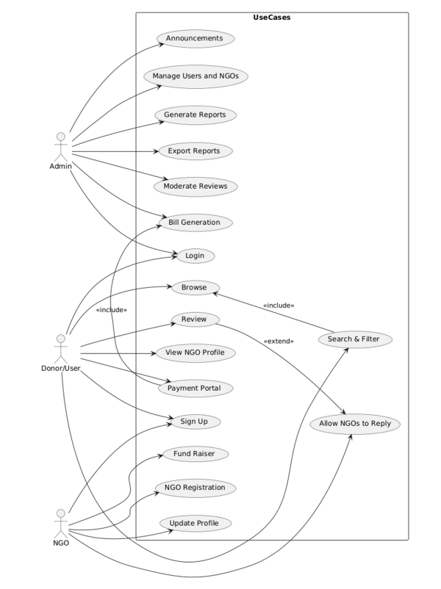

Slide 6


Poor communication between people allocated related tasks led to chaos and waste of time
Lessons learnt
Some time was wasted during redundant meetings. They could have been replaced by group calls.
and the mistakes we made through the process
Debugging was time-consuming since documentation wasn’t up to the mark. Hence learnt about its importance.
Learnt how every code is bound to have bugs. We didn’t invest much time in testing thinking it wouldn’t yield much. We were wrong and testing uncovered a lot of unnoticed bugs.

Slide 7

Despite our team having no prior development experience, we still managed to learn everything from scratch and put a fully functioning website together.
Could design, and were able to successfully implement the said models in code.
Our
Achievements
Successfully implemented the theoretical testing frameworks we learnt in class,
Deployed a fully working end-to-end system despite the severe time constraints - managing three projects and the end semester exams.

Slide 8


The Mistakes
we made along the way
Everybody made commits to the main branch instead of making forks.
Spent way too much time coding and much lesser time actually testing.
Didn’t document and keep good track of the code, leading to a lot of problems while debugging.
Allocated interconnected tasks among members like they were independent. Poor communication led to inefficiency.

Slide 9
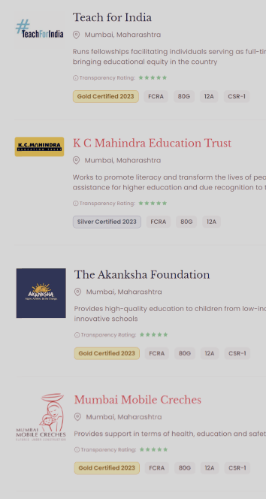
Rating Artefacts
4.5/5
User Stories
4.5/5
Sprints
4/5
Sequence and Class Diagrams
4/5
Source Code
4/5
Testing

Slide 10
Overall Project Rating
8/10

