Slide 1
SLIM: Sparse Linear Methods for Top-N Recommender Systems
based on the research paper by Xia Ning and George Karypis
Group 3: Kunj, Aditi, Jyoti, Garvika

Slide 2
Top-N recommender systems
Memory-based Collaborative Filtering
Item-based k-Nearest-Neighbors: fast but low quality
Model-based Collaborative Filtering
Singular Value Decomposition: high quality but slow
SLIM: Sparse LInear Methods
fast and high quality

Slide 3
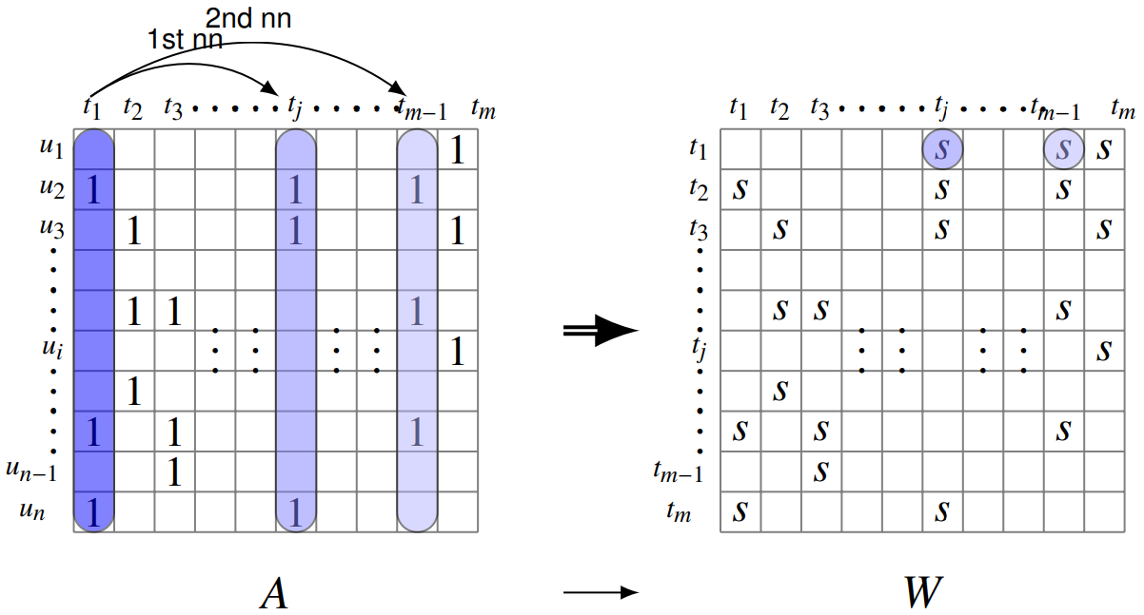
Memory-based CF: itemkNN
Identify a set of similar items
Item-item similarity calculated from A using cosine

Slide 4
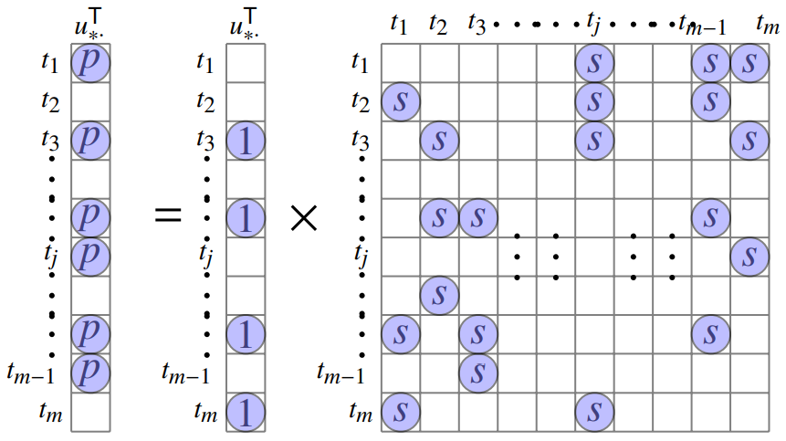

Recommend similar items to what the user has purchased
Fast: sparse item neighborhood
Low quality: no knowledge is learned

Slide 5



: rating for movie a by user u_i
: similarity b/w movie a and b
, where J is the set of similar movies to a

Slide 6
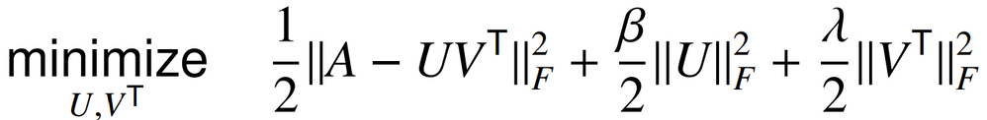
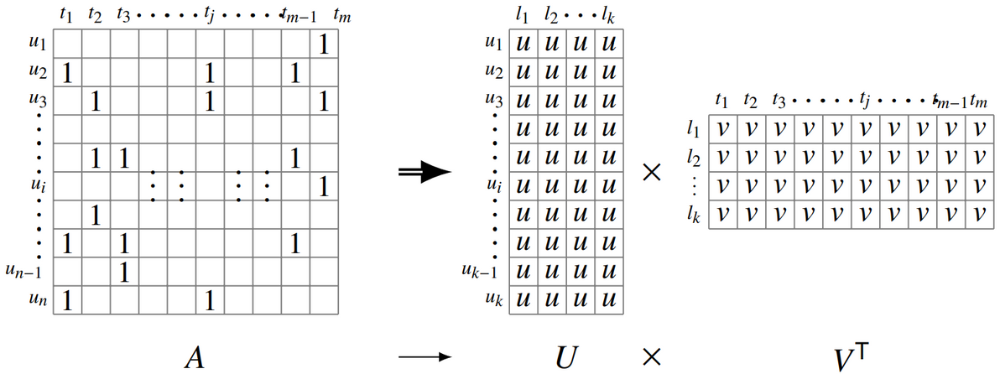
Model-based CF: SVD
Factorize A into low-rank user and item factors that represent user and item characteristics in a common latent space
Formulated as an optimization problem

Slide 7
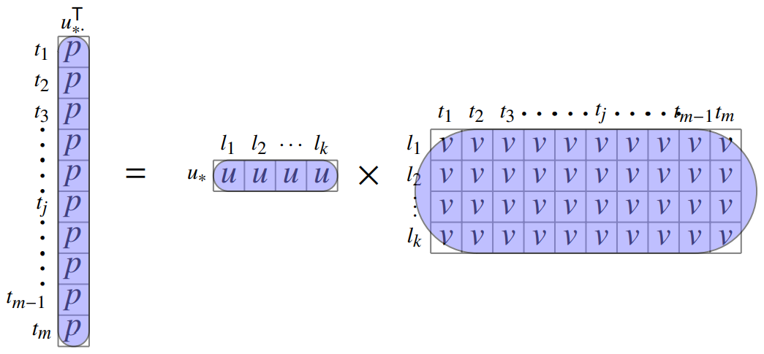

Prediction: dot product in the latent space
Slow: dense U and V^T
High quality: user tastes and item properties are learned

Slide 8
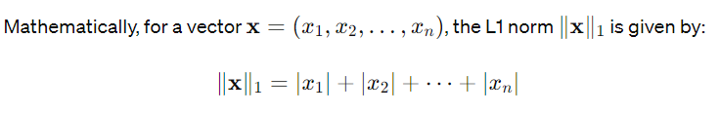
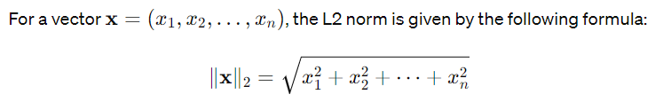
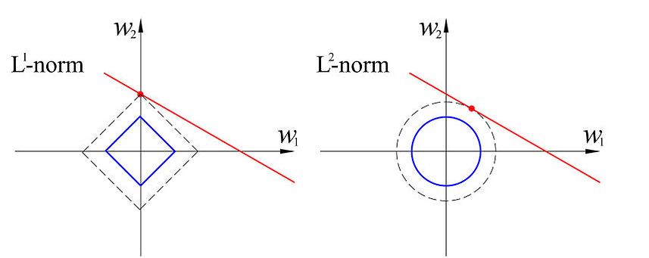

Slide 9

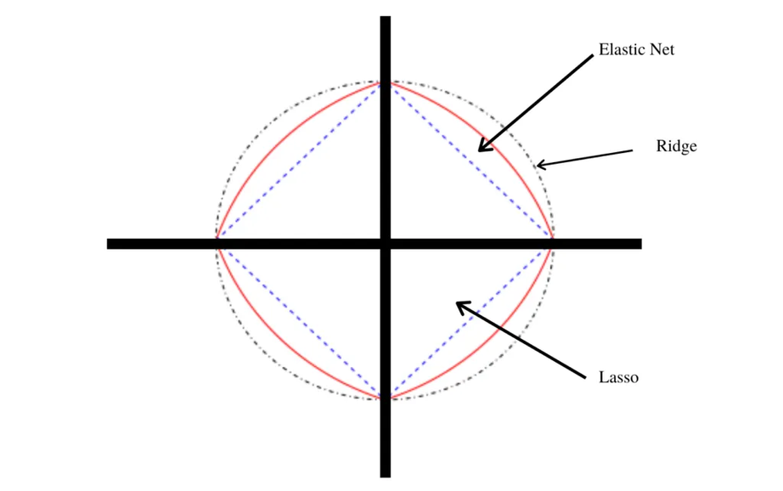



Slide 10



Minimize p_u and q_i over the loss function
Lasso
Ridge
Elastic Net

Slide 11
Motivations:
Recommendations generated fast
High quality recommendations
Key ideas:
retain the nature of itemkNN: sparse W
optimize the recommendation performance: learn W from A
sparsity structures
coefficient values

Slide 12
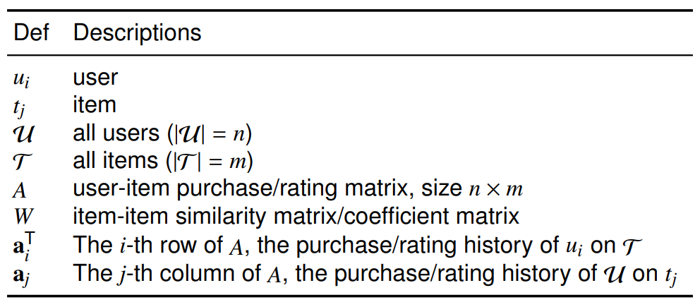
Row vectors are represented by having the transpose T supscript, otherwise by default they are column vectors.

Slide 13
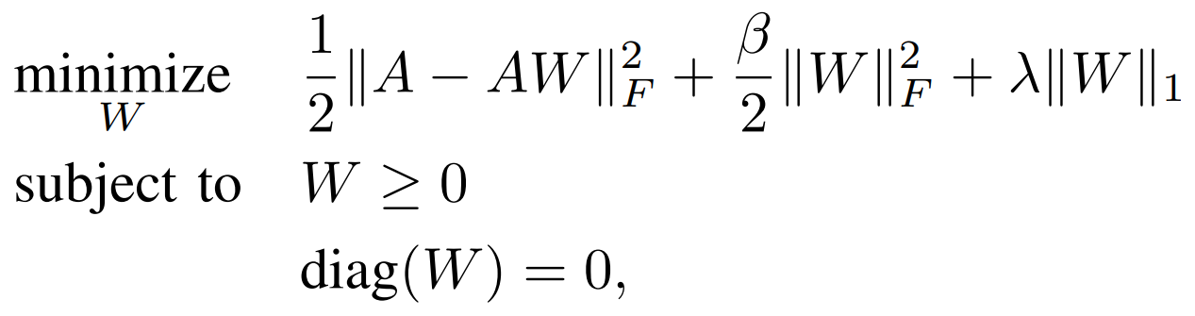

Slide 14
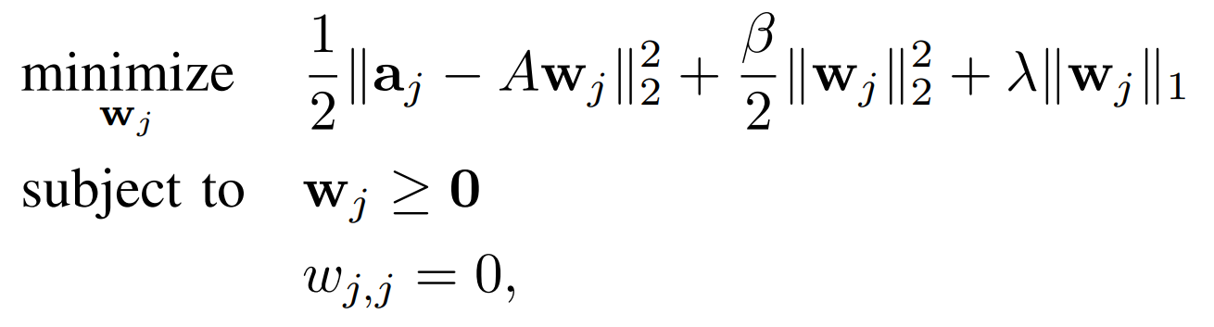
Columns of W are independent, hence are easy to parallelize

Slide 15
Learning W using coordinate descent
Objective function is separable & non-differentiable.
Input features have sparse representations.
If the dimensionality of the function is high, computing the gradient for all parameters can be very expensive.
If the objective function is not smooth or has a discontinuity, then gradient descent may get stuck in the local minima or oscillate around the optimal solution. In such cases coordinate descent can be more robust as it sequentially updates.
When input features are highly co-related, in such cases GD may suffer slow convergence due to the so-called zig-zagging effect

Slide 16
Sparsity Introduction: The L1 regularization is known to introduce sparsity. This sparsity allows SLIM to generate recommendations very quickly.
Model Complexity Control: The L2 regularization helps in controlling the complexity of the model and prevents overfitting. This leads SLIM to have better generalization performance.
Implicit Grouping: The combination of L1 and L2 regularizations together implicitly groups correlated items in the solutions. This means that items that are related or have similar characteristics are grouped.
Noise Reduction: The L1 regularization also helps in capturing the most informative signals while discarding noise due to sparsity. High-quality recommendations as only relevant information is considered.

Slide 17
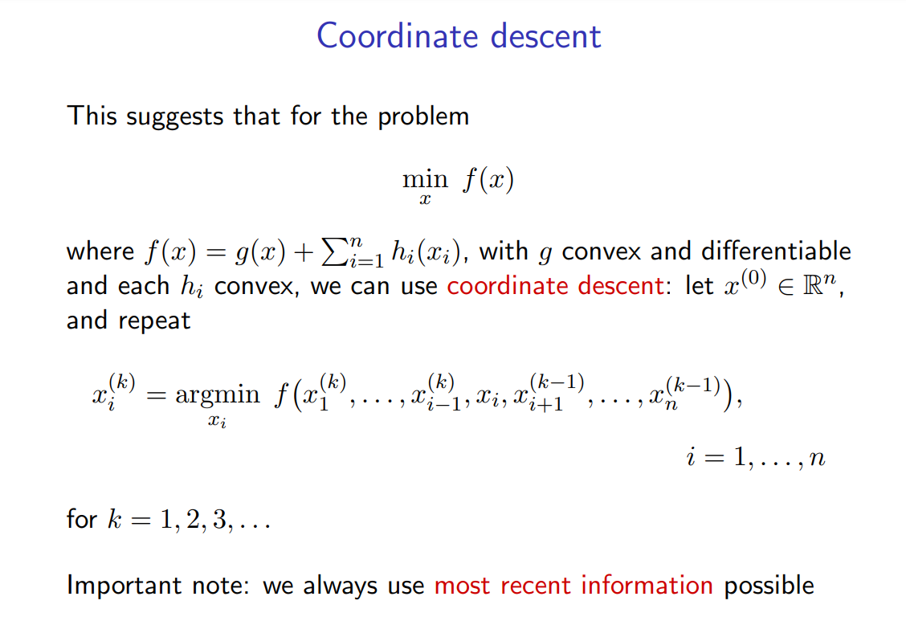

Slide 18
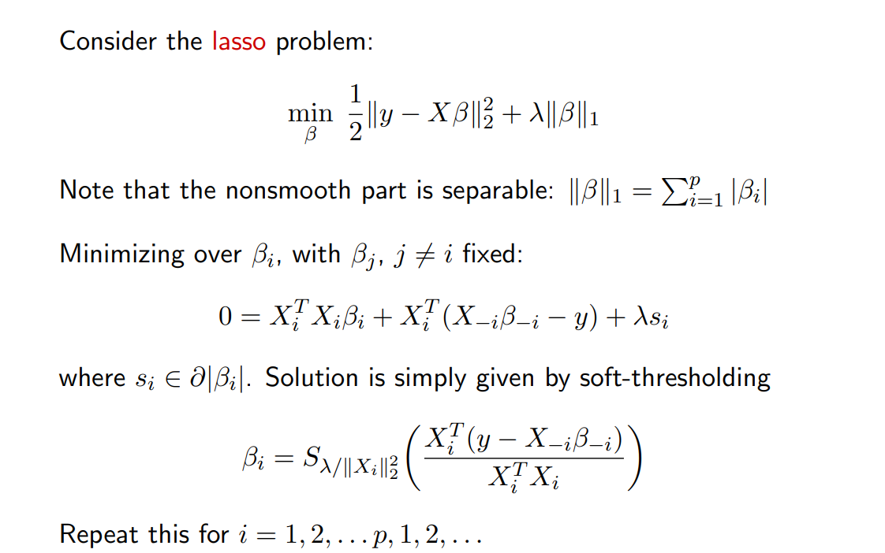

Slide 19
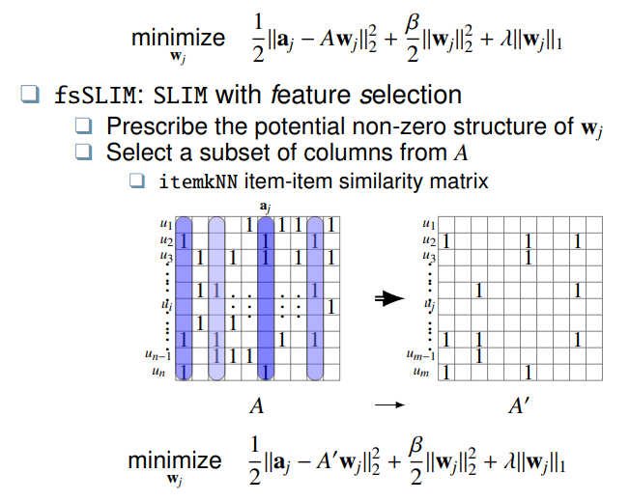

Slide 20
#users | #items | #ratings | rsize | csize | density
1292 | 313 | 23806 | 18.13 | 74.83 | 0.0589
2352 | 620 | 60976 | 25.55 | 96.92 | 0.0418
4203 | 1830 | 181442 | 42.65 | 97.97 | 0.0236
6046 | 3666 | 382038 | 62.52 | 103.11 | 0.0172
10213 | 12971 | 1276344 | 123.71 | 97.40 | 0.0096
Beer dataset with ~1.6 Million datapoints
Ratings from 1 to 5 with 0.5 granularity

Slide 21
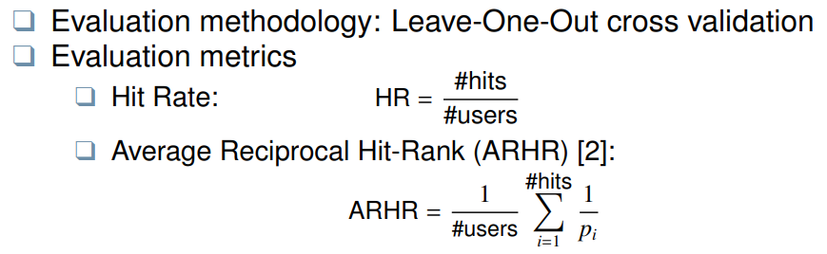

Slide 22

Questions?

