Slide 1

HACKNUTHON 6.0
Digital Farming
Team Name:
Team Members:
Hack Masters
Meet Mulani
Yash Parmar
Kunj Mungalpara
Raxeet Nakum

Slide 2

PROBLEM STATEMENT
Participants will create intelligent algorithms aimed at improving soil health assessment and
crop management, using Reve’s Spectrometer data combined with multi-parameter soil
sensor data and capacitive moisture sensing technologies.

Slide 3

IMPLEMENTATION STEPS
Train and Evaluate Model
Analyze and Visualize Data
1
3
5
2
4
Load and Prepare Data
Predict Nutrients for new Data
Save Models & Scalers

Slide 4
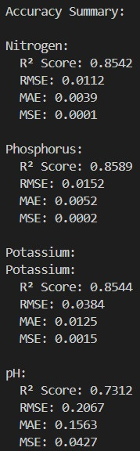
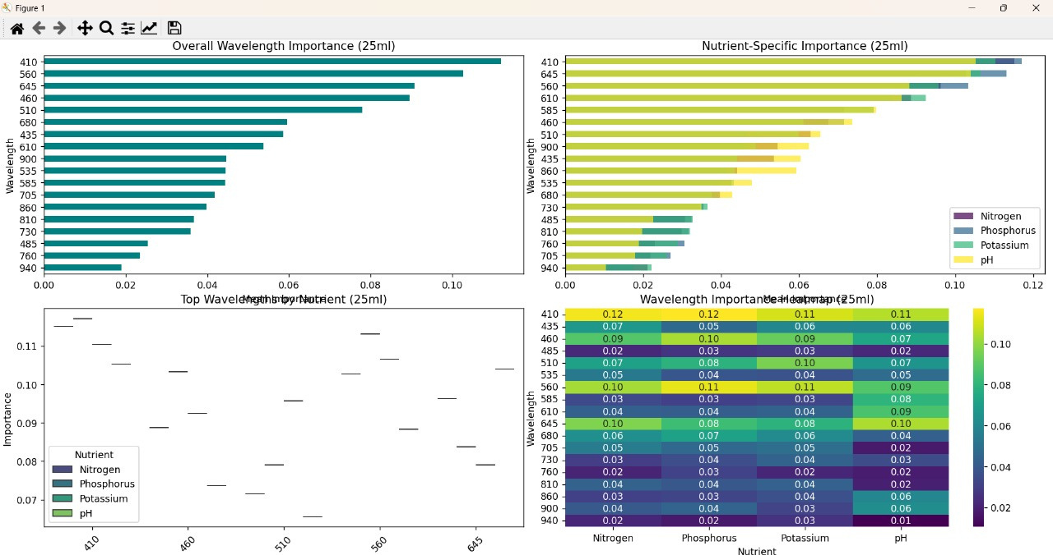
RESULTS

Slide 5
CONCLUSION
Digital farming projects aim to enhance soil health assessment and crop management using advanced algorithms and sensor data. By leveraging technology, these solutions help improve yields, sustainability, and productivity, contributing to smarter and more efficient agriculture.

Slide 6
Refernces
Github Link:
https://github.com/kunj24/HACK-MASTER
Demo Video:
https://drive.google.com/file/d/1E7Tjg68Hn3CzRC65Me2ROUkHVEnqNe2h/view?usp=drivesdk

Slide 7
THANK YOU

