Slide 1


D1 Mission Readiness & Predictive Maintenance Copilot
Team Galcogens — IBM Bob AI Innovation Hackathon, Track: AI
Predict
AI-powered prognostics for readiness
Allocate
Mission-adaptive sortie matching
Comply
Automated AFTO documentation

Slide 2

The Problem: Unreliable Mission Readiness
Military organizations face a critical challenge: accurately assessing the true mission readiness of aircraft, vehicles, and combat equipment. Current maintenance protocols often rely on fixed calendar intervals, a reactive approach that fails to account for the actual, real-time degradation of components.
This outdated approach leads to unexpected failures in over 50% of critical missions.
With the US military investing an astonishing $90 billion annually in maintenance, a strategic shift to predictive, condition-based maintenance is not just about cost-efficiency—it promises to save billions and, more importantly, protect human lives by significantly reducing mission-critical failures.

Slide 3
The Data Paradox
Gigabytes of onboard HUMS telemetry — temperatures, vibrations, pressures — sit unanalyzed in data silos while platforms remain grounded for weeks, even though the data needed to predict failures weeks in advance already exists.
What We Have
What's Happening Instead
HUMS Telemetry
Historical Maintenance Records
Data Silos
Platforms Grounded
Continuous streams of temperature, vibration, and pressure sensor data from every platform
Critical sensor data remains isolated, unprocessed, and invisible to decision-makers
Aircraft sit idle for weeks on calendar-based schedules while actionable data goes unused
Years of AFTO Form 781A discrepancy logs and repair histories

Slide 4





Solution & Architecture
An end-to-end modular monolith platform built for military-grade reliability:
Telemetry Ingestion
GPU-Accelerated XGBoost Prognostics
FMC/PMC/NMC Readiness Scoring
Real-time HUMS data pipeline
High-speed failure prediction
Tri-state mission capability rating
IBM Bob Copilot via FastMCP
watsonx.ai Granite 3-8B
Natural language diagnostics
Autonomous tool orchestration

Slide 5
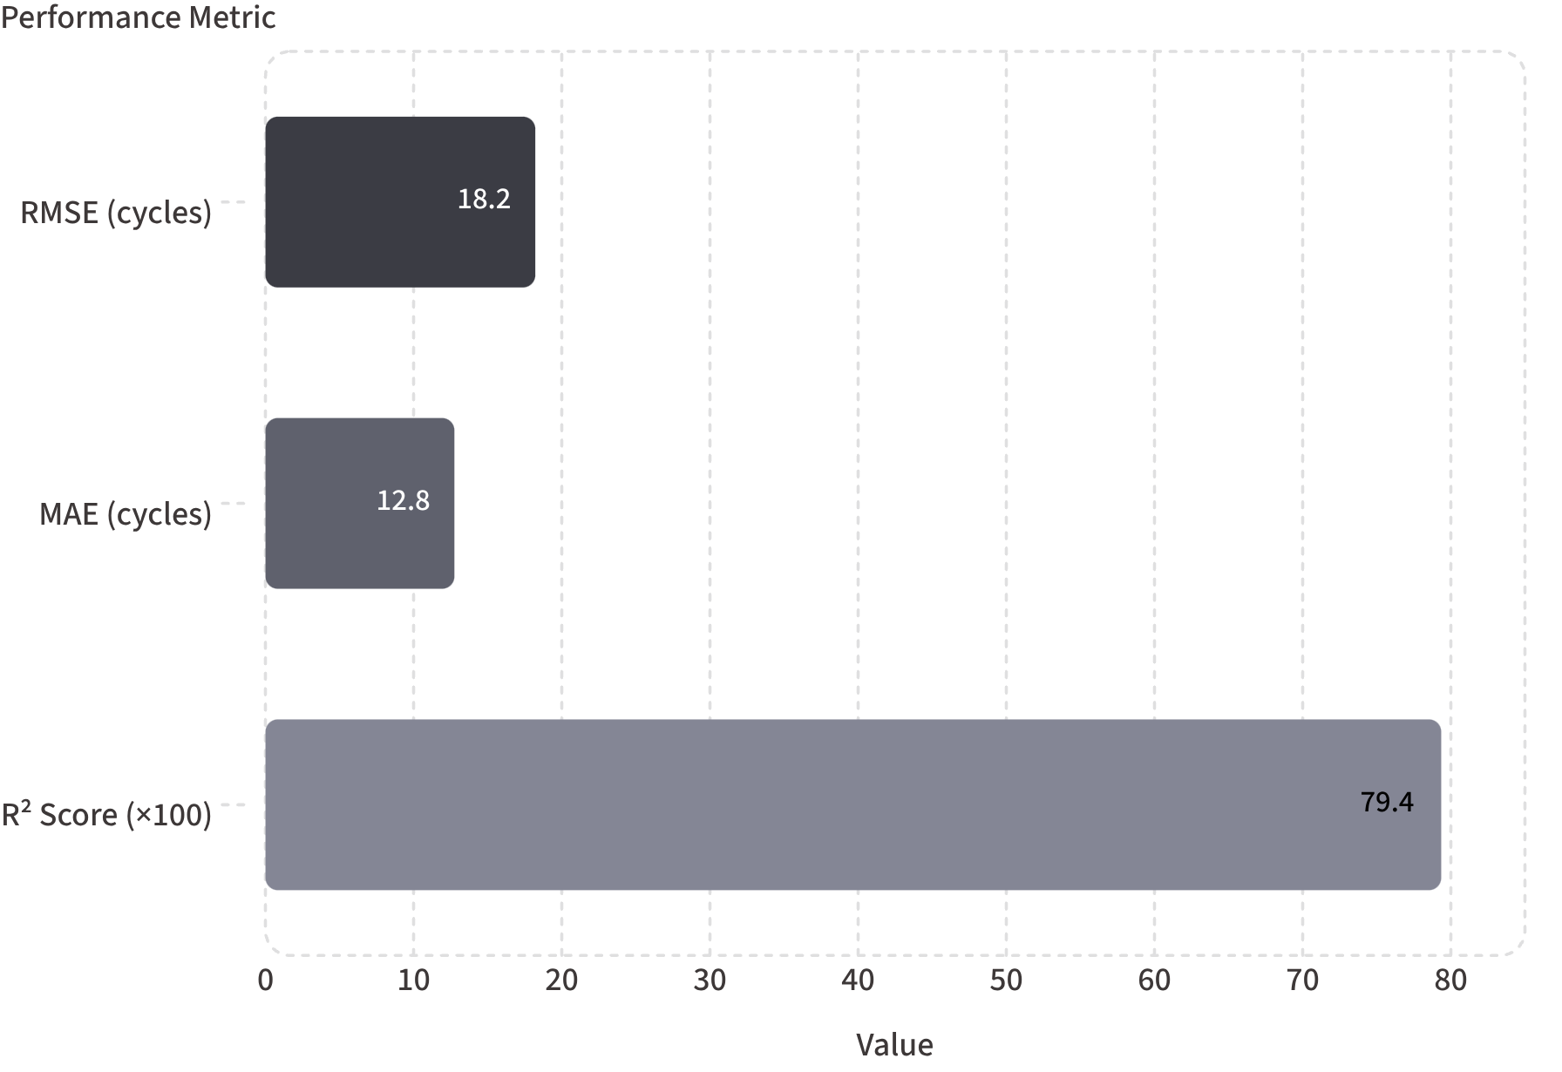

Propulsion Physics & NASA C-MAPSS ML
Model Details
GPU-accelerated XGBoost regressor trained on NASA C-MAPSS FD001 turbofan degradation benchmark
108 engineered condition features extracted from raw sensor streams
Verified holdout performance on unseen test data
R² of 0.7935 — strong predictive power on real turbofan degradation data

Slide 6
What-If Mission Stress Simulator
A counterfactual digital twin that models harsh combat environments — computing environmental wear multipliers and mission survivability probability before committing a platform to a sortie.
Desert Heat 45°C
Sand/Dust Ingestion
Thermal stress on engine and avionics components
Compressor blade erosion and filter degradation modeling
Sub-Zero Arctic
9G Combat Turns
Cold-soak hydraulic and fuel system stress simulation
Structural fatigue and airframe load cycle accumulation

Slide 7
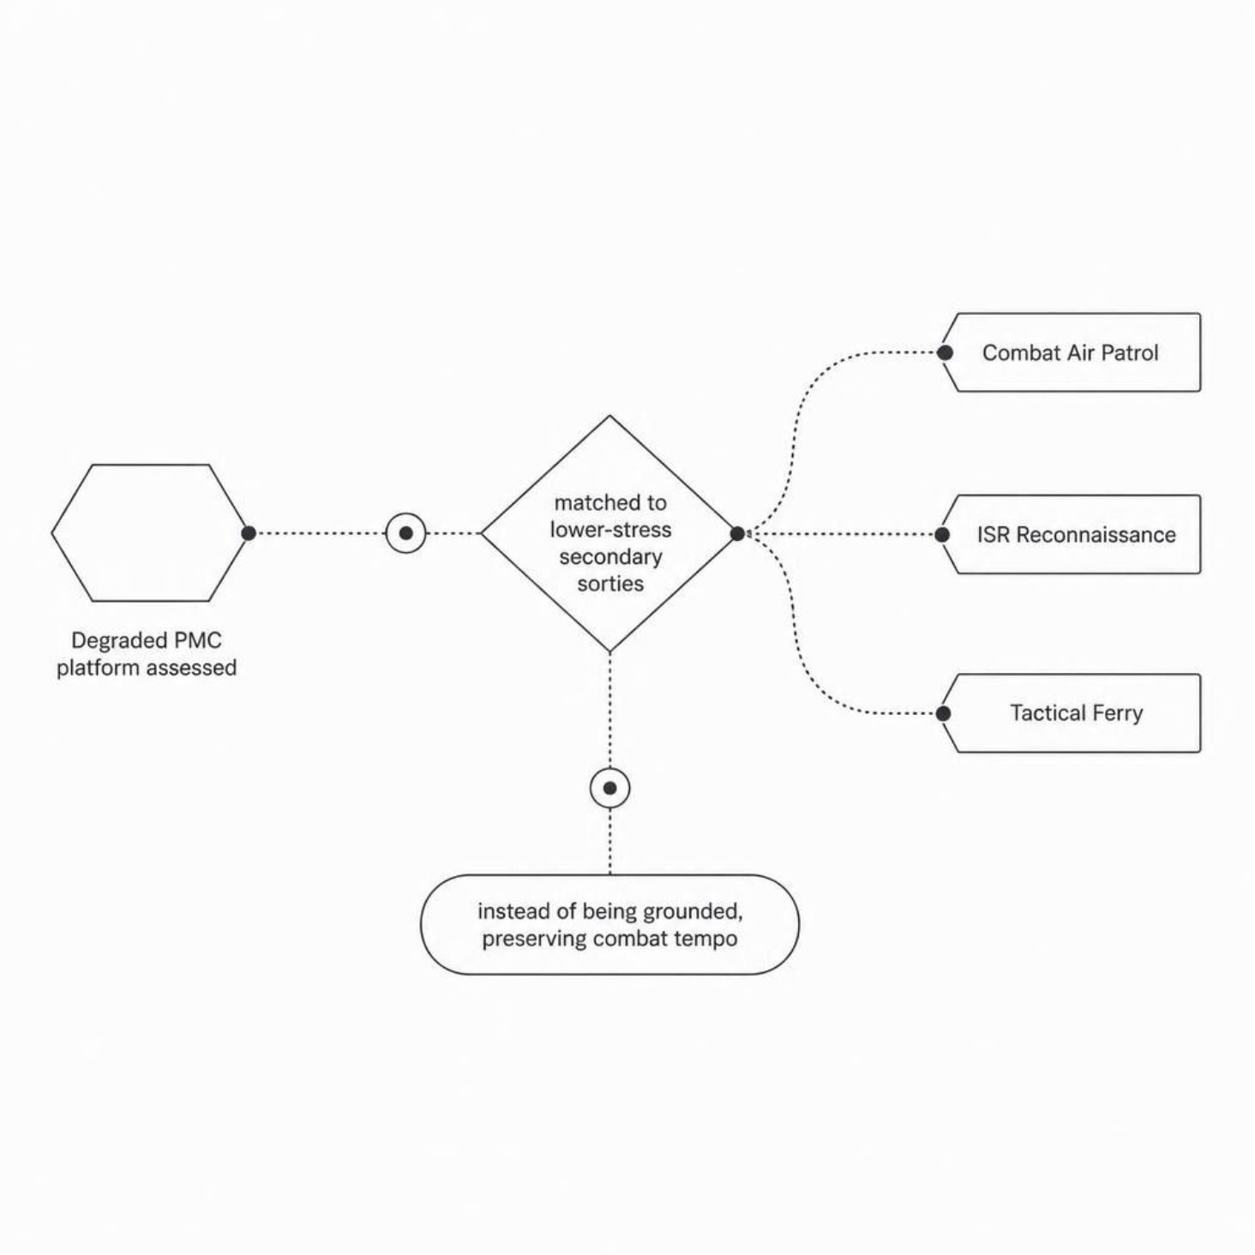

Mission-Adaptive Sortie Re-allocation
Dynamic Air Tasking Order (ATO) Engine
A dynamic ATO matching engine that re-allocates degraded (PMC) platforms to secondary, lower-stress sorties instead of grounding them outright — preserving combat tempo.
Secondary Sortie Types
Combat Air Patrol
ISR Reconnaissance
Tactical Ferry
Every available airframe stays in the fight — just matched to the right mission.

Slide 8
Digital AFTO Form 781A Compliance
Automated generation of official Air Force defense discrepancy documentation — eliminating manual paperwork and ensuring regulatory compliance at machine speed.
Grounding Symbols
Job Control Numbers
Red X and Red Diagonal grounding symbols auto-applied per technical order criteria
Automated JCN generation for every discrepancy, enabling full maintenance traceability
Military J-Codes
DLA NSN Parts Requisitions
Standardized maintenance action codes applied automatically to each work order
Defense Logistics Agency National Stock Number requisitions generated at point of diagnosis

Slide 9

Deep IBM Bob FastMCP Integration & watsonx.ai Granite Intelligence
FastMCP Server — 11 Autonomous Tools
watsonx.ai Granite 3-8B Instruct
Provides plain-language diagnostic reasoning for maintainers — translating complex sensor anomalies into actionable natural language explanations.
A FastMCP server at /mcp exposes 11 autonomous tools to IBM Bob for:
Fleet summaries
Asset diagnostics
What-if stress tests
Work order generation
Maintenance history search
Dual-mode engine guarantees crash-free execution even in air-gapped or keyless test environments — built for operational resilience.

Slide 10

Operational Impact & Metrics
Projected outcomes from full fleet deployment of the D1 Mission Readiness Copilot:
40%
20%
85%+
Fewer Unplanned Failures
Lower MTTR
FMC Readiness Rate
Reduction in unexpected in-field component failures across the fleet
Reduction in Mean Time To Repair through pre-staged parts and predictive work orders
Sustained Fully Mission Capable fleet readiness — exceeding operational thresholds
Predict Failures
Allocate Platforms
Optimize Readiness

Slide 11
Known Limitations
Simulated Bus Telemetry
Dual-Mode AI Engine
Authentication Bypass in Dev
If an evaluator does not provide active IBM Cloud credentials, the system activates an offline deterministic Granite 3-8B simulation engine to guarantee a crash-free experience.
Sensor streams are mapped from real run-to-failure NASA C-MAPSS turbofan data rather than a physical MIL-STD-1553 aircraft hardware bus.
Token requirements default to Commander role in development mode to permit frictionless evaluation.

Slide 12


Team Galcogens
Meet the dedicated team from CHARUSAT University behind the D1 Mission Readiness Copilot:
Kunj
Vedant
Path
Venisha
Team Lead, AI/ML Specialist
d24aiml082@charusat.edu.in
AI/ML Developer
23aiml042@charusat.edu.in
AI/ML Developer
23aiml055@charusat.edu.in
Data Science Specialist
23dcs134@charusat.edu.in

