Slide 1


ECS 289G 002: Advanced Topics in Vision - Language Research
FeasibilityLens
AI-driven agent assessing research feasibility by analyzing theory, practicality, and computational constraints with RAG
Team Pragmatists:
Kunjal Agrawal
Likhitha Surakasi
SriJhanyaa Srinivasan Prof. Lifu Huang

Slide 2


Contents
Problem Statement
Motivation
Background
Related Work
Proposed Idea
Results
Team Roles

Slide 3

Problem Statement
How can we extract and integrate domain-specific knowledge into LLMs for better performance?

Slide 4
Motivation
Assessing the feasibility of new research ideas is complex. Expertise is required to verify the theoretical alignment. Practical aspects such as computing requirements and data availability must be considered.
FeasibilityLens leverages RAG-powered LLMs to automate these task. By integrating domain-specific knowledge, RAG provides deeper contextual understanding and more accurate comparisons, making LLMs more efficient.

Slide 5
Background
Why did we choose this Project which is related to research papers?
Central Role in Knowledge Dissemination
Need for Improved Review Processes
Supporting Academic and Industry Collaboration
Why did we choose RAG?
Retrieval-Augmented Generation (RAG) is a technique that combines the best of both retrieval-based and generative AI models
Enhanced Accuracy and Relevance
Scalability and Flexibility
Deeper Contextual Understanding

Slide 6
Related Work
"Can Large Language Models Provide Useful Feedback on Research Papers? A Large-Scale Empirical Analysis"
Explores the use of GPT-3, to generate feedback on research papers. The authors evaluate the quality of LLM-generated feedback, comparing it with human-written feedback.
The study finds that LLMs can provide helpful feedback on aspects like clarity and relevance but they struggle with conceptual evaluation.

Slide 7
Related Work
“ReviewRobot: Explainable Paper Review Generation based on Knowledge Synthesis”
Automation of paper review process by generating comments across categories such as novelty, soundness, and impact. It uses KGs from paper, its citations, and a broader collection of related works.
These KGs serve as evidence, which is compared to generate feedback. Experimental results show the review score predictor achieves 71.4%-100% accuracy.

Slide 8

Methodology

Slide 9
Proposed Methodology
Input Papers
User Input: The researcher uploads the current research paper and a set of related papers.
Retrieval-Augmented Generation (RAG)
Paper Retrieval: Use a RAG model (which combines search and generation) to retrieve relevant papers from a pre-built database or repository.
Text Embedding: Papers are embedded into a vector space using models like BERT or Sentence-BERT, ensuring semantic similarity is captured for accurate retrieval.

Slide 10
Proposed Methodology
3. Methodology Extraction
NLP Techniques: The RAG model extracts key methodological details (e.g., experimental design, algorithms, data collection methods) from the retrieved papers using Named Entity Recognition (NER) and dependency parsing.
Relevant Information: The extracted information, such as techniques, assumptions, and methodologies, is organized and prepared for feasibility analysis.
4. Comparison & Analysis
LLM Evaluation: The extracted methodological information is passed to a Large Language Model (LLM), like GPT-4, for analysis.

Slide 11
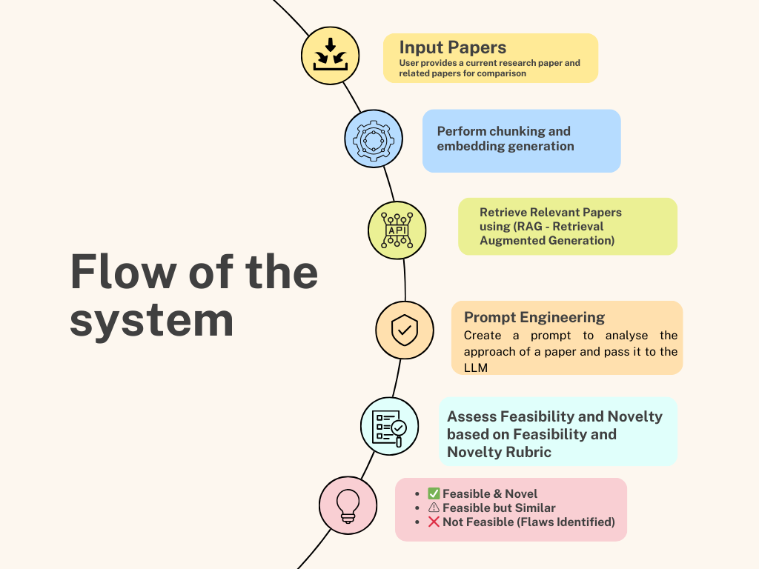

Slide 12
Team Roles
Kunjal
Likhitha
SriJhanyaa
Data Collection, Embedding Generation and Normalization, Evaluation and Testing
Data Collection, Preprocessing, Prompt Engineering and RAG implementation.
Data Collection, RAG - LLM Integration and Prompt Tuning

Slide 13
THANK YOU

