Slide 1

Coloring Black and White Images
Prepared By:
Kunjan Khatri
Kathan Patel
CSCI S-89 Introduction to Deep Learning
Summer 2020
Harvard Summer School

Slide 2
Introduction
We were recently watching a classic and historic Bollywood Movie which was originally in black and white, now colorized. This made us eager to try something like this using deep learning. So, we decided to start with colouring black and white images.
Today, colorization is done by hand in Photoshop. A picture can take up to one month to colorize. It requires extensive research.
A face alone needs up to 20 layers of pink, green and blue shades to get it just right. So, we thought of trying this using neural networks.
First attempt was to train a model on input image and get results based on that.
Second, we used the inception resnet v2 — a network trained on 1.2M images.

Slide 3
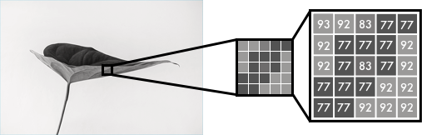
Methodology
Black and white images can be represented in grids of pixels. Each pixel has a value that corresponds to its brightness. The values span from 0 - 255, from black to white.
Color images consist of three layers: a red layer, a green layer, and a blue layer. This might be counter-intuitive to you. Imagine splitting a green leaf on a white background into the three channels. Intuitively, you might think that the plant is only present in the green layer.

Slide 4
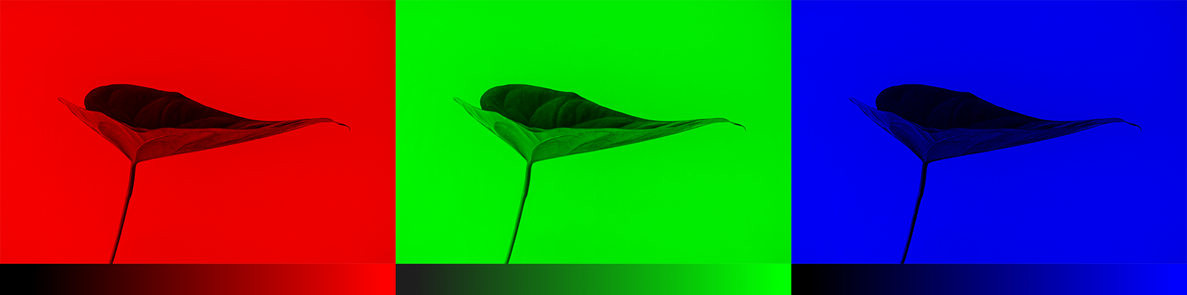

Methodology
As you see below, the leaf is present in all three channels. The layers not only determine color, but also brightness.
To achieve the color white, for example, you need an equal distribution of all colors. By adding an equal amount of red and blue, it makes the green brighter. Thus, a color image encodes the color and the contrast using three layers:

Slide 5
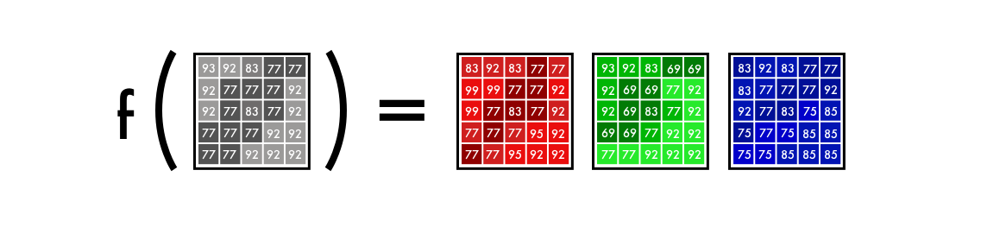
Methodology
Just like black and white images, each layer in a color image has a value from 0 - 255. The value 0 means that it has no color in this layer. If the value is 0 for all color channels, then the image pixel is black.
As you may know, a neural network creates a relationship between an input value and output value. To be more precise with our colorization task, the network needs to find the traits that link grayscale images with colored ones.
In sum, we are searching for the features that link a grid of grayscale values to the three-color grids.

Slide 6
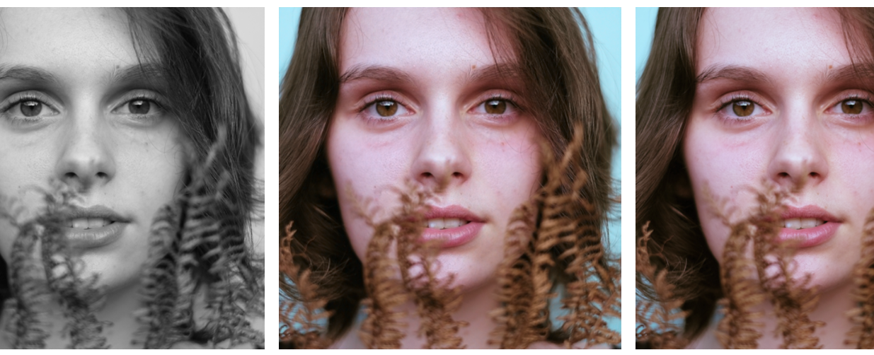
Version-1
We’ll start by making a simple version of our neural network to color an image of a woman’s face.
The middle picture is done with our neural network and the picture to the right is the original color photo. The network is trained and tested on the same image.

Slide 7
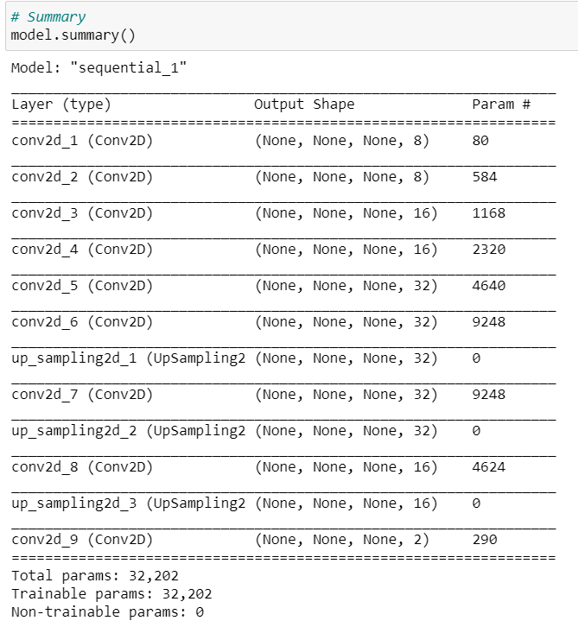
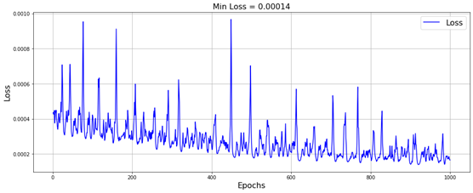
Model
Model Loss
Model Summary

Slide 8
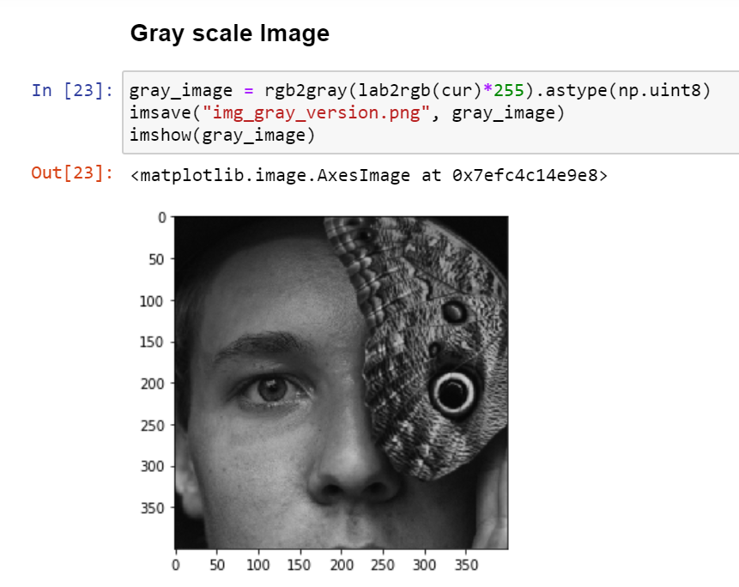
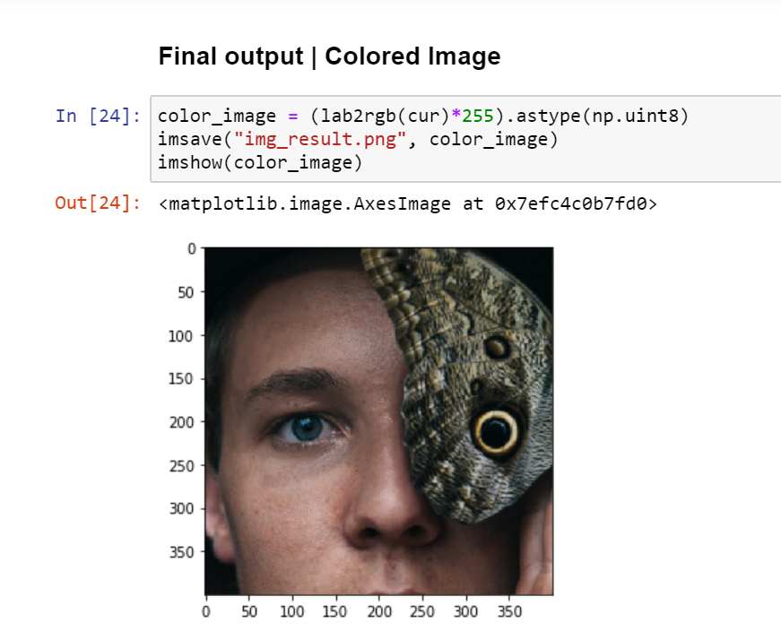
Output

Slide 9
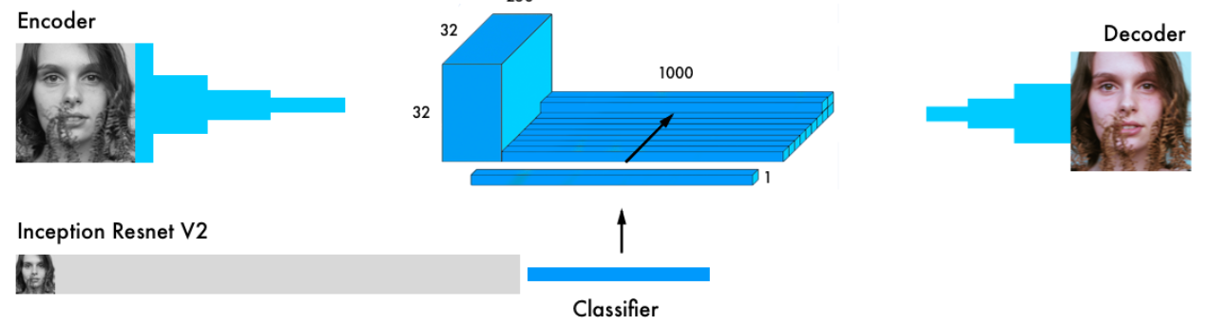
Final Version
Our final version of the colorization neural network has four components. We split the network we had before into an encoder and a decoder. Between them, we’ll use a fusion layer.
In parallel to the encoder, the input images also run through one of the today’s most powerful classifiers — the inception resnet v2 — a network trained on 1.2M images. We extract the classification layer and merge it with the output from the encoder.
By transferring the learning from the classifier to the coloring network, the network can get a sense of what is in the picture. Thus, enabling the network to match an object representation with a coloring scheme.

Slide 10
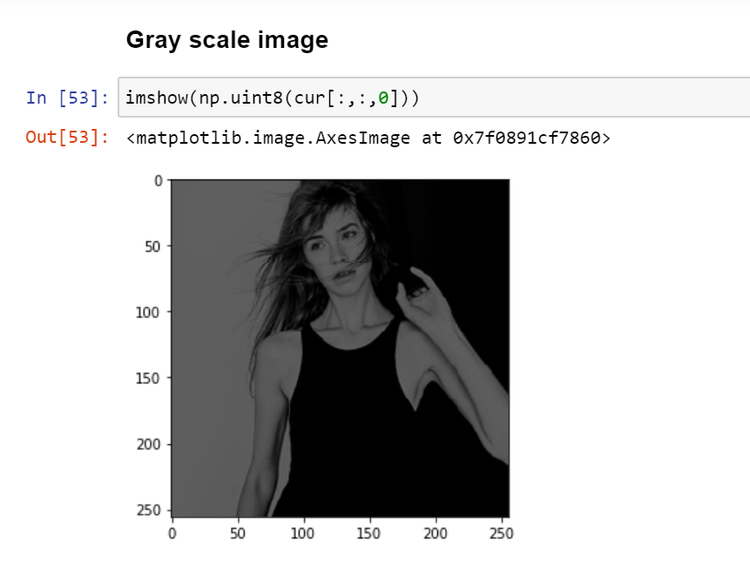
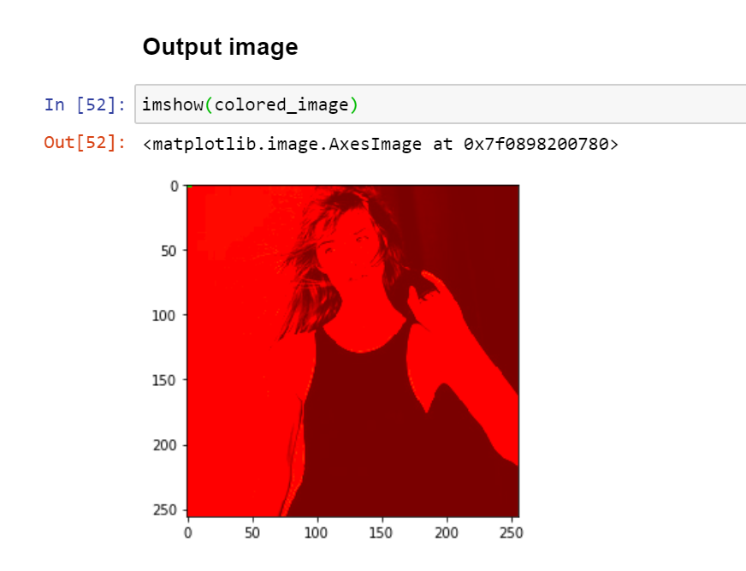
Output

Slide 11
Future Work
Implement it with another pre-trained model
Use more GPU power
A different dataset
Enable the network to grow in accuracy with more pictures
Apply it to video
Try on larger images, by tiling smaller ones

Slide 12
YouTube Video Presentation
YouTube video presentation:
https://youtu.be/9acbLWBy3oA

Slide 13
Thank You

