Slide 1
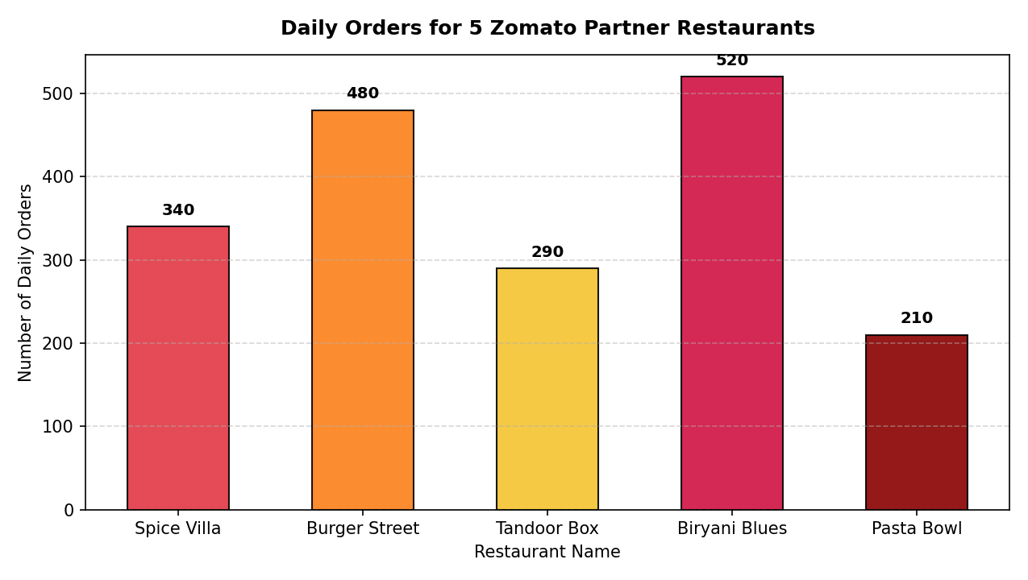
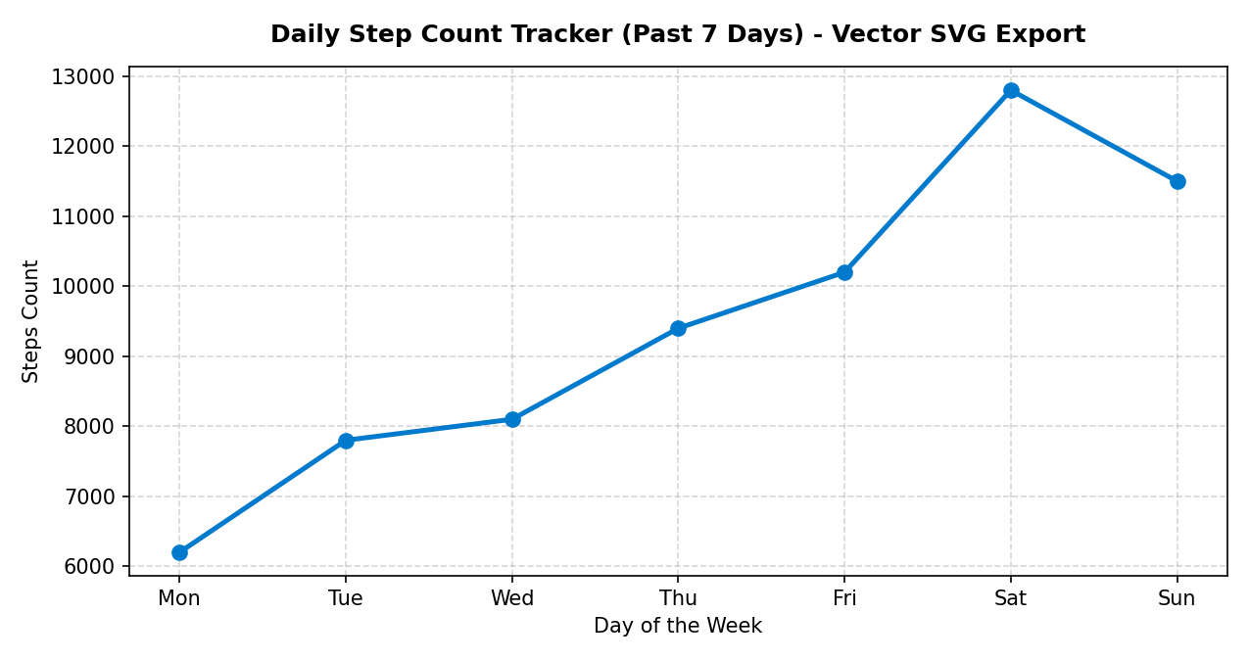
Session 11: Matplotlib High-Resolution Chart Export Presentation
Demonstrating Programmatic Image Embedding: Zomato Orders (PNG @ 150 DPI) & Weekly Steps Line Plot

