Slide 1
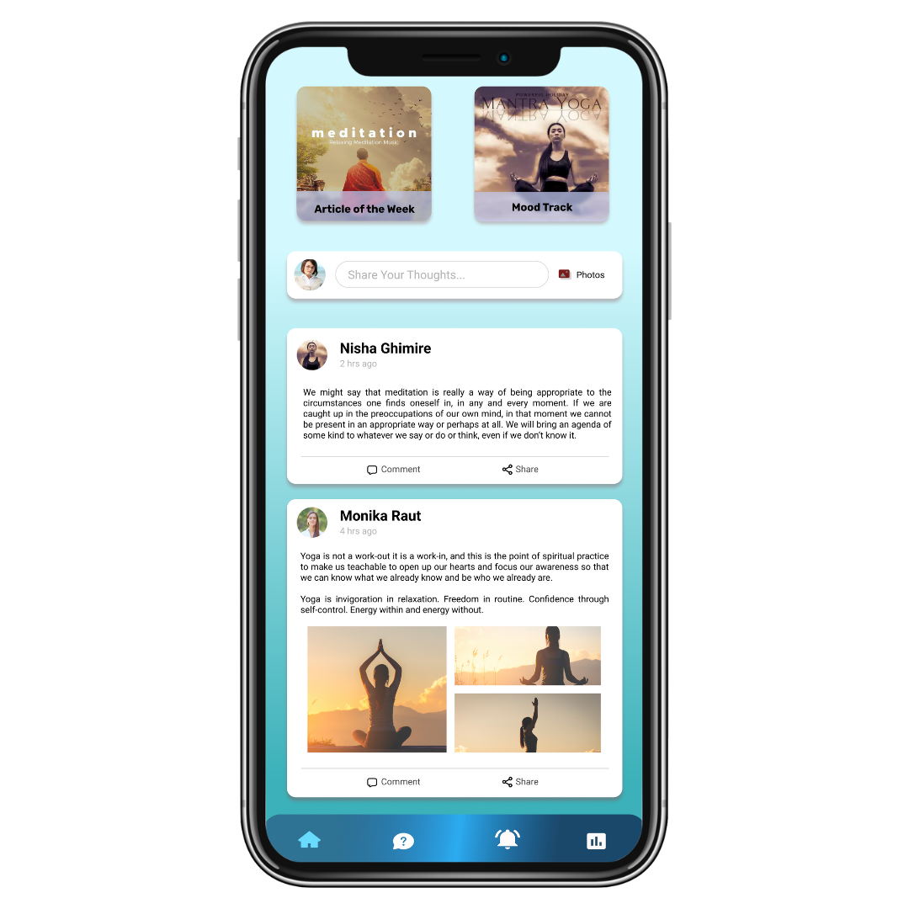
Me - You are not alone!
MENTAL
WELLBEING
We – We are here for you!

Slide 2
Modules
1.
2.
3.
Discussion Platform
Article of the week
Suicide help line
4.
5.
Push Notifications
Mood Track
This can be an every week article.
Anyone who needs help can raise the ticket.
Thought sharing Platform.
6.
Self Assessment *
Motivation, Awareness, Suicide prevention
With the help specific questionnaire
One will be able to assess themselves.
7.
Existence Alternative
For Suicide Ideation, Survival and Affected.
© Everestwalk Groups

Slide 3
Discussion Platform
This feature enables to share their thought among like minded people and posts will be monitored by the professionals.
© Everestwalk Groups

Slide 4
Article of the week
This will be an every week article on different shareable stories. The main goal of these article is to motivate and inspire the users.
© Everestwalk Groups

Slide 5
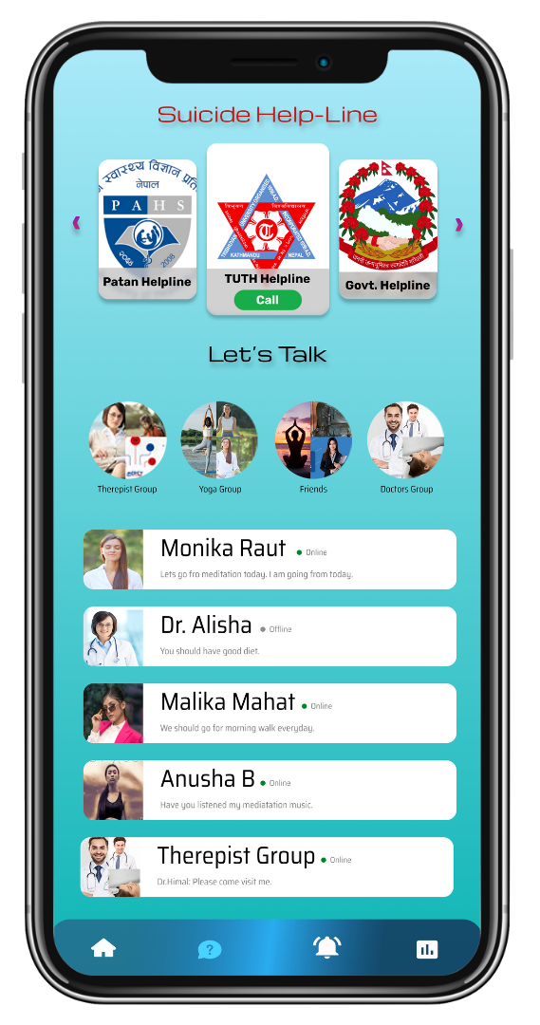
Suicide help line
Anyone who needs help can raise the ticket, post which the concern person will respond immediately looking at the severity of the issue.
© Everestwalk Groups

Slide 6
Push Notifications
This live notifications will be on the good the things happening around the world to motivate, inspire and also to create an awareness on suicide prevention.
© Everestwalk Groups

Slide 7
Mood Track
With the help specific automated questions, the application will track the mood of the users and also they will be able to share the same with in the platform.
© Everestwalk Groups

Slide 8
Self Assessment
One will be able to assess themselves by answering questions prepared by the professionals so, that they will be able to understand the severity of their issues and ask for the help accordingly.
© Everestwalk Groups

Slide 9
Existence Alternative
Suicide Ideation
Suicide Survival
Suicide Affected
© Everestwalk Groups

Slide 10





Thank You!
CONTACT INFO:
Kathmandu, Nepal - 56900
+ 977- 9745529416
info@everestwalk.com
www.everestwalk.com

