Slide 1
Computer Shop Management System
Vineet Khanna (1055695)
Kunjan Vaghela (1056029)

Slide 2
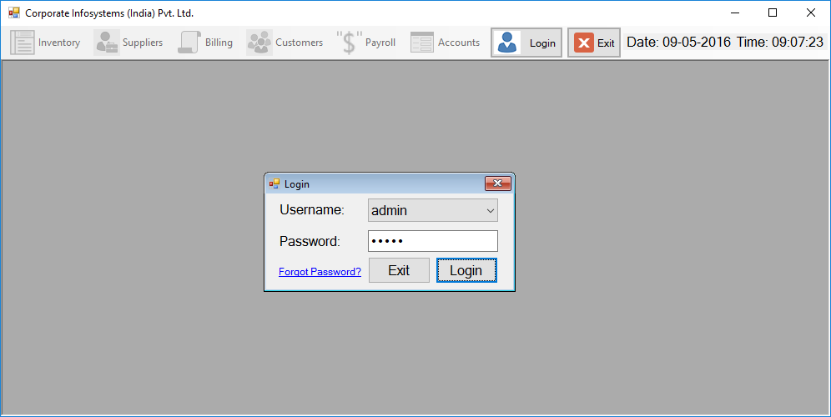
Login Form

Slide 3
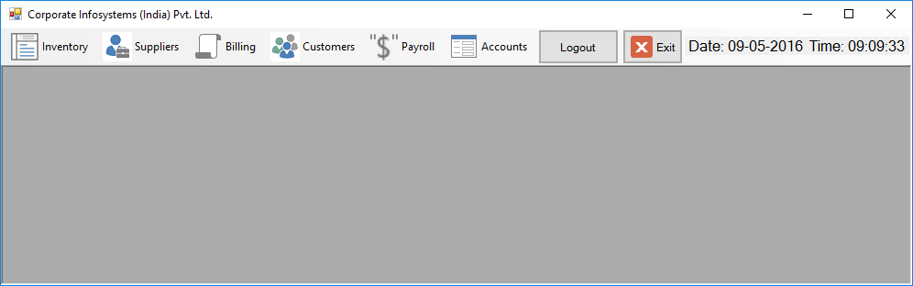
Home Screen

Slide 4
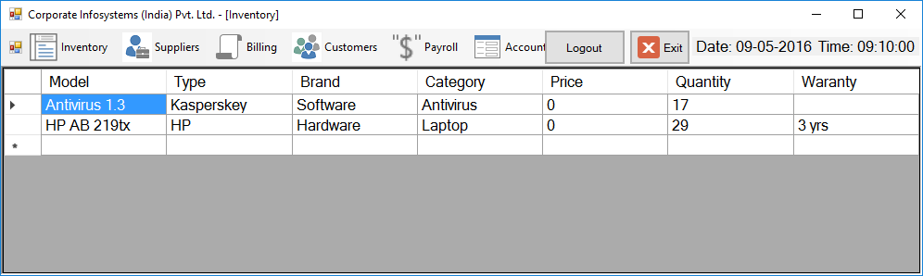
Inventory

Slide 5
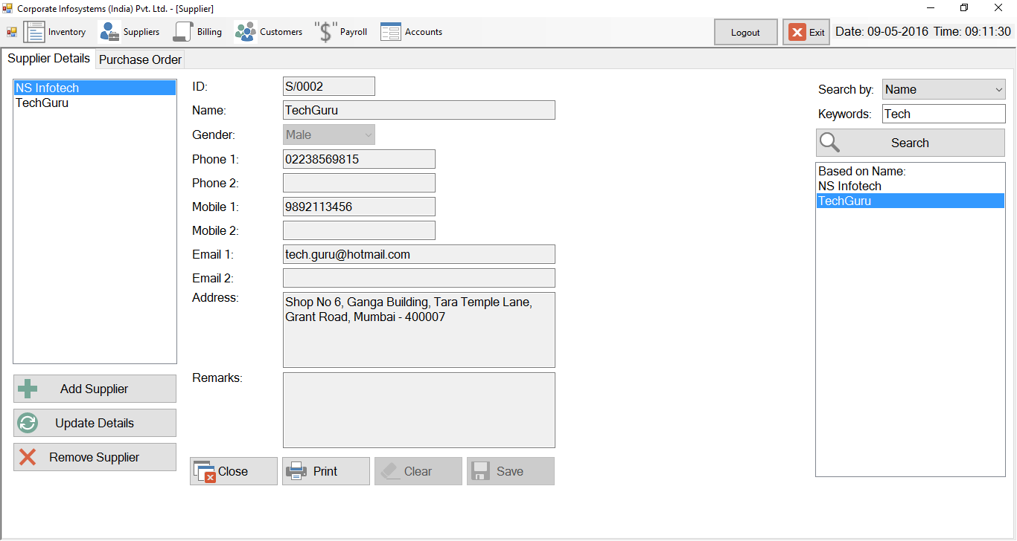
Supplier Details

Slide 6
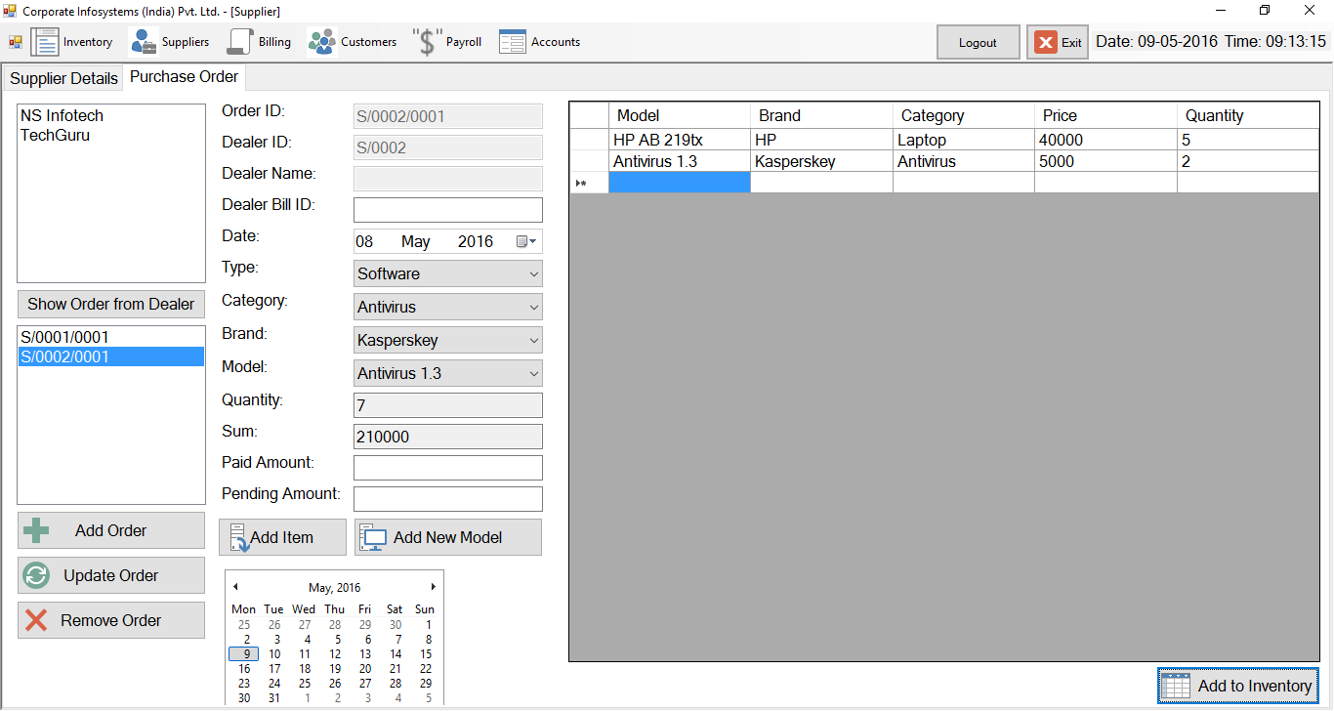
Purchase Order

Slide 7
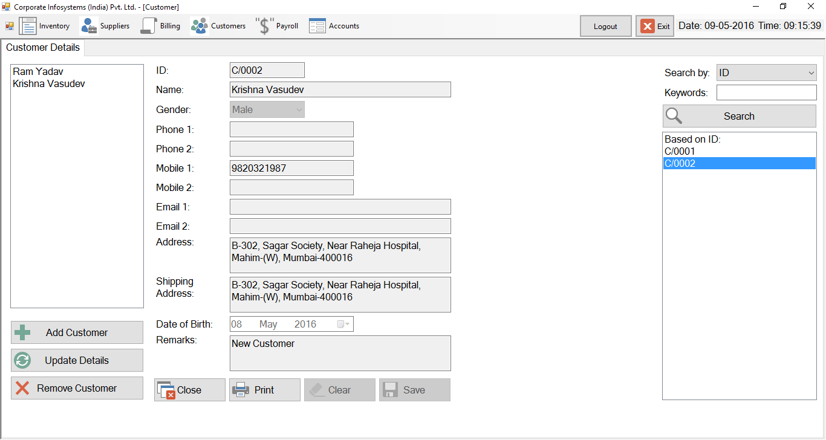
Customer Details

Slide 8
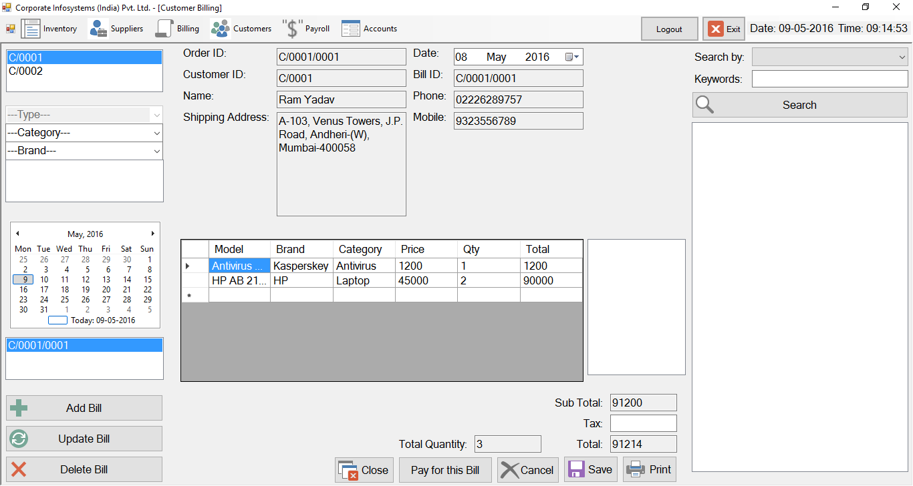
Customer Billing

Slide 9
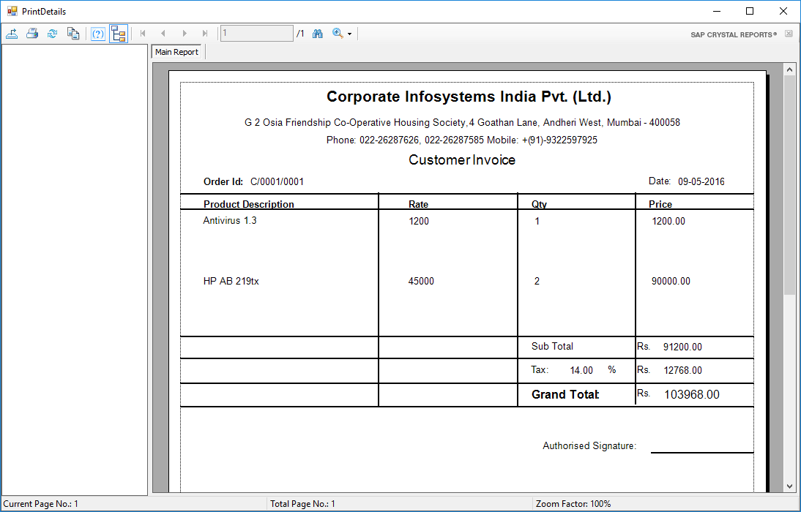
Customer Invoice

Slide 10
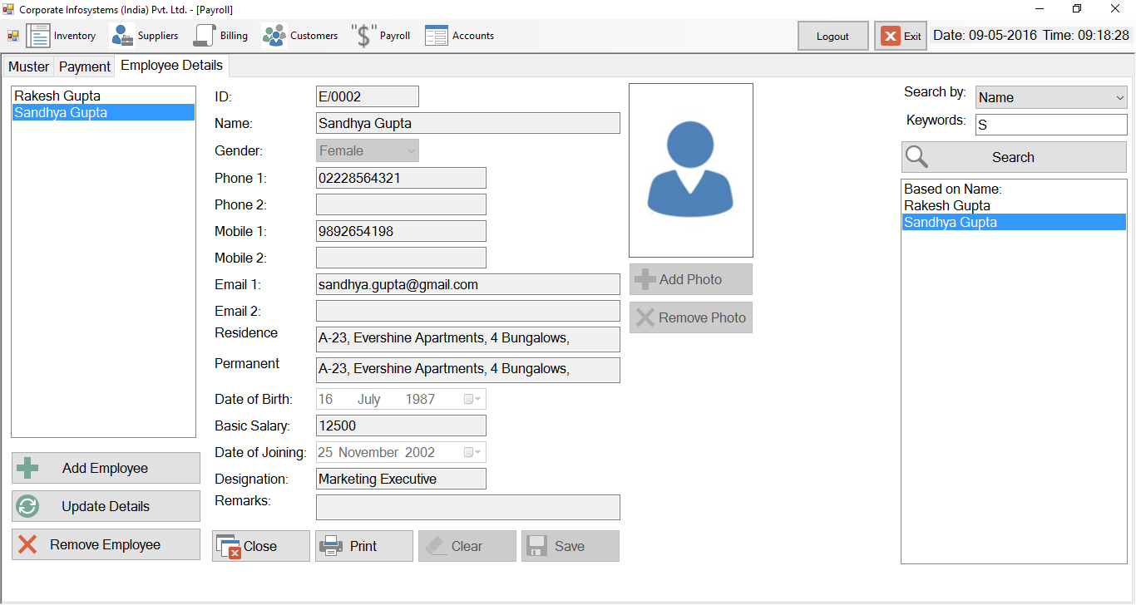
Employee Details

Slide 11
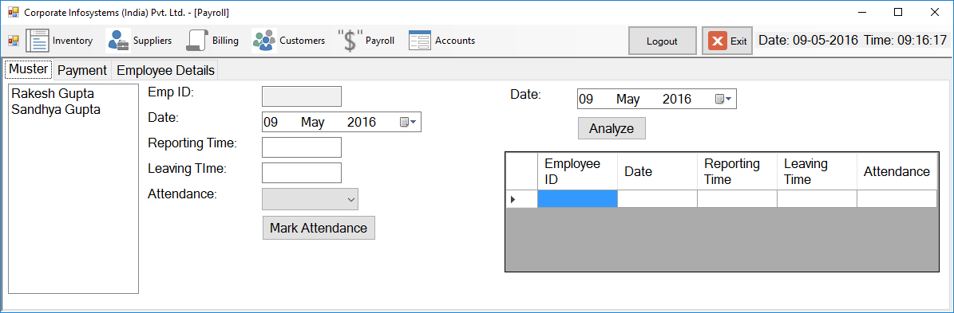
Muster

Slide 12
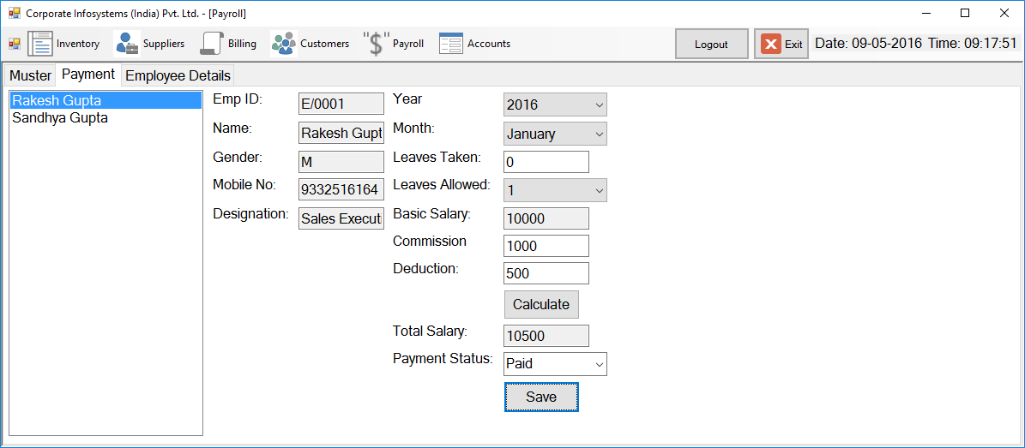
Payroll Payment

Slide 13
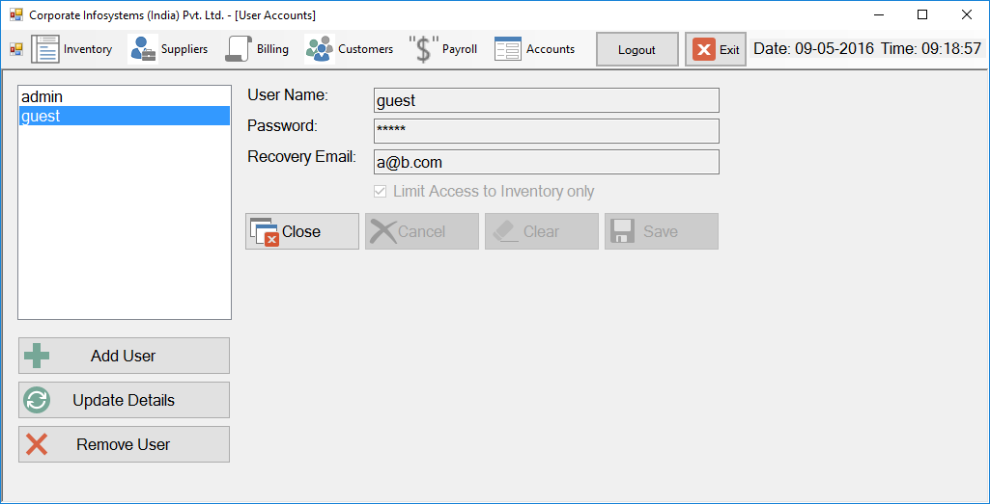
Accounts

