Slide 1
Diabetes, Hypertension and Stroke Prediction
Group Members:
Kunjan Vaghela (kv353)
Hrishikesh Salunkhe (hs1121)
Jash Jayant Shah (js3297)
Dhruv Snehal Satyapanthi (ds1990)
Notes:
This project focuses on leveraging machine learning techniques to develop accurate predictive models for diabetes, hypertension, and stroke based on demographic, health, and lifestyle features.

Slide 2
Project Objectives:
Develop Accurate Predictive Models:
Develop accurate patient centric and user centric predictive models for diabetes, hypertension, and stroke based on demographic, health, and lifestyle features.
Identify Key Risk Factors:
Identify key factors contributing to the risk of each condition
Provide Healthcare Tools:
Provide a GUI tool that can assist healthcare professionals in early diagnosis and preventive interventions
Notes:
Developing Accurate Predictive Models:
Our main goal is to make clever tools that can predict diabetes, hypertension, and stroke really well. We train these models by giving them lots of information about people's health and lifestyle choices.
Identifying key risk factors: We want to figure out why people get these health problems. By looking closely at the data, we hope to find out what things are most likely to make someone get diabetes, hypertension, or have a stroke.
Providing a Healthcare tool that Helps Doctors Help Us Better:
Our goal is to provide a user-friendly interface that healthcare professionals can utilize for early diagnosis and preventive interventions. By seamlessly integrating our predictive models into an intuitive graphical interface, it will show them who might be at risk of getting sick, so they take some preventive steps.

Slide 3
Data Collection and Analysis:
Used dataset from Kaggle: Diabetes Health Indicators Dataset (https://www.kaggle.com/datasets/prosperchuks/health-dataset)
Dataset information:
Diabetes (70692 rows, 18 features)
Hypertension (26058 rows, 14 features)
Stroke (40907 rows, 11 features)
Notes:
Data Collection and Analysis
We utilized the Diabetes Health Indicators Dataset from Kaggle, which includes information on diabetes, hypertension, and stroke detection.
The dataset encompasses various health parameters and lifestyle variables, such as age, sex, cholesterol levels, BMI, and smoking habits.
We conducted exploratory data analysis (EDA) to understand variable distributions and correlations, followed by data cleaning and preprocessing.

Slide 4
Data Preparation
For handling two versions i.e. patient centric and doctor centric, we split the attributes.
Patient centric attributes are answerable based on their routine. For ex. Good Mental Health days in a month (1-30).
Doctor centric attributes are input from the medical report. For ex. High Cholesterol.
Notes:
Data Preparation:
Our final product has two different views for Diabetic prediction, patient view, and doctor centric view. We already have a separate Stroke and Hypertension dataset. But for Diabetes, we split the dataset’s 18 attributes into two sub-datasets, for example Doctor centric dataset has attributes like high cholesterol, and patient side has the number of good mental health days i.e in the past 30 days. We made sure that the split was in a way that both the sub-datasets had attributes with a balanced correlation with the target attribute.

Slide 5
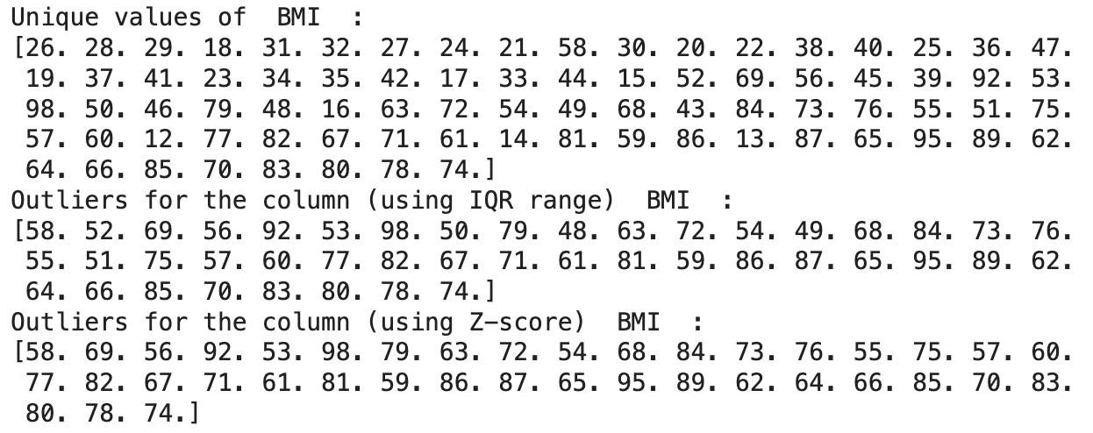
Data Analysis: Initial Check
Duplicates, Unique values for each feature
Duplicates found:
Diabetes dataset ~ 9%
Null attributes
Outliers check for multivariate attributes using:
IQR range, confidence interval
Z Score
Notes:
Now as part of our initial Data Analysis, we checked if for duplicates and null attribute values in the dataset. We furthermore checked unique values present for each feature, and also performed Outliers checks using Interquartile Range and Z-Score methods. We used this data to experiment and find the right model.

Slide 6
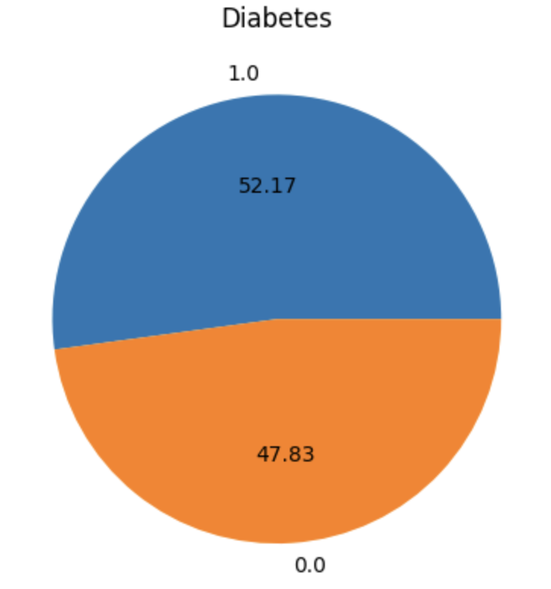
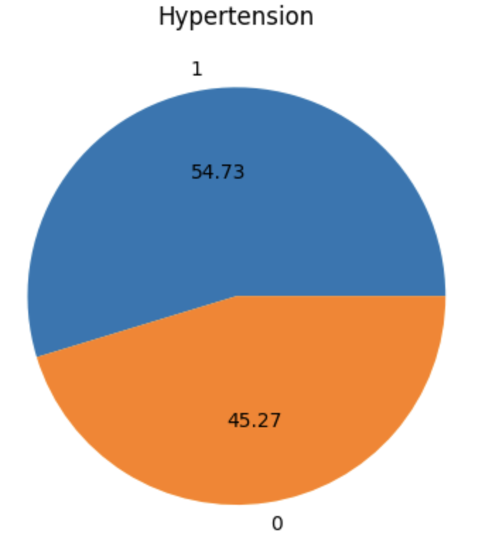
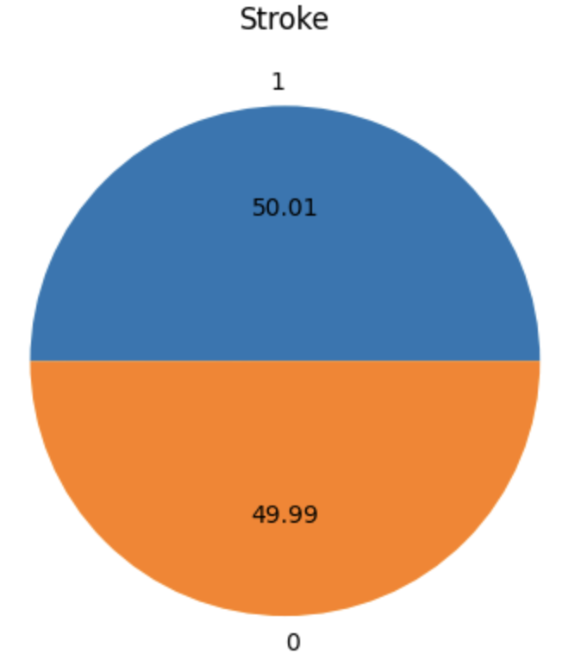
Bias check
Is our dataset biased towards any particular result?
Notes:
Next, we wanted to make sure that our target attributes were not biased in our dataset. As part of analysis we found that all the target attributes were almost in balance. As it can be seen, Stroke dataset is almost perfectly balanced; while Diabetes and Hypertension also has a good balance.
This makes our dataset ready for the next process.

Slide 7
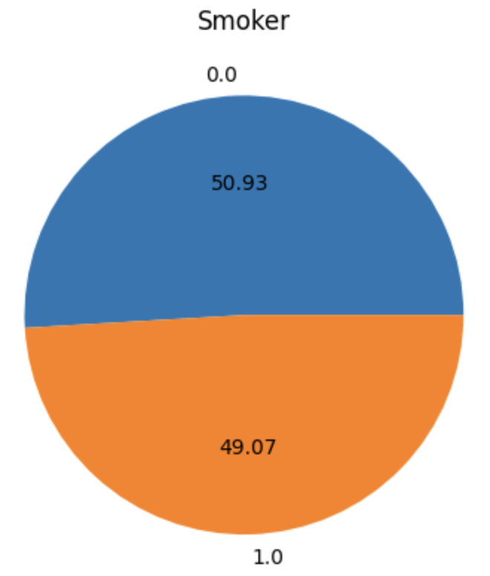
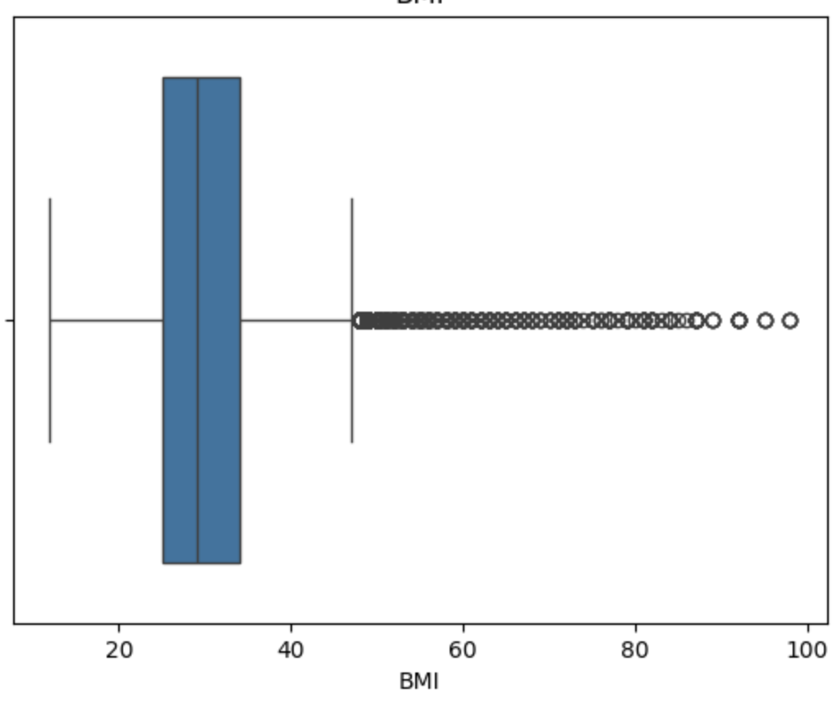
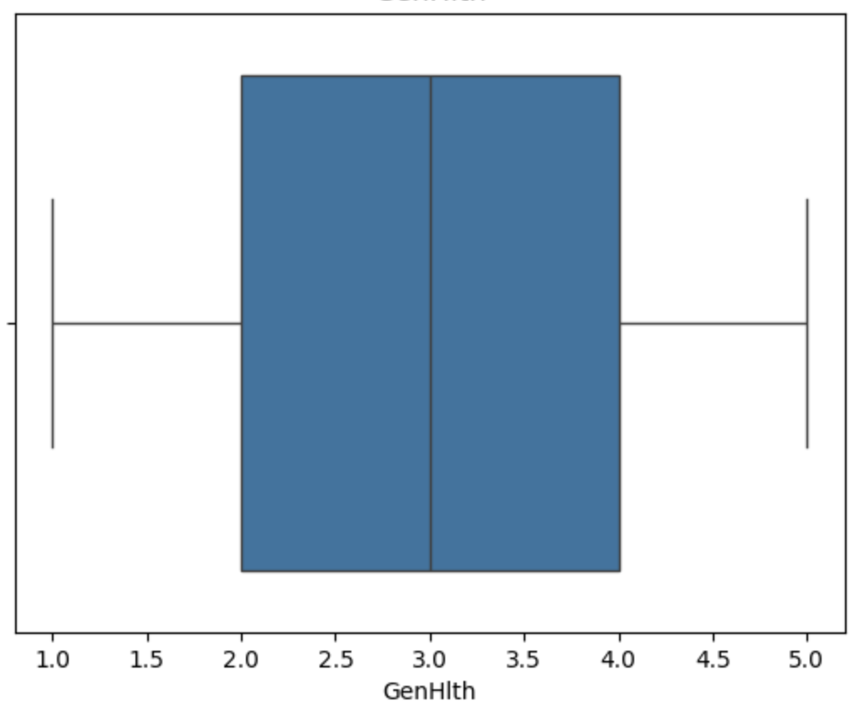
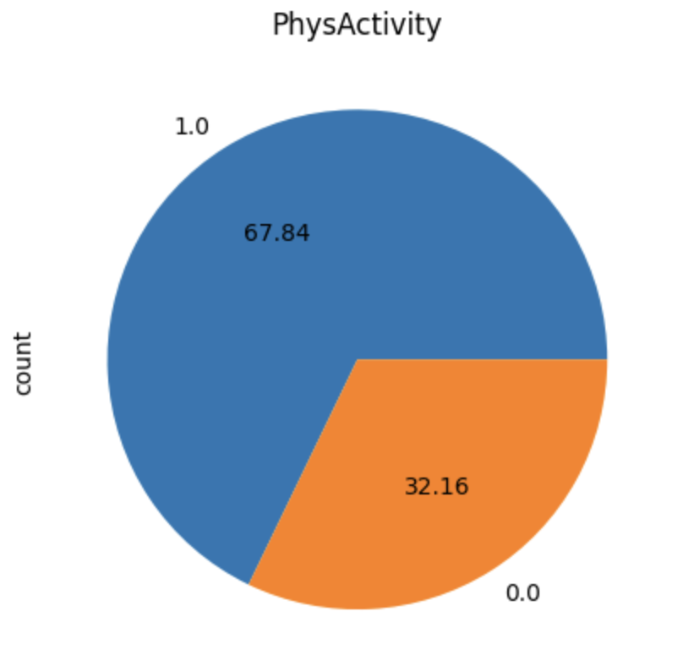
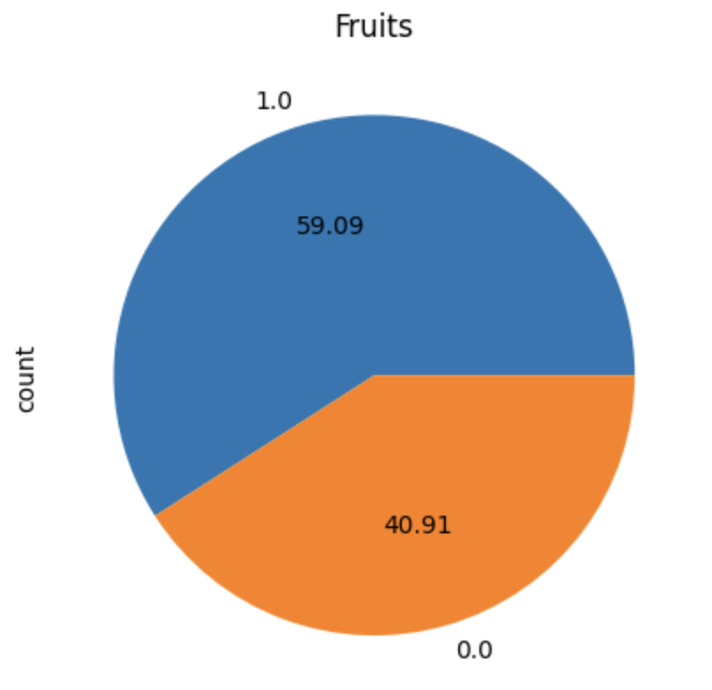
Understanding Variability/Spread of Data
Notes:
Next, we wanted to understand the spread of our data, to check if any of our feature is not too skewed.
For this, we analyzed the binary attributes with pie charts, and multivariate attributes with a mix of boxplots and histograms.
Here are a few attributes from the Diabetes Dataset, we will include all the analysis in our report for you to look over.

Slide 8
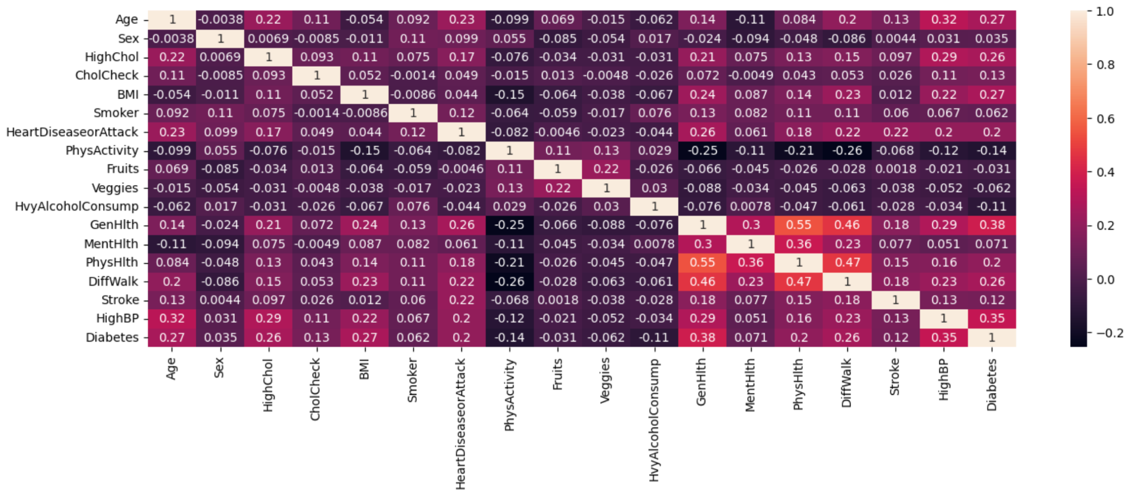
Correlation Checks
Notes:
Then we performed correlation analysis in between the features. This data is from the Diabetes dataset. There are features with both positive and negative correlation. For example here, general health attribute and high BP of a person has higher correlation with Diabetes while a person’s sex and mental health has lower correlation. We used this metric for model analysis to drop attributes and examine the results.

Slide 9
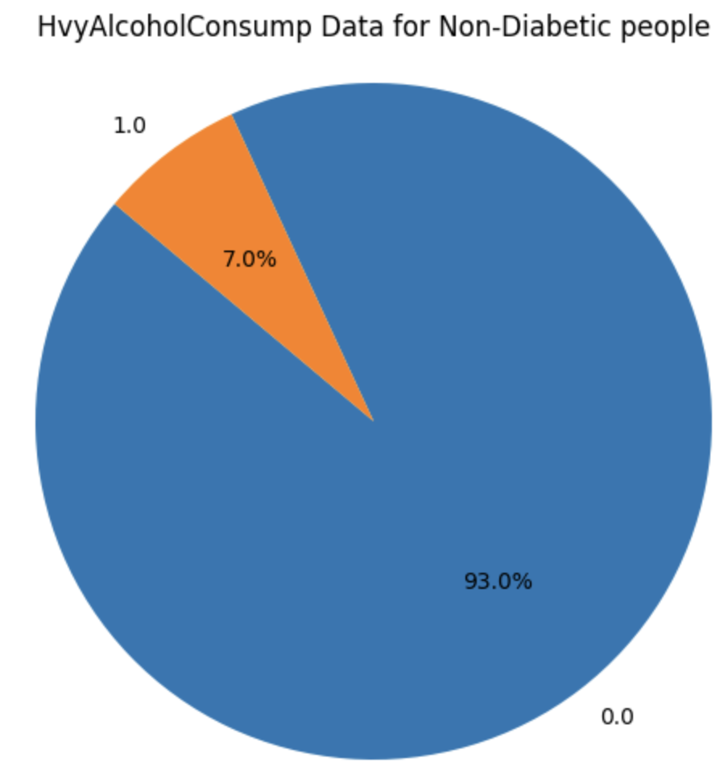
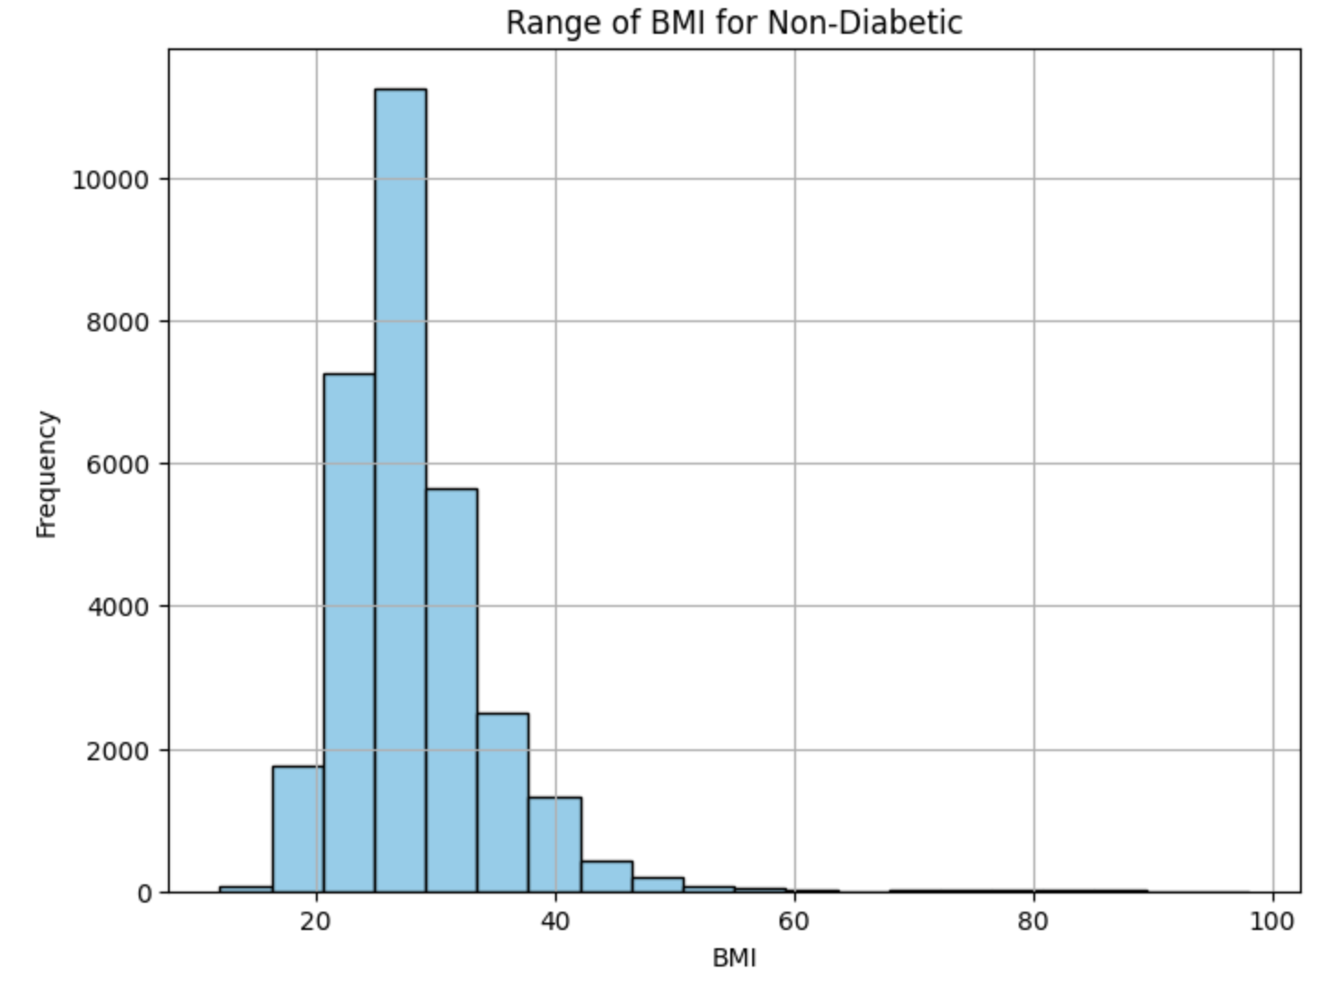
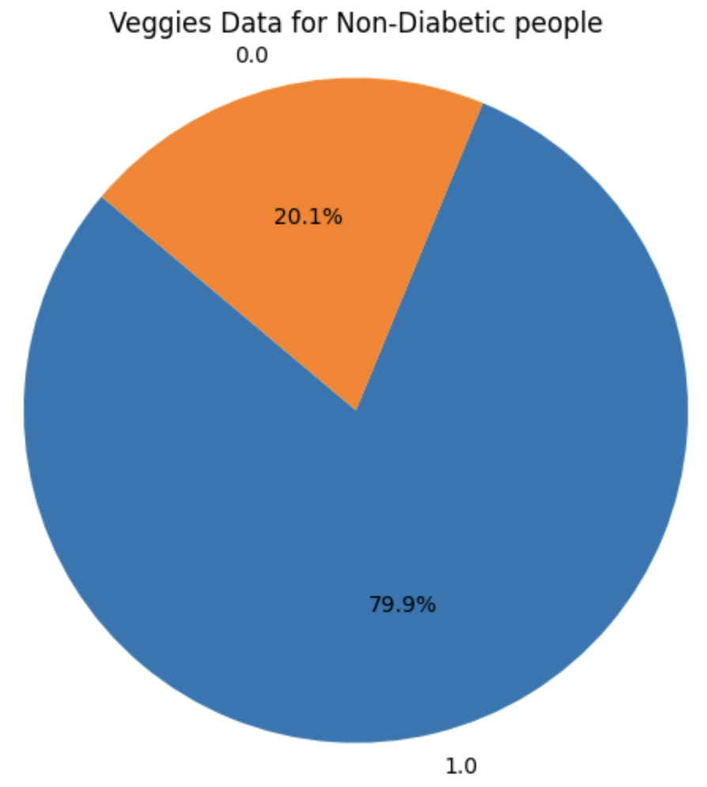
Metrics for Suggestion
Notes:
Finally, we also wanted to have data to showcase what will be considered to be a good range for a good health. We performed our analysis on the records with diabetes equal to 0, to find what our application suggest after the model prediction. Just for an example, based on the data we can see that the non-diabetic person generally does not drink, consumers lots of veggies in a day, and has BMI in a range of 20 to 30. Next, Hrishi will explain on the model we used.

Slide 10
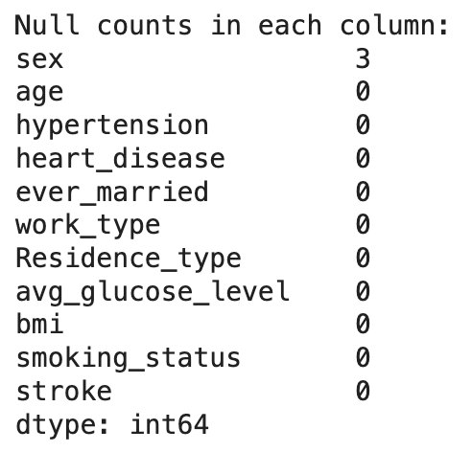
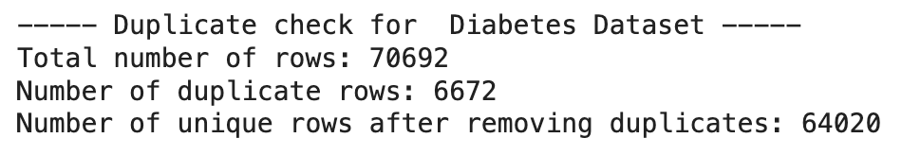
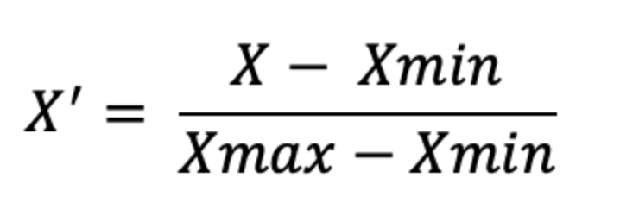
Methodology: Data Preprocessing
Removing null values
2. Removing duplicate rows
3. Min-max Normalization

Slide 11
Methodology: Model Selection based on accuracy
sklearn.linear_model.LogisticRegression | 0.7121
sklearn.linear_model.SGDClassifier | 0.6798
sklearn.naive_bayes.GaussianNB | 0.6667
sklearn.tree.DecisionTreeClassifier | 0.6669
sklearn.ensemble.RandomForestClassifier | 0.6820
Logistic Regression has the best fit for our dataset based on the model accuracies observed.

Slide 12

Methodology: Model Training
Train-test split: 70% training, 30% testing
Model: Logistic Regression
where β0, β1, β2, ..., βn are the coefficients estimated by the logistic regression.
x1, x2, ..., xn are the independent variables.

Slide 13

Front-end
Used Streamlit library in Python
Multi-page app
Dynamic front-end
User input can be added in the sidebar

Slide 14
UI components
The UI is mainly divided into 4 components:
1. All-round prediction (Stroke, HighBP, Diabetes)
2. Hypertension Prediction
3. Stroke Prediction
4. Diabetes Prediction

Slide 15
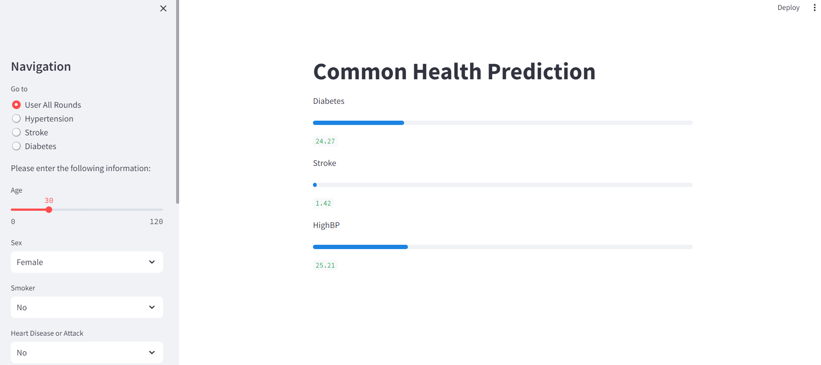
All Rounder Prediction

Slide 16
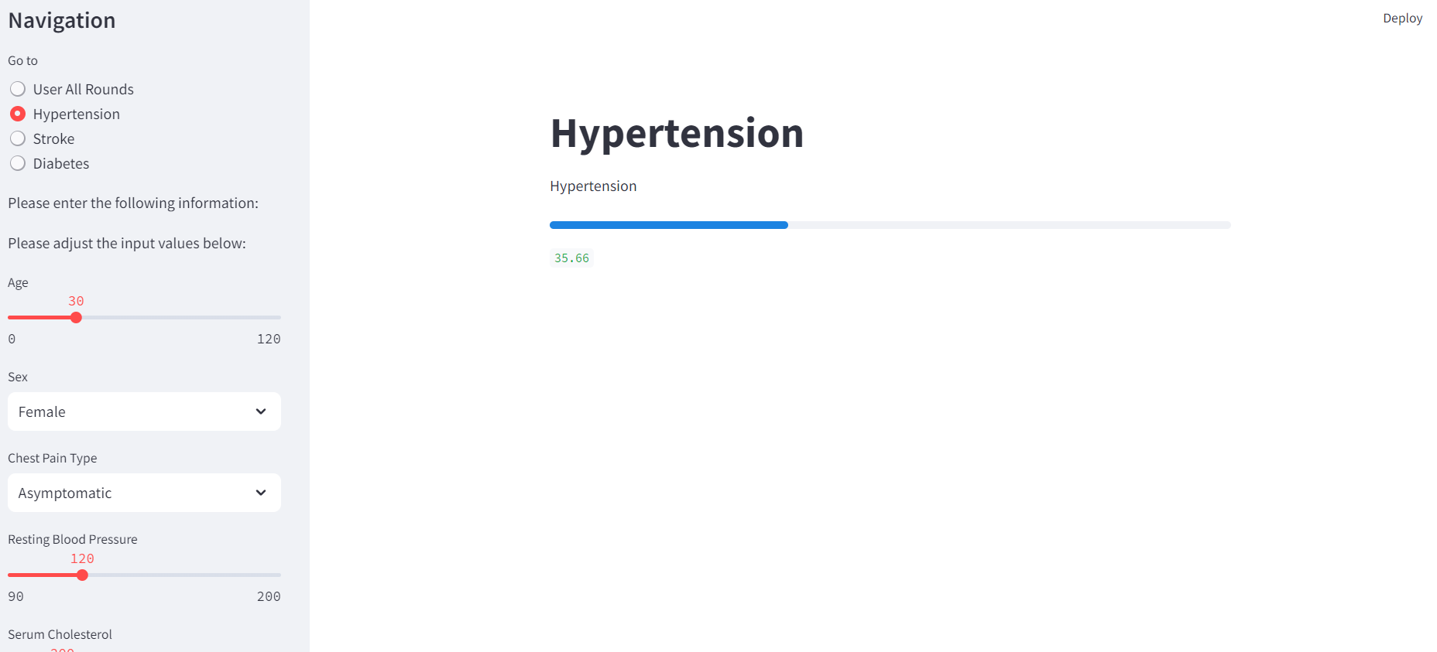
Hypertension

Slide 17
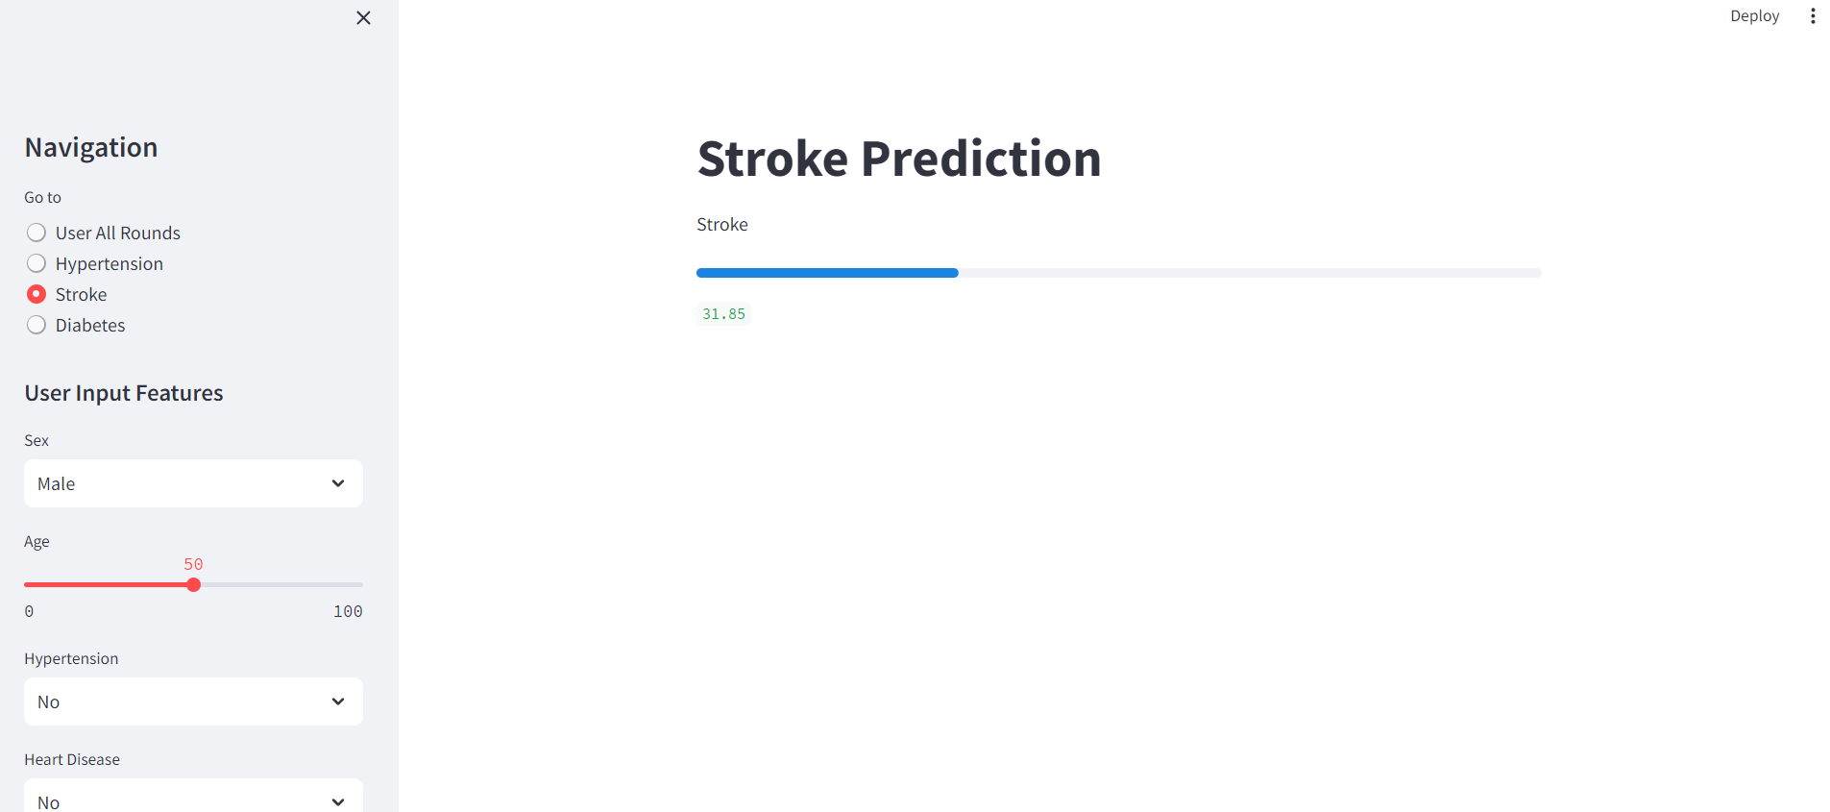
Stroke Prediction

Slide 18
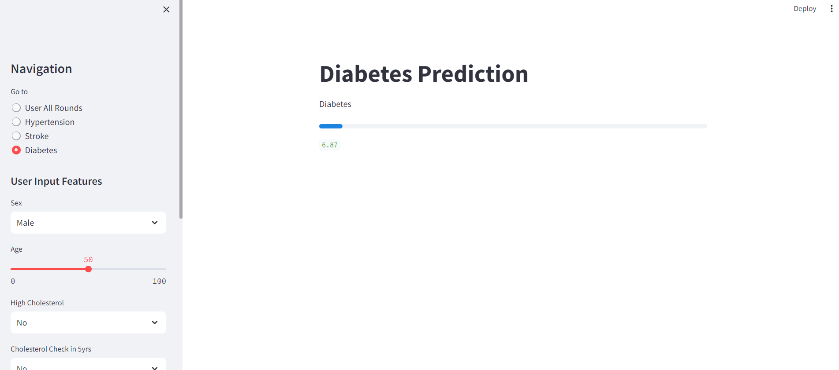
Diabetes Prediction

Slide 19
Results
All-Round Diabetes Prediction Score: 0.71
All-Round Stroke Prediction Score: 0.93
All-Round HighBP Prediction Score: 0.70
Stroke Prediction Score: 0.68
Diabetes Prediction Score: 0.70
Hypertension Prediction Score: 0.85

Slide 20
Thank you

