Slide 1

Budget Guru
Collaborative Finance Management
Track, Analyze, and Manage Finances—Together.
Created By – Kunj Bhatia

Slide 2

The Future of Shared Finance
Budget Guru transforms personal finance from a solo activity into a seamless, collaborative experience for individuals, families, and groups.
Core Features
Multi-Profile & Group Management
Advanced Expense Splitting
Budget Tracking & Analytics
Comprehensive PDF & CSV Reports
Organize finances for personal use, family, or shared groups.
Effortlessly divide bills and track who owes whom.
Visualize spending patterns and stay on financial goals.
Generate detailed financial summaries for record-keeping.

Slide 3
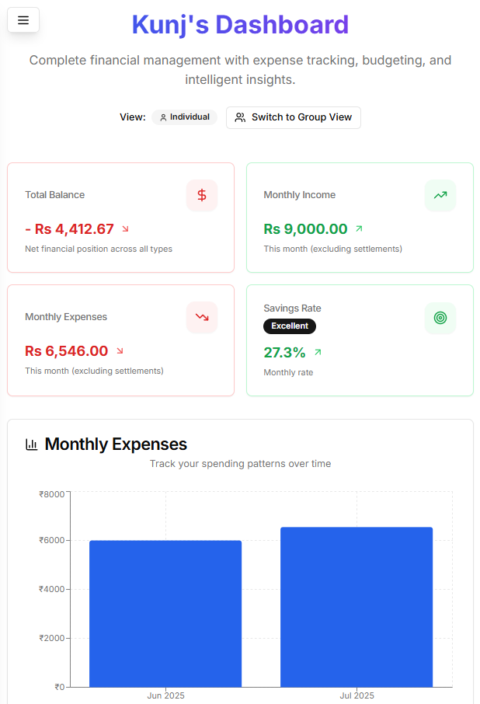
At-a-Glance Financial Clarity
The main dashboard view provides users with an immediate, actionable overview of their financial health. Key summary cards offer instant insights into total balance, group balances, and recent activity.

Slide 4
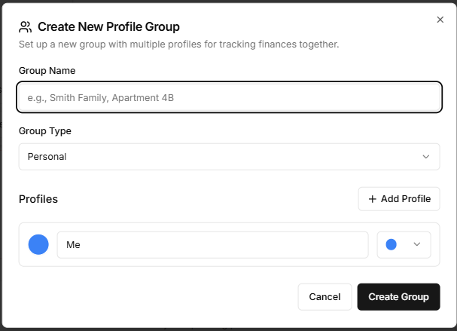
All Your Finances, One Place
Budget Guru allows you to create personal profiles and organize them into groups, such as family or roommates. Seamlessly switch between individual and group financial views for a complete and comprehensive financial picture.

Slide 5
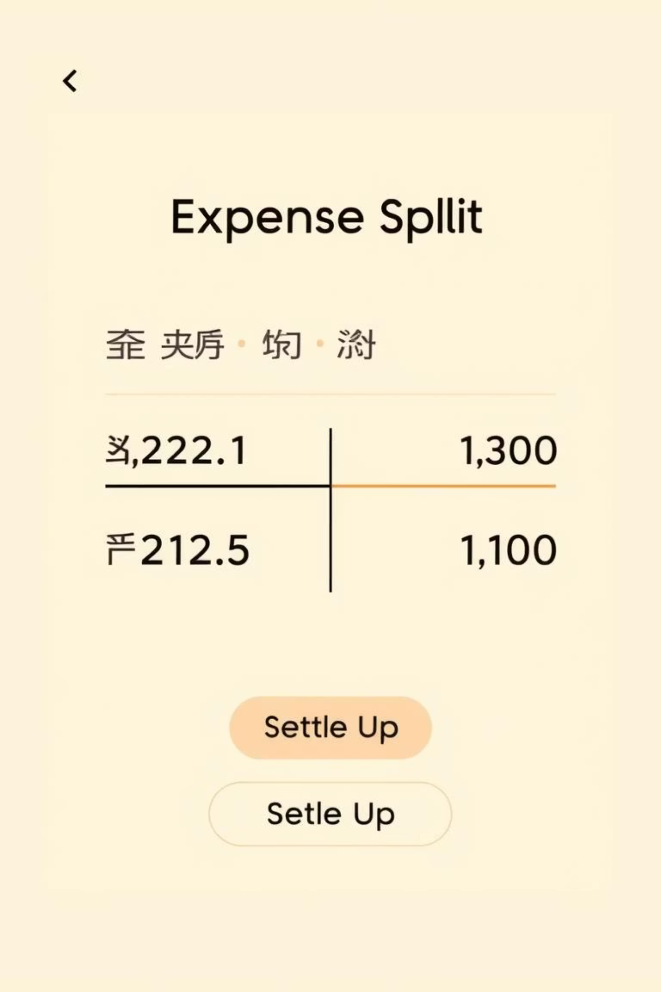
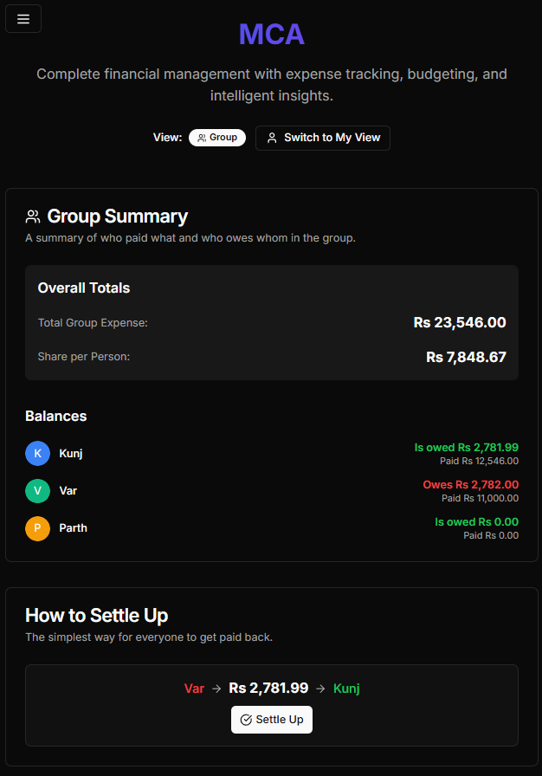
Effortless Shared Expenses
Our advanced expense splitting automatically calculates who owes whom based on shared expenses. The "Settle Up" feature creates corresponding transactions to clear debts accurately, and you can even distribute a single income source evenly among group members.

Slide 6
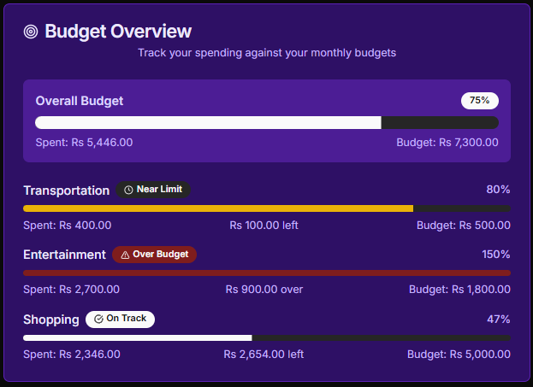
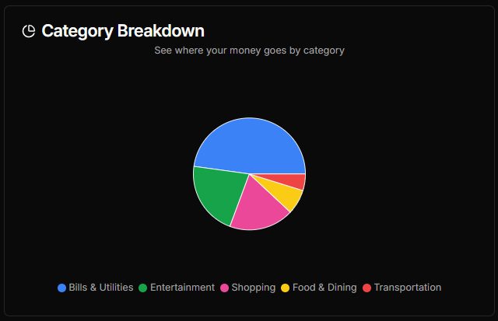
Stay on Budget with Visual Insights
Set monthly budgets for various categories and track spending with real-time progress bars showing "spent vs. remaining." Interactive charts reveal spending patterns by category and highlight monthly trends, helping you stay on track.
Budget Progress: See at a glance how close you are to your spending limits.
Category Spending: Understand where your money is going with visual breakdowns.

Slide 7
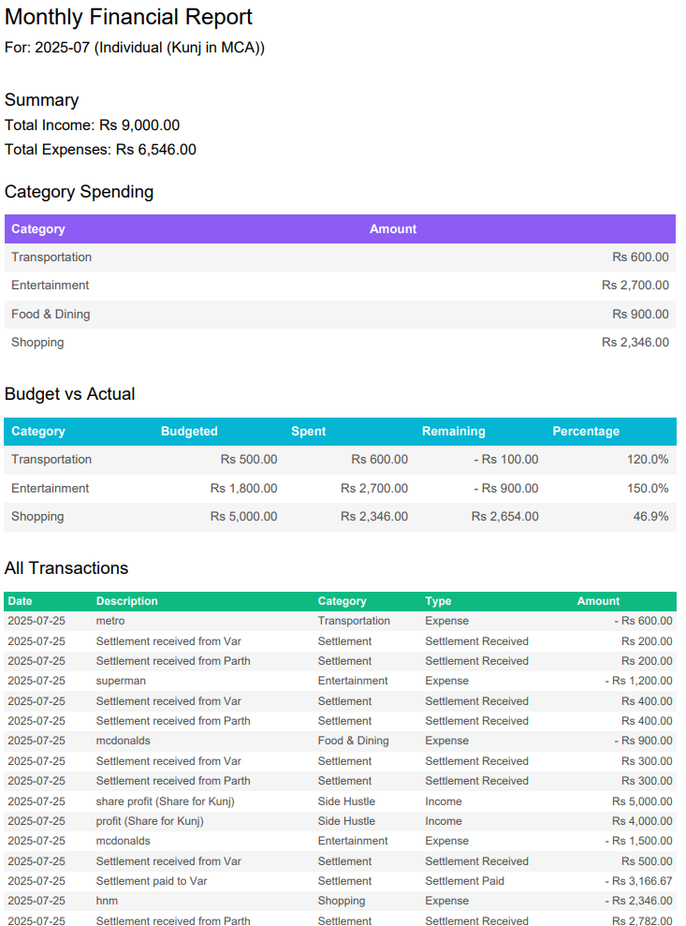
Your Finances, Your Data, Your Way
Generate detailed monthly reports for any profile or group using a dedicated month-and-year picker. Reports include comprehensive income vs. expense summaries and budget vs. actual performance, exportable to both PDF and CSV formats for effortless record-keeping.

Slide 8
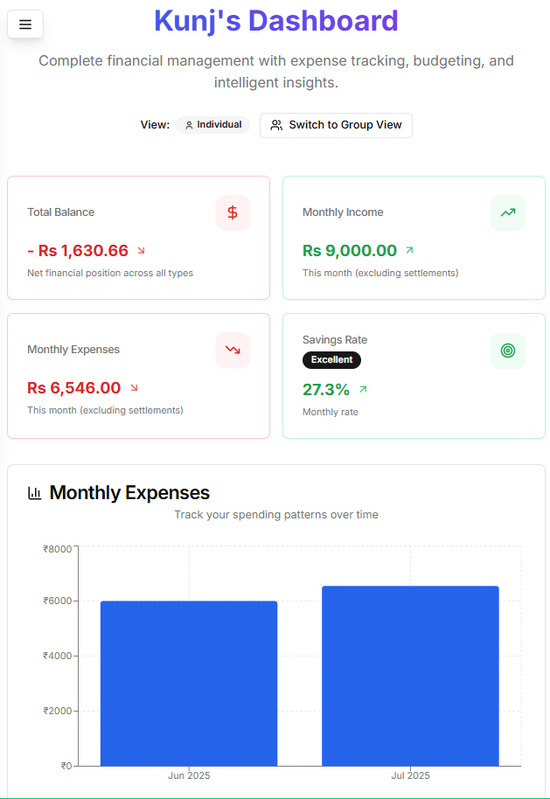
Designed for You
Budget Guru offers a seamless and optimized experience across all your devices. Switch between Dark and Light modes for comfortable viewing, ensuring your financial insights are always accessible and visually appealing, whether on desktop, tablet, or mobile.

Slide 9








Built with a Modern, Robust Stack
Next.js 14
TypeScript
App Router for high performance.
Enhanced code quality and maintainability.
MongoDB & Mongoose
Tailwind CSS & shadcn/ui
Flexible, scalable NoSQL database.
Rapid, utility-first styling.
Zustand
Recharts
Efficient state management.
Dynamic and interactive charts.
PDF/CSV Export
Lucide React
jsPDF, jspdf-autotable, xlsx.
Extensive icon library.

Slide 10




The Road Ahead
Our commitment to continuous improvement means exciting new features are on the horizon, expanding Budget Guru's capabilities to meet all your financial management needs.
User Authentication
Recurring Transactions
Secure accounts and personalized data protection.
Automate tracking for regular payments and income streams.
Financial Goals
Investment & Debt Tracking
Dedicated section for setting and tracking long-term objectives.
Manually add and monitor investments and outstanding loans.

Slide 11
THANK YOU
Created By :
Kunj Bhatia
MCA 2ND YEAR (2024 - 2026)
SEC B
35150404424

