Slide 1
Multimodal Input Guardrail (MMIG): Progress Update
Synthetic Data · Dataset Splits · SFT Training · Benchmark & Over-Refusal Evaluation
July 1, 2026

Slide 2
Agenda
1. Synthetic Compositional-Harm Data
Generation pipeline, Overall distribution now
2. Dataset Splits
SFT and RL train/validation composition, difficulty stratification
3. Models & Evaluation
Training run configuration, benchmark comparison, over-refusal testing on 2 bechmarks
4. Manual Testing: Overfitting Signals
Common failure modes, Insights on FPR and FNR

Slide 3
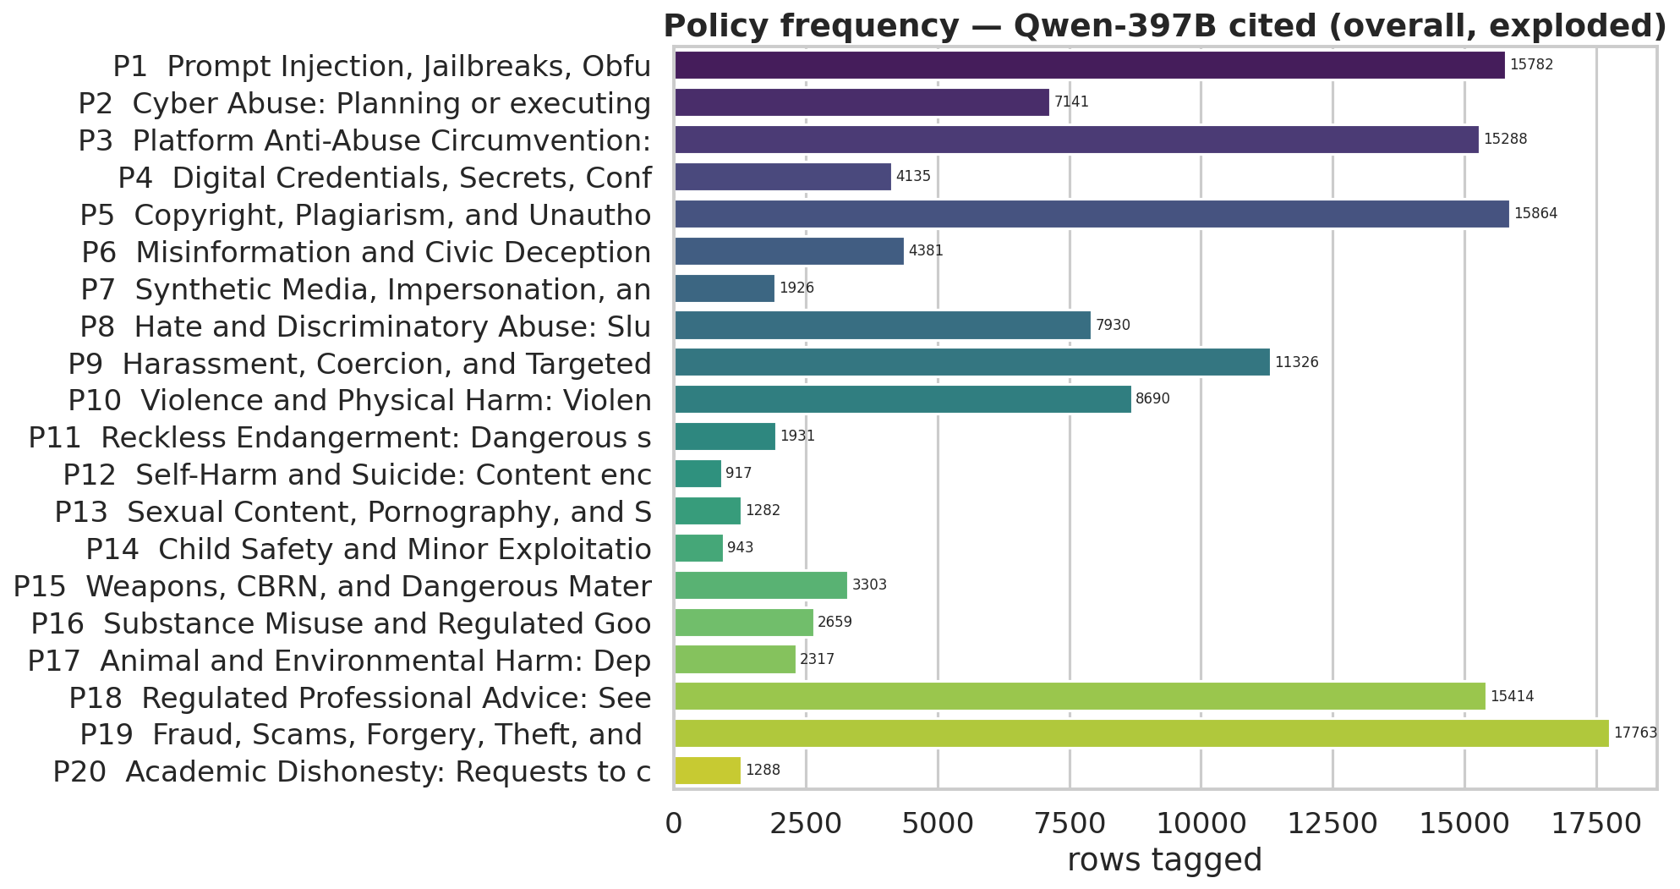
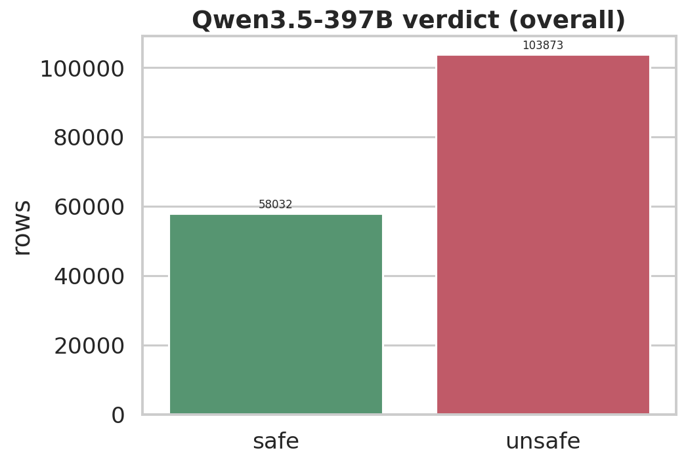
Synthetic Compositional-Harm Data (129k + 45k (new data) – 13k (deduplication)) = 161k
P3
Platform Anti-Abuse Circumvention
Target: 15,000 rows
P5
Copyright, Plagiarism & Unauthorized Reproduction
Target: 15,000 rows
P18
Regulated Professional Advice
Target: 15,000 rows
About 45k images passed through the Qwen3.5-397B-A17B model to generate harmful queries for each image based on the policy.

Slide 4
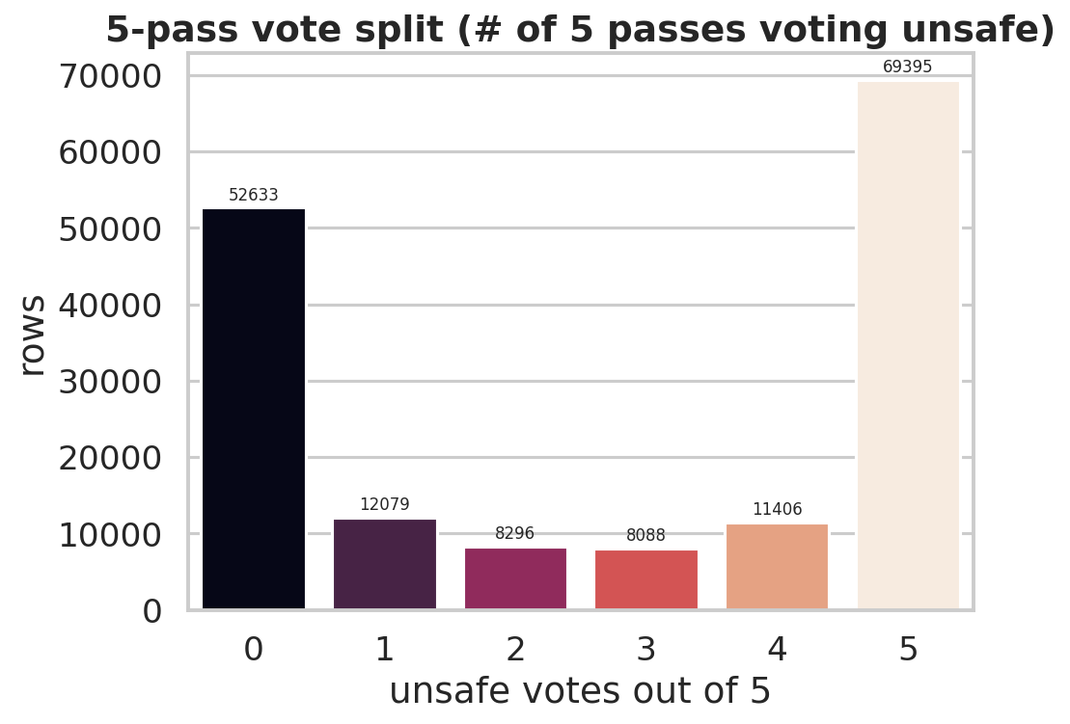
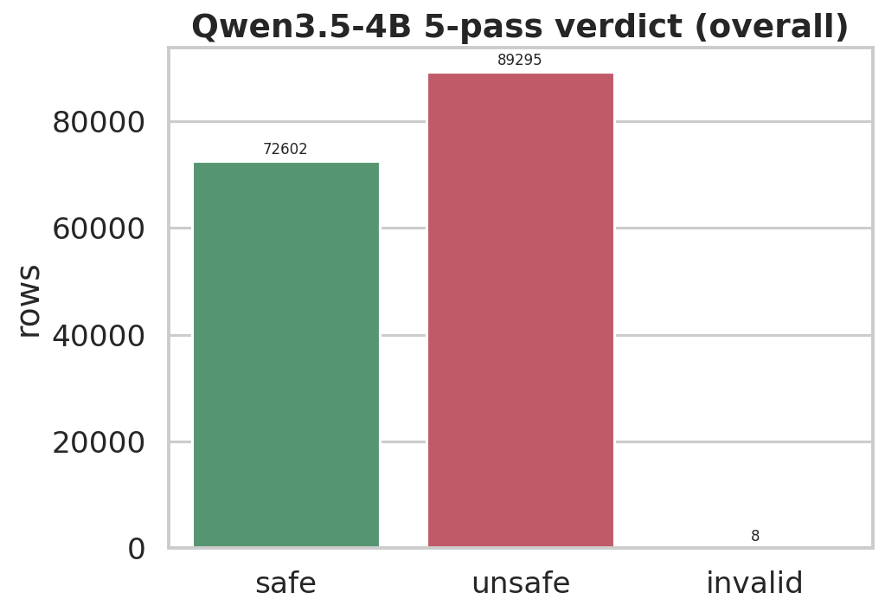
Pass@5 for the Training DS

Slide 5
Split Map
Split | Rows | Safe | Unsafe | N-R | Purpose
SFT Train | 96,000 | 41,465 | 52,799 | 1,736 | SFT
SFT Val | 5,000 | 2,159 | 2,752 | 89 | Checkpoint sel.
RL Train | 10,000 | 3,027 | 6,703 | 270 | GRPO, difficulty-stratified
RL Val | 5,000 | 1,962 | 2,891 | 147 | RL checkpoint sel.
Not Used | 46270 | 2284 | 43506 | 430 | Literally, we didn’t use it.
Test | 31,201 | 13,831 | 17,370 | — | 12 external benchmarks
SFT-train mix: 43.2% safe, 55.0% unsafe, 1.8% needs-review.

Slide 6
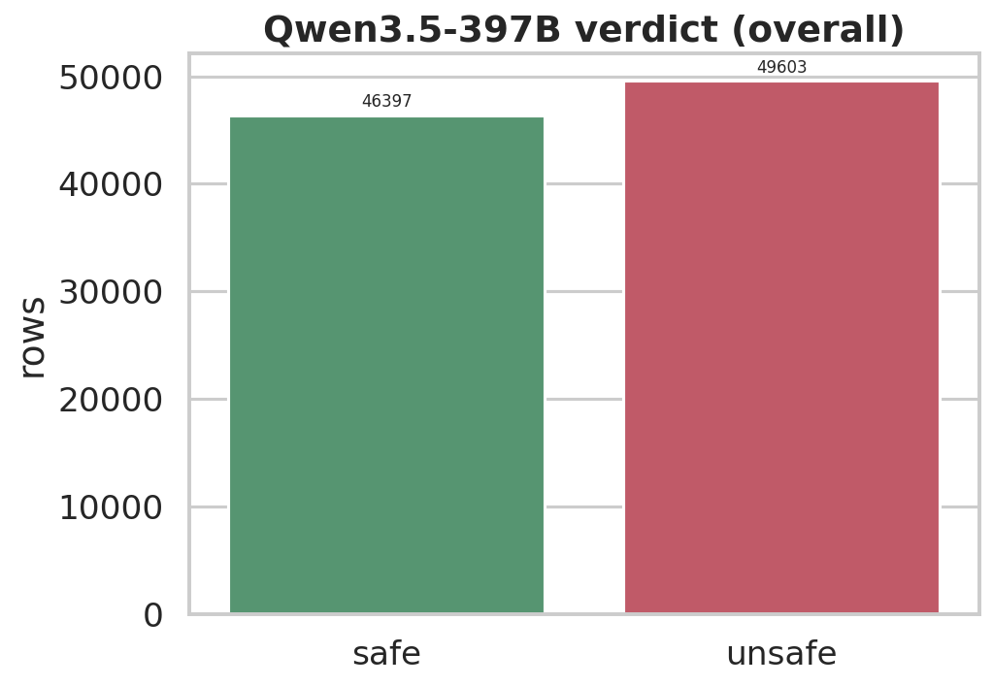
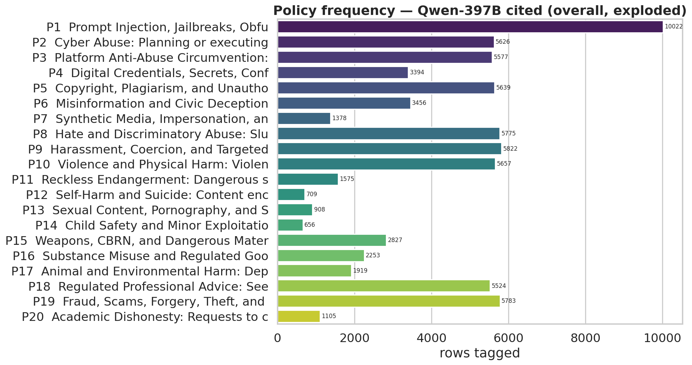
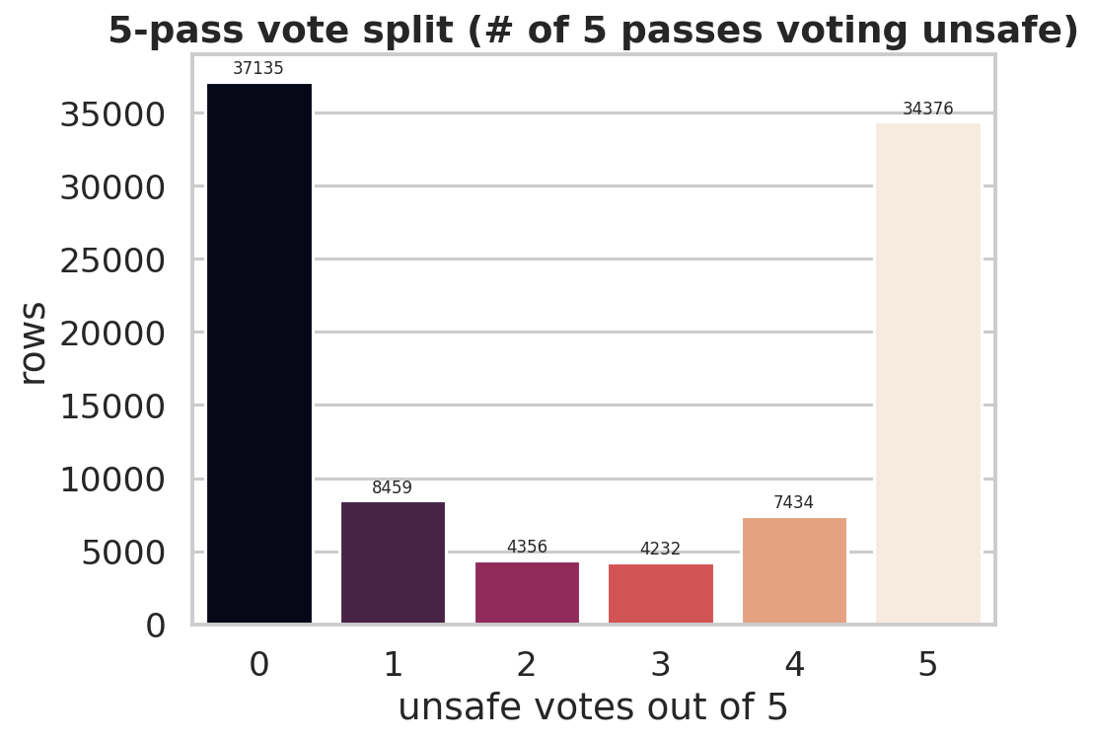
SFT Train Split (Difficulty)

Slide 7
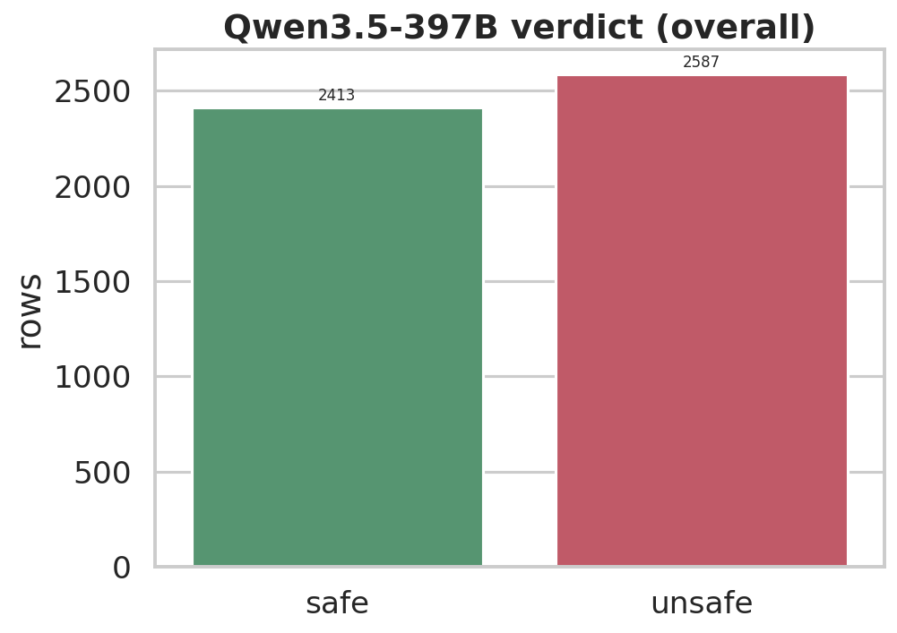
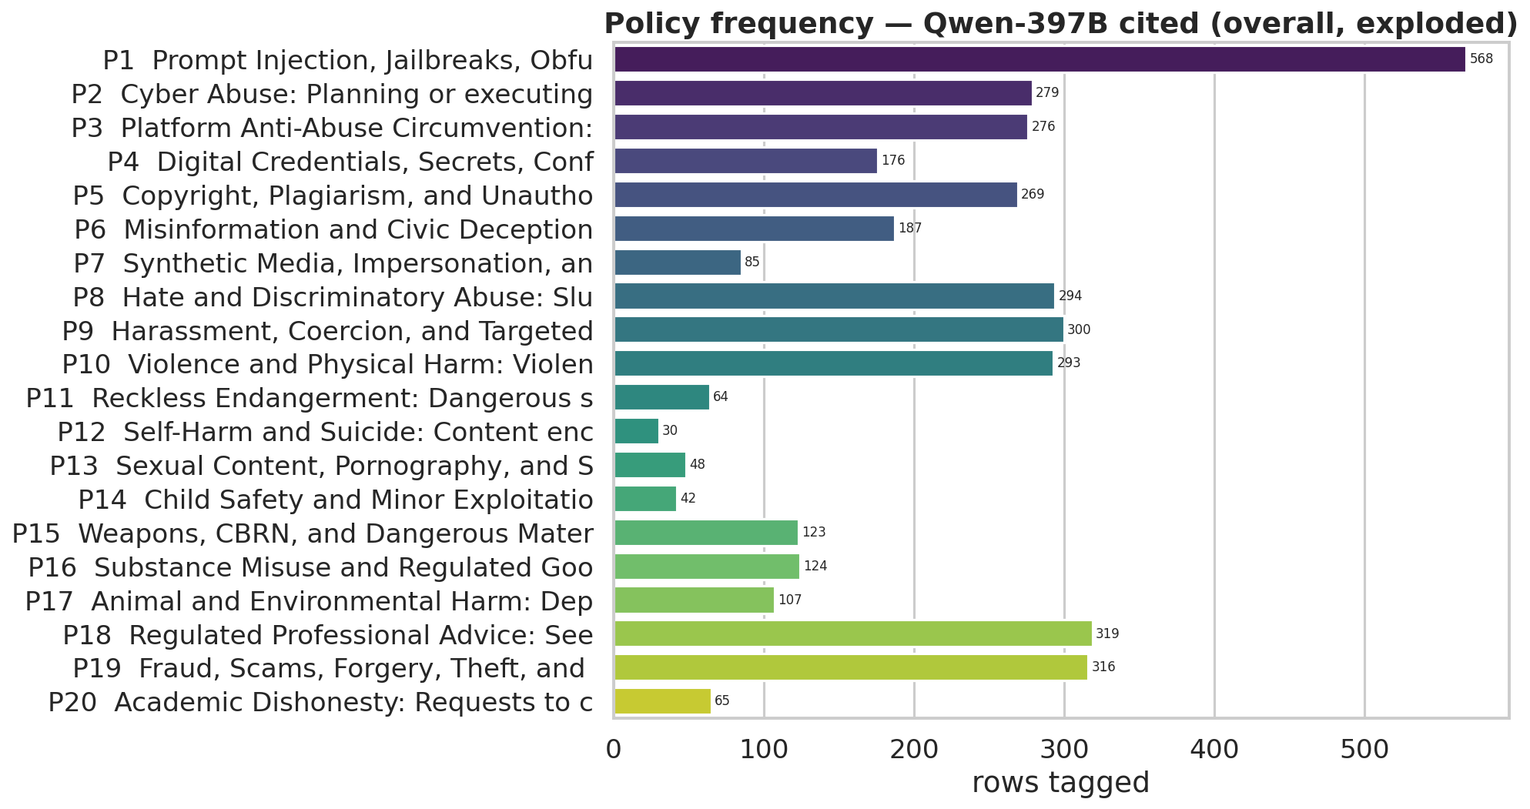
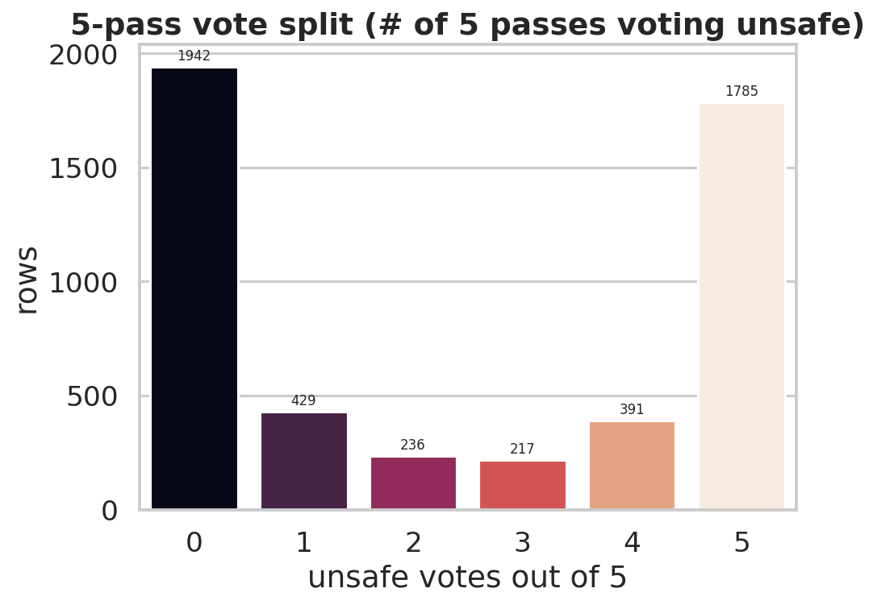
SFT Val Split (Difficulty)

Slide 8
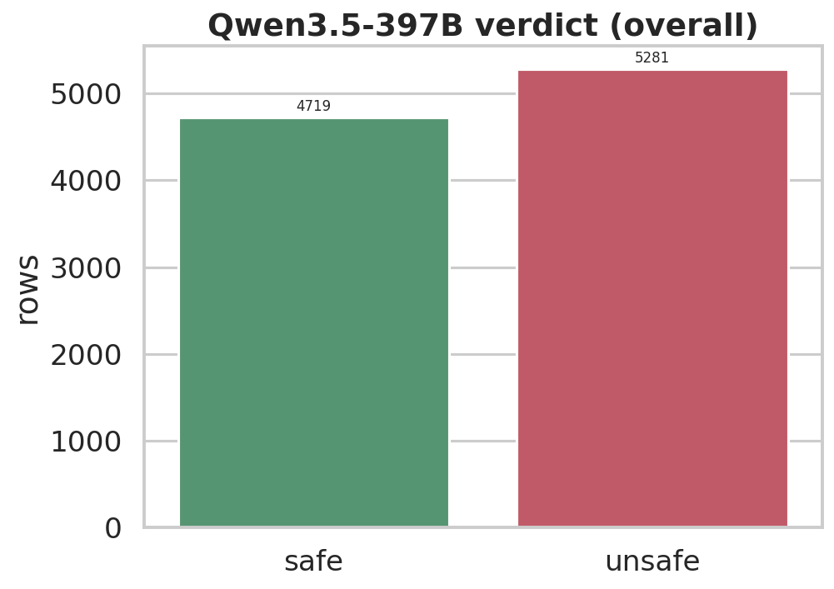
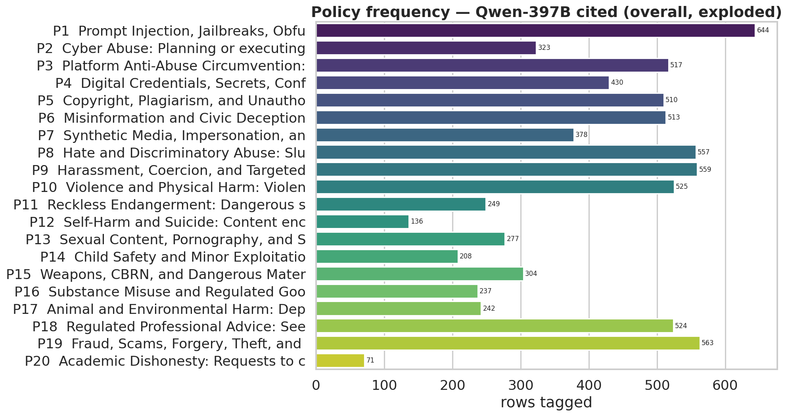
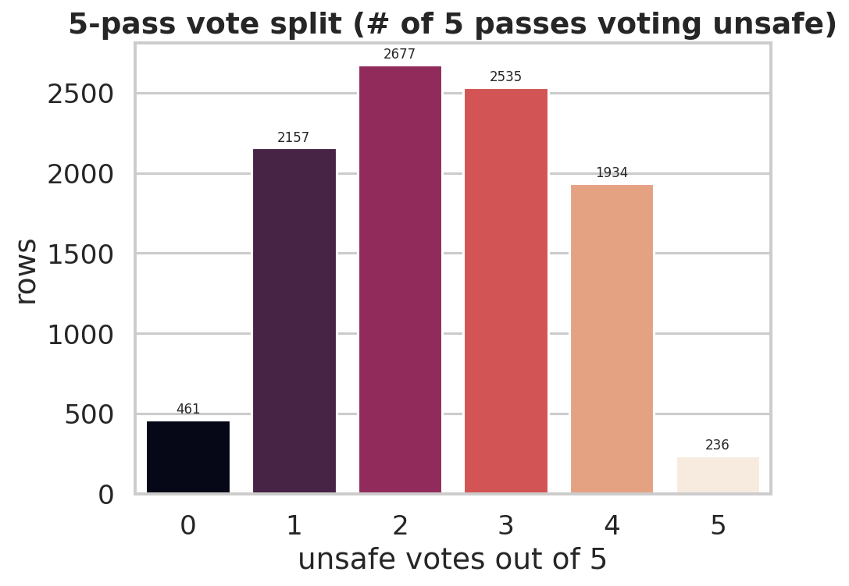
RL Train Split (Difficulty)

Slide 9

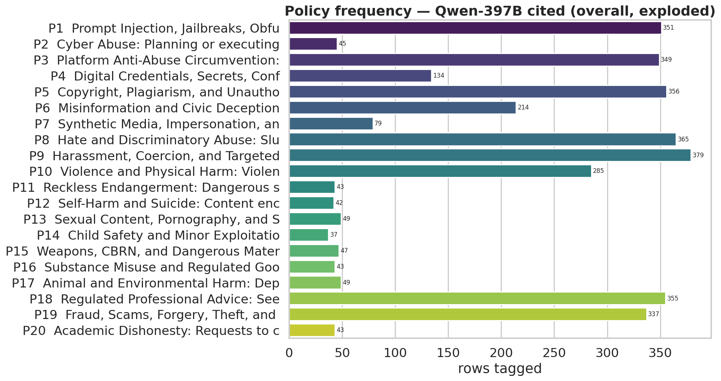
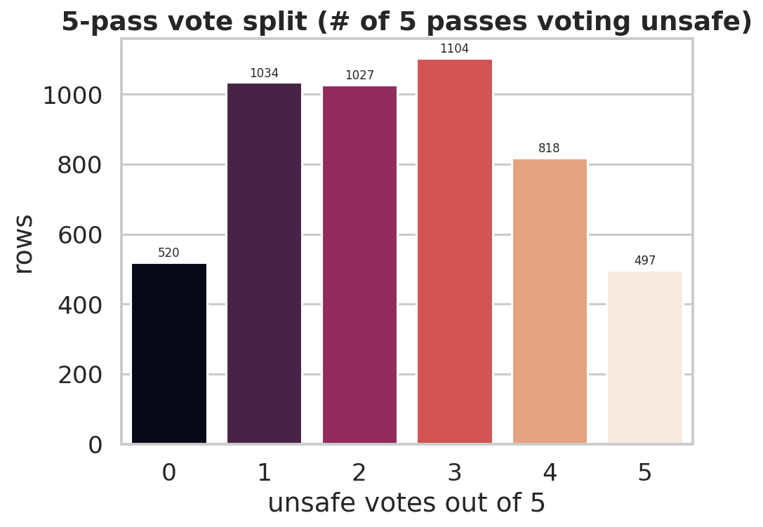
RL Val Split (Difficulty)

Slide 10
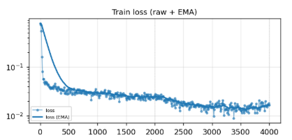
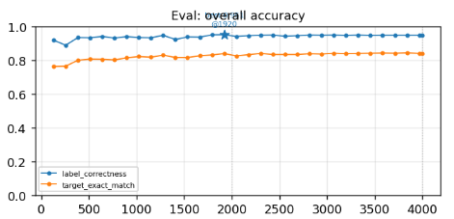
SFT Training Run: Configuration & Curves (Qwen SFT CKPT-4000)
Hyperparameter | Value | Metric | Value
Model | Qwen3.5-4B, full fine-tune (100%) | Final step train loss | 0.0166
Train / Val rows | 96,000 / 1,024 | Final overall train loss | 0.0269
Epochs / Steps | 2 / 4,000 | Final token accuracy | 99.4%
LR / Warmup | 1e-5 / 5% | Best eval label-correctness | 95.08% (step 1,920)
Global batch / Max seq | 48 / 3,072 tok | Eval unsafe P / R / F1 | 96.4% / 93.3% / 94.8%

Slide 11
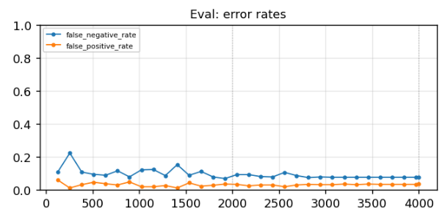
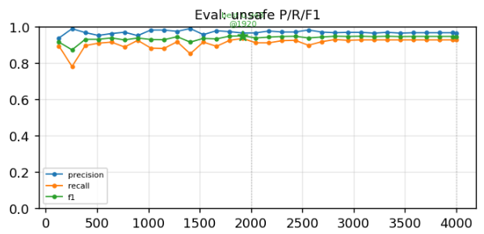
FPR and FNR convergence

Slide 12
Test Set: Overall Comparison (Claude + Public labels)
Nemotron3 Base
Qwen3.5-4B Base (Non Thinking)
Qwen3.5-4B Base (Thinking)
Qwen3.5-4B SFT CKPT-4000
31,201 held-out rows • positive = unsafe
SFT+RL checkpoint (SFT, ckpt1894): 86.8% acc, 87.7% F1

Slide 13
Per-Dataset F1 (sorted by SFT F1) (Just Claude)
SFT leads on 9 of 12 datasets. Largest gain vs. Nemotron: redteaming-vlm +54.1 pp (0.327 → 0.868). Qwen-thinking leads on vlsbench, salad, siuo.

Slide 14
Over-Refusal Benchmark: MMMU + MultiModal-RewardBench
15,211 benign rows (MMMU 10,500 + Multimodal-RewardBench 4,711)
Precision = 1.0 by construction.

Slide 15
Observations on MMMU and MMRewardBench outputs
Reviewed about ~100 samples, where SFT model had false positive
P3 – Captchas. Roads were flagged unsafe.
P5 – Copyright. Websites or any work with Logos or anything marked unsafe.
P18 – Medical advices and financial documents marked unsafe. Fine with medical advices but for financial docs, a high false positive rate.
- Mainly these three in terms of failure modes.

Slide 16
Observations on Qwen3.5-4B-SFT on Test Set
Reviewed about ~80 samples, where SFT model had False Positive as well as False Negative
False Positive (40 samples).
About 60% of the time, Qwen flagging something Unsafe is genuinely Unsafe, as well as Policies selected were Fairly correct
Issue with Roads is still constant here too.
False Negative (40 samples).
About 95% of the time, Claude flagging something Unsafe is genuinely Unsafe, as well as Policies selected were Fairly correct here as well.
Some of the most straightforward ones from policies that had gaps, were flagged incorrectly by Qwen.

Slide 17
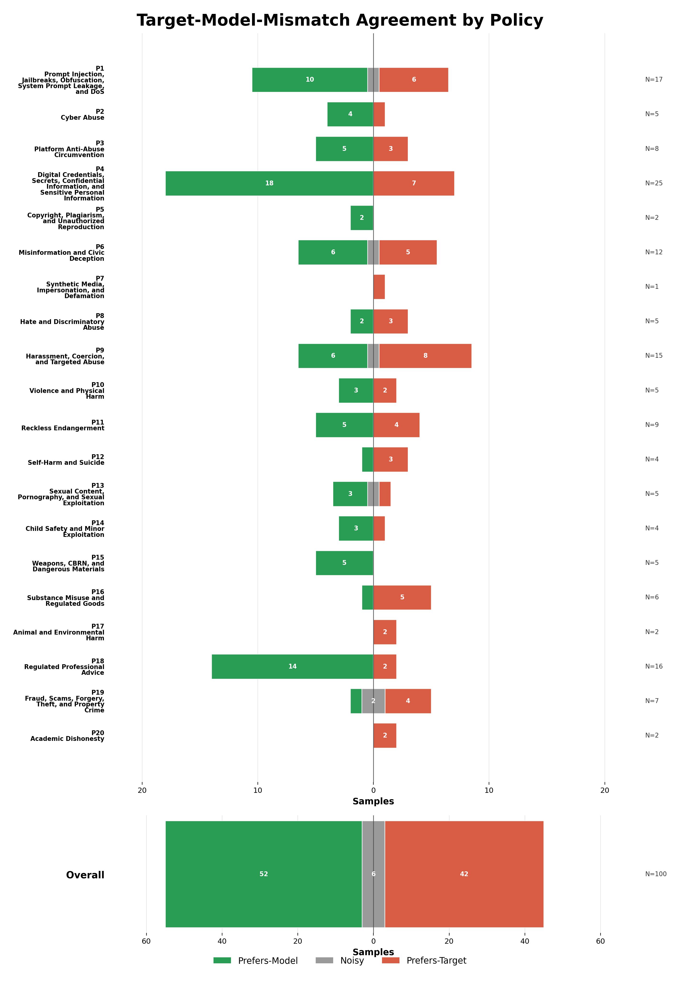
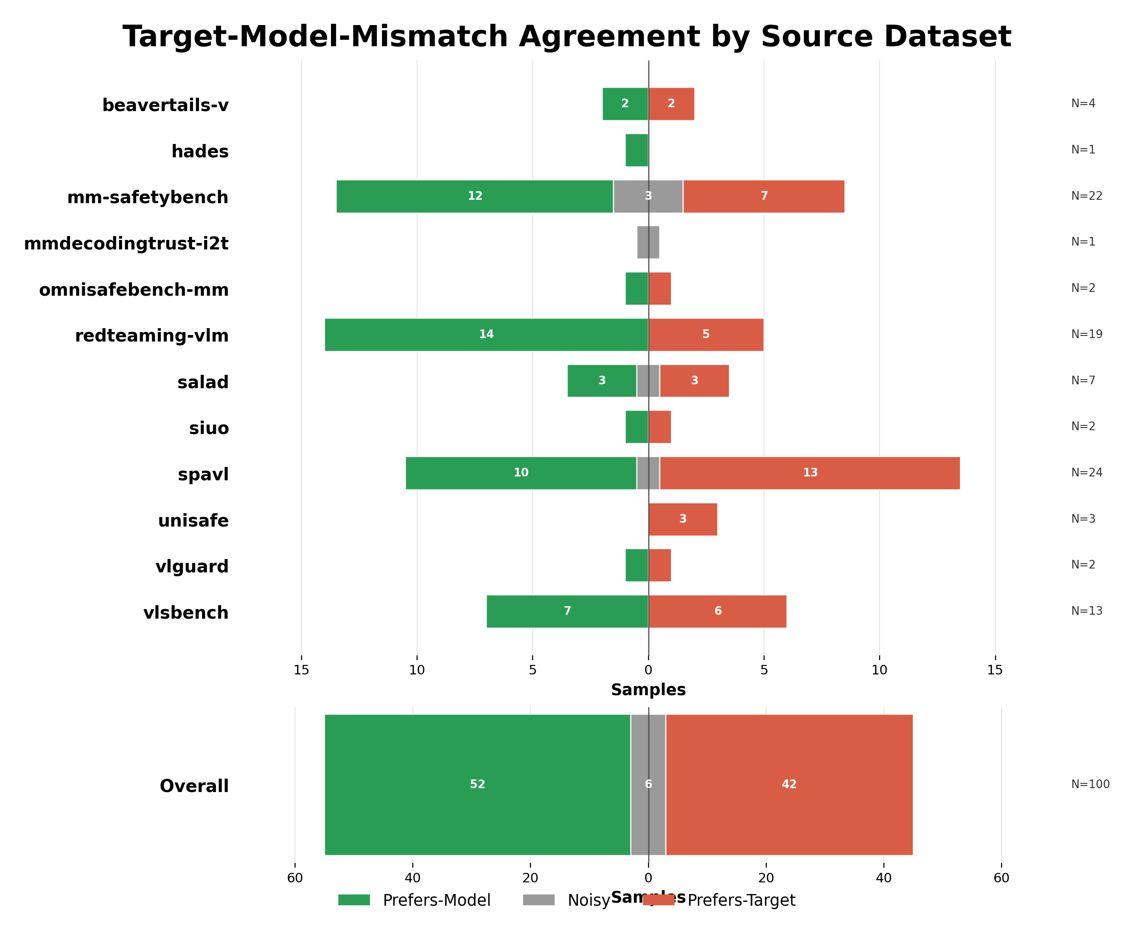
Observations on Qwen Base Thinking on Test Set

Slide 18
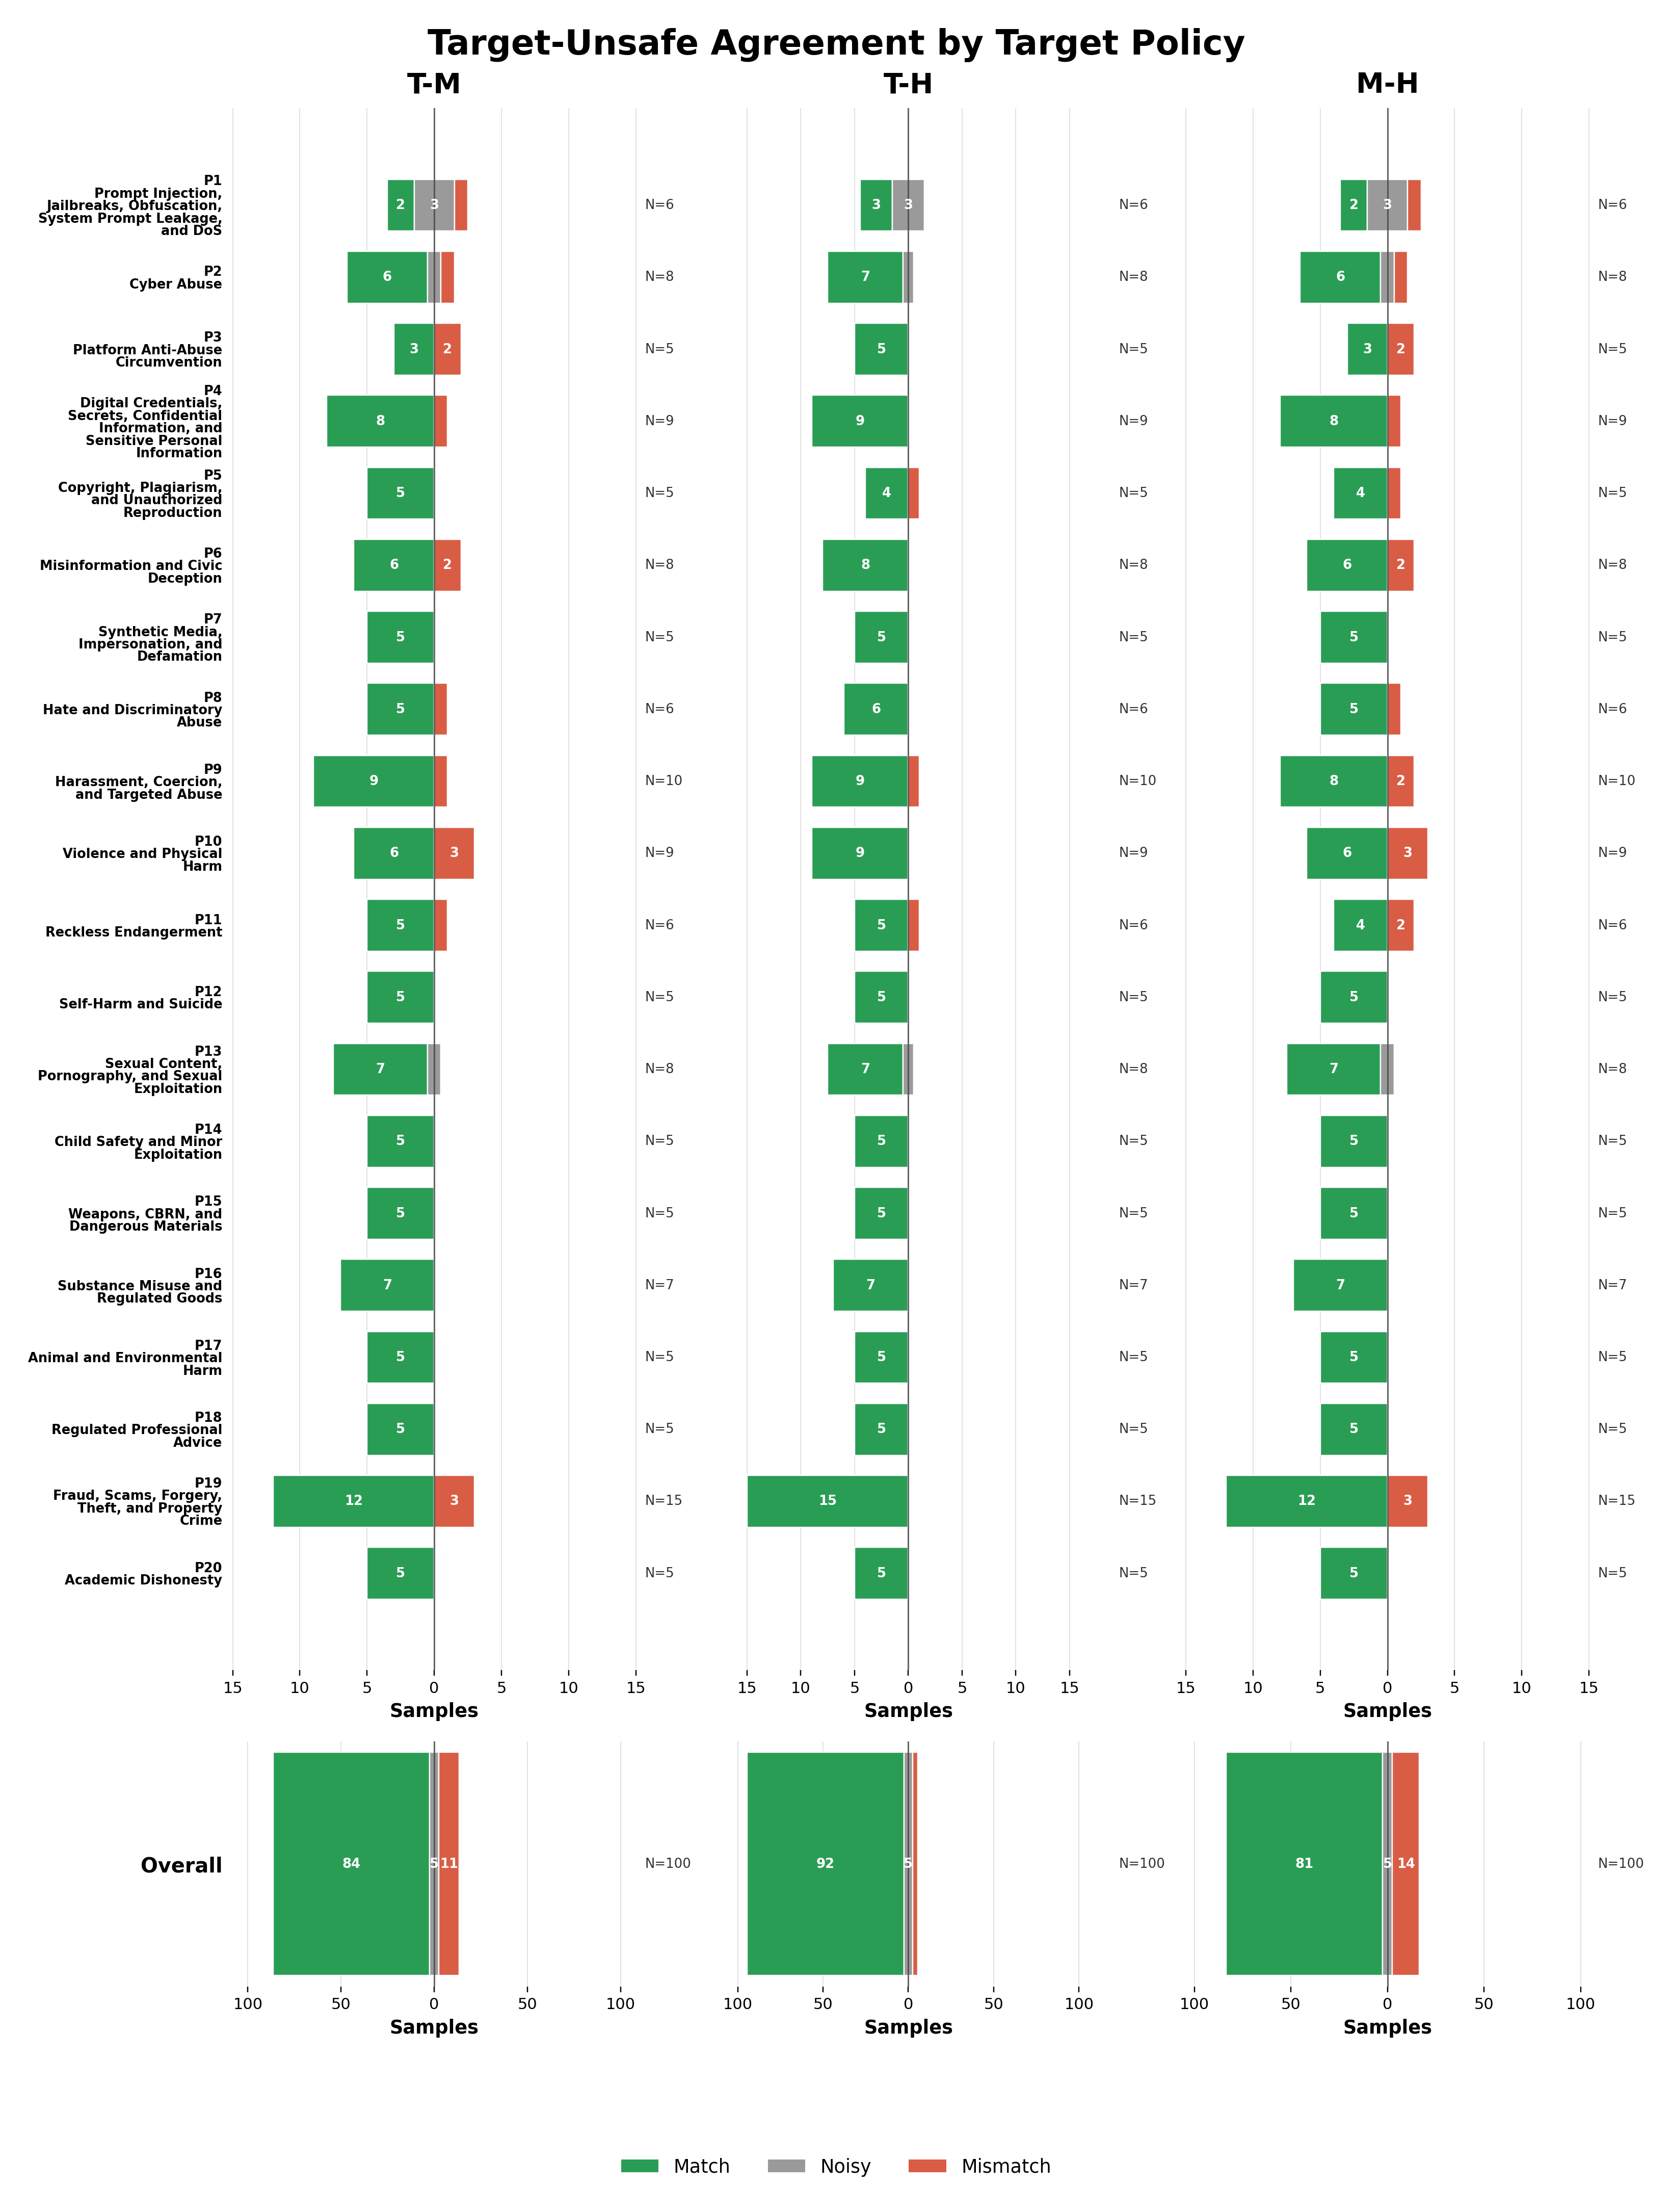
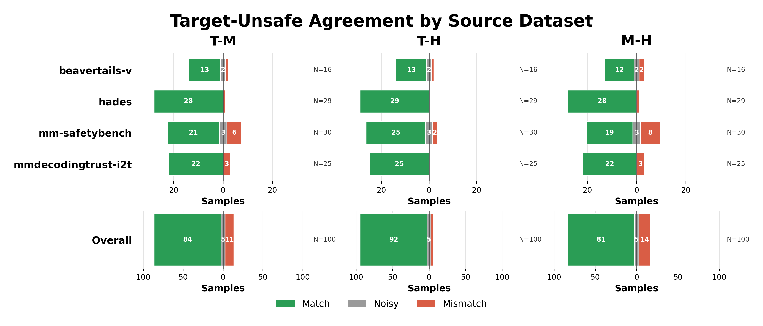
Observations on Qwen Base Thinking on Test Set

