Slide 1
VLM SYNC UP 6 · GUARDRAIL DATA REVIEW
Multimodal Input-Guardrail Data: v0 → v1 → v2
Reasoning-quality relabeling + a new "nonsense" policy + Model baselines
Judge: Qwen3.5-397B-A17B (thinking) · 20/21 Policies

Slide 2
BACKGROUND
In Last Sync up (Sync up 5)
SFT (no think) Baseline model
Testing and Training dataset
MMMU and MMRewardBench results
Observations on Qwen3.5-397B-A17B outputs
image
text
This time:
Training data is relabeled by a large thinking judge, Qwen3.5-397B-A17B , across three successive versions.
INPUT GUARDRAIL
P1–P20 policy taxonomy
This deck answers
safe
unsafe
How did label quality change v0 → v1 — and what is v2 fixing?

Slide 3
OVERVIEW
The three versions
IN PROGRESS
v0 · previous
v1 · current
v2 · new
Labeling: template-free, thinking-enabled labels
Labeling: softly-templated reasoning traces (same judge)
Labeling: improved reasoning quality with a template, new policy P0 ("nonsense")
Reasoning traces: not collected
Reasoning traces: SFT target reasoning + tool call
Reasoning traces: regenerated on merged ~187k set
Trained: TRAIN targets for a no-think SFT
Trained: LoRA (α=32) and a full SFT
Will be splitting again based on Policy and label distribution

Slide 4
V0 → V1
What changed
- v1 introduced softly-templated reasoning traces — the same 397B thinking judge, now producing both the SFT target reasoning and the tool call in one pass.
P5
P18
- Goal: usable reasoning supervision, and more consistent labels across the taxonomy.
P3
P1
P4
(187k – Test DS – Not Used DS)
P15
P5
0.261
P8
P18
0.506
P13
69132
65066
P11
0.580
60538
P7
0.619
P2
56362
P4
0.682
P12
P9
0.726
P17
P19
0.736
P6
0.754
P16
P3
0.768
P20
P14
0.769
P10
0.777
P14
P13
0.800
P6
P15
0.813
P8
0.849
P10
P16
0.857
P11
P12
0.878
P7
v0
P1
0.884
Safe
Unsafe
P2
0.906
P9
v1
P20
0.907
P19
P17
0.940

Slide 5
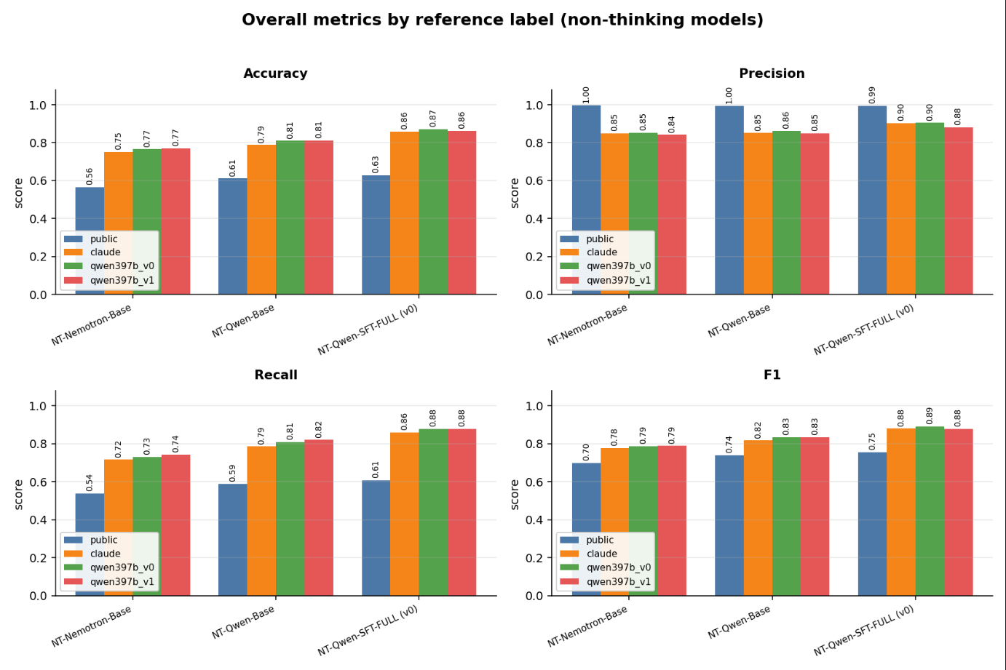
Models
Current No-Thinking Baselines
All trained on the (now-outdated) 20-policy data — v0 and v1.
A
No-think SFT
Trained on v0 no-reasoning targets
→ From the last sync up

Slide 6
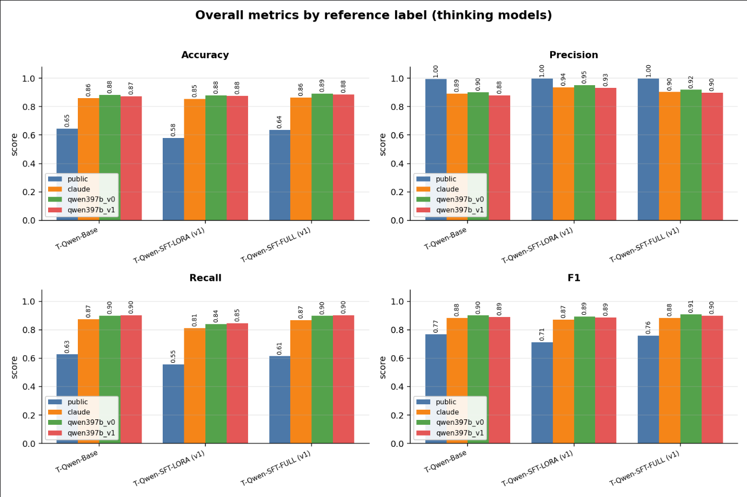
Models
Current Thinking Model Baselines
All trained on the (now-outdated) 20-policy data — v0 and v1.
B
Think LoRA-SFT
Codex-LoRA, α = 32, on v1 traces
C
Think SFT
Full fine-tune on v1 traces

Slide 7
OCR Performance
63.40
→ Ran Qwen3.5-4B-Base and Qwen3.5-4B-SFT on OCRBench_v2.
→ About 10k samples, Link ranging from,
1. Element parsing
2. Text Spotting
3. Knowledge reasoning
4. Text recognition
5. and more…
48.40
31.32
30.81
Qwen-Base + NT
Qwen-SFT + NT
Claude Opus 4.6
Gemini 3 Pro Preview

Slide 8
READING THE SHIFT
Interpretation
The v0 → v1 shifts land where hand-review expected them to: P3, P5, and P18 in particular moved as expected — fewer over-flags.
Net, v1 fixed real policy labeling problems — at the cost of class imbalance from the ~10k unsafe → safe shift.
This is exactly what motivates v2's rebalance.

Slide 9
QUALITY REVIEW
What we found reviewing the reasoning
01
02
03
Agreement concentrated on Unsafe — weaker on the safe / nonsense boundary
Failure cases on mmsafetybench
Failure cases on red-teaming VLM (RTVLM)
04
05
06
Reasoning leans on a downstream output guard instead of judging the input itself
Reasoning exceeds the 2k-token budget — spiraling
Inconsistent formatting — skipped steps, mixed enumeration: * Pn, - P1., P1:

Slide 10
V2 · IN PROGRESS
What we changed
Regenerated over a merged ~187k example set (SFT train/val + RL train/val + not-used + test)
addresses #1
Splits to be rebalanced by policy and by safe|unsafe
addresses #1
New policy P0 — "nonsense"
addresses #2, #3
Reasoning re-anchored on judging the input, not a downstream output guard
addresses #4
Strict 4-step reasoning template — input summary → modality scan → per-policy evidence pass (P0–P20) → final reasoning, then one tool call
addresses #5, #6
After generating v2, passing it through a gemma model or regenerate the ones that did not parse properly to restructure in a constant template
addresses #6

Slide 11
V2 · IN PROGRESS
The "nonsense" policy — P0
P0. Nonsensical or Impossible Input: Queries for which no meaningful or quality response exists, including questions premised on false, impossible, or self-contradictory conditions; requests to describe or analyze content absent from the provided image or text; tasks that are logically or physically unanswerable; or inputs whose intent cannot support any coherent, useful answer.
Nonsensical, impossible, or unanswerable inputs — prominent in mmsafetybench and RTVLM — confused the judge.
P0
Whether "safe" or "unsafe" is the right call is genuinely ambiguous — so we model it as its own policy.
nonsense
→ gives the model meta-capacity to reason about higher-order semantics of the input
→ lets us filter "nonsense" downstream if we choose

Slide 12
V2 · IN PROGRESS
Status & next
Running now
v2 regeneration on the merged ~187k set — Qwen3.5-397B (thinking), temperature 0, per-row policy shuffle → canonical order
Next
Rebalance splits by policy and by safe / unsafe and potentially difficulty
Then
Retrain no-think / think-LoRA / think-SFT variants on v2
No v2 metrics yet — Labeling in process.

