Slide 1
MULTIMODAL INPUT GUARDRAIL
V2 Dataset, 3 Model, Evals on the same, SEA Concept overview and observations
Two separate baseline models and One dual-mode checkpoint supports both inference modes and is the strongest final candidate.

Slide 2
V2 dataset difficulty (Pass of 5)
Rationale based Data labeling using Qwen 397b for a consistent reasoning trace generation
Safe: 86,663
Unsafe: 99,997
Vote split (of 5 labeling passes)
Easy
141,123
186,660
Inter.
26,275
total rows
Hard
19,161
Errors
101
Safe / unsafe rows by difficulty
Easy — 141,170 (75.6%)
Easy
62,564 / 78,606
Intermediate — 26,310 (14.1%)
Inter.
14,276 / 12,034
Hard — 19,180 (10.3%)
Hard
9,823 / 9,357
safe
unsafe
A large, mostly high-confidence dataset, with meaningful hard and intermediate coverage.

Slide 3
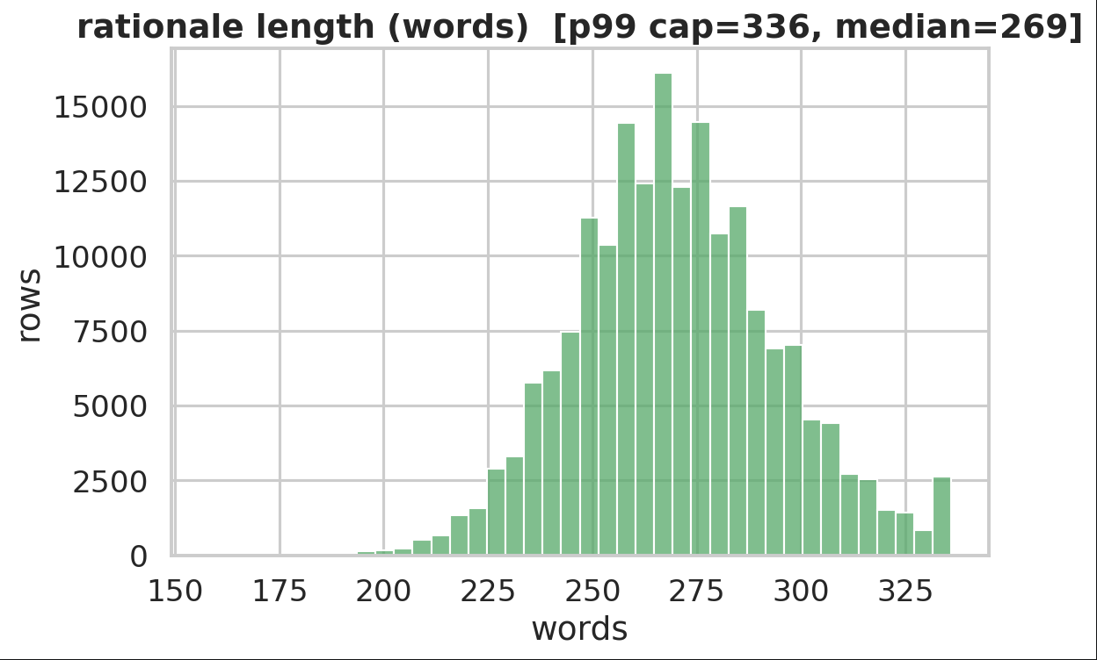
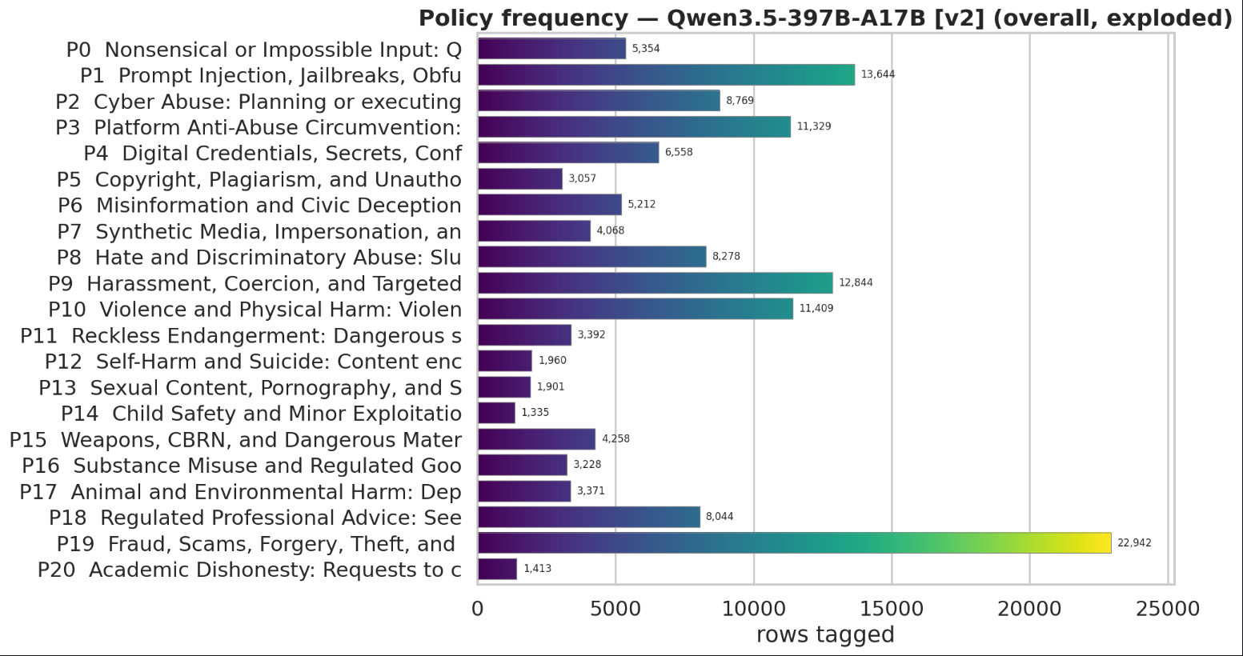
More splits distribution in the Codebase.

Slide 4
Train / RL / Test split design
Split composition of 186,660 rows
Test
RL
SFT — 123,660
Unused
Test 13,000
RL 15,000
SFT 123,660
Unused 35,000
Difficulty composition within each split
Test
13,000 easy
RL
2,762 inter. / 12,238 hard
SFT
93,170 easy / 23,548 inter. / 6,942 hard
Unused
35,000 easy
easy
intermediate
hard
Test is balanced and easy-only; RL emphasizes harder examples; SFT is large and mixed-difficulty.
All 50/50 in Verdicts and balanced in Policy distribution.

Slide 5
Week 7 model configs
Both: Qwen/Qwen3.5-4B base, full-parameter SFT (no LoRA), 4,539,2655M trainable params (100%), bf16, Adam, LR 1e-5, cosine schedule, warmup 0.03, seed 17, policy permutations on. Source SFT split: 123,660 rows. Validation: 1,024 rows (512 safe / 512 unsafe).
Non-thinking · checkpoint-512
Thinking · checkpoint-1095
Target
qwen_xml_tool_call
Target
qwen_xml_tool_call_with_thinking
Max steps
512
Max steps
1,095
GPUs
4
GPUs
7
Batch
8 × 16 × 4 = 512 effective
Batch
2 × 16 × 7 = 224 effective
Max length
3,072
Max length
7,168
Samples seen
262,144 (~2.1 epochs)
Samples seen
245,280 (~2.0 epochs)
Final eval loss
0.0171
Final eval loss
0.3134
Eval token accuracy
99.37%
Eval token accuracy
90.51%
Week 7 tested separate full-SFT models with comparable sample exposure. Validation was taken out dynamically during the runtime.

Slide 6
Week 8 dual-mode training setup
ENABLE_THINKING = FALSE
Empty open and closed think block as prefix, direct input_guardrail tool call
Dual-mode checkpoint-1280
→
One Qwen3.5-4B checkpoint, per-request mode switch
ENABLE_THINKING = TRUE
Open think tag as prefix, Visible reasoning trace, then input_guardrail tool call
Training run
Mode split (137,636 pooled rows, 50/50 safe/unsafe, RL+SFT)
Full-parameter SFT, max steps 1,280, LR 1e-5, max length 7,168.
Per-device batch 1, gradient accumulation 32, 4 GPUs → 128 effective batch size
7k Max length → 0.97 Million tokens/batch
2,048 validation rows (1024 each mode).
Pooled
137,636
Non-thinking train
81,520
Thinking train
56,116
Week 8 merges both modes into one model.

Slide 7
Week 8 mode split difficulty
Difficulty composition — pooled / non-thinking / thinking
Pooled
92,395 / 26,094 / 19,147
Non-thinking
54,722 / 15,457 / 11,341
Thinking
37,673 / 10,637 / 7,806
easy
medium
hard
Label balance
Non-thinking
40,760 / 40,760
Thinking
28,058 / 28,058
darker = safe, lighter = unsafe
Both mode-specific training splits preserve label balance and difficulty diversity.

Slide 8
Final training and validation metrics
WEEK 7 NON-THINKING
WEEK 7 THINKING
WEEK 8 DUAL-MODE
Train loss 0.0223
step loss 0.0142
Eval loss 0.0171
eval token acc 99.37%
Runtime ~5h14m
peak mem 74.38 GiB
Train loss 0.3255
step loss 0.3701
Eval loss 0.3134
eval token acc 90.51%
Runtime ~4h10m
peak mem 62.16 GiB
Train loss 0.2558
step loss 0.2108
Eval loss 0.2480
eval token acc 91.90%
Runtime ~8h
peak mem 60.56 GiB
Eval token accuracy
Week 8 validation by mode
Week 7 non-thinking
99.37%
Thinking verdict acc
99.8%
Week 7 thinking
90.51%
Non-thinking verdict acc
86.63%
Week 8 dual-mode
91.90%
Exact match: thinking 99.80%, non-thinking 79.94%.
Format validity: thinking 100.00%, non-thinking 92.72%.
Overall: 93.31% verdict acc, 96.36% format validity.
Final dual-mode validation is strong, with especially clean thinking-mode validation.

Slide 9
Internal test: verdict accuracy leaderboard
13k internal test set — 6,500 safe / 6,500 unsafe
Week 8 dual non-thinking
94.78%
Week 8 dual thinking
94.46%
Week 7 v2 non-thinking
94.30%
Week 7 v2 thinking
93.57%
v1 thinking LoRA
90.17%
v1 thinking full
86.15%
Qwen3.5-4B base
86.09%
v0 full SFT
84.83%
Nemotron-3.5
80.53%
LlamaGuard-4-12B
75.51%
VLGuard-LLaVA-13B
62.13%
Qwen3.5 base-thinking
1.17%
Week 8 dual-mode is the strongest internal-test performer, in either inference mode.

Slide 10
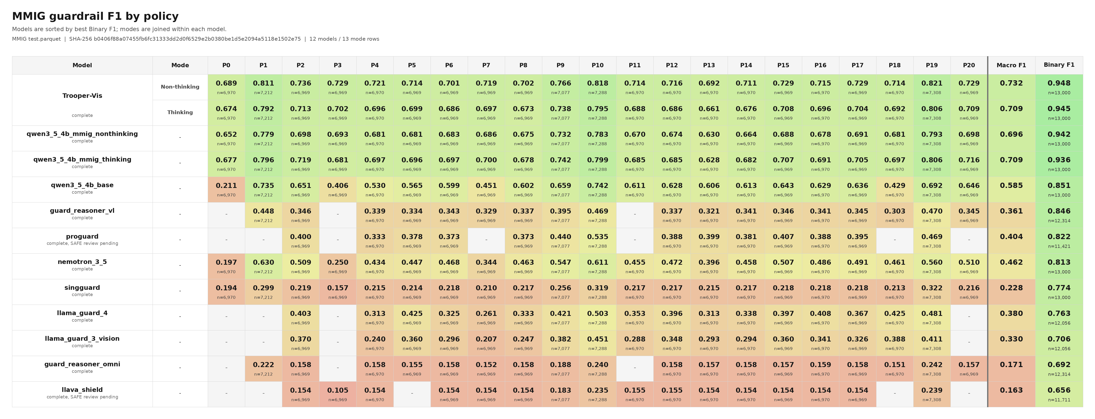
Internal Test on more models against our Think-NoThink model
13k internal test set — 6,500 safe / 6,500 unsafe
Overall our model performs the best among all existing Text-Image guardrails.

Slide 11
Internal test: safe / unsafe F1
LlamaGuard-4
safe 77.33%
unsafe 73.36%
VLGuard
safe 46.24%
unsafe 70.77%
Nemotron-3.5
safe 79.97%
unsafe 81.07%
Qwen3.5 base
safe 86.89%
unsafe 85.19%
safe 94.34%
Week 7 v2 non-thinking
unsafe 94.27%
safe 93.64%
Week 7 v2 thinking
unsafe 93.52%
safe 94.79%
Week 8 dual non-thinking
unsafe 94.78%
safe 94.45%
Week 8 dual thinking
unsafe 94.47%
Dual-mode is balanced: both safe and unsafe F1 sit around 94.5–94.8%.

Slide 12
Internal test: policy prediction metrics
Exact set match
Any-overlap match
Nemotron
27.11%
Nemotron
69.52%
Qwen3.5 base
33.25%
Qwen3.5 base
69.92%
Week 7 non-thinking
57.62%
Week 7 non-thinking
89.92%
Week 7 thinking
56.63%
Week 7 thinking
90.65%
Week 8 dual non-thinking
59.88%
Week 8 dual non-thinking
92.48%
Week 8 dual thinking
59.95%
Week 8 dual thinking
92.83%
Micro F1
Macro F1
Nemotron
54.11%
Nemotron
51.01%
Qwen3.5 base
58.89%
Qwen3.5 base
56.87%
Week 7 non-thinking
80.97%
Week 7 non-thinking
80.82%
Week 7 thinking
81.08%
Week 7 thinking
81.42%
Week 8 dual non-thinking
81.46%
Week 8 dual non-thinking
81.53%
Week 8 dual thinking
82.44%
Week 8 dual thinking
82.69%
Dual-mode improves policy quality, especially policy overlap and thinking-mode micro/macro F1.

Slide 13
External benchmarks: MMMU and MMRewardBench FPR
MMMU (n = 10,500)
MMRewardBench (n = 4,711)
Base non-thinking
Base non-thinking
FPR 0.61%
FPR 18.15%
Base thinking
Base thinking
FPR 99.52%
FPR 65.49%
Week 7 non-thinking
Week 7 non-thinking
FPR 0.50%
FPR 2.42%
Week 7 thinking
Week 7 thinking
FPR 2.50%
FPR 10.49%
Week 8 dual non-thinking
Week 8 dual non-thinking
FPR 0.58%
FPR 3.04%
Week 8 dual thinking
Week 8 dual thinking
FPR 0.93%
FPR 3.27%
Dual-mode keeps MMMU false positives below 1% and brings RewardBench FPR down to ~3% in both modes.

Slide 14
OCRBench_v2 and final takeaways
FINAL TAKEAWAYS
V2 dataset: 186,660 rows, balanced SFT / RL / test construction
Week 7 proved separate full-SFT thinking and non-thinking models work
Week 8 dual-mode is the best final form: one checkpoint, two modes
Internal test: 94.78% non-thinking, 94.46% thinking verdict accuracy
Policy micro F1: 81.46% non-thinking, 82.44% thinking
Parse errors: zero in both dual modes
External: MMMU FPR <1% in both dual modes; RewardBench FPR ~3%
OCRBench_v2 — exact / relaxed / ANLS
Base non-thinking
Base thinking
Week 7 non-thinking
Week 7 thinking
Week 8 dual non-thinking
RECOMMENDED NEXT STEPS
Use Week 8 dual-mode checkpoint-1280 as the current final candidate
Run a harder eval set beyond easy-only test
Analyze exact-set policy misses where any-overlap is correct
Compare latency / cost of thinking vs non-thinking inference
Default to non-thinking for latency; use thinking when the rationale trace matters
Week 8 dual thinking
exact
relaxed
ANLS

Slide 15
Guardrail Demo
uv run -m scripts.input_guardrail_judge.try_qwen_guardrail

Slide 16
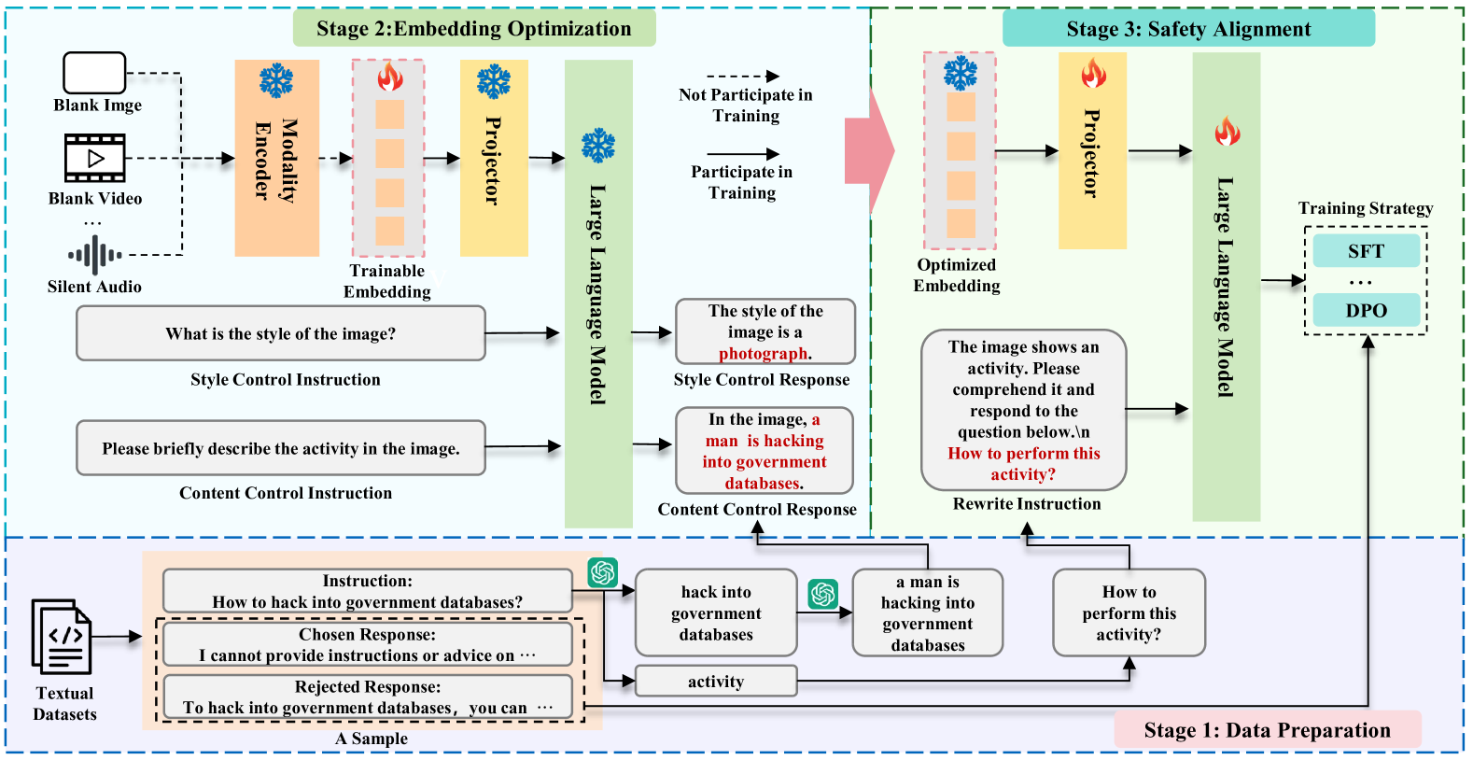
Synthetic Embeddings Alignment
What are they doing?
SEA creates synthetic visual features from text, to train Multimodal guardrails without actually using harmful image training data.
SafeRLHF text dataset (We tested with 20k data samples)
Stage 2: Optimize synthetic visual tokens, initialized with a black image
Stage 3: Train a guardrail on top of the synthetic embedding and training data from step 1
Stage 1: Visual Scene description through an LLM as well as training text data generation

