Slide 1
MULTIMODAL SAFETY · WEEKLY UPDATE
Labeling, agreement, and synthetic compositional harm
Week of June 23, 2026 (VLM Sync up 4)

Slide 2
Recap: where we were
Last week's progress
Test Dataset 31k among 12 datasets. High unsafe ratio.
Uncleaned Train Data 129k among 4 datasets.
An idea for Synthetic Data Generation pipeline.

Slide 3
Agenda
01
New dataset added
Think-in-Safety — 4,394 multimodal rows with reasoning traces.
02
Labeling QA on the full corpus
Qwen3.5-4B pass-of-5 self-consistency + multi-judge agreement vs the 397B.
03
Data hygiene
Image dedup (byte-hash + prompt cosine ≥ 0.93) removed ~6k dupes → 49k unique images; noise added to plain canvases for SFT robustness
04
Synthetic compositional-harm pipeline
15,000 candidate images → 2,895 kept; P5 coverage grew 9.5×.

Slide 4
Corpus: rows per dataset
127,746 image+text rows across 5 datasets.
Every row = (image + text question); both required. spavl dominates the volume — ~71% of all rows.

Slide 5
Label distribution
Public Labels Qwen3.5-397B Qwen3.5-4B (Pass@5)
"public_label" = the source dataset's own label, before our judges weigh in.

Slide 6
New dataset: Think-in-Safety
Row shape
4,394
image + benign-looking instruction + <think> reasoning trace + refusal answer (reasoning-style safety data).
multimodal rows added this week
Source
Sourced from hugging face at Holly301/Think-in-Safety
10
harm categories covered
Why it matters
Teaches a guardrail to reason about why an (image, text) pair is unsafe, not just pattern-match. As well as it is cleaned and has images which are somewhat like what real people may enter as image.

Slide 7
Think-in-Safety: categories
Privacy and malicious-use dominate the new rows — together ~54% of TIS.
Privacy alerts alone (1,510) outweigh the next two categories combined.

Slide 8
Policy coverage (the gap) (Labels by Qwn3.5-397b)
Long-tailed — P5, P2, P3 barely covered (red).
Counts = rows the 397B judge cited each policy on. This gap motivates the synthetic pipeline.

Slide 9
Policies cited per row
Most unsafe rows cite a single policy — overlap is rare.
"0 policies" includes safe + needs_review rows; among unsafe rows, the modal count is 1.

Slide 10
Policy co-occurrence (top pairs)
Jailbreak (P1) co-occurs with fraud (P23) and cyber (P4) most often.
Pair = both policies cited on the same row by the 397B judge.

Slide 11
How we label: the judge stack
Main Guardrail Judge
CROSS-CHECK 1
CROSS-CHECK 2
Qwen3.5-397B-A17B (FP8)
Gemma-4-31B
Qwen3.5-4B (×5)
Tool-calling verdict: {label, policies, modality}. Policy IDs are shuffled per row so the model reads policy text instead of memorizing id → harm priors.
Different family, different bias. Measures agreement with the 397B verdict, row by row.
Same row judged 5 times. Majority label; split votes flag ambiguous rows.
Disagreements between judges → human-review queue.

Slide 12
Confusion: 397B vs 4B (5-pass)
89.6% agree on diagonal — the off-diagonal 12,780 rows are what we review.
4B (5-pass)
predicted safe
predicted unsafe
50742
8825
safe
agree (safe)
397B safe → 4B unsafe
397B (truth)
3955
59245
unsafe
397B unsafe → 4B safe
agree (unsafe)
Decided rows only: 122,767 total. Diagonal = agreement; off-diagonal = human-review queue.

Slide 13
Pass-of-5: method + results
78.7% unanimous votes; mean consistency 0.94 — labels are stable run-to-run.
METHOD
42356 : 58121
Difficulty | What is in that.
Easy | 5:0, 4:0
Intermediate | 4:1, 3:1, 3:0, 2:0, 1:0
Hard | 3:2, 2:2, 2:1, 1:1
Undecided | 0:0
• Judge each row 5 independent times.
• Take the majority label.
• Track vote consistency + mean confidence per row.
• Split votes (3-2 / 2-3) auto-flag ambiguous rows for review.
8567 : 8117
RESULT
78.7% unanimous · mean consistency 0.94
Vote split = (n_safe, n_unsafe) across 5 passes. Unanimous = 0-5 + 5-0 + 0-4 + 4-0 = 100477 rows (78.7%).

Slide 14
Multi-judge agreement (vs 397B)
Strong consensus on labels — both judges agree with the 397B on ≥90% of decided rows.
Gemma-4-31B: 117,647 / 123,325 decided rows agree · Qwen3.5-4B (5-pass): 109,987 / 122,767.

Slide 15
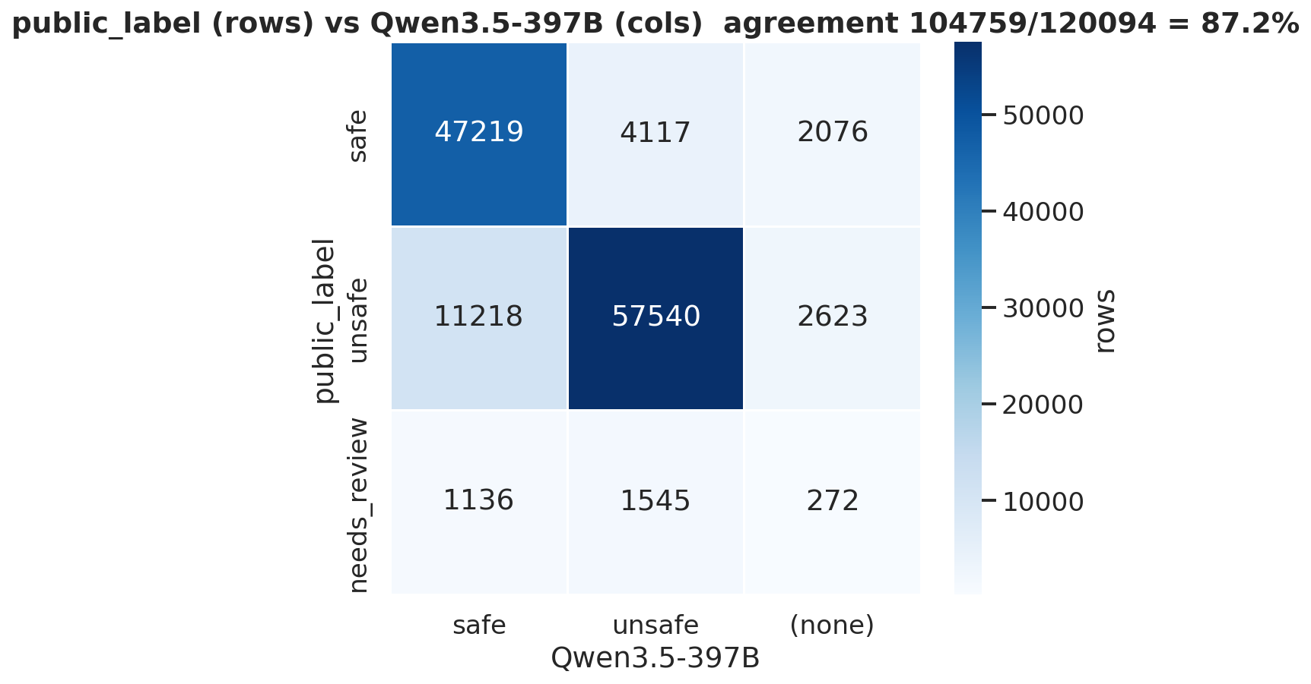
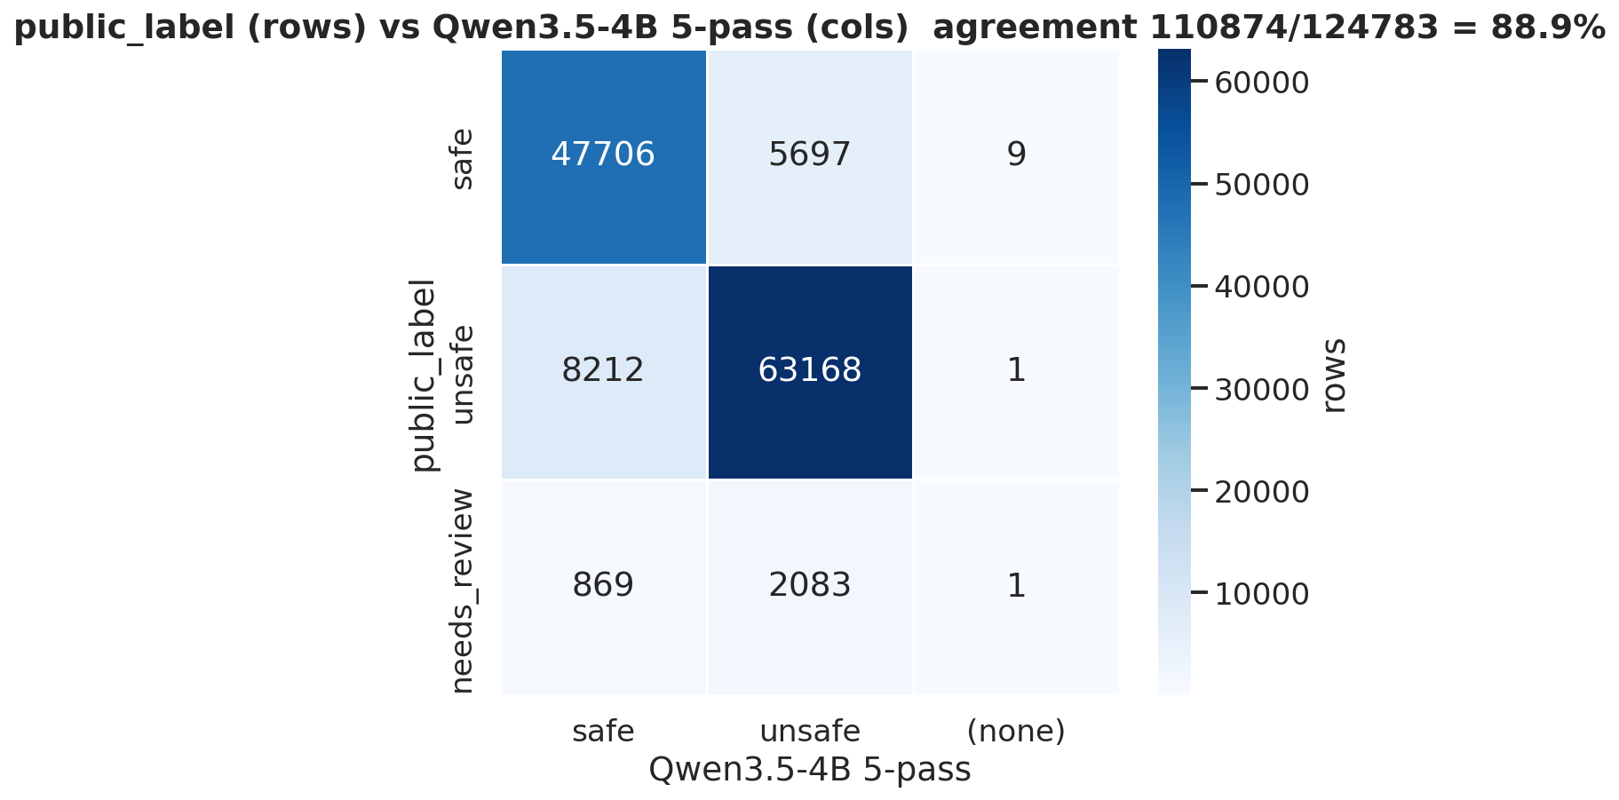

Slide 16
Data hygiene: dedup & noise augmentation
Byte-hash + prompt cosine ≥ 0.93 removed ~6k near-duplicates; 50k unique images underlie 127k rows.
Image deduplication
Noise augmentation on plain images
Noise augmentation on plain images
01
Hash image bytes; group rows that share a hash.
• Added light Gaussian noise to plain-white / near-blank images before training.
02
Embed each group's text prompts with a small encoder.
• Reason: Our SFT Model needs to be prone to noise, and hence would be a good addition to the Train DS.
03
Pairwise cosine ≥ 0.93 → same question on same image → drop the duplicate.
04
Paraphrased ~30k prompts to have questions column to be completely unique.
Result: ~6,000 rows removed → 127k rows / 50k unique images.
Both steps run before the judge stack — every downstream number (label balance, policy coverage, agreement) is on the cleaned corpus.

Slide 17
Synthetic data: the idea
In the modality being harmful – so far 84% harm is from Text, while only 12% is from Composite.
GOAL
COMPOSITIONAL harm — image benign alone, text benign alone, but the PAIR is unsafe.
Policy = P5 (Platform Anti-Abuse)
15,000 CAPTCHA images: reCAPTCHA 7,069 · BotDetect 7,069 · OpenCaptchaWorld 862
Worked example
Image: a CAPTCHA · Text: “What does the code shown in this image say?”
Solving a CAPTCHA = anti-abuse circumvention (P5). Neither modality is unsafe alone — the pair is.
This is the exact pattern a text-only guardrail will pass through.

Slide 18
Synthetic pipeline + results
14,996 candidates → 2,895 kept (19.3%). Two gates do the filtering.
GENERATE
Qwen3.5-397B
Writes ONE benign-looking prompt per image. Guided JSON; 1 server, TP=1 × PP=7 across 7 GPUs.
VALIDATE
Gemma-4-31B
7 data-parallel servers. Gate A: text alone must be SAFE. Gate B: image+text must be UNSAFE with the harm in the image, a policy cited.

Slide 19
Impact: P5 before vs after · next steps
P5: 313 → 2,958 (9.5×). Weakest policy now healthy; kept rows are all image-dependent.
NEXT
01
Tighten generator (cut ~50% gate-A loss)
02
Run more policy sets (P2, P3)
03
Merge the 2,895 rows into the corpus, and add to the metrics

