Slide 1
Brazilian Ecommerce Analysis
Name: Kunjeti Venkata Nanda Kumar
Date: 27-10-2026

Slide 2
Business Context
Olist is one of Brazil’s largest online marketplaces, connecting thousands of sellers with customers across the country. As the business grows, it becomes important to track sales, customer satisfaction, seller performance, and deliveries. Analyzing this data helps the company improve operations and make better business decisions.
Four key points:
Marketplace Scale: Connects thousands of sellers with customers nationwide.
Operational Complexity: Requires effective management of sales, customers, sellers, and deliveries.
Rich Transactional Data: Generates large amounts of data from orders, payments, products, and reviews.
Strategic Value: Uses data analysis to identify trends, improve performance, and support better decisions.

Slide 3
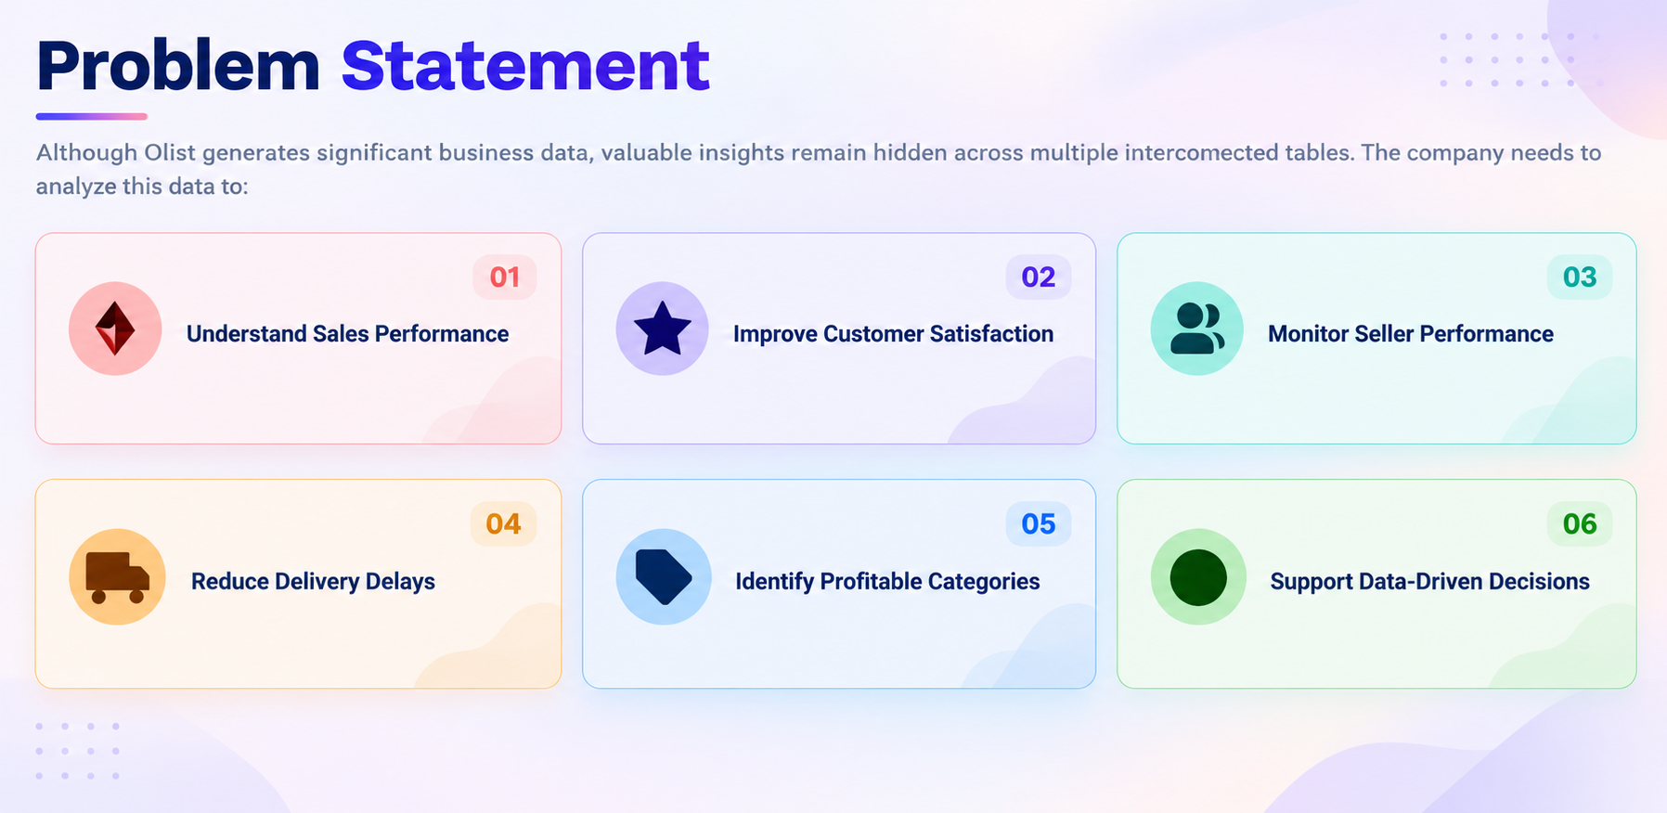

Slide 4
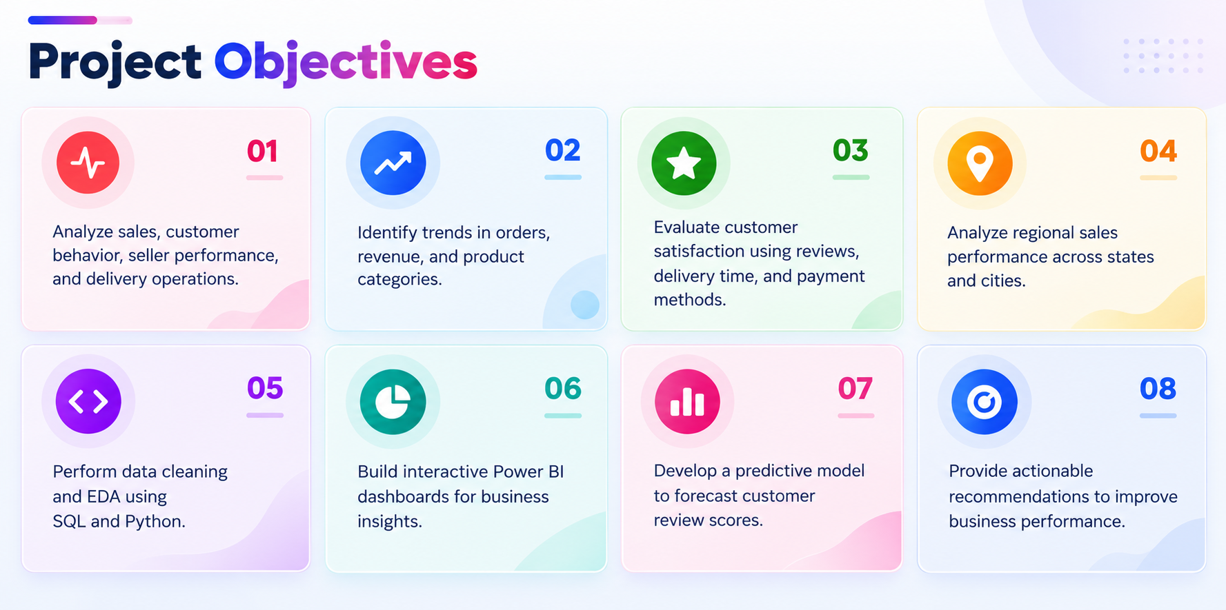

Slide 5
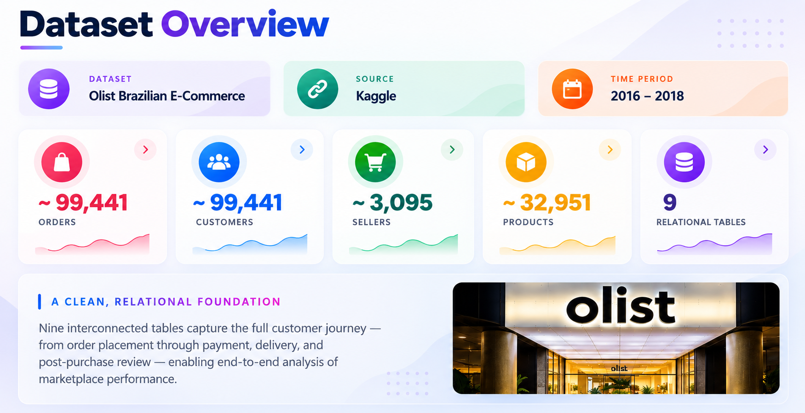

Slide 6
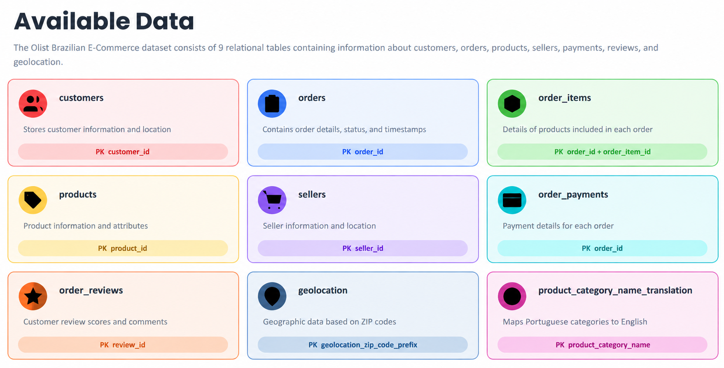

Slide 7
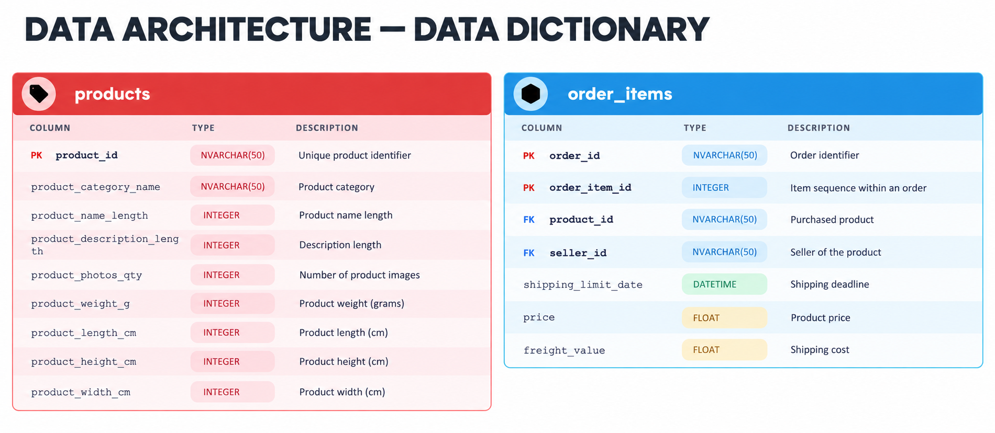

Slide 8
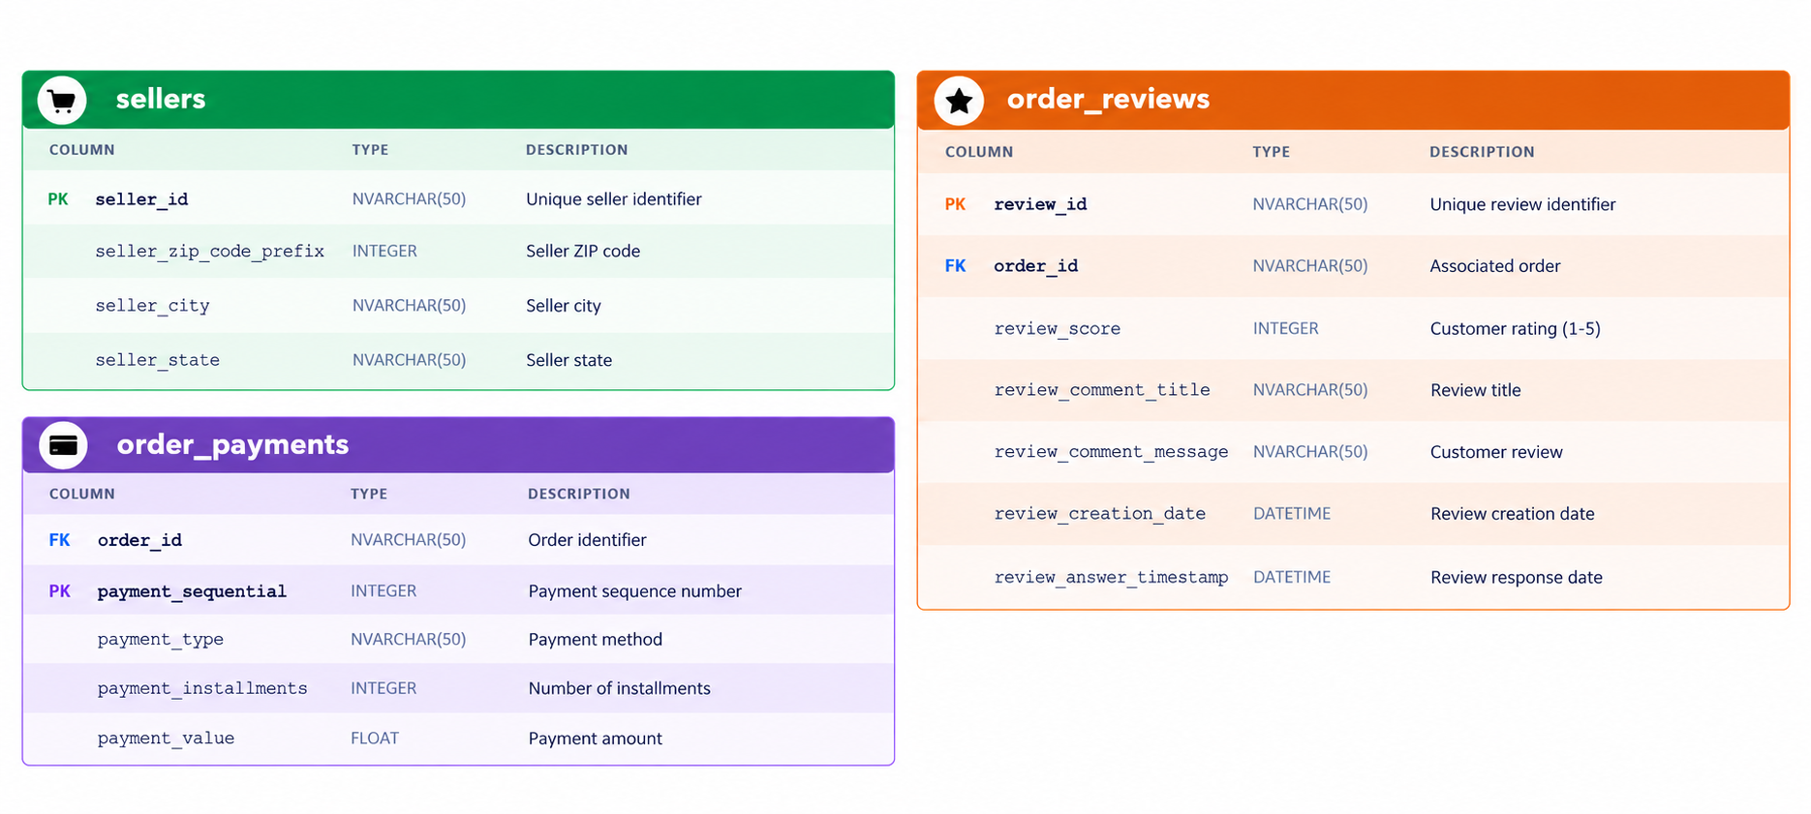

Slide 9
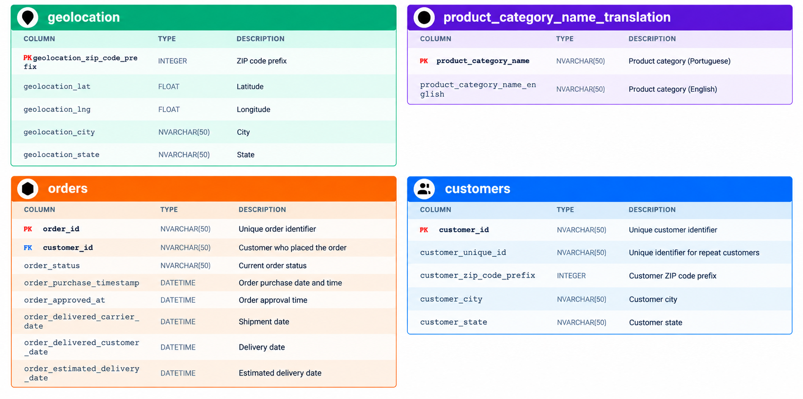

Slide 10
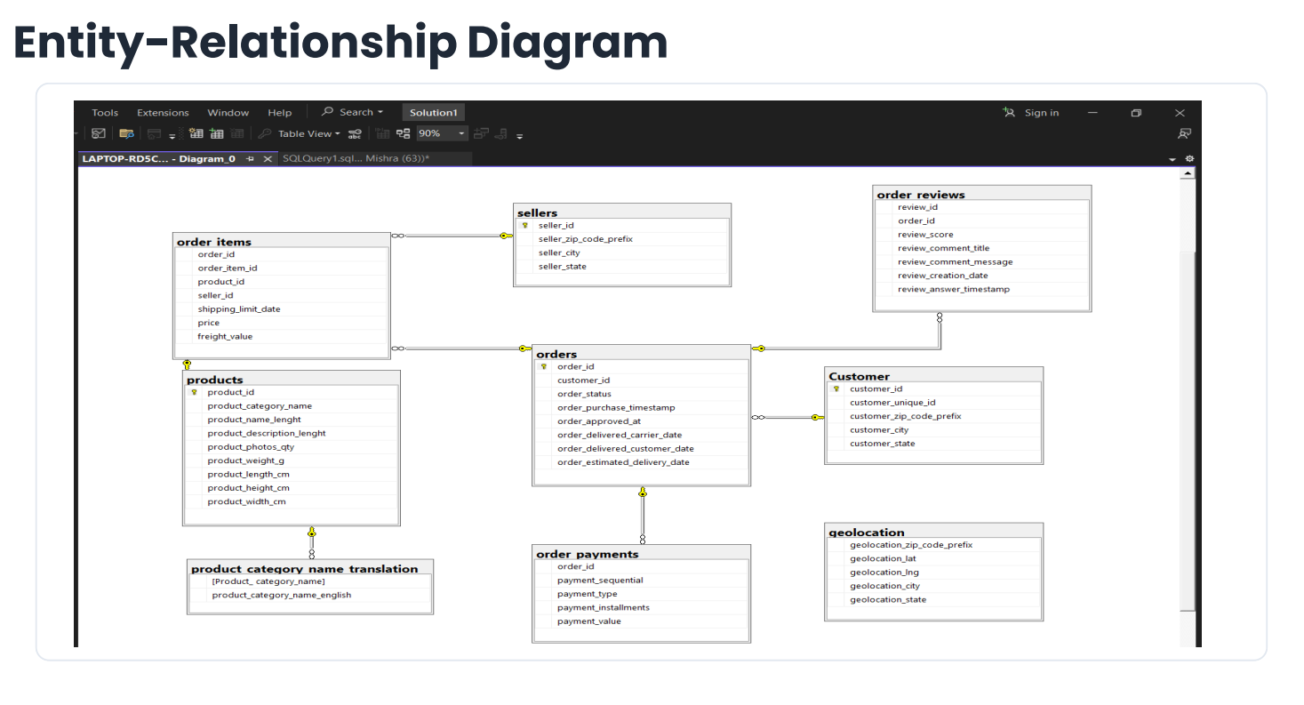

Slide 11
Business Understanding
Understand the Business Context: Analyze Brazilian e-commerce performance using customer, order, payment, product, and seller data.
Define Business Objectives: Identify sales trends, customer purchasing behavior, delivery performance, and factors influencing customer satisfaction.
Identify the Technology Stack: Use Python, Pandas, NumPy, SQL, Matplotlib, Seaborn, and Power BI/Tableau for data analysis and visualization.
Review Available Data Sources: Explore the Brazilian E-Commerce Public Dataset by Olist, including orders, customers, products, payments, reviews, and sellers.
Define Expected Deliverables: Develop an interactive dashboard, KPI reports, sales and delivery insights, customer behavior analysis, and actionable business recommendations.
Document Assumptions and Clarifications: Validate data quality, handle missing values and duplicates, define business KPIs, and clarify the analysis period and scope.

Slide 12
Data Checks & Consistency (SQL)
Import verification and row-count validation across 9 Brazilian e-commerce data tables.
Identify missing values, NULLs, blank fields, and duplicate records in key columns.
Validate referential integrity by detecting orphan records across customers, orders, products, sellers, payments, and reviews.
Perform business rule checks for negative prices, invalid payment values, review scores, product dimensions, and geographic coordinates.
Check date consistency for order approval, shipping, delivery, and estimated delivery timelines.
Reconcile order item totals, freight charges, and payment amounts to identify discrepancies.

Slide 13
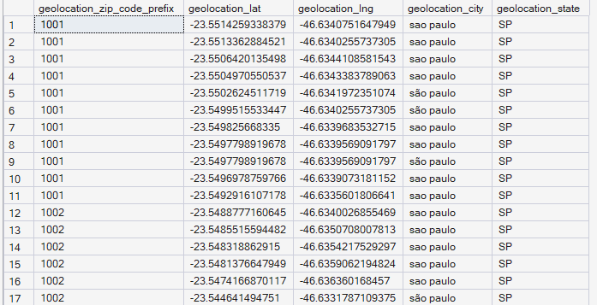
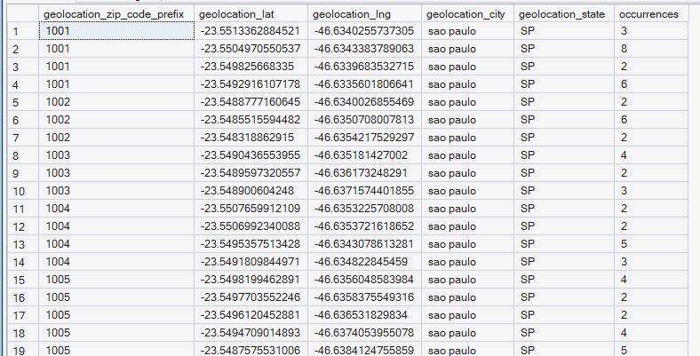
Discrepancy 1: Duplicate Geolocation Records
BEFORE
AFTER

Slide 14
Before:
Multiple identical geolocation records.
Repeated ZIP code prefixes and coordinate combinations.
After:
Exact duplicate records removed from the derived table.
Cleaned data ready for further analysis.

Slide 15
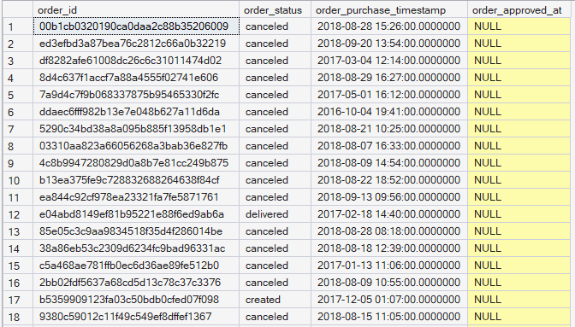
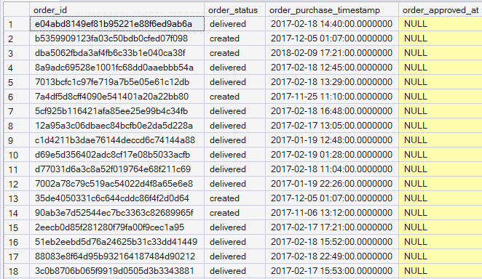
Discrepancy 2: Missing Order Approval Timestamps
BEFORE
AFTER

Slide 16
Before:
Identified 160 orders with missing order_approved_at timestamps.
Used SQL to find records where order_approved_at is NULL.
Observed that most displayed records were cancelled.
After:
Checked order statuses to understand the missing timestamps.
Recognized that missing timestamps may be valid for cancelled orders.
Avoided filling missing values without a reliable source.
Recommended recovering timestamps only from an authoritative source.

Slide 17
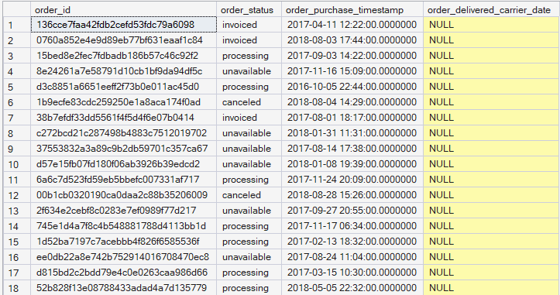
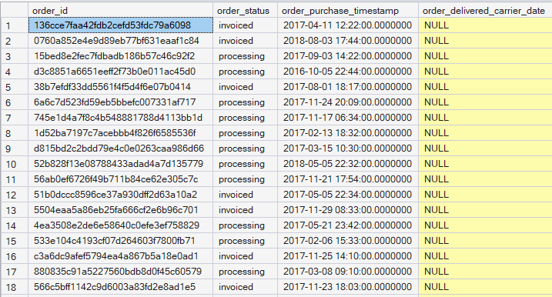
Discrepancy 3: Missing Carrier Delivery Timestamps
BEFORE
AFTER

Slide 18
Before:
Identified orders with missing carrier delivery timestamps.
Displayed order ID, order status, purchase timestamp, and carrier delivery date.
Found NULL values in the carrier delivery date column.
After:
Filtered out canceled and unavailable orders.
Identified remaining orders with missing carrier delivery timestamps.
Focused on orders that may require further shipping investigation.
Recommended verifying missing dates using reliable shipping records.

Slide 19
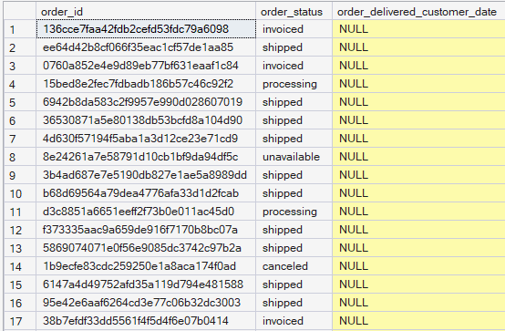
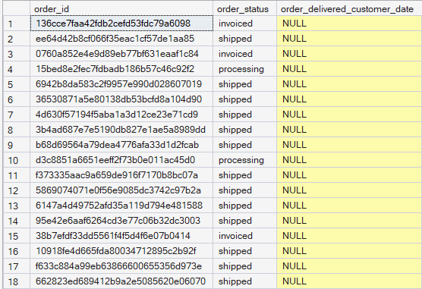
Discrepancy 4: Missing Customer Delivery Timestamps
BEFORE
AFTER

Slide 20
Before:
Identified orders with missing customer delivery timestamps.
Displayed order ID, order status, and customer delivery date.
Found NULL values in the delivery date column.
After:
Filtered out canceled and unavailable orders.
Identified remaining orders with missing customer delivery dates.
Highlighted orders that may need delivery-status investigation.
Recommended checking shipping records before updating missing dates.

Slide 21
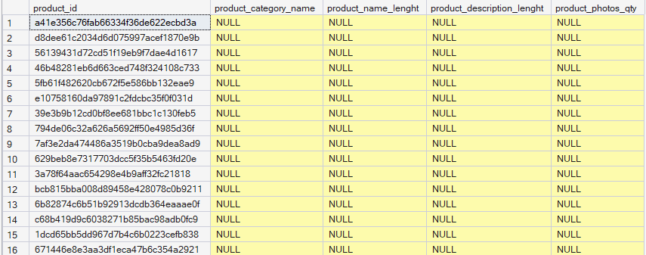
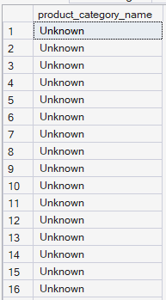
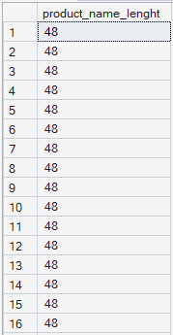
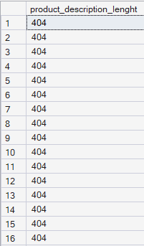
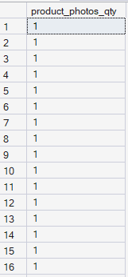
Discrepancy 5: Missing Product Attributes
AFTER
BEFORE

Slide 22
Before:
Identified products with missing product category, name length, description length, and photo quantity.
Displayed product ID and all four product attributes.
Identified 610 products with one or more missing attributes.
After:
Replaced missing product categories with 'Unknown'.
Filled missing product name lengths with 48.
Filled missing product description lengths with 404.
Filled missing product photo quantities with 1.

Slide 23
Discrepancy 6: Products with Missing Weight or Dimensions
BEFORE
AFTER

Slide 24
Before:
Identified products with missing weight and dimension information.
Displayed product ID, weight, length, height, and width.
Identified 2 products with missing measurement attributes.
After:
Retrieved the two affected product records using their product IDs.
Displayed product weight, length, height, and width for verification.
Ensured that no arbitrary measurement values were assigned.

Slide 25
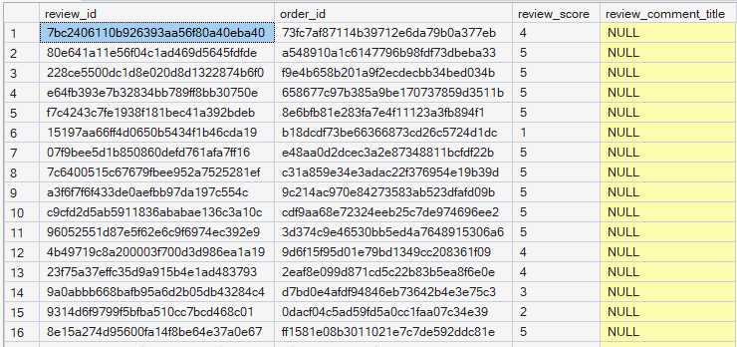
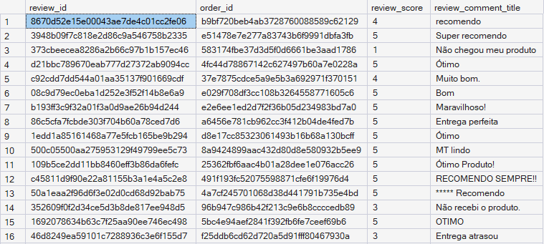
Discrepancy 7: Missing or Blank Review Titles
BEFORE
AFTER

Slide 26
Before:
Identified customer reviews with missing or blank review titles.
Displayed review ID, order ID, review score, and review comment title.
Identified 87,656 rows with missing or blank review titles.
After:
Retrieved reviews containing valid, non-blank titles.
Excluded records with NULL or empty review titles from the result.
Preserved original review data without inventing customer feedback.
Kept missing review titles as NULL because titles are optional.

Slide 27
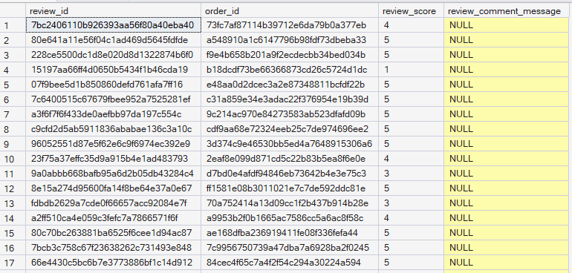
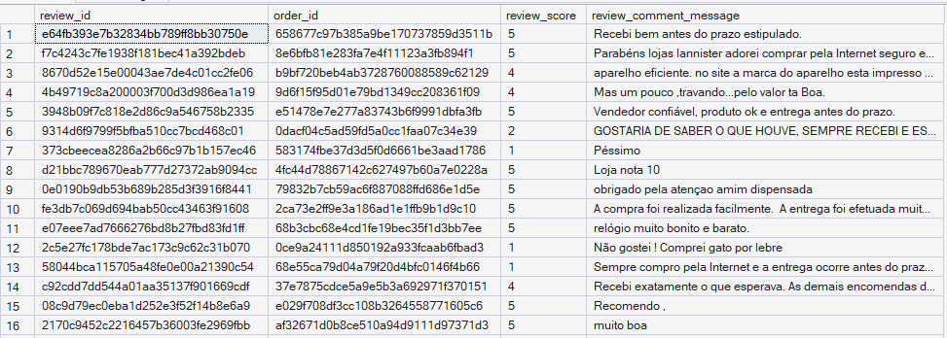
Discrepancy 8: Missing or Blank Review Messages
BEFORE
AFTER

Slide 28
Before:
Identified customer reviews with missing or blank review messages.
Displayed review ID, order ID, review score, and review comment message.
Identified 58,247 rows with missing or blank review messages.
After:
Retrieved customer reviews containing valid messages.
Excluded records with NULL or blank review messages from the result.
Preserved original customer feedback without inventing review content.
Kept missing review messages as NULL because written feedback is optional.

Slide 29
Exploratory Data Analysis (EDA) Plan
Objective: Explore Brazilian e-commerce data to understand sales performance, customer behavior, seller efficiency, delivery operations, and regional trends.
Descriptive Analysis: Summarize historical performance using KPIs, KRAs, KRIs, statistical measures and visualizations.
Diagnostic Analysis: Investigate patterns and factors associated with delivery delays, customer reviews, payment behavior, and sales variation.
Technology Stack: Python, Pandas, NumPy, Matplotlib, Seaborn, SQL Server, and Power Bl.
Expected Deliverables: KPI summary, analytical charts, diagnostic findings, documented methodology, and actionable business recommendations.

Slide 30
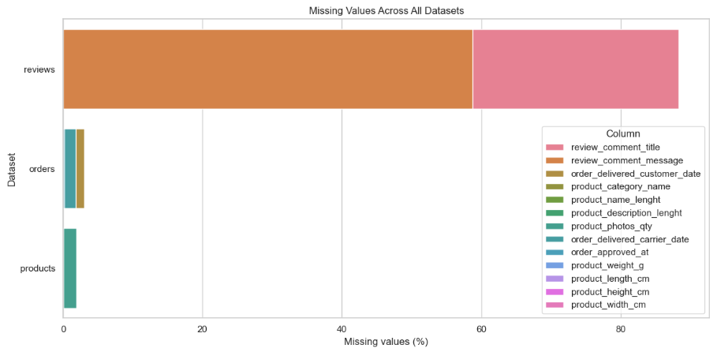
Missing values across datasets

Slide 31
Insights and recommendations: Missing values across datasets
Insights
About 59% of review messages and 29% of review titles are missing.
The orders dataset has a small number of missing values in some columns.
The products dataset has very few missing values.
Missing data may affect the accuracy of analysis.
Recommendations
Do not fill missing values with made-up data.
Check missing order dates before analyzing delivery times.
Remove missing records only when necessary.
Regularly check datasets for missing values.

Slide 32
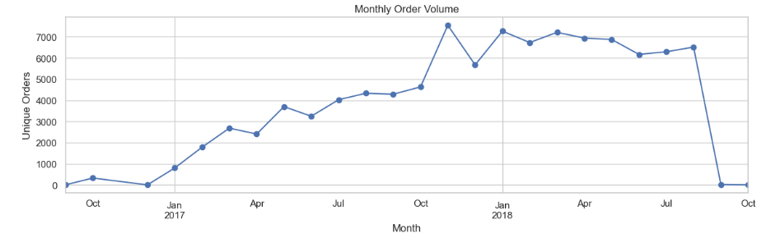
Monthly Order Volume Trends

Slide 33
Insights and Recommendations: Monthly Order Volume Trends
Insights
Orders reached a peak of around 7,500 in November 2017.
Order volume fluctuated during 2017 and 2018.
Most months in 2018 had approximately 6,000–7,000 orders.
Order volume dropped sharply to almost zero in September 2018.
Recommendations
Analyze the reasons for monthly changes in order volume.
Use peak months to understand customer demand.
Plan inventory and staffing based on order trends.
Collect and monitor order data regularly.

Slide 34
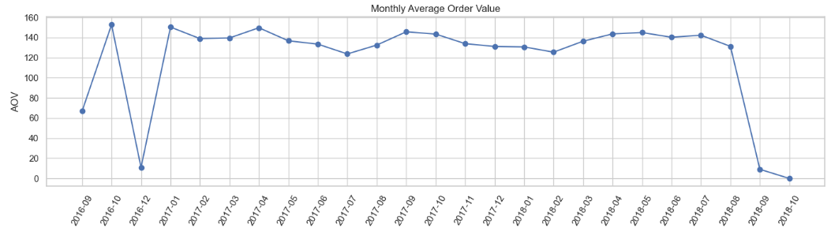
Monthly Average Order Value (AOV) Trend Analysis

Slide 35
Insights and Recommendations: Monthly Average Order Value (AOV) Trend Analysis
Insights
Stable AOV: From late 2016 to mid-2018, the average order value generally remained between 120 and 150.
Peak AOV: The highest values occurred around October 2016 and January 2017.
Sudden Drops: Very low values appear in November 2016 and September–October 2018, which may indicate incomplete data or unusual transactions.
Overall Trend: The AOV remained relatively stable during most of the period.
Recommendations
Investigate Drops: Check whether the unusually low values are caused by missing or incomplete data.
Monitor Monthly Trends: Track AOV regularly to identify changes in customer spending.
Increase Order Value: Use product bundles, cross-selling, and relevant promotions to encourage customers to purchase more.
Improve Data Quality: Verify the final months before drawing business conclusions.

Slide 36
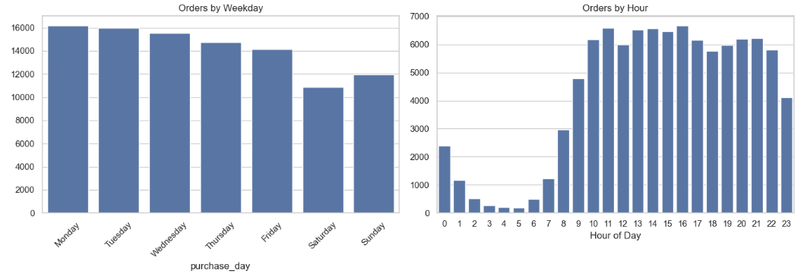
Order Trends by Day and Hour

Slide 37
Insights and Recommendations: Order Trends by Day and Hour
Insights
Weekdays: Orders are highest on Monday and Tuesday.
Weekends: Orders drop significantly on Saturday and recover slightly on Sunday.
Peak Hours: Most orders occur between 9 AM and 10 PM.
Low Activity: Order volumes are lowest during the early morning hours (2 AM–6 AM).
Recommendations
Plan Resources: Allocate more staff and delivery resources on weekdays.
Weekend Promotions: Offer discounts and deals to increase weekend orders.
Peak-Hour Support: Ensure enough staff and delivery partners during busy hours.
Early-Morning Planning: Use quieter hours for maintenance and operational preparation.

Slide 38
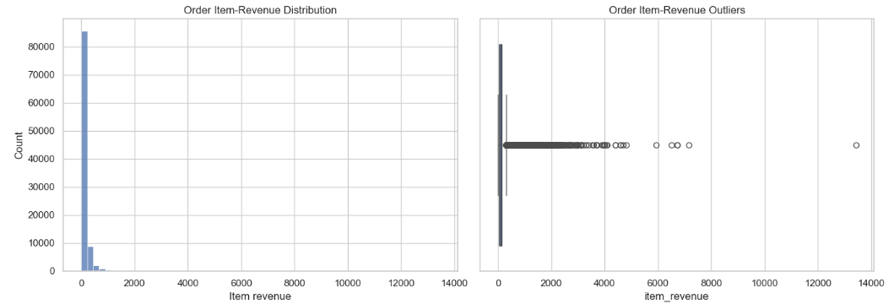
Order Item Revenue Distribution and Outlier Analysis

Slide 39
Insights and Recommendations: Order Item Revenue Distribution and Outlier Analysis
Insights
Revenue Distribution: Most order items generate low revenue, while only a few generate very high revenue.
Skewed Data: The distribution is highly right-skewed, meaning a small number of items have much higher revenue than most.
Revenue Outliers: Some items have unusually high revenue, with a few reaching above 10,000.
Business Impact: These high-value items may significantly influence total revenue.
Recommendations
Investigate Outliers: Check high-revenue items to confirm the values are correct.
Identify Top Products: Analyze which products contribute the most revenue.
Improve Reporting: Use median and percentile-based metrics alongside averages.
Optimize Sales: Focus on popular products while exploring opportunities to increase revenue from lower-performing items.

Slide 40
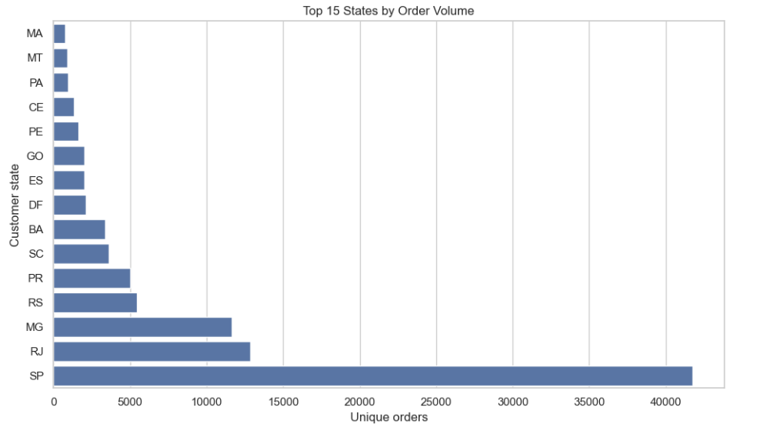
Top 15 States by Order Volume

Slide 41
Insights and Recommendations: Top 15 States by Order Volume
Insights
Highest Orders: São Paulo (SP) has the highest order volume, with over 40,000 orders.
Strong Markets: Rio de Janeiro (RJ) and Minas Gerais (MG) are the next largest markets.
Moderate Orders: Rio Grande do Sul (RS) and Paraná (PR) show moderate order volumes.
Lowest Orders: Maranhão (MA), Mato Grosso (MT), and Pará (PA) have the lowest orders among the top 15 states.
Recommendations
Focus on Top States: Maintain strong inventory and delivery services in São Paulo, Rio de Janeiro, and Minas Gerais.
Increase Sales: Offer targeted promotions in states with lower order volumes.
Improve Delivery: Strengthen logistics and delivery networks across different states.
Expand Market Reach: Use regional marketing campaigns to attract more customers in less active states.

Slide 42
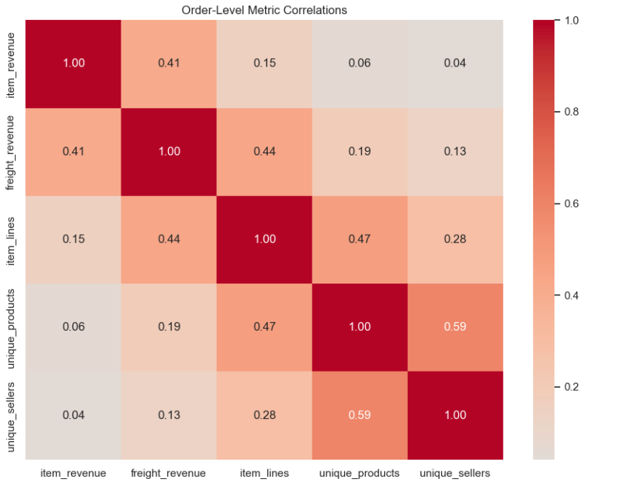
Correlation Analysis of Order-Level Metrics

Slide 43
Insights and Recommendations: Correlation Analysis of Order-Level Metrics
Insights
Products and Sellers (0.59): The strongest relationship is between the number of unique products and sellers.
Item Lines and Products (0.47): Orders with more item lines tend to include more unique products.
Freight and Item Lines (0.44): Orders with more item lines tend to have higher freight revenue.
Item and Freight Revenue (0.41): Higher item revenue is moderately associated with higher freight revenue.
Weak Relationships: Item revenue has very little correlation with the number of products (0.06) and sellers (0.04).
Recommendations
Optimize Shipping: Analyze how order size affects freight costs and improve shipping efficiency.
Increase Product Variety: Offer product combinations to encourage customers to buy different products.
Support Sellers: Encourage more sellers to offer a wider range of products.
Use Data for Planning: Track these relationships to improve sales strategies and operational decisions.

Slide 44
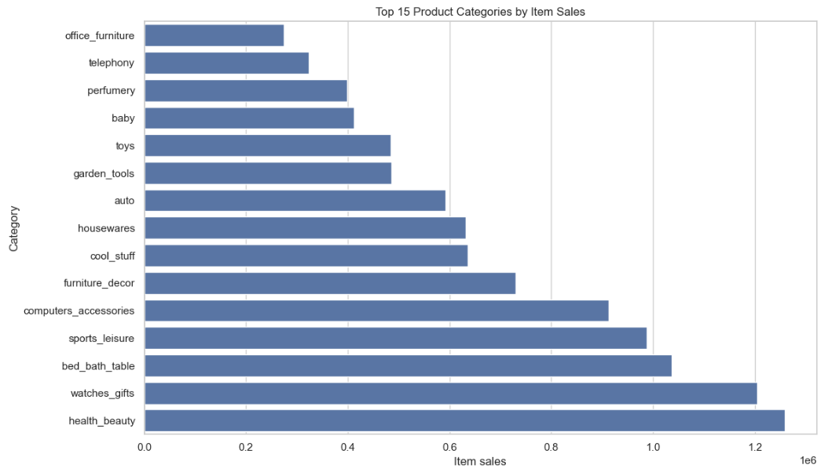
Top 15 Product Categories by Item Sales

Slide 45
Insights and Recommendations: Top 15 Product Categories by Item Sales
Insights
Top Category: Health and beauty has the highest sales, followed by watches and gifts.
Strong Performers: Bed, bath and table, sports and leisure, and computer accessories also have high sales.
Moderate Sales: Furniture decor, housewares, and automotive products show good sales performance.
Lowest Sales: Office furniture and telephony have the lowest sales among the categories shown.
Recommendations
Focus on Top Categories: Maintain stock and promote health and beauty products and watches.
Improve Low-Selling Categories: Use targeted offers and marketing to increase sales of office furniture and telephony.
Optimize Inventory: Stock products based on demand to avoid shortages and excess inventory.
Explore Growth Opportunities: Analyze customer preferences to identify other categories with potential for growth.

Slide 46
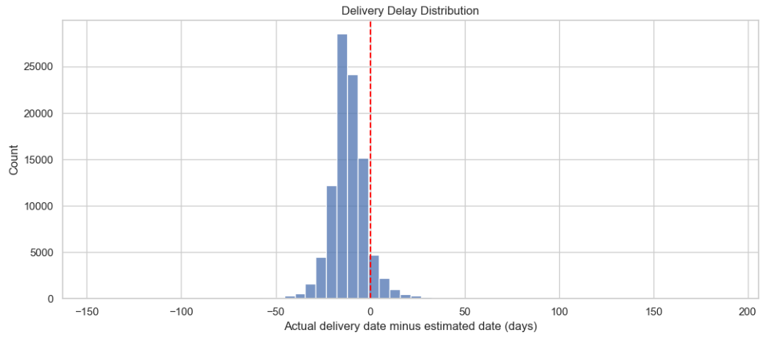
Delivery Delay Distribution Analysis

Slide 47
Insights and Recommendations: Delivery Delay Distribution Analysis
Insights
Mostly Early Deliveries: Most orders were delivered before the estimated delivery date.
Common Delay Range: Most deliveries occurred within a few days before or after the estimated date.
Late Deliveries: A smaller number of orders were delivered after the estimated date.
Extreme Delays: A few orders experienced unusually early or late deliveries, which may need further investigation.
Recommendations
Improve Estimates: Use historical delivery data to provide more accurate delivery dates.
Reduce Delays: Identify causes of late deliveries and improve logistics planning.
Monitor Performance: Track on-time delivery rates regularly.
Investigate Outliers: Review orders with unusually long delays to identify operational issues.

Slide 48
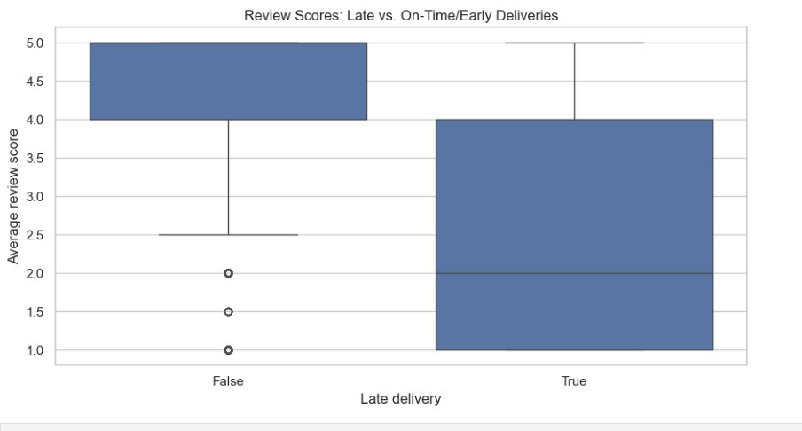
Impact of Late Delivery on Customer Review Scores

Slide 49
Insights and Recommendations: Impact of Late Delivery on Customer Review Scores
Insights
On-Time/Early Deliveries: Orders delivered on time or early generally receive higher review scores, mostly between 4 and 5.
Late Deliveries: Late orders receive lower ratings, with a median score of around 2.
Customer Satisfaction: Late delivery appears to be associated with lower customer satisfaction.
Rating Differences: On-time deliveries have more positive reviews, while late deliveries show a wider range of ratings.
Recommendations
Improve Delivery Speed: Reduce delays by improving shipping and logistics planning.
Provide Accurate Estimates: Give customers realistic delivery dates.
Communicate Delays: Inform customers promptly about delivery changes.
Monitor Reviews: Track customer ratings to measure whether delivery improvements increase satisfaction.

Slide 50
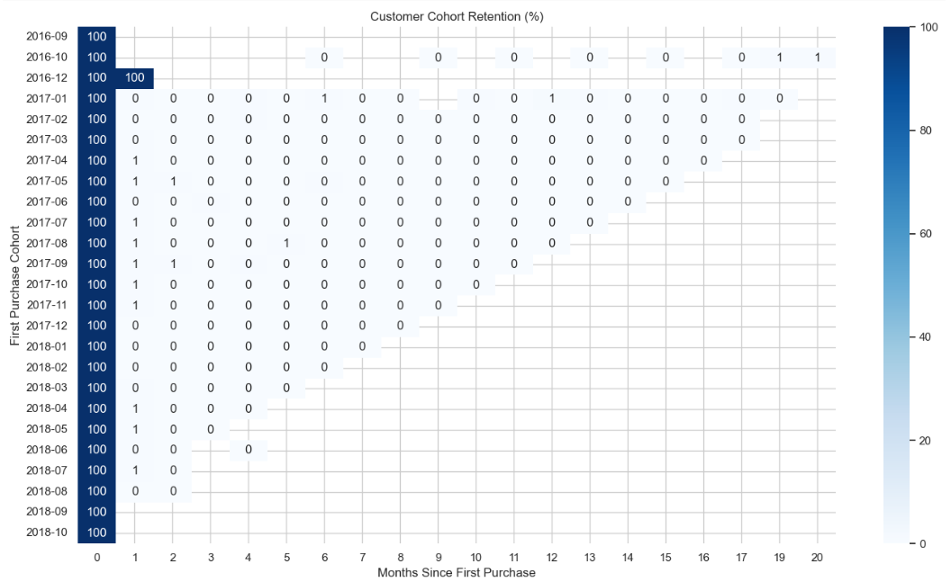
Customer Cohort Retention Analysis

Slide 51
Insights and Recommendations: Customer Cohort Retention Analysis
Insights
Initial Customers: All cohorts start at 100% in the first month.
Low Retention: Customer retention drops sharply after the first month, with very few customers returning.
Limited Repeat Purchases: Most later months show nearly 0% retention.
Similar Pattern: This low retention trend appears across multiple customer cohorts.
Recommendations
Encourage Repeat Purchases: Offer loyalty points, discounts, and special deals to existing customers.
Follow Up with Customers: Send personalized emails or reminders after their first purchase.
Improve Customer Experience: Enhance product quality, delivery speed, and customer service.
Analyze Customer Behavior: Identify why customers do not return and develop strategies to improve retention.

Slide 52
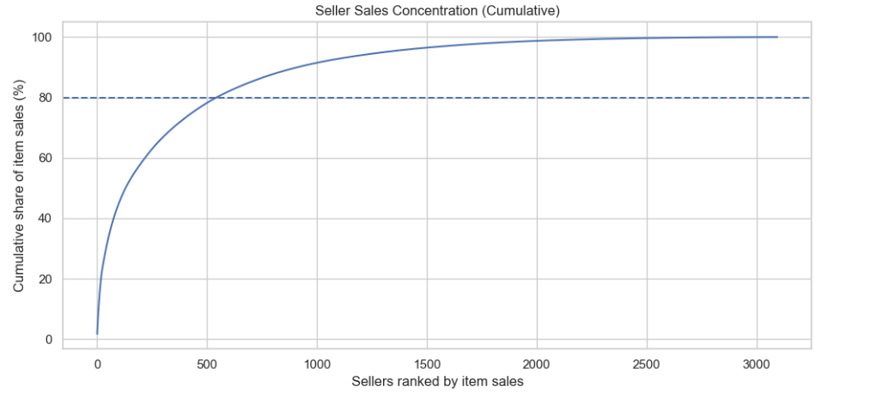
Seller Sales Concentration Analysis

Slide 53
Insights and Recommendations: Seller Sales Concentration Analysis
Insights
High Sales Concentration: A small number of sellers contribute a large share of total sales.
80% Sales Target: Approximately the top 550 sellers generate 80% of item sales.
Long-Tail Sellers: The remaining sellers contribute a smaller share of total sales individually.
Uneven Performance: Sales are not equally distributed among sellers.
Recommendations
Support Top Sellers: Maintain strong relationships with high-performing sellers.
Develop Smaller Sellers: Provide marketing support and guidance to increase their sales.
Reduce Dependency: Avoid relying too heavily on a small group of sellers.
Monitor Performance: Track seller sales regularly to identify growth opportunities and business risks.

Slide 54
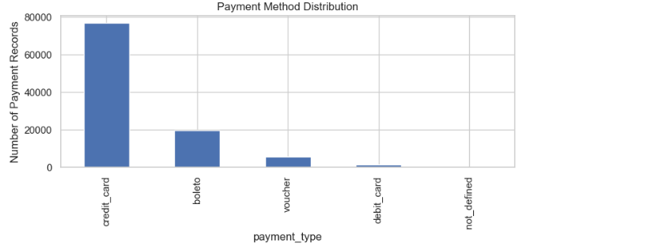
Payment Method Distribution

Slide 55
Insights and Recommendations: Payment Method Distribution
Insights
Boleto is the second most popular payment method.
Vouchers are used by fewer customers.
Debit cards have very low usage compared to credit cards.
The not_defined payment category has almost no records.
Recommendations
Improve the convenience of boleto payments.
Investigate why debit card usage is low.
Ensure all payment methods are recorded accurately.

Slide 56
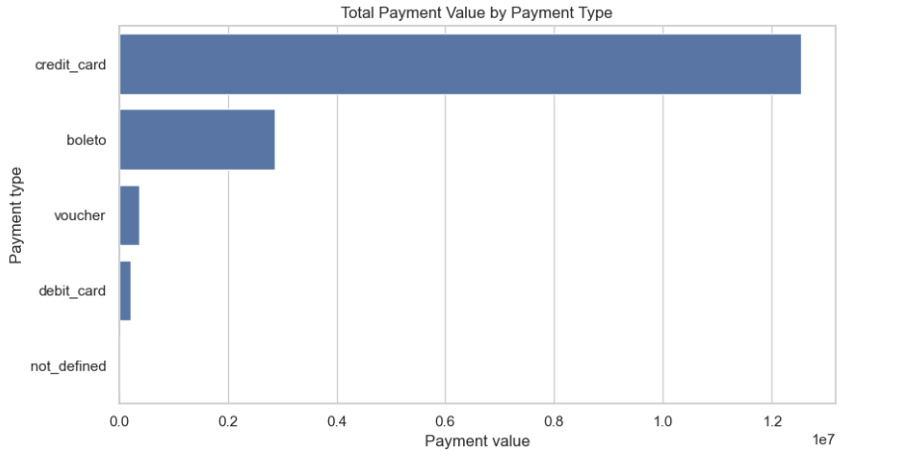
Total Payment Value by Payment Type

Slide 57
Insights and Recommendations: Total Payment Value by Payment Type
Insights
Credit Cards: Credit cards contribute the highest payment value by a large margin.
Boleto: Boleto is the second most-used payment type by total value.
Vouchers and Debit Cards: These methods contribute a much smaller share of total payments.
Undefined Payments: The undefined category has almost no recorded payment value.
Recommendations
Prioritize Credit Cards: Ensure secure and smooth credit card transactions.
Improve Payment Options: Continue supporting boleto, debit cards, and vouchers to meet different customer needs.
Promote Alternative Methods: Use targeted offers to encourage customers to explore other payment options.
Improve Data Quality: Check payment records classified as undefined to ensure accurate reporting.

Slide 58
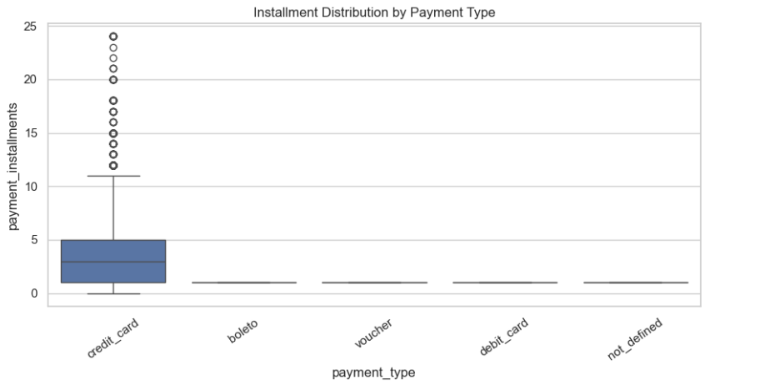
Installment Distribution by Payment Type

Slide 59
Insights and Recommendations: Installment Distribution by Payment Type
Insights
Credit Cards: Credit card payments have the widest range of installments, with some customers paying in up to 24 installments.
Typical Installments: Most credit card payments use around 1–5 installments.
Other Payment Types: Boleto, vouchers, and debit cards generally use a single payment.
Outliers: A small number of credit card transactions have a high number of installments.
Recommendations
Offer Flexible Payments: Provide installment options to make expensive purchases more affordable.
Monitor Installments: Track installment patterns to understand customer payment preferences.
Promote Single Payments: Offer suitable incentives for customers who prefer paying in full.
Analyze High Installments: Review high-installment transactions to understand purchasing behavior and manage payment risks.

Slide 60
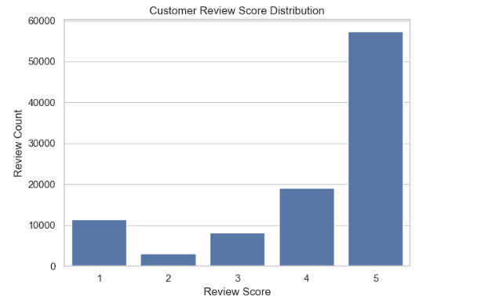
Customer Review Score Distribution

Slide 61
Insights and Recommendations: Customer Review Score Distribution
Insights
4-star ratings are the second most common.
1-star ratings are higher than 2-star and 3-star ratings.
2-star ratings are the least common.
Overall, most customers appear satisfied with their purchases.
Recommendations
Analyze 1-star reviews to identify common problems.
Improve customer support and resolve complaints quickly.
Study 4-star reviews to understand areas for improvement.
Encourage customers to provide honest feedback.

Slide 62
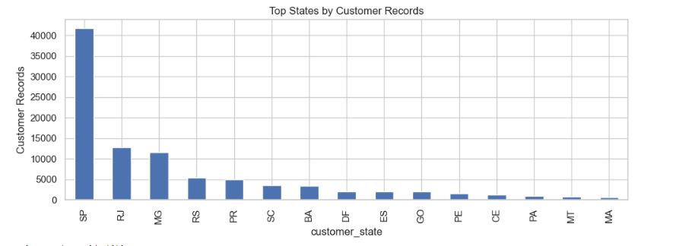
Top States by Customer Records

Slide 63
Insights and Recommendations: Top States by Customer Records
Insights
The top three states have significantly more customers than the other states.
Other states, such as RS, PR, and SC, have moderate customer counts.
States such as MA, MT, and PA have comparatively fewer customers.
Recommendations
Improve customer engagement and retention in major states.
Explore opportunities to attract customers from states with fewer records.
Analyze regional customer preferences to provide better services.
Expand delivery and promotional strategies in areas with growth potential.

Slide 64
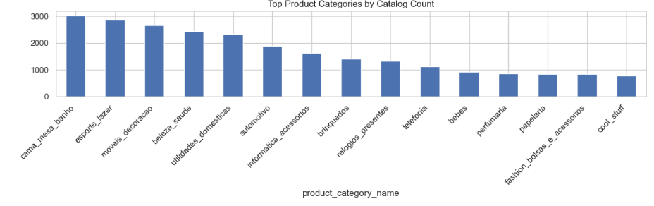
Top Product Categories by Catalog Count

Slide 65
Insights and Recommendations: Top Product Categories by Catalog Count
Insights
cama_mesa_banho has the highest number of products.
esporte_lazer and moveis_decoracao are the second and third largest categories.
beleza_saude and utilidades_domesticas also have high product counts.
Product availability varies significantly across categories.
Recommendations
Focus marketing campaigns on high-demand categories.
Analyze sales data to identify the most profitable categories.
Avoid overstocking products that have low demand.
Regularly update the product catalog based on customer preferences.

Slide 66
Descriptive Data Analysis Plan
Sales Performance: Analyze total orders, item sales value, freight value, payment value, average order value, and monthly sales trends.
Customer Behavior: Measure unique customers, repeat purchasing patterns, order frequency, and customer distribution by state.
Product & Category Analysis: Rank product categories by item sales value, order volume, and average selling price.
Delivery Performance: Calculate average delivery duration, on-time delivery rate, late-delivery rate and delivery-status distribution.
Seller Performance: Compare seller order volume, item sales value, freight, delivery outcomes, and customer review scores.
Payment & Reviews: Examine payment methods, installment patterns, review-score distribution and review coverage.

Slide 67
Diagnostic Data Analysis Plan
Sales Trend Investigation: Examine changes in order volume and item sales value across months, weekdays, product categories, and states.
Delivery Delay Analysis: Compare actual and estimated delivery dates to identify patterns associated with late deliveries.
Customer Satisfaction Analysis: Investigate relationships between review scores, delivery duration, delivery delays, order status, and payment characteristics.
Product & Seller Investigation: Identify categories and sellers with unusual sales patterns, delivery outcomes, or review distributions.
Payment Analysis: Compare payment methods, installment counts, and order values to understand differences in transaction patterns.
Regional Analysis: Investigate state-level variation in sales, customer activity, delivery performance, and review scores.

Slide 68
KPI, KRA & KRI Framework
KPIs - Key Performance Indicators: Total Orders, Item Sales Value, Average Order Value, Average Review Score, Delivery Duration, and Late-Delivery Rate.
KRAs - Key Result Areas: Sales Growth, Customer Experience, Delivery Efficiency, Seller Performance, Product Category Performance, and Regional Performance.
KRIs - Key Risk Indicators: Late-Delivery Rate, Cancellation Rate, Missing Critical Data, Unmatched Records, Invalid Timestamps, and Payment Reconciliation Differences.
Total Orders = Count of distinct order IDs under the agreed status rules.
Item Sales Value = Sum of order item prices.
Average Order Value = Item Sales Value + eligible distinct orders.
Average Review Score = Mean of available review scores.
Delivery Duration = Actual Customer Delivery Timestamp - Purchase Timestamp.
Late-Delivery Rate = Eligible delivered orders delivered after the estimate * eligible delivered orders x 100.

Slide 69
EDA Analytical Approach & Methodology
Step 1- Data Profiling: Review table structures, data types, row counts, missing values, duplicates and key relationships.
Step 2 - Data Preparation: Resolve import and schema issues, handle missing values appropriately, validate timestamps, and document transformations.
Step 3 - Descriptive Statistics: Calculate counts, sums, averages, medians, percentages, distributions, and time-based summaries.
Step 4 - Diagnostic Investigation: Use segmentation, correlation analysis, outlier detection, and comparisons across relevant business groups.
Step 5 - Validation: Reconcile SQL and Python results, verify join cardinality, prevent double-counting, and document metric denominators.
Step 6 - Visualization: Build charts and interactive Power BI reports showing sales, customers, categories, delivery, reviews, sellers, and regional performance.
Step 7 - Recommendations: Translate validated findings into prioritized business actions with measurable follow-up indicators.

Slide 70
Predictive Analysis Plan
Objective: Develop machine learning models to predict customer review scores and identify potential delivery and order-related risks.
Primary Use Case: Predict customer review scores using relevant order and customer-experience features.
Additional Use Cases: Estimate delivery duration, identify late-delivery risk, and predict order cancellation or non-delivery risk where the available labels support reliable modelling.
Technology Stack: Python, Pandas, NumPy, Scikit-learn, Matplotlib, Seaborn, and SQL Server.
Business Value: Support early identification of operational risks, improve service monitoring, and prioritize investigation.
Expected Deliverables: Trained models, feature-selection report, evaluation metrics, error analysis, and documented business recommendations.

Slide 71
Predictive Analysis Opportunities
Customer Review Score Prediction: Estimate review scores from 1 to 5 using information available at the agreed prediction time.
Delivery Delay Prediction: Classify whether an order is likely to arrive after its estimated delivery date.
Delivery Duration Prediction: Estimate the number of days between purchase and customer delivery.
Order Cancellation Risk: Identify orders at elevated risk of cancellation using historical order and operational features.
Order Value Estimation: Estimate item sales value using relevant order characteristics, if a clear forecasting use case is approved.
Customer Purchase Behavior: Explore repeat-purchase prediction if the available customer history provides sufficient reliable examples.

Slide 72
Model Selection & Rationale
Linear Regression: Predict continuous numerical outcomes, such as delivery duration or order value. It can provide a simple benchmark for review scores but may produce values outside the valid 1-5 range.
Logistic Regression: Predict class probabilities, making it suitable for categorical outcomes such as late versus on-time delivery.
Multiclass Logistic Regression: Predict one of the five review-score classes (1, 2, 3, 4, or 5).
Ordinal Logistic Regression: Consider when the ordered nature of review scores is important and a suitable implementation is available.
Baseline Comparison: Compare candidate models against a simple majority-class or other appropriate baseline before selecting the final approach.
Selection Criteria: Predictive performance, interpretability, class imbalance, data availability, leakage risk, and business usefulness.

Slide 73
Feature Selection Strategy
Order Features: Order status, purchase month, purchase weekday, and relevant order characteristics available at prediction time.
Customer Features: Customer location, historical purchase frequency, and other customer-level summaries when sufficient history exists.
Product Features: Product category, item price, freight value, and item characteristics.
Payment Features: Payment type, installment count, and aggregated payment information where available before prediction.
Delivery Features: Estimated delivery time and shipping-related attributes; actual delivery duration and delivery outcome only when known at prediction time.
Feature Engineering: Create date-based variables, delivery estimates, category encodings, and properly aggregated customer or seller history.
Feature Selection: Use domain knowledge, missing-value analysis, correlation checks, and model-based importance where appropriate.

Slide 74
Model Evaluation Metrics
Classification Accuracy: Measure the proportion of correctly predicted review-score classes.
Macro F1-Score: Evaluate performance across all review classes while giving each class equal weight.
Confusion Matrix: Identify which review scores are most frequently confused with one another.
Mean Absolute Error (MAE): Measure the average absolute difference between actual and predicted review scores, respecting the ordered scale.
Precision & Recall: Evaluate the reliability and coverage of important classes, such as low review scores or delayed deliveries.
Regression Metrics: Use MAE and RMSE for continuous targets such as delivery duration.
Validation Strategy: Prefer a time-based train/test split when feasible, compare models against a baseline, and inspect performance across relevant customer, seller, and regional segments.

Slide 75
Predictive Modeling Workflow
Step 1-Define the Objective: Confirm the prediction target, intended prediction time, and business decision the model will support.
Step 2 - Prepare the Dataset: Resolve relevant data-quality issues, validate relationships, handle missing values, and define eligible records.
Step 3 - Engineer Features: Create suitable predictors from order, customer, product, payment and permitted delivery information.
Step 4 - Split the Data: Establish training, validation, and test datasets while preventing temporal and related-record leakage.
Step 5 - Train Candidate Models: Establish a baseline and train suitable regression or classification algorithms.
Step 6 - Evaluate Performance: Calculate relevant metrics, inspect error patterns, and compare model performance across segments.
Step 7 - Document Results: Record assumptions, selected features, model parameters, limitations, and recommendations.

Slide 76
Expected Predictive Analysis Deliverables
Model Performance Report: Compare baseline and candidate models using documented evaluation metrics.
Review Score Prediction: Generate estimated review-score classes and assess prediction errors.
Delivery Risk Insights: Identify operational segments associated with higher late-delivery risk.
Feature Importance Analysis: Explain which available features contribute to model predictions using suitable interpretation methods.
Business Recommendations: Suggest areas for further investigation in delivery operations, customer experience, and seller service.
Reproducibility: Maintain documented preprocessing steps, feature definitions, data splits, and model settings.
Responsible Use: Communicate uncertainty and limitations; do not treat predicted scores as actual customer sentiment or use unvalidated predictions to penalize sellers.

Slide 77
Dashboard Layout Plan
Dashboard 1 - Executive Sales Overview: Monitor overall sales, order volume, order status, and regional performance.
Dashboard 2 -Order & Delivery Performance: Evaluate fulfillment, delivery duration, late deliveries, and cancellation patterns.
Dashboard 3 - Product, Seller & Customer Insights: Analyze product categories, seller performance, customer reviews, and geographic distribution.
Technology: Power BI Desktop for data modeling and report development; Power BI Service for publishing and sharing.
Common Features: KPI cards, interactive charts, date and category slicers, consistent navigation and documented metric definitions.
Design Principles: Light background, consistent colors, readable titles, clear units, and validated totals.

Slide 78
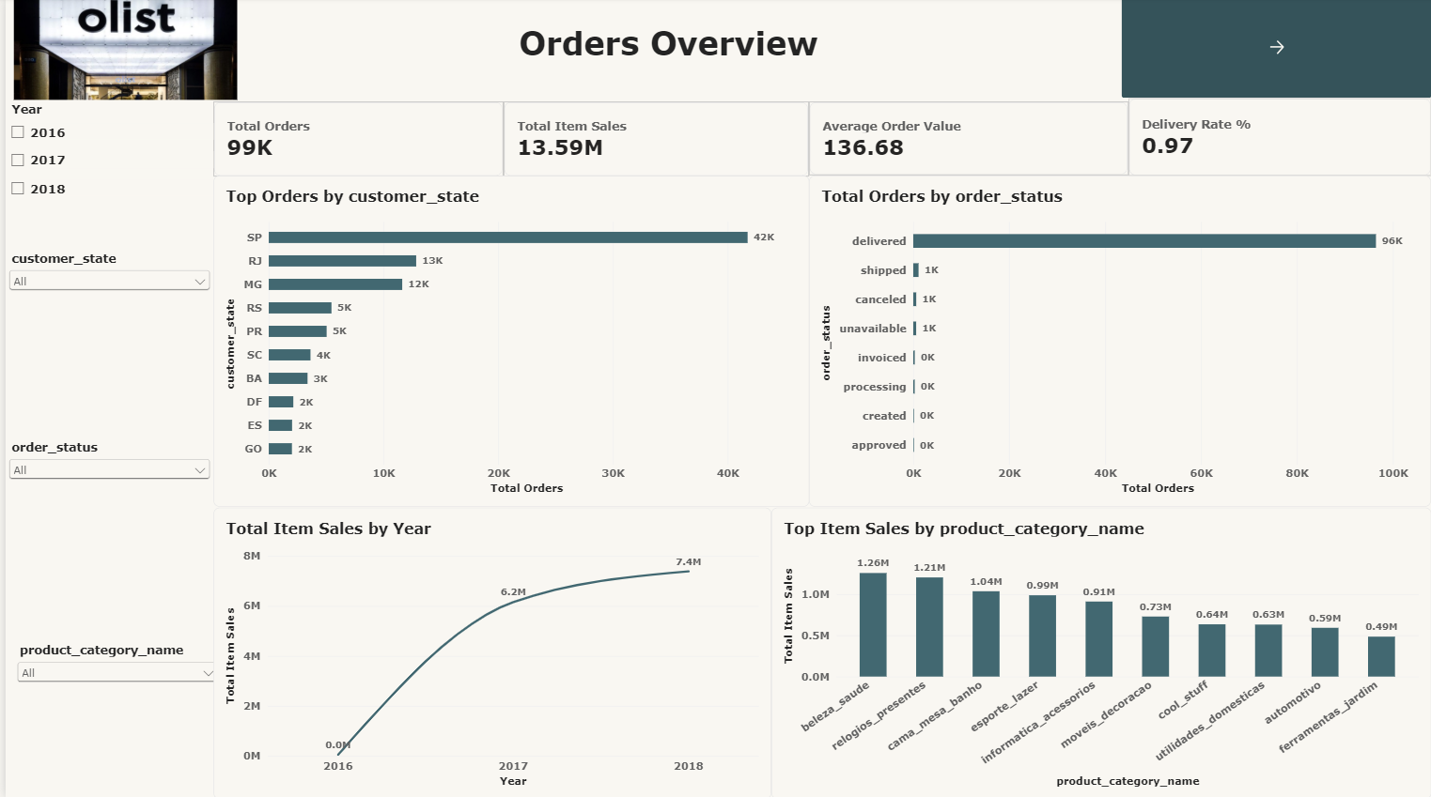

Slide 79
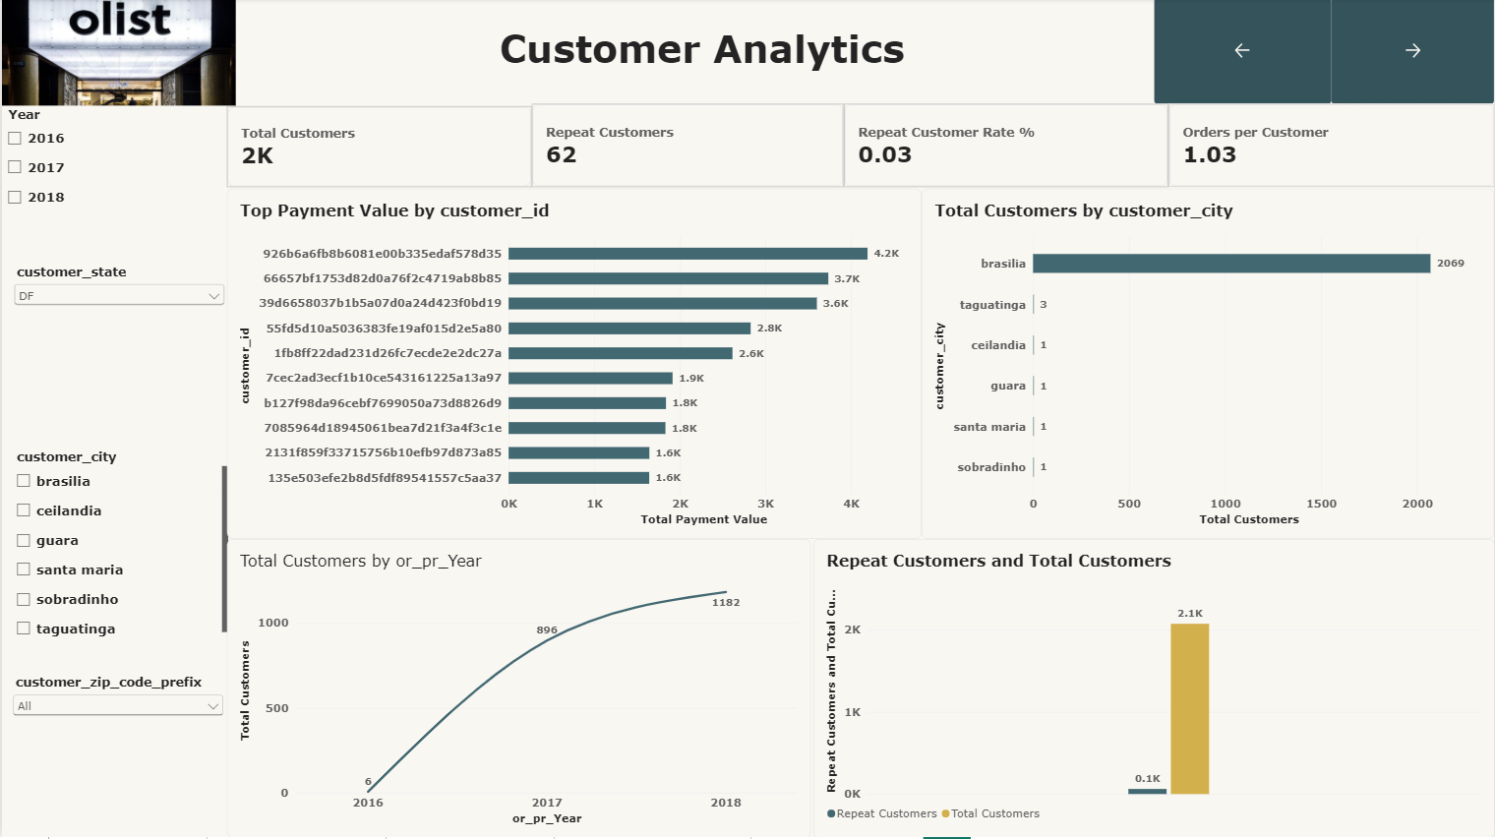

Slide 80
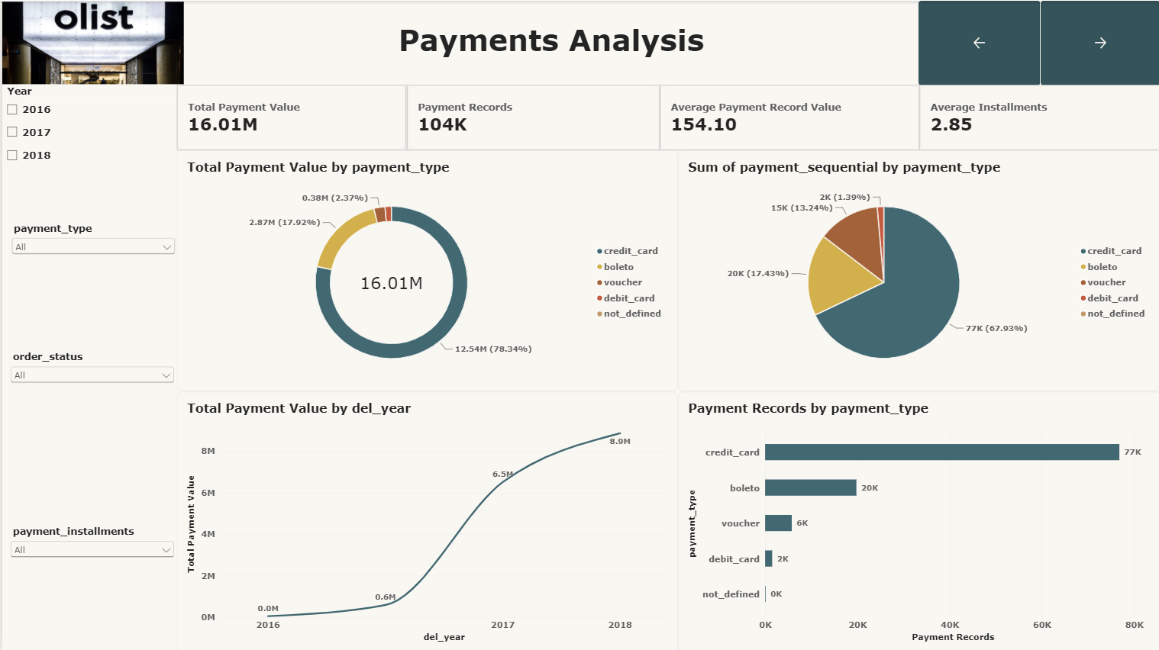

Slide 81
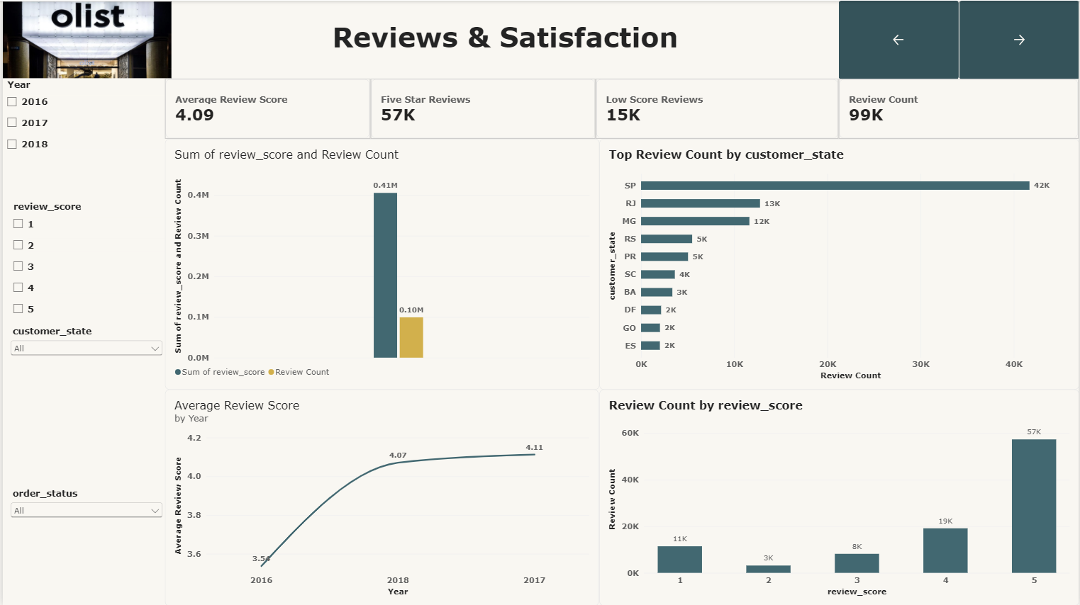

Slide 82
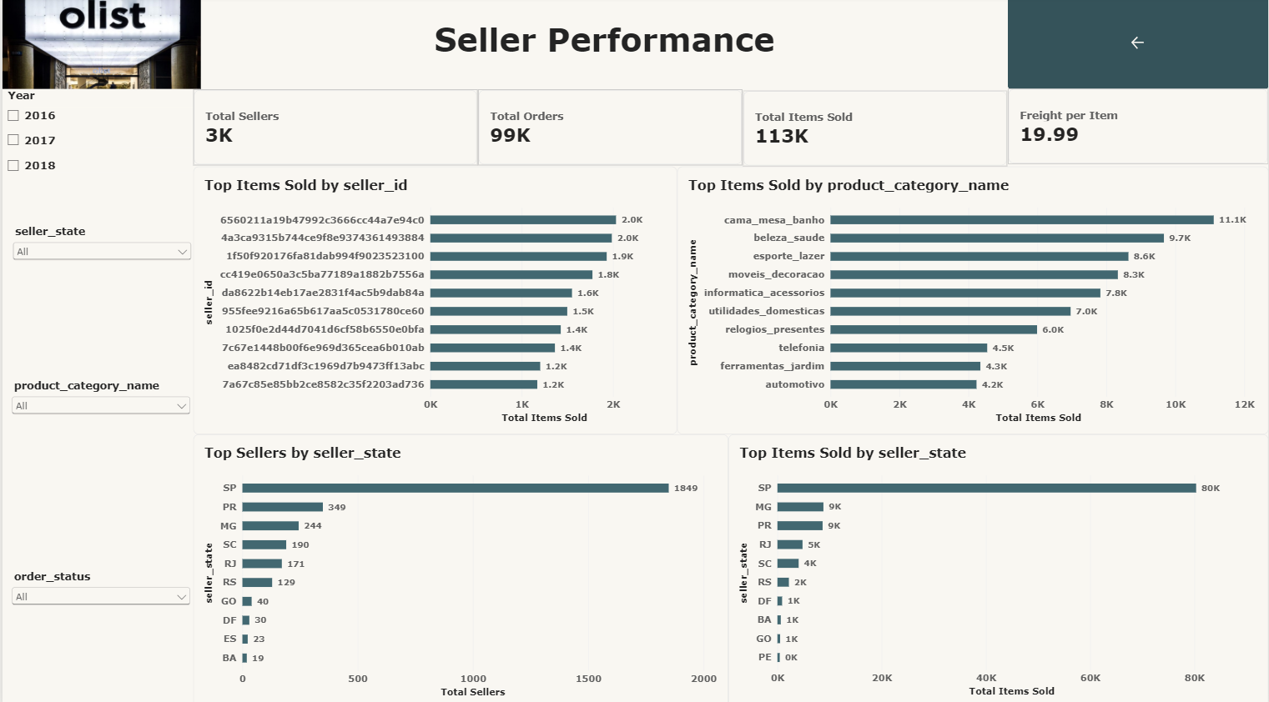

Slide 83
Dashboard 1
Orders Overview
Provides an overview of order performance, sales, and delivery efficiency from 2016-2018.
KPI cards summarize 99K Total Orders, 13.59M Total Item Sales, 136.68 Average Order Value, and97% Delivery Rate.
Geographical and order-status analysis highlights order distribution and fulfillment performance.
Product and yearly sales analysis identifies business growth and top-performing categories.

Slide 84
Charts & Granularity
1. Horizontal Bar Chart - State Level: Compares total orders across customer states
2. Horizontal Bar Chart - Order Status Level: Displays the distribution of orders by status.
3. Line Chart - Yearly Level: Shows the trend in total item sales from 2016 to 2018.
4. Column Chart - Product Category Level: Compares item sales across product categories.

Slide 85
Dashboard 2
Customer Analytics
Provides insights into customer acquisition, purchasing behavior, geographical distribution, and retention.
KPI cards highlight 2K Total Customers, 62 Repeat Customers, 3% Repeat Customer Rate, and 1.03Orders per Customer.
Payment analysis identifies high-value customers based on their payment contribution.
City-level analysis shows Brasilia as the major customer concentration area, with 2,069 customers.
Yearly analysis tracks customer growth, while repeat purchase analysis evaluates customer retention.

Slide 86
Charts & Granularity
1. Horizontal Bar Chart - Customer Level: Identifies top customers based on total payment value.
2. Horizontal Bar Chart - City Level: Compares the number of customers across different cities.
3. Line Chart - Yearly Level: Shows customer growth trends from 2016 to 2018.4. Clustered Column Chart - Customer Segment Level: Compares repeat customers against total customers.

Slide 87
Dashboard 3
Payments Analysis
Provides insights into payment transactions, payment methods, transaction values, and yearly payment trends.
KPI cards highlight 16.01M Total Payment Value, 104K Payment Records, 154.10 Average Payment Record Value, and 2.85 Average Installments.
Credit cards dominate payment value with 12.54M (78.34%) and transaction frequency with approximately 77K records.
Boleto contributes 2.87M (17.92%) to the total payment value.
Yearly analysis shows payment value increasing from 0.6M in 2016 to 8.9M in 2018.

Slide 88
Charts & Granularity
1. Doughnut Chart - Payment Type Level: Compares total payment value contributed by each payment method.
2. Pie Chart - Payment Type Level: Displays the distribution of payment transaction counts across payment methods.
3. Line Chart - Yearly Level: Tracks total payment value growth from 2016 to 2018.
4. Horizontal Bar Chart - Payment Type Level: Compares payment record counts across different payment methods.

Slide 89
Dashboard 4
Reviews & Satisfaction
Provides insights into customer feedback, satisfaction levels, review distribution, and yearly rating trends.
KPI cards highlight an Average Review Score of 4.09, 57K Five-Star Reviews, 15K Low-Score Reviews, and 99K Total Reviews.
Geographical analysis identifies São Paulo (SP) as the leading state with approximately 42K reviews.
Yearly analysis tracks changes in average customer review scores.
Rating distribution shows that 5-star reviews dominate with approximately 57K reviews, followed by 4-star reviews with 19K.

Slide 90
Charts & Granularity
1. Clustered Column Chart - Review Metric Level: Compares the sum of review scores with the total review count.
2. Horizontal Bar Chart - State Level: Compares review counts across different customer states.
3. Line Chart - Yearly Level: Tracks average customer review scores from 2016 to 2018.
4. Column Chart - Rating Level: Displays the distribution of customer reviews across ratings from 1to 5.

Slide 91
Dashboard 5
Seller Performance
Provides insights into seller productivity, product sales, geographical distribution, and overall seller performance.
KPI cards highlight 3K Total Sellers, 99K Total Orders, 113K Total Items Sold, and 19.99 Freight per Item.
Seller-level analysis identifies the top 10 sellers based on item sales.
Product-category analysis shows cama_mesa_banho as the leading category with approximately 11.1K items sold.
Geographical analysis identifies São Paulo (SP) as the leading seller state, with 1,849 sellers and approximately 80K items sold.

Slide 92
Charts & Granularity
1. Horizontal Bar Chart - Seller Level: Identifies top-performing sellers based on total items sold.
2. Horizontal Bar Chart - Product Category Level: Compares item sales across different product categories.
3. Horizontal Bar Chart - State Level: Displays the distribution of sellers across geographical states.
4. Horizontal Bar Chart - State Level: Compares total items sold across different seller states.

Slide 93
KPI Definitions & Data Validation
Data Sources: Customer, orders, order_items, order_payments, order_reviews, products, sellers, geolocation, and product_category_name_translation.
KPI Governance: Document each formula, unit, denominator, date field, order-status inclusion rule and refresh date.
Join Validation: Check one-to-many relationships and aggregate payments, reviews, or order items to the required grain before joining.
Financial Reconciliation: Compare item sales value, freight value, and payment totals; investigate differences rather than assuming they are errors.
Delivery Validation: Exclude incomplete delivery timestamps from eligible delivery calculations and document the resulting denominator.
Data Quality: Validate NULLs, duplicates, missing keys, category mappings, and geographic fields before publishing.
Report Accuracy: Reconcile Power BI totals against validated SQL queries and test representative filters.

Slide 94
Dashboard Interaction & Business Value
Executive Dashboard Filters: Purchase date, order status, and customer state.
Delivery Dashboard Filters: Purchase date, order status, and customer state.
Product & Customer Dashboard Filters: Product category, seller, customer state, and relevant timeperiod.
Navigation: Provide Home, Previous, and Next navigation between dashboards, with consistent titles and formatting.
Stakeholder Access: Publish through Power BI Service with permissions appropriate to each audience.
Business Value: Enable performance tracking, delivery-risk investigation, category comparisons, seller evaluation, and customer-experience monitoring.
Success Criteria: Accurate KPI calculations, reconciled totals, responsive slicers, clear visualizations and documented refresh procedures.

Slide 95
THANK YOU!

