Slide 1
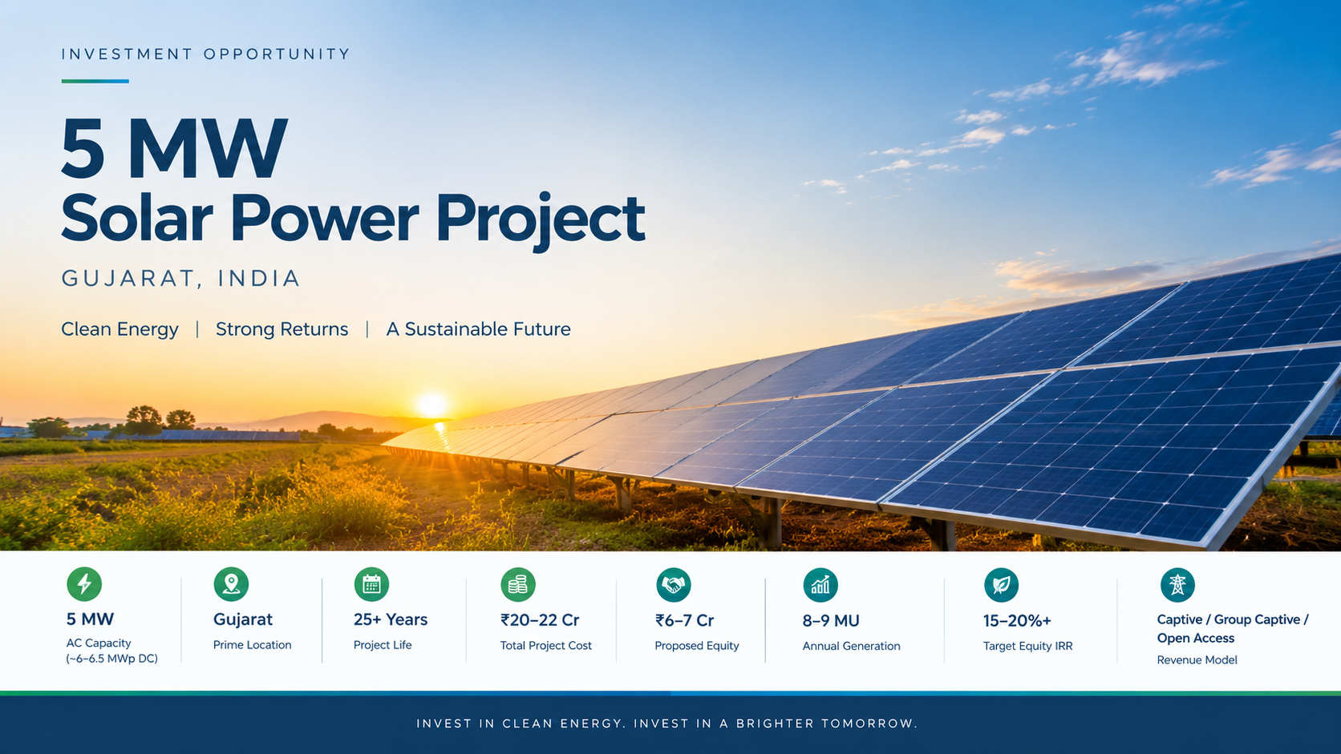

Slide 2
5 MW Solar Power Project — Gujarat
A long-term renewable energy asset opportunity for the discerning infrastructure investor
₹21 Crore
₹6–7 Crore
Total Project Cost
Promoter Equity
8.5 MU/Year
25+ Years
Annual Generation
Asset Operating Life
Prepared for Private Review — Gujarat, India

Slide 3
BUSINESS OPPORTUNITY SNAPSHOT
The Investment Thesis
The promoter invests ₹6–7 Crore as promoter equity and owns a long-life, power-generating infrastructure asset. Project debt finances the balance. This is not a short-cycle business — it is a 25-year asset with predictable cash flows and no fuel cost exposure.
Project Parameters
Capital Structure
Plant Capacity
Land Requirement
Total Project Cost
Owner's Equity
5 MW AC (6–6.5 MWp DC)
20–25 acres
₹20–22 Crore (base case: ₹21 Cr)
₹6–7 Crore (promoter contribution)
Project Life
Annual Generation
Project Debt
Business Models
25+ years
8–9 million units (base: 8.5 MU)
~₹14 Crore (subject to bank appraisal)
Captive / Group Captive / Open Access / PPA

Slide 4

INVESTMENT RATIONALE
Why Solar? Why Now?
Solar power is a proven, mature technology that has been commercially deployed for over three decades. Unlike conventional businesses, a solar plant has no fuel purchase requirement, minimal variable costs, and highly predictable generation profiles. The investment case rests on infrastructure logic, not speculative demand.
Multiple Monetisation Paths
Captive, Group Captive, Open Access, and long-term PPA models provide flexibility to optimise returns based on market conditions.
No Fuel Cost
Sunlight is free. Operating costs are dominated by O&M and financing — both controllable and predictable.
Rising Industrial Demand
Industrial consumers face rising grid tariffs. Renewable electricity is increasingly their lowest-cost option — creating durable offtake demand.
25+ Year Asset Life
Modern solar modules carry 25–30 year linear performance warranties. The infrastructure outlasts most conventional businesses.
Strong Post-Debt Cash Flow
After the ~12-year loan repayment period, the asset generates near-pure free cash flow for the remaining 13+ years of its operating life.
Low Operating Overhead
Professional O&M contracts keep running costs minimal. No large workforce, no raw material procurement.
This is an infrastructure business with long operating life — not a conventional high-overhead enterprise.

Slide 5
LOCATION RATIONALE
Why Gujarat?
Gujarat offers one of the strongest combinations of solar resource, industrial demand, and infrastructure readiness in India. The state's renewable energy ecosystem is mature, reducing execution risk significantly.
Solar Resource
Industrial Consumer Base
High solar irradiation levels and clear-sky days per year ensure reliable, high-yield generation across the project's operating life.
Gujarat hosts one of India's largest concentrations of industrial electricity consumers — a ready pool of potential captive and open-access offtakers.
Transmission Infrastructure
Renewable Ecosystem
Existing high-tension transmission networks reduce grid evacuation risk and capital cost for new renewable projects.
Established EPC contractors, O&M providers, financial institutions, and regulatory frameworks are all in place for smooth project execution.

Slide 6
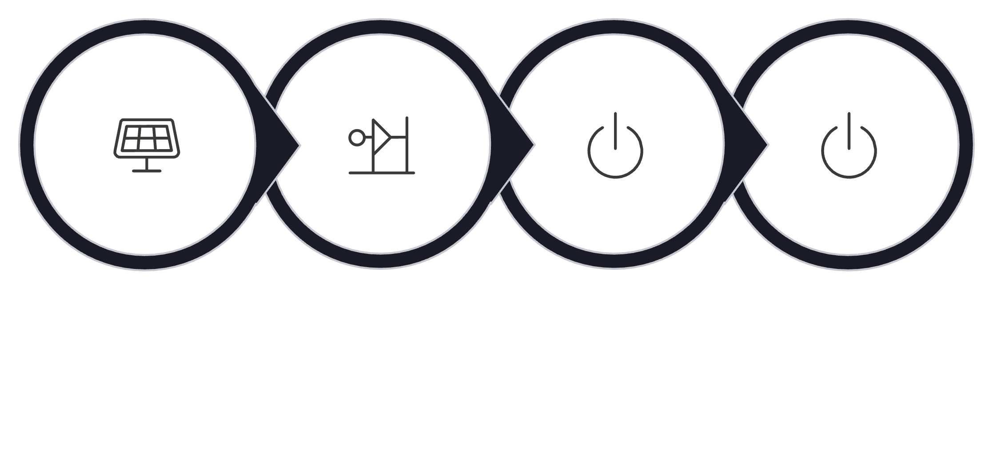
TECHNICAL PROFILE
The 5 MW Solar Plant — Technical Overview
Plant Configuration
Generation Process
AC Capacity
DC Capacity
5 MW — the rated grid injection capacity of the plant
~6–6.5 MWp — oversized DC array to maximise generation hours
Module Technology
Land Requirement
N-Type TOPCon or equivalent — current generation, higher efficiency
~20–25 acres of flat, unobstructed land in Gujarat
Solar Modules
Inverters
Transformer
Grid Delivery
Annual Generation
Grid Connection
Generation Depends On
~8–9 MU per year (base case: 8.5 MU)
HT evacuation with SCADA and remote monitoring capability
Location and solar irradiation levels
Plant design and module technology
O&M Model
Grid availability and curtailment
Plant performance ratio over time
Professional contract — AMC with performance guarantees

Slide 7
REVENUE ARCHITECTURE
How the Business Earns
The plant generates electricity which is monetised through one of four commercial structures. The choice of model determines the effective revenue per unit — which is the single most important variable in the financial case.
1
2
Captive Consumption
Group Captive
Owner's own industrial business consumes the electricity directly. Saves the full industrial grid tariff — potentially the highest economic value per unit with lowest regulatory friction.
Supply to a group of eligible participating captive consumers who hold equity in the project. Governed by Group Captive regulations — applicable charges must be evaluated carefully.
3
4
Open Access
Long-Term PPA
Supply to an industrial consumer through the state transmission grid. Subject to wheeling charges, transmission losses, and banking regulations — net realised value is what matters, not the headline rate.
Sell electricity under a contractual Power Purchase Agreement with a creditworthy offtaker. Provides revenue certainty and bankability — critical for securing project debt at favourable terms.
Recommended Approach: First identify a strong industrial offtaker and calculate the actual net realised value per unit after all applicable charges. Do not decide the business case based on a headline "₹X/unit" figure alone.

Slide 8
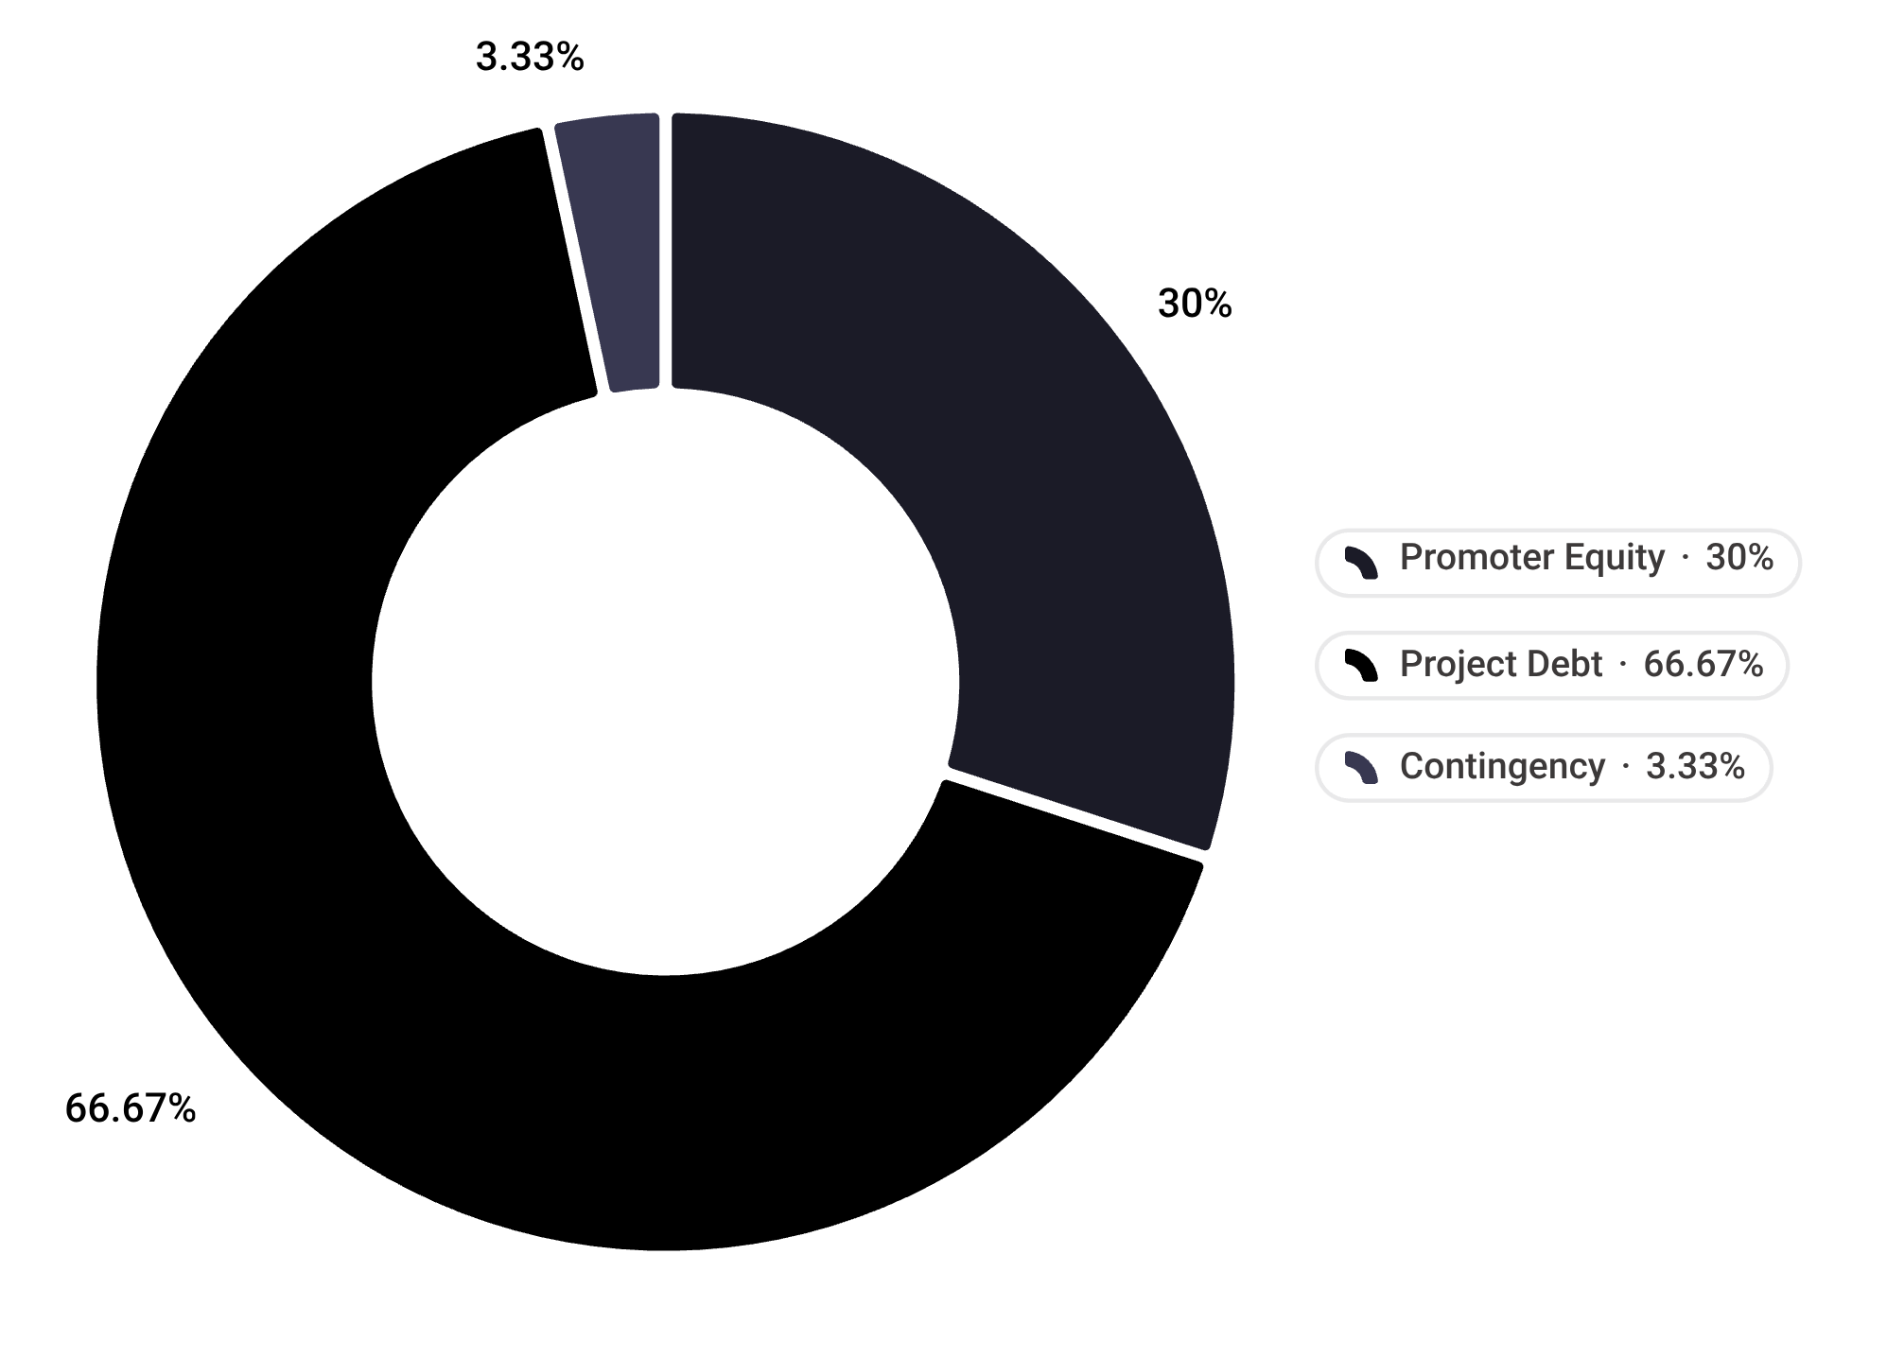
CAPITAL STRUCTURE
Project Cost & Funding Structure
Capital Stack — ₹21 Crore Total
Funding Structure Detail
Promoter Equity — ₹6.3 Crore
Project Debt — ~₹14 Crore (Target)
Promoter contribution. Establishes ownership, promoter commitment, and skin-in-the-game — a prerequisite for bank financing.
Bank or NBFC project finance. Subject to bank appraisal, sanction, and security requirements. We are targeting ₹14 Cr debt — not assuming it.
Contingency — ~₹0.7 Crore
Buffer for cost overruns, regulatory changes, and EPC variations during construction.
Bank Financing Depends On
Promoter financial strength and credit profile
Land ownership or long-term lease documentation
PPA/offtake agreement quality and offtaker creditworthiness
Grid connectivity approval from the utility
Acceptable DSCR, security structure, and bank's RE lending policy

Slide 9
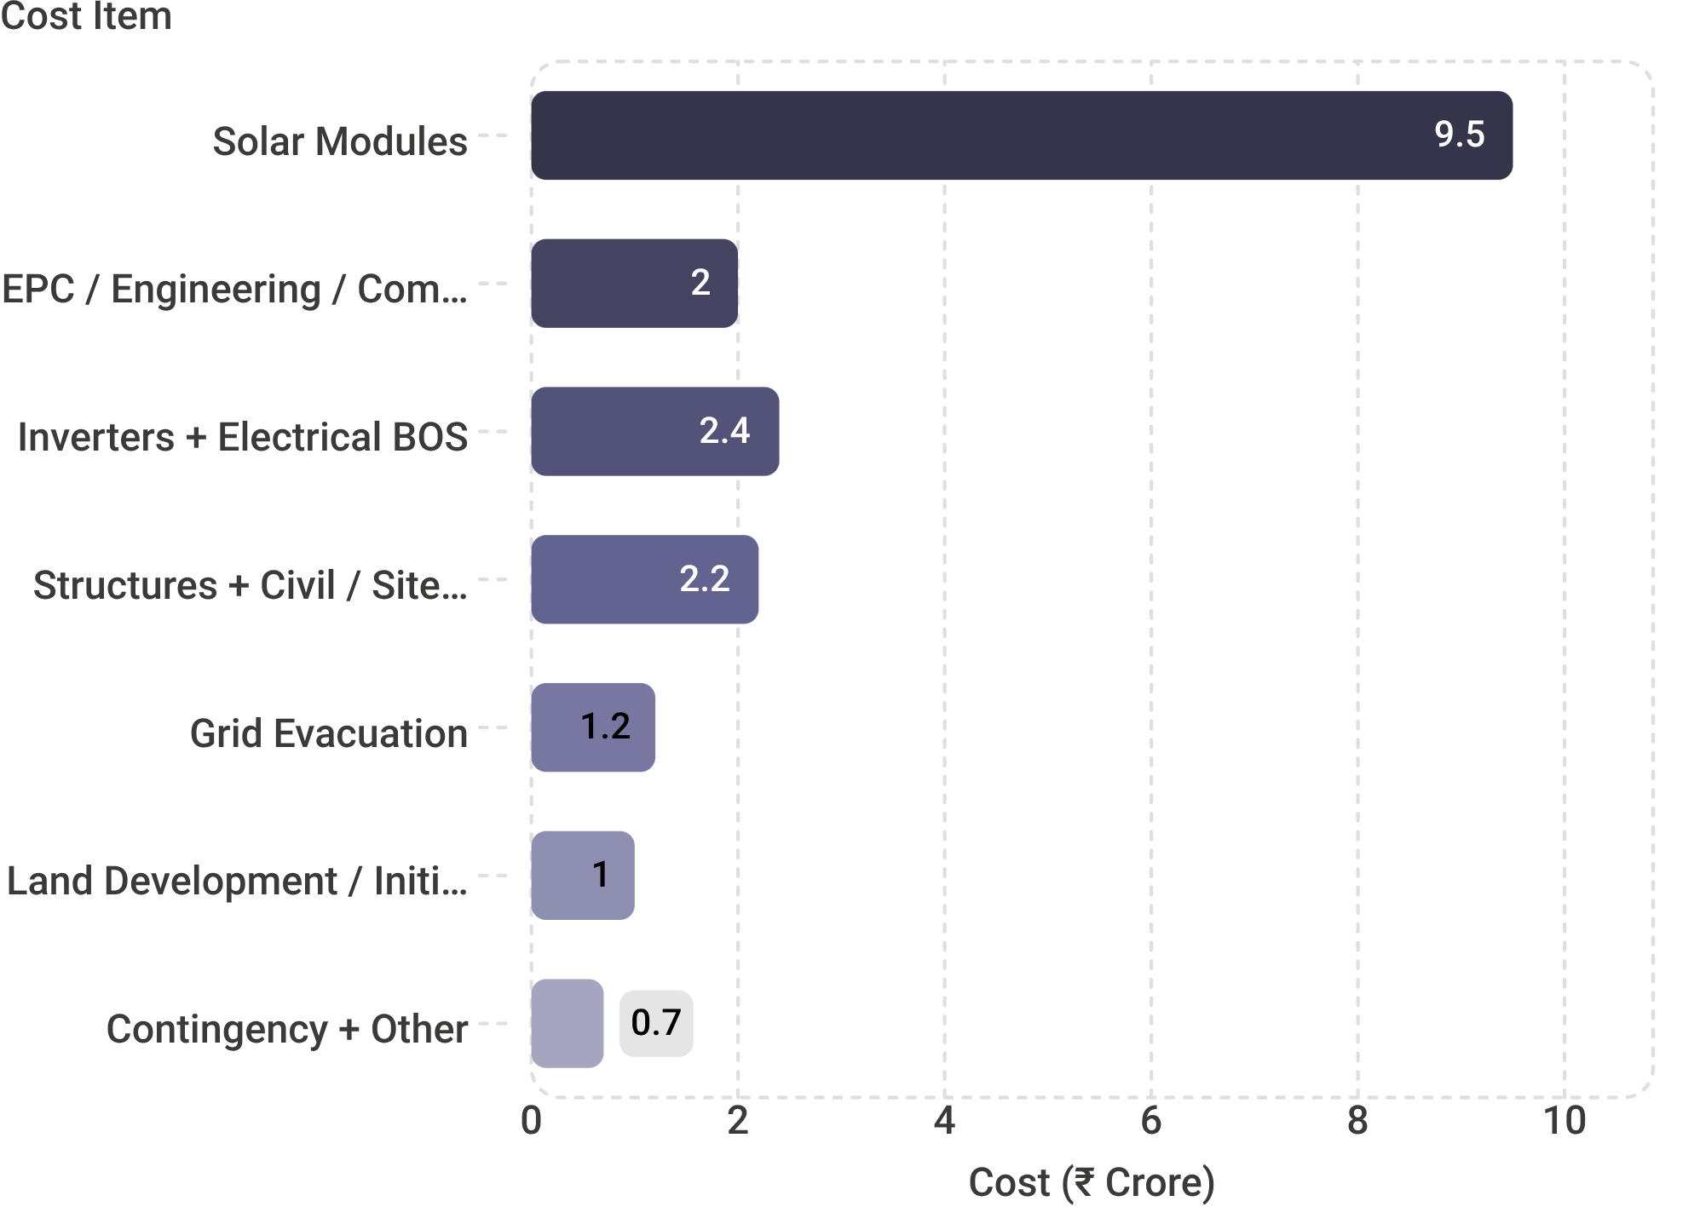
COST BREAKDOWN
Where the ₹21 Crore Goes
Cost Commentary
Solar modules represent 45% of total project cost — making module procurement strategy a critical lever in cost optimisation. The second-largest block is inverters, electrical BOS, and civil/structural works combined.
Modules — ₹9.5 Cr
Largest single cost item. Technology, brand, and warranty terms matter as much as unit price. N-Type TOPCon preferred for long-term yield.
Grid Evacuation — ₹1.2 Cr
Subject to utility-specific requirements. Must be validated with actual utility connectivity estimate before project cost is finalised.
EPC / Engineering — ₹2.0 Cr
Covers design, procurement management, commissioning, and project management. A fixed-price EPC contract is strongly recommended.

Slide 10
CONSERVATIVE CASE ANALYSIS
The Critical Case: ₹3/Unit Economics
This analysis models the plant at the lowest commercially viable electricity price — ₹3 per unit. It is not the target case. It is the stress test that demonstrates whether the project can survive its most conservative revenue scenario during the loan repayment period.
Annual P&L at ₹3/Unit
What This Means
Annual Generation
Revenue @ ₹3/unit
At ₹3/unit, the project covers all operating costs and services its debt — but leaves almost no surplus for the promoter during the loan period. This is precisely why ₹3/unit is a conservative downside case, not a business target.
8.5 million units (base case)
₹2.55 Crore
Less: Land Rent
Less: O&M + Insurance + Admin
Loan Period (~12 Years)
₹0.15 Crore
₹0.45 Crore
Project cash flows are fully absorbed by operating costs and debt service. Promoter receives no meaningful distribution unless offtake price is above ₹3/unit.
Less: Bank Debt Service (EMI)
Cash Remaining
~₹1.96 Crore (₹14 Cr @ 9.5%, 12 years)
≈ ₹0 Crore
Post-Debt Period (Year 13–25+)
After loan repayment, annual revenue of ₹2.55 Cr (at ₹3/unit) flows almost entirely as free cash to the owner — a dramatically different picture.
The Honest Analysis
This model demonstrates realistic, conservative thinking — not exaggerated projections. The project must be structured to perform above ₹3/unit to generate promoter returns during the loan period.

Slide 11
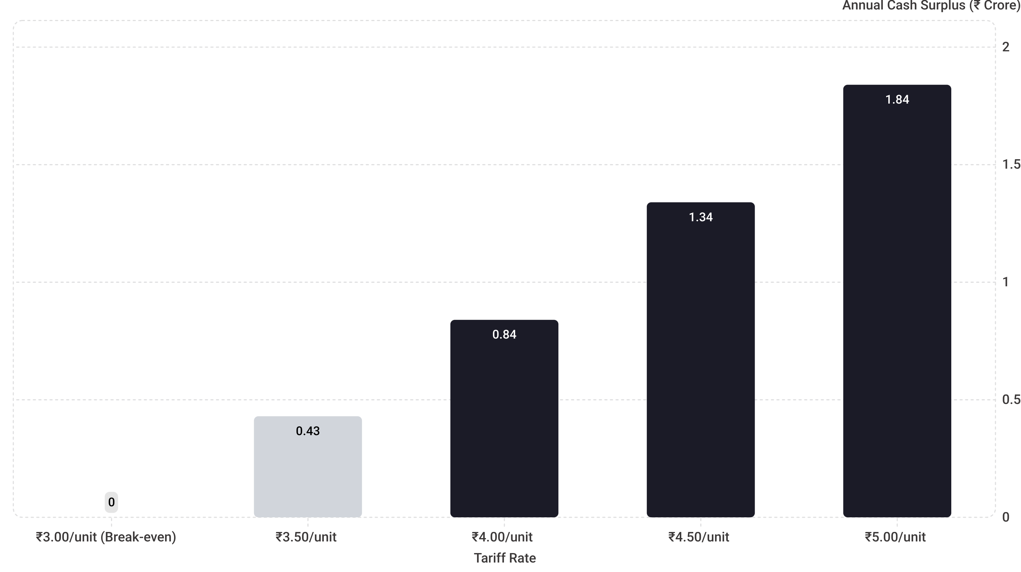
SENSITIVITY ANALYSIS & CONCLUSION
Profitability Sensitivity: ₹3–₹5 Per Unit
The table below shows how annual cash surplus changes as the effective realised price per unit increases. The three levers that drive profitability are: (1) offtake price, (2) project cost, and (3) cost of finance. Our job — before construction — is to optimise all three.
The Three Profitability Levers
"The project does not become attractive merely because it is solar. It becomes attractive when we secure the right offtake, build at the right cost, and finance it correctly."
1
Offtake Price
Five Prerequisites Before Construction
2
The single largest driver. Securing a creditworthy industrial offtaker at ₹4.00+ per unit changes the project economics fundamentally during the loan period.
01
Project Cost
Land
3
Every ₹1 Crore saved in EPC cost reduces required debt and improves DSCR. Competitive EPC procurement is a non-negotiable exercise.
Clear title or long-term lease, 20–25 acres
Cost of Finance
02
Interest rate and loan tenure directly determine annual debt service. A lower rate or longer tenor meaningfully improves monthly cash flow during the repayment period.
Grid Connectivity
Utility approval for HT evacuation
03
Offtake / PPA
Creditworthy buyer at viable rate
04
EPC Contract
Fixed-price, performance-guaranteed
05
Project Financing
Bank sanction at target terms

Slide 12


