Slide 3
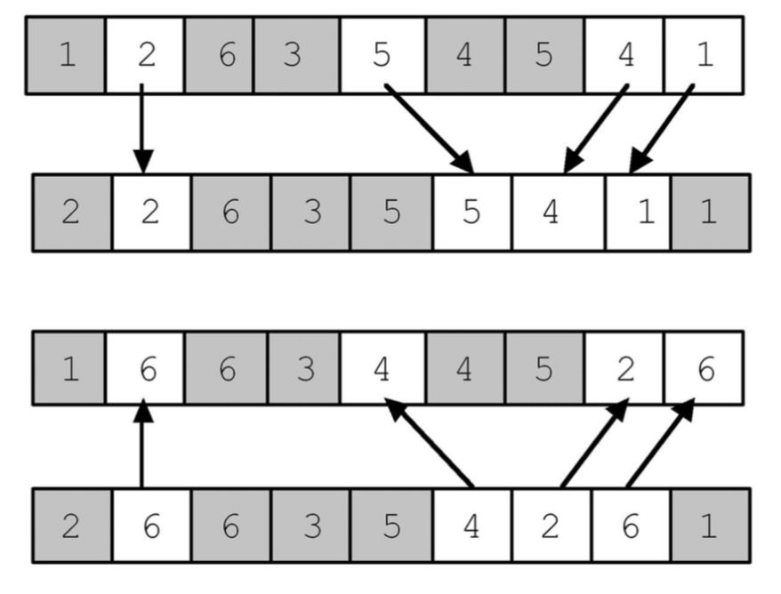
Parent 1
Child 1
Child 2
Parent 2

Slide 4
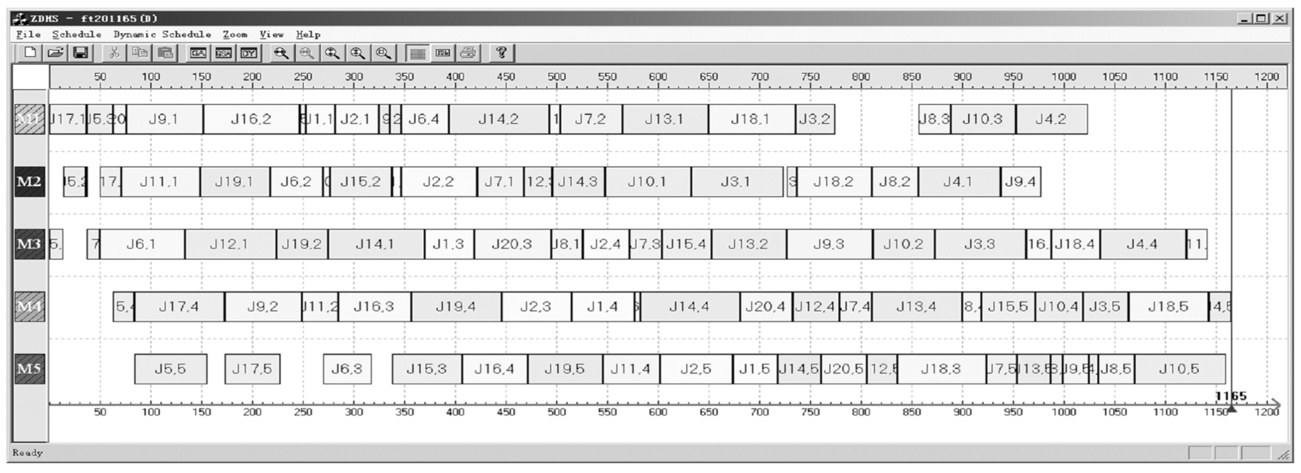

Slide 5
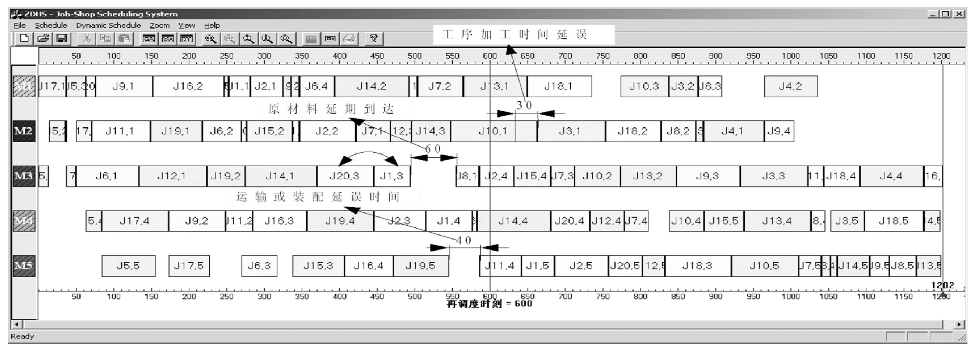
Delay of job processing time
Delayed arrival of raw materials
transportation or assembly delayed time units
Rescheduling time = 600

Slide 6
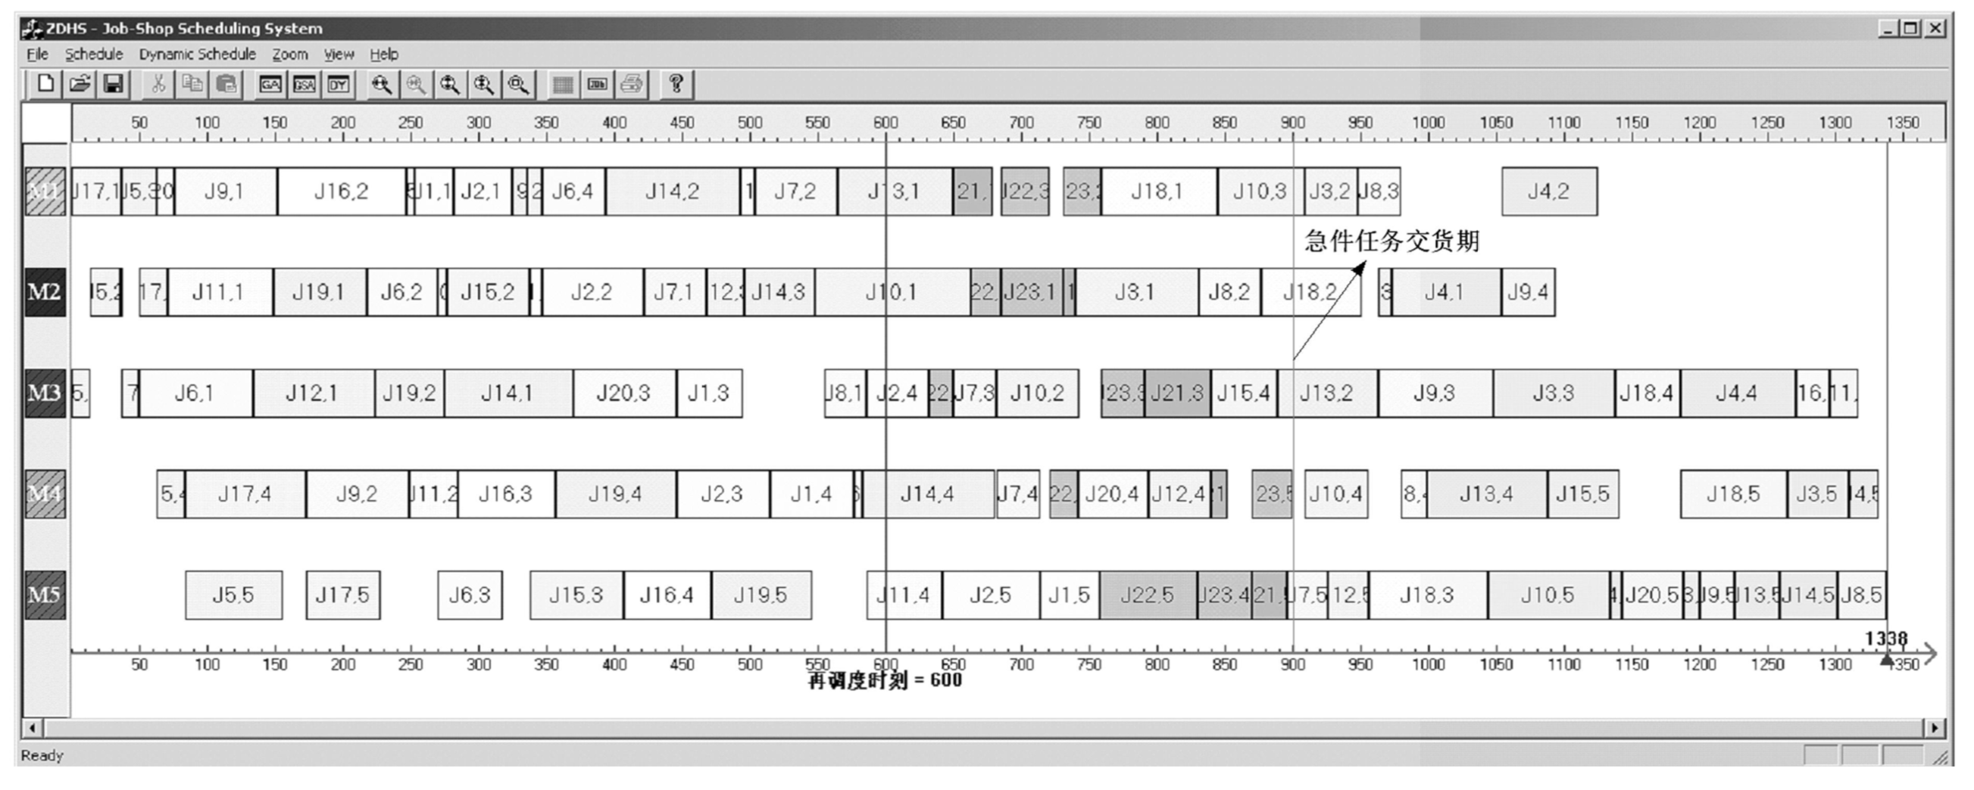
Urgent job delivery time
Rescheduling time = 600

