Slide 1

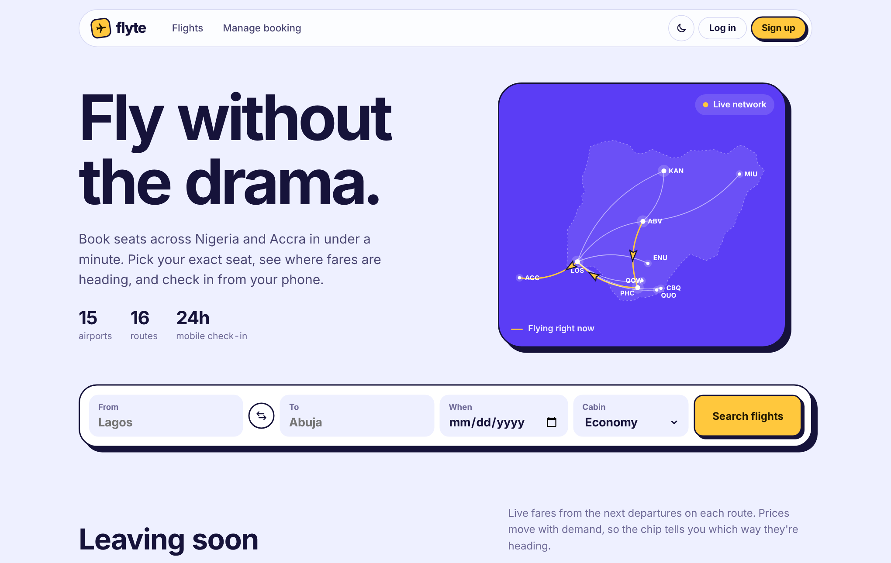
flyte
Fly without the drama.
A Nigerian airline booking web app built from a console OOP project, with a pricing engine, demand forecasting and customer segmentation on top.
Home page: live route map, search ticket and departures
Python + Flask pandas + NumPy SQLite Vanilla JS
Notes:
Fly without the drama. Flyte started as a terminal menu for managing flights, passengers and bookings. This deck shows what it became: a full web app travellers can use, and an operations console that uses data science to price, forecast and segment. Everything still runs on the same object-oriented core.

Slide 2

From an 11-option terminal menu to a web product
Console version
Flyte web app
1 Python file
99 + 15 Python + JS classes
14 classes
29 automated tests
Same OOP core
11 menu options
4 airlines to compare, with bag rules
500 flat miles per trip
Distance based miles with 4 tiers
0 tests
Live prices, forecasts and segments
Notes:
Left is the original coursework: a single file with a console menu. Right is Flyte. The original Passenger, Flight, Booking and AirlineSystem classes are still the heart of it, extended rather than rewritten. The original console menu still runs against the same database.

Slide 3
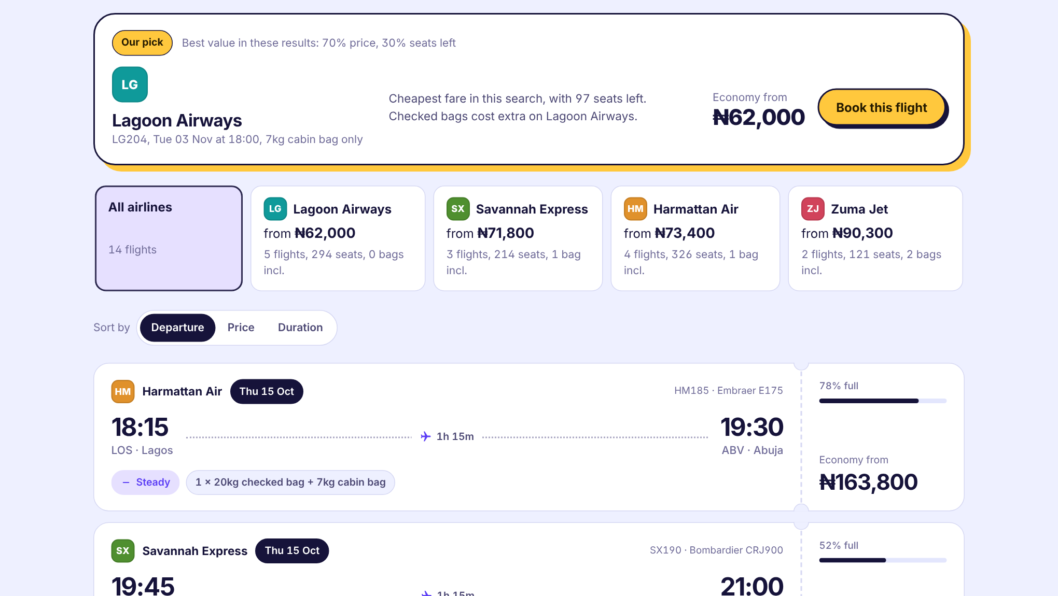
Compare airlines, then book in five steps
1
Pick a cabin
Economy, Business or First, with the live fare and seats left.
2
Choose a seat
Tap any free seat in your cabin on the seat map.
3
Add luggage
Extra checked bags, priced by that airline's own bag rules.
4
Add cover
None, your own, Basic Medical or Premium.
5
Pay
Card checkout in test mode. The server sets the price.
Before step 1: the search page compares four airlines and AirlineRecommender picks the best value (70% price, 30% seats left), with a reason.
Notes:
Start on the search page: four airlines fly the same route at different prices and bag rules, and the AirlineRecommender class picks the best value and explains why. Then the five booking steps. Each step is handled by a class: FlightClass for cabins, Flight for seats, BaggagePolicy for luggage fees, InsuranceTier for cover, PaymentGateway for payment.

Slide 4
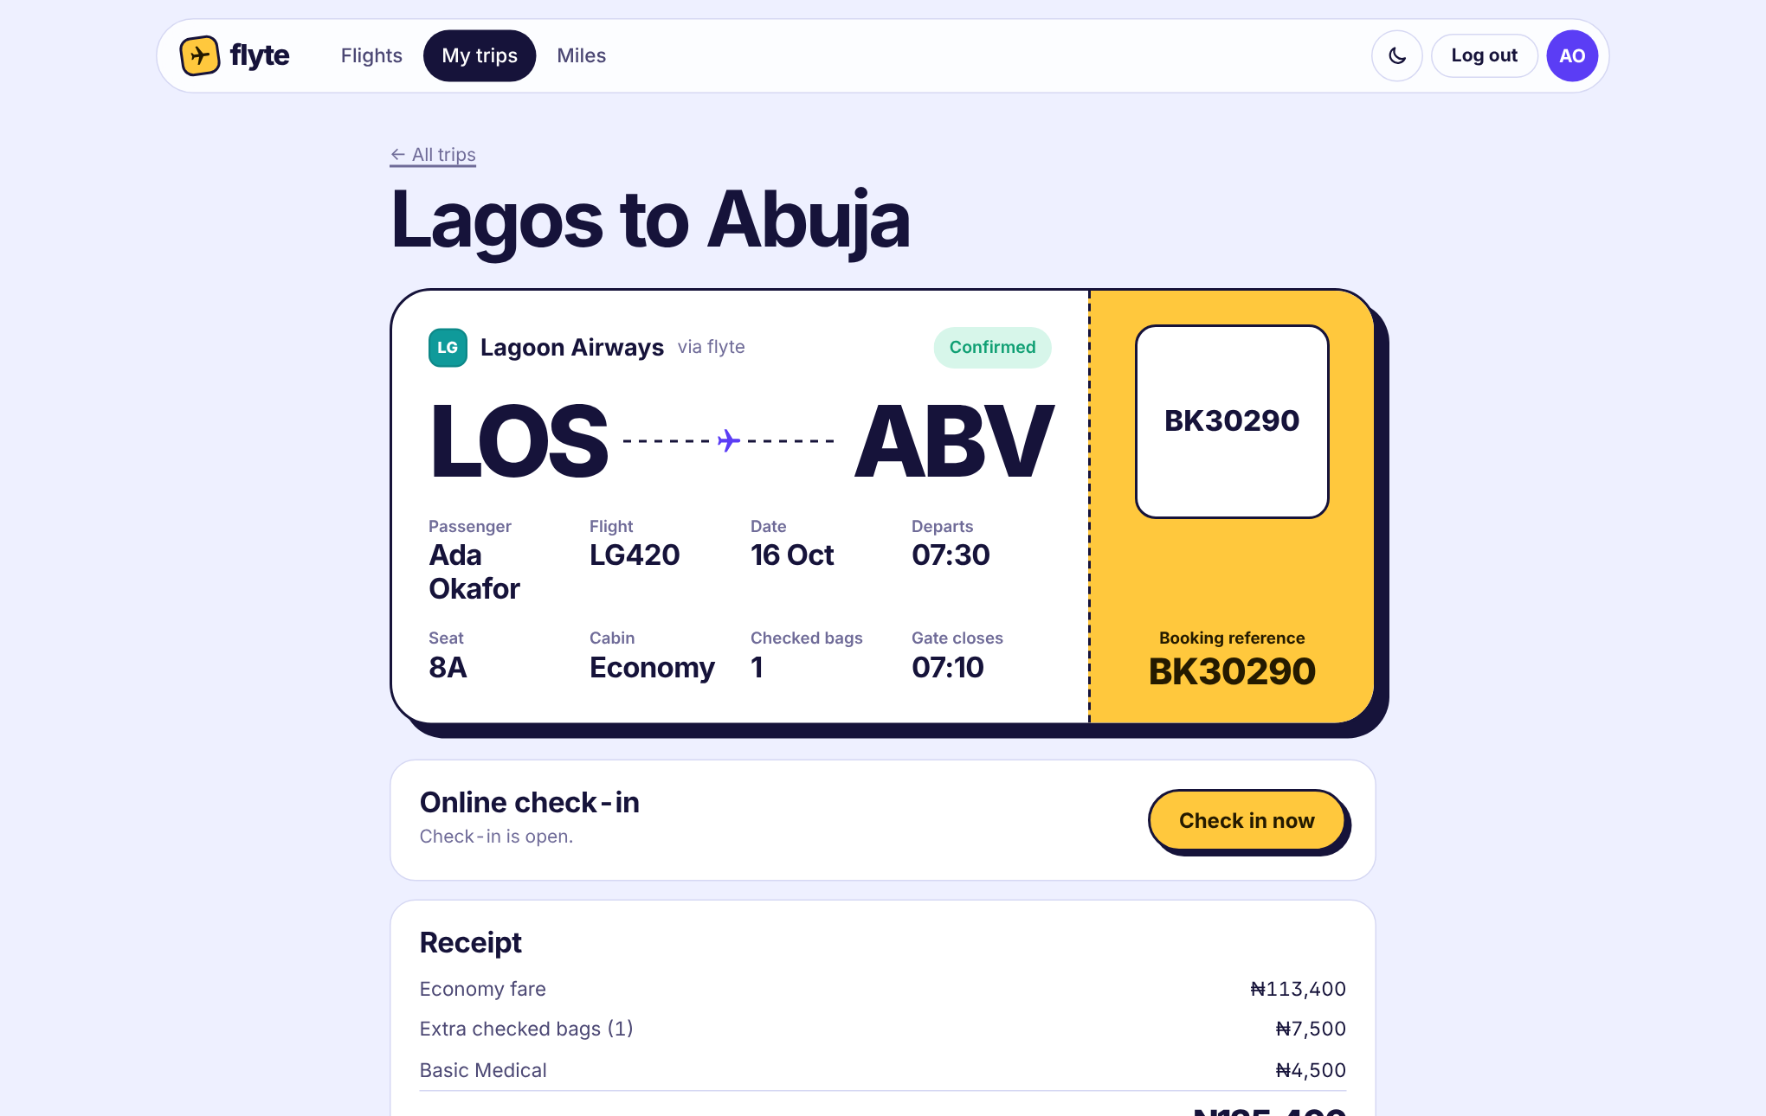



Every trip ends in a boarding pass
Check in on your phone
Opens 24h before departure, closes 45 min before. Assigns a boarding group, back rows first.
Refunds by policy
Over 72h: 90% of fare. 24–72h: 50%. Under 24h: none. Premium cover or airline cancellation: full.
Miles that mean distance
Kilometres flown × cabin bonus × tier bonus. Blue, Silver, Gold, Platinum.
Notes:
The boarding pass page is where a booking lives. Check-in, refunds and miles are each their own class: Booking handles the check-in window, RefundPolicy calculates refunds, and LoyaltyProgram awards miles.

Slide 5
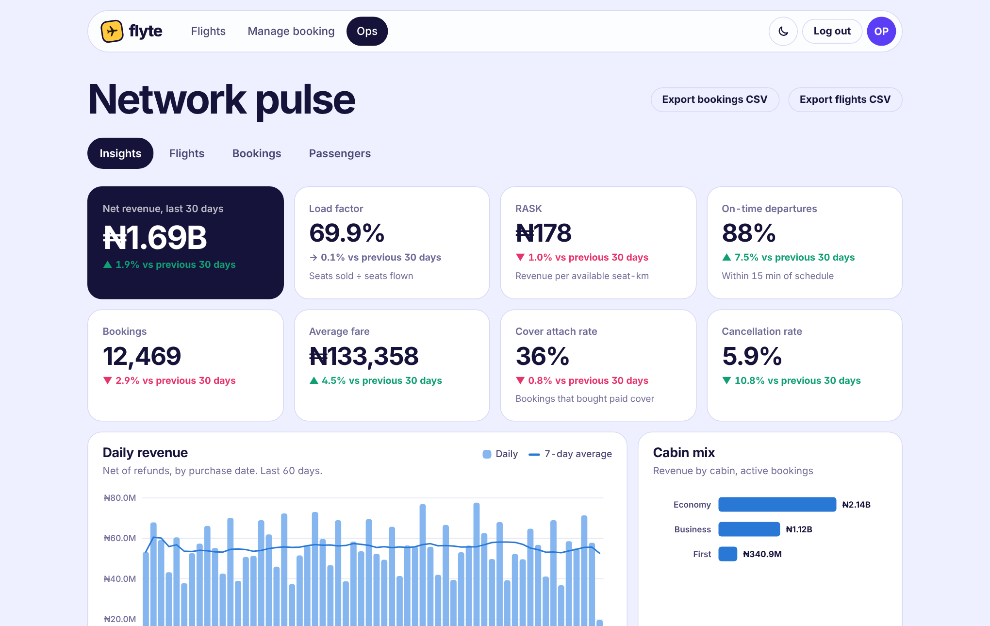
The ops console shows the airline's health at a glance
₦967M
net revenue, last 30 days
70.4%
load factor (seats sold ÷ seats flown)
88%
departures within 15 min of schedule
₦170
revenue per available seat-km (RASK)
Figures from the seeded demo data: 3,500 passengers, 282 flights, 17,000+ bookings.
Notes:
The admin dashboard is built from the AnalyticsEngine class, which turns the live objects into pandas DataFrames. Each KPI is compared with the previous 30 days. Staff can also delay or cancel flights, and every affected passenger is refunded and notified automatically.

Slide 6

Four layers around one domain model
Browser
HTML pages + JS classes: BookingFlow, SeatMap, TimeChart, RouteMap
Flask web layer
FlyteApp factory, class-based views (BaseView → JsonView), Auth, CSRFGuard
ConsoleUI
Your original menu still works. It calls the same AirlineSystem and reads the same database, so both apps always agree.
AirlineSystem
The original service class: flights, passengers, bookings, check-in, refunds
Models
Passenger, Flight, Booking, Airline, BaggagePolicy, User
Services
PricingEngine, AirlineRecommender, RefundPolicy, PaymentGateway
Analytics
AnalyticsEngine, Forecaster, KMeans
StorageBackend
SqliteStorage (web) or JsonStorage (console's original format)
Notes:
Read top to bottom. The browser never touches data directly. Flask views call AirlineSystem, which owns the models and delegates to services and analytics. Storage is an abstract class, so SQLite and JSON are interchangeable. The original console UI plugs into the same AirlineSystem.

Slide 7
The four OOP pillars, each with a real job
Inheritance
Abstraction + polymorphism
One base error, many specific ones. The web layer maps each to the right HTTP code.
Swap storage, payments, email or forecasting without touching the callers.
class SeatOccupiedError(AirlineError):
http_status = 409
class SqliteStorage(StorageBackend): ...
class JsonStorage(StorageBackend): ...
Encapsulation
Composition + injection
A booking freezes its fare at purchase, so later price changes can't rewrite history.
AirlineSystem is assembled from parts, which is why tests can run on an in-memory database.
@property
def total_cost(self):
return self.ticket_price + self.insurance_cost
AirlineSystem(storage=SqliteStorage(":memory:"),
payments=MockPaymentGateway())
Notes:
These are the examples to point to if you're asked about OOP. Each pillar solves a concrete problem in the app rather than being there for show.

Slide 8
Fares respond to demand and to the calendar
PricingEngine
demand = 0.90 + 0.75 × LF²
time = 0.95 + 0.45 × e^(−days/5)
fare = list × demand × time
LF is how full the cabin is. An empty cabin sells at 0.90× the list price and a full one at 1.65×. Prices climb steeply in the last week.
FareAdvisor projects this curve forward from each flight's booking speed and tells travellers to book now or wait.
Booking a month ahead costs about 48% less than booking the day before.
Notes:
This chart is computed from the demo bookings, each priced by the PricingEngine at the moment it was made. It shows the airline revenue management idea in one picture: early bookers get lower fares, last-minute travellers pay more.

Slide 9
Models forecast demand and find customer types
7.7% average error on the last 14 days, tested on data the model never saw. Method: linear trend + day-of-week effects (ridge least squares).
19% of passengers bring 59% of revenue. K-means written from scratch in NumPy (silhouette 0.505).
Notes:
Left: the demand forecaster, with its honest backtest score. Right: customer segments. The clusters are named automatically from their centroids. The frequent commuters are a small group that carries most of the revenue, which is the classic case for a loyalty programme.

Slide 10



Run it, ship it, and what it can't do yet
Run locally
Put it online
Known limitations
python -m venv .venv
activate .venv
pip install -r requirements.txt
python app.py → localhost:5000
Push to GitHub (VS Code: Publish)
Free demo: PythonAnywhere
Always on: Render, $7/mo + disk
Anywhere: the Dockerfile
Payments are test mode only
Airlines and data are fictional
One server, SQLite database
Emails need a mail server
No password reset yet
One passenger per booking
Full steps and the complete limitations list: docs/RUNNING.md and docs/DEPLOYMENT.md.
Notes:
Run it on a laptop in four commands, put it online through GitHub and PythonAnywhere, and be upfront about the limits: payments are test mode, the airlines and data are fictional, it runs on one server with SQLite, emails need a mail server, there is no password reset, and each booking is for one passenger. The biggest gap is payments, and fixing it is one new class that inherits from PaymentGateway.

