Slide 1

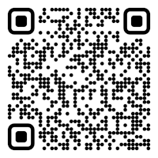
CS 5/7320 Artificial Intelligence Adversarial Search and Games AIMA Chapter 5
Slides by Michael Hahsler with figures from the AIMA textbook
This work is licensed under a Creative Commons Attribution-ShareAlike 4.0 International License.
"Reflected Chess pieces" by Adrian Askew
Online Material

Slide 2
Contents
What are two-player zero-sum games with deterministic game mechanics?
Games as Search Problems
Exact Methods Non-deterministic Actions Minimax Search
Heuristic Methods Heuristic Alpha-Beta Tree Search Monte Carlo Tree search
Stochastic Games

Slide 3

Games
Games typically confront the agent with a competitive (adversarial) environment affected by an opponent (strategic environment).
Games are episodic.
We will focus on planning for
two-player zero-sum games with
deterministic game mechanics and
perfect information (i.e., fully observable environment).
We call the two players:
Max tries to maximize his utility.
Min tries to minimize Max’s utility since it is a zero-sum game.

Slide 4

Definition of a Game
Definition:
$s_{0}$ The initial state (position, board, hand).
$Actions(s)$ Legal moves in state $s$.
$Result(s,a)$ Transition model.
$Terminal(s)$ Test for terminal states.
$Utility(s)$ Utility for player Max for terminal states.

Slide 5
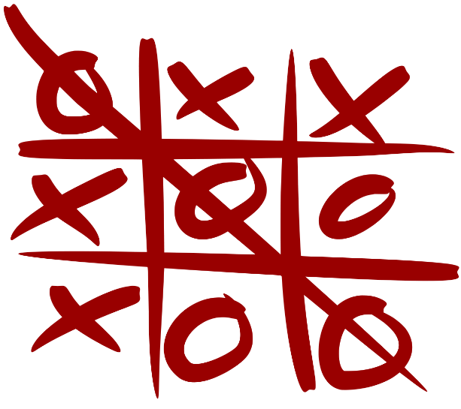
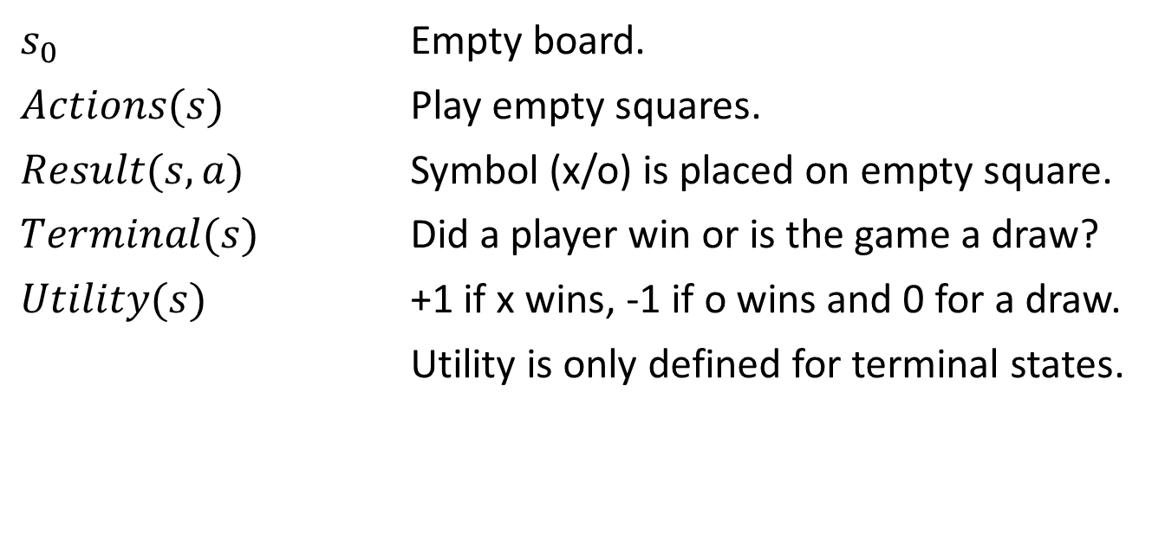
Example: Tic-tac-toe
$s_{0}$ Empty board.
$Actions(s)$ Play empty squares.
$Result(s,a)$ Symbol (x/o) is placed on empty square.
$Terminal(s)$ Did a player win or is the game a draw?
$Utility(s)$ +1 if x wins, -1 if o wins and 0 for a draw.
Utility is only defined for terminal states.
Here player x is Max and player o is Min.
Note: This game still uses a goal-based agent that plans actions to reach a winning terminal state!

Slide 6
Games as Search Problems
Making a move is a decision problem that can be addressed as a search problem. We need to search for sequences of moves that lead to a winning position.
Search problems have a state space: a graph defined by the initial state and the transition function containing all reachable states (e.g., chess positions).
For games we consider a game tree: A complete game tree follows every sequence from the current state to the terminal state (the game ends). It consists of the set of paths through the state space representing all possible games that can be played.

Slide 7
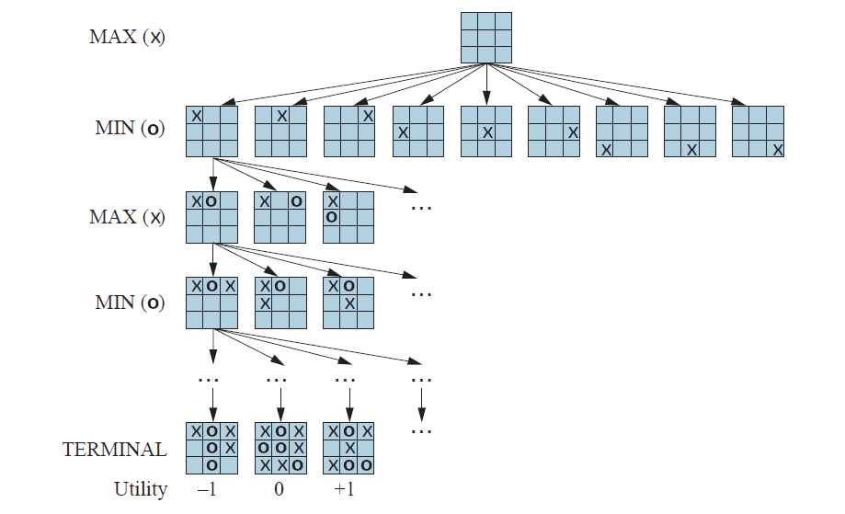


Tic-tac-toe: Partial Game Tree
Note: This game has no cycles!
state / node
# of nodes
action / result
1
9
redundant path
$$9×8$$
The state space size (number of possible boards) is much smaller than:
$3^{9}=19,683$ states.
However, the complete game tree is much larger because the same state (board) can be reached in different subtrees (redundant paths). The game tree here is a little smaller than:
$$1+\left(9× 8\right)+\left(9×8×7\right)+…\left(9!\right)$$ $=\text{986,409}$ nodes
Terminal states have a known utility

Slide 8
Methods for Adversarial Games
Exact Methods
Model as nondeterministic actions: The opponent is seen as part of an environment with nondeterministic actions. Non-determinism is the result of the unknown moves by the opponent. We consider all possible moves by the opponent.
Find optimal decisions: Minimax search and Alpha-Beta pruning where each player plays optimally to the end of the game.
Heuristic Methods (game tree is too large)
Heuristic Alpha-Beta Tree Search:
Cut off game tree and use heuristic for utility.
Forward Pruning: ignore poor moves.
Monte Carlo Tree search: Estimate utility of a state by simulating complete games and average the utility.

Slide 9

Nondeterministic Actions
Recall AND-OR Search from AIMA Chapter 4

Slide 10
Methods for Adversarial Games
Exact Methods
Model as nondeterministic actions: The opponent is seen as part of an environment with nondeterministic actions. Non-determinism is the result of the unknown moves by the opponent. We consider all possible moves by the opponent.
Find optimal decisions: Minimax search and Alpha-Beta pruning where each player plays optimally to the end of the game.
Heuristic Methods (game tree is too large)
Heuristic Alpha-Beta Tree Search:
Cut off game tree and use heuristic for utility.
Forward Pruning: ignore poor moves.
Monte Carlo Tree search: Estimate utility of a state by simulating complete games and average the utility.

Slide 11
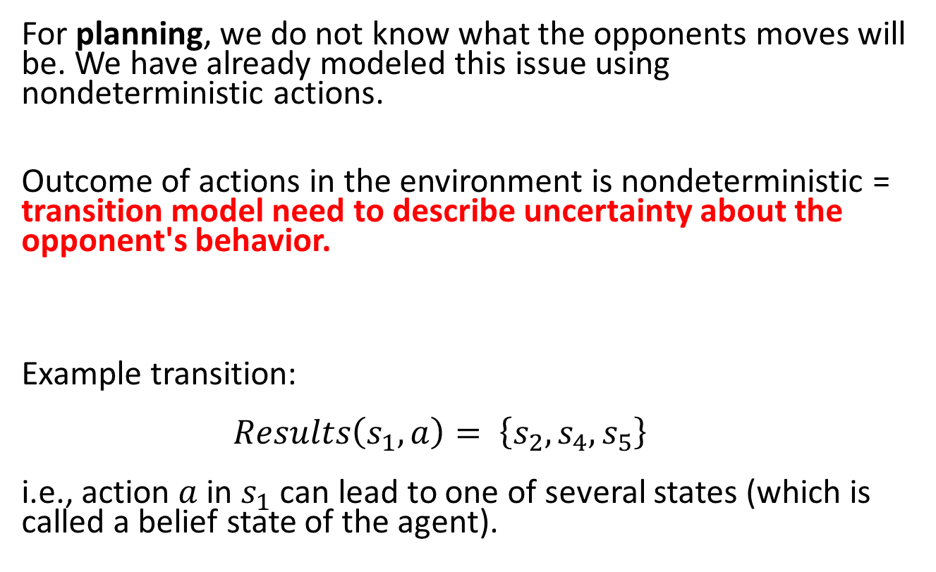
Recall: Nondeterministic Actions
For planning, we do not know what the opponents moves will be. We have already modeled this issue using nondeterministic actions.
Outcome of actions in the environment is nondeterministic = transition model need to describe uncertainty about the opponent's behavior.
Example transition: $Results\left(s_{1},a\right)= \left\{s_{2},s_{4},s_{5}\right\}$ i.e., action $a$ in $s_{1}$ can lead to one of several states (which is called a belief state of the agent).
Each action consists of the move by the player and all possible (i.e., nondeterministic) responses by the opponent.

Slide 12
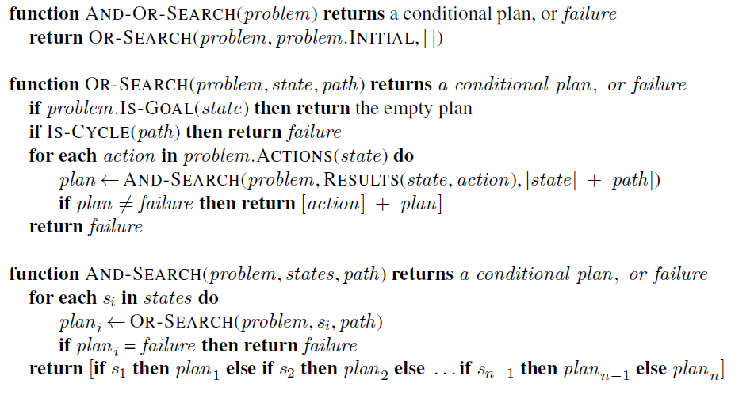
Recall: AND-OR DFS Search Algorithm
= nested If-then-else statements
// don’t follow loops
my moves
// check all possible actions
all states that can result from opponent’s moves
// check all possible current states
abandon subtree if a loss is found
Go through
opponent
moves

Slide 13
Tic-tac-toe: AND-OR Search
We play MAX and decide on our actions (OR). MIN’s actions introduce non-determinism (AND).
Depth (ply)
Pick an action that leads to a subtree with only win leaves.
0
OR
1
AND
2
Objective: Find a subtree that has only win leaf nodes (utility +1). We can abandon a subtree if we find a single loss (utility -1).
We call playing always the best move playing optimally. Since we consider all the opponent’s moves in the AND stage, we also includes MIN’s best move. This means we consider MIN playing optimally.
OR
3
AND
m

Slide 14

Optimal Decisions
Minimax Search and Alpha-Beta Pruning

Slide 15
Methods for Adversarial Games
Exact Methods
Model as nondeterministic actions: The opponent is seen as part of an environment with nondeterministic actions. Non-determinism is the result of the unknown moves by the opponent. We consider all possible moves by the opponent.
Find optimal decisions: Minimax search and Alpha-Beta pruning where each player plays optimally to the end of the game.
Heuristic Methods (game tree is too large)
Heuristic Alpha-Beta Tree Search:
Cut off game tree and use heuristic for utility.
Forward Pruning: ignore poor moves.
Monte Carlo Tree search: Estimate utility of a state by simulating complete games and average the utility.

Slide 16
Immediate vs. Long-Term Rewards
?
Utility for terminal states is known. We call this the immediate reward of the state.
The immediate reward of all non-terminal states is here 0. But, how good is it to be in any of the other states? We need to complete the game and see. This is called the (expected) long-term reward of the state.
The optimal decision is to always choose the action that leads to the highest long-term reward state.

Slide 17
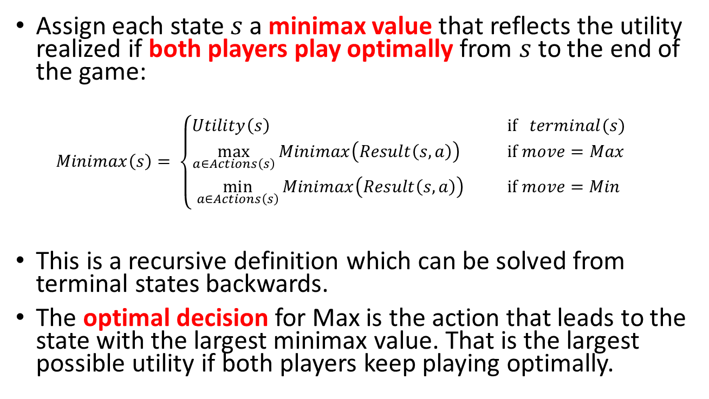
Idea: Minimax Decision
Assign each state $s$ a minimax value that reflects the utility realized if both players play optimally from $s$ to the end of the game:
$$Minimax\left(s\right)= \left\{\begin{aligned}Utility\left(s\right) \text{if} terminal(s) \\ \max_{a∈Actions\left(s\right)}{Minimax\left(Result\left(s,a\right)\right)} \text{if} move=Max \\ \min_{a∈Actions\left(s\right)}{Minimax\left(Result\left(s,a\right)\right) } \text{if} move=Min\end{aligned}\right.$$
This is a recursive definition which can be solved from terminal states backwards.
The optimal decision for Max is the action that leads to the state with the largest minimax value. That is the largest possible utility if both players keep playing optimally.

Slide 18
Minimax Search: Back-up Minimax Values
Pick action that leads to the largest MV
MV
MV
MV
MV
MV
MV
MV
MV
MV
min
1
MV
MV
Determine MVs using a bottom-up strategy
Max always picks the action that has the largest value.
Min always picks the action that has the smallest value.
max
0
1
1
min
…
= minimax value (MV)

Slide 19
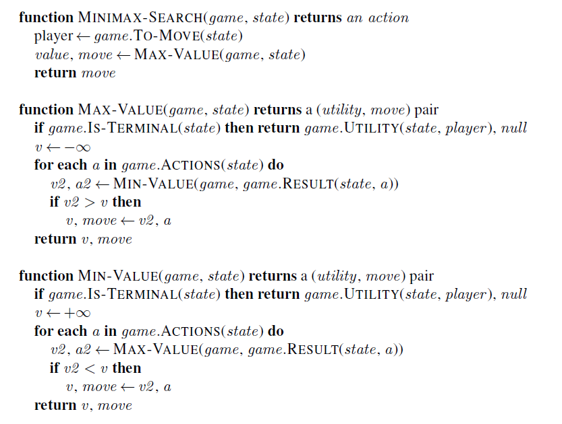
MiniMax-Search Algorithm
Approach: Follow tree to each terminal node and back up minimax value.
Note: This is just a generalization of the AND-OR Tree Search and returns the first action of the conditional plan.
Represents OR Search
Find the action that leads to the best value.
Represents AND Search

Slide 20












Exercise: Simple 2-Ply Game
MV
Max
$$a_{1}$$
$$a_{2}$$
$$a_{3}$$
MV
MV
MV
Min
$$a_{1}$$
$$a_{3}$$
$$a_{1}$$
$$a_{3}$$
$$a_{1}$$
$$a_{3}$$
$$a_{2}$$
$$a_{2}$$
$$a_{2}$$
Utility for Max
2
0
5
-5
-2
7
5
-7
4
Compute all MV (minimax values).
How do we traverse the game tree? What is the Big-O notation for time and space?
What is the optimal action for Max?

Slide 21
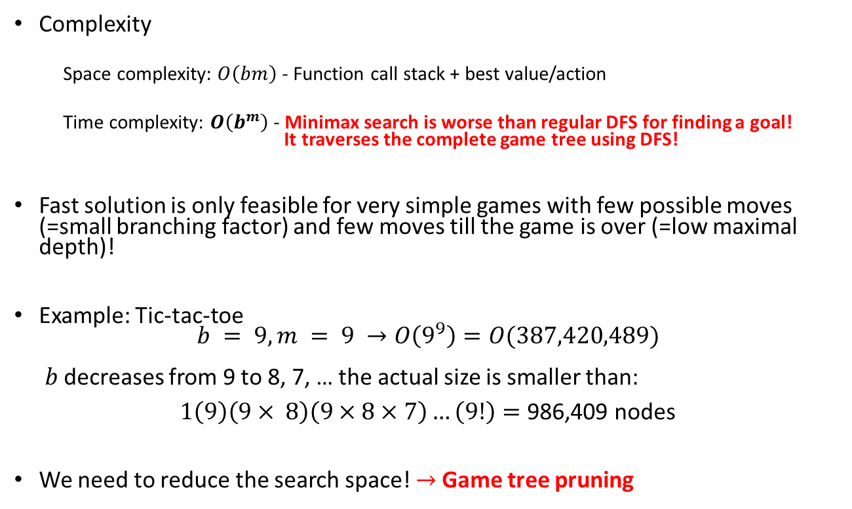
Issue: Search Time
b: max branching factor
m: max depth of tree
Complexity
Space complexity: $O\left(bm\right)$ - Function call stack + best value/action
Time complexity: $O\left(b^{m}\right)$ - Minimax search is worse than regular DFS for finding a goal! It traverses the complete game tree using DFS!
Fast solution is only feasible for very simple games with few possible moves (=small branching factor) and few moves till the game is over (=low maximal depth)!
Example: Tic-tac-toe $b = 9, m = 9 →O\left(9^{9}\right)=O(387,420,489)$ $b$ decreases from 9 to 8, 7, … the actual size is smaller than:
$1\left(9\right)\left(9× 8\right)\left(9×8×7\right)…\left(9!\right)=\text{986,409}$ nodes
We need to reduce the search space! $→$Game tree pruning

Slide 22
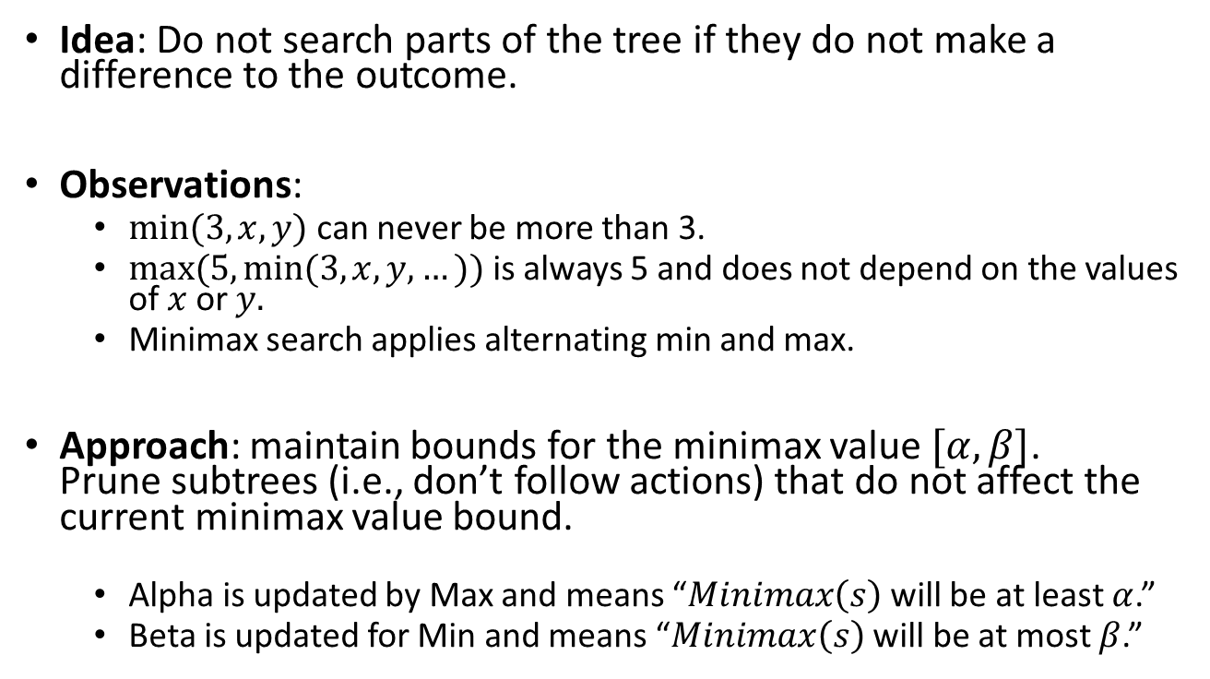
Alpha-Beta Pruning
Idea: Do not search parts of the tree if they do not make a difference to the outcome.
Observations:
$min⁡(3, x, y)$can never be more than 3.
$max⁡(5, min⁡(3, x, y, …))$ is always 5 and does not depend on the values of $x$ or $y.$
Minimax search applies alternating min and max.
Approach: maintain bounds for the minimax value $[α, β]$. Prune subtrees (i.e., don’t follow actions) that do not affect the current minimax value bound.
Alpha is updated by Max and means “$Minimax\left(s\right)$ will be at least $α$.”
Beta is updated for Min and means “$Minimax\left(s\right)$ will be at most $β$.”

Slide 23
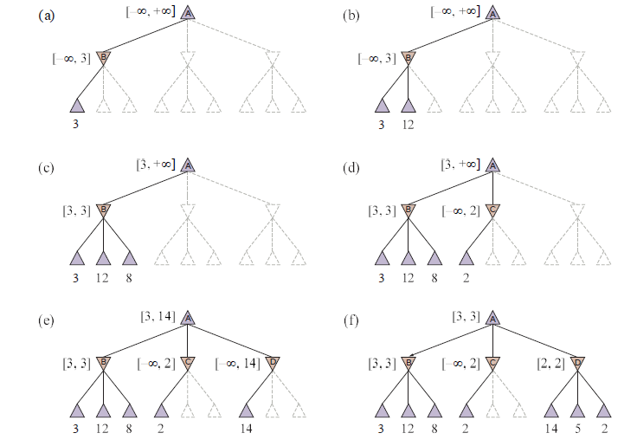

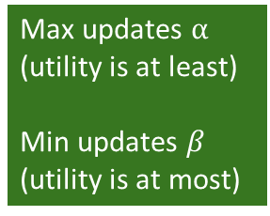



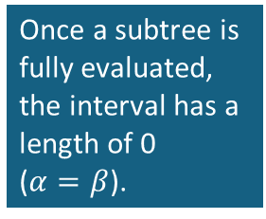

Example: Alpha-Beta Search
[$α,β$]
Max updates $α$
(utility is at least)
Min updates $β$
(utility is at most)
Max
Max
Min
Min
Utility cannot be more than 2 in the subtree, but we already can get 3 from the first subtree. Prune the rest.
Max
Max
$$v=3$$
Min
Min
$$v≤2$$
Max
$$v=3$$
Max
Once a subtree is fully evaluated, the interval has a length of 0 ($α=β$).
$$v=2$$
Min
Min

Slide 24
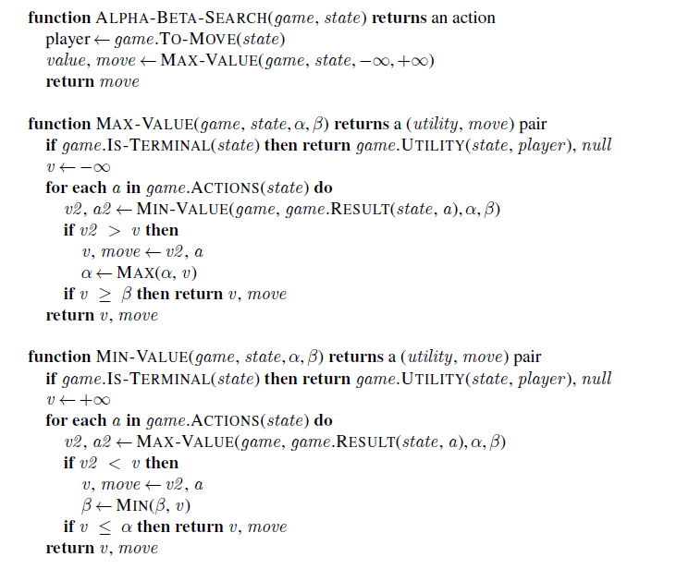
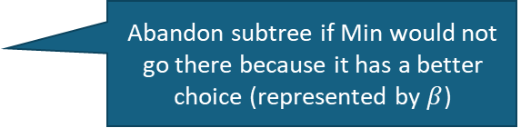
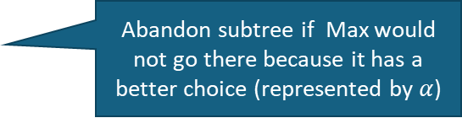
Alpha-Beta-Search Algorithm
= minimax search + pruning
// v is the minimax value
Found a better action?
Abandon subtree if Min would not go there because it has a better choice (represented by $β$)
Found a better action?
Abandon subtree if Max would not go there because it has a better choice (represented by $α$)

Slide 25
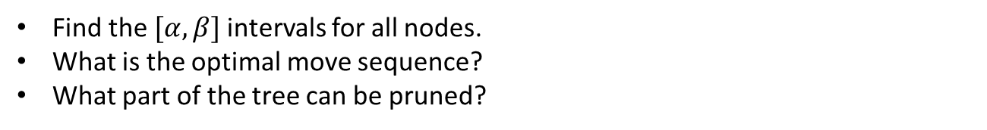

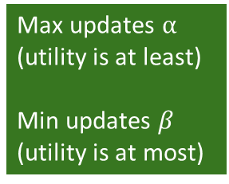



Exercise: Simple 2-Ply Game with Alpha-Beta Pruning
Max updates $α$
(utility is at least)
Min updates $β$
(utility is at most)
$$[α,β]$$
Max
$$a_{1}$$
$$a_{2}$$
$$a_{3}$$
$$[α,β]$$
$$[α,β]$$
$$[α,β]$$
Min
$$a_{1}$$
$$a_{3}$$
$$a_{1}$$
$$a_{3}$$
$$a_{1}$$
$$a_{3}$$
$$a_{2}$$
$$a_{2}$$
$$a_{2}$$
Utility for Max
-5
2
5
7
0
2
5
-7
-4
Find the $[α,β]$ intervals for all nodes.
What is the optimal move sequence?
What part of the tree can be pruned?

Slide 26
Move Ordering for Alpha-Beta Search
Idea: Pruning is more effective if good alpha-beta bounds can be found in the first few checked subtrees.
Move ordering for DFS = Check good moves for Min and Max first.
This is very similar to Greedy Best-first Search. We need expert knowledge (a heuristic) to determine what a good move is.

Slide 27



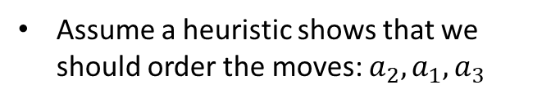





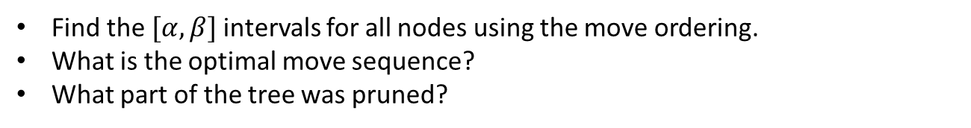








Exercise: Simple 2-Ply Game with Alpha-Beta Pruning and Move Ordering
Max updates $α$
(utility is at least)
Min updates $β$
(utility is at most)
Assume a heuristic shows that we should order the moves: $a_{2}, a_{1},a_{3}$
$$[α,β]$$
Max
$$a_{1}$$
$$a_{2}$$
$$a_{3}$$
$$[α,β]$$
$$[α,β]$$
$$[α,β]$$
Min
$$a_{1}$$
$$a_{1}$$
$$a_{1}$$
$$a_{3}$$
$$a_{3}$$
$$a_{3}$$
$$a_{2}$$
$$a_{2}$$
$$a_{2}$$
Utility for Max
-5
2
5
7
0
2
5
-7
-4
Find the $[α,β]$ intervals for all nodes using the move ordering.
What is the optimal move sequence?
What part of the tree was pruned?

Slide 28
The Effect of Alpha-Beta Pruning
Tic-tac-toe
Method | Searched Nodes | Search Time
Minimax Search | 549,946 | 13 s
+ Alpha-Beta Pruning | 18,297 | 660 ms
+ Move ordering (center, corner, rest) | 7,275 | 202 ms
Issue: Optimal decision algorithms still scale poorly even when using alpha-beta pruning with move ordering.

Slide 29

Heuristic Alpha-Beta Tree Search

Slide 30
Methods for Adversarial Games
Exact Methods
Model as nondeterministic actions: The opponent is seen as part of an environment with nondeterministic actions. Non-determinism is the result of the unknown moves by the opponent. We consider all possible moves by the opponent.
Find optimal decisions: Minimax search and Alpha-Beta pruning where each player plays optimally to the end of the game.
Heuristic Methods (game tree is too large or search takes too long)
Heuristic Alpha-Beta Tree Search:
Cut off game tree and use heuristic for utility.
Forward Pruning: ignore poor moves.
Monte Carlo Tree search: Estimate utility of a state by simulating complete games and average the utility.

Slide 31
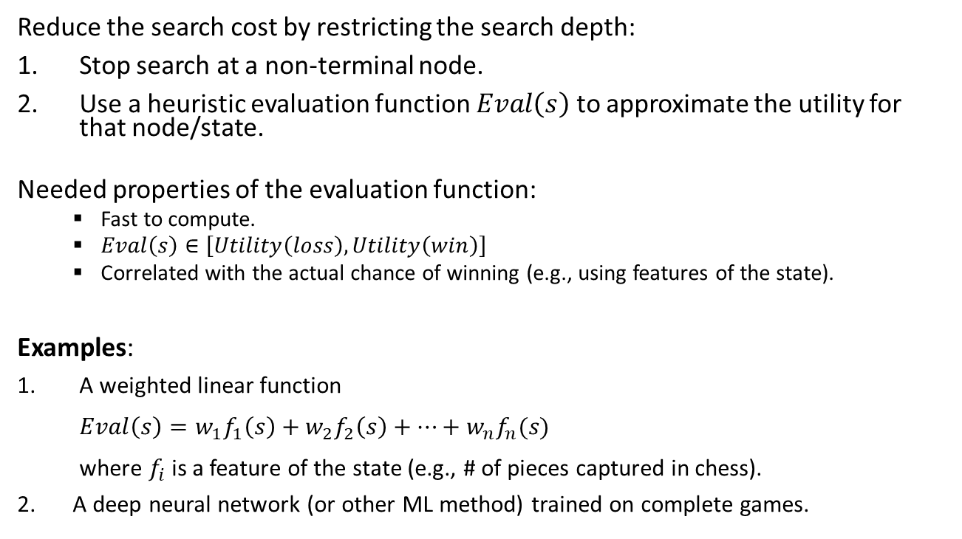
Option A: Heuristic Cut Off Search
Reduce the search cost by restricting the search depth:
Stop search at a non-terminal node.
Use a heuristic evaluation function $Eval\left(s\right)$ to approximate the utility for that node/state.
Needed properties of the evaluation function:
Fast to compute.
$Eval\left(s\right)∈\left[Utility\left(loss\right),Utility\left(win\right)\right]$
Correlated with the actual chance of winning (e.g., using features of the state).
Examples:
A weighted linear function $Eval\left(s\right)=w_{1}f_{1}\left(s\right)+w_{2}f_{2}\left(s\right)+⋯+w_{n}f_{n}(s)$ where $f_{i}$is a feature of the state (e.g., # of pieces captured in chess).
A deep neural network (or other ML method) trained on complete games.

Slide 32
Heuristic Alpha-Beta Tree Search: Cut Off Search
HMV = heuristic minimax value
Depth (ply)
0
Pick the action with the highest HMV
1
HMV
HMV
HMV
HMV
HMV
HMV
HMV
HMV
HMV
2
Eval
Eval = heuristic to estimate of the minimax value/utility of the state.
Eval
Eval
3
Cut search off at depth =2
This is also called: search with a “look ahead” of 2

Slide 33
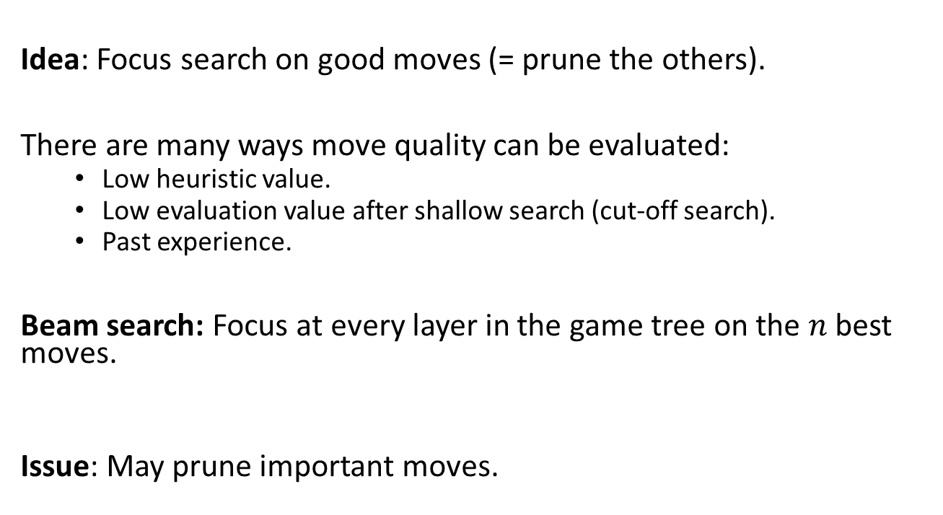
Option B: Heuristic Forward Pruning
Idea: Focus search on good moves (= prune the others).
There are many ways move quality can be evaluated:
Low heuristic value.
Low evaluation value after shallow search (cut-off search).
Past experience.
Beam search: Focus at every layer in the game tree on the $n$ best moves.
Issue: May prune important moves.

Slide 34
Heuristic Alpha-Beta Tree Search: Example for Forward Pruning
x … prune low HMV actions
x
x
x
x
x
x
HMV
HMV
HMV
HMV
HMV
HMV
HMV
HMV
HMV
Continue alpha-beta search on these.
Eval
Eval
Eval
Perform Cut-off search.
Choose the n best actions using the heuristic minimax value and prune the rest.
Explore the chosen actions using heuristic Alpha-Beta Tree search.
Cut search off at depth =2

Slide 35

Monte Carlo Tree Search (MCTS)

Slide 36
Methods for Adversarial Games
Exact Methods
Model as nondeterministic actions: The opponent is seen as part of an environment with nondeterministic actions. Non-determinism is the result of the unknown moves by the opponent. We consider all possible moves by the opponent.
Find optimal decisions: Minimax search and Alpha-Beta pruning where each player plays optimally to the end of the game.
Heuristic Methods (game tree is too large or search takes too long)
Heuristic Alpha-Beta Tree Search:
Cut off game tree and use heuristic for utility.
Forward Pruning: ignore poor moves.
Monte Carlo Tree search: Estimate utility of a state by simulating complete games and average the utility.

Slide 37
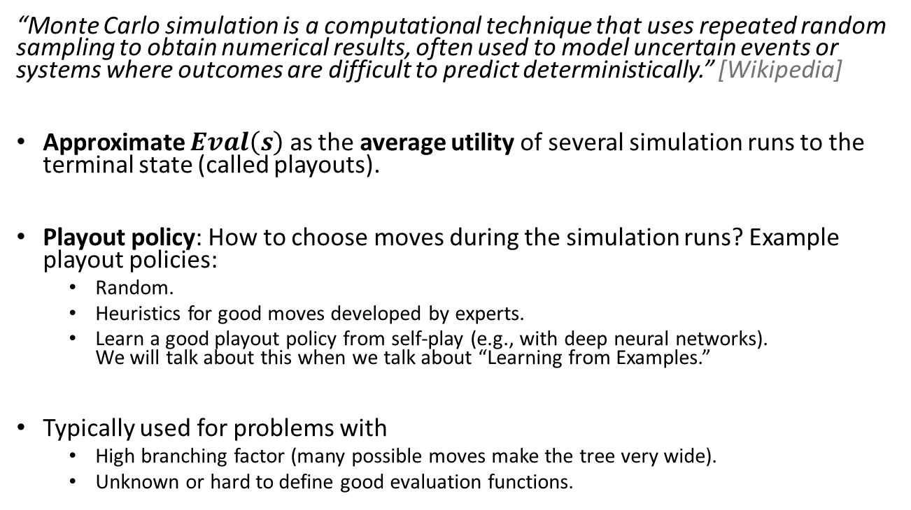
Idea of Monte Carlo Search
“Monte Carlo simulation is a computational technique that uses repeated random sampling to obtain numerical results, often used to model uncertain events or systems where outcomes are difficult to predict deterministically.” [Wikipedia]
Approximate $Eval\left(s\right)$ as the average utility of several simulation runs to the terminal state (called playouts).
Playout policy: How to choose moves during the simulation runs? Example playout policies:
Random.
Heuristics for good moves developed by experts.
Learn a good playout policy from self-play (e.g., with deep neural networks). We will talk about this when we talk about “Learning from Examples.”
Typically used for problems with
High branching factor (many possible moves make the tree very wide).
Unknown or hard to define good evaluation functions.

Slide 38
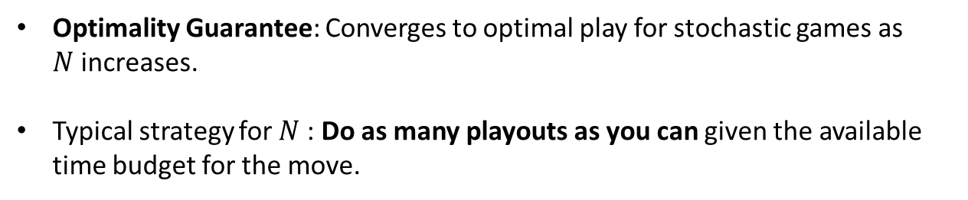
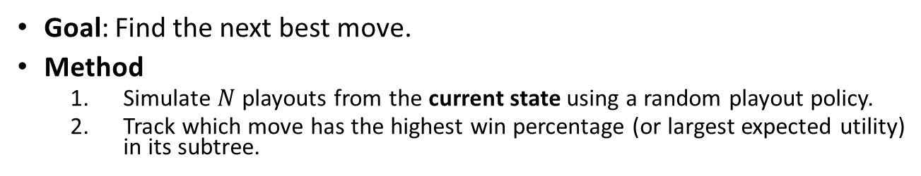
Pure Monte Carlo Search
Goal: Find the next best move.
Method
Simulate $N$ playouts from the current state using a random playout policy.
Track which move has the highest win percentage (or largest expected utility) in its subtree.
Start playouts
0.61
Estimate win probability
#wins/playouts
0.54
0.50
0.62
0.57
0.78
0.52
0.38
0.65
0.14
Optimality Guarantee: Converges to optimal play for stochastic games as $N$increases.
Typical strategy for $N$: Do as many playouts as you can given the available time budget for the move.

Slide 39
Playout Selection Strategy
For the empty board, Max can start a playout at any of these states. Which one should it choose?
Issue: Pure Monte Carlo Search with a random playout policy spends a lot of time to create playouts for bad move.
Better: Select the starting state for playouts to focus on important parts of the game tree (i.e., good moves).
This presents the following tradeoff:
Exploration: perform more playouts from states that currently have no or few playouts.
Exploitation: more playouts for states that have done well to get more accurate estimates.

Slide 40
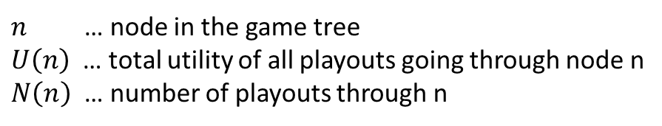
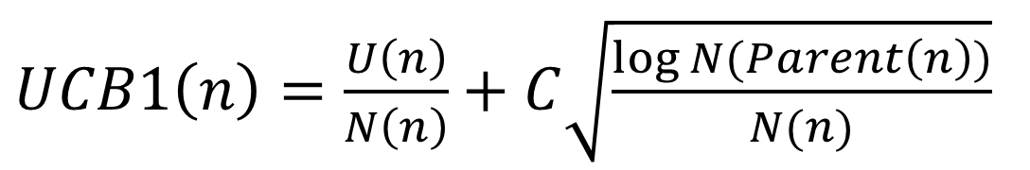
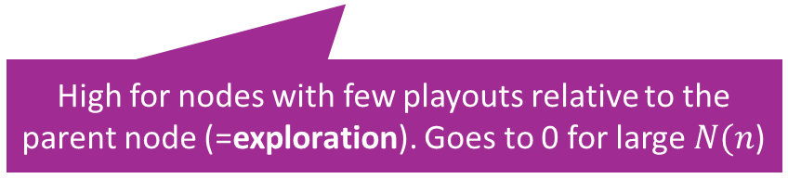
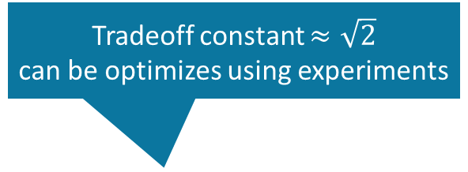
Selection using Upper Confidence Bounds (UCB1)
Tradeoff constant $≈\sqrt{2}$ can be optimizes using experiments
$UCB1\left(n\right)=\frac{U\left(n\right)}{N\left(n\right)}+C\sqrt{\frac{\log{N(Parent\left(n\right))}}{N(n)}}$
Average utility (=exploitation)
High for nodes with few playouts relative to the parent node (=exploration). Goes to 0 for large $N(n$)
$n$ … node in the game tree
$U\left(n\right)$ … total utility of all playouts going through node n
$N\left(n\right)$ … number of playouts through n
Selection strategy: Select node with highest UCB1 score.

Slide 41
Monte Carlo Tree Search (MCTS)
Pure Monte Carlo search always start playouts from a given state (or its children).
Monte Carlo Tree Search builds a partial game tree and can start playouts from any state (node) in that tree.
Important considerations:
We can use UCB1 as the selection strategy to decide what part of the tree we should focus on for the next playout. This balances exploration and exploitation.
We typically can only store a small part of the game tree, so we do not store the complete playout runs.

Slide 42
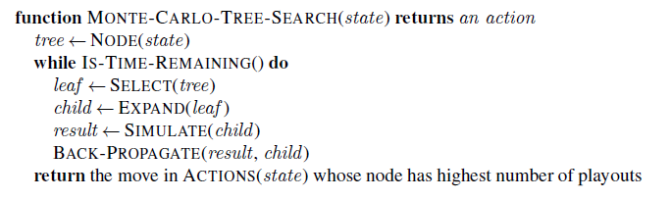
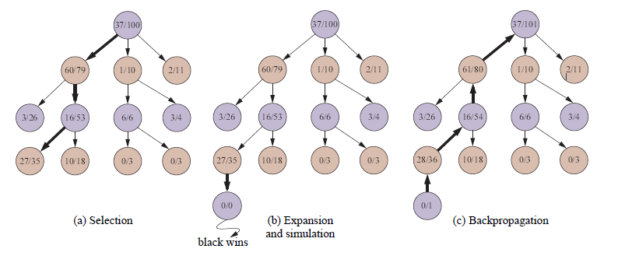
Monte-Carlo-Tree-Search Algorithm
Highest UCB1 score
UCB1 selection favors win percentage more and more.
White
Wins/Playouts
Black
First few levels
White
Black
White
(update counts)
Select leaf with highest UCB1 score
Expand and Simulate: the simulation path is not recorded to preserve memory!

Slide 43
Online Play Using MCTS
Search and update a partial tree to use up the time budget for the move.
Keep the relevant subtree from move to move and expand from there.
Do highest playout move
Keep subtree and explore/exploit.
White
Wins/Playouts
Black
After move
White
Black
White

Slide 44

Stochastic Games
Games With Random Events

Slide 45
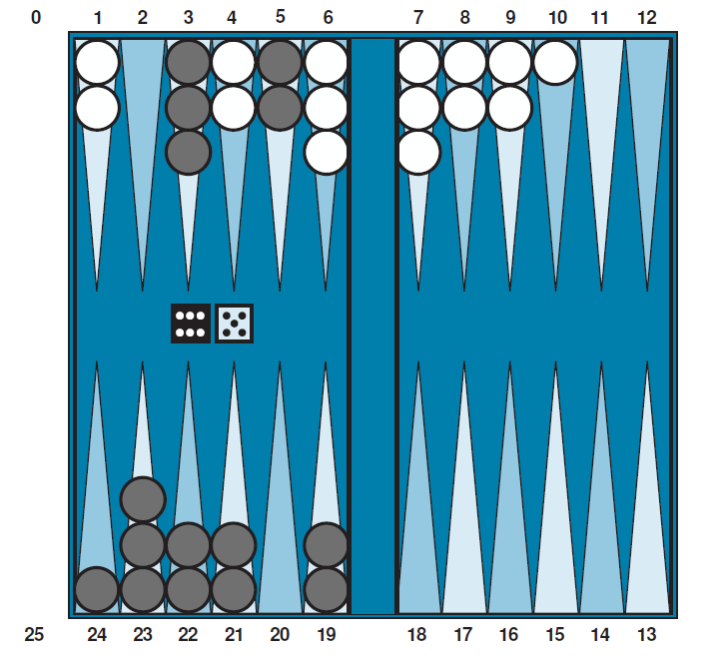
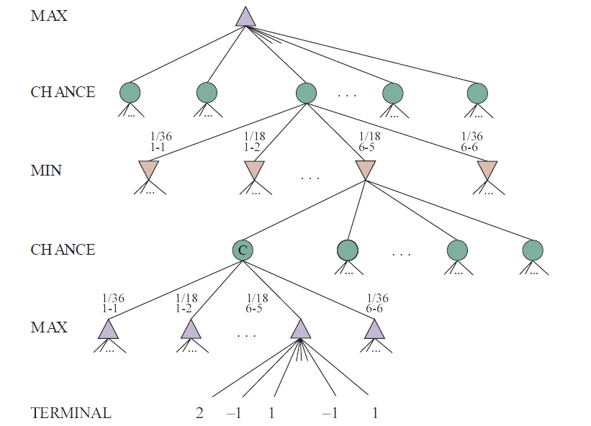
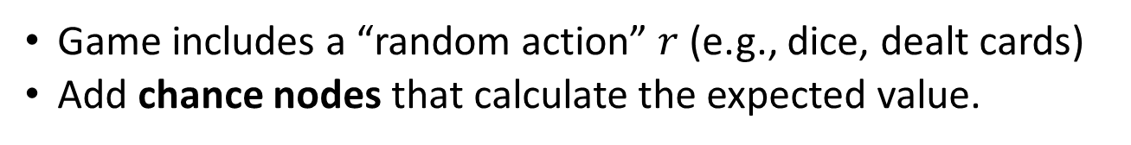
Stochastic Games
Game includes a “random action” $r$ (e.g., dice, dealt cards)
Add chance nodes that calculate the expected value.
Backgammon

Slide 46
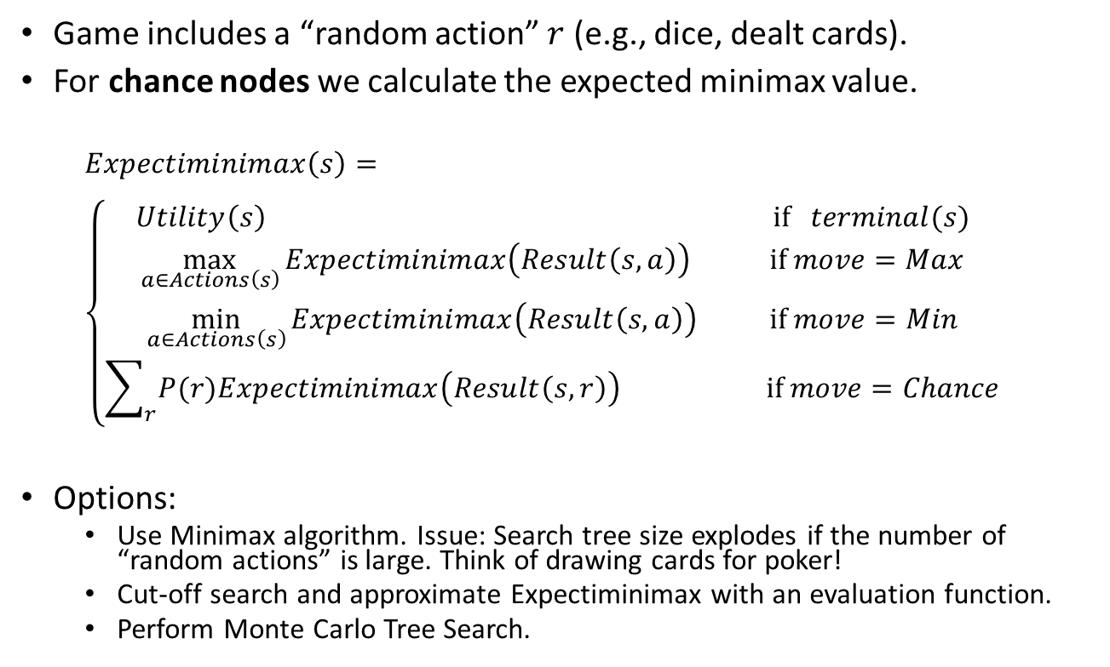
Expectiminimax
Game includes a “random action” $r$ (e.g., dice, dealt cards).
For chance nodes we calculate the expected minimax value.
$$Expectiminimax\left(s\right)= \\ \left\{\begin{aligned}Utility\left(s\right) \text{if} terminal(s) \\ \max_{a∈Actions\left(s\right)}{Expectiminimax\left(Result\left(s,a\right)\right)}{} \text{if} move=Max \\ \min_{a∈Actions\left(s\right)}{Expectiminimax\left(Result\left(s,a\right)\right) } \text{if} move=Min \\ \sum_{r}{P(r)Expectiminimax\left(Result\left(s,r\right)\right) } \text{if} move=Chance\end{aligned}\right.$$
Options:
Use Minimax algorithm. Issue: Search tree size explodes if the number of “random actions” is large. Think of drawing cards for poker!
Cut-off search and approximate Expectiminimax with an evaluation function.
Perform Monte Carlo Tree Search.

Slide 47
Conclusion
Nondeterministic actions:
The opponent is seen as part of an environment with nondeterministic actions. Non-determinism is the result of the unknown moves by the opponent. All possible moves are considered.
Optimal decisions:
Minimax search and Alpha-Beta pruning where each player plays optimal to the end of the game.
Choice nodes and Expectiminimax for stochastic games.
Heuristic Alpha-Beta Tree Search:
Cut off game tree and use heuristic evaluation function for utility (based on state features).
Forward Pruning: ignore poor moves.
Learn heuristic from data using MCTS
Monte Carlo Tree search:
Simulate complete games and calculate proportion of wins.
Use modified UCB1 scores to expand the partial game tree.
Learn playout policy using self-play and deep learning.
Scale only for tiny problems!
State of the Art

