Slide 1
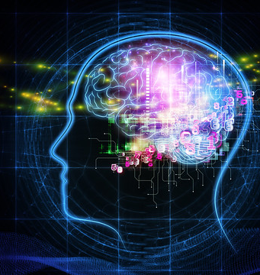


CS 5/7320 Artificial Intelligence Knowledge-Based Agents AIMA Chapters 7-9
Slides by Michael Hahsler
based on slides by Svetlana Lazepnik with figures from the AIMA textbook
This work is licensed under a Creative Commons Attribution-ShareAlike 4.0 International License.
Image: "Exercise Plays Vital Role Maintaining Brain Health" by A Health Blog
Online Material

Slide 2
Outline
Knowledge-Based Agents
Logical Agents
Large Language Models
Probabilistic Reasoning Agents

Slide 3
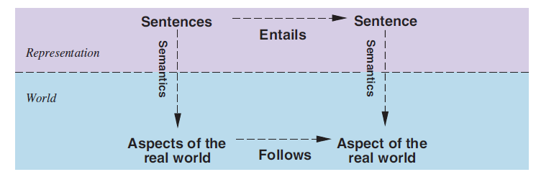
Reality vs. Knowledge Representation
Facts
Knowledge
Learning
Facts: Sentences we know to be true.
Possible worlds: all worlds/models which are consistent with the facts we know (compare with belief state).
Learning new facts reduces the number of possible worlds.
Entailment: A new sentence logically follows from what we already know.

Slide 4
Knowledge-Based Agents
Knowledge base
Domain-specific content
Inference engine
Domain-independent algorithms that find new sentences using entailment.
Knowledge base (KB) = set of facts. E.g., set of sentences in a formal language that are known to be true.
Declarative approach to building an agent: Define what it needs to know in its KB.
Separation between data (knowledge) and program (inference).
Actions are based on knowledge (sentences + inferred sentences) + an objective function. E.g., the agent knows the effects of 5 possible actions and chooses the action with the largest utility.

Slide 5
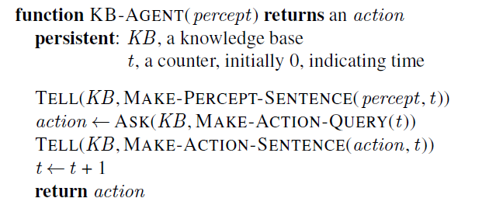
Generic Knowledge-based Agent
KB
Inference engine
Learning from precepts
action
Prior knowledge
Memorize percept at time t
Ask for logical action given an objective
Record action taken at time t

Slide 6
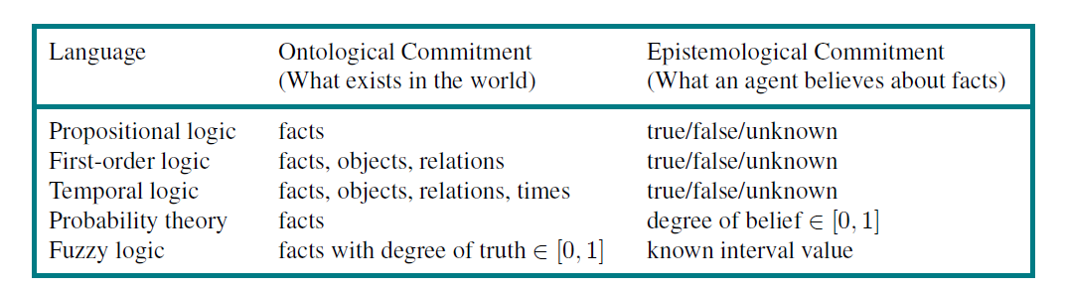
Different Languages to Represent Knowledge
+
Natural Language word patterns representing facts, objects, relations, … ???

Slide 7
Outline
Knowledge-Based Agents
Logical Agents
Large Language Models
Probabilistic Reasoning Agents

Slide 8
Logical Agents
Facts are logical sentences that are known to be true.
Inference: Generate new sentences that are entailed by all known sentences.
Implementation: Typically using Prolog
Declarative logic programing language.
Runs queries over the program (= the knowledge base)
Synonyms: Symbolic AI, Expert Systems
Issues:
Inference is computationally very expensive.
Logic cannot deal with uncertainty.

Slide 9
Outline
Knowledge-Based Agents
Logical Agents
Large Language Models
Probabilistic Reasoning Agents

Slide 10
Probabilistic Reasoning
Replaces true/false with a probability.
This is the basis for
Probabilistic reasoning under uncertainty
Decision theory
Machine Learning
We will talk about these topics a lot more

Slide 11
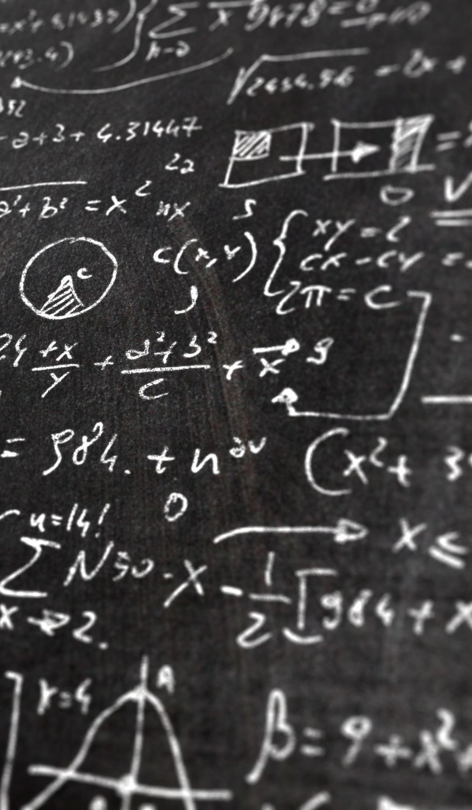
Conclusion
The clear separation between knowledge and inference engine is very useful.
Pure logic is often not flexible enough. The fullest realization of knowledge-based agents using logic was in the field of expert systems or knowledge-based systems in the 1970s and 1980s.
Pretrained Large Language Models are an interesting new application of knowledge-based agents based on natural language.
In one of the following chapters, we will talk about probability theory, the standard language to reason under uncertainty, and forms the basis of machine learning.

Slide 12
Outline
Knowledge-Based Agents
Logical Agents
Large Language Models
Probabilistic Reasoning Agents

Slide 13
LLMs - Large Language Models
+
Natural Language word patterns representing facts, objects, relations, … ???
Store knowledge as parameters in a deep neural networks.

Slide 14
Using Natural Language for Knowledge Representation
Pretrained model knows words relationship, grammar, and facts stored as parameters in a network.
KB
Generates
Text
Prompts
Useful?
The user formulates a question about the real world as a natural language prompt (a sequence of tokens).
The LLM generates text using a model representing its knowledge base.
The text (hopefully) is useful in the real world. The objective function is not clear. Maybe it is implied in the prompt?

Slide 15
LLM as a Knowledge-Based Agents
Learned word relationships, grammar, facts.
pretrained
Knowledge base
Domain-independent content (pre-training)
+
Domain-specific content (fine tuning)
Text Generator
Domain-independent algorithms
Current text generators are:
Pretrained decoder-only transformer models (e.g., GPT stands for Generative Pre-trained Transformer). The knowledge base is not updated during interactions.
Tokens are created autoregressively. One token is generated at a time based on all the previous tokens using the transformer attention mechanism.

Slide 16
LLM as a Generic Knowledge-based Agent
Prompt + already generated tokens
Next token
A chatbot repeatedly calls the agent function till the agent function returns the ‘end’ token.

Slide 17

Many Open Questions about LLMs
Correlation is not causation: Can LLMs reason to solve problems?
Generative stochasticity leads to hallucinations: LLM makes up facts.
Autoregression is an exponentially diverging diffusion process.
The training data contains biases, nonsense and harmful content.
Security: LLM can reveal sensitive information it was trained on.
Rights-laundering: Copyrighted or licensed material can be in the training data.
Leaky data makes it hard to evaluate true reasoning performance.
Reading: [2307.04821] Amplifying Limitations, Harms and Risks of Large Language Models (arxiv.org)

Slide 18

Appendix: Logic
Details on Propositional and First-Order Logic

Slide 19
Logic to Represent Knowledge
Logic is a formal system for representing and manipulating facts (i.e., knowledge) so that true conclusions may be drawn
Syntax: rules for constructing valid sentences
E.g., x + 2 ≥ y is a valid arithmetic sentence, ≥x2y + is not
Semantics: “meaning” of sentences, or relationship between logical sentences and the real world
Specifically, semantics defines truth of sentences
E.g., x + 2 ≥ y is true in a world where x = 5 and y = 7

Slide 20
Propositional Logic

Slide 21
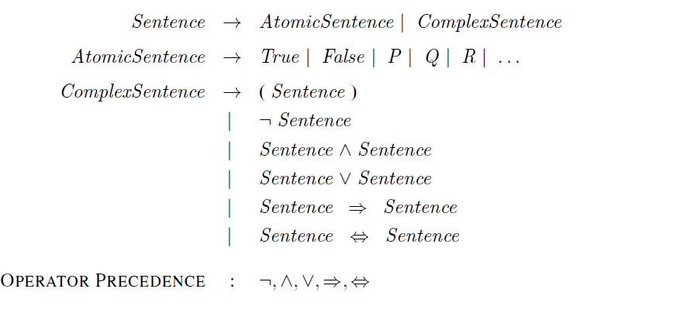
Propositional Logic: Syntax in Backus-Naur Form
= Symbols
Negation
Conjunction
Disjunction
Implication
Biconditional

Slide 22
Validity and Satisfiability
A sentence is valid if it is true in all models/worlds
e.g., True, A ∨¬A, A ⇒ A, (A ∧ (A ⇒ B)) ⇒ B are called tautologies and are useful to deduct new sentences.
A sentence is satisfiable if it is true in some model
e.g., A∨B, C useful to find new facts that satisfy all current possible worlds.
A sentence is unsatisfiable if it is true in no models
e.g., A∧¬A

Slide 23
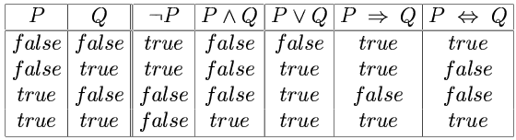
Possible Worlds, Models and Truth Tables
A model specifies a “possible world” with the true/false status of each proposition symbol in the knowledge base
E.g., P is true and Q is true
With two symbols, there are $2^{2}=4$ possible worlds/models, and they can be enumerated exhaustively using:
With two symbols, there are 2^2=4 possible worlds/models, and they can be enumerated exhaustively using:
A truth table specifies the truth value of a composite sentence for each possible assignments of truth values to its atoms. Each row is a model.
We have 3 possible worlds for $P⇒Q=true$

Slide 24
Propositional Logic: Semantics
Rules for evaluating truth with respect to a model:
¬P is true iff P is false
P ∧ Q is true iff P is true and Q is true
P ∨ Q is true iff P is true or Q is true
P ⇒ Q is true iff P is false or Q is true
Sentence
Model

Slide 25
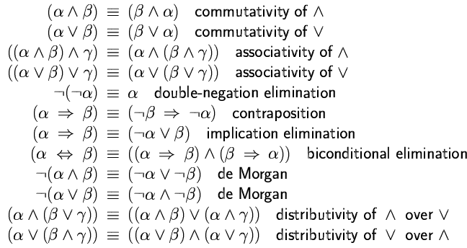
Logical Equivalence
Two sentences are logically equivalent iff (read if, and only if) they are true in same models

Slide 26
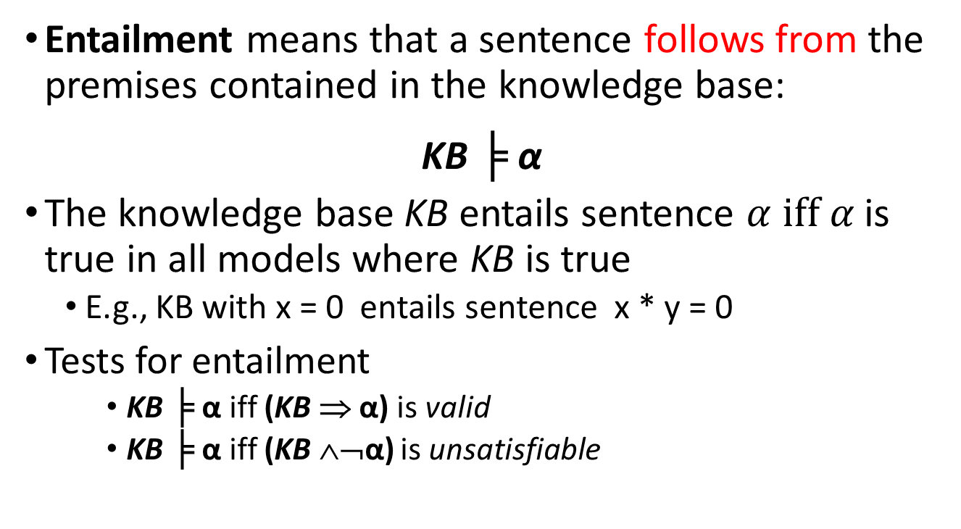
Entailment
Entailment means that a sentence follows from the premises contained in the knowledge base:
KB ╞ α
The knowledge base KB entails sentence $α \text{iff} α$is true in all models where KB is true
E.g., KB with x = 0 entails sentence x * y = 0
Tests for entailment
KB ╞ α iff (KB ⇒ α) is valid
KB ╞ α iff (KB ∧¬α) is unsatisfiable
Notes:
If a╞ b, a is a stronger assertion than b (a rules out more possible worlds)

Slide 27
Inference
Logical inference: a procedure for generating sentences that follow from (ar entailed by) a knowledge base KB.
An inference procedure is sound if it derives a sentence α iff KB╞ α. I.e, it only derives true sentences.
An inference procedure is complete if it can derive all α for which KB╞ α.

Slide 28
Inference
How can we check whether a sentence α is entailed by KB?
How about we enumerate all possible models of the KB (truth assignments of all its symbols), and check that α is true in every model in which KB is true?
This is sound: All produced answer are correct.
This is complete: It will produce all correct answers.
Problem: if KB contains n symbols, the truth table will be of size 2^{n}
Better idea: use inference rules, or sound procedures to generate new sentences or conclusions given the premises in the KB.
Look at the textbook for inference rules and resolution.

Slide 29

Inference Rules
Modus Ponens
This means: If the KB contains the sentences $α⇒β$ and $α$ then $β$ is true.
And-elimination
premises
conclusion

Slide 30
Inference Rules
And-introduction
Or-introduction

Slide 31
Inference Rules
Double negative elimination
Unit resolution

Slide 32
Resolution
or
Example:
α: “The weather is dry”
β: “The weather is rainy”
γ: “I carry an umbrella”

Slide 33
Resolution is Complete
To prove KB╞ α, assume KB ∧ ¬ α and derive a contradiction
Rewrite KB ∧ ¬ α as a conjunction of clauses, or disjunctions of literals
Conjunctive normal form (CNF)
Keep applying resolution to clauses that contain complementary literals and adding resulting clauses to the list
If there are no new clauses to be added, then KB does not entail α
If two clauses resolve to form an empty clause, we have a contradiction and KB╞ α

Slide 34
Complexity of Inference
Propositional inference is co-NP-complete
Complement of the SAT problem: α ╞ β if and only if the sentence α ∧ ¬ β is unsatisfiable
Every known inference algorithm has worst-case exponential run time complexity.
Efficient inference is only possible for restricted cases
e.g., Horn clauses are disjunctions of literals with at most one positive literal.
Notes:
Co-NP: class of problems for which the “no” answer is easy to check, e.g., “Is this formula unsatisfiable?”

Slide 35
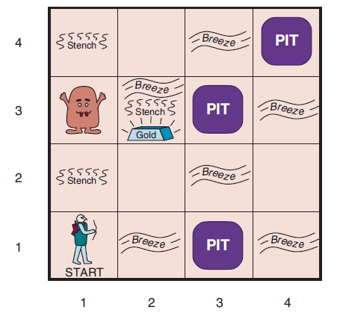
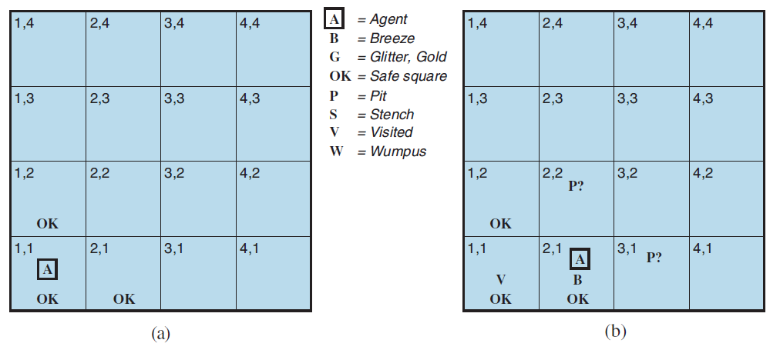
Example: Wumpus World

Slide 36
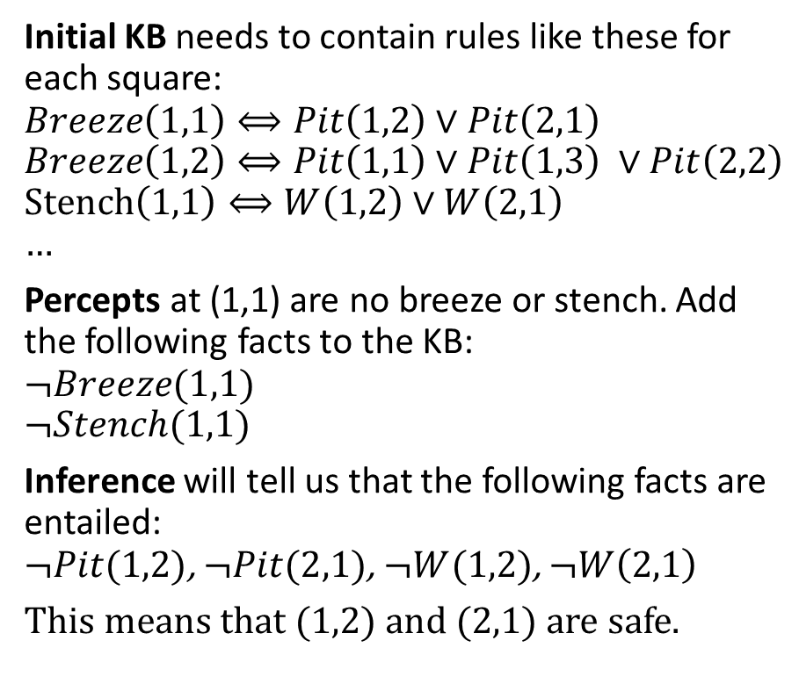
Example: Wumpus World
Initial KB needs to contain rules like these for each square:
$$Breeze\left(1,1\right)⟺Pit\left(1,2\right)∨Pit\left(2,1\right)$$
$$Breeze\left(1,2\right)⟺Pit\left(1,1\right)∨Pit\left(1,3\right) ∨Pit\left(2,2\right)$$
$$Stench\left(1,1\right)⟺W\left(1,2\right)∨W\left(2,1\right) \\ …$$
Percepts at (1,1) are no breeze or stench. Add the following facts to the KB:
$$¬Breeze(1,1)$$
$$¬Stench(1,1)$$
Inference will tell us that the following facts are entailed: $¬Pit(1,2)$, $¬Pit(2,1)$, $¬W(1,2)$, $¬W\left(2,1\right)$
This means that (1,2) and (2,1) are safe.
We have to enumerate all possible scenarios in propositional logic! First-order logic can help.

Slide 37
Summary
Logical agents apply inference to a knowledge base to derive new information and make decisions. Basic concepts of logic:
syntax: formal structure of sentences semantics: truth of sentences in models entailment: necessary truth of one sentence given another inference: deriving sentences from other sentences soundness: derivations produce only entailed sentences completeness: derivations can produce all entailed sentences
Resolution is complete for propositional logic.
Algorithms use forward, backward chaining, are linear in time, and complete for special clauses (definite clauses).

Slide 38
Limitations of Propositional Logic
Suppose you want to say “All humans are mortal”
In propositional logic, you would need ~6.7 billion statements of the form: Michael_Is_Human and Michael_Is_Mortal,
Sarah_Is_Human and Sarah_Is_Mortal, …
Suppose you want to say “Some people can run a marathon”
You would need a disjunction of ~6.7 billion statements:
Michael_Can_Run_A_Marathon or … or Sarah_Can_Run_A_Marathon

Slide 39
First-Order Logic
First-order Logic adds objects and relations to the facts of propositional logic.
This addresses the issues of propositional logic, which needs to store a fact for each instance of and object individually.

Slide 40
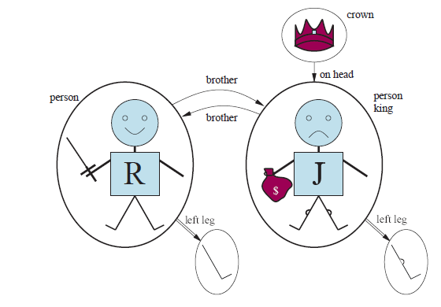
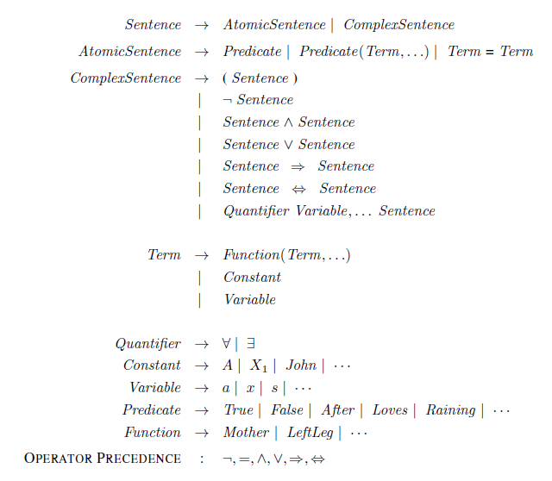
Syntax of FOL
Objects
Relations. Predicate is/returns True or False
Function returns an object

Slide 41
Universal Quantification
∀x P(x)
Example: “Everyone at SMU is smart”
∀x At(x,SMU) ⇒ Smart(x)
Why not ∀x At(x,SMU) ∧ Smart(x)?
Roughly speaking, equivalent to the conjunction of all possible instantiations of the variable:
[At(John, SMU) ⇒ Smart(John)] ∧ ...
[At(Richard, SMU) ⇒ Smart(Richard)] ∧ ...
∀x P(x) is true in a model m iff P(x) is true with x being each possible object in the model

Slide 42
Existential Quantification
∃x P(x)
Example: “Someone at SMU is smart”
∃x At(x,SMU) ∧ Smart(x)
Why not ∃x At(x,SMU) ⇒ Smart(x)?
Roughly speaking, equivalent to the disjunction of all possible instantiations:
[At(John,SMU) ∧ Smart(John)] ∨
[At(Richard,SMU) ∧ Smart(Richard)] ∨ …
∃x P(x) is true in a model m iff P(x) is true with x being some possible object in the model

Slide 43
Properties of Quantifiers
∀x ∀y is the same as ∀y ∀x
∃x ∃y is the same as ∃y ∃x
∃x ∀y is not the same as ∀y ∃x
∃x ∀y Loves(x,y)
“There is a person who loves everyone”
∀y ∃x Loves(x,y)
“Everyone is loved by at least one person”
Quantifier duality: each quantifier can be expressed using the other with the help of negation
∀x Likes(x,IceCream) ¬∃x ¬Likes(x,IceCream)
∃x Likes(x,Broccoli) ¬∀x ¬Likes(x,Broccoli)

Slide 44
Equality
Term₁ = Term₂ is true under a given model if and only if Term₁ and Term₂ refer to the same object
E.g., definition of Sibling in terms of Parent:
∀x,y Sibling(x,y) ⇔ [¬(x = y) ∧ ∃m,f ¬ (m = f) ∧ Parent(m,x) ∧ Parent(f,x) ∧ Parent(m,y) ∧ Parent(f,y)]

Slide 45
Example: The Kinship Domain
Brothers are siblings
∀x,y Brother(x,y) ⇒ Sibling(x,y)
“Sibling” is symmetric
∀x,y Sibling(x,y) ⇔ Sibling(y,x)
One's mother is one's female parent
∀m,c (Mother(c) = m) ⇔ (Female(m) ∧ Parent(m,c))

Slide 46
Example: The Set Domain
∀s Set(s) ⇔ (s = {}) ∨ (∃x,s₂ Set(s₂) ∧ s = {x|s₂})
¬∃x,s {x|s} = {}
∀x,s x ∈ s ⇔ s = {x|s}
∀x,s x ∈ s ⇔ [ ∃y,s₂ (s = {y|s₂} ∧ (x = y ∨ x ∈ s₂))]
∀s₁,s₂ s₁ ⊆ s₂ ⇔ (∀x x ∈ s₁ ⇒ x ∈ s₂)
∀s₁,s₂ (s₁ = s₂) ⇔ (s₁ ⊆ s₂ ∧ s₂ ⊆ s₁)
∀x,s₁,s₂ x ∈ (s₁ ∩ s₂) ⇔ (x ∈ s₁ ∧ x ∈ s₂)
∀x,s₁,s₂ x ∈ (s₁ ∪ s₂) ⇔ (x ∈ s₁ ∨ x ∈ s₂)

Slide 47
Inference in FOL
Inference in FOL is complicated!
Reduction to propositional logic and then use propositional logic inference.
Directly do inference on FOL (or a subset like definite clauses)
Unification: Combine two sentences into one.
Forward Chaining for FOL
Backward Chaining for FOL
Logical programming (e.g., Prolog)

