Slide 1
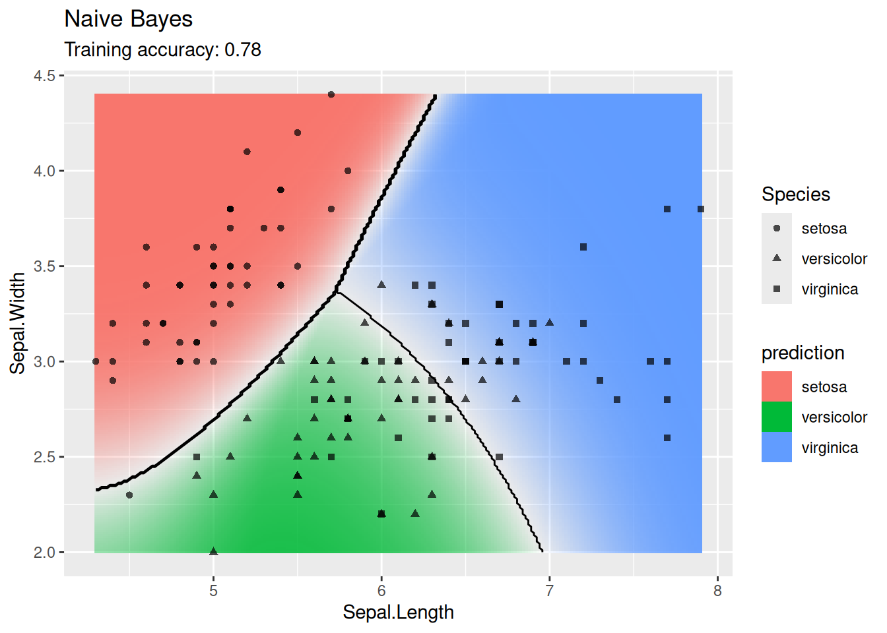
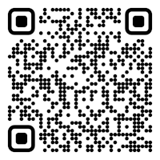

CS 5/7320 Artificial Intelligence Learning from Examples: Machine Learning AIMA Chapter 19 Slides by Michael Hahsler Based on slides by Dan Klein, Pieter Abbeel, Sergey Levine, and A. Farhadi (http://ai.berkeley.edu) with figures from the AIMA textbook.
This work is licensed under a Creative Commons Attribution-ShareAlike 4.0 International License.
Online Material
Notes:
Please retain proper attribution, including the reference to ai.berkeley.edu. Thanks!

Slide 2
Topics
Supervised Learning
Data
Training & Testing
Types of supervised ML Models
Use in AI
ML & Agents

Slide 3
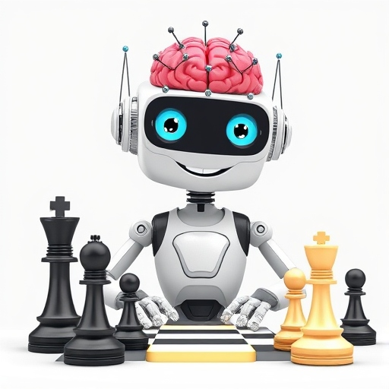
ML and Agents
DeepAi.org with prompt: “A happy cartoon robot with an artificial neural network for a brain on white background learning to play chess”

Slide 4
Learning from Examples: Machine Learning
Up until now in this course:
Hand-craft algorithms to make rational/optimal or at least good decisions. Examples: Search strategies, heuristics.
Issues
Designer cannot anticipate all possible future situations.
Designer may have examples but does not know how to program a solution.
Machine Learning
Learning = Improving performance after making observations about the world. That is, learn what works and what does not.
We learn a model that decides on the actions to take. This is called the “performance element.”
The goal is to get closer to optimal decisions. I.e., it is an optimization problem.

Slide 5
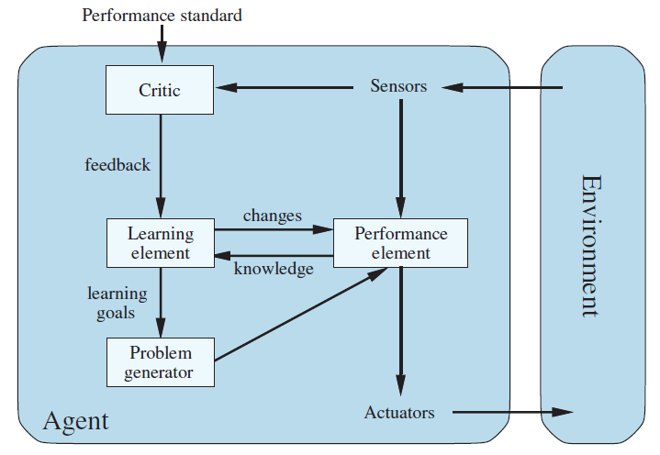
From Chapter 2: Agents that Learn
The learning element modifies the performance element to improve its performance.
Critic: How is the agent currently performing?
Learning Element: Update the performance element and changes how it selects actions.
E.g., adding rules, changing weights
Problem generators: Explore actions that lead to better information

Slide 6
Considerations for Using Machine Learning in Agents
What component of the performance element is learned? E.g., how to select an action, estimate the utility of a state, …
What representation (model) is used in the component? Linear regression, rules, trees, neural nets,…
What feedback is available for learning?
Unsupervised Learning: No feedback, just organize data (e.g., clustering, embedding)
Supervised Learning: Uses a dataset with correct answers. Learn a function (model) to map an input (e.g., state) to an output (e.g., action or utility). Examples:
Use a naïve Bayesian classifier to distinguish between spam/non-spam
Learn a playout policy to simulate games (current board -> good move)
Reinforcement Learning: Learn from rewards/punishment (e.g., winning a game) obtained via interaction with the environment over time.
We focus on supervised learning

Slide 7

Supervised Learning
1+1=2

Slide 8



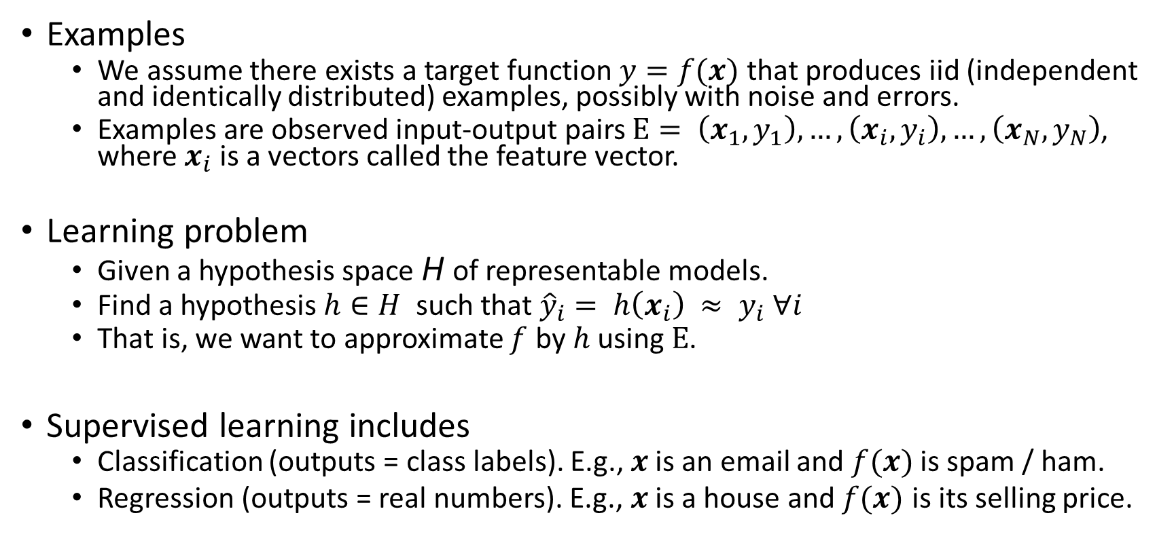
Supervised Learning As Function Approximation
Examples
We assume there exists a target function $y=f(x)$ that produces iid (independent and identically distributed) examples, possibly with noise and errors.
Examples are observed input-output pairs $E= \left(x_{1},y_{1}\right),…, \left(x_{i}, y_{i}\right),…,\left(x_{N},y_{N}\right)$, where $x_{i}$ is a vectors called the feature vector.
Learning problem
Given a hypothesis space H of representable models.
Find a hypothesis $h∈H$ such that ${\hat{y}}_{i}= h\left(x_{i}\right) ≈ y_{i} ∀i$
That is, we want to approximate $f$ by $h$ using $E$.
Supervised learning includes
Classification (outputs = class labels). E.g., $x$ is an email and $f(x)$ is spam / ham.
Regression (outputs = real numbers). E.g., $x$ is a house and $f(x)$ is its selling price.
$$f$$
Set of all functions

Slide 9
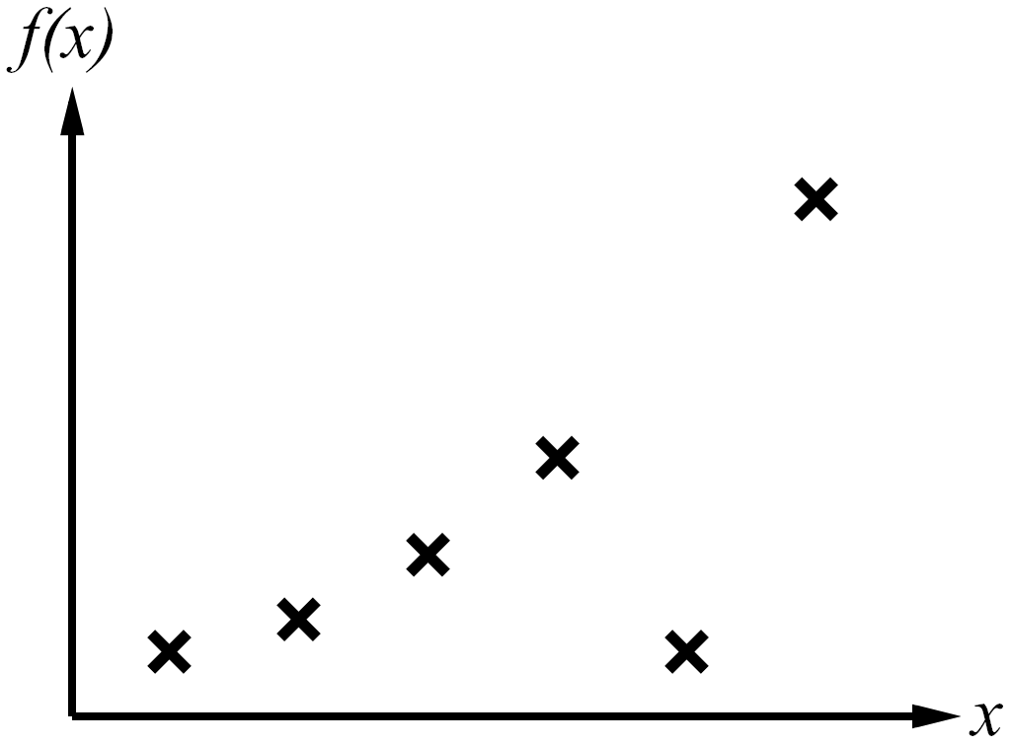
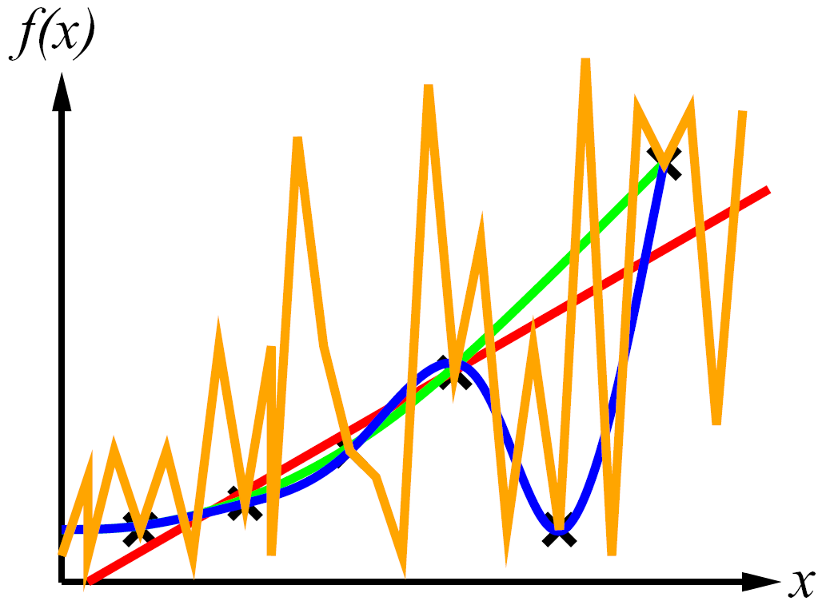
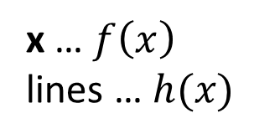
Consistency vs. Simplicity
Example: Univariate curve fitting (regression, function approximation)
y
Examples
y
Learned Models
x … $f\left(x\right)$
lines … $h(x)$
Very simple, but not very consistent with the data!
Consistency: $h\left(x_{i}\right)≈ y_{i}$ (minimize the error)
Simplicity: small number of model parameters

Slide 10
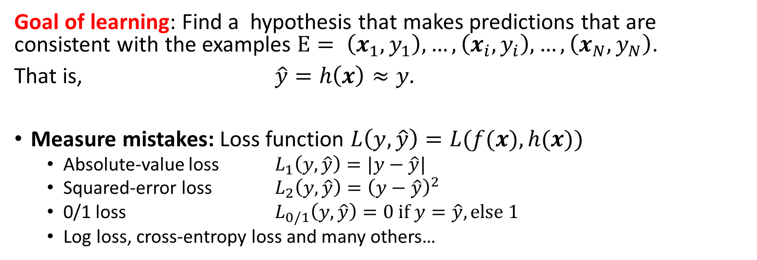


Measuring Consistency using Loss
Goal of learning: Find a hypothesis that makes predictions that are consistent with the examples $E= \left(x_{1},y_{1}\right),…, \left(x_{i}, y_{i}\right),…,\left(x_{N},y_{N}\right)$.
That is, $\hat{y}=h\left(x\right)≈y.$
Measure mistakes: Loss function $L\left(y, \hat{y}\right)=L(f(x), h(x))$
Absolute-value loss $L_{1}\left(y, \hat{y}\right)=|y−\hat{y}|$
Squared-error loss $L_{2}\left(y, \hat{y}\right)={\left(y−\hat{y}\right)}^{2}$
0/1 loss $L_{0/1}\left(y, \hat{y}\right)=0 if y=\hat{y}, else 1$
Log loss, cross-entropy loss and many others…
For Regression
For Classification
Loss
$$f$$
$$h^{∗}$$

Slide 11
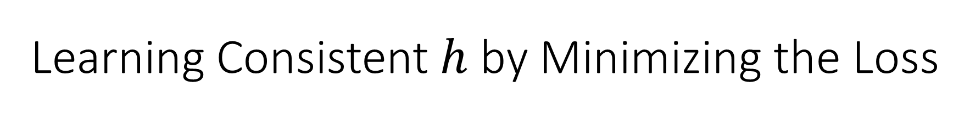
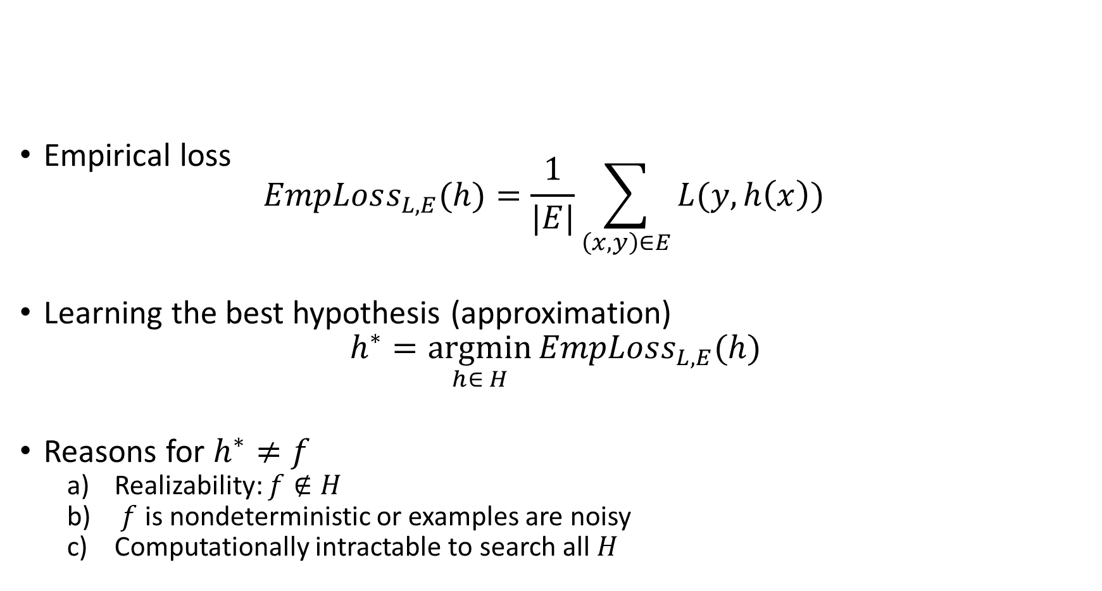
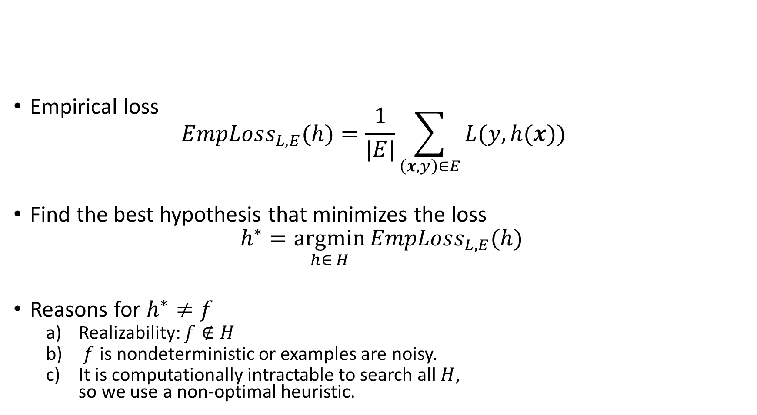
Learning Consistent $h$ by Minimizing the Loss
Empirical loss $EmpLoss_{L,E}(h)=\frac{1}{|E|}\sum_{\left(x,y\right)∈E}{L(y, h(x))}$
Find the best hypothesis that minimizes the loss
$$h^{∗}=\underset{h∈ H}{argmin}{EmpLoss_{L,E}(h)}$$
Reasons for $h^{∗}≠f$
Realizability: $f∉H$
$f$ is nondeterministic or examples are noisy.
It is computationally intractable to search all $H$, so we use a non-optimal heuristic.
Loss
$$f$$
$$h^{∗}$$

Slide 12
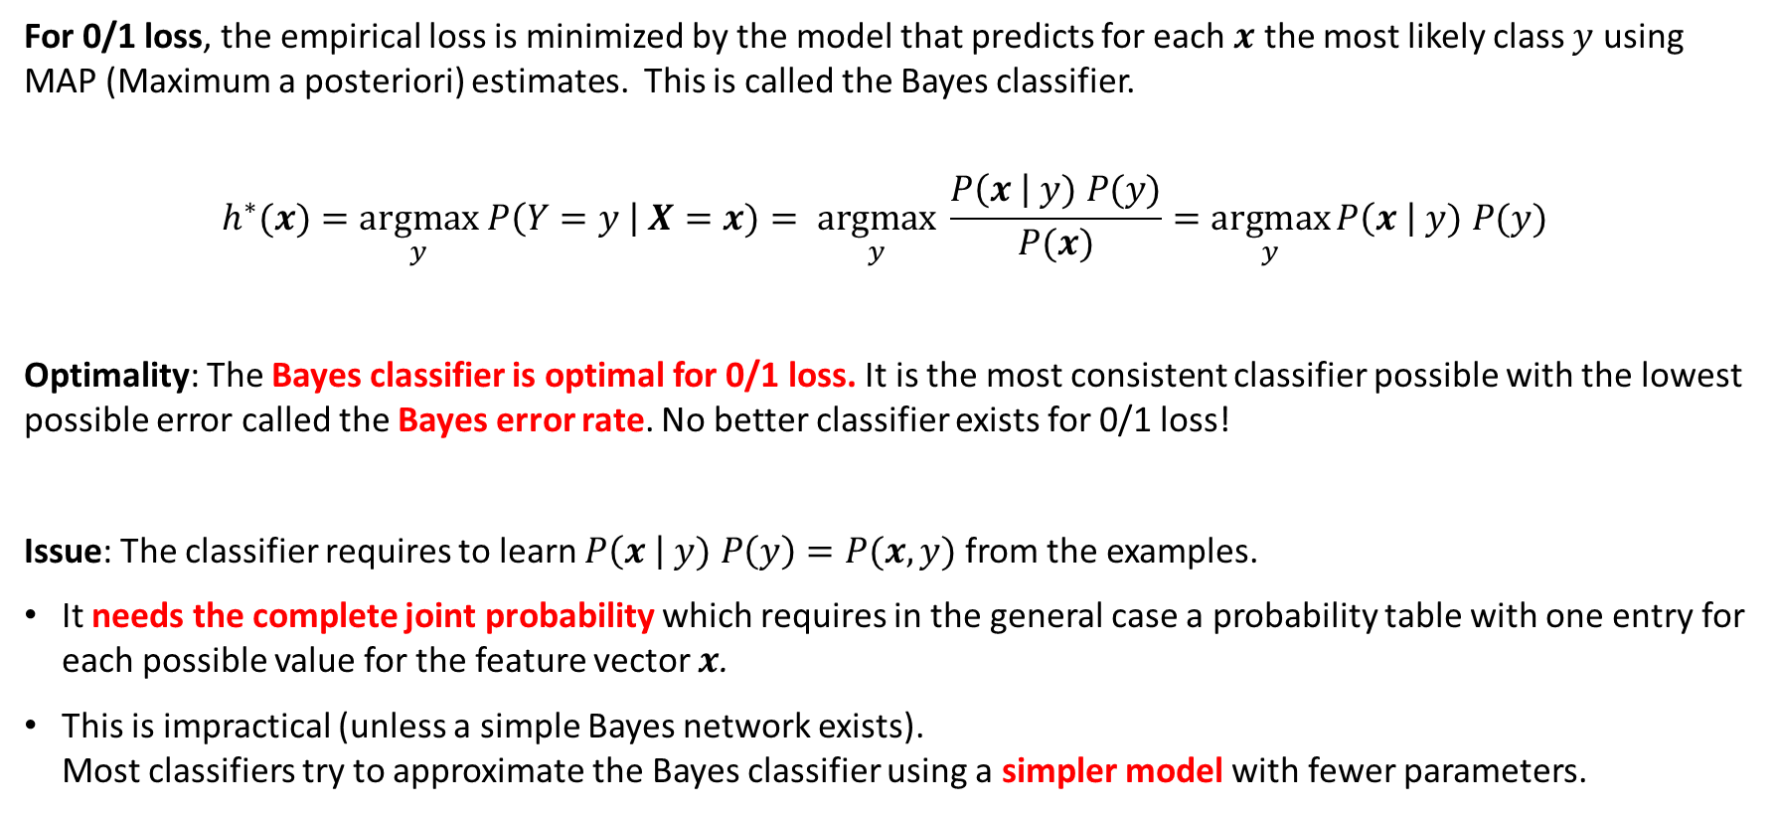
The Most Consistent Classifier The Bayes Classifier
For 0/1 loss, the empirical loss is minimized by the model that predicts for each $x$ the most likely class $y$ using MAP (Maximum a posteriori) estimates. This is called the Bayes classifier.
$$h^{∗}(x)=\underset{y}{argmax} P\left(Y=y \right| X=x)= \underset{y}{argmax} \frac{P\left(x \right| y) P(y)}{P(x)}=\underset{y}{argmax}{P\left(x \right| y) P(y)}$$
Optimality: The Bayes classifier is optimal for 0/1 loss. It is the most consistent classifier possible with the lowest possible error called the Bayes error rate. No better classifier exists for 0/1 loss!
Issue: The classifier requires to learn $P\left(x \right| y) P\left(y\right)=P(x,y)$ from the examples.
It needs the complete joint probability which requires in the general case a probability table with one entry for each possible value for the feature vector $x$.
This is impractical (unless a simple Bayes network exists). Most classifiers try to approximate the Bayes classifier using a simpler model with fewer parameters.

Slide 13
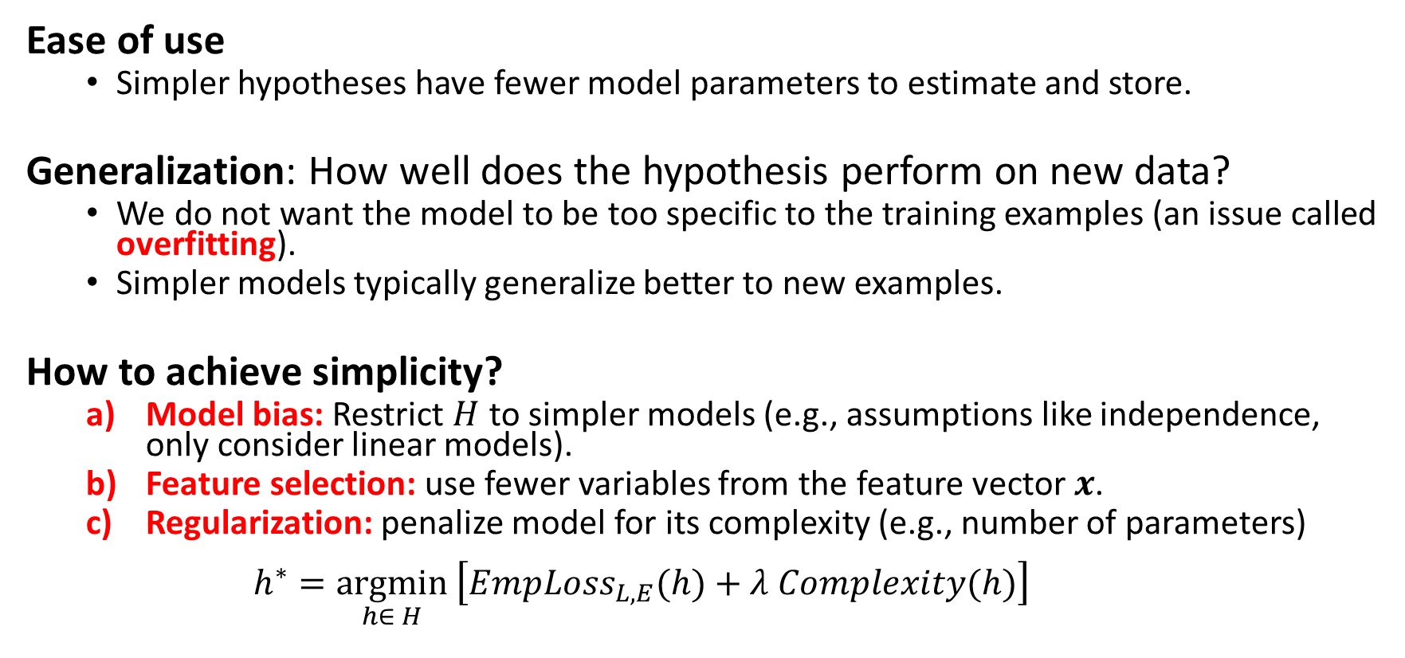
Simplicity
Ease of use
Simpler hypotheses have fewer model parameters to estimate and store.
Generalization: How well does the hypothesis perform on new data?
We do not want the model to be too specific to the training examples (an issue called overfitting).
Simpler models typically generalize better to new examples.
How to achieve simplicity?
Model bias: Restrict $H$ to simpler models (e.g., assumptions like independence, only consider linear models).
Feature selection: use fewer variables from the feature vector $x$.
Regularization: penalize model for its complexity (e.g., number of parameters) $h^{∗}=\underset{h∈ H}{argmin}\left[EmpLoss_{L,E}(h)+λ Complexity(h)\right]$
Penalty term

Slide 14
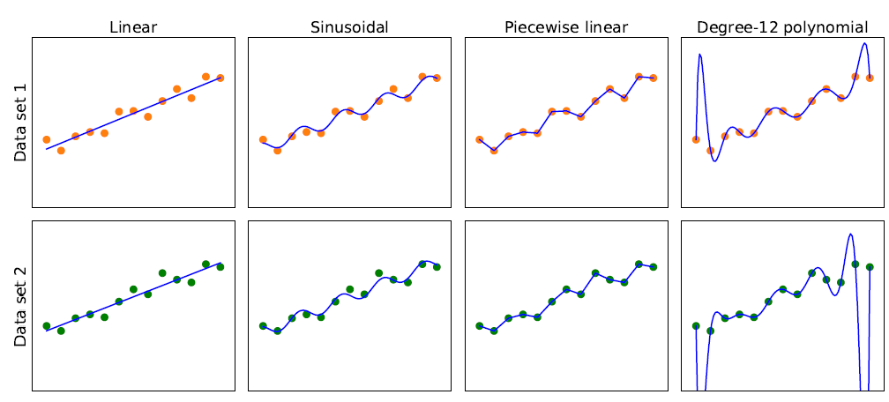
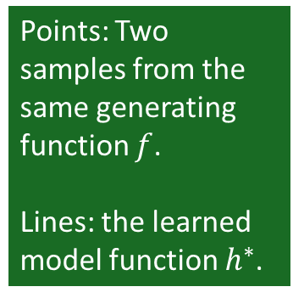
Model Selection: Bias vs. Variance
Overfitting
Simpler
More consistent
Points: Two samples from the same generating function $f$.
Lines: the learned model function $h^{∗}$.
High Bias: restrictions by the model class Low
Low Variance: difference in the model due to slightly different data. high
This is a tradeoff

Slide 15
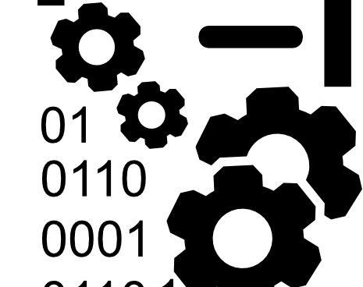
Data

Slide 16
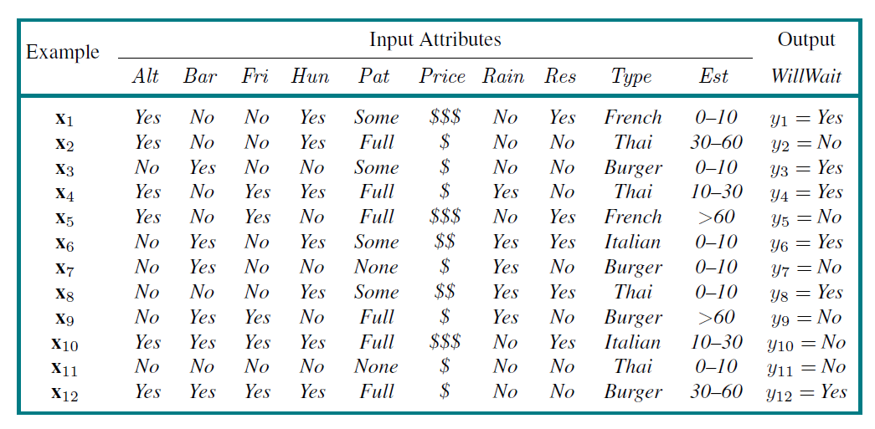
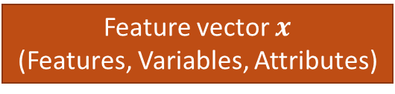
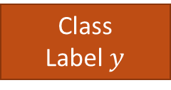
The Dataset
Feature vector $x$
(Features, Variables, Attributes)
Class
Label $y$
Examples
(Instances,
Observation)
Alternative
Hungry
Patrons
Reservation
Wait time
Task: Find a hypothesis (called “model”) to predict the class given the features.

Slide 17
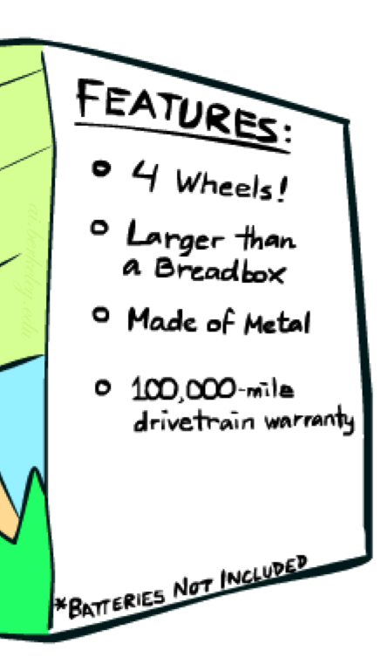

Feature Engineering
Add information sources as new variables to the model.
Add derived features that help the classifier (e.g., $x_{1}x_{2}$, $x_{1}^{2}, ln⁡(x_{1})$).
Embedding: E.g., convert words to vectors where vector similarity between vectors reflects semantic similarity.
Feature Selection: Which features should be used in the model is a model selection problem (choose between models with different features).
(Deep) neural networks can perform “automatic” feature engineering called end-to-end machine learning.
Example for Spam detection: In addition to words, add features for:
Have you emailed the sender before?
Have 1000+ other people just gotten the same email?
Is the email in ALL CAPS?

Slide 18

Data in AI
Data in AI can come from many sources
Existing Data: Download documents from the internet to train Large Language Models.
Observation: Record video of a task being performed (e.g., for self-driving cars).
Simulation: E.g., simulated games using a playout strategy.
Expert feedback on how well a task was performed.

Slide 19

Training and Testing

Slide 20

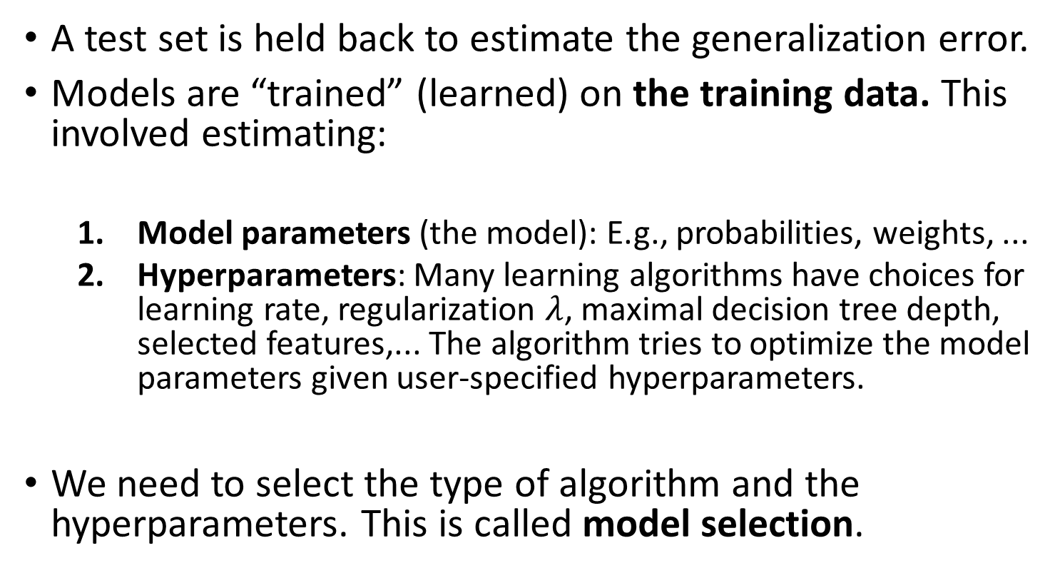
Training a Model
Training
Data
A test set is held back to estimate the generalization error.
Models are “trained” (learned) on the training data. This involved estimating:
Model parameters (the model): E.g., probabilities, weights, ...
Hyperparameters: Many learning algorithms have choices for learning rate, regularization $λ$, maximal decision tree depth, selected features,... The algorithm tries to optimize the model parameters given user-specified hyperparameters.
We need to select the type of algorithm and the hyperparameters. This is called model selection.
Test
Data

Slide 21
Hyperparameter Tuning/Model Selection
Hold a validation data set back from the training data.
Learn models using the training set with different hyperparameters. Often, a grid of possible hyperparameter combinations or some greedy search is used.
Evaluate the models using the validation data and choose the model with the best accuracy. Selecting the right type of model, hyperparameters, and features is called model selection.
Learn the final model with the chosen hyperparameters using all training (including validation data).
Notes:
The validation set was not used for training with different hyperparameters, so we get an estimate of the generalization error for comparing different hyperparameter settings.
If no model selection is necessary, then no validation set is used.
Training
Data
Training
Data
Validation
Data
Test
Data

Slide 22

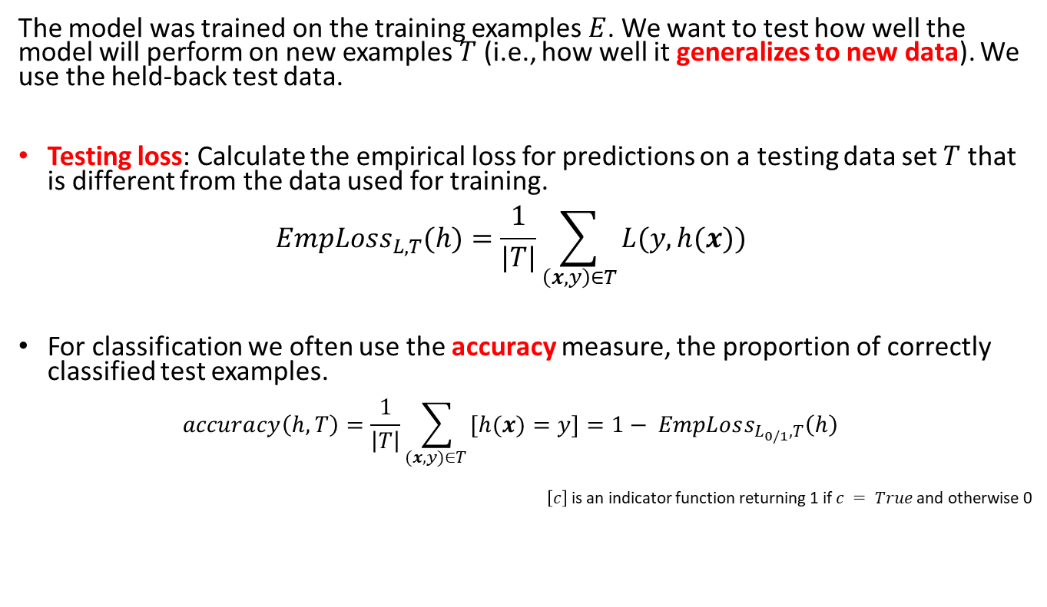

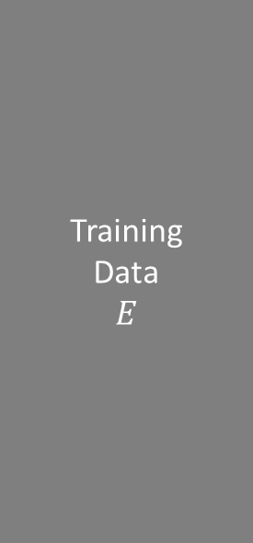
Model Evaluation (Testing)
Training
Data $$E$$
The model was trained on the training examples $E$. We want to test how well the model will perform on new examples $T$ (i.e., how well it generalizes to new data). We use the held-back test data.
Testing loss: Calculate the empirical loss for predictions on a testing data set $T$ that is different from the data used for training. $EmpLoss_{L,T}(h)=\frac{1}{|T|}\sum_{\left(x,y\right)∈T}{L(y, h(x))}$
For classification we often use the accuracy measure, the proportion of correctly classified test examples. $accuracy\left(h, T\right)=\frac{1}{\left|T\right|}\sum_{(x,y)∈T }{[h(x)=y]}=1− EmpLoss_{L_{0/1},T}\left(h\right)$
$\left[c\right]$ is an indicator function returning 1 if $c = True$and otherwise 0
Test
Data $T$

Slide 23
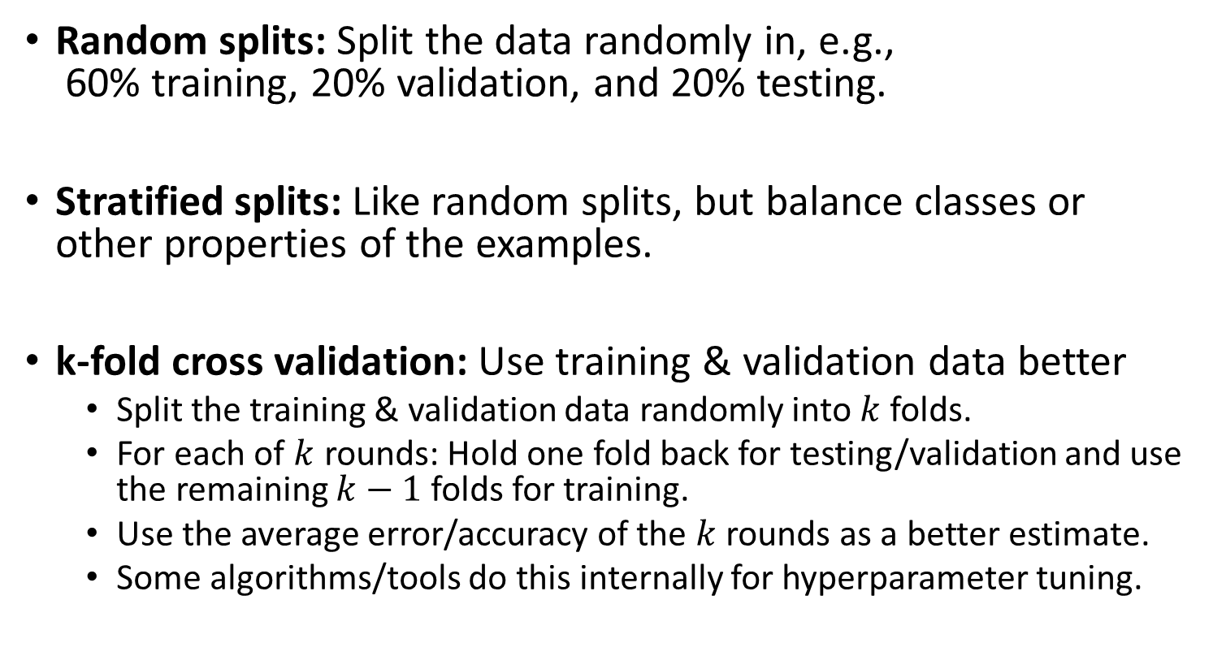
How to Split the Dataset
Random splits: Split the data randomly in, e.g., 60% training, 20% validation, and 20% testing.
Stratified splits: Like random splits, but balance classes or other properties of the examples.
k-fold cross validation: Use training & validation data better
Split the training & validation data randomly into $k$ folds.
For each of $k$ rounds: Hold one fold back for testing/validation and use the remaining $k−1$ folds for training.
Use the average error/accuracy of the $k$ rounds as a better estimate.
Some algorithms/tools do this internally for hyperparameter tuning.
Training
Data
Training
Data
Validation
Data
Test
Data

Slide 24
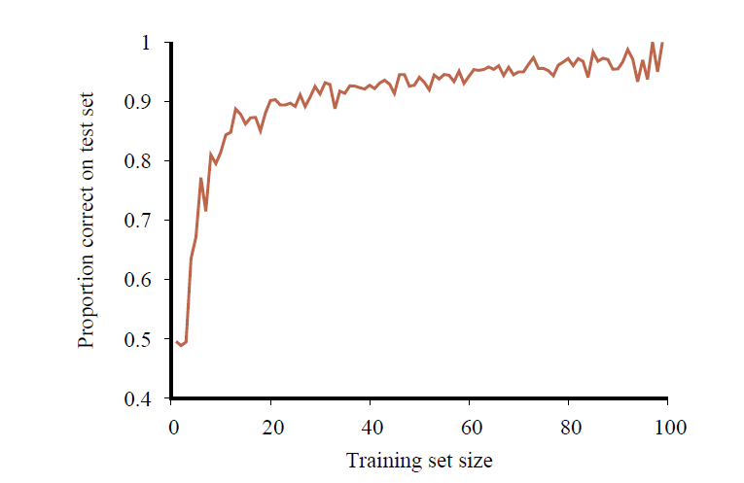
Learning Curve: The Effect the Training Data Size
No classifier can get consistently better than the Bayesian error rate
Accuracy increases when the amount of available training data increases.
More data is better!
At some point, the learning curve flattens out, and more data does not contribute much!
Accuracy

Slide 25

Comparing to a Baselines
First step: get a baseline
Baselines are very simple straw man model.
Helps to determine how hard the task is.
Helps to find out what a good accuracy is.
Weak baseline: The most frequent label classifier
Gives all test instances whatever label was most common in the training set.
Example: For spam filtering, give every message the label “ham.”
Accuracy might be very high if the problem is skewed (called class imbalance).
Example: If calling everything “ham” gets already 66% right, so a classifier that gets 70% isn’t very good…
Strong baseline: For research, we typically compare to previous published state-of-the-art as a baseline.

Slide 26

Types of ML Models
Regression: Predict a number
Classification: Predict a label

Slide 27
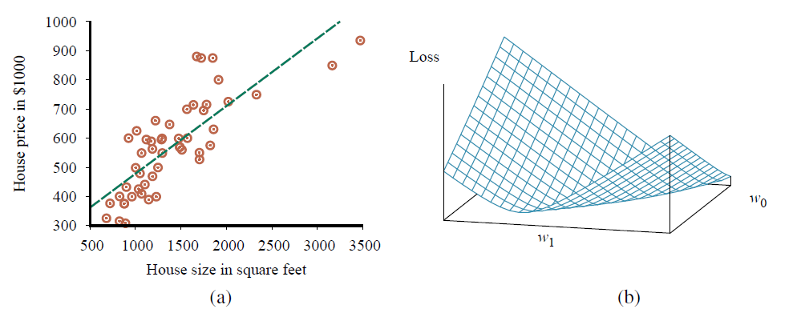
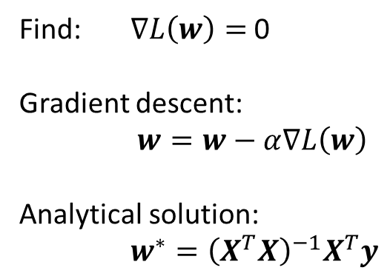
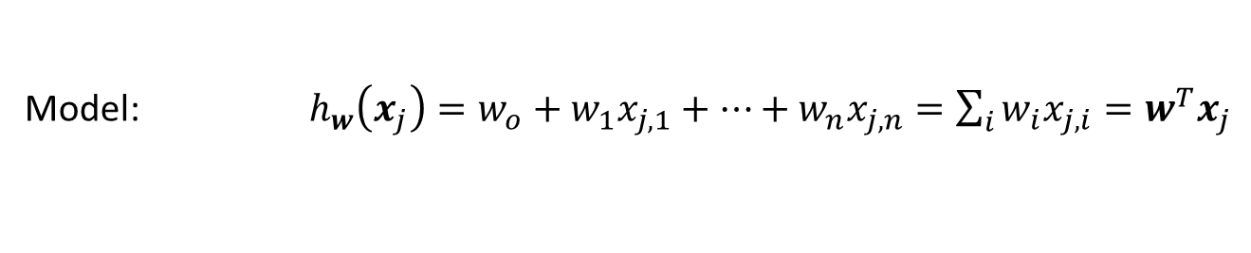

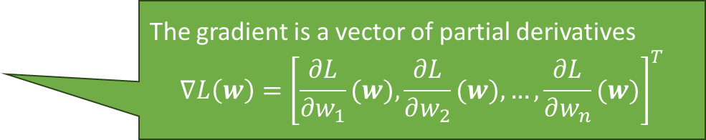



Regression: Linear Regression
Model: $h_{w}\left(x_{j}\right)=w_{o}+w_{1}x_{j,1}+…+w_{n}x_{j,n}=\sum_{i}{w_{i}x_{j,i}}=w^{T}x_{j}$
Squared error loss over the whole data matrix $X$
Empirical Loss: $L\left(w\right)={\left\|Xw−y\right\|}^{2}$
The gradient is a vector of partial derivatives $$∇L\left(w\right)={\left[\frac{∂L}{∂w_{1}}(w),\frac{∂L}{∂w_{2}}(w),…,\frac{∂L}{∂w_{n}}(w)\right]}^{T}$$
Gradient: $∇L\left(w\right)=2X^{T}\left(Xw−y\right)$
Find: $∇L\left(w\right)=$ 0
Gradient descent:
$w=w−α∇L\left(w\right)$
Analytical solution:
$w^{∗}={\left(X^{T}X\right)}^{−1}X^{T}y$
$$∇L\left(w\right)$$
$$w$$
Pseudo inverse

Slide 28
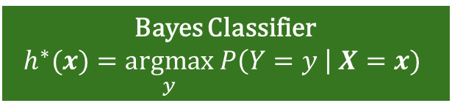
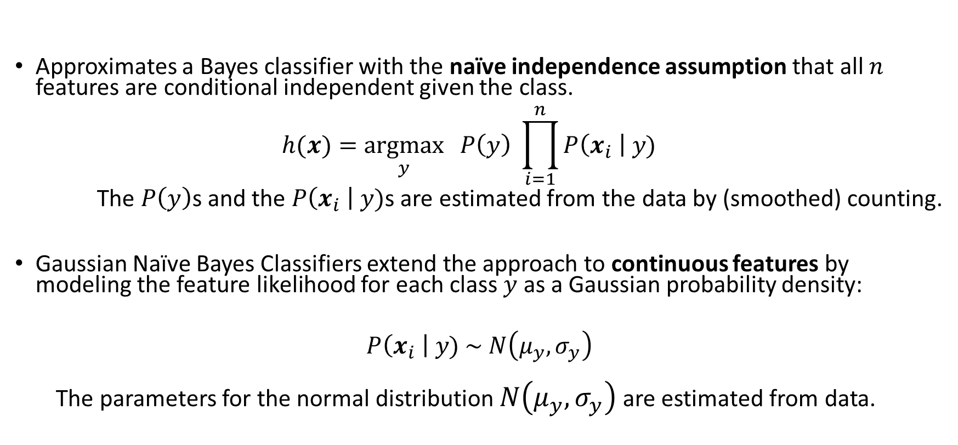
Naïve Bayes Classifier
Bayes Classifier
$$h^{∗}(x)=\underset{y}{argmax} P\left(Y=y \right| X=x)$$
Approximates a Bayes classifier with the naïve independence assumption that all $n$ features are conditional independent given the class. $h(x)=\underset{y}{argmax}{ P\left(y\right) \prod_{i=1}^{n}{P\left(x_{i} \right| y)}}$
The $P\left(y\right)$s and the $P\left(x_{i} \right| y)$s are estimated from the data by (smoothed) counting.
Gaussian Naïve Bayes Classifiers extend the approach to continuous features by modeling the feature likelihood for each class $y$ as a Gaussian probability density:
$$P\left(x_{i} \right| y) \sim N\left(μ_{y},σ_{y}\right)$$
The parameters for the normal distribution $N\left(μ_{y},σ_{y}\right)$ are estimated from data.

Slide 29
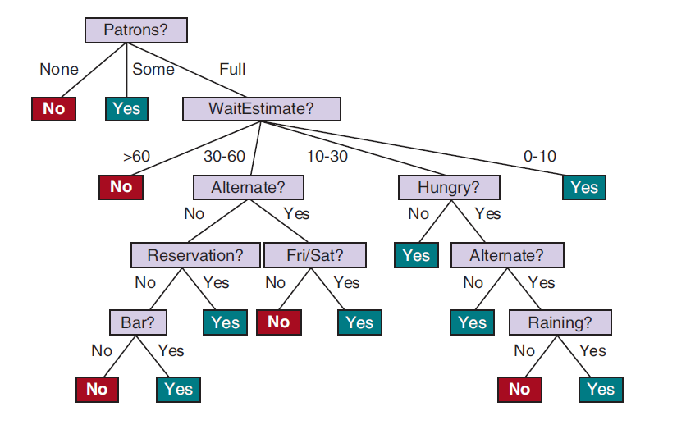
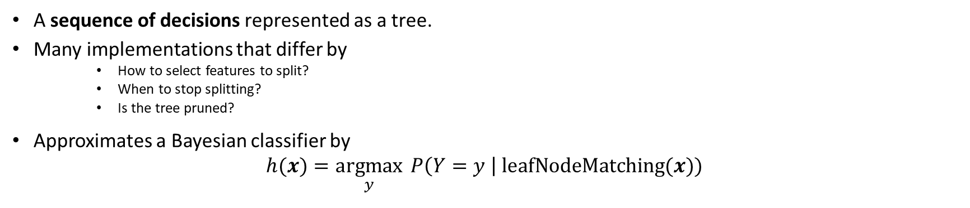
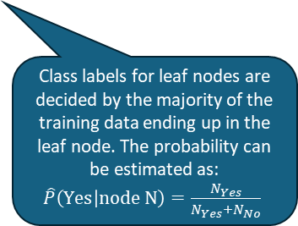
Decision Trees
Bayes Classifier
$$h^{∗}(x)=\underset{y}{argmax} P\left(Y=y \right| X=x)$$
A sequence of decisions represented as a tree.
Many implementations that differ by
How to select features to split?
When to stop splitting?
Is the tree pruned?
Approximates a Bayesian classifier by $h(x)=\underset{y}{argmax}{ P\left(Y=y \right| \text{leafNodeMatching}(x)) }$
Class labels for leaf nodes are decided by the majority of the training data ending up in the leaf node. The probability can be estimated as: $\hat{P}\left(\text{Y}\text{es} | \text{node} \text{N}\right)=\frac{N_{Yes}}{N_{Yes}+N_{No}}$

Slide 30
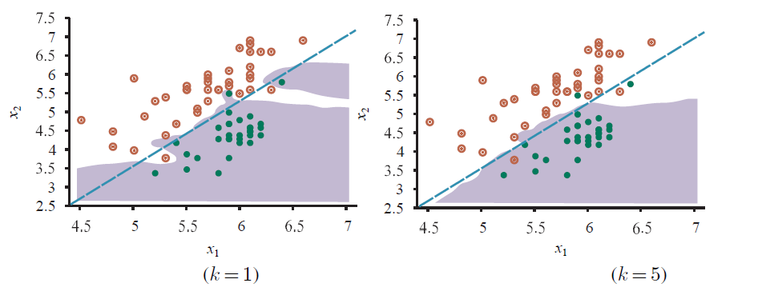
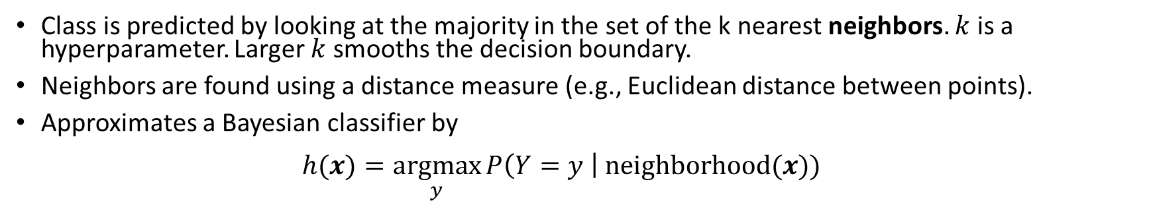
K-Nearest Neighbors Classifier
Bayes Classifier
$$h^{∗}(x)=\underset{y}{argmax} P\left(Y=y \right| X=x)$$
Class is predicted by looking at the majority in the set of the k nearest neighbors. $k$ is a hyperparameter. Larger $k$ smooths the decision boundary.
Neighbors are found using a distance measure (e.g., Euclidean distance between points).
Approximates a Bayesian classifier by $h(x)=\underset{y}{argmax}{P\left(Y=y \right| \text{neighborhood}(x)) }$

Slide 31
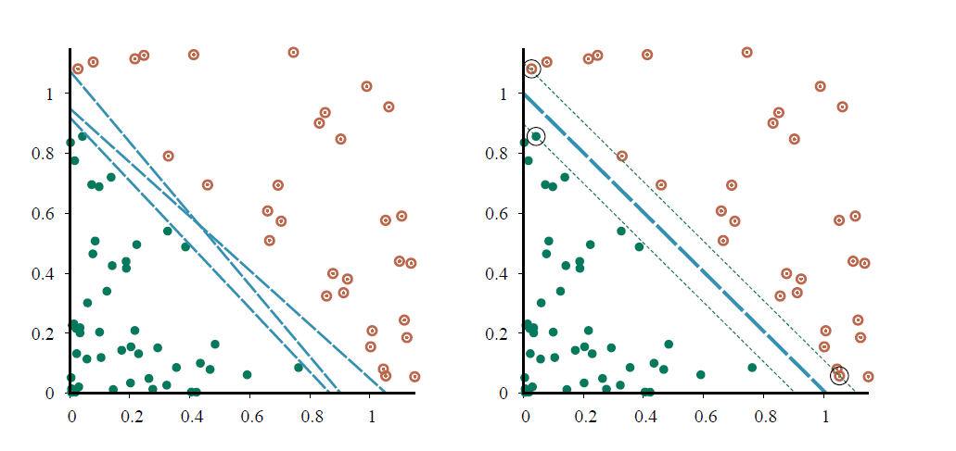
Support Vector Machine (SVM)
Margin
Decision boundary
Linear classifier that finds the maximum margin separator using only the points that are “support vectors” and quadratic optimization.
The kernel trick can be used to learn non-linear decision boundaries.

Slide 32
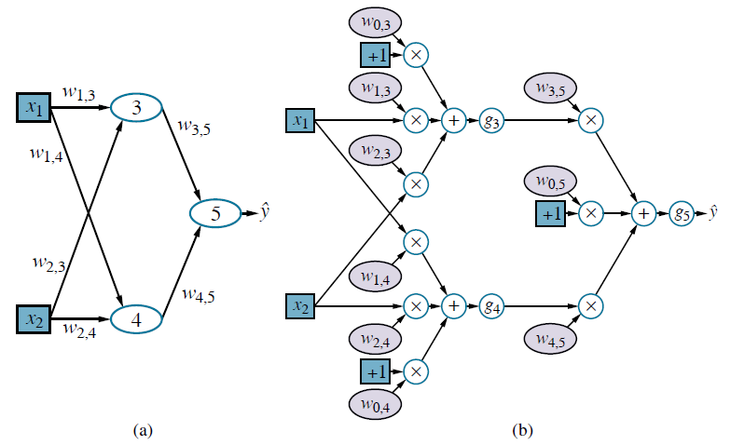
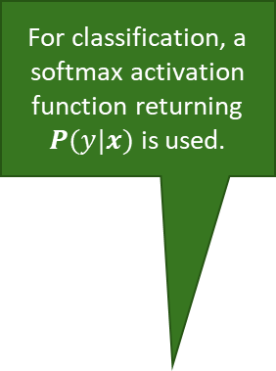
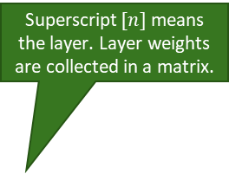
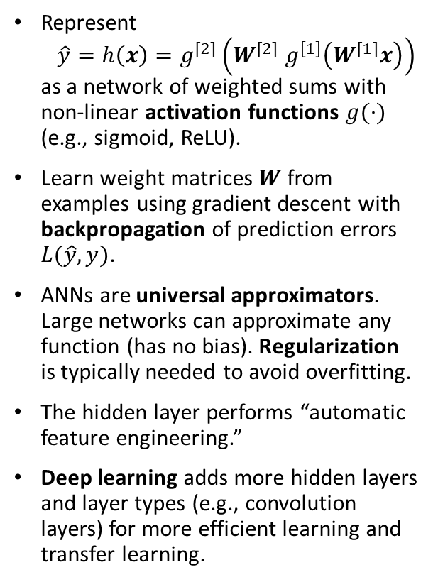
Artificial Neural Networks
Superscript $[n]$means the layer. Layer weights are collected in a matrix.
Network Topology
Computational graph
Hidden Layer
For classification, a softmax activation function returning $P(y|x)$ is used.
Represent $\hat{y}=h\left(x\right)=g^{[2]}\left(W^{[2]} g^{\left[1\right]}\left(W^{[1]}x\right)\right)$ as a network of weighted sums with non-linear activation functions $g(⋅)$ (e.g., sigmoid, ReLU).
Learn weight matrices $W$ from examples using gradient descent with backpropagation of prediction errors $L(\hat{y}, y)$.
ANNs are universal approximators. Large networks can approximate any function (has no bias). Regularization is typically needed to avoid overfitting.
The hidden layer performs “automatic feature engineering.”
Deep learning adds more hidden layers and layer types (e.g., convolution layers) for more efficient learning and transfer learning.
Neuron
Non-linear activation function
Bias term

Slide 33
Other Popular Models and Methods
Many other models exist
Generalized linear model (GLM): This important model family includes linear regression, Poisson regression and the classification method logistic regression.
Often used methods
Regularization: Enforce simplicity and reduce overfitting by using a penalty for complexity.
Kernel trick: Lets a linear classifier learn non-linear decision boundaries.
Ensemble Learning: Use many models and combine the results (e.g., random forest, boosting).
Embedding and Dimensionality Reduction: Learn how to represent data in a simpler way. E.g., principal components analysis (PCA), variational autoencoders, text embeddings.

Slide 34
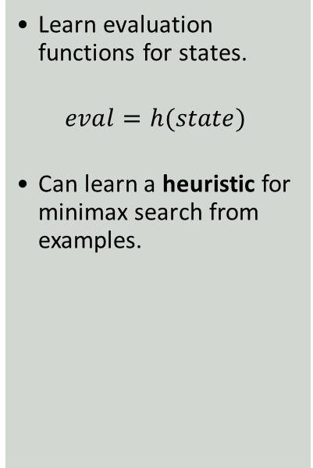
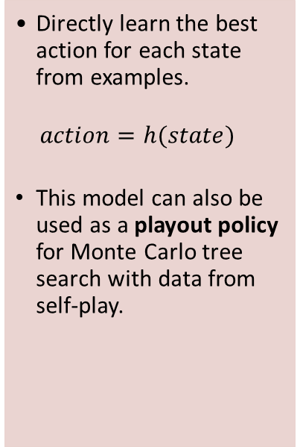
Some Use Cases of ML for Intelligent Agents
Learn a Policy
Learn Evaluation Functions
Learn Perception for Sensors
Compressing Tables
Directly learn the best action for each state from examples.
$$action=h(state)$$
This model can also be used as a playout policy for Monte Carlo tree search with data from self-play.
Learn evaluation functions for states.
$$eval=h(state)$$
Can learn a heuristic for minimax search from examples.
Natural language processing: Use deep learning / word embeddings / language models to understand concepts, translate between languages, or generate text.
Speech recognition: Identify the most likely sequence of words.
Vision: Object recognition in images/videos. Generate images/video.
Neural networks can be used as a compact representation of tables that do not fit in memory. E.g.,
Joint and conditional probability tables
State utility tables (i.e., an evaluation function)
The table/function representing the table can be learned from data.
Bottom line: Learning a function is often more effective than hard-coding it. However, we do not always know how it performs for rare and edge cases!

