Slide 1
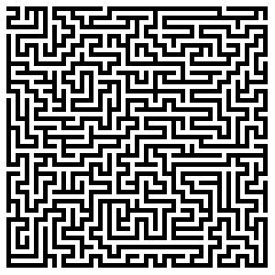
CS 5/7320 Artificial Intelligence Solving problems by searching AIMA Chapter 3
Discussion
Slides by Michael Hahsler based on slides by Svetlana Lazepnik with figures from the AIMA textbook.
This work is licensed under a Creative Commons Attribution-ShareAlike 4.0 International License.

Slide 2
Module Review
Intro and Uninformed Search

Slide 3
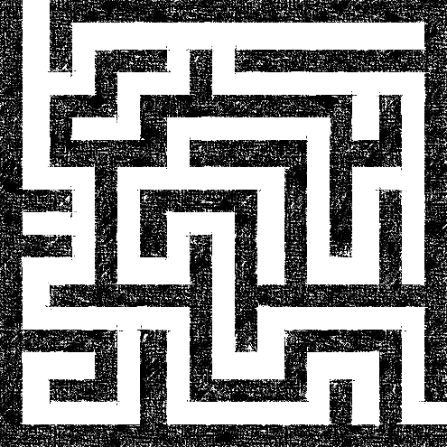
Complete Planning Agent to Solve a Maze
Map = Transition function + initial and goal state
Environment
Physical Maze
Physical agent
has an event loop:
Read sensors
Call agent function
Execute action in the physical environment
Repeat
Planning function
Sensors
Sensor input
Need to plan or replan
percepts
State
Plan
Agent function
next action
Follow the plan
Current step in plan
Actuators
Execute action in the physical environment
The event loop calls the agent function for the next action.
The agent function follows the plan or calls the planning function if there is no plan yet or it thinks the current plan does not work based on the percepts (replanning).

Slide 4
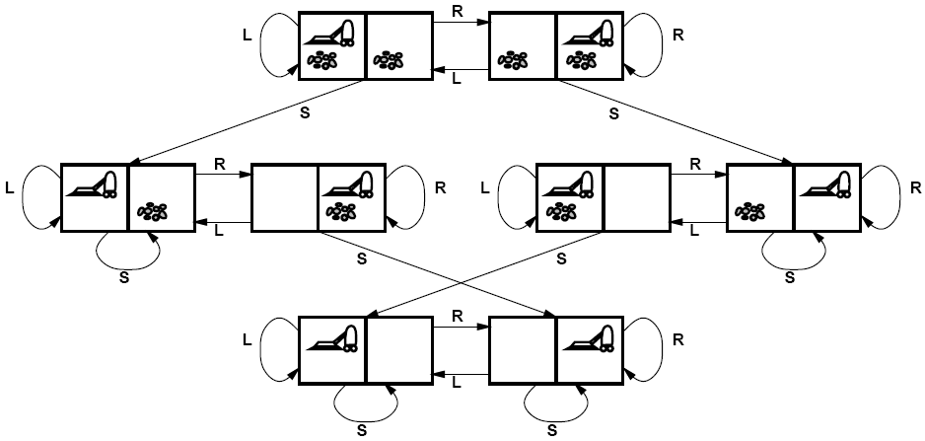
Solving Search Problems
Given a search problem definition
Initial state
Actions
Transition model
Goal state
Path cost
How do we find the optimal solution (sequence of actions/states)?
Construct a search tree for the state space graph!
Initial state
State space
Goal states

Slide 5
Creating a Search Tree
Superimpose a “what if” tree of possible actions and outcomes (states) on the state space graph.
The Root node represents the initial stare.
An action child node is reached by an edge representing an action. The corresponding state is defined by the transition model.
Trees cannot have cycles (loops). Cycles in the search space must be broken to prevent infinite loops.
Trees cannot have multiple paths to the same state. These are called redundant paths. Removing other redundant paths improves search efficiency.
A path through the tree corresponds to a sequence of actions (states).
A solution is a path ending in a node representing a goal state.
Nodes vs. states: Each tree node represents a state of the system. If redundant path cannot be prevented then state can be represented by multiple nodes in the tree.
Root node = Initial state
a
Edge = Action
Child node
Non-cycle redundant
path
b
c
d
e
e
Cycle
…
…
…
b
Solution path
Node representing a Goal state
f

Slide 6
Differences Between Typical Tree Search and AI Search
Typical tree search
Assumes a given tree that fits in memory.
Trees have by construction no cycles or redundant paths.
AI tree/graph search
The search tree is too large to fit into memory.
Builds parts of the tree from the initial state using the transition function representing the graph.
Memory management is very important.
The search space is typically a very large and complicated graph. Memory-efficient cycle checking is very important to avoid infinite loops or minimize searching parts of the search space multiple times.
Checking redundant paths often requires too much memory and we accept searching the same part multiple times.

Slide 7
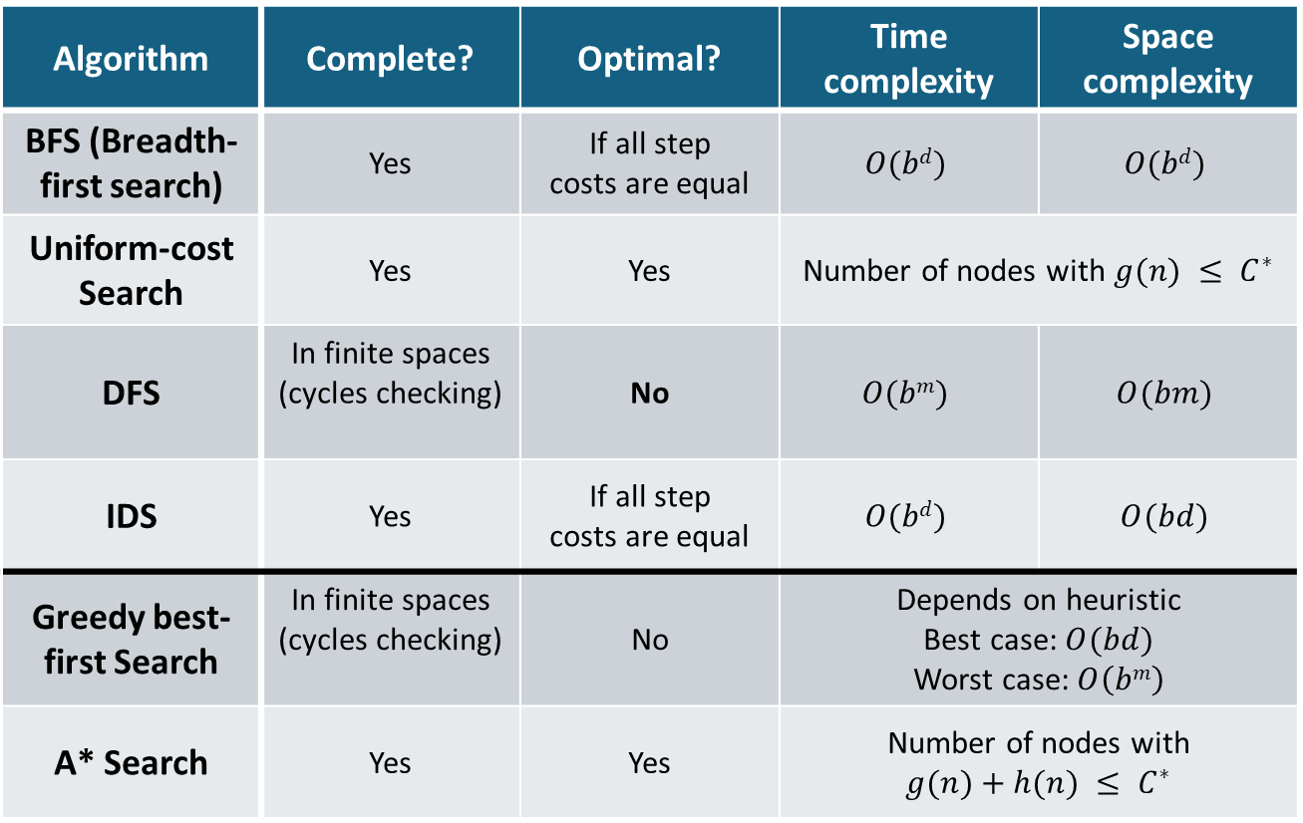
Summary: All Search Strategies
b: maximum branching factor of the search tree
d: depth of the optimal solution
m: maximum length of any path in the state space
C*: cost of optimal solution
Algorithm | Complete? | Optimal? | Time complexity | Space complexity
BFS (Breadth-first search) | Yes | If all step costs are equal | $$O(bd)$$ | $$O(bd)$$
Uniform-cost Search | Yes | Yes | Number of nodes with $g(n) ≤ C^{∗}$
DFS | In finite spaces (cycles checking) | No | $$O(bm)$$ | $$O(bm)$$
IDS | Yes | If all step costs are equal | $$O(bd)$$ | $$O(bd)$$
Greedy best-first Search | In finite spaces (cycles checking) | No | Depends on heuristic $$\text{Best} \text{case}\text{: }O(bd)$$ Worst case: $O\left(bm\right)$
A* Search | Yes | Yes | Number of nodes with $$g(n)+h(n) ≤ C^{∗}$$
Uninformed Search
Informed Search
With a good heuristic

Slide 8
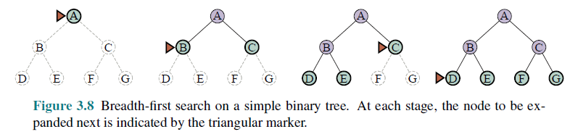
Breadth-First Search (BFS)
All nodes are in memory!
Expansion rule: Expand shallowest unexpanded node in the frontier (=FIFO).
Data Structures
Frontier data structure: holds references to the green nodes (green) and is implemented as a FIFO queue.
Reached data structure: holds references to all visited nodes (gray and green) and is used to prevent visiting nodes more than once (cycle and redundant path checking).
Builds a complete tree with links between parent and child.

Slide 9

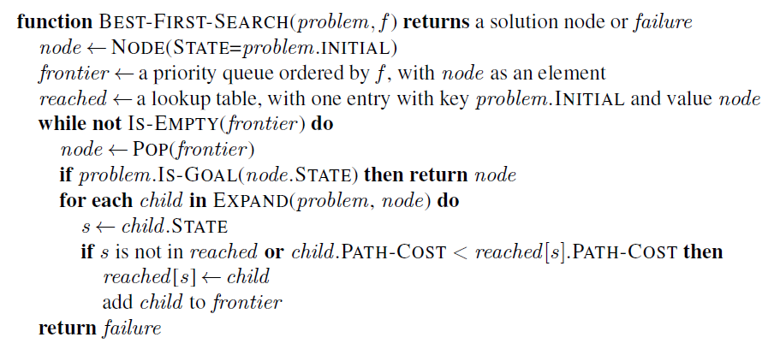
Implementation: Best-First Search Strategy
This is a generalization of Breadth-first search that expands the search based on cost and not on the number of steps.
The order for expanding the frontier is determined by f(n) = path cost from the initial state to node n.
This check is added to BFS! It visits a node again if it can be reached by a better (cheaper) path.
See BFS for function EXPAND.

Slide 10
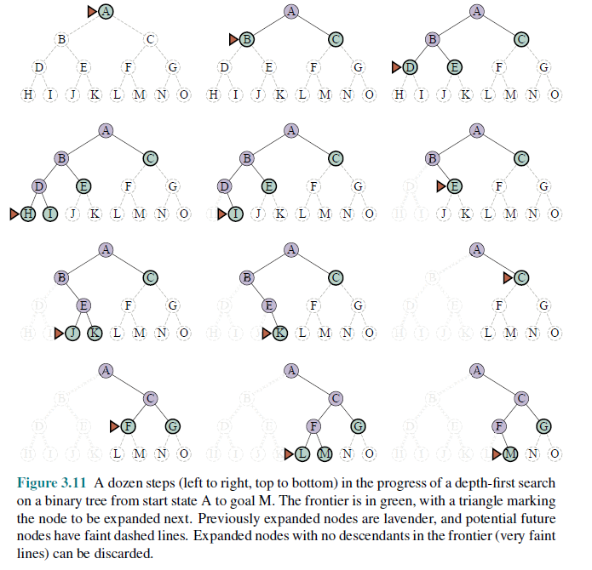
Depth-First Search (DFS)
Expansion rule: Expand deepest unexpanded node in the frontier (last added).
Frontier: stack (LIFO)
No reached data structure! Cycle checking checks only the current path. Redundant paths can not be identified and lead to replicated work.
Memory management: only the current path is in memory!

Slide 11
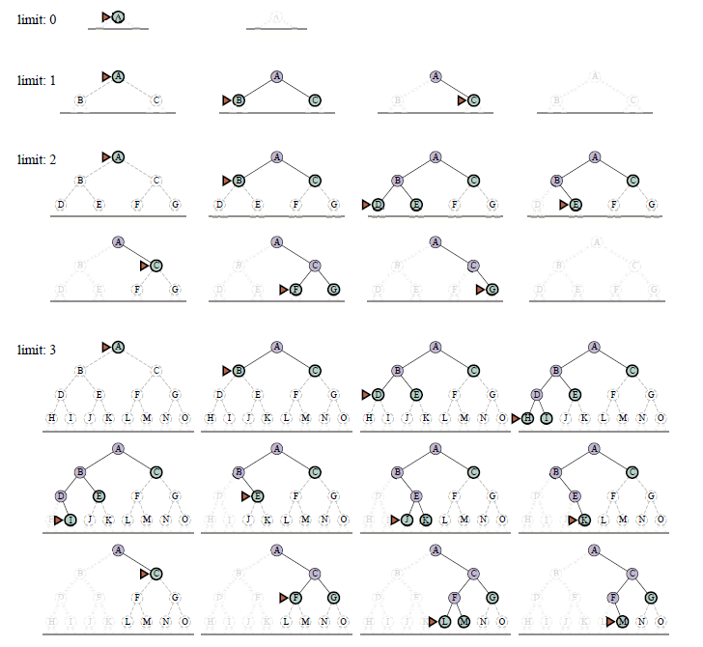
Iterative Deepening Search (IDS)
This is a very important algorithm in AI!

Slide 12
Module Review
Statespace and Search Complexity

Slide 13
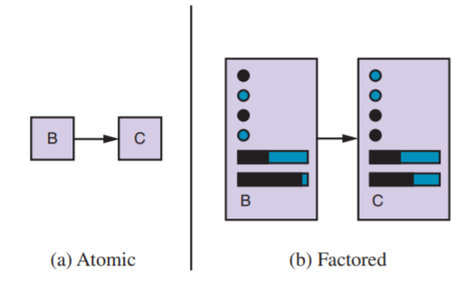
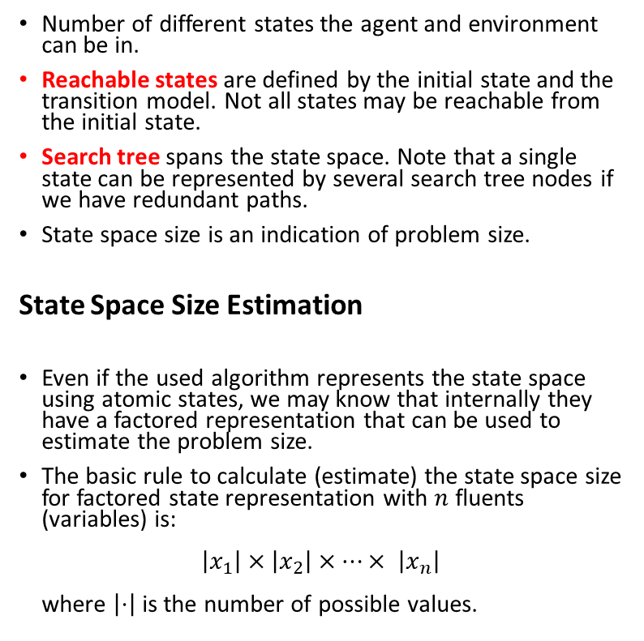


State Space
Number of different states the agent and environment can be in.
Reachable states are defined by the initial state and the transition model. Not all states may be reachable from the initial state.
Search tree spans the state space. Note that a single state can be represented by several search tree nodes if we have redundant paths.
State space size is an indication of problem size.
State Space Size Estimation
Even if the used algorithm represents the state space using atomic states, we may know that internally they have a factored representation that can be used to estimate the problem size.
The basic rule to calculate (estimate) the state space size for factored state representation with $n$ fluents (variables) is: $\left|x_{1}\right|×\left|x_{2}\right|×⋯× \left|x_{n}\right|$ where $\left|⋅\right|$ is the number of possible values.
State representation
$$x_{1}$$
$$x_{2}$$
…
The state consists of variables called fluents that represent conditions that can change over time.

Slide 14
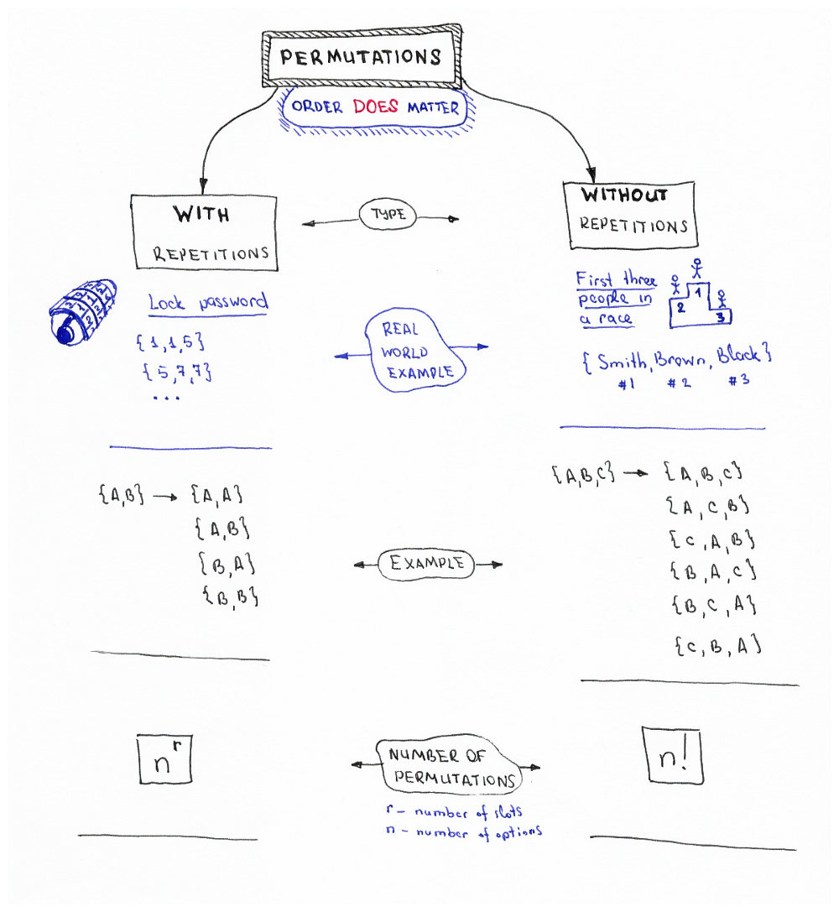



In how many ways can we order/arrange n objects?
$$2×2=2^{2}=4$$
$$3×2×1=6$$
Factorial: $n!=n×\left(n−1\right)×…×2×1$
#Python
import math
print (math.factorial(23))
Source: Permutations/Combinations Cheat Sheets by Oleksii Trekhleb https://itnext.io/permutations-combinations-algorithms-cheat-sheet-68c14879aba5

Slide 15
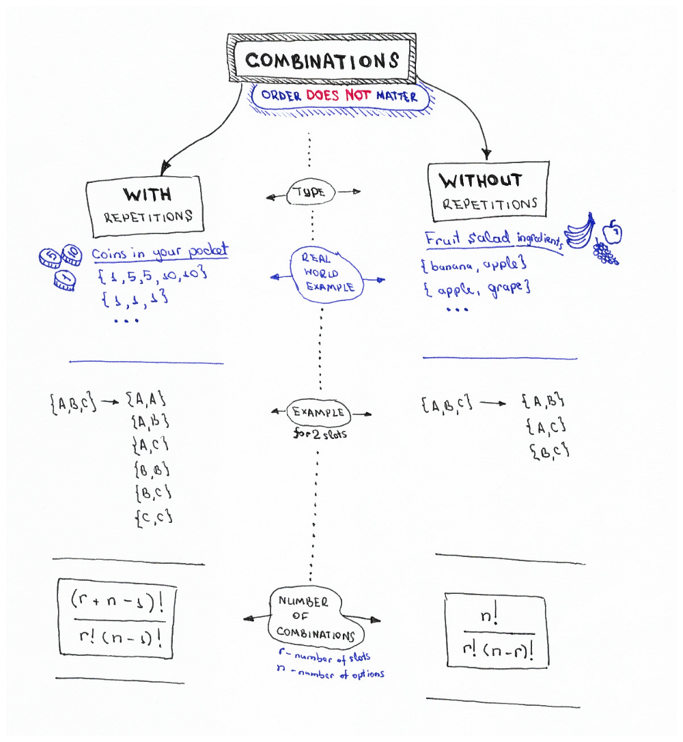
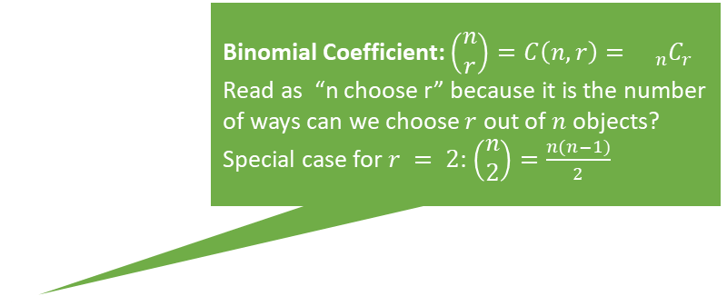

Binomial Coefficient: $\left(\begin{matrix}n \\ r\end{matrix}\right)=C\left(n,r\right)={{}_{n}C}_{r}$
Read as “n choose r” because it is the number of ways can we choose $r$ out of $n$ objects?
Special case for $r = 2$: $\left(\begin{matrix}n \\ 2\end{matrix}\right)=\frac{n(n−1)}{2}$
$$\left(\begin{matrix}3 \\ 2\end{matrix}\right)=3$$
#Python
import scipy.special
# the two give the same results
scipy.special.binom(10, 5)
scipy.special.comb(10, 5)
Source: Permutations/Combinations Cheat Sheets by Oleksii Trekhleb https://itnext.io/permutations-combinations-algorithms-cheat-sheet-68c14879aba5

Slide 16
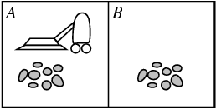
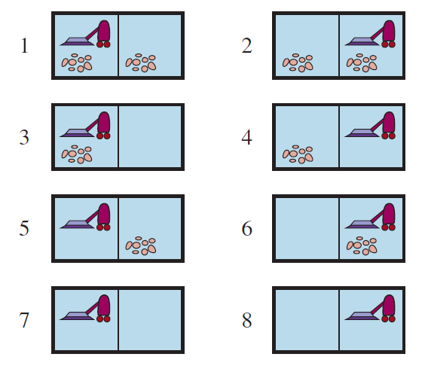
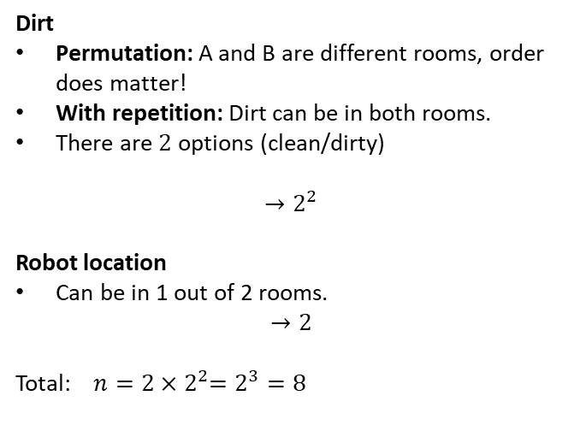
Example: What is the State Space Size?
Dirt
Permutation: A and B are different rooms, order does matter!
With repetition: Dirt can be in both rooms.
There are $2$ options (clean/dirty)
$${→2}^{2}$$
Robot location
Can be in 1 out of 2 rooms.
$$→2$$
Total: $n=2{×2}^{2}=2^{3}=8$
r … # of rooms n … options

Slide 17
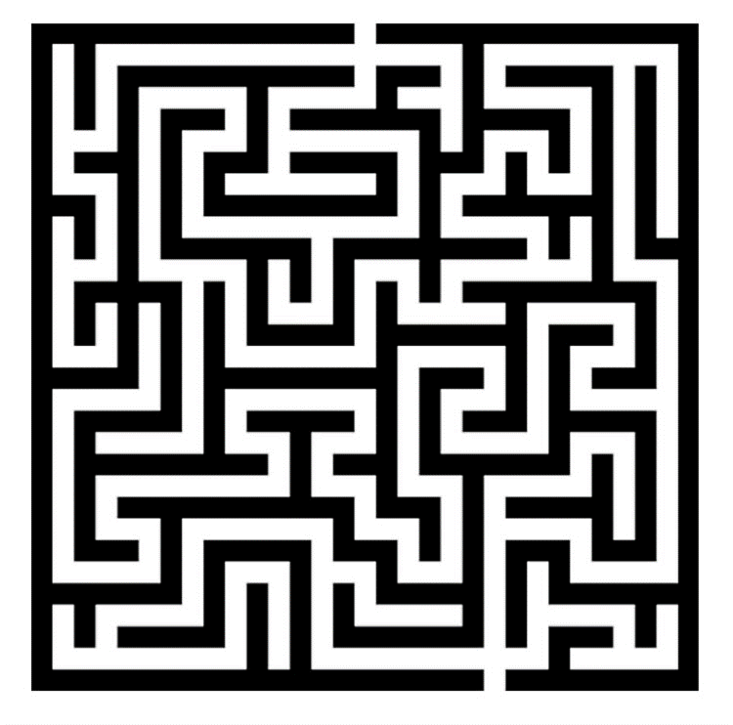
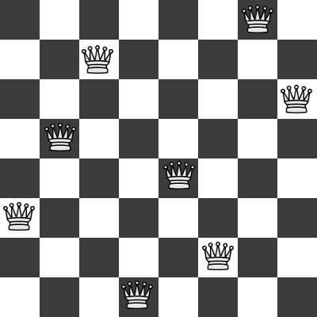
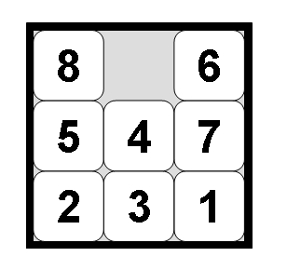
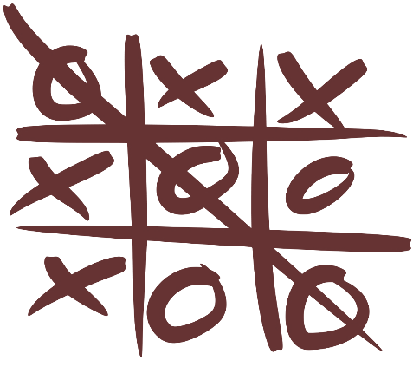
Examples: What is the State Space Size?
Often a rough upper limit is sufficient to determine how hard the search problem is.
Maze
8-queens problem
8-puzzle problem
Tic-tac-toe

Slide 18
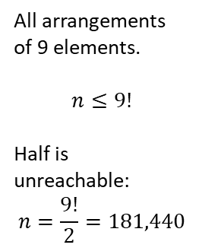
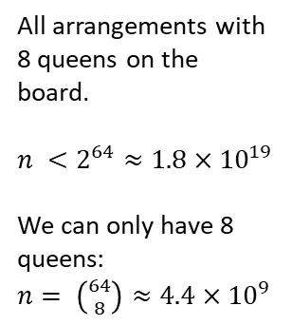
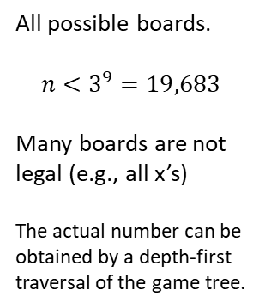
Examples: What is the State Space Size?
Often a rough upper limit is sufficient to determine how hard the search problem is.
Maze
8-queens problem
8-puzzle problem
Tic-tac-toe
Positions the agent can be in.
n = Number of white squares.
All arrangements with 8 queens on the board.
$n <2^{64}≈1.8×{10}^{19}$
We can only have 8 queens: $n= \left({64 \atop 8}\right)≈4.4×{10}^{9}$
All arrangements of 9 elements.
$$n≤9!$$
Half is unreachable: $$n=\frac{9!}{2}=181,440$$
All possible boards.
$$n<3^{9}=19,683$$
Many boards are not legal (e.g., all x’s)
The actual number can be obtained by a depth-first traversal of the game tree.

Slide 19
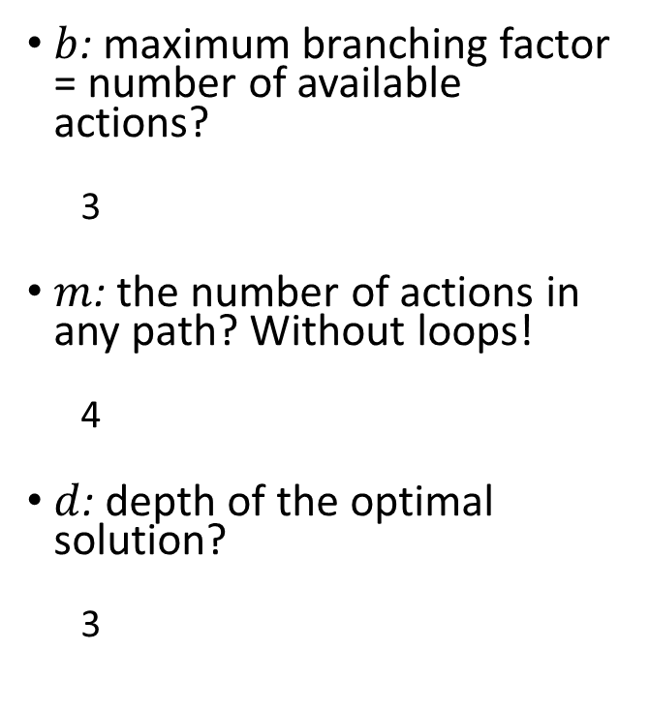
Example: What is the Search Complexity?
$b$: maximum branching factor = number of available actions?
3
$m$: the number of actions in any path? Without loops!
4
$d$: depth of the optimal solution?
3
State Space with Transition Model
Initial state
Goal states

Slide 20
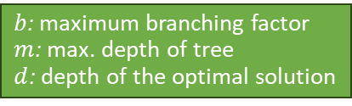
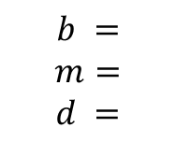
Examples: What is the Search Complexity?
$b$: maximum branching factor
$m$: max. depth of tree
$d$: depth of the optimal solution
Often a rough upper limit is sufficient to determine how hard the search problem is.
Maze
8-queens problem
8-puzzle problem
Tic-tac-toe
$$b =$$
$$m=$$
$$d =$$

Slide 21
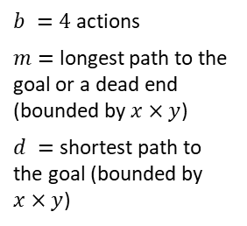
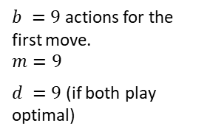
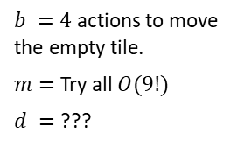
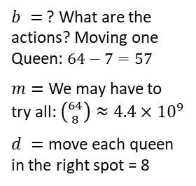
Examples: What is the Search Complexity?
$b$: maximum branching factor
$m$: max. depth of tree
$d$: depth of the optimal solution
Often a rough upper limit is sufficient to determine how hard the search problem is.
Maze
8-queens problem
8-puzzle problem
Tic-tac-toe
$b =4$ actions
$m=$ longest path to the goal or a dead end (bounded by $x×y$)
$d =$ shortest path to the goal (bounded by $x×y$)
$b =$ ? What are the actions? Moving one Queen: $64−7=57$
$m=$ We may have to try all: $\left({64 \atop 8}\right)≈4.4×{10}^{9}$
$d =$ move each queen in the right spot = 8
$b =4$ actions to move the empty tile.
$m=$ Try all $O(9!)$
$d =$ ???
$b =9$ actions for the first move.
$$m=9$$
$d =9$ (if both play optimal)

Slide 22
Module Review
Informed Search

Slide 23
Summary: All Search Strategies
b: maximum branching factor of the search tree
d: depth of the optimal solution
m: maximum length of any path in the state space
C*: cost of optimal solution
Algorithm | Complete? | Optimal? | Time complexity | Space complexity
BFS (Breadth-first search) | Yes | If all step costs are equal | $$O(bd)$$ | $$O(bd)$$
Uniform-cost Search | Yes | Yes | Number of nodes with $g(n) ≤ C^{∗}$
DFS | In finite spaces (cycles checking) | No | $$O(bm)$$ | $$O(bm)$$
IDS | Yes | If all step costs are equal | $$O(bd)$$ | $$O(bd)$$
Greedy best-first Search | In finite spaces (cycles checking) | No | Depends on heuristic $$\text{Best} \text{case}\text{: }O(bd)$$ Worst case: $O\left(bm\right)$
A* Search | Yes | Yes | Number of nodes with $$g(n)+h(n) ≤ C^{∗}$$
Uninformed Search
Informed Search
With a good heuristic

Slide 24
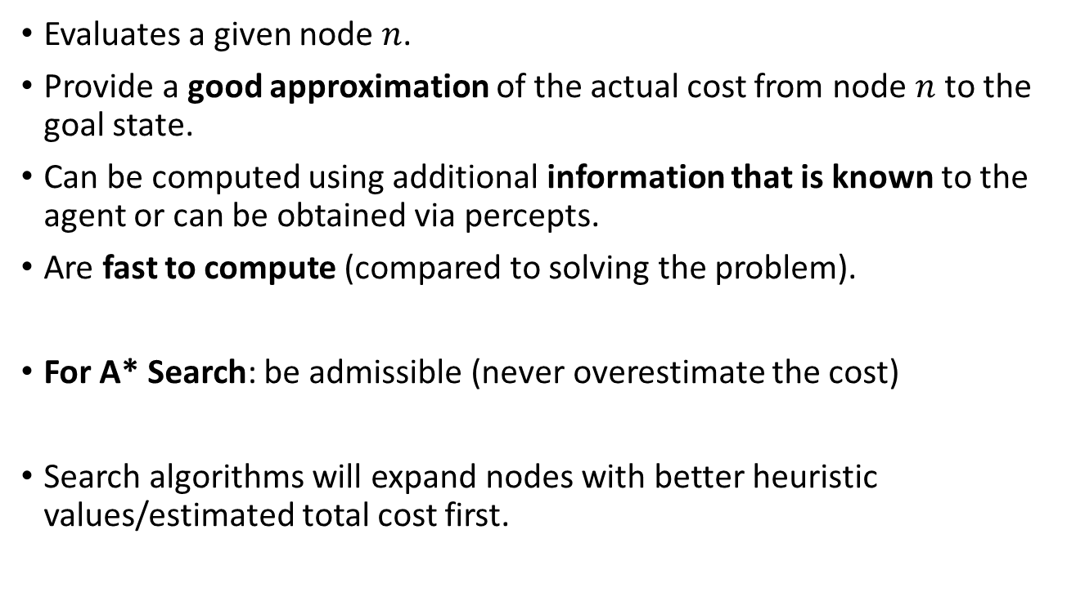
Properties of Heuristic Functions
Evaluates a given node $n$.
Provide a good approximation of the actual cost from node $n$ to the goal state.
Can be computed using additional information that is known to the agent or can be obtained via percepts.
Are fast to compute (compared to solving the problem).
For A* Search: be admissible (never overestimate the cost)
Search algorithms will expand nodes with better heuristic values/estimated total cost first.

Slide 25
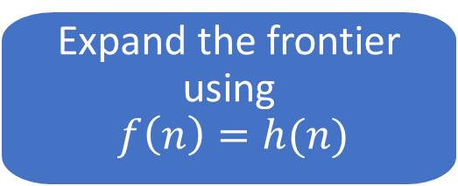
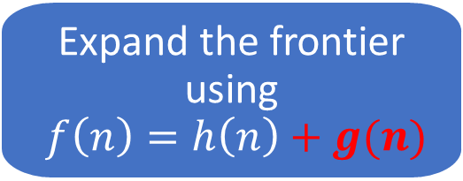
Implementation
Greedy Best-First search
Best-First Search
Expand the frontier using $$f\left(n\right)=h(n)$$
A* Search
Best-First Search
Expand the frontier using $f\left(n\right)=h\left(n\right)+g(n)$

Slide 26
Heuristics from Relaxed Problems
What relaxations are used in these two cases?
Euclidean distance
Manhattan distance
Start state
Start state
Goal state
Goal state

Slide 27
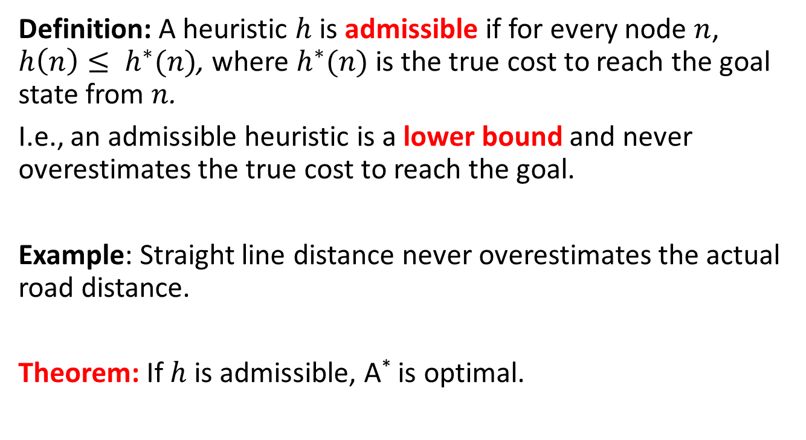
A* Search Optimality: Admissible Heuristics
Definition: A heuristic $h$ is admissible if for every node $n$, $h\left(n\right)≤ h^{∗}(n)$, where $h^{∗}(n)$ is the true cost to reach the goal state from $n$.
I.e., an admissible heuristic is a lower bound and never overestimates the true cost to reach the goal.
Example: Straight line distance never overestimates the actual road distance.
Theorem: If $h$ is admissible, A* is optimal.

Slide 28
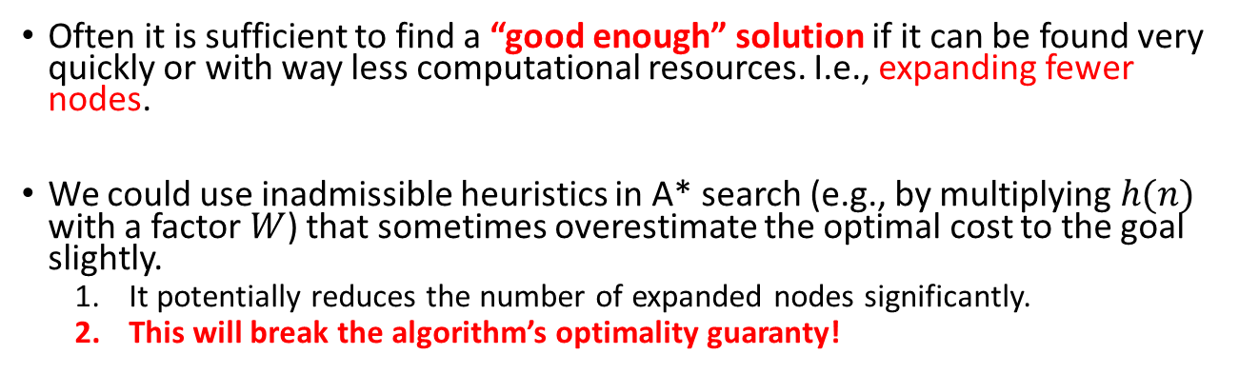
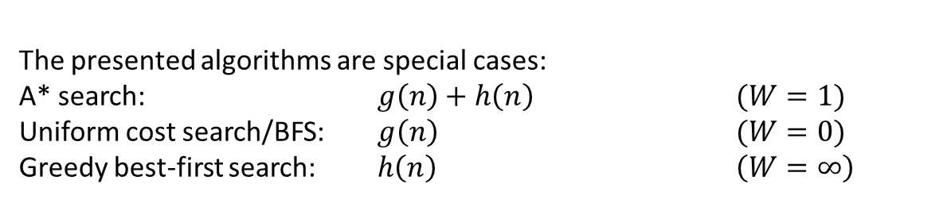

Satisficing Search: Weighted A* Search
Often it is sufficient to find a “good enough” solution if it can be found very quickly or with way less computational resources. I.e., expanding fewer nodes.
We could use inadmissible heuristics in A* search (e.g., by multiplying $h(n)$ with a factor $W$) that sometimes overestimate the optimal cost to the goal slightly.
It potentially reduces the number of expanded nodes significantly.
This will break the algorithm’s optimality guaranty!
$$f\left(n\right)=g\left(n\right)+W×h(n)$$
Weighted A* search: $g\left(n\right)+W×h\left(n\right)$ $(1<W<∞)$
The presented algorithms are special cases:
A* search: $g\left(n\right)+h\left(n\right)$ $(W=1)$
Uniform cost search/BFS: $g\left(n\right)$ $(W=0)$
Greedy best-first search: $h\left(n\right)$ $\left(W=∞\right)$

Slide 29


Case Study: Heuristic for Tic-Tac-Toe
Define the goal states:
What is the cost that needs to be estimated?
What would be a heuristic value for these boards:
How do you calculate the heuristic value?
Is the heuristic admissible?
Does the heuristic use a relaxation?

Slide 30
Assignment
Q&A

