Slide 1



CS 5/7320 Artificial Intelligence Making Simple Decisions (Decision Networks) AIMA Chapter 16
Introduction slides by Michael Hahsler
Decision network slides by Dan Klein and Pieter Abbeel
This work is licensed under a Creative Commons Attribution-ShareAlike 4.0 International License.
Online Material

Slide 2
Decision-theoretic Agents (=Utility-based Agent)
Recap
Agents based on logic: Cannot deal with uncertainty, conflicting goals, etc.
Goal-based agents: Can only assign goal/not goal to states and find goal states.
Utility-based agents
Assign a utility value to each state.
Utility is related to the external performance measure (see PEAS).
A rational agent optimizes the expected utility (i.e., is utility-based).
Decisions are made using decision theory.
Decision theory = Probability theory (evidence & belief) + Utility theory (want)

Slide 3














Simple vs. Complex Decisions
$$a_{0}$$
$$U(s_{1})$$
…
$$U(s_{T−1})$$
$$U(s_{T})$$
Currentstate $s$
Action $a$
Future state $s′$
$$U(s’)$$
Currentstate $s_{0}$
$$s_{1}$$
$$s_{T−1}$$
$$s_{T}$$
$$a_{1}$$
$$a_{T−1}$$
We make the same decision frequently + making it once does not affect future decisions. This means we have an episodic environment.
May have a stochastic environment (e.g., with non-deterministic actions or probabilistic transitions).
May be partially observable.
Sequential decision making: The agent’s utility depends on a sequence of decisions.
Search, planning, and playing games we have covered so far are such problems.
To solve this with decision theory requires different methods: Markov Decision Processes (MDP)
We focus on making simple decisions for now!

Slide 4


Utility
+
A utility function $U\left(s\right)$ expresses the desirability of being in state $s$.
Utility functions are derived from preferences:
$U\left(A\right)>U\left(B\right)\overset{⇔}{}A≻B$ and $$U\left(A\right)=U\left(B\right)\overset{⇔}{}A \sim B$$
It is often enough to know an ordinal utility function representing a ranking of states to make decisions like move to the better state.
To use expectation, we need a cardinal utility function where the number represents levels of absolute satisfaction. That is $2×U$ is twice as good as $U$!
10
10
20

Slide 5



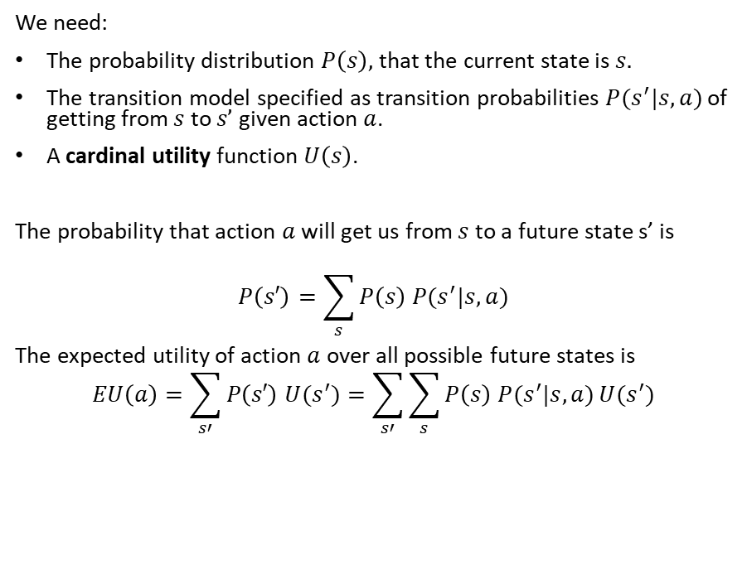

Expected Utility of an Action Under Uncertainty
If I do action $a$ then I will have later have
Currentstate $s$
Action $a$
Future state $s′$
$$U(s’)$$
We need:
The probability distribution $P\left(s\right),$that the current state is $s.$
The transition model specified as transition probabilities $P(s^{′}|s,a)$ of getting from $s$ to $s’$ given action $a$.
A cardinal utility function $U\left(s\right)$.
The probability that action $a$ will get us from $s$ to a future state s’ is
$$P\left(s′\right)=\sum_{s}{P\left(s\right) P(s^{′}|s,a)}$$
The expected utility of action $a$ over all possible future states is $$EU\left(a\right)=\sum_{s′}{P\left(s′\right) U(s^{′})}=\sum_{s′}{\sum_{s}{P\left(s\right) P(s^{′}|s,a)}U(s^{′})}$$

Slide 6


Principle of Maximum Expected Utility (MEU)
Action?
Given the expected utility of an action $$EU\left(a\right)=\sum_{s′}{\sum_{s}{P\left(s\right) P(s^{′}|s,a)}U(s^{′})}$$
Choose the action that maximizes the expected utility: $$a^{∗}={argmax}_{a} EU(a)$$
Issue:
$P(s^{′}|s,a)$ will be a very large table if we have many states .
Possible solution:
Bayes Nets with a factored state representation considering independence between variable describing the state.

Slide 7
Decision Networks Using Bayes Nets to calculate the Expected Utility of Actions.
These slides were created by Dan Klein, Pieter Abbeel, Sergey Levine, with some materials from A. Farhadi. All CS188 materials are at http://ai.berkeley.edu

Slide 8

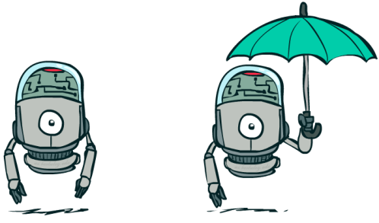
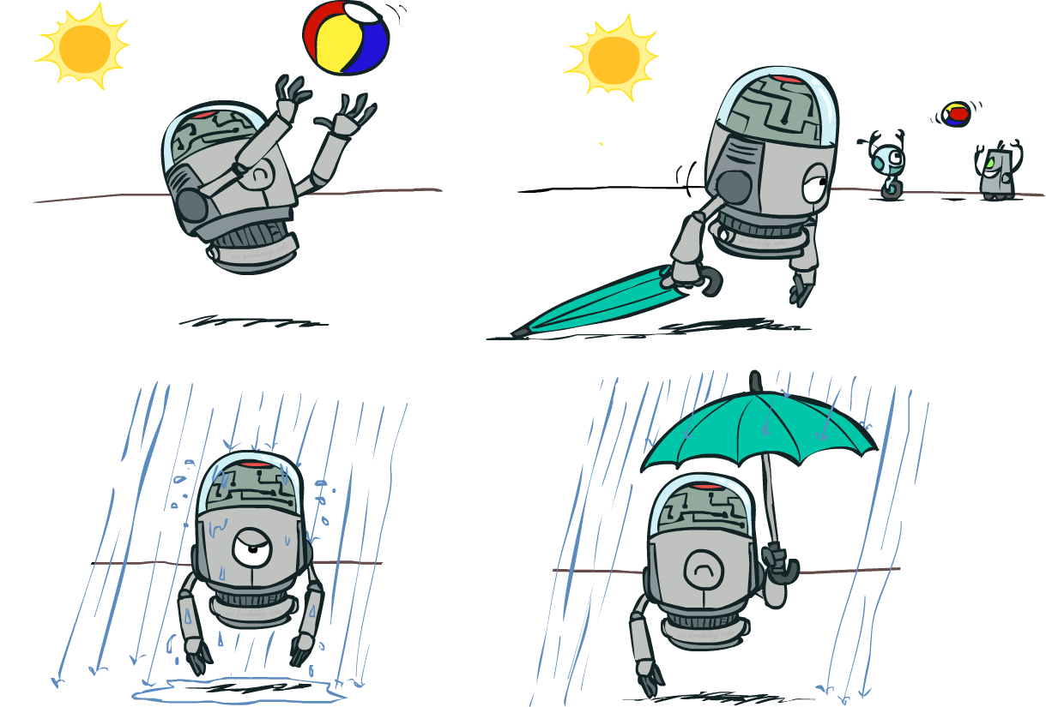

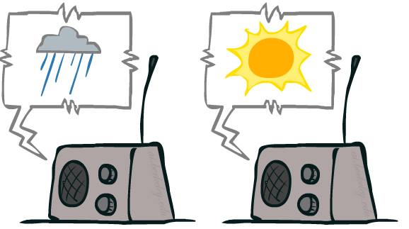
Example: Decision Networks
Action
Utility
Umbrella
U
Weather
Random Events
Forecast
Notes:
There exists a ghostbusters demo

Slide 9
Definition: Decision Networks
Decision networks
Bayes nets with additional nodes for utility and actions.
Allows to specify the joint probability in a compact way using independence.
Calculate the expected utility for each possible action and choose the best.
Node types
Chance nodes: Random variables in BNs
Action nodes: Cannot have parents, act as observed evidence
Utility node: Depends on action and chance nodes
Umbrella
U
Weather
Forecast
Notes:
There exists a ghostbusters demo

Slide 10
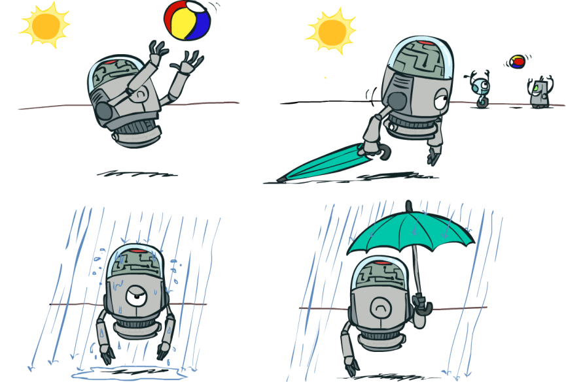
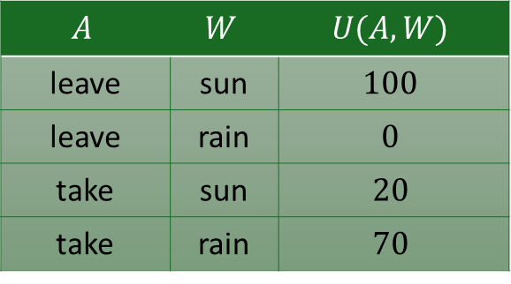
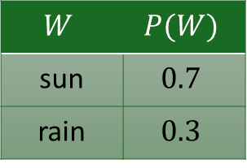
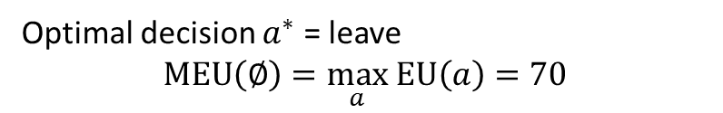
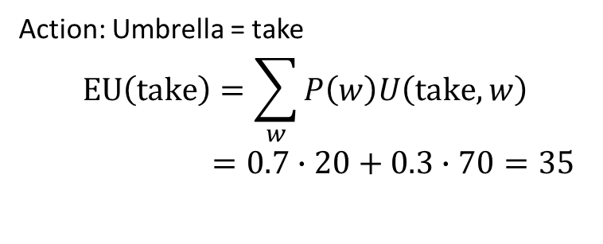
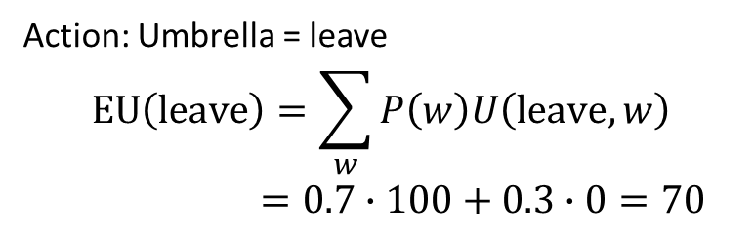
Decision Network without Forecast
Action: Umbrella = leave
$$EU\left(leave\right)=\sum_{w}{P\left(w\right)U\left(leave,w\right)}$$
$=0.7∙100+0.3∙0=70$
Umbrella (A)
U
Action: Umbrella = take
$$EU\left(take\right)=\sum_{w}{P\left(w\right)U\left(take,w\right)}$$
$=0.7∙20+0.3∙70=35$
Weather
$$W$$ | $$P(W)$$
sun | $$0.7$$
rain | $$0.3$$
$$A$$ | $$W$$ | $$U(A,W)$$
leave | sun | $$100$$
leave | rain | $$0$$
take | sun | $$20$$
take | rain | $$70$$
Optimal decision $a^{∗}$ = leave
$$MEU\left(∅\right)=\max_{a} EU\left(a\right)=70$$
Notes:
There exists a ghostbusters demo

Slide 11
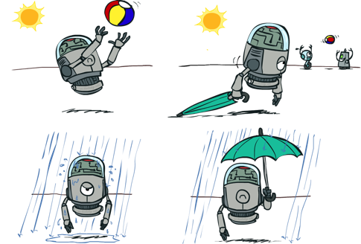
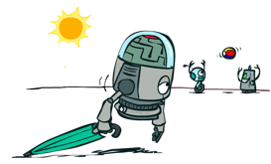


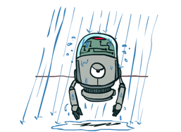
Decisions as Outcome Trees
{} … no evidence available
{}
Action
take
leave
Umbrella
Weather | {}
Weather | {}
U
Random Event
Weather
sun
sun
rain
rain
U(t,s)
U(t,r)
U(l,s)
U(l,r)
This is similar to an AND-OR tree!

Slide 12

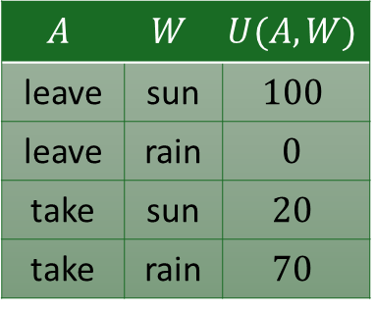
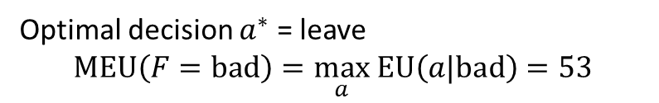
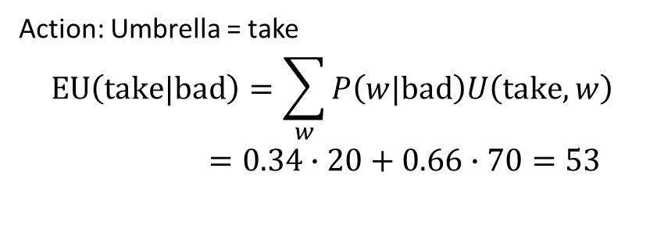
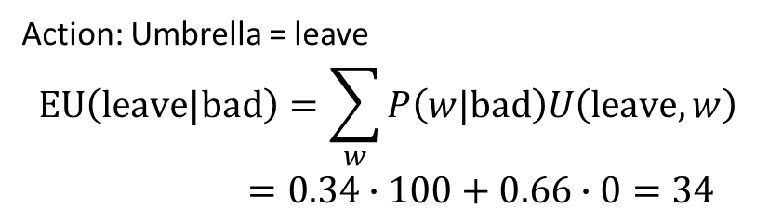
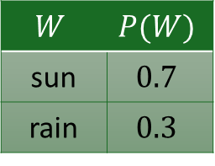
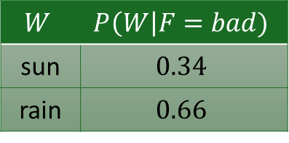
Decision Network with Bad Forecast
Action: Umbrella = leave
$$EU\left(leave|bad\right)=\sum_{w}{P\left(w|bad\right)U\left(leave,w\right)}$$
$=0.34∙100+0.66∙0=34$
Umbrella (A)
$$A$$ | $$W$$ | $$U(A,W)$$
leave | sun | $$100$$
leave | rain | $$0$$
take | sun | $$20$$
take | rain | $$70$$
U
Action: Umbrella = take
$$EU\left(take|bad\right)=\sum_{w}{P\left(w|bad\right)U\left(take,w\right)}$$
$=0.34∙20+0.66∙70=53$
Weather
$$W$$ | $$P(W)$$
sun | $$0.7$$
rain | $$0.3$$
$$W$$ | $$P\left(W\right|F=bad)$$
sun | $$0.34$$
rain | $$0.66$$
Optimal decision $a^{∗}$ = leave
$$MEU\left(F=bad\right)=\max_{a} EU\left(a|bad\right)=53$$
Forecast
=bad
A forecast of bad weather is a result of an increased the probability of rain!

Slide 13

Decisions as Outcome Trees with Evidence
{b} … evidence of bad weather forecast is a result of increased the probability of rain
Umbrella
{b}
take
leave
U
W | {b}
W | {b}
Weather
sun
sun
rain
rain
U(t,s)
U(t,r)
U(l,s)
U(l,r)
Forecast
=bad
This is similar to an AND-OR tree!

Slide 14
Conclusion
Decision networks are an extension of Bayes nets that add actions and utility to compactly specify the joint probability. The network is used to calculate the expected utility of actions.
Decision networks can be used to make simple repeated decisions in a stochastic, partially observable, and episodic environment.
Sequential decision-making deals with decisions that influence each other and are made over time. This is a more complex decision problem and needs different methods like Markov Decision Processes.

