Slide 1
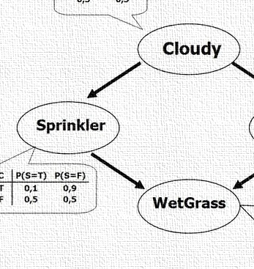


CS 5/7320 Artificial Intelligence Probabilistic Reasoning AIMA Chapter 13
Slides by Michael Hahsler based on slides by Svetlana Lazepnik with figures from the AIMA textbook
This work is licensed under a Creative Commons Attribution-ShareAlike 4.0 International License.
Online Material

Slide 2
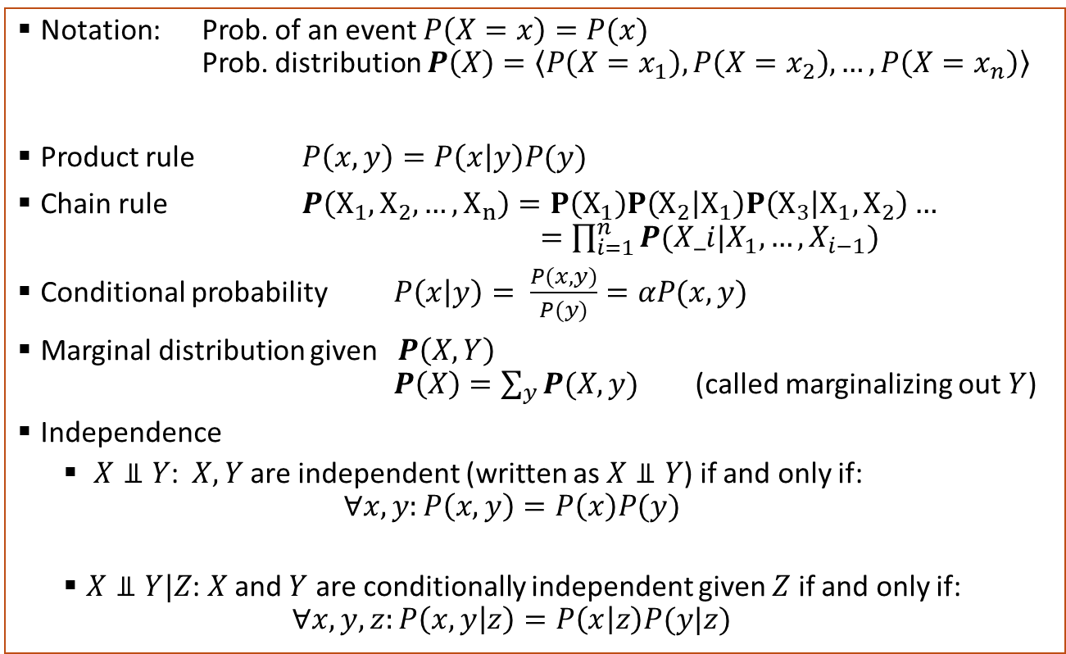
Probability Theory Recap
Notation: Prob. of an event $P\left(X=x\right)=P(x)$ Prob. distribution $P\left(X\right)=\left\langle P\left(X=x_{1}\right), P\left(X=x_{2}\right), …, P\left(X=x_{n}\right)\right\rangle$
Product rule $P\left(x,y\right)=P\left(x | y\right)P(y)$
Chain rule $P\left(X_{1},X_{2},…,X_{n}\right)=P\left(X_{1}\right)P\left(X_{2} | X_{1}\right)P\left(X_{3} | X_{1},X_{2}\right)…$ $=\prod_{i=1}^{n}{P(X_i|X_{1},…,X_{i−1})}$
Conditional probability $P\left(x | y\right)= \frac{P(x,y)}{P(y)}=αP(x,y)$
Marginal distribution given $P\left(X,Y\right)$ $P\left(X\right)=\sum_{y}{P(X,y)}$ (called marginalizing out $Y$)
Independence
$X⫫Y$: $X, Y$are independent (written as $X⫫Y$) if and only if: $∀x,y:P\left(x,y\right)=P\left(x\right)P(y)$
$X⫫Y|Z$: $X$ and $Y$ are conditionally independent given $Z$ if and only if: $∀x,y,z:P\left(x,y | z\right)=P\left(x | z\right)P(y|z)$

Slide 3
Contents
Bayesian Networks to Specify Dependence
Exact Inference
Approximate Inference

Slide 4

Bayesian Networks
Modeling a Joint Distribution

Slide 5
Bayesian Networks (aka Belief Networks)
Weather
Cavity
Toothache
Catch
A type of graphical model.
A way to specify dependence between random variables.
A compact specification of a full joint probability distribution.
A general and important model to reason with uncertainty in AI.

Slide 6
Structure of Bayesian Networks
Weather
Cavity
Nodes: Random variables
Can be assigned (observed) or unassigned (unobserved)
Arcs: Dependencies
An arrow from one variable to another indicates direct influence.
Show independence
Weather is independent of the other variables (no connection).
Toothache and Catch are conditionally independent given Cavity (directed arc).
Must form a directed acyclic graph (DAG)
A network with all random variables assigned represents a state of the system.
Toothache
Catch

Slide 7
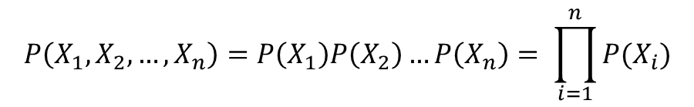
Example: N independent coin flips
Complete independence: no interactions between coin flips
…
X₁
X₂
X_{n}
$$P\left(X_{1},X_{2},…,X_{n}\right)=P\left(X_{1}\right)P\left(X_{2}\right)…P\left(X_{n}\right)= \prod_{i=1}^{n}{P(X_{i})}$$
Joint probability distribution

Slide 8
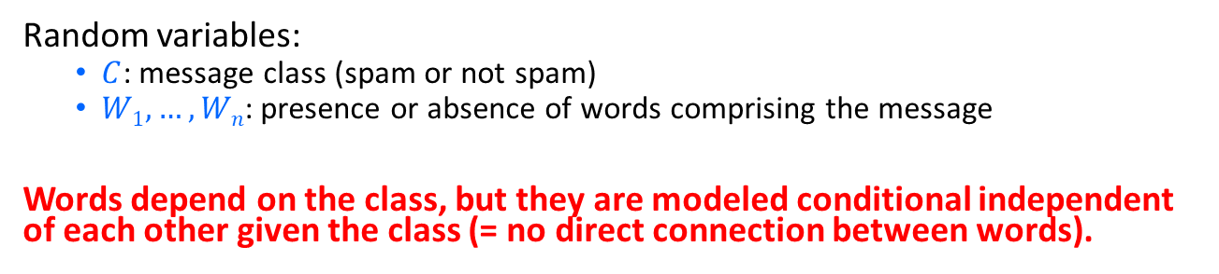

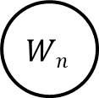
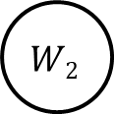
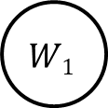
Example: Naïve Bayes spam filter
Random variables:
$C$: message class (spam or not spam)
$W1, …, Wn$: presence or absence of words comprising the message
Words depend on the class, but they are modeled conditional independent of each other given the class (= no direct connection between words).
$$C$$
…
$$W1$$
$$W2$$
$$Wn$$
$$P\left(W_{1},W_{2},…,W_{n}|C\right)=P\left(W_{1}|C\right)P\left(W_{2}|C\right)…P(W_{n}|C)$$

Slide 9
Example: Burglar Alarm
Description: I have a burglar alarm that is sometimes set off by minor earthquakes. My two neighbors, John and Mary, promised to call me at work if they hear the alarm
Example inference task: suppose Mary calls and John doesn’t call. What is the probability of a burglary?
What are the random variables?
Burglary, Earthquake, Alarm, JohnCalls, MaryCalls
What are the direct influence relationships?
A burglar can set off the alarm
An earthquake can set off the alarm
The alarm can cause Mary to call
The alarm can cause John to call

Slide 10
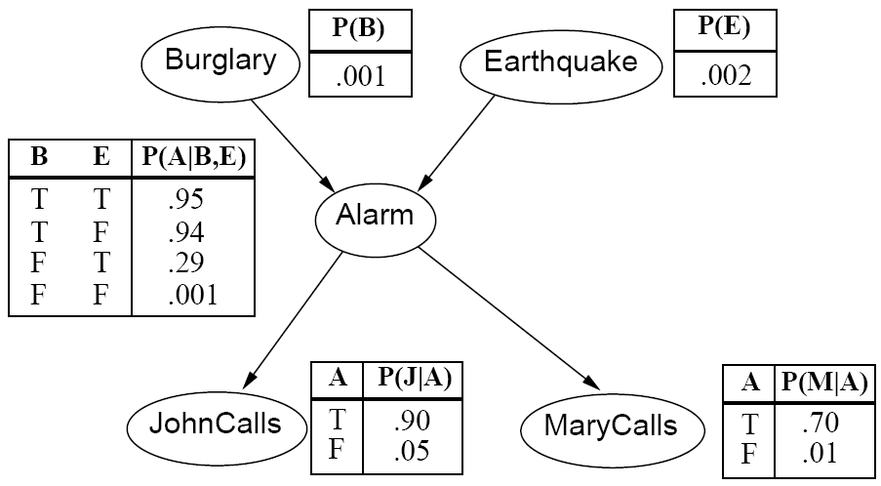
Example: Burglar Alarm as a Network
Direct influence relationships:
A burglar can set off the alarm
An earthquake can set off the alarm
The alarm can cause Mary to call
The alarm can cause John to call

Slide 11






Parameters: Conditional probability tables
The full joint distribution, can be broken down into conditional distribution for each node given its parents: $$P (X | Parents(X))$$
These distributions are stored in conditional probability tables (CPTs)
…
Example:
$$Z1$$
$$Z2$$
$$Zn$$
$$X$$
$$P (X | Z1, …, Zn)$$

Slide 12
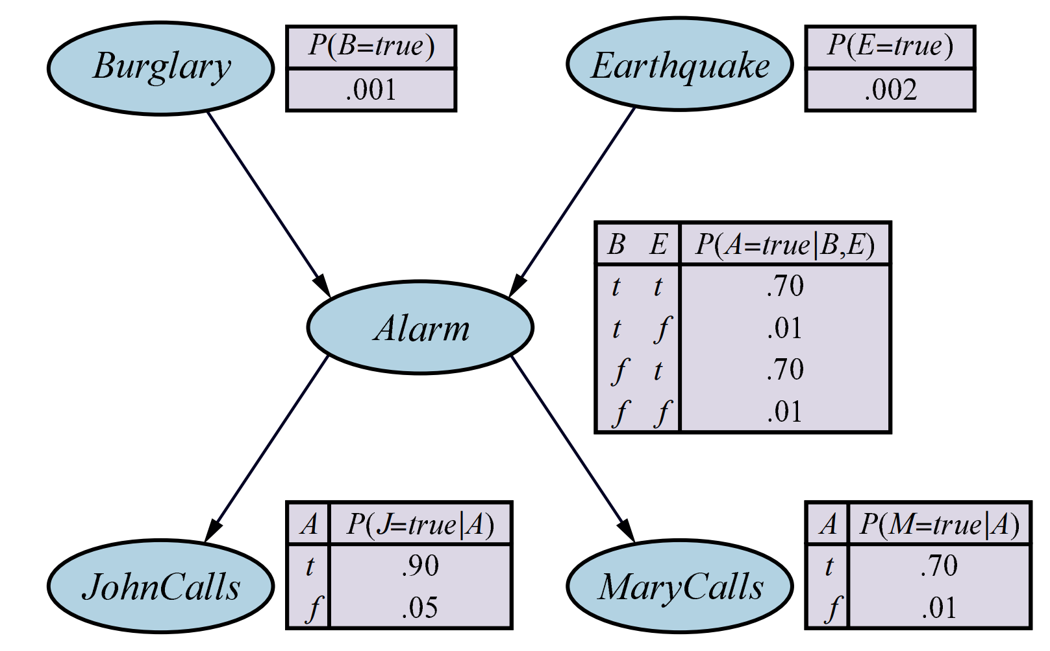
Example: Burglar Alarm with CPTs
No parents
2 parents
1 parent

Slide 13
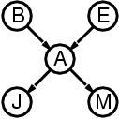
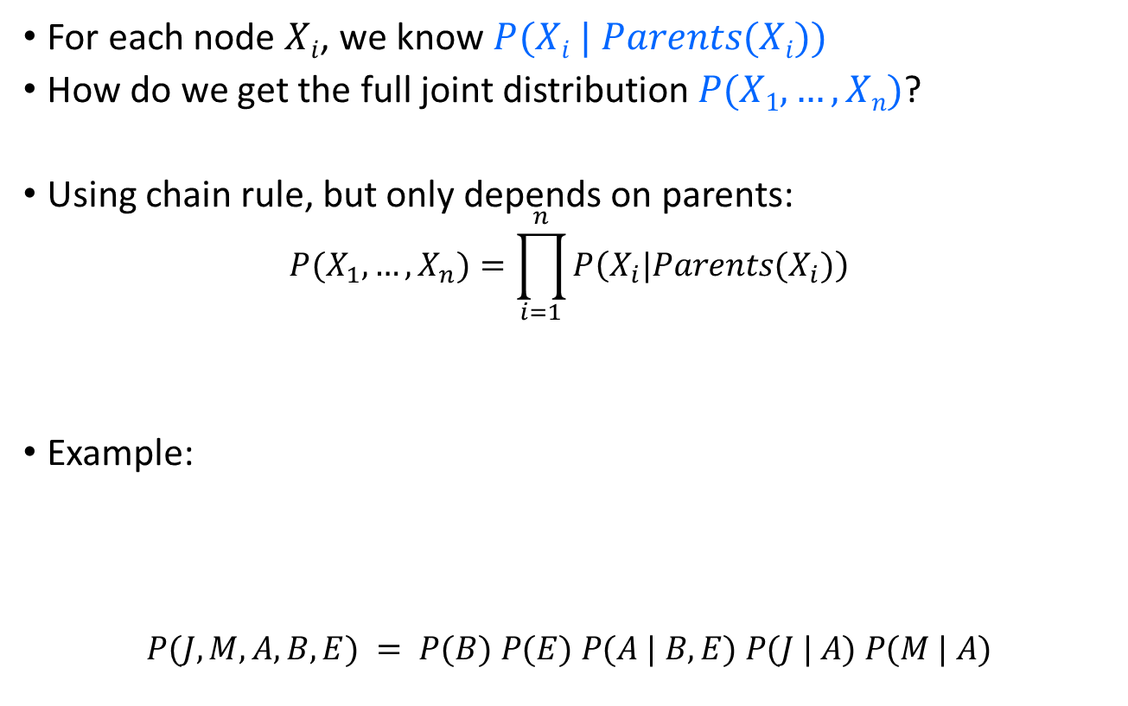
The Joint Probability Distribution
For each node $Xi$, we know $P(Xi | Parents(Xi))$
How do we get the full joint distribution $P(X1, …, Xn)$?
Using chain rule, but only depends on parents:
$$P(X_{1},…,X_{n})=\prod_{i=1}^{n}{P\left(X_{i}|Parents(X_{i})\right)}$$
Example:
$$P(J, M, A, B, E) = P(B) P(E) P(A | B, E) P(J | A) P(M | A)$$
Construct following arrows

Slide 14
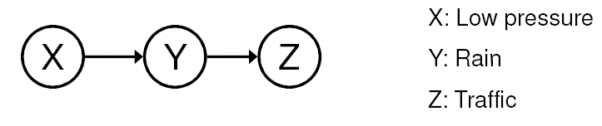
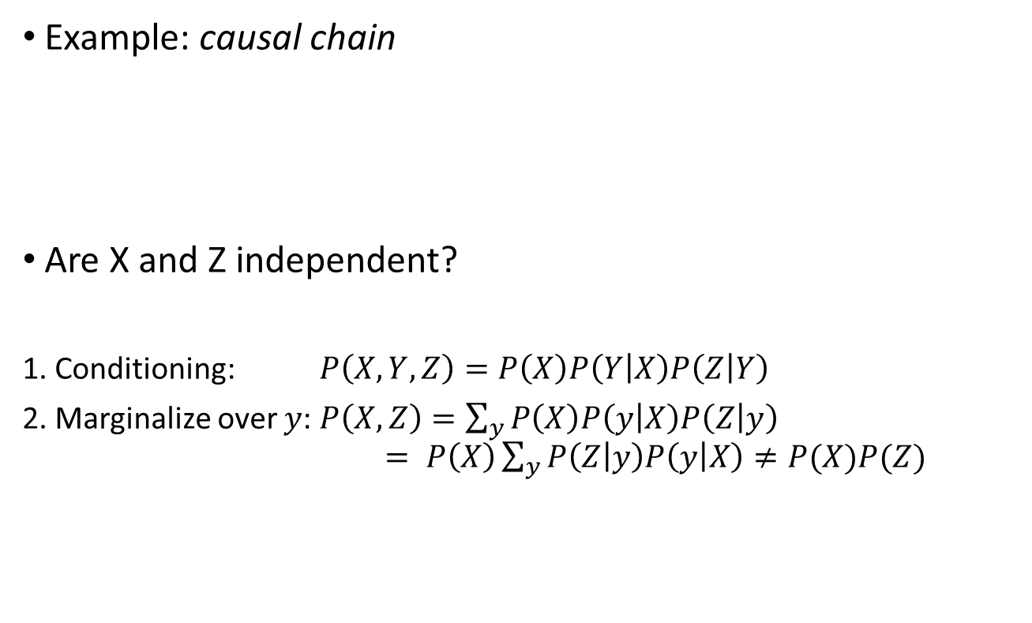
Dependence
Example: causal chain
Are X and Z independent?
1. Conditioning: $P\left(X,Y,Z\right)=P\left(X\right)P\left(Y | X\right)P\left(Z | Y\right)$
2. Marginalize over $y$: $P\left(X,Z\right)=\sum_{y}{P\left(X\right)P\left(y | X\right)P\left(Z | y\right)}$ $= P\left(X\right)\sum_{y}{P\left(Z | y\right)P\left(y | X\right)≠P(X)P(Z) }$
We are not interested in y.
X and Z are not independent!

Slide 15
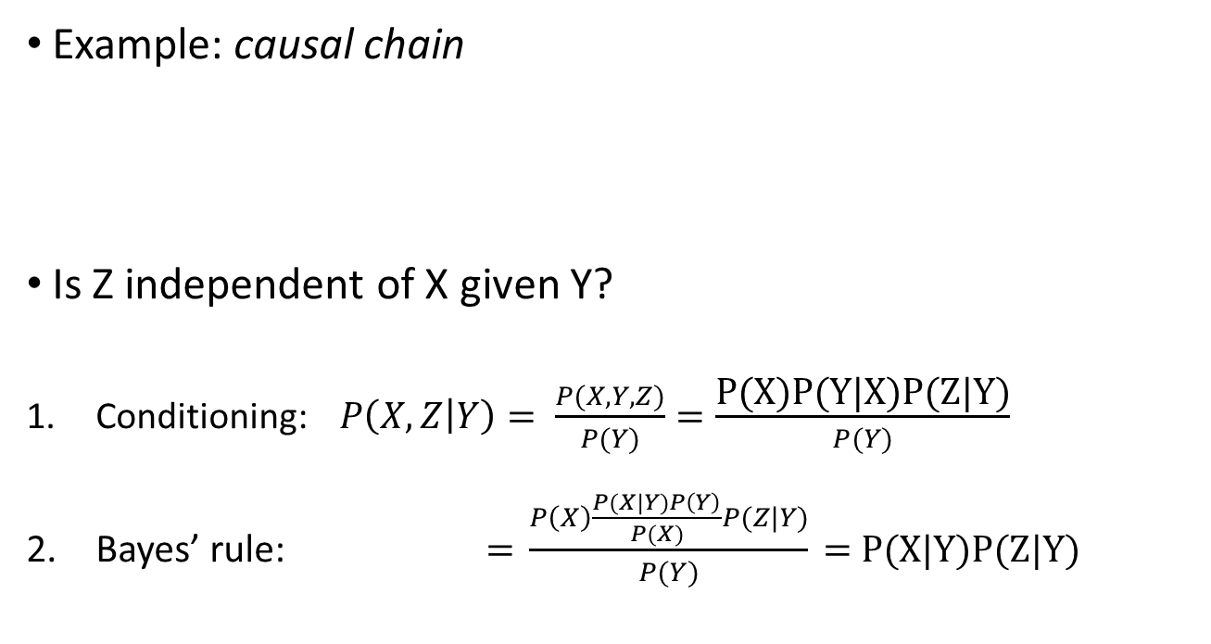
Conditional Independence
Example: causal chain
Is Z independent of X given Y?
Conditioning: $P\left(X,Z | Y\right)= \frac{P(X,Y,Z)}{P(Y)}=\frac{\text{P}\text{(}\text{X}\text{)}\text{P}\text{(}\text{Y}\text{|}\text{X}\text{)}\text{P}\text{(}\text{Z}\text{|}\text{Y}\text{)}}{P(Y)}$
Bayes’ rule: $\text{= }\frac{P\left(X\right)\frac{P(X|Y)P\left(Y\right)}{P(X)}P(Z|Y)}{P(Y)}\text{ = }\text{P}\text{(}\text{X}\text{|}\text{Y}\text{)}\text{P}\text{(}\text{Z}\text{|}\text{Y}\text{)}$
= Definition of conditional independence
X and Z are conditionally independent given Y

Slide 16
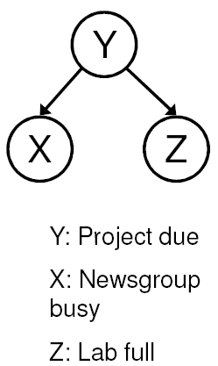
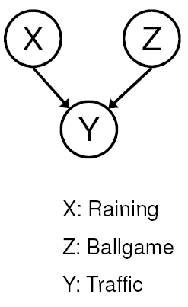
Conditional Independence cont.
Common cause
Are X and Z independent?
No
Are they conditionally independent given Y?
Yes
Common effect
Are X and Z independent?
Yes
Are they conditionally independent given Y?
No

Slide 17
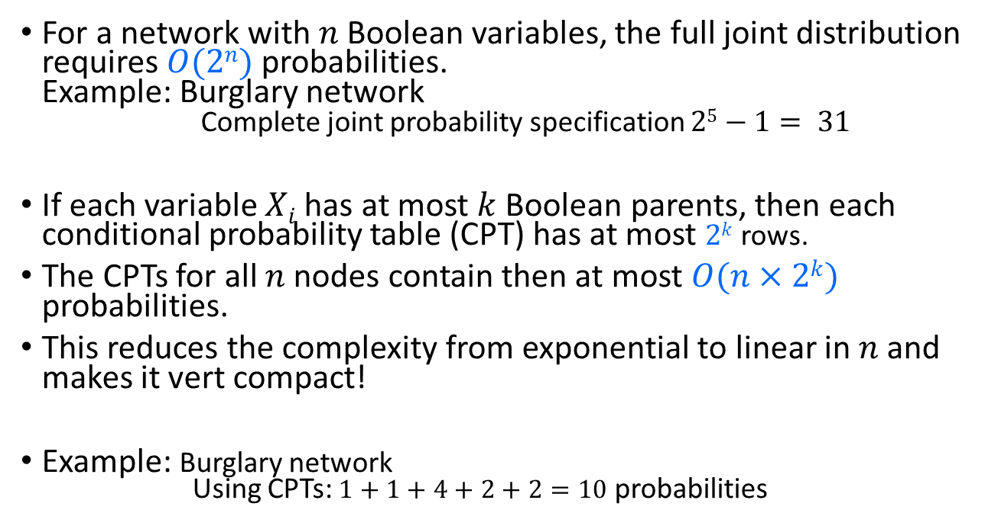
Compactness
For a network with $n$ Boolean variables, the full joint distribution requires $O(2n)$probabilities. Example: Burglary network Complete joint probability specification $25−1= 31$
If each variable $Xi$ has at most $k$ Boolean parents, then each conditional probability table (CPT) has at most $2k$ rows.
The CPTs for all $n$ nodes contain then at most $O(n×2k)$ probabilities.
This reduces the complexity from exponential to linear in $n$ and makes it vert compact!
Example: Burglary network Using CPTs: $1+1+4+2+2=10$ probabilities

Slide 18
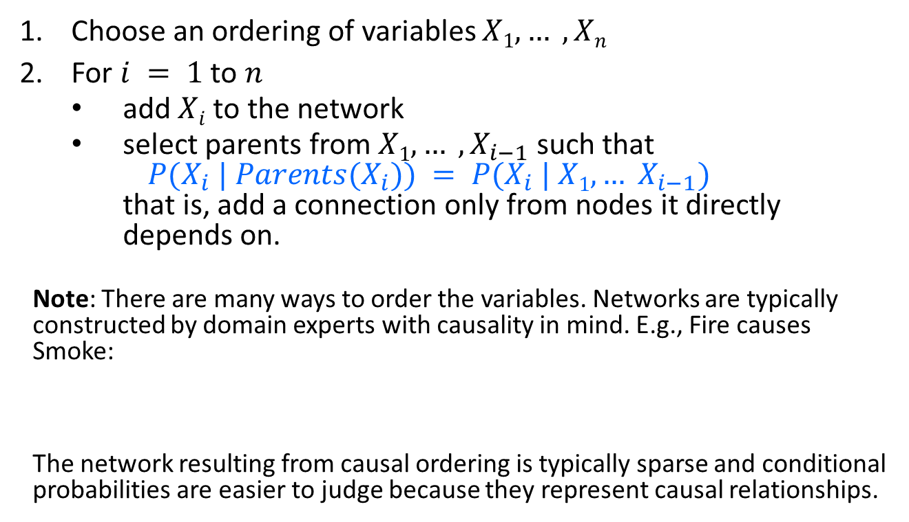
Constructing Bayesian Networks
Choose an ordering of variables $X1, … , Xn$
For $i = 1$to $n$
add $Xi$to the network
select parents from $X1, … ,X_{i−1}$ such that $P(X_{i} | Parents(X_{i})) = P(X_{i} | X1, … X_{i−1})$ that is, add a connection only from nodes it directly depends on.
Note: There are many ways to order the variables. Networks are typically constructed by domain experts with causality in mind. E.g., Fire causes Smoke:
The network resulting from causal ordering is typically sparse and conditional probabilities are easier to judge because they represent causal relationships.
Fire
Smoke

Slide 19
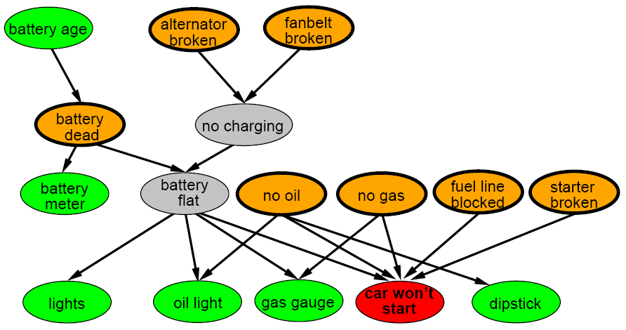
A more realistic Bayes Network: Car diagnosis
Initial observation: car won’t start.
Green: testable evidence.
Orange: reasons: “if broken, then fix it”
Gray: “hidden variables” to ensure sparse structure, reduce parameters
Initial Observation

Slide 20
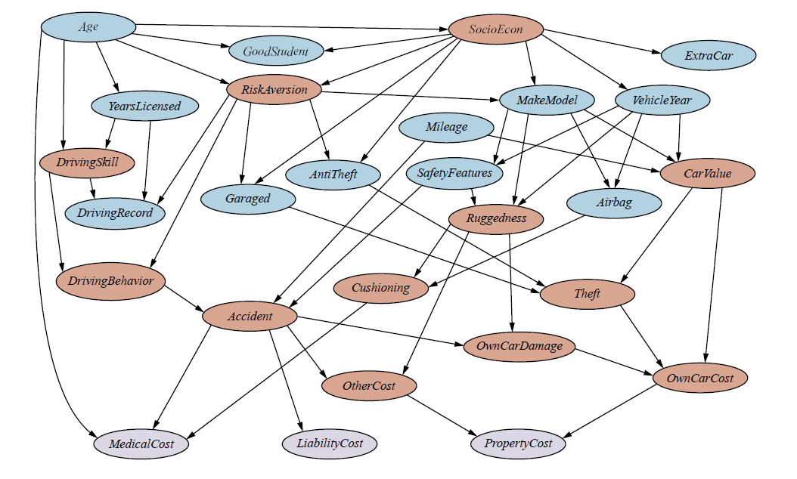
Car insurance: Cost is affected by many factors

Slide 21
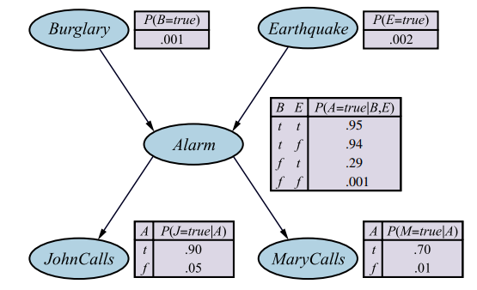

Summary
Bayesian networks provide a natural representation for joint probabilities used to calculated conditional probabilities needed for inference (prediction).
Independence and conditional independence (induced by causality) reduces the number of needed parameters and creates a compact network.
Representation
Topology (nodes and edges)
Conditional probability tables
Typically easy for domain experts to construct
$P(B, E, A, J, M)$ is defined by

Slide 22
Exact Inference in BN
Calculate the posterior probability given evidence

Slide 23
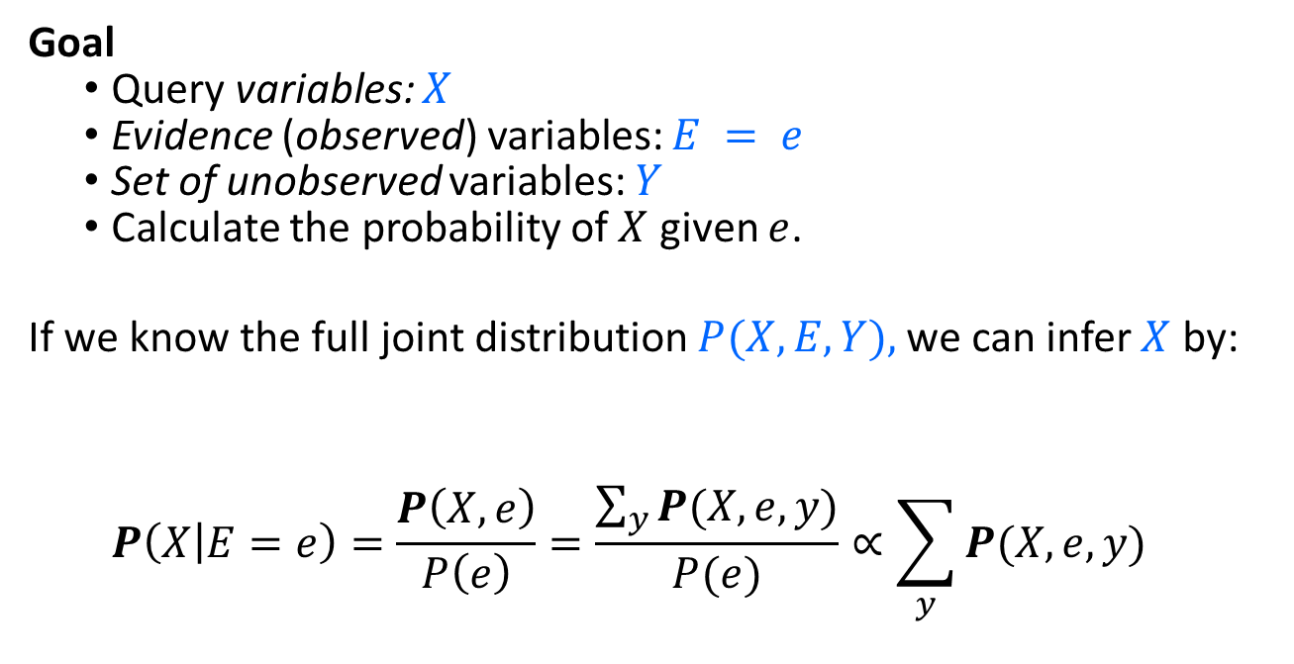
Exact Inference
Goal
Query variables: $X$
Evidence (observed) variables: $E = e$
Set of unobserved variables: $Y$
Calculate the probability of $X$ given $e$.
If we know the full joint distribution $P(X, E, Y),$we can infer $X$ by:
$$P\left(X | E=e\right)=\frac{P\left(X,e\right)}{P\left(e\right)}=\frac{\sum_{y}{P(X,e,y)}}{P(e)}∝\sum_{y}{P(X,e,y)}$$
Sum over values of unobservable variables = marginalizing them out.

Slide 24
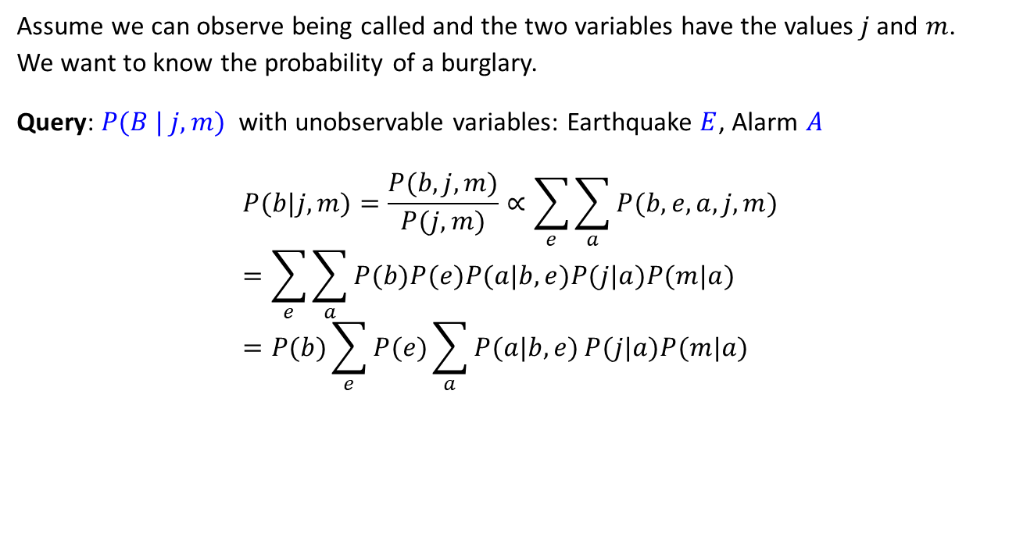
Exact inference: Example – Calculation
Assume we can observe being called and the two variables have the values$j$and $m$.
We want to know the probability of a burglary.
Query: $P(B | j, m)$ with unobservable variables: Earthquake $E$, Alarm $A$
$$P(b|j,m)=\frac{P(b,j,m)}{P(j,m)}∝\sum_{e}{\sum_{a}{P(b,e,a,j,m)}} \\ =\sum_{e}{\sum_{a}{P(b)P(e)P(a|b,e)P(j|a)P(m|a)}} \\ =P(b)\sum_{e}{P(e)\sum_{a}{P(a|b,e)}P(j|a)P(m|a)}$$
Full joint probability and marginalize over E and A

Slide 25
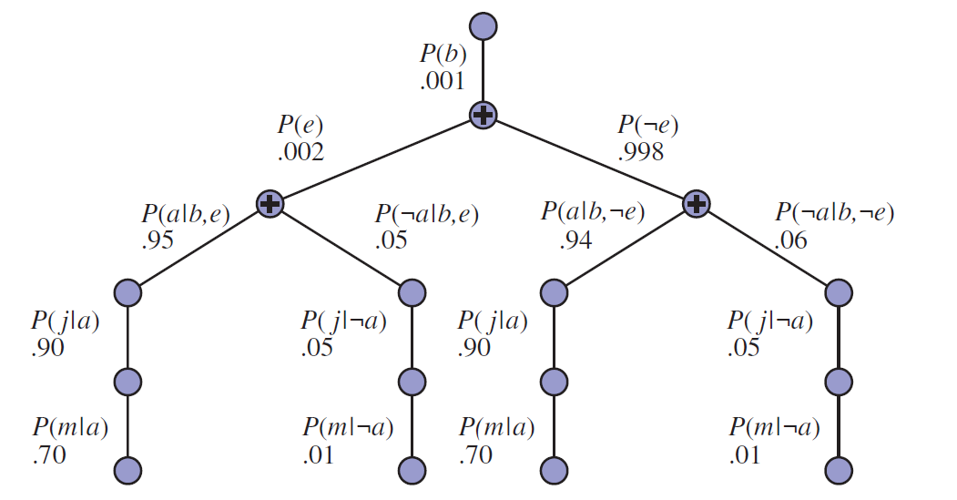

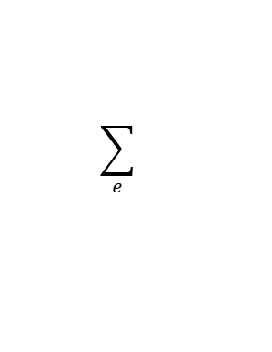
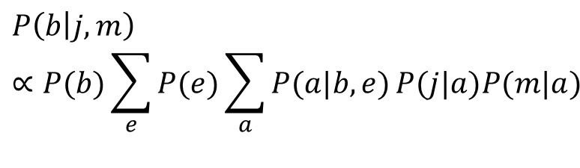
Exact inference: Example – Evaluation Tree
$$P\left(b | j,m\right)∝P(b)\sum_{e}{P(e)\sum_{a}{P(a|b,e)}P(j|a)P(m|a)}$$
Implementation using an evaluation tree and CPTs (lines represent multiplications)
$$\sum_{e}{}$$
$$\sum_{a}{}$$

Slide 26
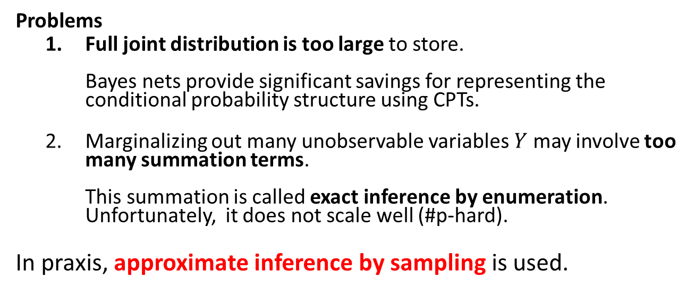
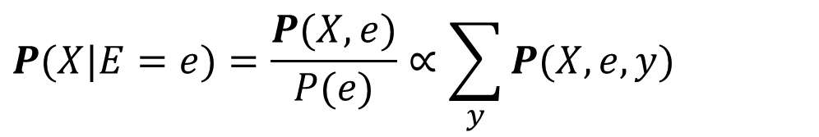
Issues with Exact Inference in AI
$$P(X|E=e)=\frac{P(X,e)}{P(e)}∝\sum_{y}{P(X,e,y)}$$
Problems
Full joint distribution is too large to store. Bayes nets provide significant savings for representing the conditional probability structure using CPTs.
Marginalizing out many unobservable variables $Y$ may involve too many summation terms. This summation is called exact inference by enumeration. Unfortunately, it does not scale well (#p-hard).
In praxis, approximate inference by sampling is used.

Slide 27
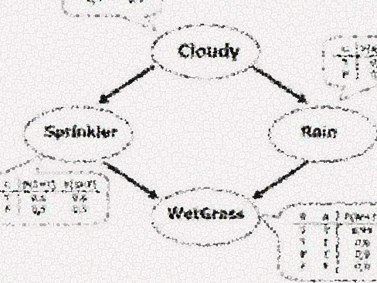
Approximate Inference in BN
Estimate the posterior probability given evidence

Slide 28
Bayesian Networks as a Generative Models
Bayesian networks can be used as generative models.
Generative models allow us to efficiently generate samples from the joint distribution.
Idea: Generate samples from the network to estimate joint and conditional probability distributions using Monte Carlo methods.

Slide 29
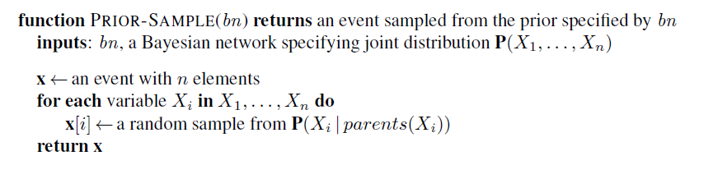
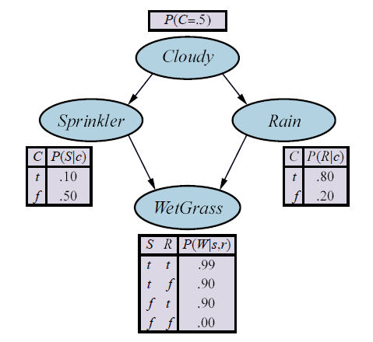
Prior-Sample Algorithm
Order is important! We need to start with the random variables that have no parents.
Variable Order

Slide 30
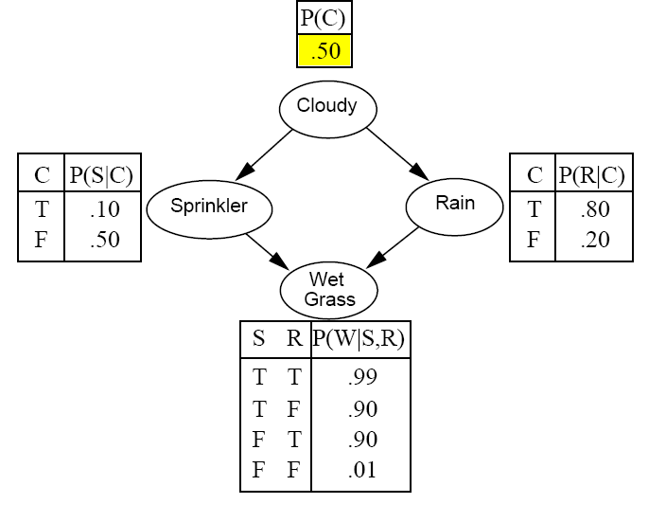
Example: Sampling from a Bayesian Network
Variable order

Slide 31
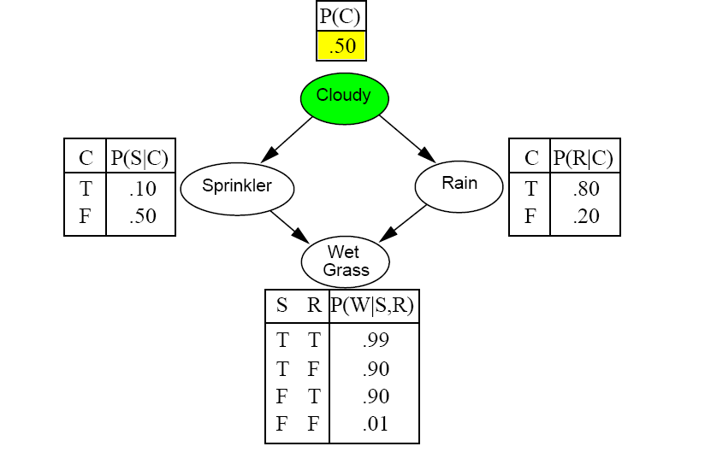
Example: Sampling from a Bayesian Network
Draw a random value using the probability.

Slide 32
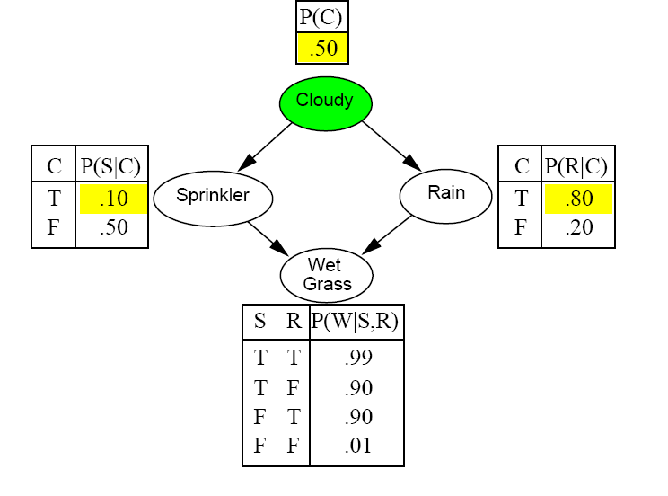
Example: Sampling from a Bayesian Network

Slide 33
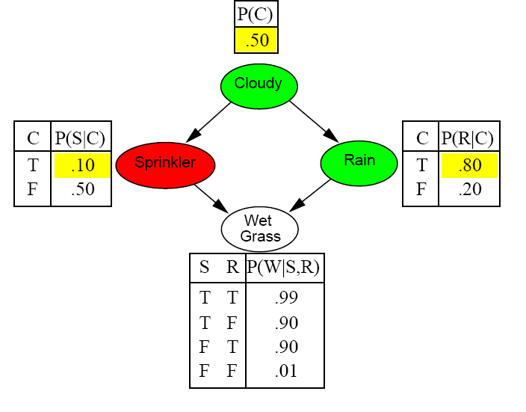
Example: Sampling from a Bayesian Network

Slide 34
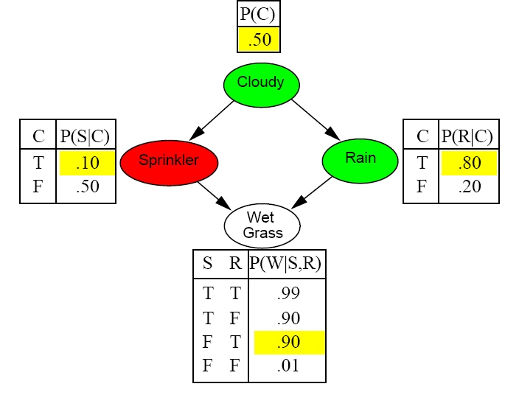
Example: Sampling from a Bayesian Network

Slide 35
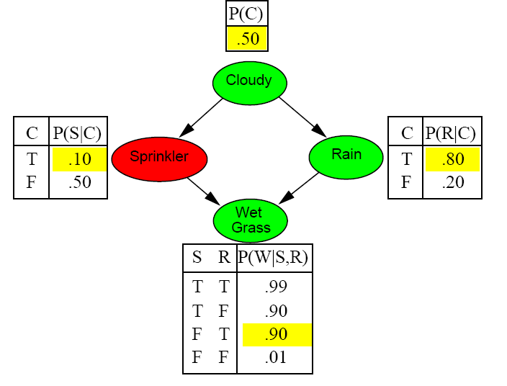
Example: Sampling from a Bayesian Network
Prior Sample returns the event:
[C = True, S = False, R = True, W = True]

Slide 36
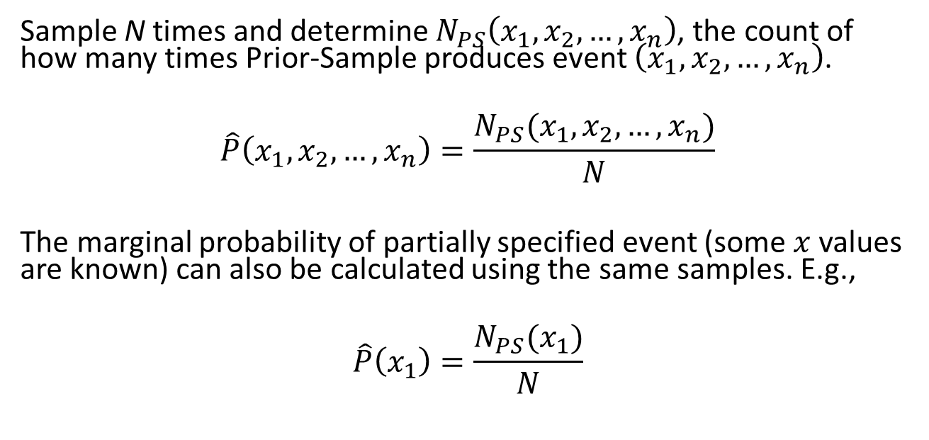
Estimating the Joint Probability Distribution from Individual Samples
Sample N times and determine $N_{PS}\left(x_{1},x_{2},…,x_{n}\right)$, the count of how many times Prior-Sample produces event $\left(x_{1},x_{2},…,x_{n}\right)$.
$$\hat{P}\left(x_{1},x_{2},…,x_{n}\right)=\frac{N_{PS}(x_{1},x_{2},…,x_{n})}{N}$$
The marginal probability of partially specified event (some $x$ values are known) can also be calculated using the same samples. E.g.,
$$\hat{P}\left(x_{1}\right)=\frac{N_{PS}(x_{1})}{N}$$

Slide 37
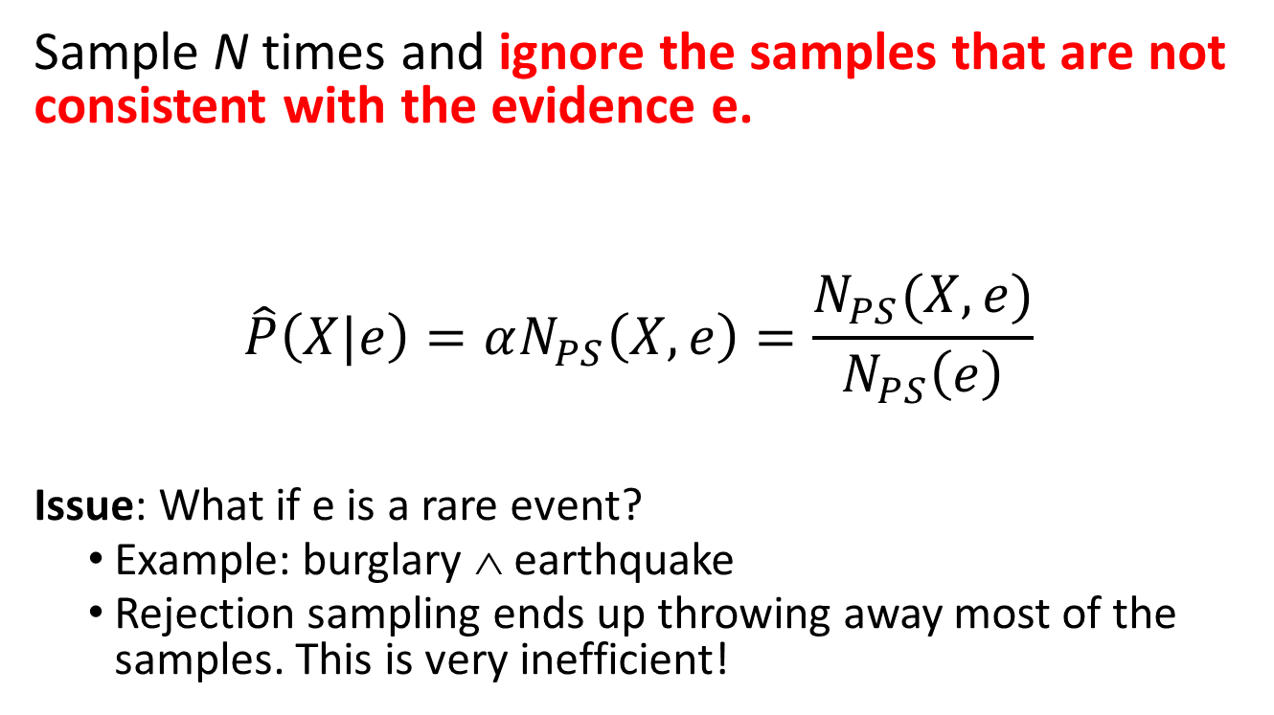
Estimating Conditional Probabilities: Rejection Sampling
Sample N times and ignore the samples that are not consistent with the evidence e.
$$\hat{P}\left(X|e\right)=αN_{PS}\left(X,e\right)=\frac{N_{PS}(X,e)}{N_{PS}\left(e\right)}$$
Issue: What if e is a rare event?
Example: burglary ∧ earthquake
Rejection sampling ends up throwing away most of the samples. This is very inefficient!

Slide 38
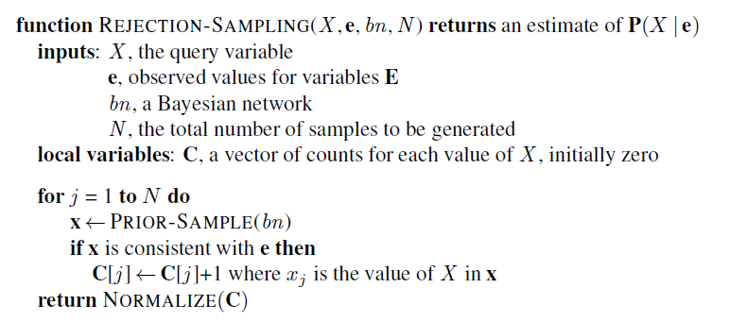
Estimating Conditional Probabilities: Rejection Sampling
We throw away many samples if e is rare!

Slide 39
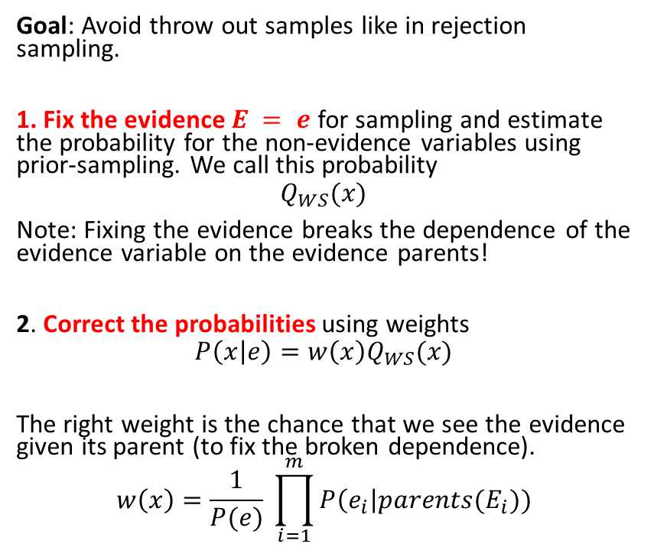
Estimating Conditional Probabilities: Importance Sampling (likelihood weighting)
Goal: Avoid throw out samples like in rejection sampling.
1. Fix the evidence $E = e$ for sampling and estimate the probability for the non-evidence variables using prior-sampling. We call this probability
$$Q_{WS}(x)$$
Note: Fixing the evidence breaks the dependence of the evidence variable on the evidence parents!
2. Correct the probabilities using weights
$$P\left(x | e\right)=w\left(x\right)Q_{WS}(x)$$
The right weight is the chance that we see the evidence given its parent (to fix the broken dependence).
$$w\left(x\right)=\frac{1}{P(e)} \prod_{i=1}^{m}{P\left(e_{i}\right|parents(E_{i}))}$$
Example: Evidence = it rains
1. Fix as true

Slide 40
Estimating Conditional Probabilities: Markov Chain Monte Carlo Sampling (MCMC)
Idea: Instead of creating each sample individually from scratch, generates a sequence of samples.
Create the next state (= sample) by making random changes to the current state (= modify non-evidence variables). The sequence of states forms a random process called a Markov Chain (MC).
The MC’s stationary distribution turns out to be the posterior distribution of the non-evidence variables.
The stationary distribution of a MC can be estimated using Monte Carlo simulation by counting how often each state is reached and normalize to obtain probability estimates.
Algorithms:
Gibbs sampling works well for BNs since we have CPTs.
Metropolis-Hastings sampling is more general.
Note: Simulated annealing local search belongs to the family of MCMC algorithms.

Slide 41
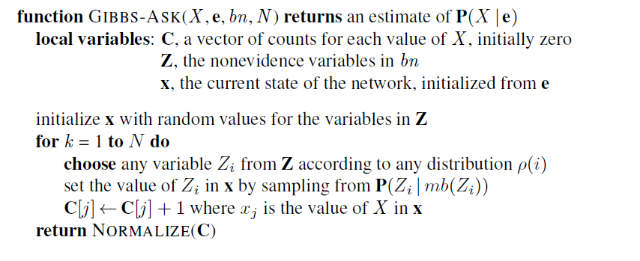
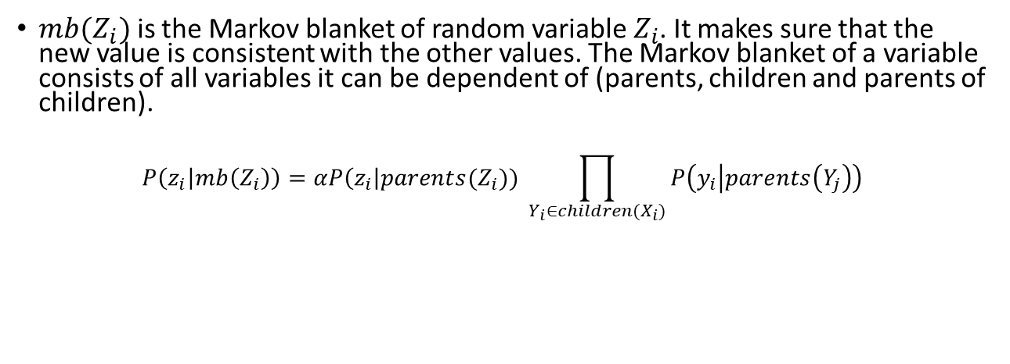
Gibbs Sampling in Bayes Networks
Start with a random state
Change one non-evidence variable at a time
Count
$mb(Z_{i})$ is the Markov blanket of random variable $Z_{i}$. It makes sure that the new value is consistent with the other values. The Markov blanket of a variable consists of all variables it can be dependent of (parents, children and parents of children).
$$P\left(z_{i} | mb\left(Z_{i}\right)\right)=αP\left(z_{i}\right|parents(Z_{i})) \prod_{Y_{i}∈children(X_{i})}{P\left(y_{i} | parents\left(Y_{j}\right)\right)}$$

Slide 42
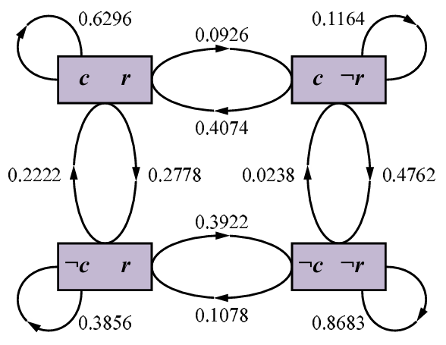
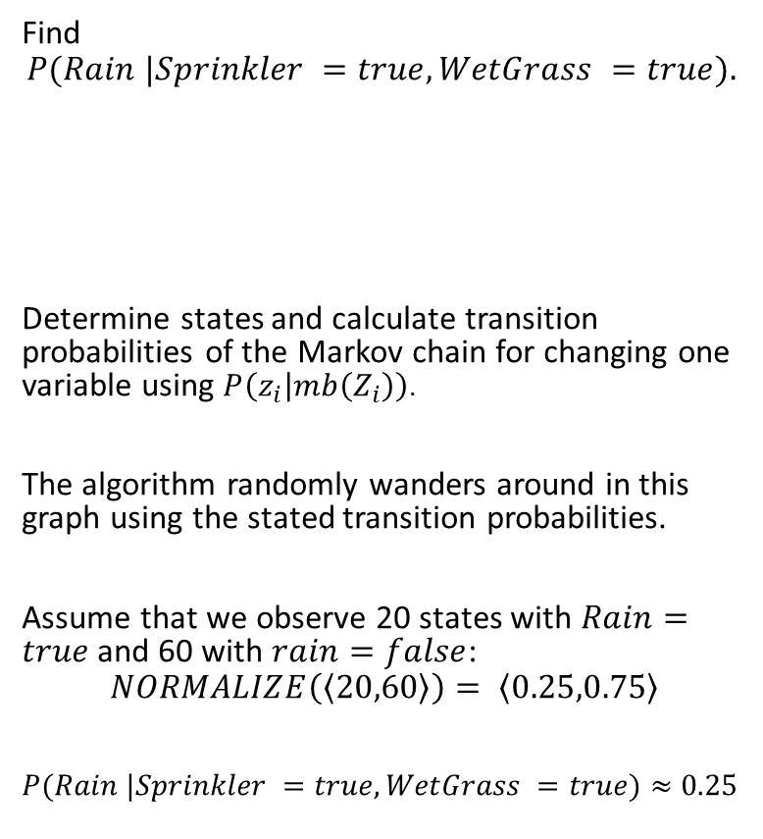
Gibbs Sampling: Example
unknown
Find
$$P(Rain |Sprinkler =true,WetGrass =true).$$
Determine states and calculate transition probabilities of the Markov chain for changing one variable using $P\left(z_{i} | mb\left(Z_{i}\right)\right)$.
The algorithm randomly wanders around in this graph using the stated transition probabilities.
Assume that we observe 20 states with $Rain=true$and 60 with $rain=false$:
$$NORMALIZE\left(\left\langle 20,60\right\rangle \right)= \left\langle 0.25,0.75\right\rangle$$
$P(Rain |Sprinkler =true,WetGrass =true)≈0.25$
?
true
true
20 visits
60 visits
Note the self-loops: the state stays the same when the resampled value is same it already has.

Slide 43

Conclusion
Bayesian networks provide an efficient way to store a complete probabilistic model by exploiting (conditional) independence between variables.
Inference means querying the model for a conditional probability given some evidence.
Exact inference is difficult, for all but tiny models.
State of the art is to use approximate inference by sampling from the model.
Software libraries provide general inference engines.

