Slide 1



CS 5/7320 Artificial Intelligence Automated Planning: Hierarchical Planning and Monitoring AIMA Chapter 11
Slides by Michael Hahsler with figures from the AIMA textbook
This work is licensed under a Creative Commons Attribution-ShareAlike 4.0 International License.
Online Material

Slide 2
Contents
Classical Planning
Hierarchical Planning
Monitoring and Replaning

Slide 3

Classical Planning
Using Planning Domain Definition Languages

Slide 4
Classical Planning
Find a sequence of actions to accomplish a goal in a discrete, deterministic, static, fully observable environment.
Options we have already discussed:
Chapter 3: Search with a heuristic for informed search.
Chapter 7: Propositional logic with custom code.
Issue: Large state space.
Solution: Factored state representation using a Planning Domain Definition Language (PDDL) + Action schemas

Slide 5
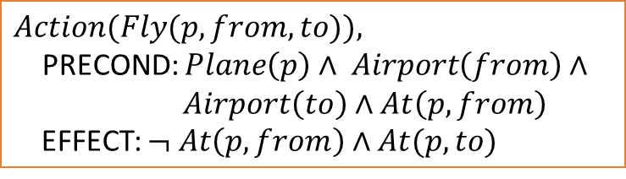
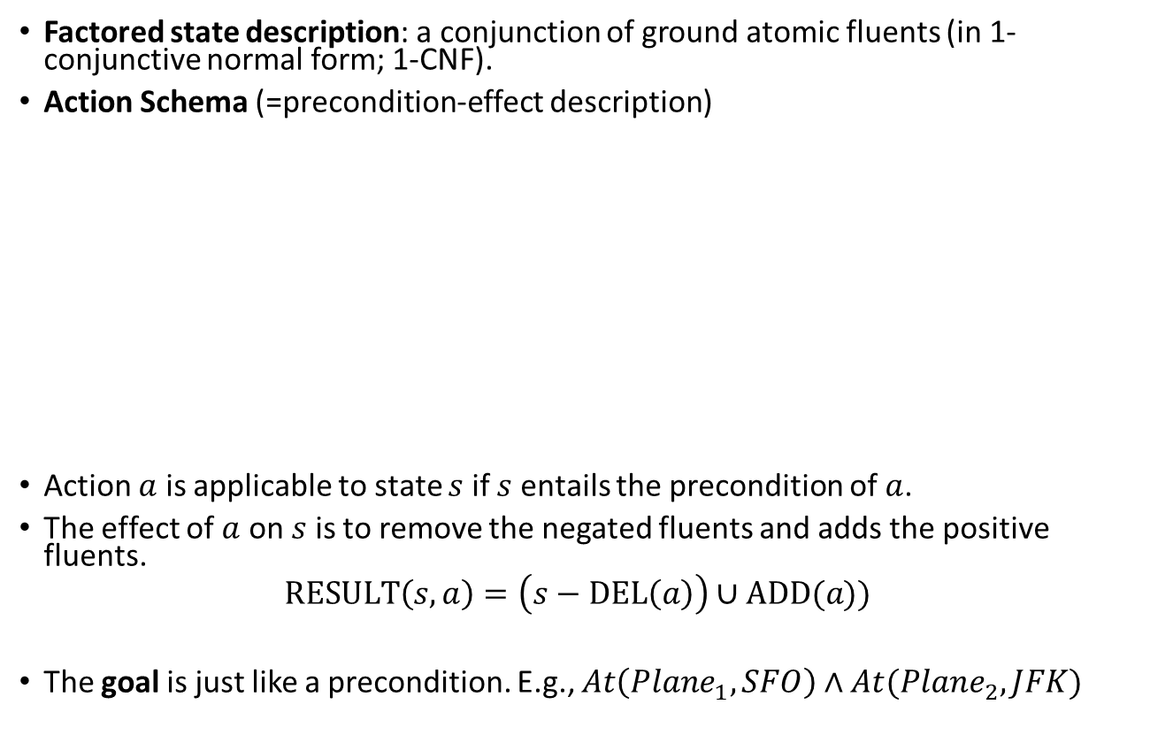


Planning Domain Definition Language (PDDL)
an aspect of the world that can change over time
Factored state description: a conjunction of ground atomic fluents (in 1-conjunctive normal form; 1-CNF).
Action Schema (=precondition-effect description)
Action $a$ is applicable to state $s$ if $s$ entails the precondition of $a$.
The effect of $a$ on $s$ is to remove the negated fluents and adds the positive fluents.
$$RESULT\left(s,a\right)=\left(s−DEL\left(a\right)\right)∪ADD(a))$$
The goal is just like a precondition. E.g., $At\left(Plane_{1}, SFO\right)∧At(Plane_{2}, JFK)$
$$Action(Fly(p, from, to)),$$ PRECOND: $Plane\left(p\right)∧ Airport\left(from\right)∧$ $Airport\left(to\right)∧At\left(p, from\right)$ EFFECT: $¬ At\left(p, from\right)∧At(p, to)$
$$DEL()$$
$$ADD()$$

Slide 6
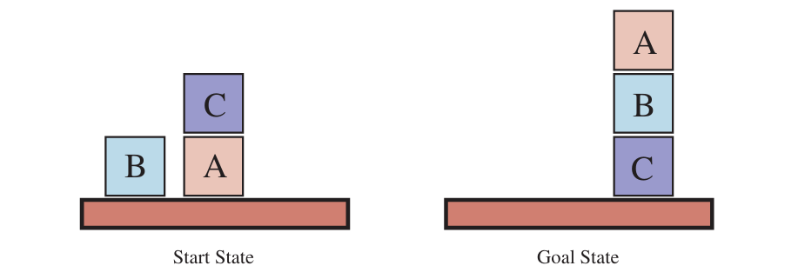
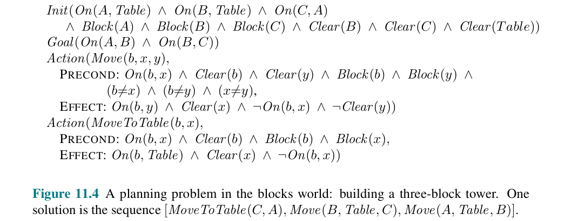
Example: Block World

Slide 7
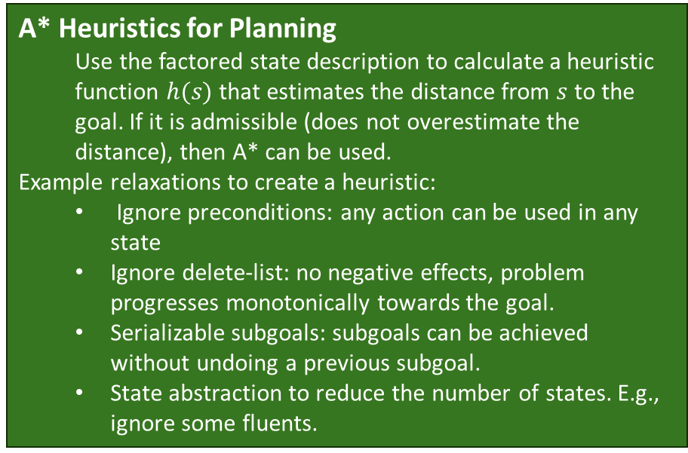
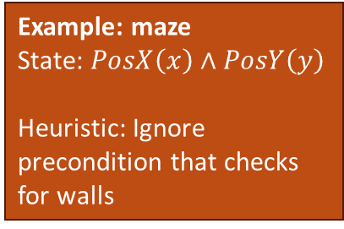
Algorithm Options
Forward state-space search: Action schema represents the transition model. Perform regular BFS/DFS search. Often A* with a heuristics is used to deal with the state space size.
Backward search (= regression search): keeps the branching factor low. Issue: How do we define heuristics?
Convert the PDDL description into propositional form and use an efficient solver for the Boolean satisfiability problem (SAT).
A* Heuristics for Planning Use the factored state description to calculate a heuristic function $h(s)$ that estimates the distance from $s$ to the goal. If it is admissible (does not overestimate the distance), then A* can be used.
Example relaxations to create a heuristic:
Ignore preconditions: any action can be used in any state
Ignore delete-list: no negative effects, problem progresses monotonically towards the goal.
Serializable subgoals: subgoals can be achieved without undoing a previous subgoal.
State abstraction to reduce the number of states. E.g., ignore some fluents.
Example: maze
State: $PosX\left(x\right)∧PosY\left(y\right)$
Heuristic: Ignore precondition that checks for walls

Slide 8

Hierarchical Planning
Manage complexity using high-level actions.

Slide 9





High-level Actions
A high-level action (HLA) solves a problem or a subproblem in one step.
An HLA has one or several refinements into a sequence of HLAs or primitive actions.
HLA
Refinement
…
HLA
HLA
HLA
HLA
HLA
…
$$a$$
$$a$$
$$a$$
$$a$$
$$a$$
“Implementation” with only primitive actions
Reasoning and search for HLAs reduces the search space.
A top-level HLA achieves the goal if at least one implementation achieves the goal.

Slide 10
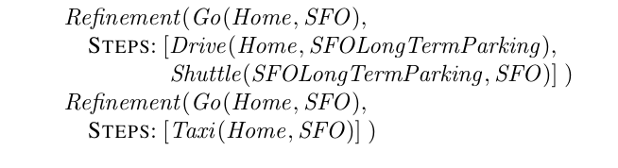

Example: Refinement
Two refinements for the HLA $Go(Home, SFO)$ to go from home to the SFO airport:
Since both refinements achieve the goal, the agent can choose which implementation of the HLA to use.

Slide 11
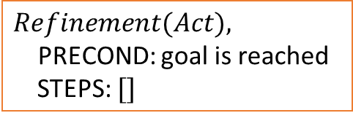
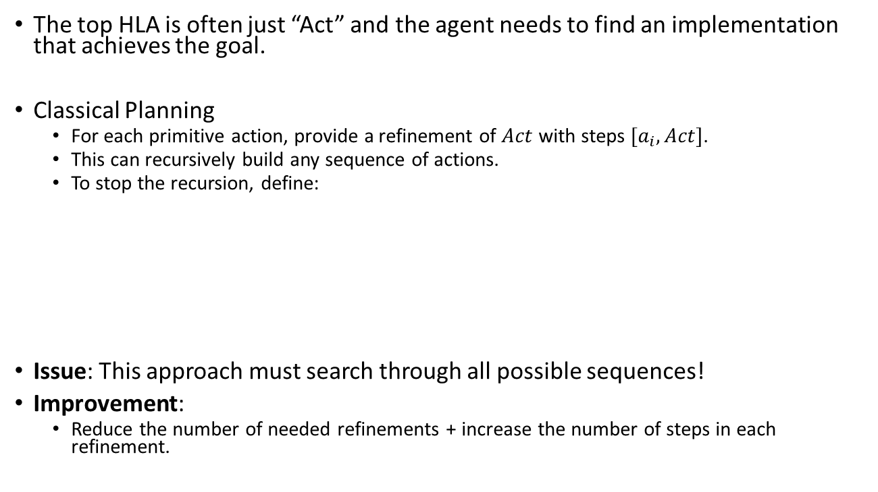
Option 1: Search for Primitive Solutions
The top HLA is often just “Act” and the agent needs to find an implementation that achieves the goal.
Classical Planning
For each primitive action, provide a refinement of $Act$ with steps $[a_{i},Act]$.
This can recursively build any sequence of actions.
To stop the recursion, define:
Issue: This approach must search through all possible sequences!
Improvement:
Reduce the number of needed refinements + increase the number of steps in each refinement.
$$Refinement(Act),$$ PRECOND: goal is reached STEPS: $[]$

Slide 12
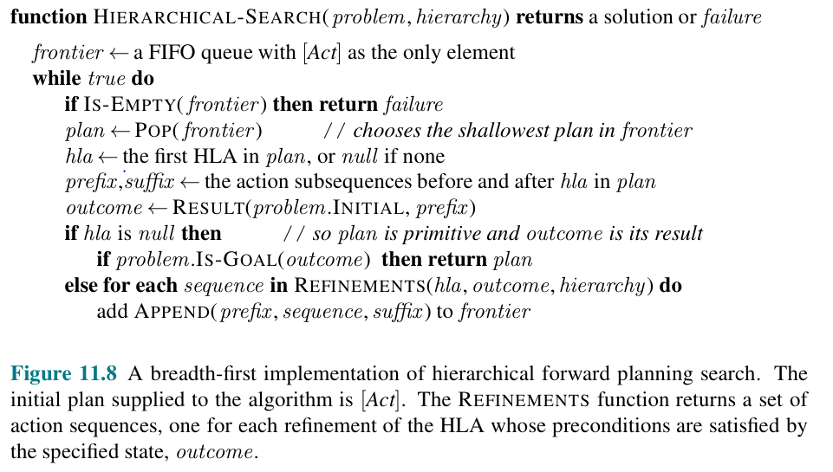
Option 1: Search for Primitive Solutions – BFS Implementation

Slide 13
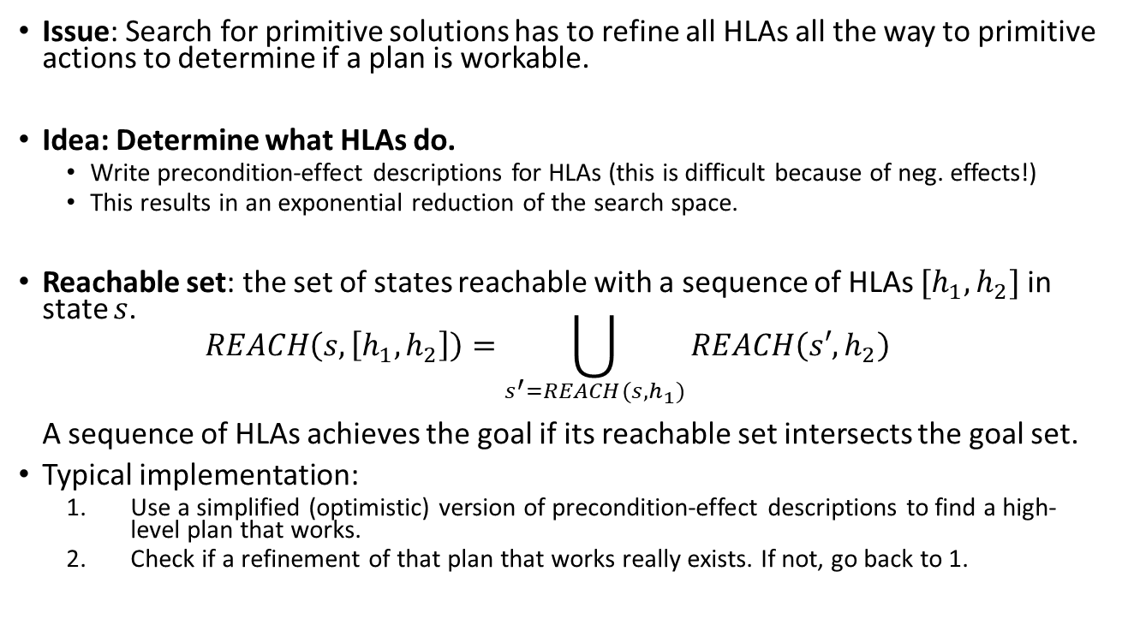
Option 2: Searching for Abstract Solutions
Issue: Search for primitive solutions has to refine all HLAs all the way to primitive actions to determine if a plan is workable.
Idea: Determine what HLAs do.
Write precondition-effect descriptions for HLAs (this is difficult because of neg. effects!)
This results in an exponential reduction of the search space.
Reachable set: the set of states reachable with a sequence of HLAs $[h_{1},h_{2}]$ in state $s$. $REACH\left(s,\left[h_{1},h_{2}\right]\right)=\bigcup_{s^{′}=REACH(s, h_{1})}{REACH\left(s′,h_{2}\right)}$ A sequence of HLAs achieves the goal if its reachable set intersects the goal set.
Typical implementation:
Use a simplified (optimistic) version of precondition-effect descriptions to find a high-level plan that works.
Check if a refinement of that plan that works really exists. If not, go back to 1.

Slide 14


Conclusion
High-level actions are a powerful concept for dealing with large search spaces/search trees.
Example:
Actions: {N, E, S, W}
Top high-level action:
A sequence of second-level HLAs.
Second-level HLA: Go to the next intersection
Example Implementation: [E, E, N, N, E, E, E]
This leads to a much smaller state space and search tree!

Slide 15

Monitoring and Replanning
Planning and Acting in Partially Observable, Nondeterministic, and Unknown Environments

Slide 16
Belief States
For nondeterministic or partially observable environments we need belief states.
A belief state is a set of possible physical states the agent might be in given its current knowledge.
The belief state concept needs to be extended to the factored state representation.
A belief state becomes a logical formula of fluents.
Fluents that do not appear in the formula are unknow.
Technical note: If we manage to keep the belief state in 1-CNF (1-conjunctive normal form, i.e., fluents are combined with ANDs), then the complexity is reduced from being exponential in the number of fluents to linear!

Slide 17
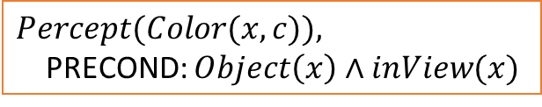
Observability: Percept Schema
For partially observable environments, we need to be able to define what percepts the agent can get when.
The agent uses a percept schema to reason about percepts that it can obtain during executing a plan.
Example: Whenever the agent sees an object, then it will perceive its color. The agent can now reason that it needs to get an object inView to see the color.
Percept schemata and observability
Fully observable: Percept schemas have no preconditions.
Partially observable: Some percepts have preconditions.
Sensorless agent: has no percept schemas.
$$Percept(Color(x, c)),$$ PRECOND: $Object\left(x\right)∧inView(x)$

Slide 18
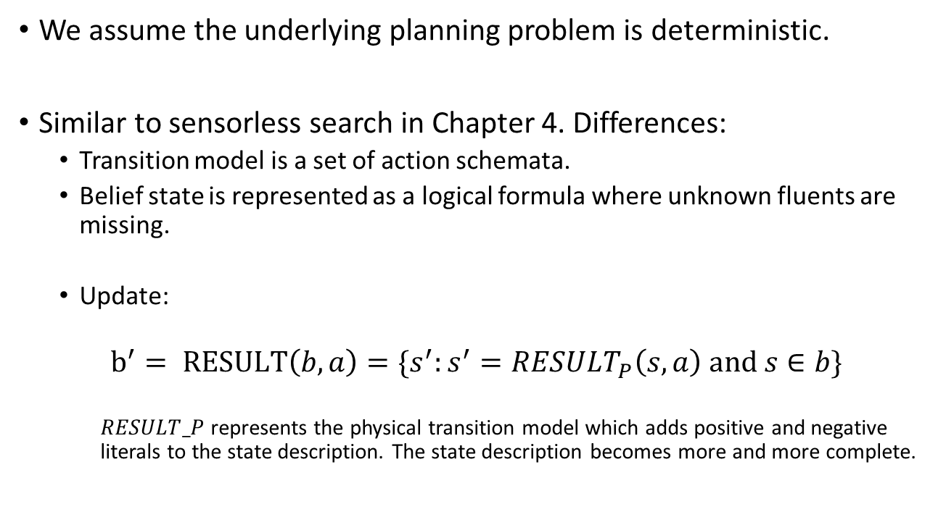
Observability: Sensorless Planning
We assume the underlying planning problem is deterministic.
Similar to sensorless search in Chapter 4. Differences:
Transition model is a set of action schemata.
Belief state is represented as a logical formula where unknown fluents are missing.
Update:
$$b^{′}= RESULT\left(b,a\right)=\{s^{′}:s^{′}=RESULT_{P}\left(s,a\right) \text{and} s∈b\}$$
$RESULT_P$ represents the physical transition model which adds positive and negative literals to the state description. The state description becomes more and more complete.

Slide 19
Determinism & Observability: Contingency Planning
We can create a conditional plan for partially observable planning problems and non-deterministic problems.
We already have introduced conditional plans in Chapter 4 and just need to augment it by:
Action schemata instead of a transition function.
Percept schemata to reason about how to get needed percepts.
The state has a factored representation as facts in 1-CNF.
Use AND-OR search over belief states.
Issues:
Contingency plans become very complicated with non-deterministic effects like failures in actions or percepts. E.g., moving north fails 1 out of 100 times.
Plan fails with incorrect model of the world. E.g., actions with missing preconditions or missing effects, missing fluents, exogenous effects.
→ Online Planning

Slide 20
Execution Monitoring and Replanning
Perform regular planning, but replan when plan execution fails.
Requires execution monitoring to determine the need for replanning. The agent can perform:
Action monitoring: Only execute the action if the preconditions are met.
Plan monitoring: Verify that the remaining plan will still succeed.
Goal monitoring: Check if a better set of goals has become available.
Large contingency plans can often be made simpler by having unlikely branches just say “REPLAN.” E.g., Chess: don’t plan for very unlikely moves of the opponent.

Slide 21
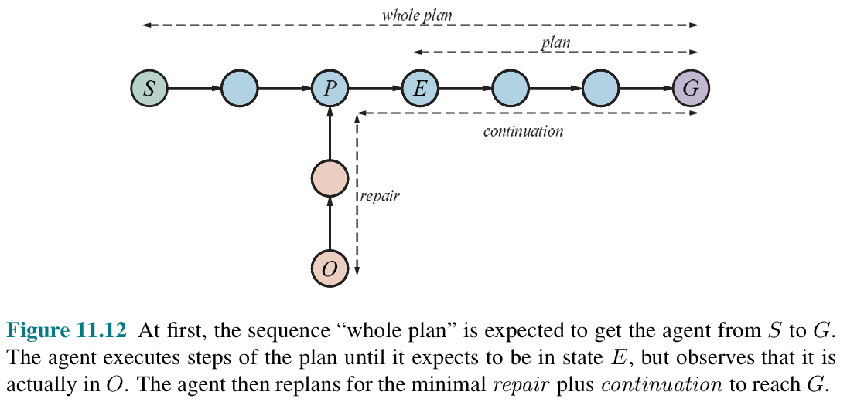
Example: Plan Monitoring with Repair
1. Initial plan
Actual path taken
2. Failure detected: Should be in state E. Remaining plan will not work.
3. Repair
+ Continuation

Slide 22

Summary
Action schemata make specifying the transition function easier.
Hierarchical planning lets us deal with the exponential size of the state space. The agent can reason at a more abstract level of high-level actions and the states are typically discrete.
Online planning with monitoring and replanning is
very flexible
can deal with many types of issues (sensor/actuator failure, imperfect models of the environment)
Can make conditional plans smaller by omitting unlikely paths and leaving them for later replanning.

