Slide 1



CS 5/7320 Artificial Intelligence Making Simple Decisions: Decision Networks AIMA Chapter 16
Introduction slides by Michael Hahsler
Decision network slides by Dan Klein and Pieter Abbeel
This work is licensed under a Creative Commons Attribution-ShareAlike 4.0 International License.
Online Material

Slide 2
Decision-theoretic Agents
Recap
Agents based on logic: Cannot deal with uncertainty, conflicting goals, etc.
Goal-based agents: Can only assign goal/not goal to states and find goal states.
A decision-theoretic agent is a special type of a utility-based agent based on decision theory. Approach:
Assign a utility value to each state.
Utility is related to the external performance measure (in the PEAS description).
Uses probabilities to assess its current state (for partial observability) and the results of actions (for stochastic environments).
A rational agent optimizes the expected utility.
Decision theory = Probability theory (evidence & belief) + Utility theory (want)

Slide 3














Simple vs. Complex Decisions
$$a_{0}$$
$$U(s_{1})$$
…
$$U(s_{T−1})$$
$$U(s_{T})$$
Currentstate $s$
Action $a$
Future state $s′$
$$U(s’)$$
Currentstate $s_{0}$
$$s_{1}$$
$$s_{T−1}$$
$$s_{T}$$
$$a_{1}$$
$$a_{T−1}$$
We make the same decision frequently + making it once does not affect future decisions. This means we have an episodic environment.
May have a stochastic environment (e.g., with non-deterministic actions or probabilistic transitions).
May be partially observable.
Sequential decision making: The agent’s utility depends on a sequence of decisions.
Search, planning, and playing games we have covered so far are examples of such problems.
To solve this with decision theory requires different methods: Markov Decision Processes (MDP)
We focus on making simple decisions for now!

Slide 4


Utility
+
A utility function $U\left(s\right)$ expresses the desirability of being in state $s$.
Utility functions are derived from preferences:
$U\left(A\right)>U\left(B\right)\overset{⇔}{}A≻B$ … Preference and $U\left(A\right)=U\left(B\right)\overset{⇔}{}A \sim B$ … Indifference
It is often enough to know an ordinal utility function representing a ranking of states to make decisions like moving to the better state.
To use expectation, we need a cardinal utility function where the number represents levels of absolute satisfaction. That is:
$U\left(0\right) \sim \text{nothing}$
$2×U$ is twice as good as $U$
10
10
20

Slide 5



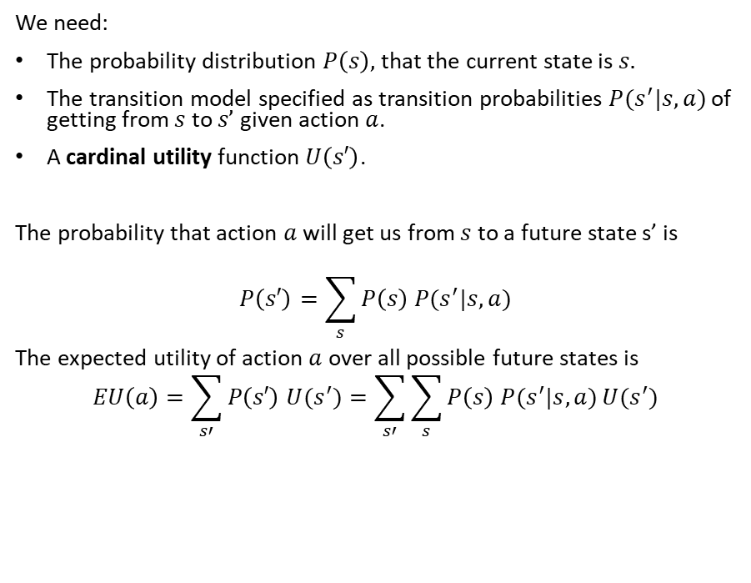

Expected Utility of an Action Under Uncertainty
If I do action $a$ then I will have later have
Currentstate $s$
Action $a$
Future state $s′$
$$U(s’)$$
We need:
The probability distribution $P\left(s\right),$that the current state is $s.$
The transition model specified as transition probabilities $P(s^{′}|s,a)$ of getting from $s$ to $s’$ given action $a$.
A cardinal utility function $U\left(s′\right)$.
The probability that action $a$ will get us from $s$ to a future state s’ is
$$P\left(s′\right)=\sum_{s}{P\left(s\right) P(s^{′}|s,a)}$$
The expected utility of action $a$ over all possible future states is $$EU\left(a\right)=\sum_{s′}{P\left(s′\right) U(s^{′})}=\sum_{s′}{\sum_{s}{P\left(s\right) P(s^{′}|s,a)}U(s^{′})}$$

Slide 6

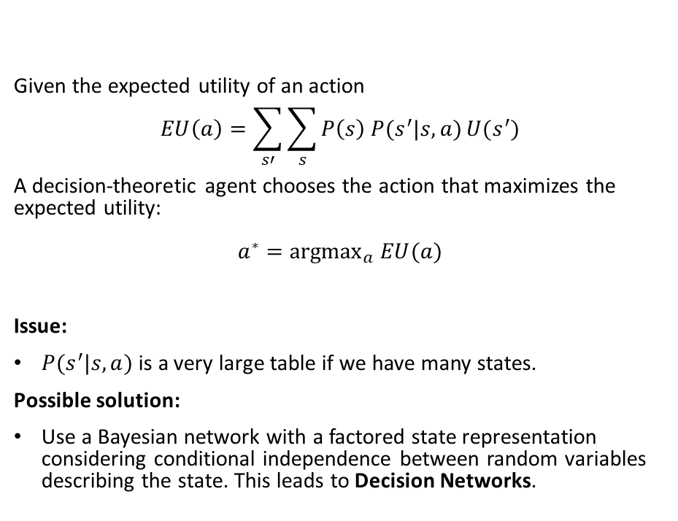
Principle of Maximum Expected Utility (MEU)
Action?
Given the expected utility of an action $$EU\left(a\right)=\sum_{s′}{\sum_{s}{P\left(s\right) P(s^{′}|s,a)}U(s^{′})}$$
A decision-theoretic agent chooses the action that maximizes the expected utility: $$a^{∗}={argmax}_{a} EU(a)$$
Issue:
$P(s^{′}|s,a)$ is a very large table if we have many states.
Possible solution:
Use a Bayesian network with a factored state representation considering conditional independence between random variables describing the state. This leads to Decision Networks.

Slide 7
Decision Networks Using Bayesian Networks to calculate the Expected Utility of Actions
The slides are based on slides by Dan Klein, Pieter Abbeel, Sergey Levine, with some materials from A. Farhadi (http://ai.berkeley.edu)

Slide 8
Definition: Decision Networks
Decision networks
Bayesian network with additional nodes for utility and actions.
Allows to specify the joint probability in a compact way using conditional independence.
Calculate the expected utility for each possible action and select the best one.
Node types
Chance nodes (oval): Random variables in BNs
Action nodes (rectangle): Cannot have parents, act as observed evidence
Utility node (diamond): Depends on action and chance nodes
Umbrella
U
Weather
Forecast
Notes:
There exists a ghostbusters demo

Slide 9


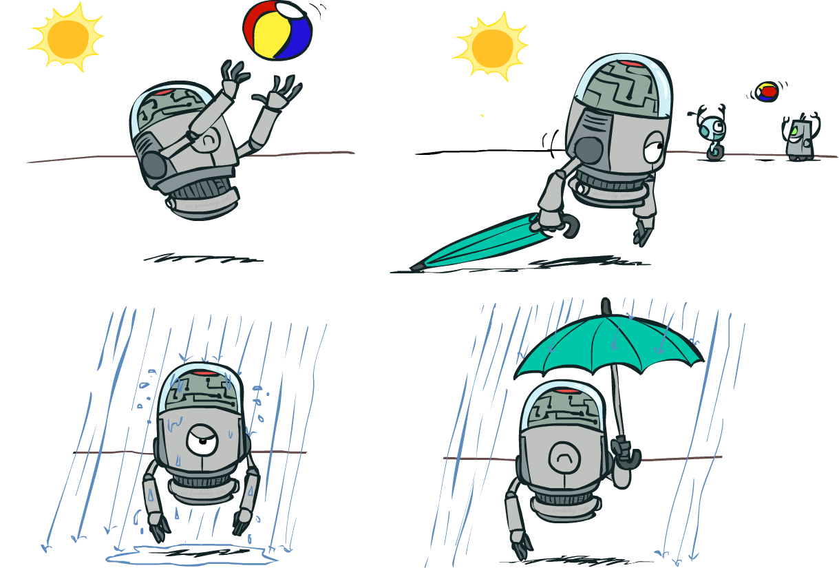

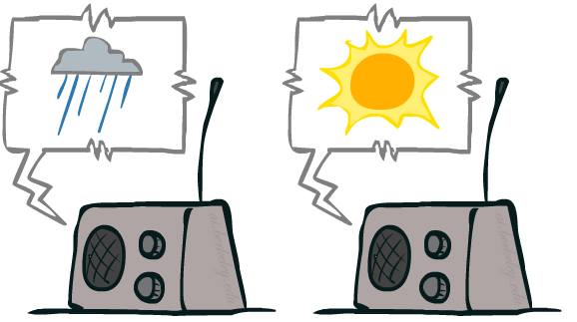
Example: Decision Networks
Action
Utility
Umbrella
U
Weather
Random Events
Forecast
Notes:
There exists a ghostbusters demo

Slide 10
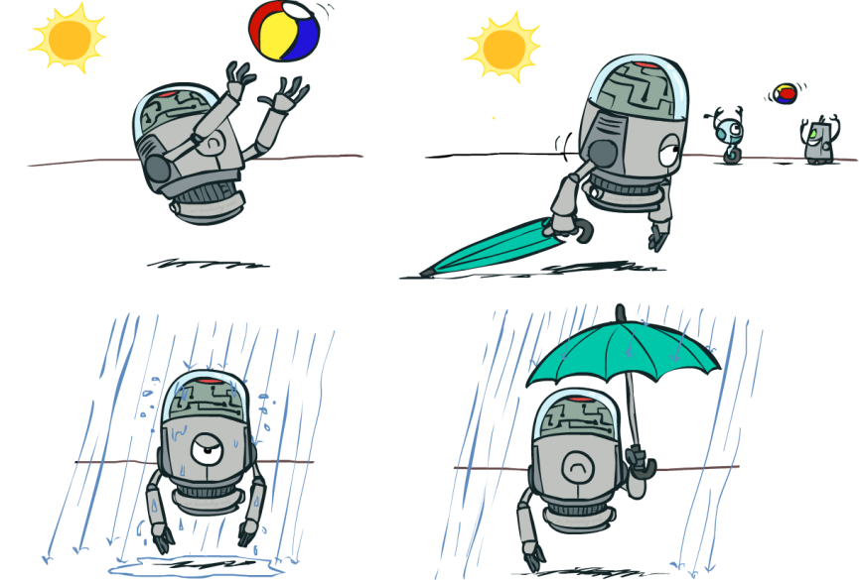
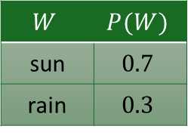
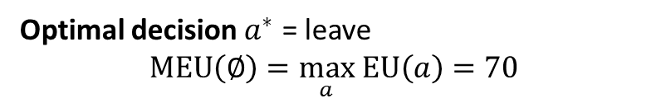
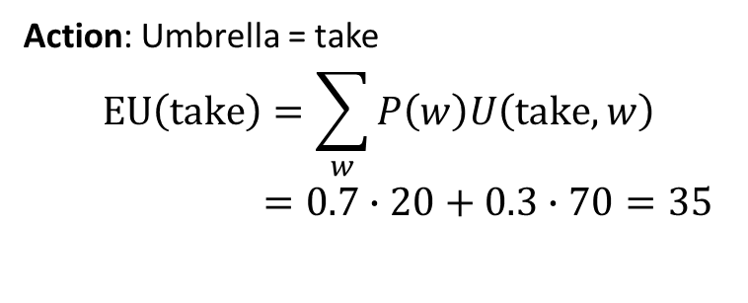
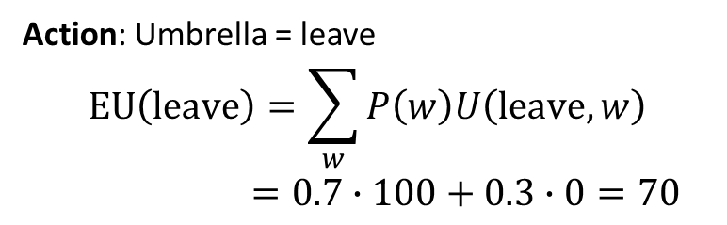
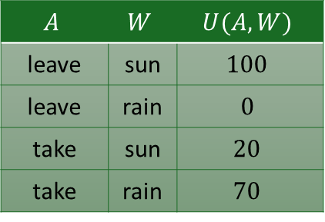
Decision Network without Forecast
Umbrella (A)
Action: Umbrella = leave
$$EU\left(leave\right)=\sum_{w}{P\left(w\right)U\left(leave,w\right)}$$
$=0.7∙100+0.3∙0=70$
U
Weather
Action: Umbrella = take
$$EU\left(take\right)=\sum_{w}{P\left(w\right)U\left(take,w\right)}$$
$=0.7∙20+0.3∙70=35$
$$W$$ | $$P(W)$$
sun | $$0.7$$
rain | $$0.3$$
$$A$$ | $$W$$ | $$U(A,W)$$
leave | sun | $$100$$
leave | rain | $$0$$
take | sun | $$20$$
take | rain | $$70$$
Optimal decision $a^{∗}$ = leave
$$MEU\left(∅\right)=\max_{a} EU\left(a\right)=70$$
Notes:
There exists a ghostbusters demo

Slide 11
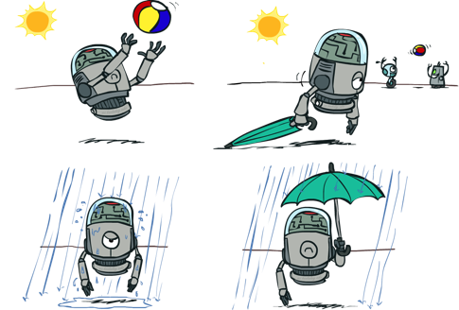
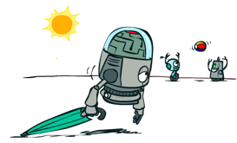

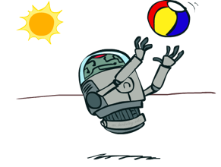
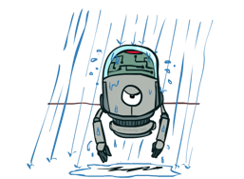
Decisions as Outcome Trees
{} … no evidence available
{}
Action (agent picks one)
take
leave
Umbrella
Weather | {}
Weather | {}
U
Random Event (calculate expectation)
sun
sun
Weather
rain
rain
U(t,s)
U(t,r)
U(l,s)
U(l,r)
Traverse the tree and pick the actions that have the highest expected utility.

Slide 12

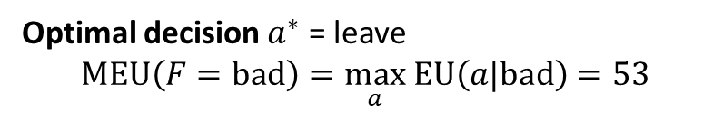
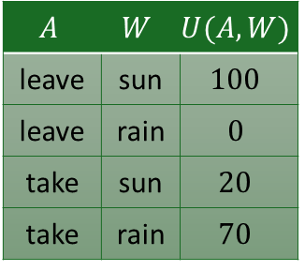
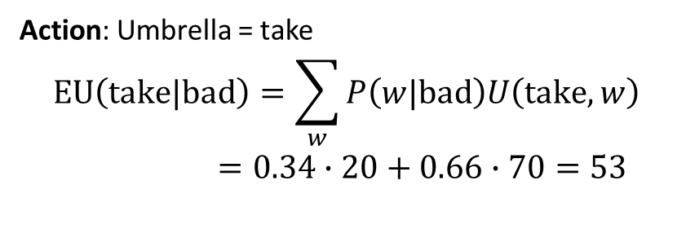
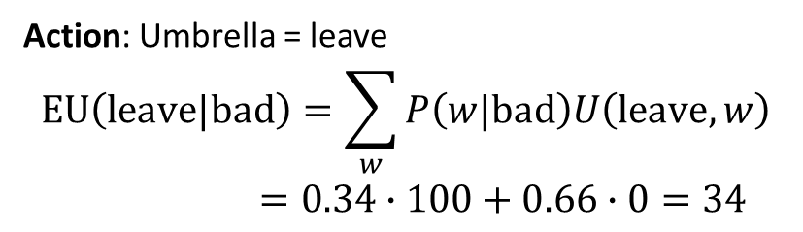
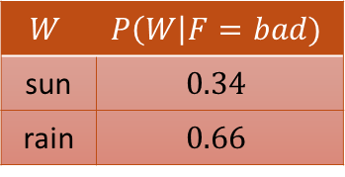
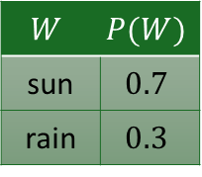

Decision Network with Bad Forecast
Umbrella (A)
$$A$$ | $$W$$ | $$U(A,W)$$
leave | sun | $$100$$
leave | rain | $$0$$
take | sun | $$20$$
take | rain | $$70$$
Action: Umbrella = leave
$$EU\left(leave|bad\right)=\sum_{w}{P\left(w|bad\right)U\left(leave,w\right)}$$
$=0.34∙100+0.66∙0=34$
U
Weather
$$W$$ | $$P(W)$$
sun | $$0.7$$
rain | $$0.3$$
$$W$$ | $$P\left(W\right|F=bad)$$
sun | $$0.34$$
rain | $$0.66$$
Action: Umbrella = take
$$EU\left(take|bad\right)=\sum_{w}{P\left(w|bad\right)U\left(take,w\right)}$$
$=0.34∙20+0.66∙70=53$
Forecast
rain
The evidence fixes forecast. This increases our belief of the probability of rain!
Optimal decision $a^{∗}$ = leave
$$MEU\left(F=bad\right)=\max_{a} EU\left(a|bad\right)=53$$
$P(F|W$)

Slide 13

Decisions as Outcome Trees with Evidence
{b} … evidence of bad weather increased the probability of rain
Umbrella
Action (agent picks one)
{b}
take
leave
U
W | {b}
Random Event (calculate expectation)
W | {b}
Weather
sun
sun
rain
rain
U(t,s)
U(t,r)
U(l,s)
U(l,r)
Forecast
rain
Traverse the tree and pick the actions that have the highest expected utility.

Slide 14



Conclusion
Decision networks are an extension of Bayesian networks that add actions and utility to compactly specify the joint probability. The network is used to calculate the expected utility of actions.
Sequential decision-making deals with decisions that influence each other and are made over time. This is a more complex decision problem and needs different methods like Markov Decision Processes.
Decision networks can be used to make simple repeated decisions in a stochastic, partially observable, and episodic environment.

