Slide 1
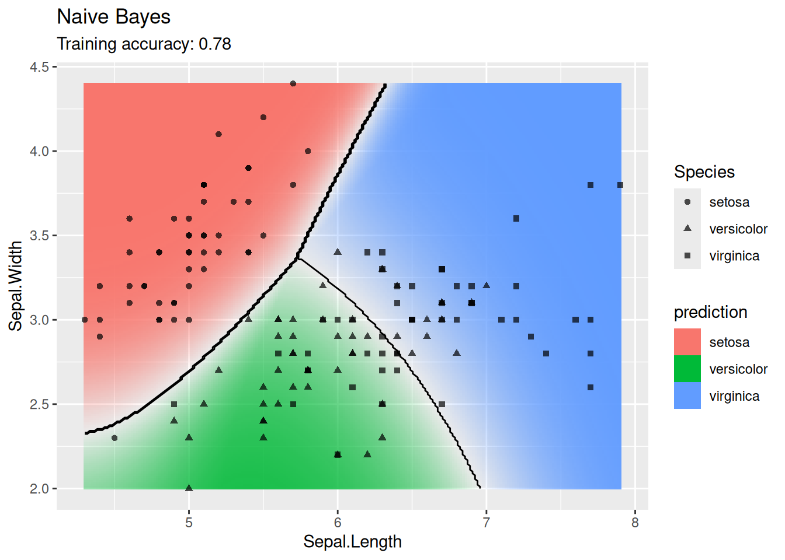
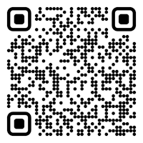

CS 5/7320 Artificial Intelligence Learning from Examples: Supervised Machine Learning AIMA Chapter 19 Slides by Michael Hahsler Some slides are based on Dan Klein’s slides (http://ai.berkeley.edu); with figures from the AIMA textbook.
This work is licensed under a Creative Commons Attribution-ShareAlike 4.0 International License.
Online Material
Notes:
Please retain proper attribution, including the reference to ai.berkeley.edu. Thanks!

Slide 2
Topics
Supervised Learning
Training Data
Training & Testing
Types of supervised ML Models
Use in AI
Agents & ML

Slide 3
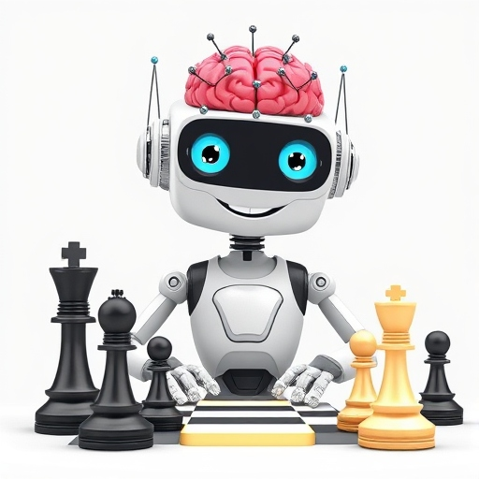
Agents and ML
DeepAi.org with prompt: “A happy cartoon robot with an artificial neural network for a brain on white background learning to play chess”

Slide 4

Learning from Examples
Up until now in this course:
Hand-craft algorithms to make rational/optimal or at least good decisions. Examples: Search strategies, heuristics, and constructing Bayesian networks.
Issues
We may not be able to anticipate all possible future scenarios.
We may have examples, but we do not know how to implement a solution.
Supervised Machine Learning
Uses observations: training data with the correct answers.
Learn a function (model) to map an input (e.g., state) to an output (e.g., action) representing the desired behavior.
Examples:
Use a naïve Bayesian classifier to distinguish between spam/non-spam.
Learn a playout policy to simulate games (current board -> good move)
Data
(behavior)
Algorithm chooses actions
creates
Data
(observations)
learn
Model chooses actions

Slide 5
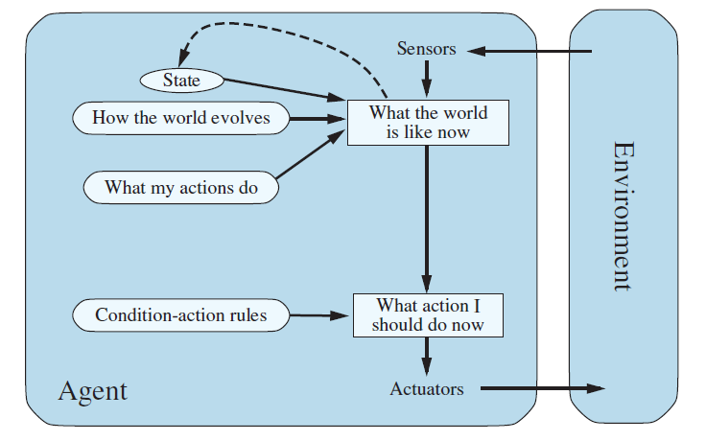




Learning Components of an Agent
We can learn many different components of an agent from examples
Example: Learning components of a model-based reflex agent
Learn the state representation
Learn a utility function
Learn the transition model
$$p$$
$$s^{′}=T(s,a)$$
$$a=f(p,s)$$
$$a$$
Learn rules

Slide 6

Supervised Learning
1+1=2
Teaching a model to answer correctly

Slide 7



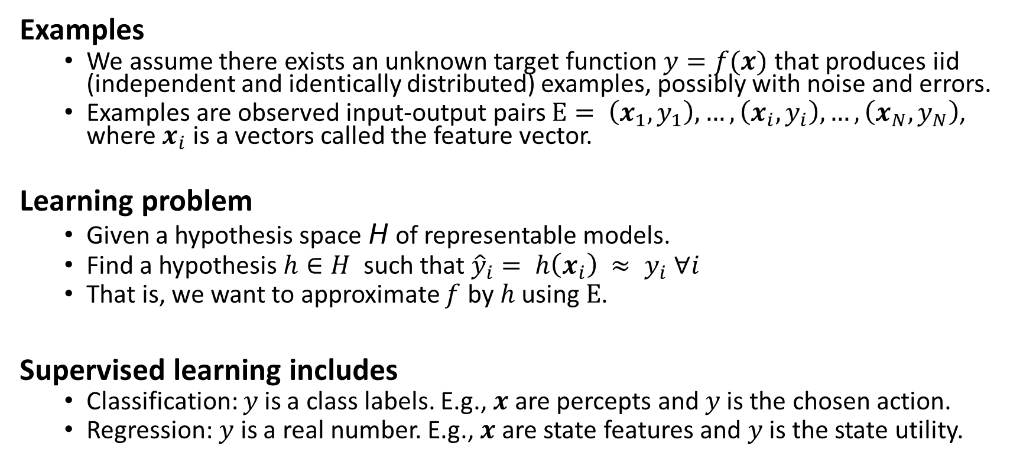
Supervised Learning As Function Approximation
Examples
We assume there exists an unknown target function $y=f(x)$ that produces iid (independent and identically distributed) examples, possibly with noise and errors.
Examples are observed input-output pairs $E= \left(x_{1},y_{1}\right),…, \left(x_{i}, y_{i}\right),…,\left(x_{N},y_{N}\right)$, where $x_{i}$ is a vectors called the feature vector.
Learning problem
Given a hypothesis space H of representable models.
Find a hypothesis $h∈H$ such that ${\hat{y}}_{i}= h\left(x_{i}\right) ≈ y_{i} ∀i$
That is, we want to approximate $f$ by $h$ using $E$.
Supervised learning includes
Classification: $y$is a class labels. E.g., $x$ are percepts and $y$is the chosen action.
Regression: $y$ is a real number. E.g., $x$ are state features and $y$is the state utility.
$$f$$
Set of all functions

Slide 8
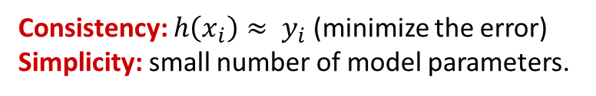
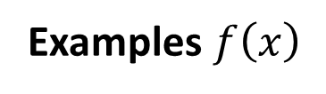
Consistency vs. Simplicity
Example: Univariate curve fitting (regression, function approximation)
Learned Models
Examples $f\left(x\right)$
Consistency: $h\left(x_{i}\right)≈ y_{i}$ (minimize the error)
Simplicity: small number of model parameters.

Slide 9
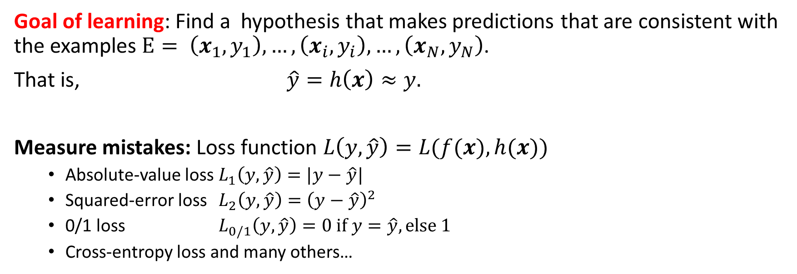


Measuring Consistency using Loss
Goal of learning: Find a hypothesis that makes predictions that are consistent with the examples $E= \left(x_{1},y_{1}\right),…, \left(x_{i}, y_{i}\right),…,\left(x_{N},y_{N}\right)$.
That is, $\hat{y}=h\left(x\right)≈y.$
Measure mistakes: Loss function $L\left(y, \hat{y}\right)=L(f(x), h(x))$
Absolute-value loss $L_{1}\left(y, \hat{y}\right)=|y−\hat{y}|$
Squared-error loss $L_{2}\left(y, \hat{y}\right)={\left(y−\hat{y}\right)}^{2}$
0/1 loss $L_{0/1}\left(y, \hat{y}\right)=0 if y=\hat{y}, else 1$
Cross-entropy loss and many others…
For Regression
For Classification
Loss
$$f$$
$$h^{∗}$$

Slide 10
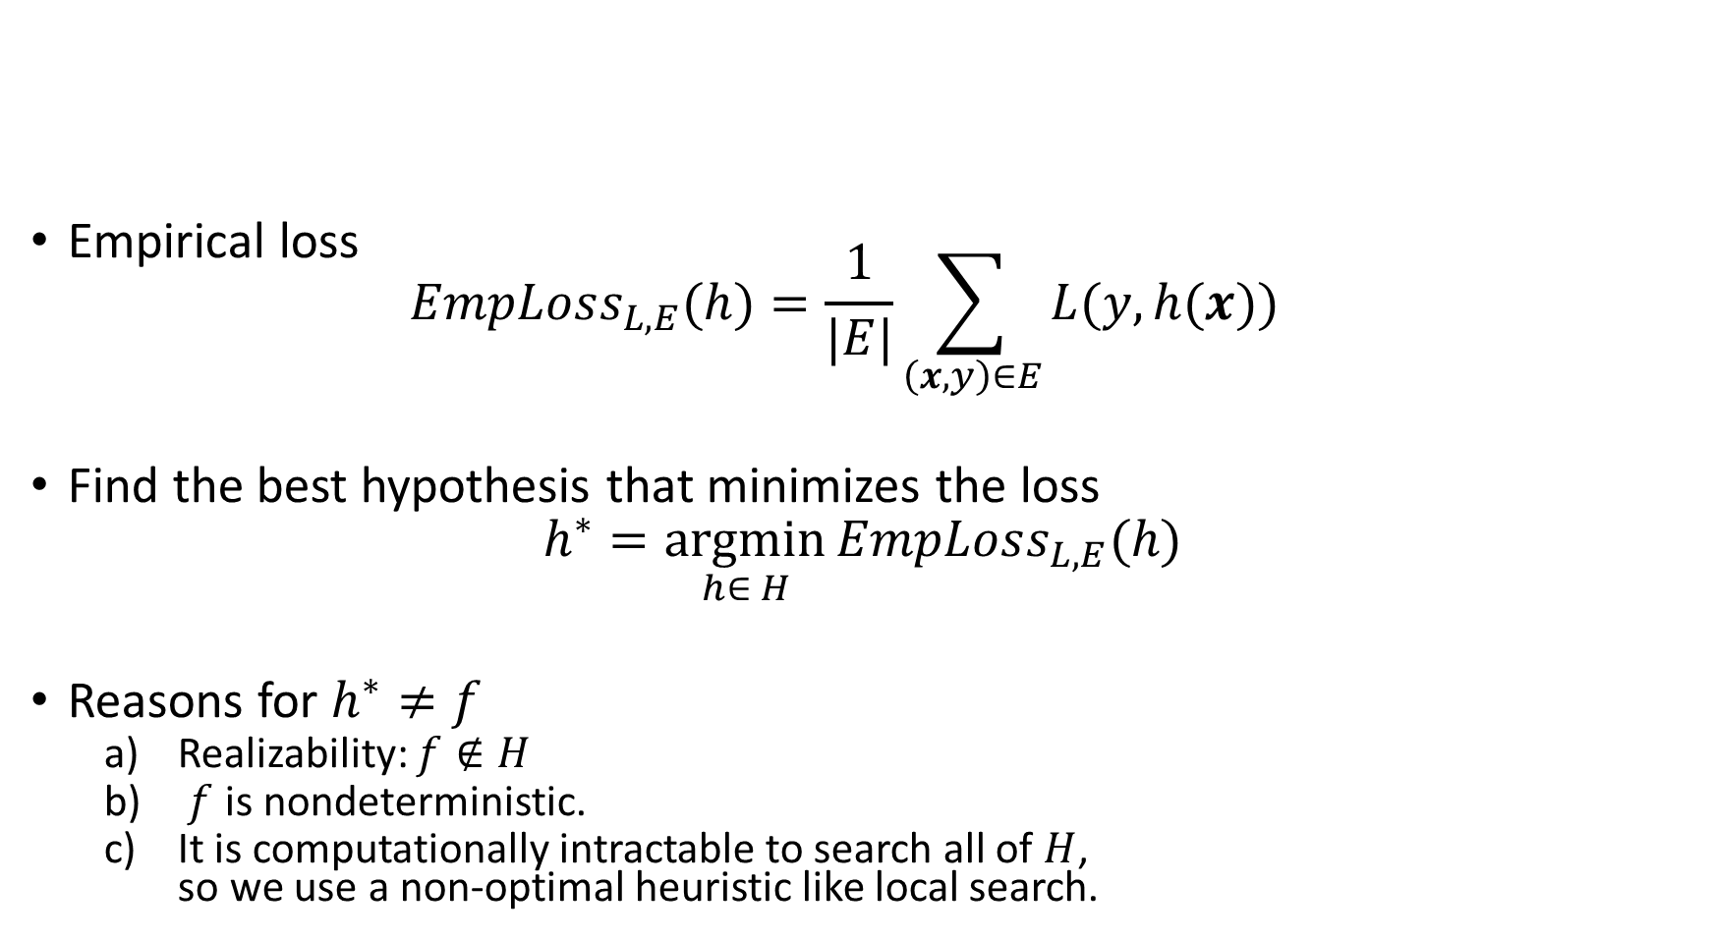
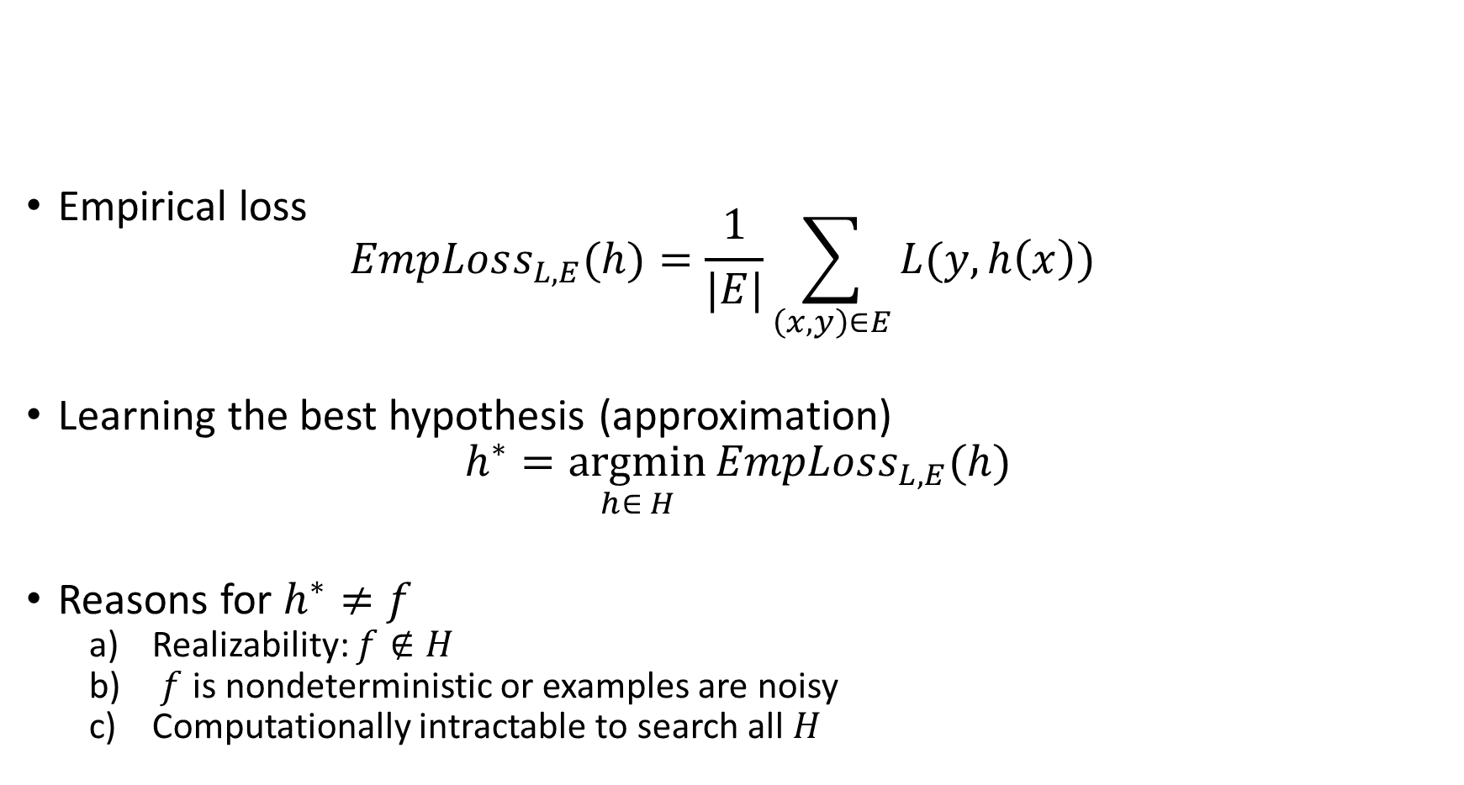
Learning Consistent Approximations
Empirical loss $EmpLoss_{L,E}(h)=\frac{1}{|E|}\sum_{\left(x,y\right)∈E}{L(y, h(x))}$
Find the best hypothesis that minimizes the loss
$$h^{∗}=\underset{h∈ H}{argmin}{EmpLoss_{L,E}(h)}$$
Reasons for $h^{∗}≠f$
Realizability: $f∉H$
$f$ is nondeterministic.
It is computationally intractable to search all of $H$, so we use a non-optimal heuristic like local search.
Loss
$$f$$
$$h^{∗}$$

Slide 11
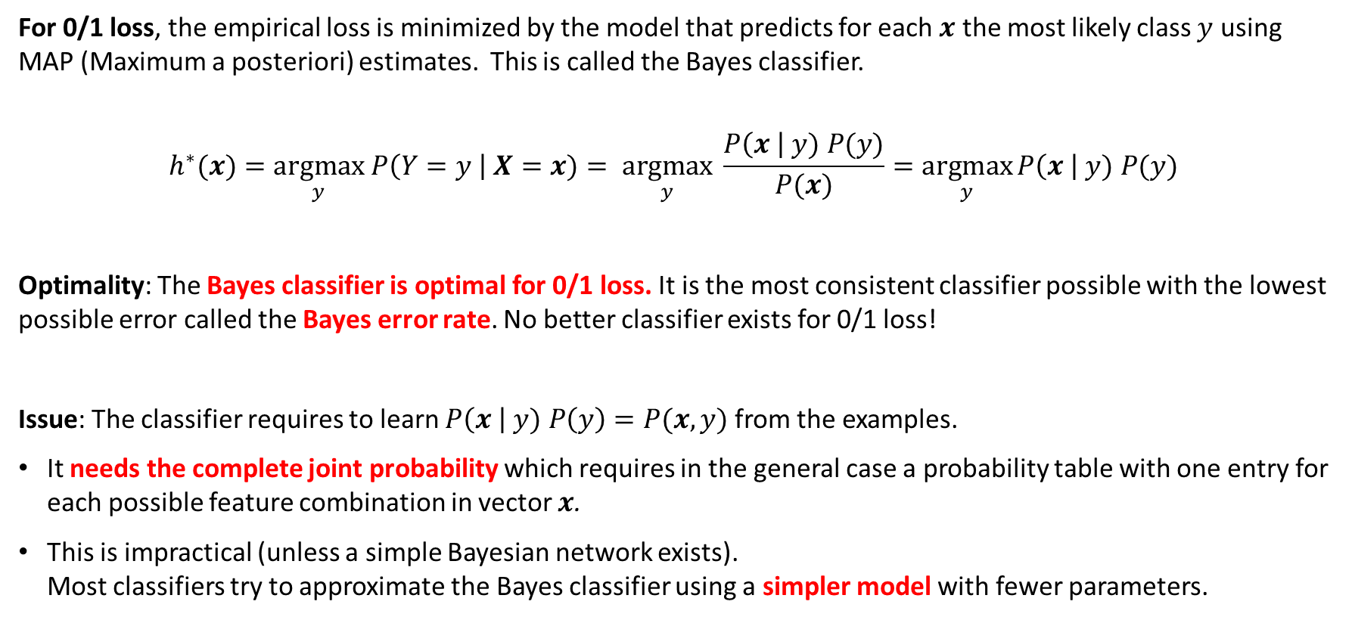
The Most Consistent Classifier
For 0/1 loss, the empirical loss is minimized by the model that predicts for each $x$ the most likely class $y$ using MAP (Maximum a posteriori) estimates. This is called the Bayes classifier.
$$h^{∗}(x)=\underset{y}{argmax} P\left(Y=y \right| X=x)= \underset{y}{argmax} \frac{P\left(x \right| y) P(y)}{P(x)}=\underset{y}{argmax}{P\left(x \right| y) P(y)}$$
Optimality: The Bayes classifier is optimal for 0/1 loss. It is the most consistent classifier possible with the lowest possible error called the Bayes error rate. No better classifier exists for 0/1 loss!
Issue: The classifier requires to learn $P\left(x \right| y) P\left(y\right)=P(x,y)$ from the examples.
It needs the complete joint probability which requires in the general case a probability table with one entry for each possible feature combination in vector $x$.
This is impractical (unless a simple Bayesian network exists). Most classifiers try to approximate the Bayes classifier using a simpler model with fewer parameters.

Slide 12
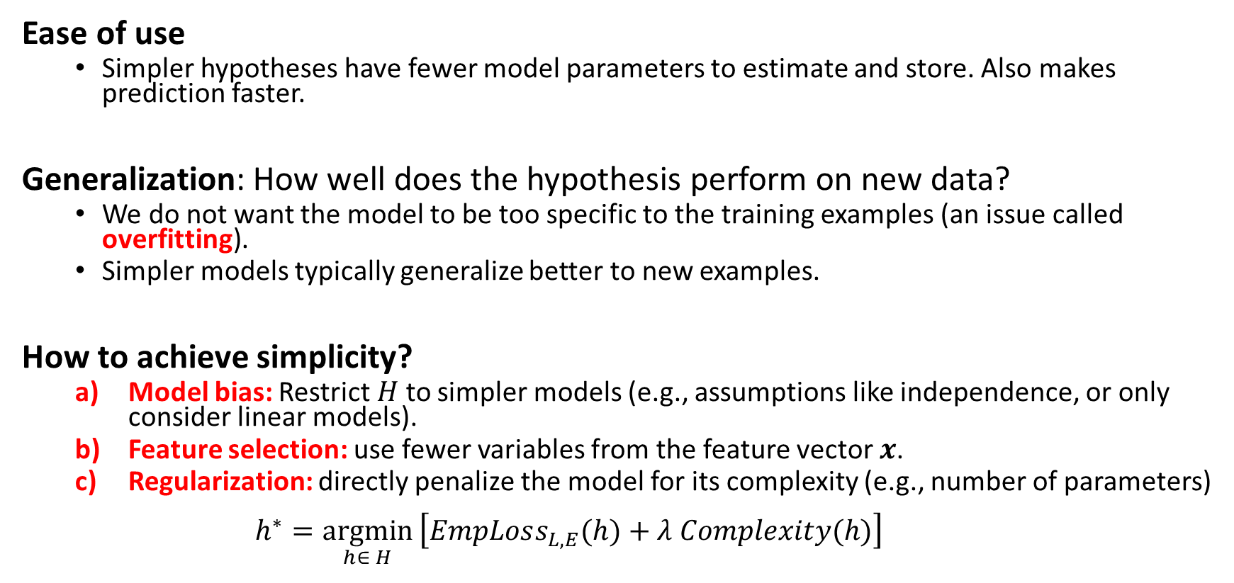
Simplicity
Ease of use
Simpler hypotheses have fewer model parameters to estimate and store. Also makes prediction faster.
Generalization: How well does the hypothesis perform on new data?
We do not want the model to be too specific to the training examples (an issue called overfitting).
Simpler models typically generalize better to new examples.
How to achieve simplicity?
Model bias: Restrict $H$ to simpler models (e.g., assumptions like independence, or only consider linear models).
Feature selection: use fewer variables from the feature vector $x$.
Regularization: directly penalize the model for its complexity (e.g., number of parameters) $h^{∗}=\underset{h∈ H}{argmin}\left[EmpLoss_{L,E}(h)+λ Complexity(h)\right]$
Penalty term

Slide 13
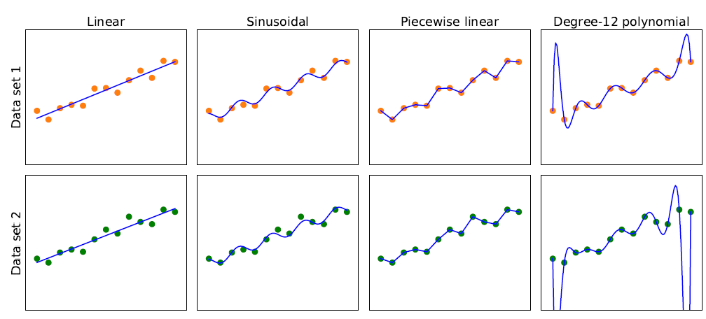
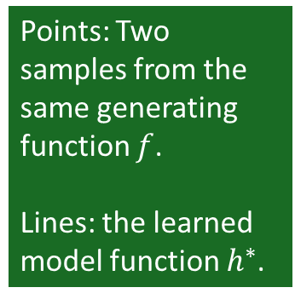
Model Selection: Bias vs. Variance
Overfitting
Simpler
More consistent
Points: Two samples from the same generating function $f$.
Lines: the learned model function $h^{∗}$.
High Bias: restrictions by the model class Low
This is a tradeoff The right choice depends on the application.
Low Variance: difference in the model due to slightly different data. high

Slide 14
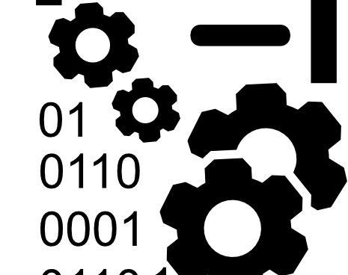
Training Data

Slide 15
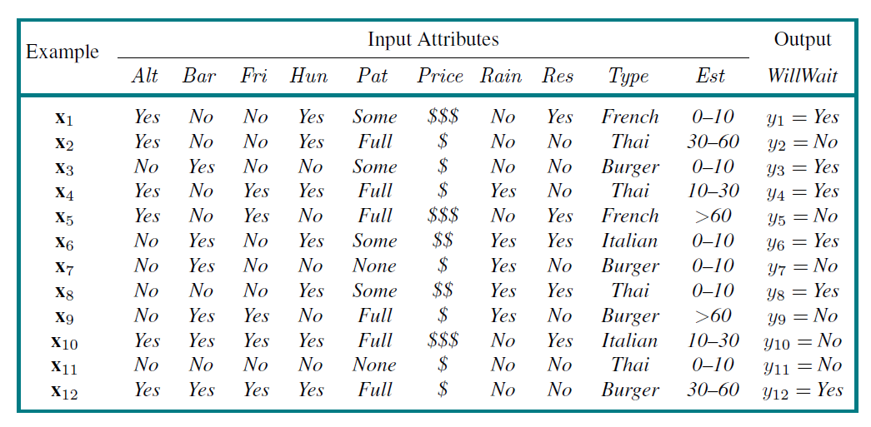
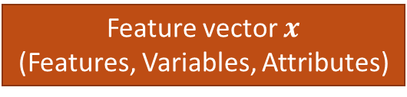
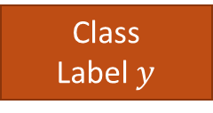
The Dataset
Feature vector $x$
(Features, Variables, Attributes)
Class
Label $y$
Examples
(Instances,
Observation)
Alternative
Hungry
Patrons
Reservation
Wait time
Task: Find a hypothesis (called “model”) to predict the class given the features.

Slide 16
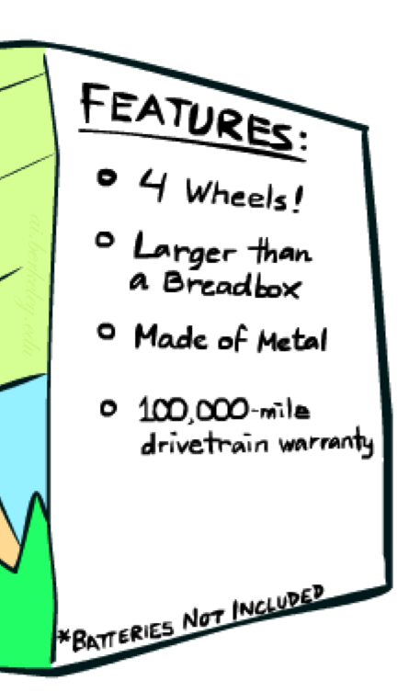

Feature Engineering
Add more information sources as new variables to the model.
Add derived features that help the classifier (e.g., $x_{1}x_{2}$, $x_{1}^{2}, ln⁡(x_{1})$).
Embedding: E.g., convert words to vectors where vector similarity between vectors reflects semantic similarity.
Feature Selection: Which features should be used in the model is a model selection problem (choose between models with different features).
(Deep) neural networks can perform “automatic” feature engineering called end-to-end machine learning.
Example for Spam detection: In addition to words, add features for:
Have you emailed the sender before?
Have 1,000+ other people received the same email?
Is the email in ALL CAPS?

Slide 17

Training Data in AI
Training Data in AI can come from many sources
Existing Data: Download documents from the internet to train Large Language Models.
Observation: Record video of a task being performed (e.g., for self-driving cars).
Simulation: E.g., simulated games using a playout strategy.
Expert feedback on how well a task was performed.

Slide 18

Training and Testing

Slide 19

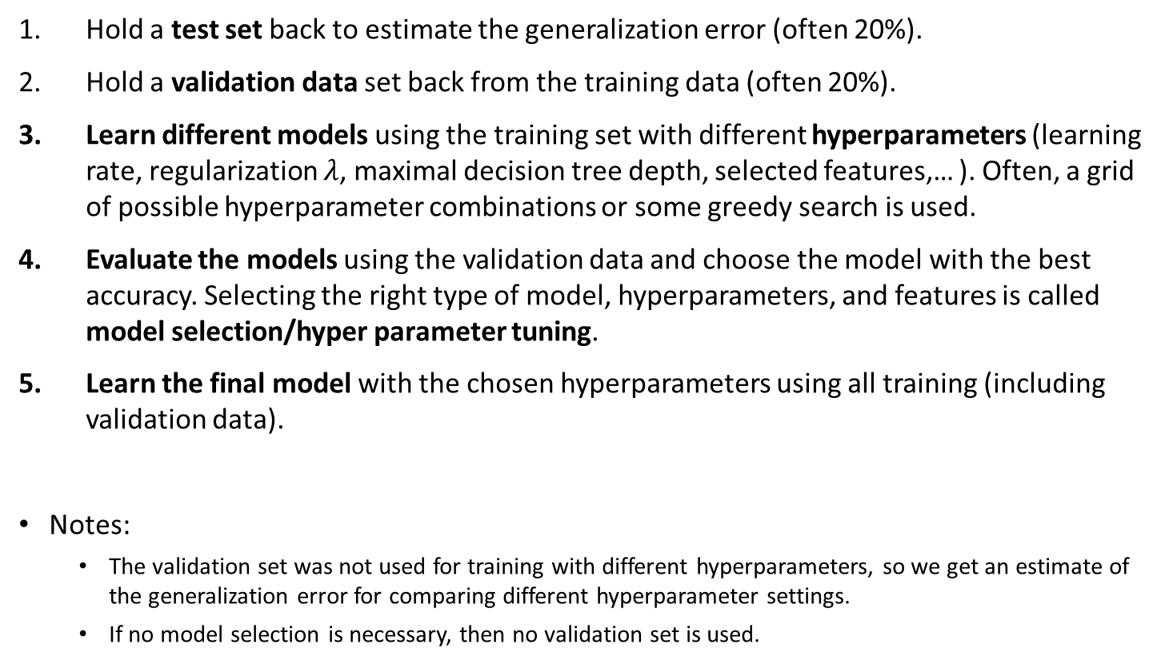
Training a Model
Training
Data
Hold a test set back to estimate the generalization error (often 20%).
Hold a validation data set back from the training data (often 20%).
Learn different models using the training set with different hyperparameters (learning rate, regularization $λ$, maximal decision tree depth, selected features,… ). Often, a grid of possible hyperparameter combinations or some greedy search is used.
Evaluate the models using the validation data and choose the model with the best accuracy. Selecting the right type of model, hyperparameters, and features is called model selection/hyper parameter tuning.
Learn the final model with the chosen hyperparameters using all training (including validation data).
Notes:
The validation set was not used for training with different hyperparameters, so we get an estimate of the generalization error for comparing different hyperparameter settings.
If no model selection is necessary, then no validation set is used.
Training
Data
Validation
Data
Test
Data

Slide 20

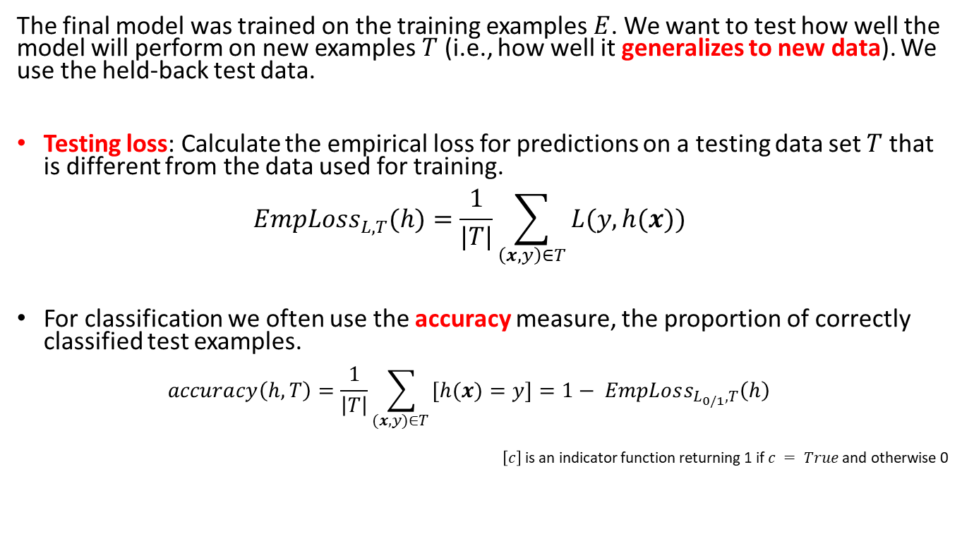

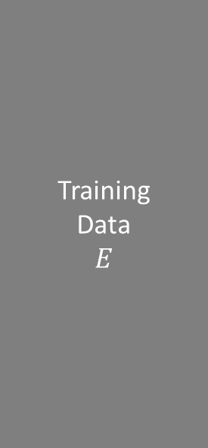
Testing: Evaluating the Final Model
Training
Data $$E$$
The final model was trained on the training examples $E$. We want to test how well the model will perform on new examples $T$ (i.e., how well it generalizes to new data). We use the held-back test data.
Testing loss: Calculate the empirical loss for predictions on a testing data set $T$ that is different from the data used for training. $EmpLoss_{L,T}(h)=\frac{1}{|T|}\sum_{\left(x,y\right)∈T}{L(y, h(x))}$
For classification we often use the accuracy measure, the proportion of correctly classified test examples. $accuracy\left(h, T\right)=\frac{1}{\left|T\right|}\sum_{(x,y)∈T }{[h(x)=y]}=1− EmpLoss_{L_{0/1},T}\left(h\right)$
$\left[c\right]$ is an indicator function returning 1 if $c = True$and otherwise 0
Test
Data $T$

Slide 21
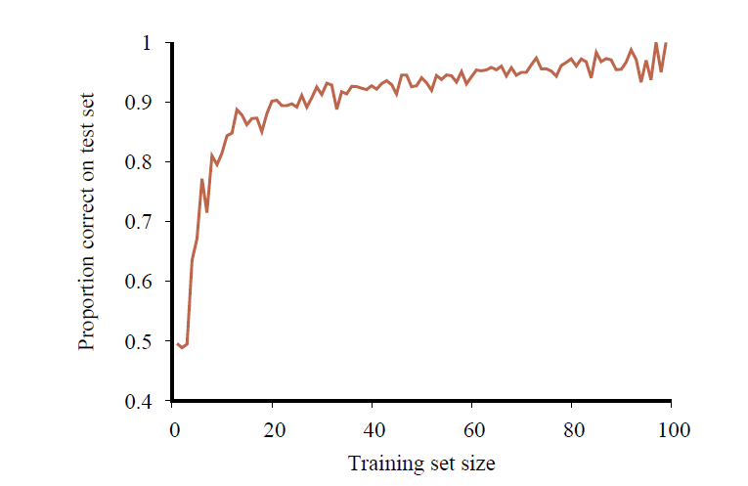
Learning Curve: The Effect the Training Data Size
No classifier can get consistently better than the Bayesian error rate
Accuracy increases when the amount of available training data increases.
More data is better!
At some point, the learning curve flattens out, and more data does not contribute much!
Accuracy

Slide 22

Comparing to a Baselines
First step: get a baseline
The baseline is often a simple model.
Helps to determine how hard the task is.
Helps determine what a good accuracy is.
Weak baseline: E.g., the most frequent label classifier
Gives all test instances the same label which is the most common label in the training set.
Example: For spam filtering, give every message the label “ham” since most messages are ham.
Accuracy might be very high if the problem is skewed (called class imbalance).
Example: If calling everything “ham” gets already 66% right, then a classifier that gets 68% isn’t a big improvement!
Strong baseline: For research, we typically compare our model with the performance of previously published state-of-the-art methods.

Slide 23

Types of Supervised ML Models
Regression: Predict a number
Classification: Predict a label

Slide 24
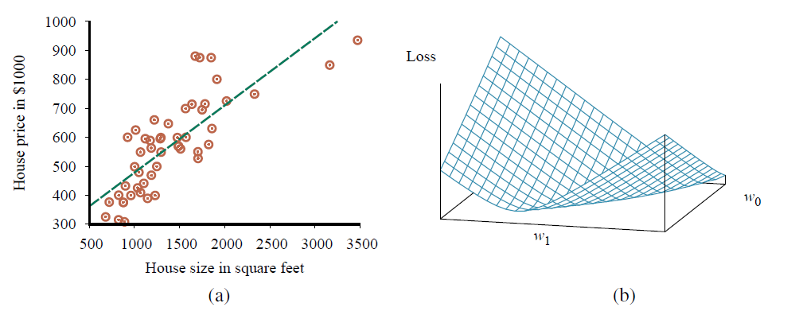

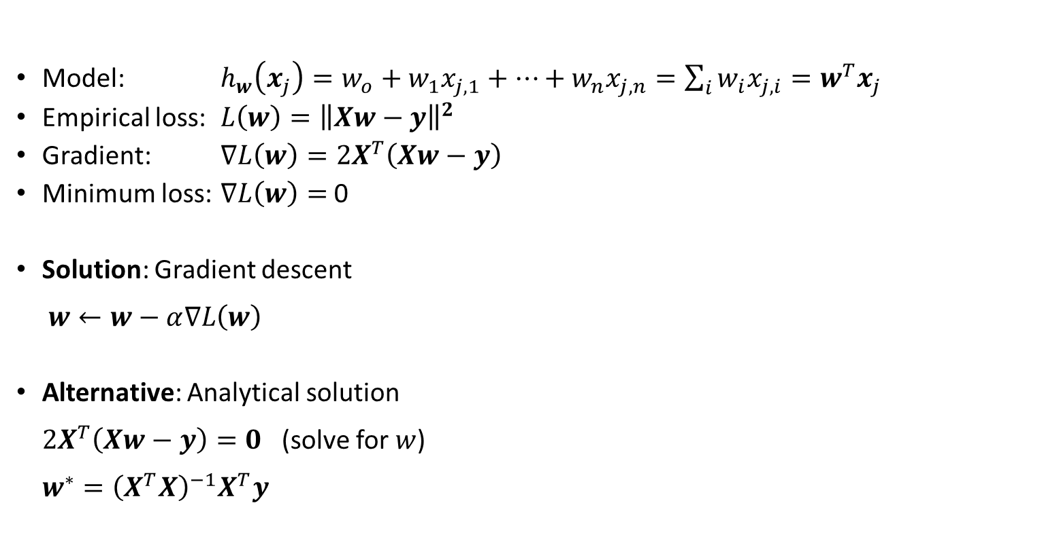

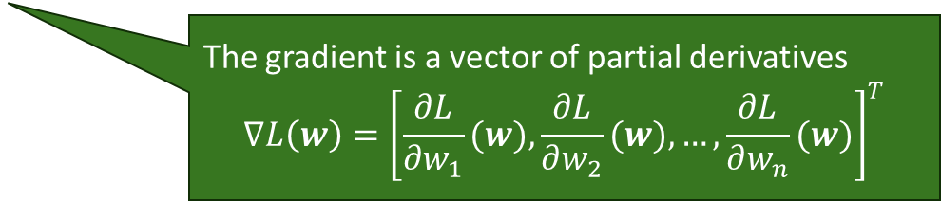
Regression: Linear Regression
Model: $h_{w}\left(x_{j}\right)=w_{o}+w_{1}x_{j,1}+…+w_{n}x_{j,n}=\sum_{i}{w_{i}x_{j,i}}=w^{T}x_{j}$
Empirical loss: $L\left(w\right)={\left\|Xw−y\right\|}^{2}$
Gradient: $∇L\left(w\right)=2X^{T}\left(Xw−y\right)$
Minimum loss: $∇L\left(w\right)=$ 0
Solution: Gradient descent $w←w−α∇L\left(w\right)$
Alternative: Analytical solution $2X^{T}\left(Xw−y\right)=0$ (solve for $w$) $w^{∗}={\left(X^{T}X\right)}^{−1}X^{T}y$
Squared error loss over the whole data matrix $X$
The gradient is a vector of partial derivatives $$∇L\left(w\right)={\left[\frac{∂L}{∂w_{1}}(w),\frac{∂L}{∂w_{2}}(w),…,\frac{∂L}{∂w_{n}}(w)\right]}^{T}$$
$$∇L\left(w\right)$$
$$w$$
Pseudo inverse
Convex loss function

Slide 25
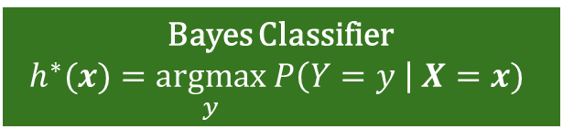
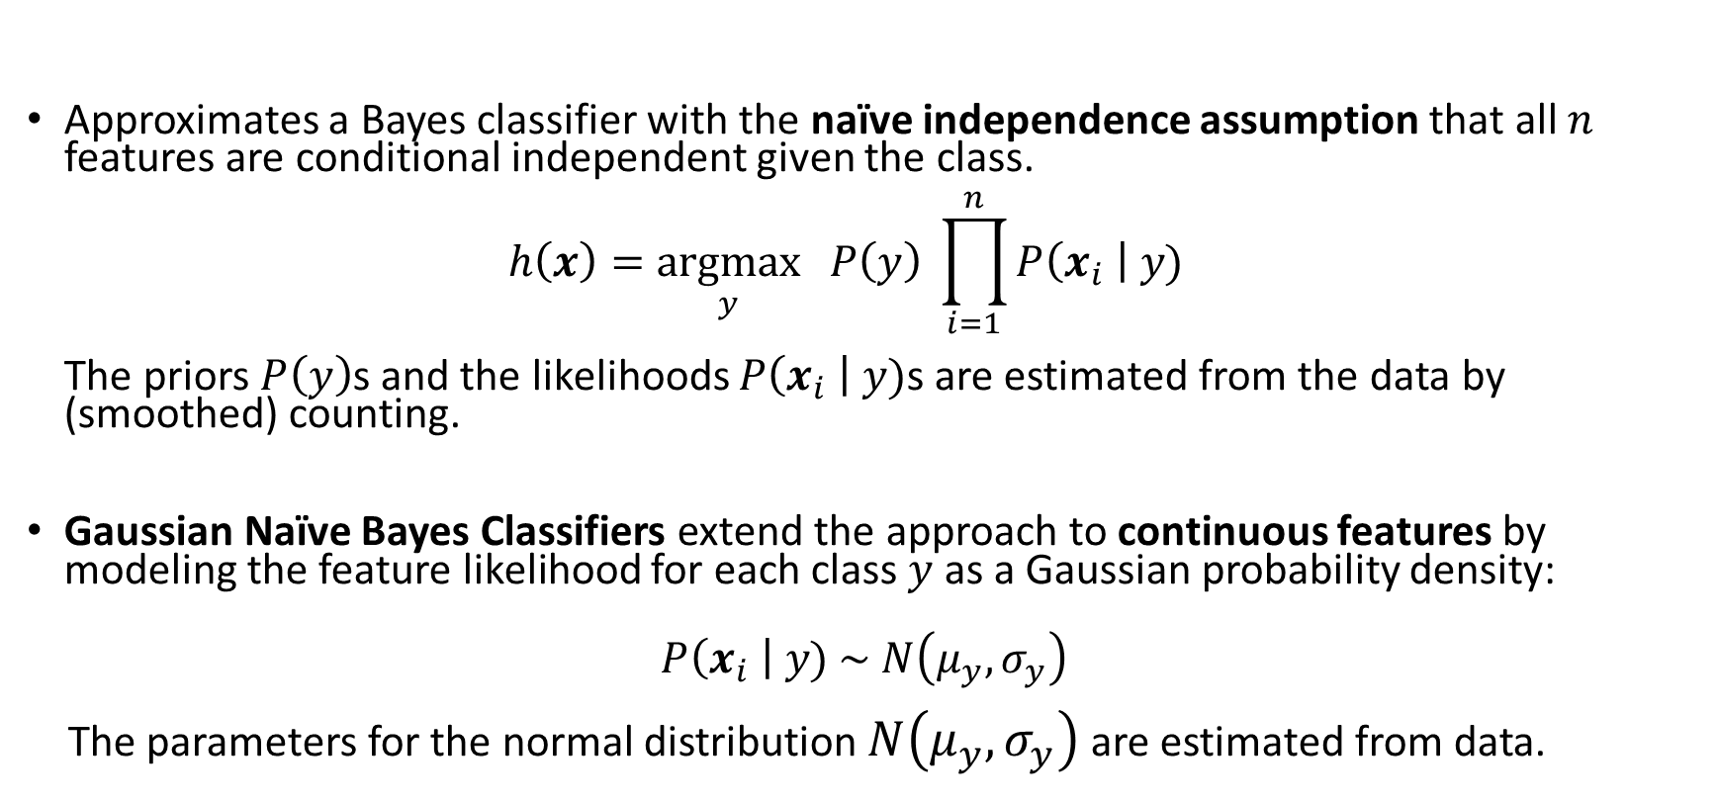
Naïve Bayes Classifier
Bayes Classifier
$$h^{∗}(x)=\underset{y}{argmax} P\left(Y=y \right| X=x)$$
Approximates a Bayes classifier with the naïve independence assumption that all $n$ features are conditional independent given the class. $h\left(x\right)=\underset{y}{argmax}{ P\left(y\right) \prod_{i=1}^{n}{P\left(x_{i} \right| y)}}$ The priors $P\left(y\right)$s and the likelihoods $P\left(x_{i} \right| y)$s are estimated from the data by (smoothed) counting.
Gaussian Naïve Bayes Classifiers extend the approach to continuous features by modeling the feature likelihood for each class $y$ as a Gaussian probability density:
$$P\left(x_{i} \right| y) \sim N\left(μ_{y},σ_{y}\right)$$ The parameters for the normal distribution $N\left(μ_{y},σ_{y}\right)$ are estimated from data.

Slide 26
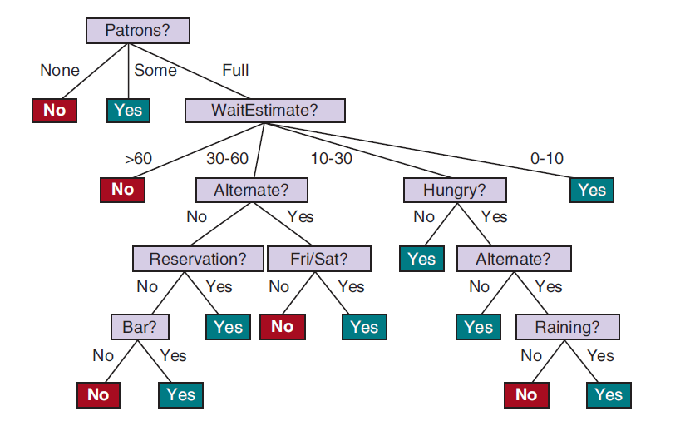
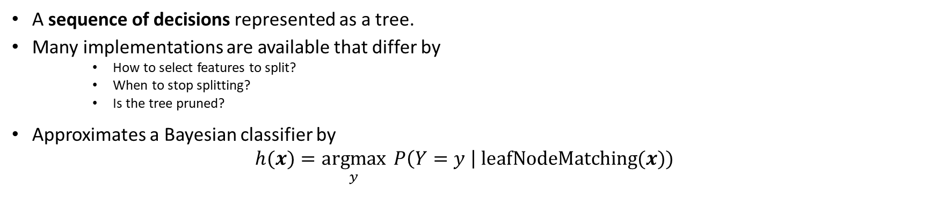
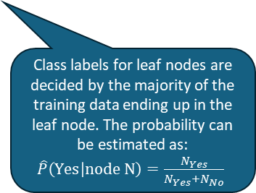
Decision Trees
Bayes Classifier
$$h^{∗}(x)=\underset{y}{argmax} P\left(Y=y \right| X=x)$$
A sequence of decisions represented as a tree.
Many implementations are available that differ by
How to select features to split?
When to stop splitting?
Is the tree pruned?
Approximates a Bayesian classifier by $h(x)=\underset{y}{argmax}{ P\left(Y=y \right| \text{leafNodeMatching}(x)) }$
Class labels for leaf nodes are decided by the majority of the training data ending up in the leaf node. The probability can be estimated as: $\hat{P}\left(\text{Y}\text{es} | \text{node} \text{N}\right)=\frac{N_{Yes}}{N_{Yes}+N_{No}}$

Slide 27
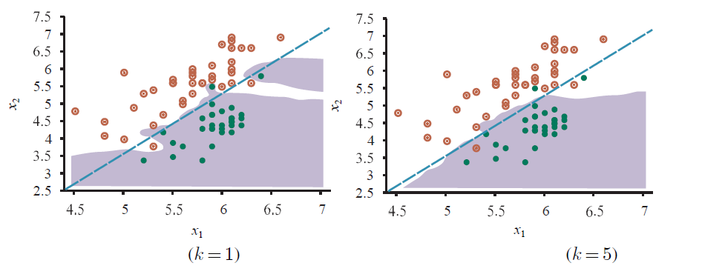
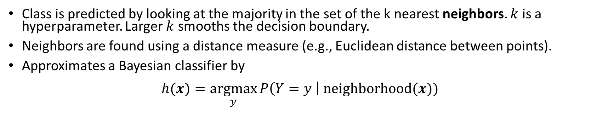
K-Nearest Neighbors Classifier
Bayes Classifier
$$h^{∗}(x)=\underset{y}{argmax} P\left(Y=y \right| X=x)$$
Class is predicted by looking at the majority in the set of the k nearest neighbors. $k$ is a hyperparameter. Larger $k$ smooths the decision boundary.
Neighbors are found using a distance measure (e.g., Euclidean distance between points).
Approximates a Bayesian classifier by $h(x)=\underset{y}{argmax}{P\left(Y=y \right| \text{neighborhood}(x)) }$

Slide 28
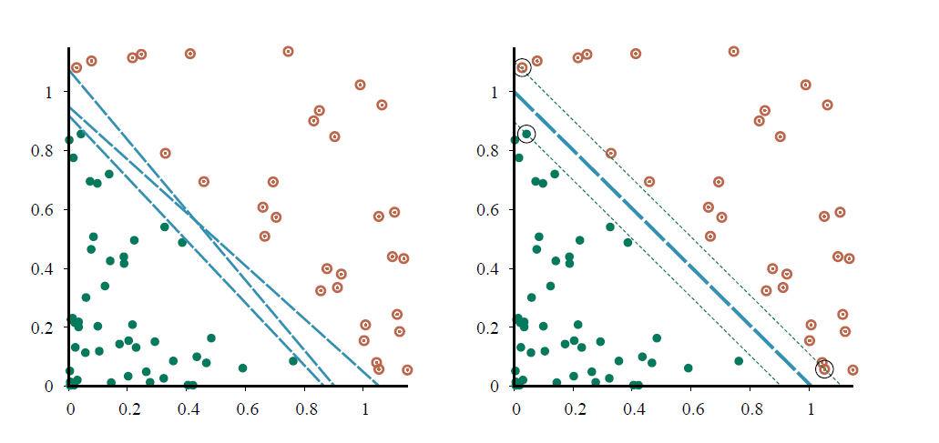
Support Vector Machine (SVM)
Margin
Decision boundary
Linear classifier that finds the maximum margin separator using only the points that are “support vectors” and quadratic optimization.
The kernel trick can be used to learn non-linear decision boundaries.

Slide 29
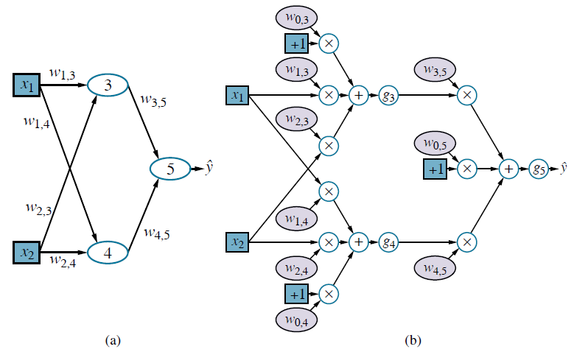
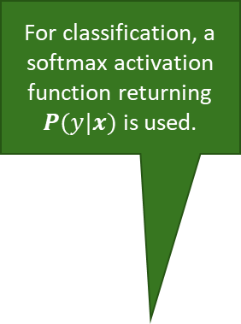
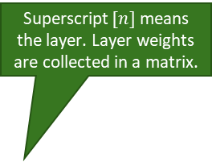
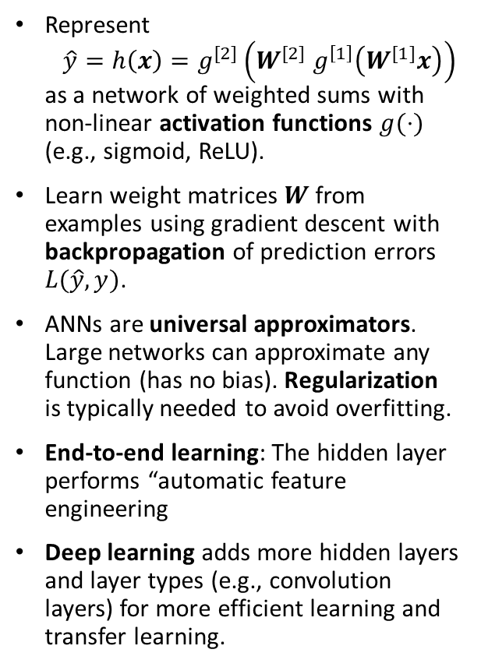
Most Used in AI: Artificial Neural Networks
Superscript $[n]$means the layer. Layer weights are collected in a matrix.
Network Topology
Computational graph
Hidden Layer
For classification, a softmax activation function returning $P(y|x)$ is used.
Represent $\hat{y}=h\left(x\right)=g^{[2]}\left(W^{[2]} g^{\left[1\right]}\left(W^{[1]}x\right)\right)$ as a network of weighted sums with non-linear activation functions $g(⋅)$ (e.g., sigmoid, ReLU).
Learn weight matrices $W$ from examples using gradient descent with backpropagation of prediction errors $L(\hat{y}, y)$.
ANNs are universal approximators. Large networks can approximate any function (has no bias). Regularization is typically needed to avoid overfitting.
End-to-end learning: The hidden layer performs “automatic feature engineering
Deep learning adds more hidden layers and layer types (e.g., convolution layers) for more efficient learning and transfer learning.
Neuron
Non-linear activation function
Bias term

Slide 30
Other Popular Models and Methods
Many other models exist
Generalized linear model (GLM): This important model family includes linear regression, Poisson regression and the classification method logistic regression.
Often used methods
Regularization: Enforce simplicity and reduce overfitting by using a penalty for complexity.
Kernel trick: Lets a linear classifier learn non-linear decision boundaries.
Ensemble Learning: Use many models and combine the results (e.g., random forest, boosting).
Embedding and Dimensionality Reduction: Learn how to represent data in a simpler way. E.g., principal components analysis (PCA), variational autoencoders, text embeddings.

Slide 31
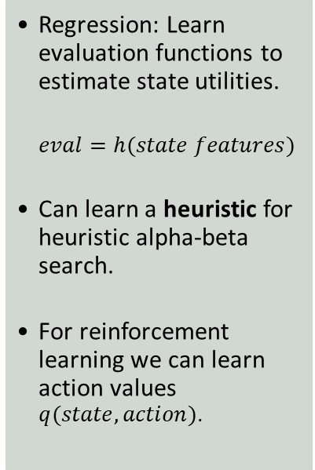
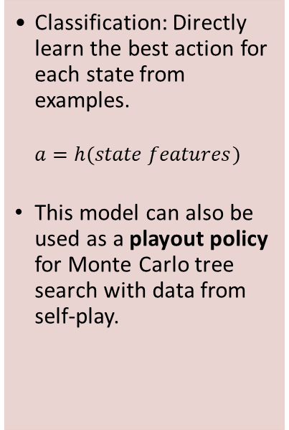
Typical Use of Supervised ML for Intelligent Agents
Learn a Policy
Learn Evaluation Functions
Learn Perception and Actuation
Compressing Tables
Classification: Directly learn the best action for each state from examples.
$$a=h(state features)$$
This model can also be used as a playout policy for Monte Carlo tree search with data from self-play.
Regression: Learn evaluation functions to estimate state utilities.
$$eval=h(state features)$$
Can learn a heuristic for heuristic alpha-beta search.
For reinforcement learning we can learn action values $q(state,action)$.
Natural language processing: Use deep learning / word embeddings / language models to understand concepts, translate between languages, or generate text.
Speech recognition: Identify the most likely sequence of words.
Vision: Object recognition in images/videos. Generate images/video.
Robotics: Learn how to move safely.
Neural networks can be used as a compact representation of tables that do not fit in memory. E.g.,
Joint and conditional probability tables
State utility tables (i.e., an evaluation function)
Q-Value tables in reinforcement learning
Bottom line: Learning a function is often more effective than hard-coding it. However, we do not always know how it performs for rare and edge cases!

