Slide 1
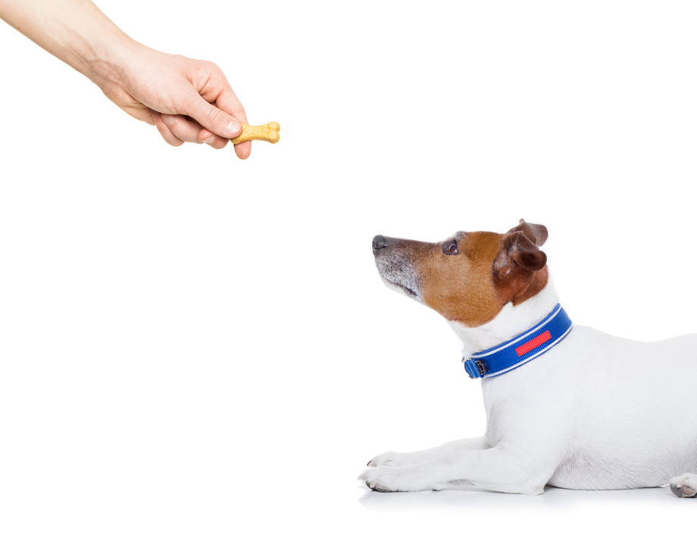
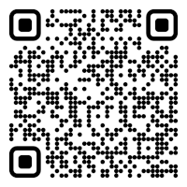

CS 5/7320 Artificial Intelligence Reinforcement Learning AIMA Chapter 17+22
Slides by Michael Hahsler with figures from the AIMA textbook.
This work is licensed under a Creative Commons Attribution-ShareAlike 4.0 International License.
Online Material

Slide 2
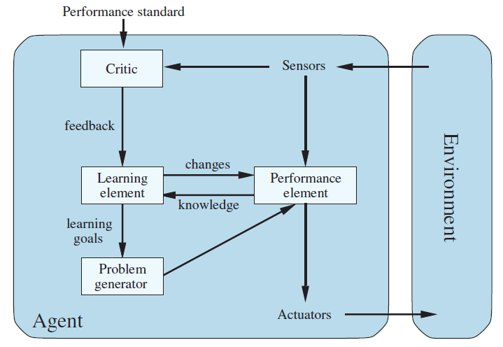
From Chapter 2: Agents That Learn
Critic: How is the agent currently performing?
Learning Element: Improve the performance element and changes how it selects actions.
E.g., adding rules, changing weights
Problem generators: Explore new actions.
Positive feedback from the critic reinforces the performance element.

Slide 3
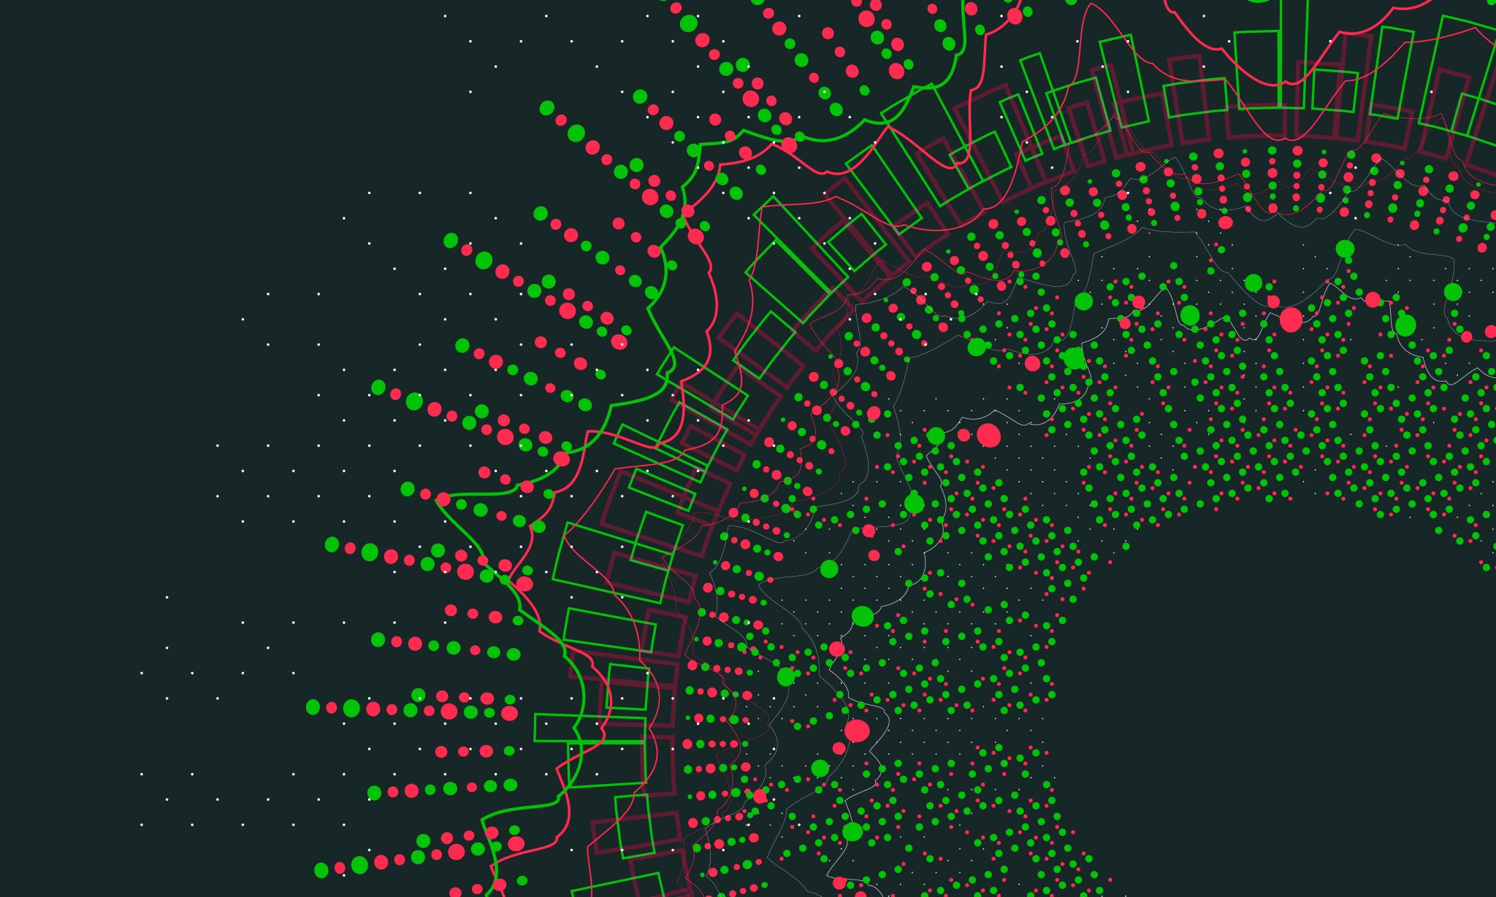
Making Complex Decisions: Sequential Decision Making
AIMA Chapter 17

Slide 4





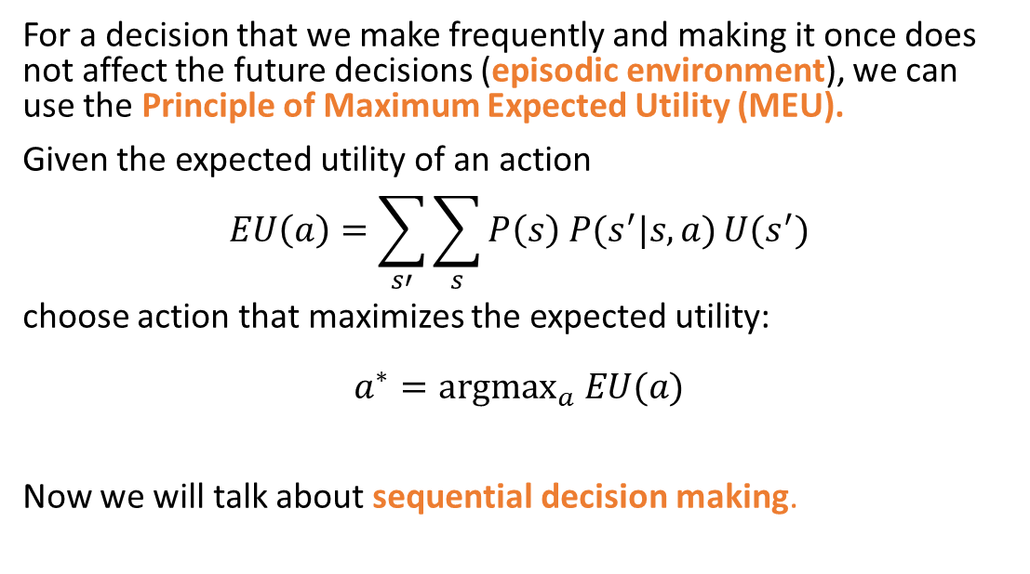


Remember Chapter 16: Making Simple Decisions
Currentstate $s$
Action $a$
Future state $s′$
$$U(s’)$$
Action
For a decision that we make frequently and making it once does not affect the future decisions (episodic environment), we can use the Principle of Maximum Expected Utility (MEU).
Given the expected utility of an action $$EU\left(a\right)=\sum_{s′}{\sum_{s}{P\left(s\right) P(s^{′}|s,a)}U(s^{′})}$$
choose action that maximizes the expected utility: $$a^{∗}={argmax}_{a} EU(a)$$
Now we will talk about sequential decision making.

Slide 5







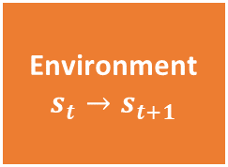


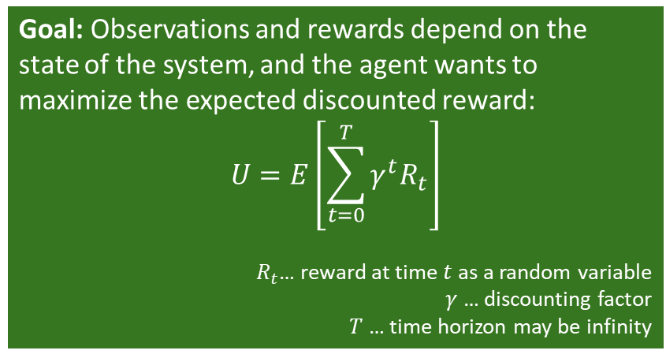

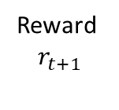



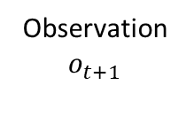


Sequential Decision Problems
$$a_{0}$$
$$U(s_{1})$$
…
$$U(s_{T−1})$$
$$U(s_{T})$$
Currentstate $s_{0}$
$$s_{1}$$
$$s_{T−1}$$
$$s_{T}$$
$$a_{1}$$
$$a_{T−1}$$
Utility-based agent: The agent’s utility depends on a sequence of decisions that depend on each other.
Sequential decision problems incorporate utility (called immediate and long-term reward), uncertainty, and sensing.
$$s_{0}$$
$$s_{1}$$
$$s_{2}$$
Action
$a_{t}$
Agent
Sequence: ${{(o}_{0},r}_{0}), a_{0}, {(o_{1},r}_{1}), a_{1},(o_{2},r_{2}), a_{2}, …$
Goal: Observations and rewards depend on the state of the system, and the agent wants to maximize the expected discounted reward:
$$U=E\left[\sum_{t=0}^{T}{γ^{t}R_{t}}\right]$$
$R_{t}$… reward at time $t$ as a random variable
$γ$ … discounting factor $T$ … time horizon may be infinity
Observation $$o_{t+1}$$
Reward $$r_{t+1}$$
Environment
$$s_{t}→s_{t+1}$$
If we have a model of the environment then we can plan.

Slide 6

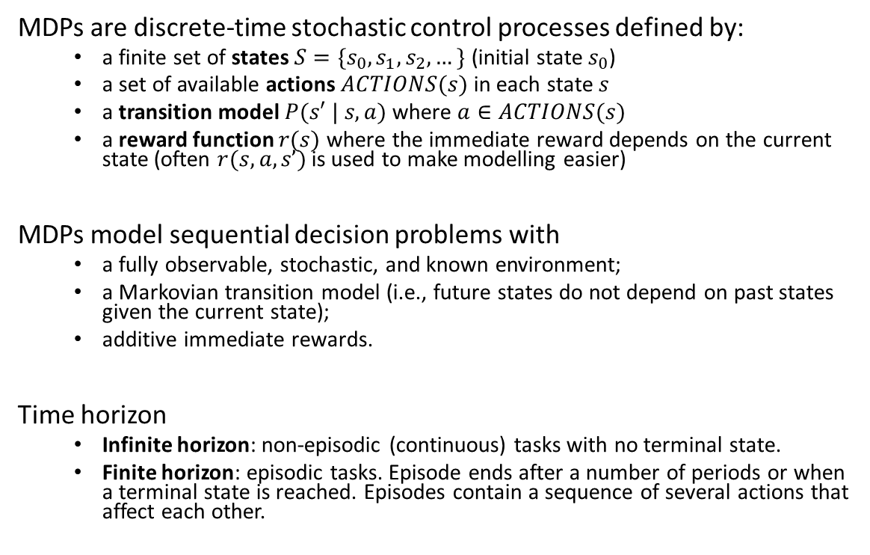

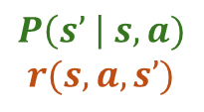






An Environment Model: Markov Decision Process (MDP)
MDPs are discrete-time stochastic control processes defined by:
a finite set of states $S=\{s_{0}, s_{1},s_{2}, …\}$ (initial state $s_{0}$)
a set of available actions $ACTIONS(s)$ in each state $s$
a transition model $P(s′ | s, a)$ where $a∈ACTIONS(s)$
a reward function $r(s)$ where the immediate reward depends on the current state (often $r(s,a,s’)$is used to make modelling easier)
MDPs model sequential decision problems with
a fully observable, stochastic, and known environment;
a Markovian transition model (i.e., future states do not depend on past states given the current state);
additive immediate rewards.
Time horizon
Infinite horizon: non-episodic (continuous) tasks with no terminal state.
Finite horizon: episodic tasks. Episode ends after a number of periods or when a terminal state is reached. Episodes contain a sequence of several actions that affect each other.
$$P\left(s’ \right| s,a)$$
$$r(s,a,s’)$$
1
$$a_{1}$$
.5
10
$$s_{0}$$
$$s_{1}$$
$$a_{2}$$
-5
10
$$a_{2}$$
.5
1
$$a_{1}$$
100
$$s_{2}$$
$$a_{1},a_{2}$$
0

Slide 7
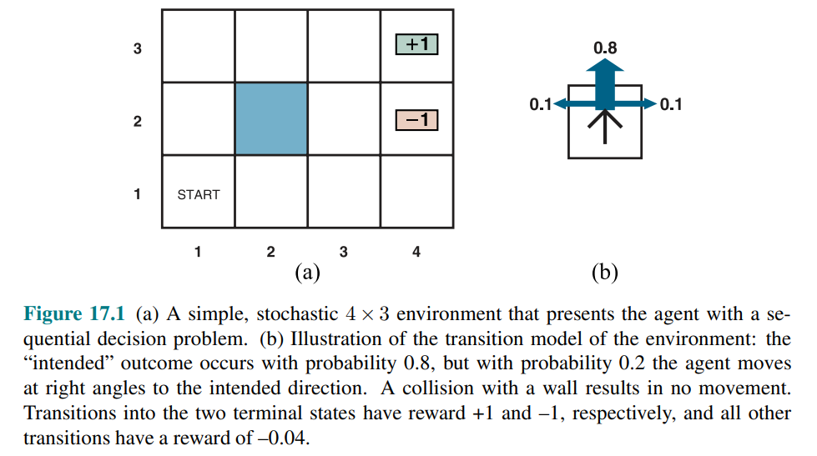
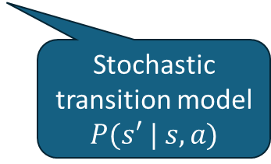
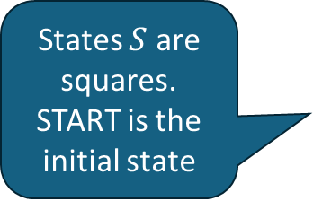
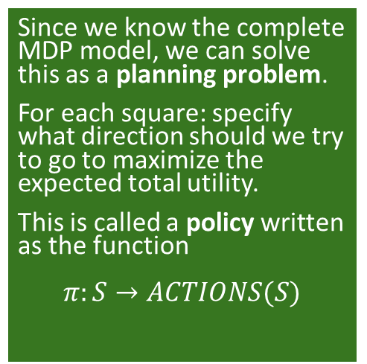
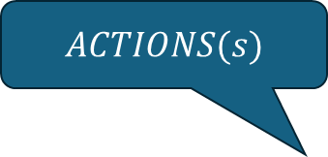
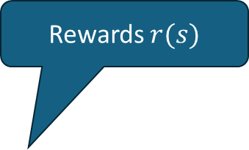
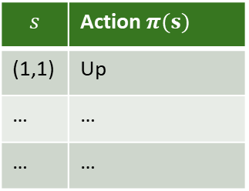
Example: 4x3 Grid World
Since we know the complete MDP model, we can solve this as a planning problem.
For each square: specify what direction should we try to go to maximize the expected total utility.
This is called a policy written as the function $$π:S→ACTIONS(S)$$
Rewards $r(s)$
$ACTIONS(s)$
-0.04
-0.04
-0.04
States $S$ are squares. START is the initial state
-0.04
-0.04
-0.04
-0.04
-0.04
Stochastic transition model
$P(s′ | s, a)$
-0.04
Policy as a Table
$$s$$ | Action $π(s)$
(1,1) | Up
… | …
… | …

Slide 8
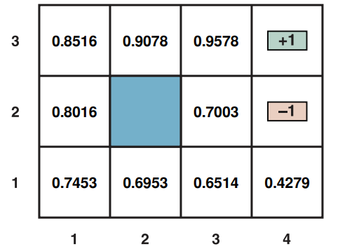
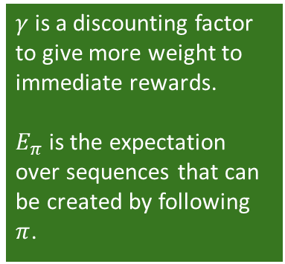
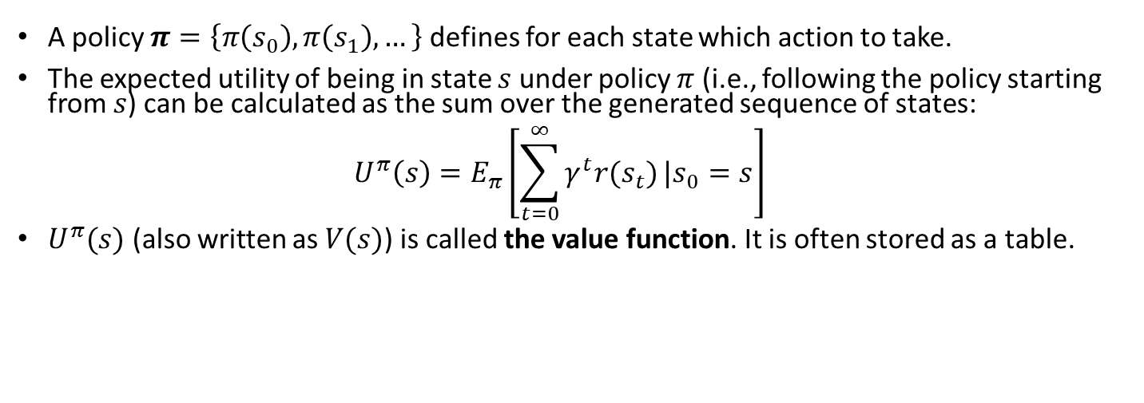
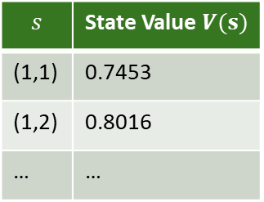
Value Function
A policy $π=\left\{π\left(s_{0}\right), π\left(s_{1}\right), …\right\}$ defines for each state which action to take.
The expected utility of being in state $s$ under policy $π$ (i.e., following the policy starting from $s$) can be calculated as the sum over the generated sequence of states: $U^{π}\left(s\right)=E_{π}\left[\sum_{t=0}^{∞}{γ^{t}r(s_{t})}|s_{0}=s\right]$
$U^{π}(s)$ (also written as $V(s)$) is called the value function. It is often stored as a table.
$γ$ is a discounting factor to give more weight to immediate rewards.
$E_{π}$ is the expectation over sequences that can be created by following $π$.
Value Function
Value Function
$$s$$ | State Value $V(s)$
(1,1) | 0.7453
(1,2) | 0.8016
… | …

Slide 9
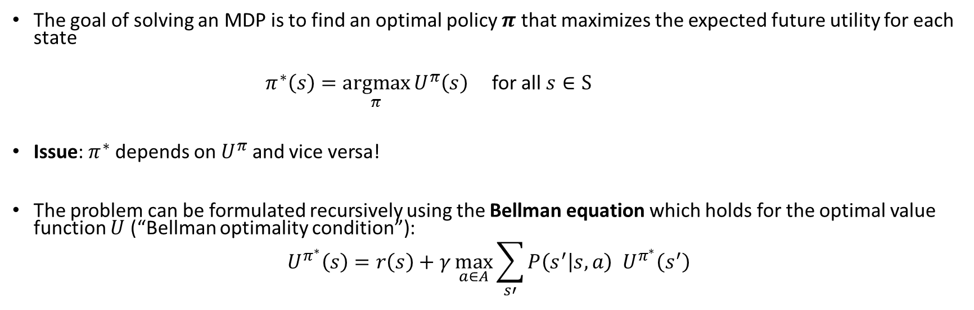
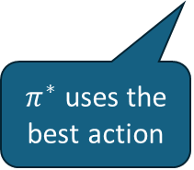
Planning: Finding the Optimal Policy
The goal of solving an MDP is to find an optimal policy $π$ that maximizes the expected future utility for each state
$π^{∗}\left(s\right)=\underset{π}{argmax}{U^{π}\left(s\right)}$ for all $s∈S$
Issue: $π^{∗}$ depends on $U^{π}$ and vice versa!
The problem can be formulated recursively using the Bellman equation which holds for the optimal value function $U$ (“Bellman optimality condition”):
$$U^{π^{∗}}\left(s\right)=r\left(s\right)+γ\max_{a∈A}{\sum_{s′}{P\left(s^{′} | s,a\right){ U}^{π^{∗}}\left(s^{′}\right)}}$$
Immediate Reward
$π^{∗}$ uses the best action
Expectation
Utility of the next state

Slide 10
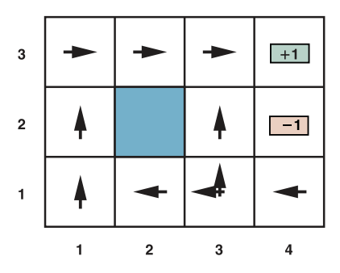
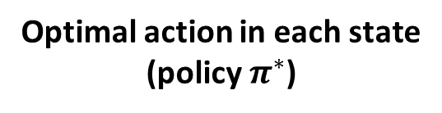

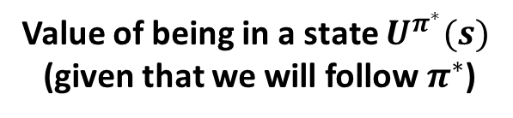
Example Solution: 4x3 Grid World
Optimal action in each state
(policy $π^{∗}$)
Value of being in a state $U^{π^{∗}}(s)$ (given that we will follow $π^{∗}$)
Greedy policy:
Always pick the action leading to the state with the highest expected utility.
$$γ=1$$
It is optimal to walk away from the +1 square!
How do we find the optimal value function/optimal policy?
Policy Iteration
Value Iteration

Slide 11
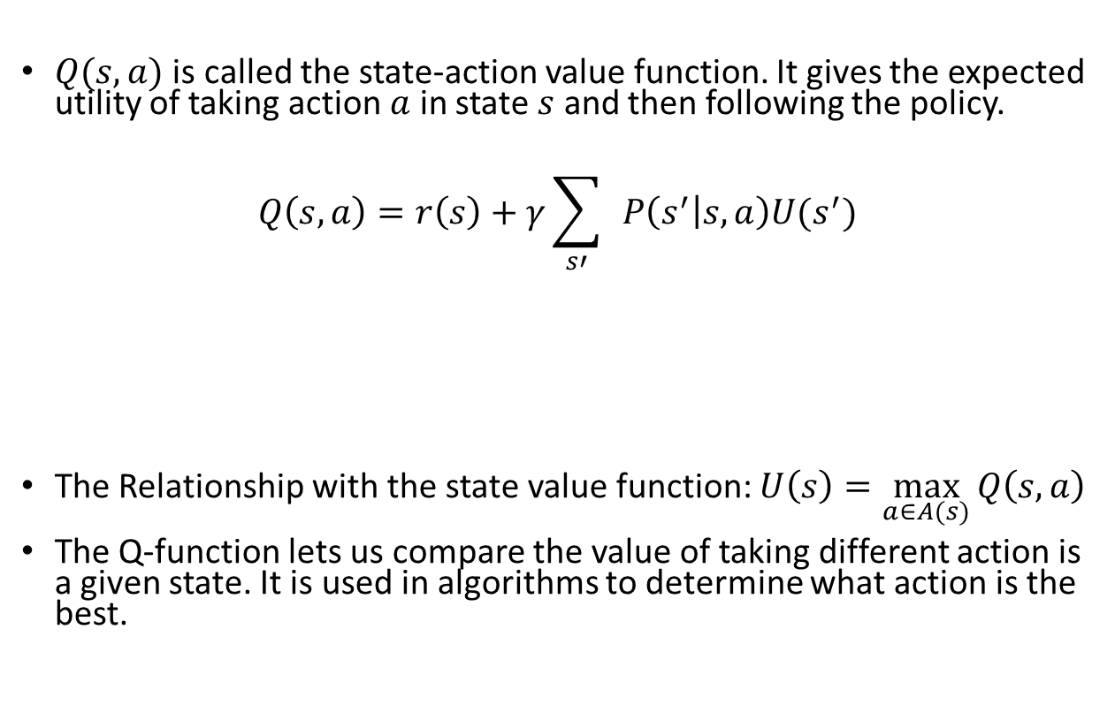
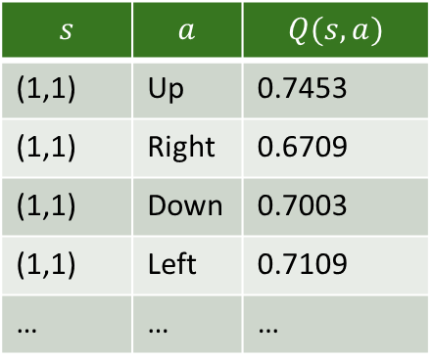
Q-Function
Value Function
$Q(s,a)$ is called the state-action value function. It gives the expected utility of taking action $a$ in state $s$ and then following the policy.
$$Q\left(s,a\right)=r\left(s\right)+γ\sum_{s′}{ }P\left(s^{′} | s,a\right)U(s^{′})$$
The Relationship with the state value function: $U\left(s\right)=\max_{a∈A(s)}{Q\left(s, a\right)}$
The Q-function lets us compare the value of taking different action is a given state. It is used in algorithms to determine what action is the best.
Immediate Reward
Expected utility of the next state
Q-Table
$$s$$ | $$a$$ | $$Q(s,a)$$
(1,1) | Up | 0.7453
(1,1) | Right | 0.6709
(1,1) | Down | 0.7003
(1,1) | Left | 0.7109
… | … | …

Slide 12
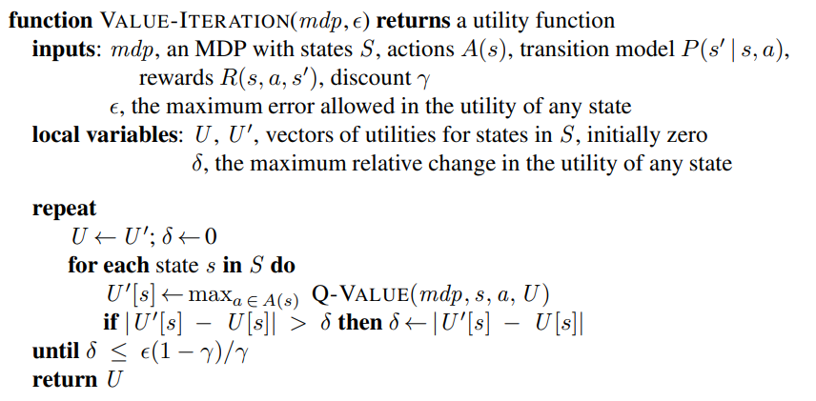

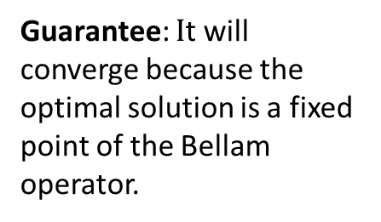
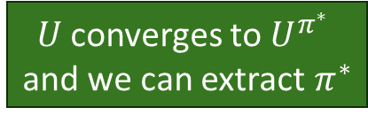
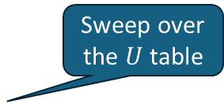
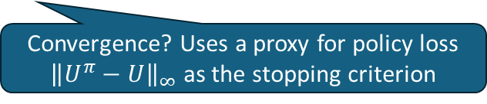
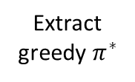


Value Iteration: Estimate the Optimal Value Function $U^{π^{∗}}$
Algorithm: Start with a $U$ table (vector) of 0 for all states and then apply the Bellman update over the entries of the table until it converges to the unique optimal solution $U^{π^{∗}}.$
Bellman updates
$$U$$
$$U′$$
$$U^{π^{∗}}$$
Sweep over the $U$table
Extract greedy $π^{∗}$
Bellman update: Value of the best action in state s.
Guarantee: $I$t will converge because the optimal solution is a fixed point of the Bellam operator.
$U$ converges to $U^{π^{∗}}$ and we can extract $π^{∗}$
Convergence? Uses a proxy for policy loss ${\left\|U^{π}−U\right\|}_{∞}$ as the stopping criterion

Slide 13
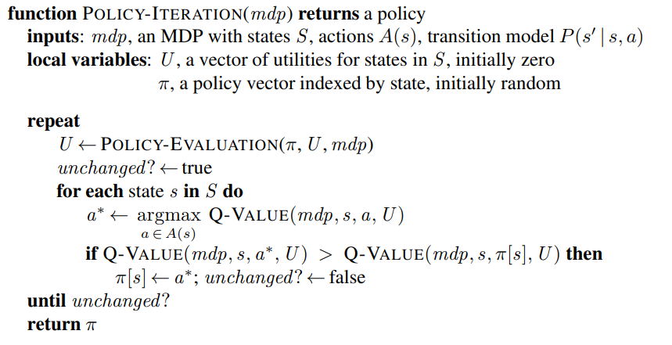

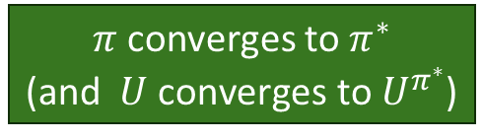


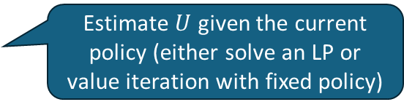
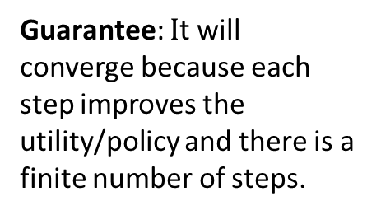
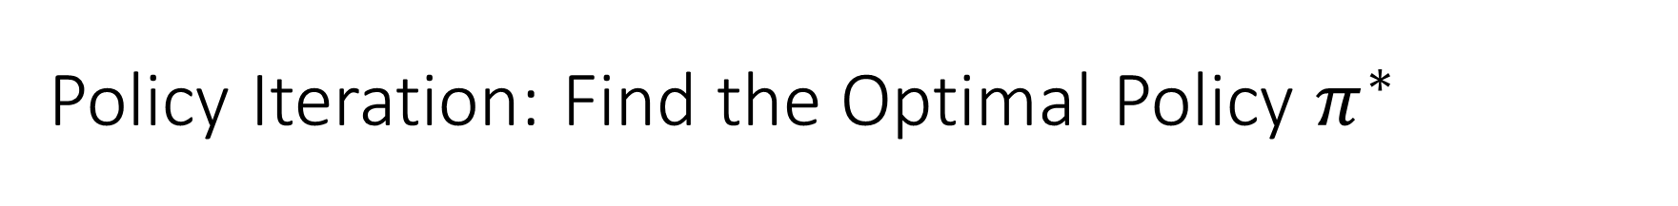

Policy Iteration: Find the Optimal Policy $π^{∗}$
Policy iteration tries to directly find the optimal policy by iterating policy evaluation and improvement.
$$U$$
$$U^{π^{∗}}$$
P. improvement
Policy evaluation
$$π^{∗}$$
Estimate $U$ given the current policy (either solve an LP or value iteration with fixed policy)
$$π$$
Greedy policy
Improvement.
Guarantee: $I$t will converge because each step improves the utility/policy and there is a finite number of steps.
$π$ converges to $π^{∗}$ (and $U \text{converges} \text{to} U^{π^{∗}}$)
Convergence?

Slide 14
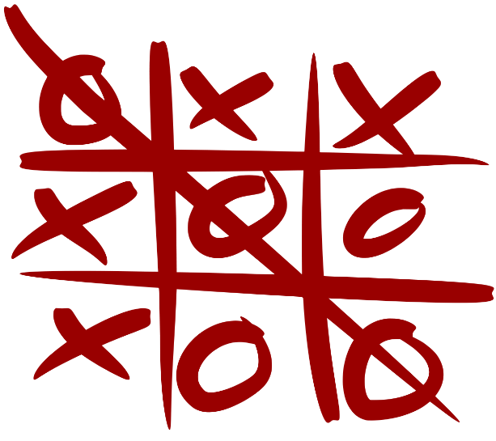
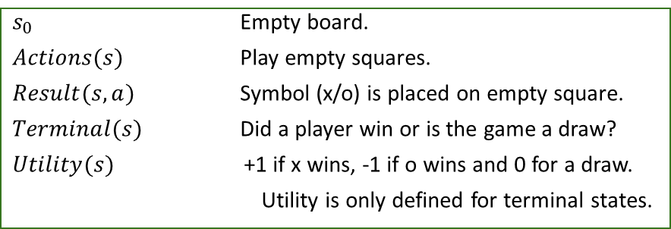
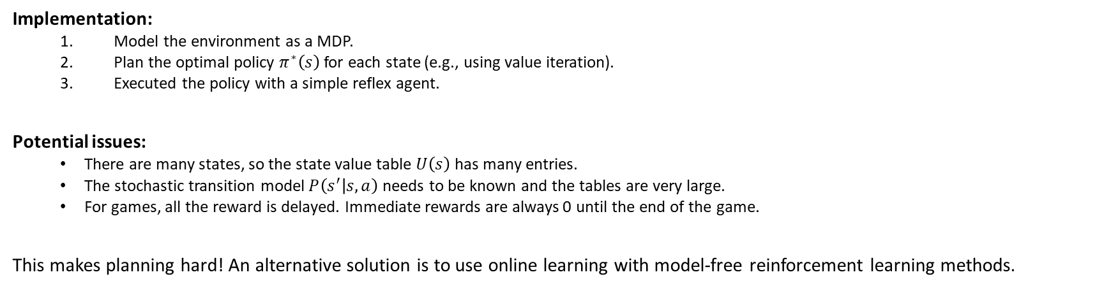


Playing a Game as a Sequential Decision Problem: Tic-Tac-Toe
Definitions from Chapter 5 on Games for a goal-based agent:
$s_{0}$ Empty board.
$Actions(s)$ Play empty squares.
$Result(s,a)$ Symbol (x/o) is placed on empty square.
$Terminal(s)$ Did a player win or is the game a draw?
$Utility(s)$ +1 if x wins, -1 if o wins and 0 for a draw.
Utility is only defined for terminal states.
Stochastic transition model $P\left(s^{′} | s,a\right)$
Reward function $r(s)$
Implementation:
Model the environment as a MDP.
Plan the optimal policy $π^{∗}\left(s\right)$for each state (e.g., using value iteration).
Executed the policy with a simple reflex agent.
Potential issues:
There are many states, so the state value table $U\left(s\right)$has many entries.
The stochastic transition model$P\left(s^{′} | s,a\right)$ needs to be known and the tables are very large.
For games, all the reward is delayed. Immediate rewards are always 0 until the end of the game.
This makes planning hard! An alternative solution is to use online learning with model-free reinforcement learning methods.

Slide 15



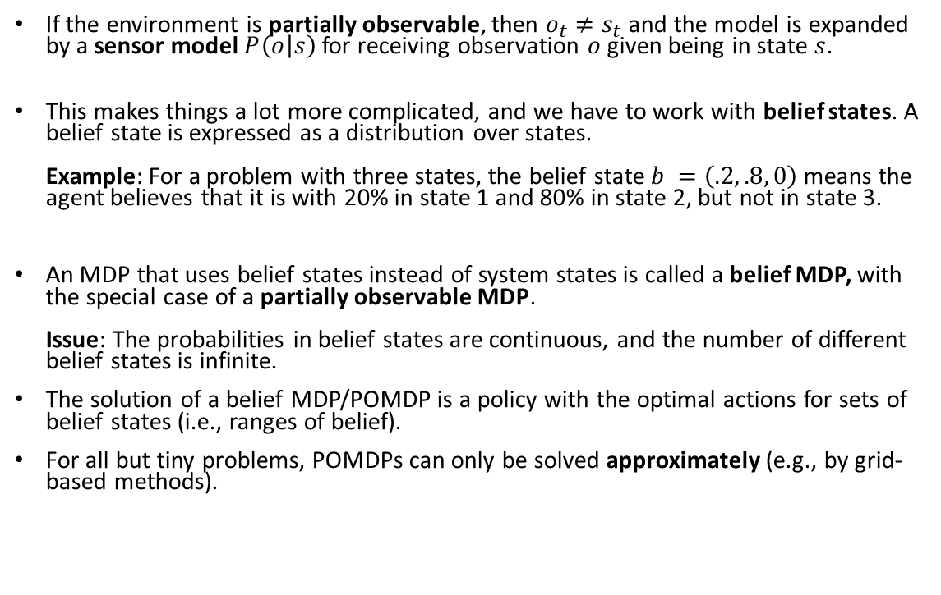

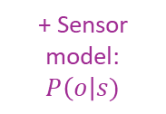




Partially Observable Markov Decision Process (POMDP)
If the environment is partially observable, then $o_{t}≠s_{t}$ and the model is expanded by a sensor model $P\left(o | s\right)$ for receiving observation $o$ given being in state $s$.
This makes things a lot more complicated, and we have to work with belief states. A belief state is expressed as a distribution over states. Example: For a problem with three states, the belief state $b =\left(.2, .8, 0\right)$ means the agent believes that it is with 20% in state 1 and 80% in state 2, but not in state 3.
An MDP that uses belief states instead of system states is called a belief MDP, with the special case of a partially observable MDP. Issue: The probabilities in belief states are continuous, and the number of different belief states is infinite.
The solution of a belief MDP/POMDP is a policy with the optimal actions for sets of belief states (i.e., ranges of belief).
For all but tiny problems, POMDPs can only be solved approximately (e.g., by grid-based methods).
$${ o}_{1}$$
$${ o}_{2}$$
$${ o}_{3}$$
+ Sensor model: $P\left(o\right|s)$
$$a_{1}$$
1
10
.5
10
$$s_{0}$$
$$s_{1}$$
$$a_{2}$$
-5
$$a_{2}$$
.5

Slide 16
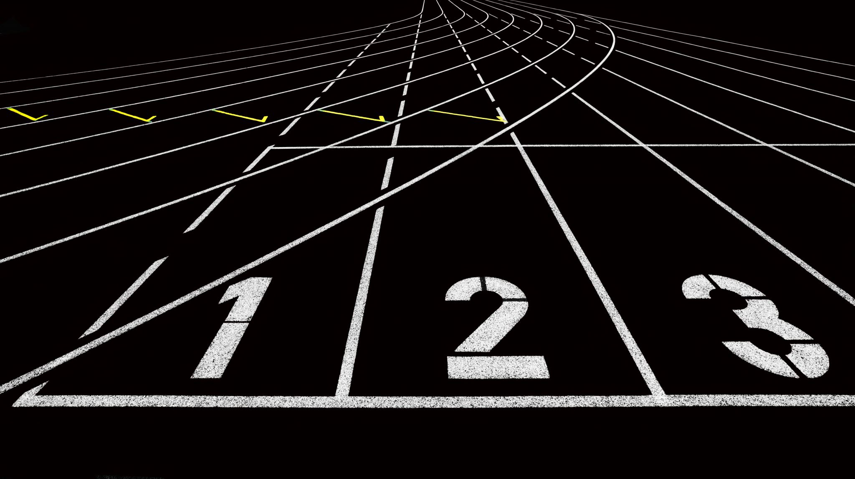
(Model-Free) Reinforcement Learning
AIMA Chapter 22

Slide 17












Model-based vs. Model-free Reinforcement Learning (RL)
Model-based RL
Model-free RL
Agent
Action
$a_{t}$
Action
$a_{t}$
Agent
Observation $$o_{t+1}$$
Reward $$r_{t+1}$$
Observation $$o_{t+1}$$
Reward $$r_{t+1}$$
Environment
$$s_{t}→s_{t+1}$$
Environment
$$s_{t}→s_{t+1}$$
MDP
MDP
$$P\left(s’ \right| s,a)$$
$$r(s,a,s’)$$
?
1
$$a_{1}$$
.5
$$s_{0}$$
10
$$s_{1}$$
$$a_{2}$$
-5
.5
1
10
$$a_{2}$$
$$a_{1}$$
100
$$s_{2}$$
$$a_{1},a_{2}$$
0
Use the MDP model for planning (e.g., value iteration, sampling, etc.)
An unknown MDP model means we have to try actions and use online learning.
Notes:
Reward may be sparse. Need for credit assignment.
Reward shaping creates pseudo rewards that advance learning (e.g., ball possession or distance to the goal in soccer).
Hierarchical RL: Break the task into smaller sub-tasks so we can learn the succession of sub-task efficiently.

Slide 18
Reinforcement Learning (RL)
RL assumes that the problem can be modeled as a Markov Decision Process (MDP).
However, we do not know the transition or the reward model. This means we have an unknown environment, and we need “model-free” methods.
We cannot use offline planning in unknown environments. The agent needs to explore the environment (try actions) and use the reward signal to update its estimate of the utility of states and actions. This is an online learning process that provides positive reinforcement through rewards.
A popular algorithm is Q-Learning, which tries to learn the state-action value function of important states.
Notes:
Reward may be sparse. Need for credit assignment.
Reward shaping creates pseudo rewards that advance learning (e.g., ball possession or distance to the goal in soccer).
Hierarchical RL: Break the task into smaller sub-tasks so we can learn the succession of sub-task efficiently.

Slide 19
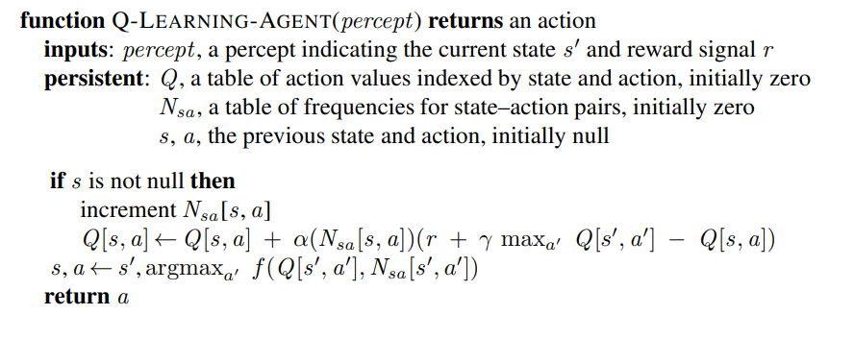
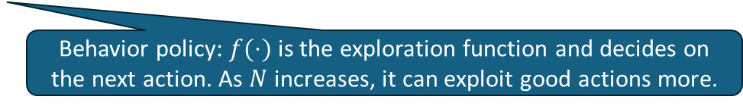
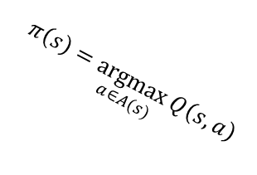
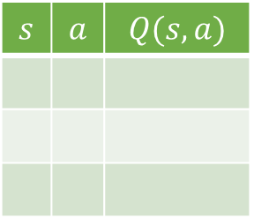

Q-Learning
Q-Table
$$s$$ | $$a$$ | $$Q(s,a)$$
Q-Learning learns the state-action value function as a table from interactions with the environment.
$$π\left(s\right)=\underset{a∈A(s)}{argmax}{Q\left(s, a\right)}$$
Encodes learned policy
A new episode starts with no previous state.
Make $Q\left[s,a\right]$ a little more similar to the received reward + the best Q-value of the successor state.
Learning rate
TD-error
Behavior policy: $f(⋅)$ is the exploration function and decides on the next action. As $N$ increases, it can exploit good actions more.

Slide 20








Tabular Methods vs. Value Function Approximation
$U$ (or $Q$) tables needs to store and estimate one entry for each state (state/action combination).
Issues and possible solutions
Too many entries to store → lossy compression
Many combinations are rarely seen → generalize to unseen entries
Idea: Estimate the state value by learning an approximation function $\hat{U}\left(s\right)=h_{θ}\left(s\right)$ based on features of $s$ (ML).
Example: 4x3 Grid World with a linear combination of state features $(x, y)$ and learn $θ$ from observed data.
Value function $U\left(s\right)$ Stored as a table
$$y$$
Example: Linear approximation using state features ($x,y$)
Table vs. approximate $U(s)$
$${\hat{U}}_{θ}\left(x,y\right)=θ_{0}+θ_{1}x+θ_{2}y$$
$θ=(θ_{0},θ_{1},θ_{2})$ can be updated iteratively after each new observed reward using gradient descent.
$$x$$
Notes:
Deep RL is still somewhat unpredictable since the deep ANN has many parameters…

Slide 21








Deep Q-Learning
Traditional Tabular Q-Learning
$$s$$ | $$a$$ | $$Q(s,a)$$
1 | 1 | 0.7
1 | 2 | 0.3
… | … | …
$$s$$
$$Q(s, a)$$
target
prediction
Q-Table
Target networks: It turns out that the Q-Network is unstable if the same network is used to estimate $Q(s, a)$ and also $Q(s′, a′)$. Deep Q-Learning uses a second target network for $Q\left(s^{′}, a^{′}\right)$ that is updated with the prediction network every $C$ steps.
Experience replay: To reduce instability more, generate actions using the current network and store the experience $\left\langle s, a, r, s′\right\rangle$ in a table. Regularly use samples from the table to update the networks..
Loss function: squared difference between prediction and target.
$$S$$
$$A$$
$$s$$
$$Q(s, a)$$
Q-Table as a Deep Q-Network (DQN)
Volodymyr Mni et al., Playing Atari with Deep Reinforcement Learning, NIPS Deep Learning Workshop 2013.

Slide 22

Summary
Agents can learn the value of being in a state from reward signals.
Rewards can be delayed (e.g., at the end of a game).
Unknown transition models lead to the need for exploration by trying actions (model-free methods such as Q-Learning).
All RL problems are computationally very expensive and often can only be solved by approximation. The state-of-the-art approach is to use deep artificial neural networks for function approximation.
Not covered here: Not being able to fully observe the state makes the problem more difficult and leads to Partially Observable MDPs.

