Slide 1
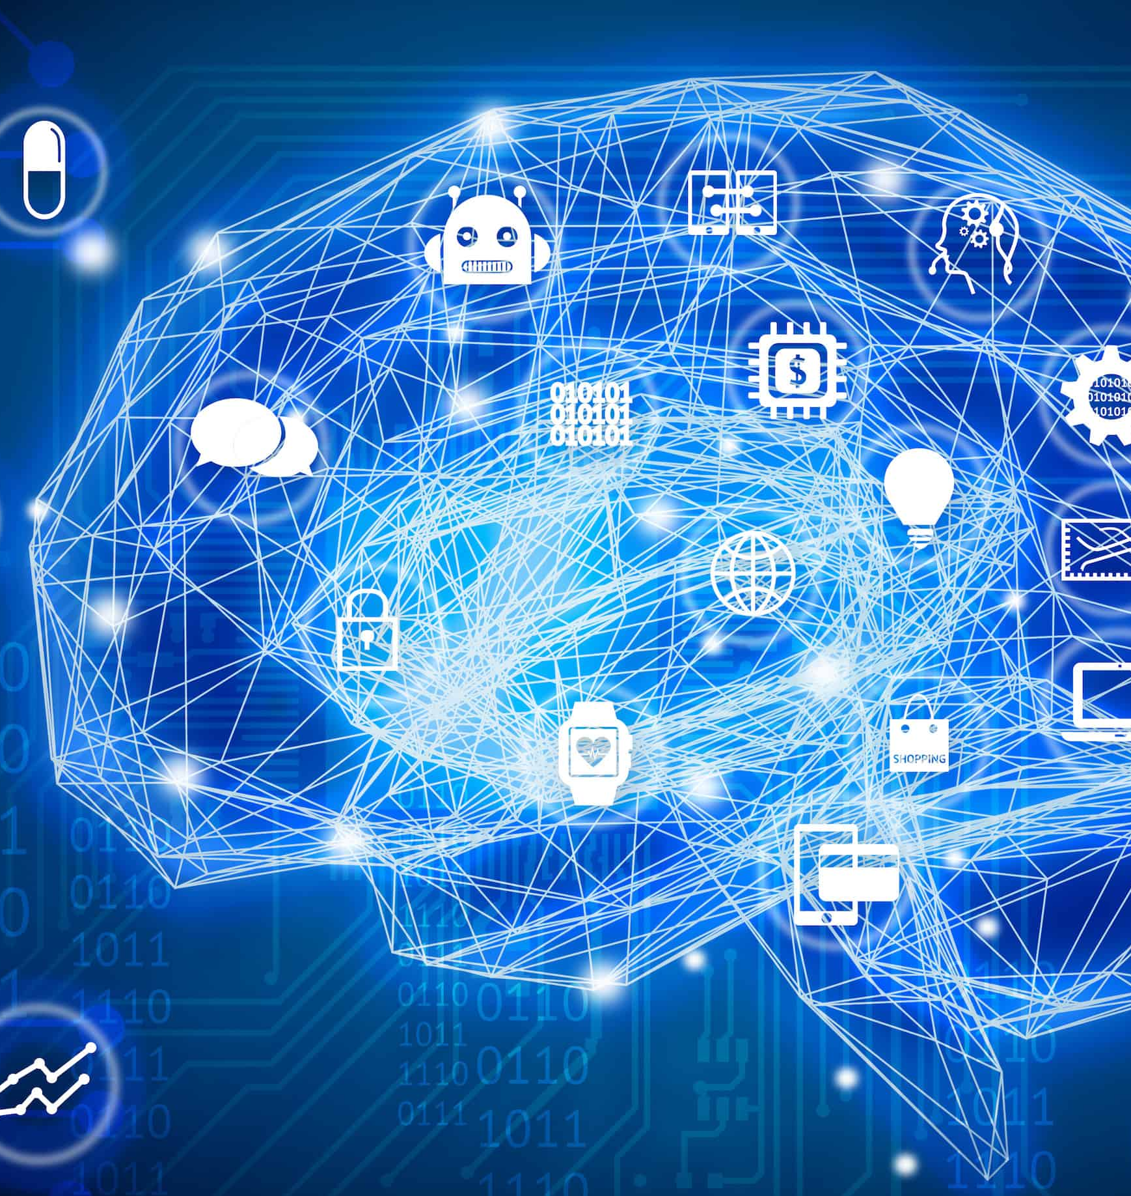

CS 5/7320 Artificial Intelligence Conclusion
Slides by Michael Hahsler
This work is licensed under a Creative Commons Attribution-ShareAlike 4.0 International License.
Online Material

Slide 2

What We Have Covered
Agents and the environment
Many flavors of search for good actions
Uncertainty and the Bayesian update rule
Supervised machine learning and agents
In the following, I will go through important areas that we have not covered and that you can take a class on.

Slide 3
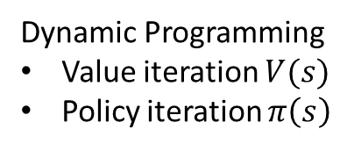
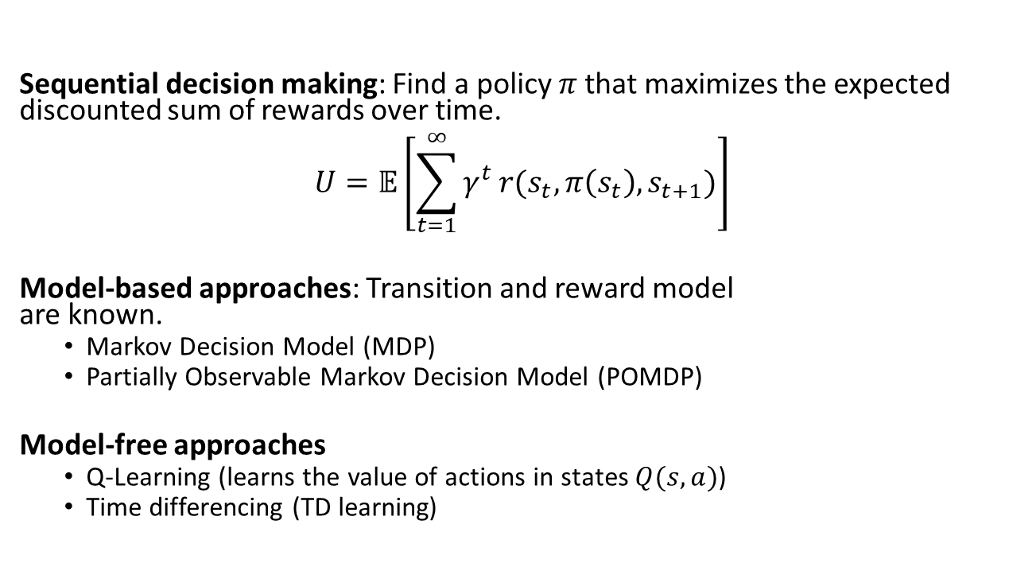
Reinforcement Learning
action
observation + reward
action
observation + reward
…
Max. reward over time
Sequential decision making: Find a policy $π$ that maximizes the expected discounted sum of rewards over time. $$U=𝔼\left[\sum_{t=1}^{∞}{γ^{t}}r(s_{t}, π\left(s_{t}\right), s_{t+1})\right]$$
Model-based approaches: Transition and reward model are known.
Markov Decision Model (MDP)
Partially Observable Markov Decision Model (POMDP)
Model-free approaches
Q-Learning (learns the value of actions in states $Q(s,a)$)
Time differencing (TD learning)
Dynamic Programming
Value iteration $V(s)$
Policy iteration $π\left(s\right)$
Learn iteratively

Slide 4
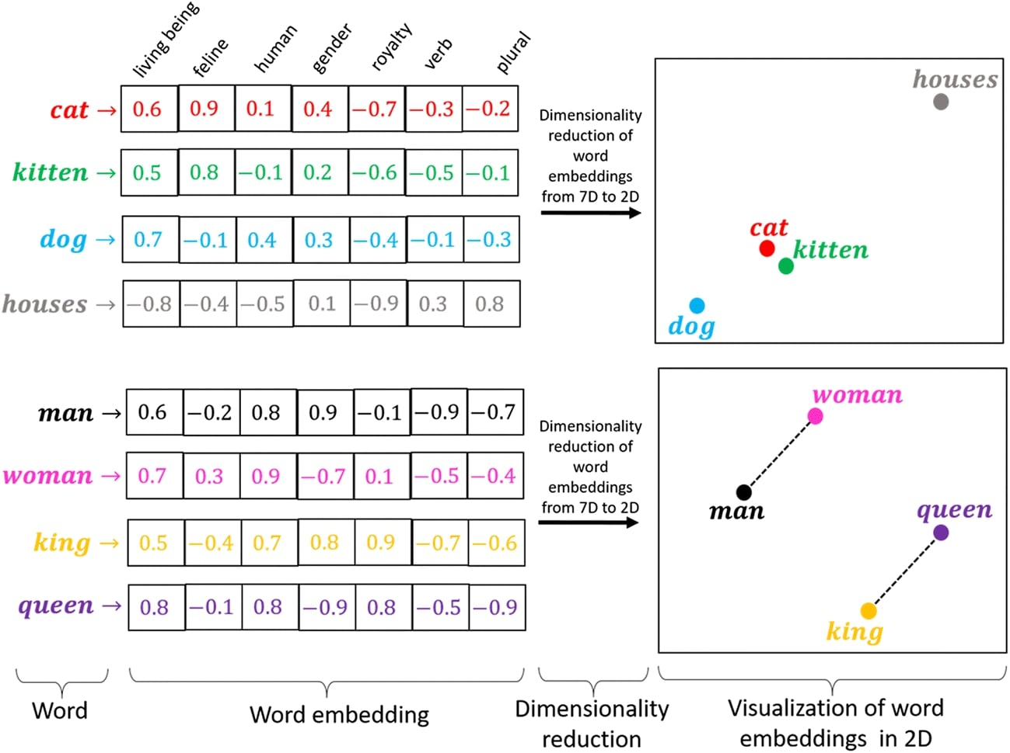
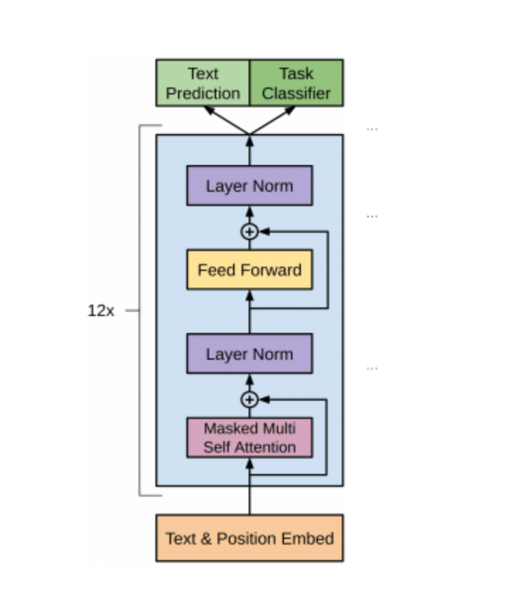
Natural Language Processing (NLP)
Tasks:
Speech recognition
Text classification
Natural-language understanding
Natural-language generation.
Techniques:
Text embeddings
Transformers
Large language models (LLMs)
Decoder-only transformer used by LLMs
Source: Word Embeddings for PyTorch Text Classification Networks

Slide 5
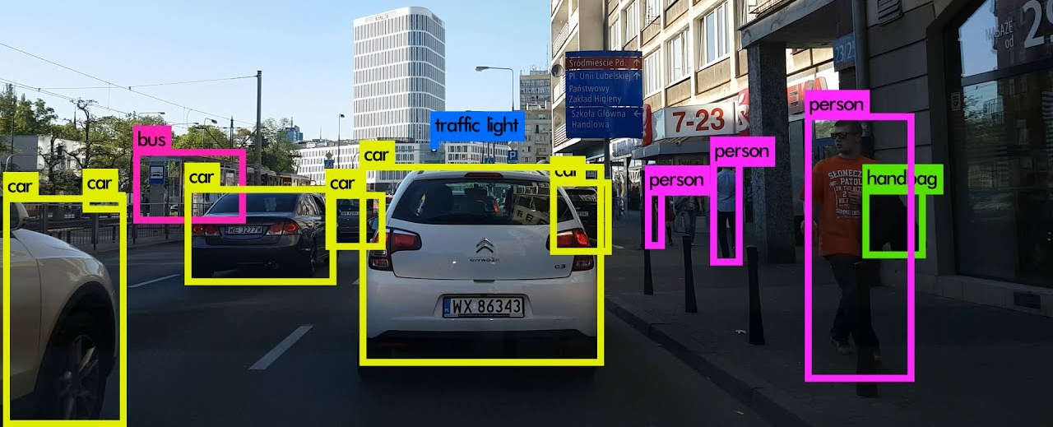
Computer Vision
Percepts
Object detection
Event detection
Activity recognition
Video tracking
Object recognition
3D pose estimation
Uses Deep Convolutional Neural Networks

Slide 6
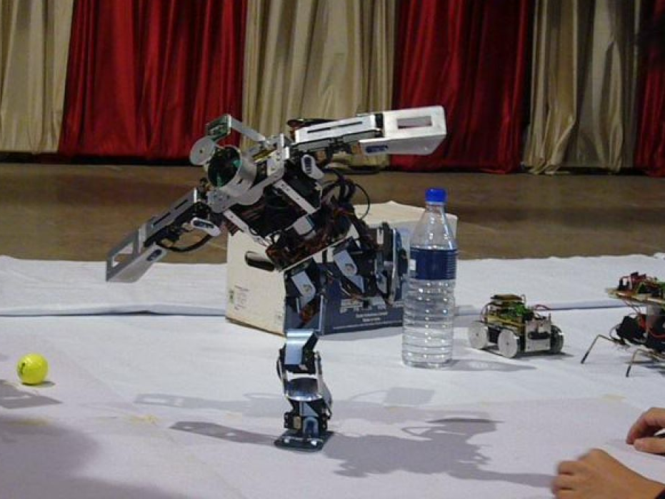
Robotics
Percepts & Actions
Hardware, sensors, control theory (feedback-based controllers)

Slide 7
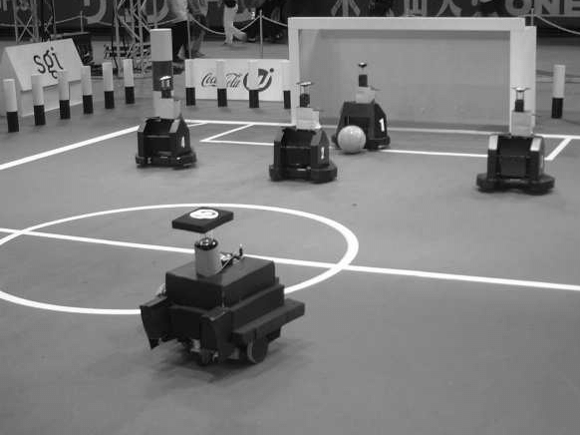
Multiagent Decision Making
Communication and Coordination

Slide 8

Conclusion
AI development is currently moving at the speed of light!

