Slide 1
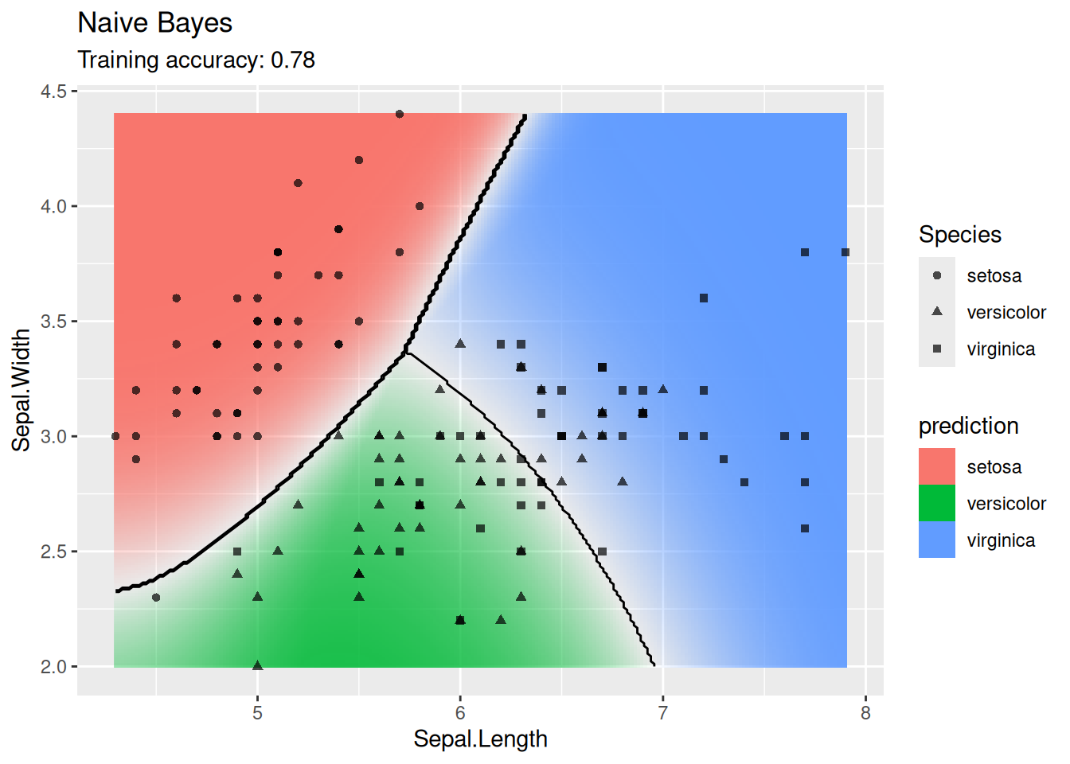
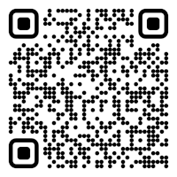

CS 5/7320 Artificial Intelligence Machine Learning: Learning from Examples and Statistical Learning AIMA Chapters 19-21 Slides by Michael Hahsler Some slides are based on Dan Klein’s slides (http://ai.berkeley.edu); with figures from the AIMA textbook.
This work is licensed under a Creative Commons Attribution-ShareAlike 4.0 International License.
Online Material
Notes:
Please retain proper attribution, including the reference to ai.berkeley.edu. Thanks!

Slide 2
Topics
Supervised Learning
Training Data
Training & Testing
Types of supervised ML Models
Use in AI
Agents & ML

Slide 3
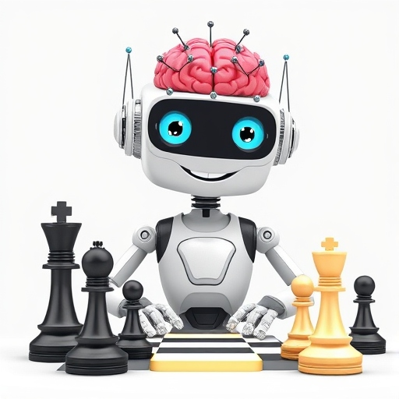
Agents and Machine Learning
DeepAi.org with prompt: “A happy cartoon robot with an artificial neural network for a brain on white background learning to play chess”

Slide 4
Learning from Examples
Up until now in this course:
Hand-craft algorithms to make rational/optimal or at least good decisions. Examples: Search strategies, heuristics, and constructing Bayesian networks.
Issues
We may not be able to anticipate all possible future scenarios.
We may have examples, but we do not know how to implement a solution.
Supervised Machine Learning
Uses observations: training data with the correct answers.
Learn a function (model) to map an input (e.g., state) to an output (e.g., action) representing the desired behavior.
Examples:
Use a naïve Bayesian classifier to distinguish between spam/non-spam.
Learn a playout policy to simulate games (current board -> good move)
Data
(behavior)
Algorithm chooses actions
creates
Data
(observations)
learn
Model chooses actions

Slide 5
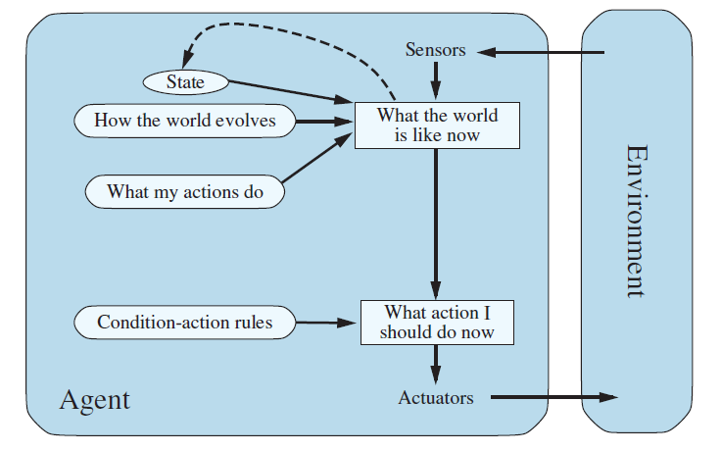




Learning Components of an Agent
We can learn many different components of an agent from examples
Example: Learning components of a model-based reflex agent
Learn the state representation
Learn a utility function
Learn the transition model
$$p$$
$$s^{′}=T(s,a)$$
$$a=f(p,s)$$
$$a$$
Learn rules

Slide 6

Supervised Learning
1+1=2
Teaching a model to answer correctly

Slide 7



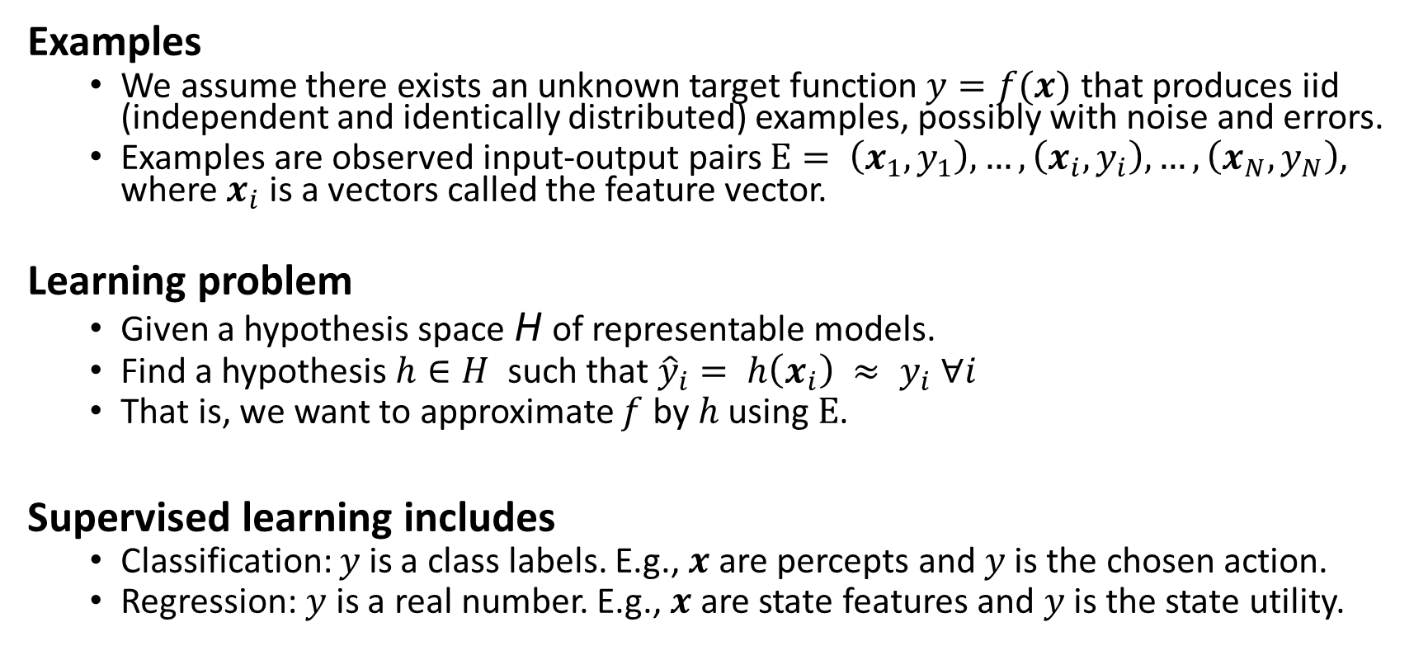
Supervised Learning As Function Approximation
Examples
We assume there exists an unknown target function $y=f(x)$ that produces iid (independent and identically distributed) examples, possibly with noise and errors.
Examples are observed input-output pairs $E= \left(x_{1},y_{1}\right),…, \left(x_{i}, y_{i}\right),…,\left(x_{N},y_{N}\right)$, where $x_{i}$ is a vectors called the feature vector.
Learning problem
Given a hypothesis space H of representable models.
Find a hypothesis $h∈H$ such that ${\hat{y}}_{i}= h\left(x_{i}\right) ≈ y_{i} ∀i$
That is, we want to approximate $f$ by $h$ using $E$.
Supervised learning includes
Classification: $y$is a class labels. E.g., $x$ are percepts and $y$is the chosen action.
Regression: $y$ is a real number. E.g., $x$ are state features and $y$is the state utility.
$$f$$
Set of all functions

Slide 8
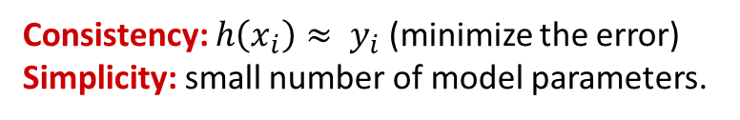
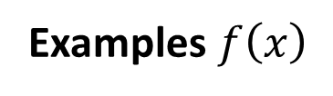
Consistency vs. Simplicity
Example: Univariate curve fitting (regression, function approximation)
Learned Models
Examples $f\left(x\right)$
Consistency: $h\left(x_{i}\right)≈ y_{i}$ (minimize the error)
Simplicity: small number of model parameters.

Slide 9
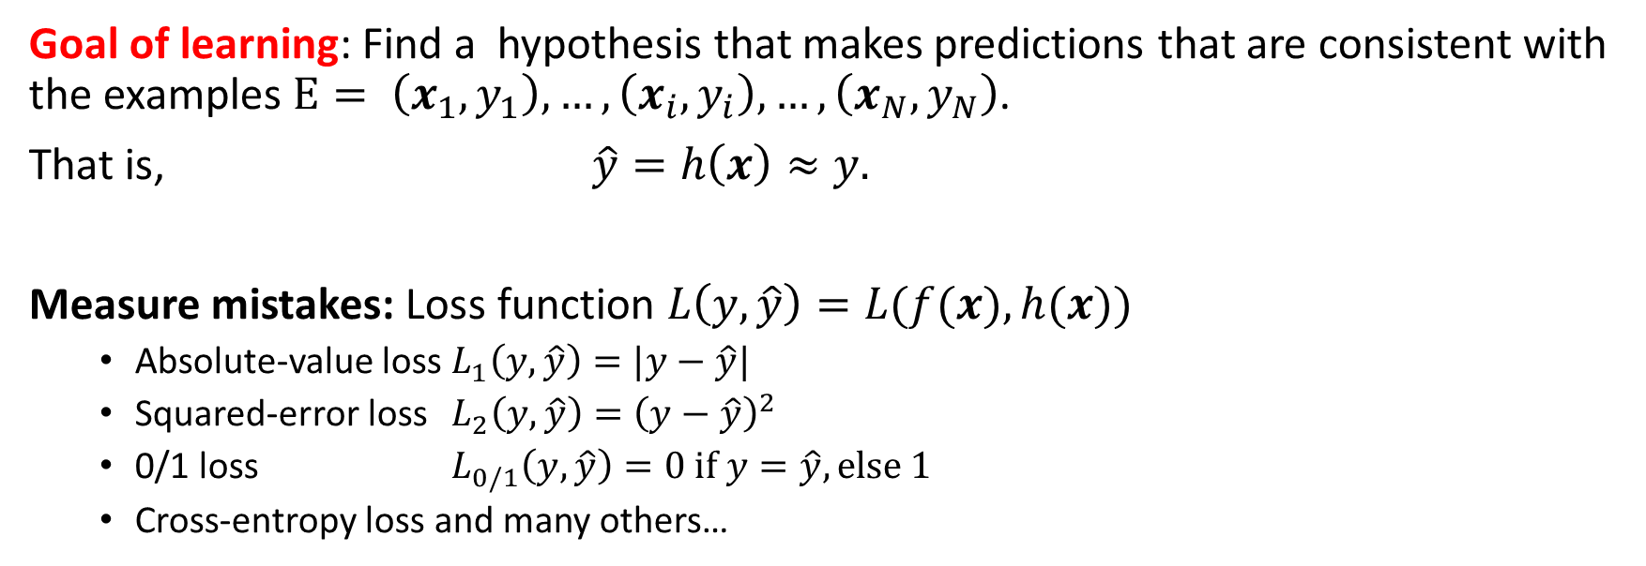


Measuring Consistency using Loss
Goal of learning: Find a hypothesis that makes predictions that are consistent with the examples $E= \left(x_{1},y_{1}\right),…, \left(x_{i}, y_{i}\right),…,\left(x_{N},y_{N}\right)$.
That is, $\hat{y}=h\left(x\right)≈y.$
Measure mistakes: Loss function $L\left(y, \hat{y}\right)=L(f(x), h(x))$
Absolute-value loss $L_{1}\left(y, \hat{y}\right)=|y−\hat{y}|$
Squared-error loss $L_{2}\left(y, \hat{y}\right)={\left(y−\hat{y}\right)}^{2}$
0/1 loss $L_{0/1}\left(y, \hat{y}\right)=0 if y=\hat{y}, else 1$
Cross-entropy loss and many others…
For Regression
For Classification
Loss
$$f$$
$$h^{∗}$$

Slide 10
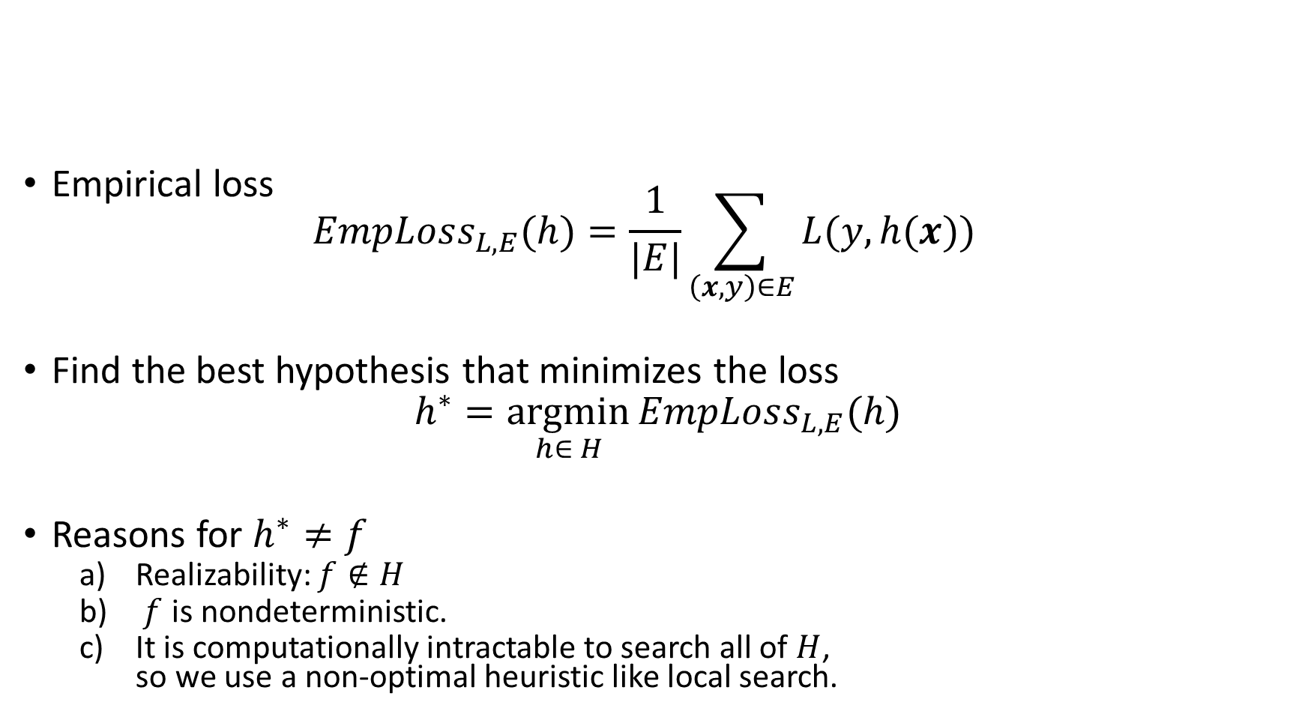
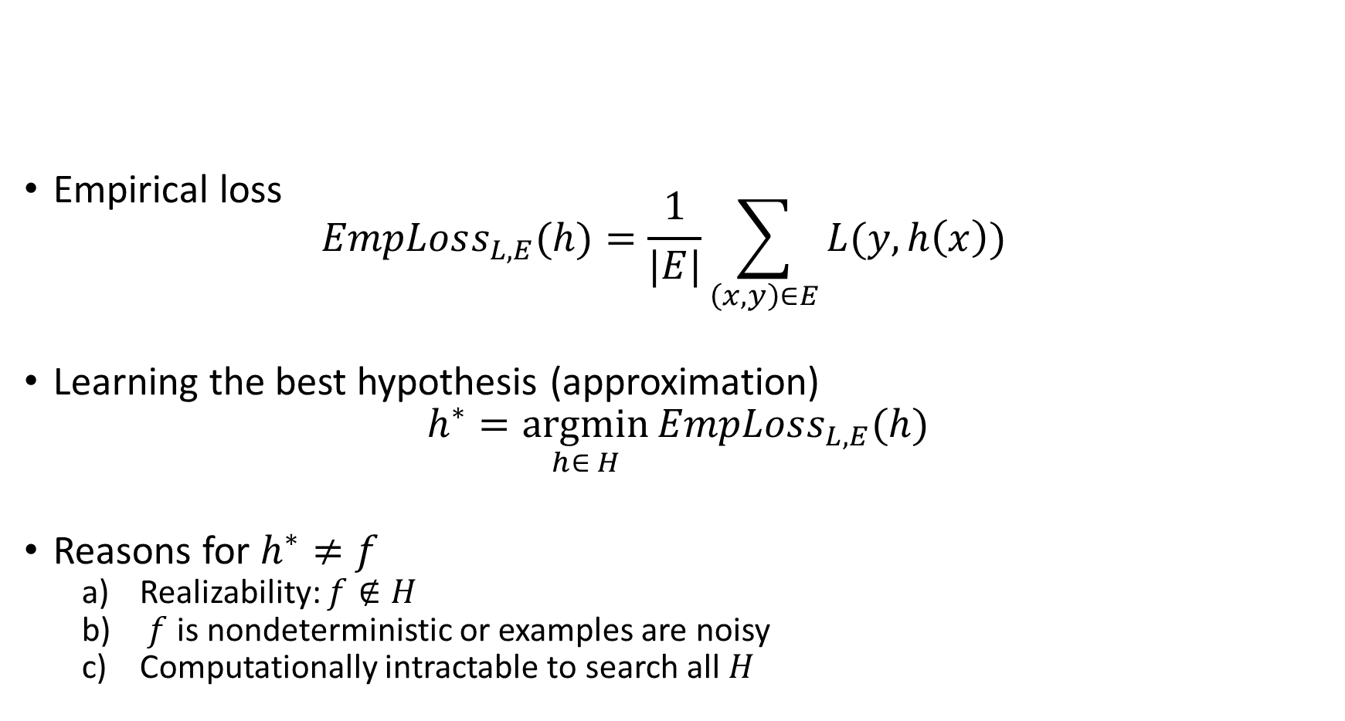
Learning Consistent Approximations
Empirical loss $EmpLoss_{L,E}(h)=\frac{1}{|E|}\sum_{\left(x,y\right)∈E}{L(y, h(x))}$
Find the best hypothesis that minimizes the loss
$$h^{∗}=\underset{h∈ H}{argmin}{EmpLoss_{L,E}(h)}$$
Reasons for $h^{∗}≠f$
Realizability: $f∉H$
$f$ is nondeterministic.
It is computationally intractable to search all of $H$, so we use a non-optimal heuristic like local search.
Loss
$$f$$
$$h^{∗}$$

Slide 11
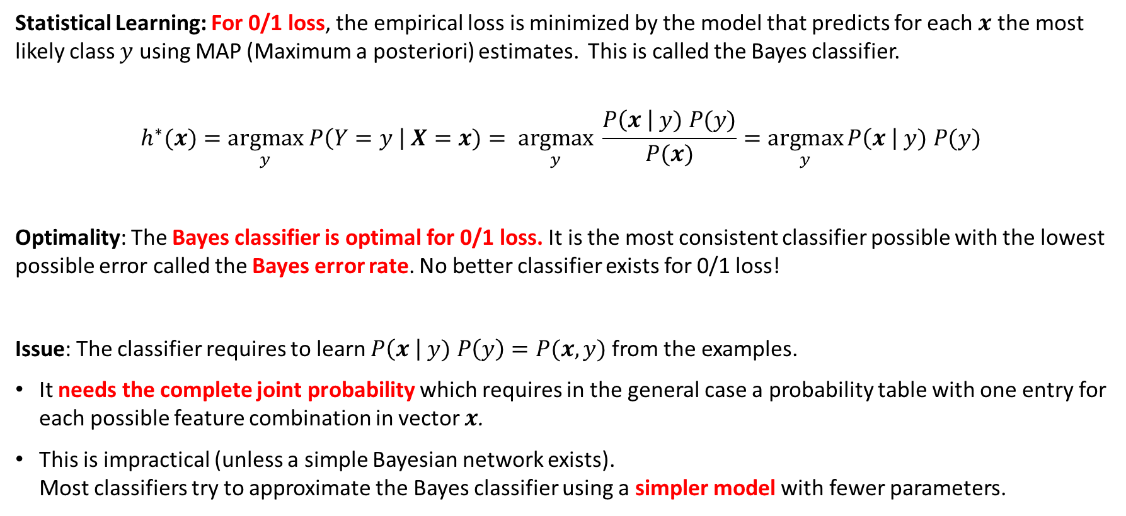
The Most Consistent Classifier
Statistical Learning: For 0/1 loss, the empirical loss is minimized by the model that predicts for each $x$ the most likely class $y$ using MAP (Maximum a posteriori) estimates. This is called the Bayes classifier.
$$h^{∗}(x)=\underset{y}{argmax} P\left(Y=y \right| X=x)= \underset{y}{argmax} \frac{P\left(x \right| y) P(y)}{P(x)}=\underset{y}{argmax}{P\left(x \right| y) P(y)}$$
Optimality: The Bayes classifier is optimal for 0/1 loss. It is the most consistent classifier possible with the lowest possible error called the Bayes error rate. No better classifier exists for 0/1 loss!
Issue: The classifier requires to learn $P\left(x \right| y) P\left(y\right)=P(x,y)$ from the examples.
It needs the complete joint probability which requires in the general case a probability table with one entry for each possible feature combination in vector $x$.
This is impractical (unless a simple Bayesian network exists). Most classifiers try to approximate the Bayes classifier using a simpler model with fewer parameters.

Slide 12
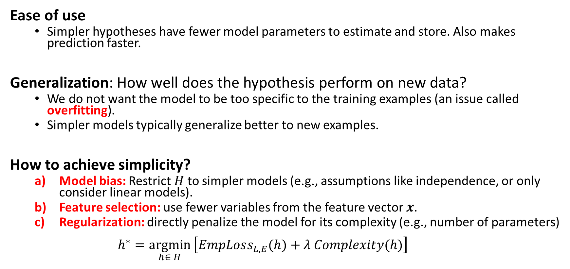
Simplicity
Ease of use
Simpler hypotheses have fewer model parameters to estimate and store. Also makes prediction faster.
Generalization: How well does the hypothesis perform on new data?
We do not want the model to be too specific to the training examples (an issue called overfitting).
Simpler models typically generalize better to new examples.
How to achieve simplicity?
Model bias: Restrict $H$ to simpler models (e.g., assumptions like independence, or only consider linear models).
Feature selection: use fewer variables from the feature vector $x$.
Regularization: directly penalize the model for its complexity (e.g., number of parameters) $h^{∗}=\underset{h∈ H}{argmin}\left[EmpLoss_{L,E}(h)+λ Complexity(h)\right]$
Penalty term

Slide 13
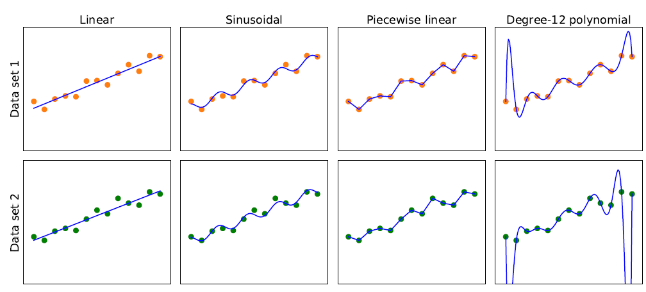
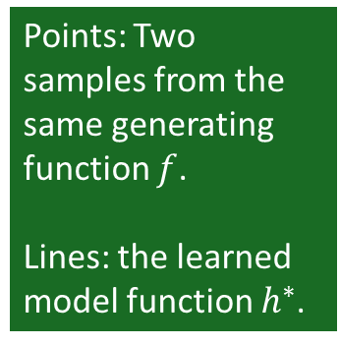
Model Selection: Bias vs. Variance
Overfitting
Simpler
More consistent
Points: Two samples from the same generating function $f$.
Lines: the learned model function $h^{∗}$.
High Bias: restrictions by the model class Low
This is a tradeoff The right choice depends on the application.
Low Variance: difference in the model due to slightly different data. high

Slide 14
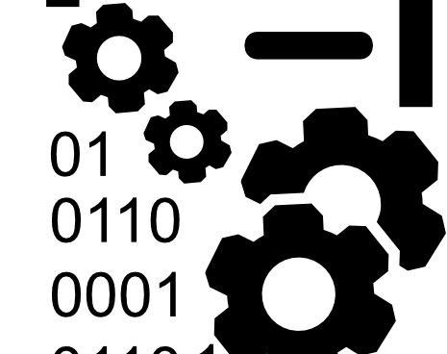
Training Data

Slide 15

Training Data in AI
Training Data in AI can come from many sources
Existing Data: Download documents from the internet to train Large Language Models.
Observation: Record video of a task being performed (e.g., for self-driving cars).
Simulation: E.g., simulated games using a playout strategy.
Expert feedback on how well a task was performed.

Slide 16
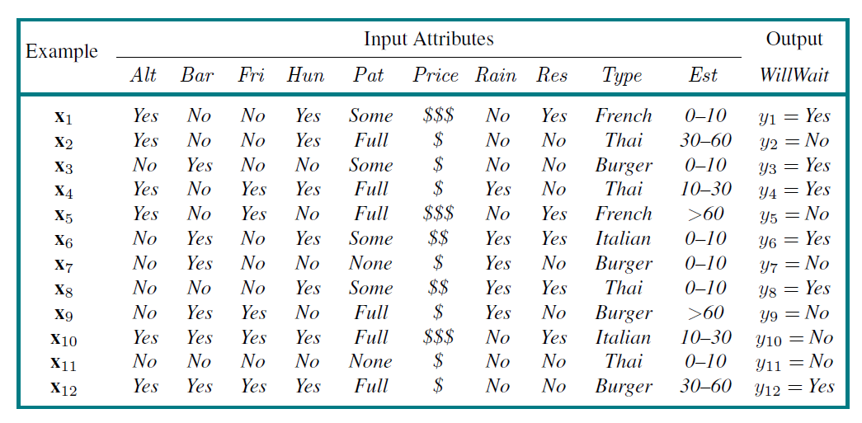
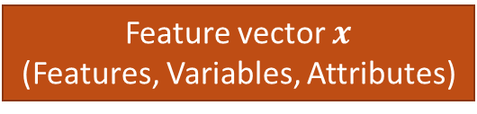
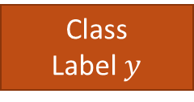
The Dataset
Feature vector $x$
(Features, Variables, Attributes)
Class
Label $y$
Examples
(Instances,
Observation)
Alternative
Hungry
Patrons
Reservation
Wait time
Task: Find a hypothesis (called “model”) to predict the class given the features.

Slide 17
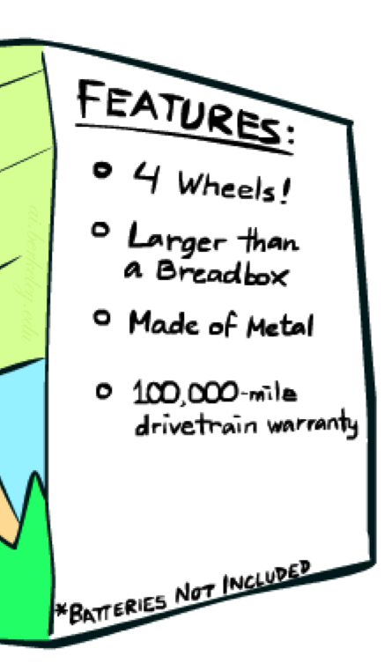

Feature Engineering
Information fusion: Combine information sources to add new variables to the model.
Derived features: Manipulate the features to help the model learn (e.g., $x_{1}x_{2}$, $x_{1}^{2}, ln⁡(x_{1})$).
Embedding: Unsupervised/self-supervised learning of features. E.g., convert words to vectors where vector similarity between vectors reflects semantic similarity.
Feature Selection: Which features should be used in the model is a model selection problem (choose between models with different features).
End-to-end machine learning: Deep learning with neural networks can perform “automatic” feature engineering.
Example for Spam detection: In addition to words, add features for:
Have you emailed the sender before?
Have 1,000+ other people received the same email?
Is the email in ALL CAPS?

Slide 18

Training and Testing

Slide 19
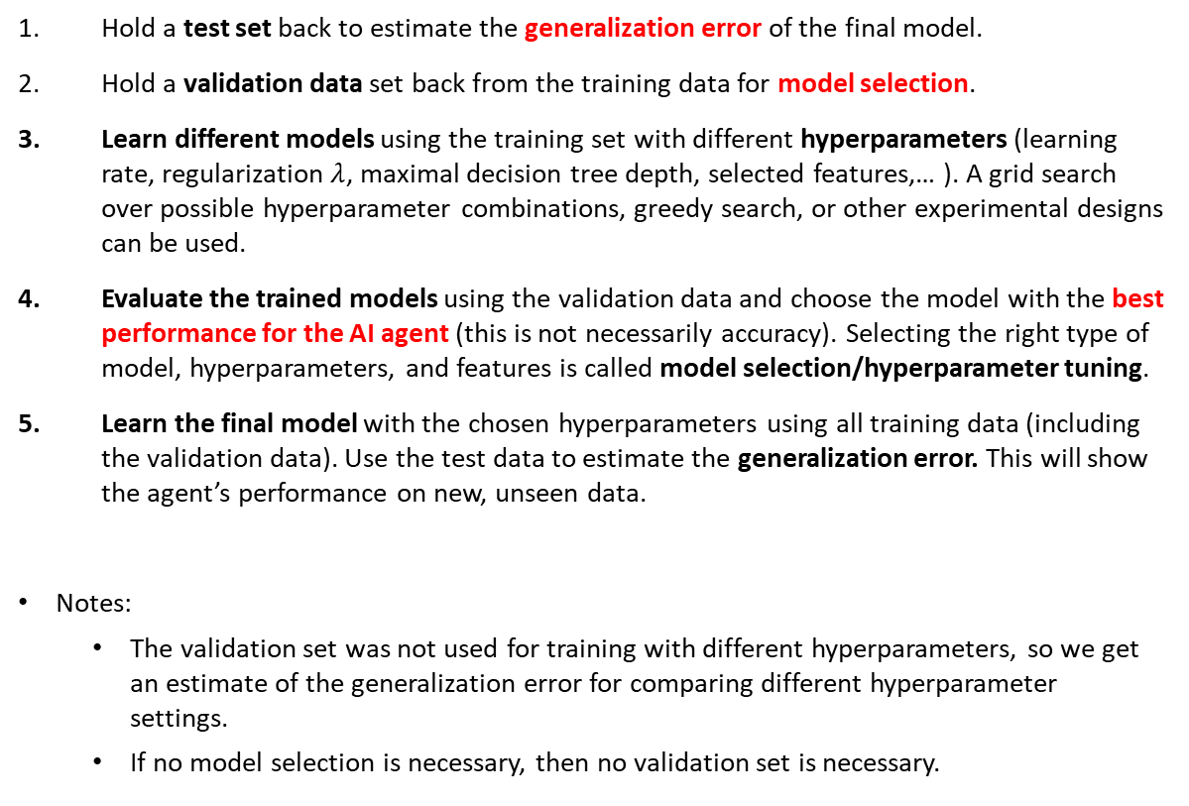
Training a ML Model for AI
Training
Data
Hold a test set back to estimate the generalization error of the final model.
Hold a validation data set back from the training data for model selection.
Learn different models using the training set with different hyperparameters (learning rate, regularization $λ$, maximal decision tree depth, selected features,… ). A grid search over possible hyperparameter combinations, greedy search, or other experimental designs can be used.
Evaluate the trained models using the validation data and choose the model with the best performance for the AI agent (this is not necessarily accuracy). Selecting the right type of model, hyperparameters, and features is called model selection/hyperparameter tuning.
Learn the final model with the chosen hyperparameters using all training data (including the validation data). Use the test data to estimate the generalization error. This will show the agent’s performance on new, unseen data.
Notes:
The validation set was not used for training with different hyperparameters, so we get an estimate of the generalization error for comparing different hyperparameter settings.
If no model selection is necessary, then no validation set is necessary.
Training
Data
Validation
Data
Often 10% of the training data or cross-validation.
Test
Data
Often 20% of the data

Slide 20
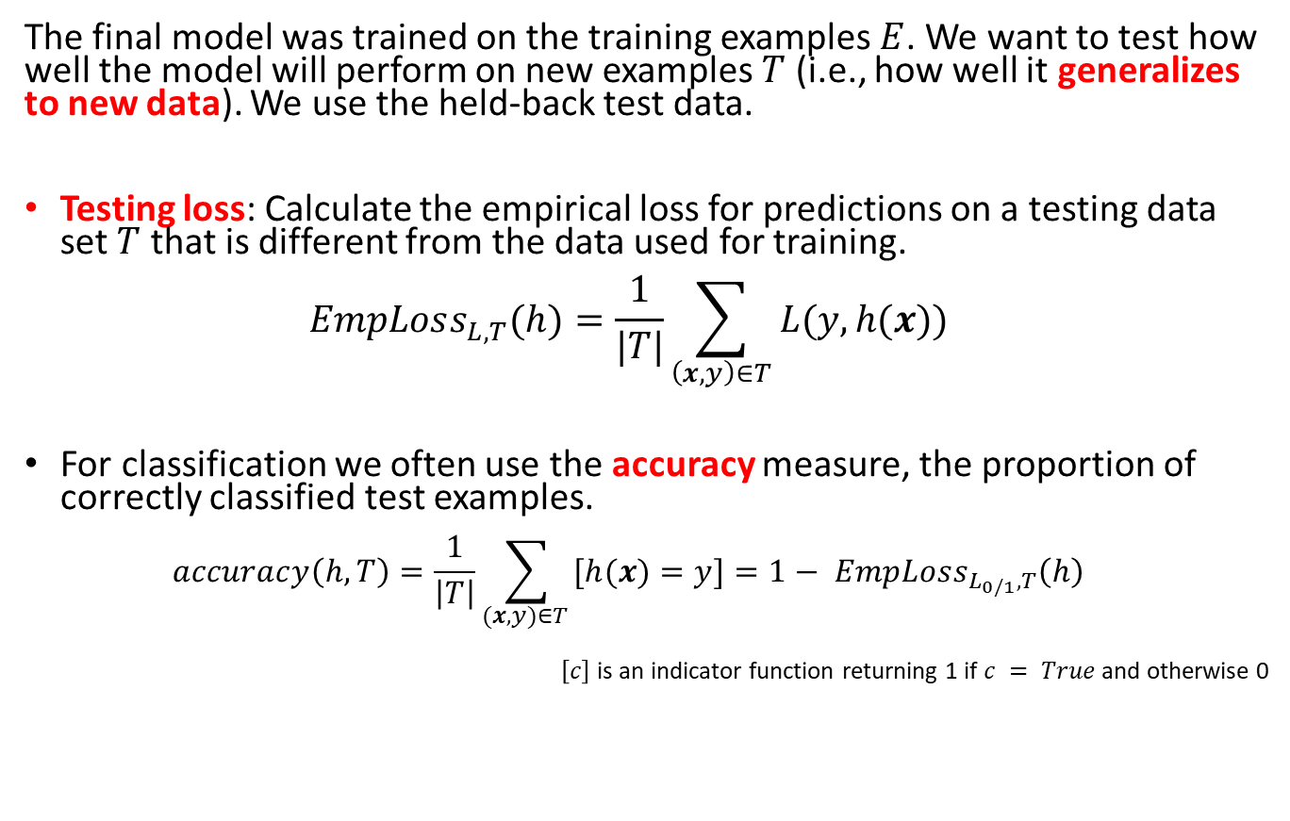

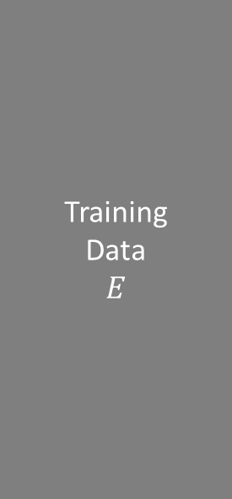
Testing: Evaluating the Final Model
Training
Data $$E$$
The final model was trained on the training examples $E$. We want to test how well the model will perform on new examples $T$ (i.e., how well it generalizes to new data). We use the held-back test data.
Testing loss: Calculate the empirical loss for predictions on a testing data set $T$ that is different from the data used for training. $EmpLoss_{L,T}(h)=\frac{1}{|T|}\sum_{\left(x,y\right)∈T}{L(y, h(x))}$
For classification we often use the accuracy measure, the proportion of correctly classified test examples. $accuracy\left(h, T\right)=\frac{1}{\left|T\right|}\sum_{(x,y)∈T }{[h(x)=y]}=1− EmpLoss_{L_{0/1},T}\left(h\right)$
$\left[c\right]$ is an indicator function returning 1 if $c = True$and otherwise 0
Test
Data $T$

Slide 21
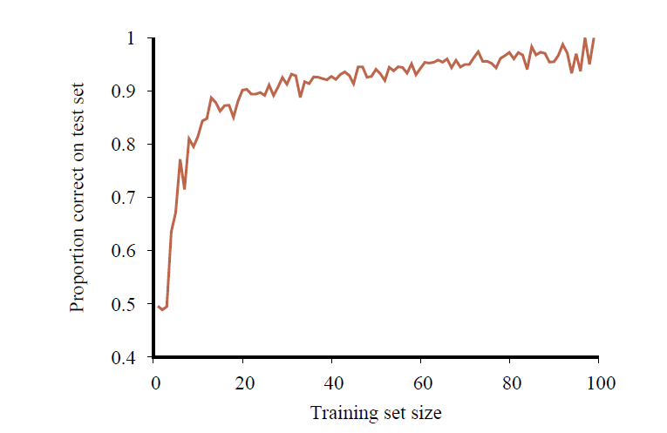
Learning Curve: The Effect the Training Data Size
No classifier can get consistently better than the Bayesian error rate
Accuracy increases when the amount of available training data increases.
More data is better!
At some point, the learning curve flattens out, and more data does not contribute much!
Accuracy

Slide 22
Comparing to a Baselines
First step: get a baseline
The baseline is often a simple model.
Helps to determine how hard the task is.
Helps determine what a good accuracy is.
Weak baseline: E.g.,
Random choice: Choose a random answer.
Example: Choose a random valid action for an agent playing Connect-4.
Most frequent label classifier: Gives all test instances the same label, which is the most common label in the training set.
Example: For spam filtering, give every message the label “ham” since most messages are ham.
Note: Accuracy might be very high if the problem is skewed. This is called class imbalance. Example: If calling everything “ham” gets already 66% right, then a classifier that gets 68% isn’t a big improvement!
Strong baseline: For research, we typically compare our model with the performance of previously published state-of-the-art methods.

Slide 23

Types of Supervised ML Models
Regression: Predict a number
Classification: Predict a label

Slide 24
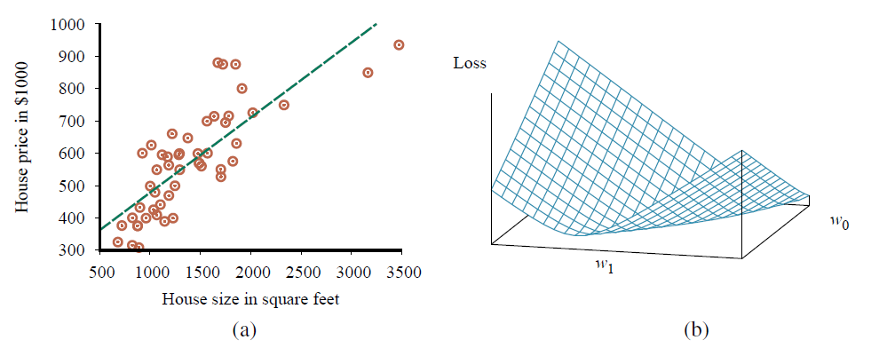

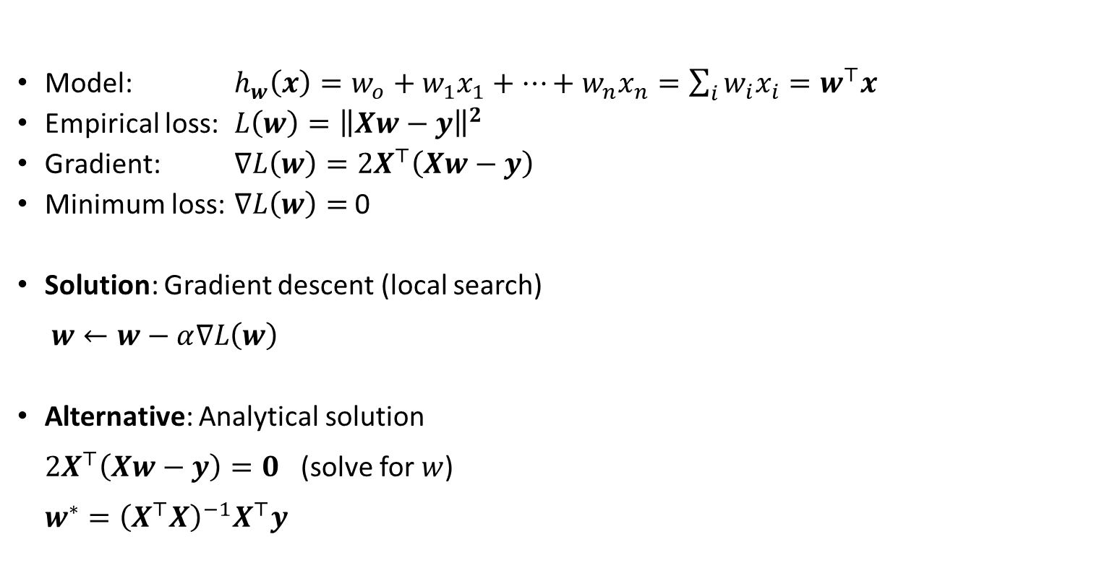

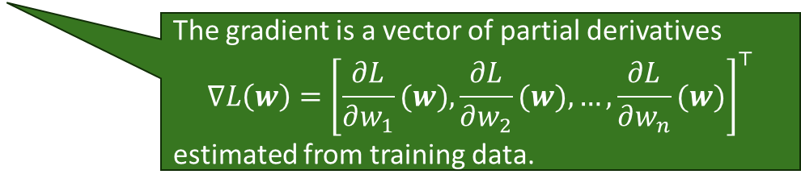
Regression: Linear Regression
Model: $h_{w}\left(x\right)=w_{o}+w_{1}x_{1}+…+w_{n}x_{n}=\sum_{i}{w_{i}x_{i}}=w^{⊤}x$
Empirical loss: $L\left(w\right)={\left\|Xw−y\right\|}^{2}$
Gradient: $∇L\left(w\right)=2X^{⊤}\left(Xw−y\right)$
Minimum loss: $∇L\left(w\right)=$ 0
Solution: Gradient descent (local search) $w←w−α∇L\left(w\right)$
Alternative: Analytical solution $2X^{⊤}\left(Xw−y\right)=0$ (solve for $w$) $w^{∗}={\left(X^{⊤}X\right)}^{−1}X^{⊤}y$
Squared error loss over the whole data matrix $X$
The gradient is a vector of partial derivatives $$∇L\left(w\right)={\left[\frac{∂L}{∂w_{1}}(w),\frac{∂L}{∂w_{2}}(w),…,\frac{∂L}{∂w_{n}}(w)\right]}^{⊤}$$ estimated from training data.
$$∇L\left(w\right)$$
$$w$$
Pseudo inverse
Convex loss function

Slide 25
Classification
Predicting a label

Slide 26
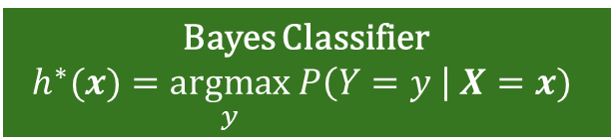
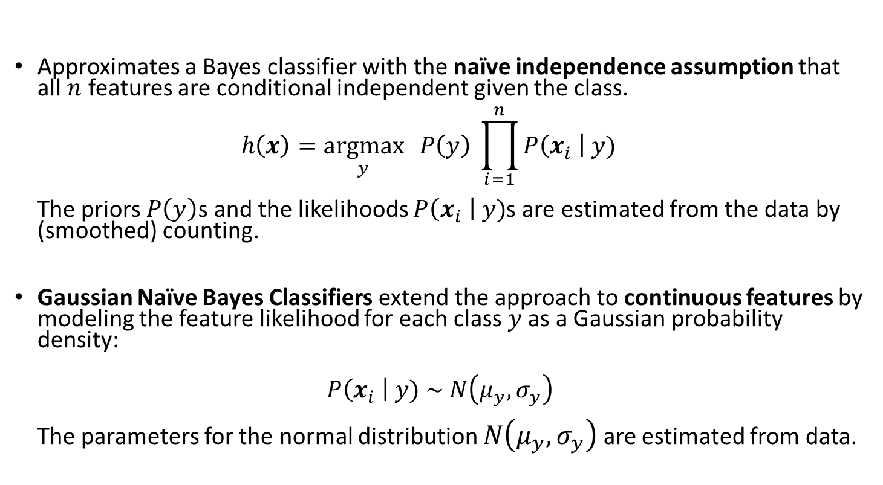
Naïve Bayes Classifier
Bayes Classifier
$$h^{∗}(x)=\underset{y}{argmax} P\left(Y=y \right| X=x)$$
Approximates a Bayes classifier with the naïve independence assumption that all $n$ features are conditional independent given the class. $h\left(x\right)=\underset{y}{argmax}{ P\left(y\right) \prod_{i=1}^{n}{P\left(x_{i} \right| y)}}$ The priors $P\left(y\right)$s and the likelihoods $P\left(x_{i} \right| y)$s are estimated from the data by (smoothed) counting.
Gaussian Naïve Bayes Classifiers extend the approach to continuous features by modeling the feature likelihood for each class $y$ as a Gaussian probability density:
$$P\left(x_{i} \right| y) \sim N\left(μ_{y},σ_{y}\right)$$ The parameters for the normal distribution $N\left(μ_{y},σ_{y}\right)$ are estimated from data.

Slide 27
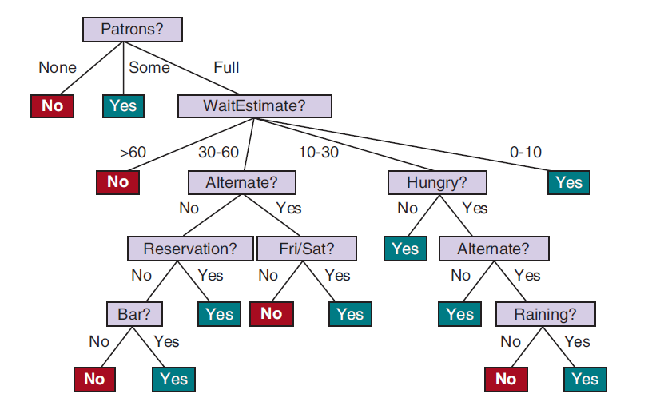
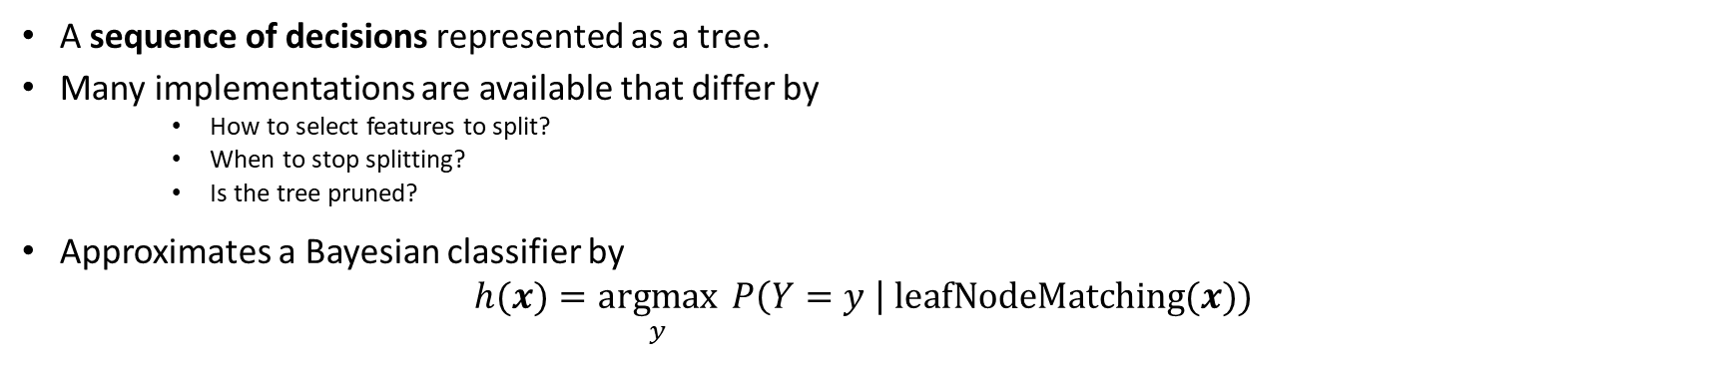
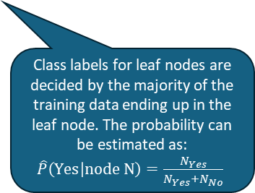
Decision Tree
Bayes Classifier
$$h^{∗}(x)=\underset{y}{argmax} P\left(Y=y \right| X=x)$$
A sequence of decisions represented as a tree.
Many implementations are available that differ by
How to select features to split?
When to stop splitting?
Is the tree pruned?
Approximates a Bayesian classifier by $h(x)=\underset{y}{argmax}{ P\left(Y=y \right| \text{leafNodeMatching}(x)) }$
Class labels for leaf nodes are decided by the majority of the training data ending up in the leaf node. The probability can be estimated as: $\hat{P}\left(\text{Y}\text{es} | \text{node} \text{N}\right)=\frac{N_{Yes}}{N_{Yes}+N_{No}}$

Slide 28
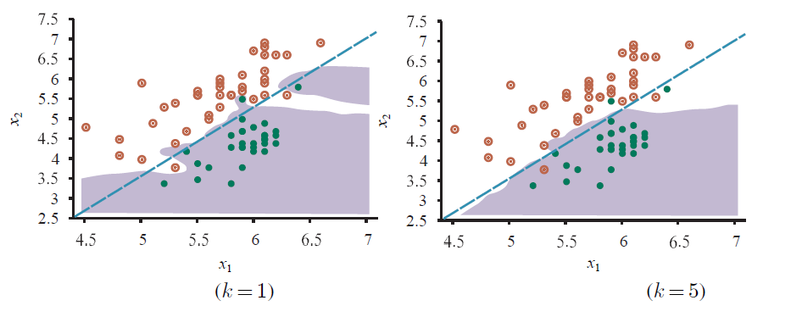
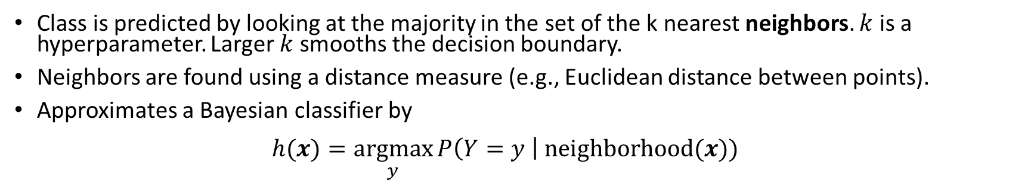
K-Nearest Neighbors Classifier
Bayes Classifier
$$h^{∗}(x)=\underset{y}{argmax} P\left(Y=y \right| X=x)$$
Class is predicted by looking at the majority in the set of the k nearest neighbors. $k$ is a hyperparameter. Larger $k$ smooths the decision boundary.
Neighbors are found using a distance measure (e.g., Euclidean distance between points).
Approximates a Bayesian classifier by $h(x)=\underset{y}{argmax}{P\left(Y=y \right| \text{neighborhood}(x)) }$

Slide 29
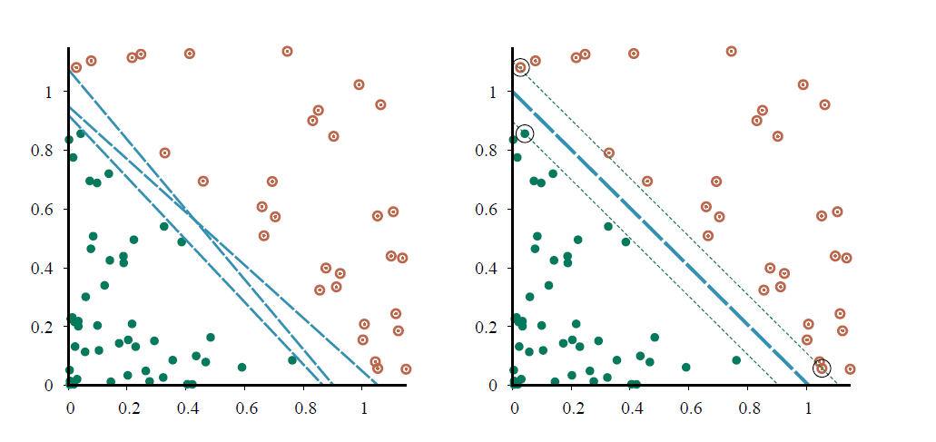
Support Vector Machine (SVM)
Margin
Decision boundary
Linear classifier that finds the maximum margin separator using only the points that are “support vectors” and quadratic optimization.
The kernel trick can be used to learn non-linear decision boundaries.

Slide 30
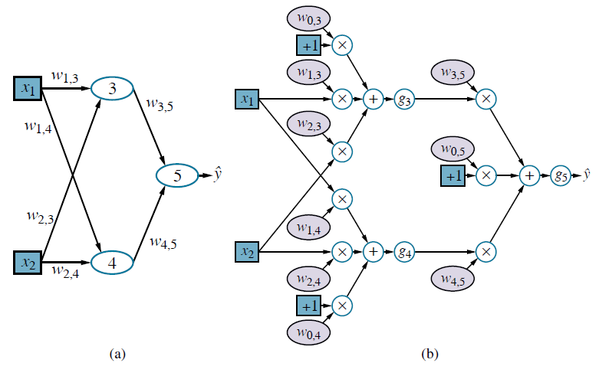
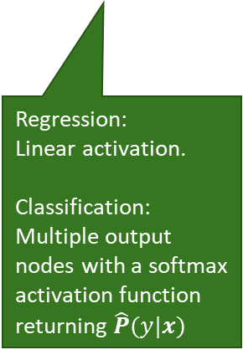
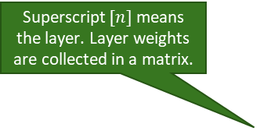
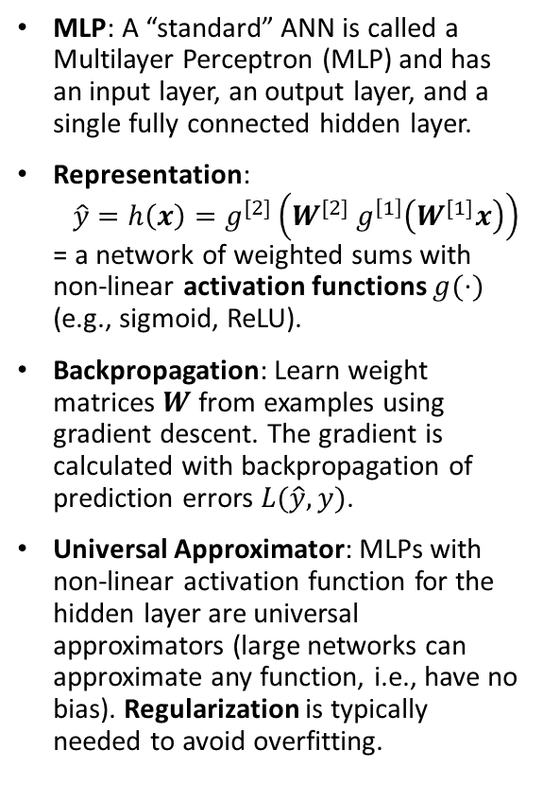
MLP: Artificial Neural Network (ANN)
Network Topology
Computational graph
One or more hidden layers
MLP: A “standard” ANN is called a Multilayer Perceptron (MLP) and has an input layer, an output layer, and a single fully connected hidden layer.
Representation: $\hat{y}=h\left(x\right)=g^{[2]}\left(W^{[2]} g^{\left[1\right]}\left(W^{[1]}x\right)\right)$ = a network of weighted sums with non-linear activation functions $g(⋅)$ (e.g., sigmoid, ReLU).
Backpropagation: Learn weight matrices $W$ from examples using gradient descent. The gradient is calculated with backpropagation of prediction errors $L(\hat{y}, y)$.
Universal Approximator: MLPs with non-linear activation function for the hidden layer are universal approximators (large networks can approximate any function, i.e., have no bias). Regularization is typically needed to avoid overfitting.
Superscript $[n]$means the layer. Layer weights are collected in a matrix.
Regression: Linear activation.
Classification: Multiple output nodes with a softmax activation function returning $\hat{P}(y|x)$
Neuron
Non-linear activation function. E.g., ReLU
Bias term

Slide 31
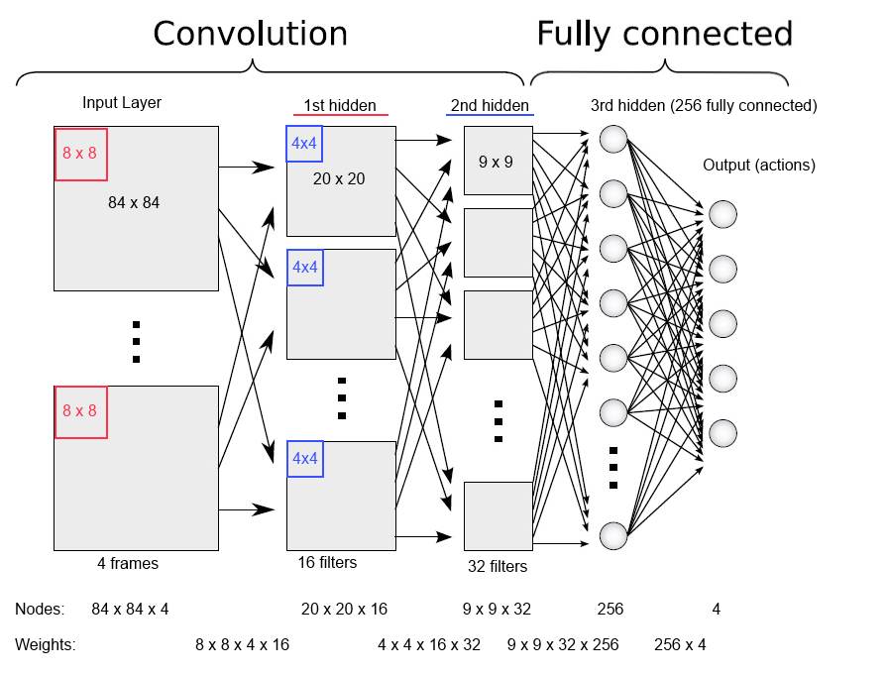
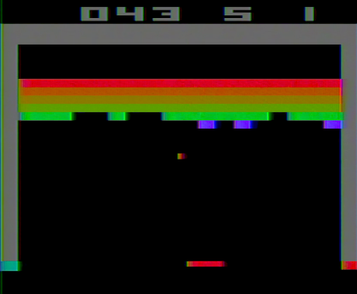
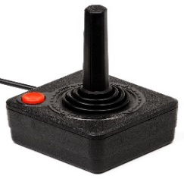
Deep Learning: Foundation of Moden AI
Extends MLPs with several hidden layers.
Introduces layer types (e.g., convolution layers for image processing) for more efficient learning.
End-to-end learning: The hidden layers perform “automatic feature engineering” and support transfer learning.
Called subsymbolic AI because it is not built on rules about humanly readable symbols, but on patterns stored as weights.
Example: A deep ANN to play Classic Atari Breakout (1978)
up
down
right
left
button
Output: Actions
Input features: Frame with Pixels
Source: https://robohub.org/artificial-general-intelligence-that-plays-atari-video-games-how-did-deepmind-do-it/

Slide 32
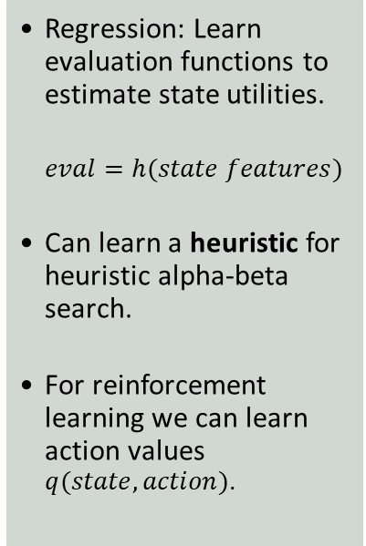
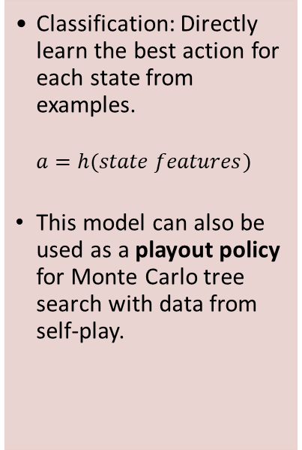
Typical Use of Supervised ML for Intelligent Agents
Learn a Policy
Learn Evaluation Functions
Learn Perception and Actuation
Compressing Tables
Classification: Directly learn the best action for each state from examples.
$$a=h(state features)$$
This model can also be used as a playout policy for Monte Carlo tree search with data from self-play.
Regression: Learn evaluation functions to estimate state utilities.
$$eval=h(state features)$$
Can learn a heuristic for heuristic alpha-beta search.
For reinforcement learning we can learn action values $q(state, action)$.
Natural language processing: Use deep learning / word embeddings / language models to understand concepts, translate between languages, or generate text.
Speech recognition: Identify the most likely sequence of words.
Vision: Object recognition in images/videos. Generate images/video.
Robotics: Learn how to move safely.
Neural networks can be used as a compact representation of tables that do not fit in memory. E.g.,
Joint and conditional probability tables
State utility tables (i.e., an evaluation function)
Q-Value tables in reinforcement learning
Deep learning + symbolic AI = Neuro-symbolic AI

Slide 33
What You Should Know
Agent design: Replace hard-coded functions with functions learned from training data to tell the agent:
How to act: Learn a policy.
How to evaluate a situation: Learn an evaluation function.
How to interpret sensors and how to use actuators.
How to store information in an efficient way (compression).
Performance: Learned functions often outperform hard-coded functions.
Issue: Predictability and robustness
Hard-coded functions react predictably.
For learned functions, we do not always know how they will perform for rare and edge cases!
Reinforcement Learning: Online learning methods where agents learn directly from interactions with the environment.
1+1=2

