Slide 1



Large Language Models in AI A Quick Overview
Michael Hahsler
This work is licensed under a Creative Commons Attribution-ShareAlike 4.0 International License.
Online Material

Slide 2
LLMs as Knowledge-Based Agents

Slide 3
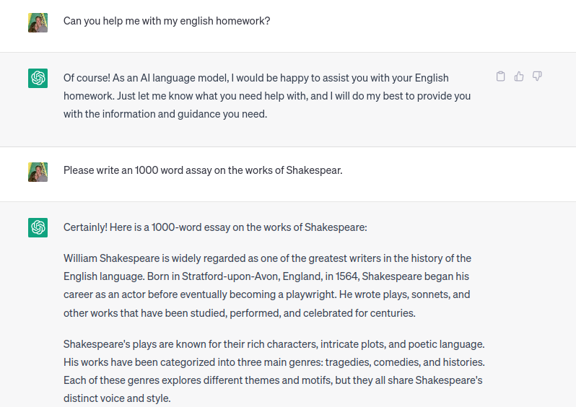
Example Conversation With a Large Language Model (LLM) Chat Bot
This knowledge has to come from somewhere!
…
Source: https://chat.openai.com/

Slide 4
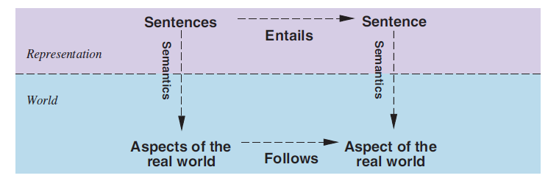
Using Natural Language for Knowledge Representation
Pretrained model knows words relationship, grammar, and facts stored as parameters in a network.
Modified version of knowledge represented using logic.
KB
Generates
Text
Prompts
Useful?
The user formulates a question about the real world as a natural language prompt (a sequence of tokens).
The LLM generates text using a pretrained model that represents its knowledge base.
The text (hopefully) is useful in the real world. The objective function is not clear. Maybe it is implied in the prompt?

Slide 5
What are LLMs
Large language models are knowledge-based agents.
The knowledge base is a large, deep artificial neural network using the transformer architecture.
The model is pretrained for the task of predicting the next word using self-supervised learning on a large text corpus.
The pretrained model is specialized for a specific task using fine-tuning on examples. For chatbots, this includes
supervised instruction training followed by
reinforcement learning from human feedback (RLHF).
The model can generate text following a “prompt.”
Learned word relationships, grammar, facts, and how to answer questions.
Knowledge base
Domain-independent content (pre-training)
+
Domain-specific content (fine tuning)
Text Generator
Domain-independent algorithms
LLM as a knowledge-based agent
Pretrained models can be downloaded from Hugging Face: https://huggingface.co/models

Slide 6
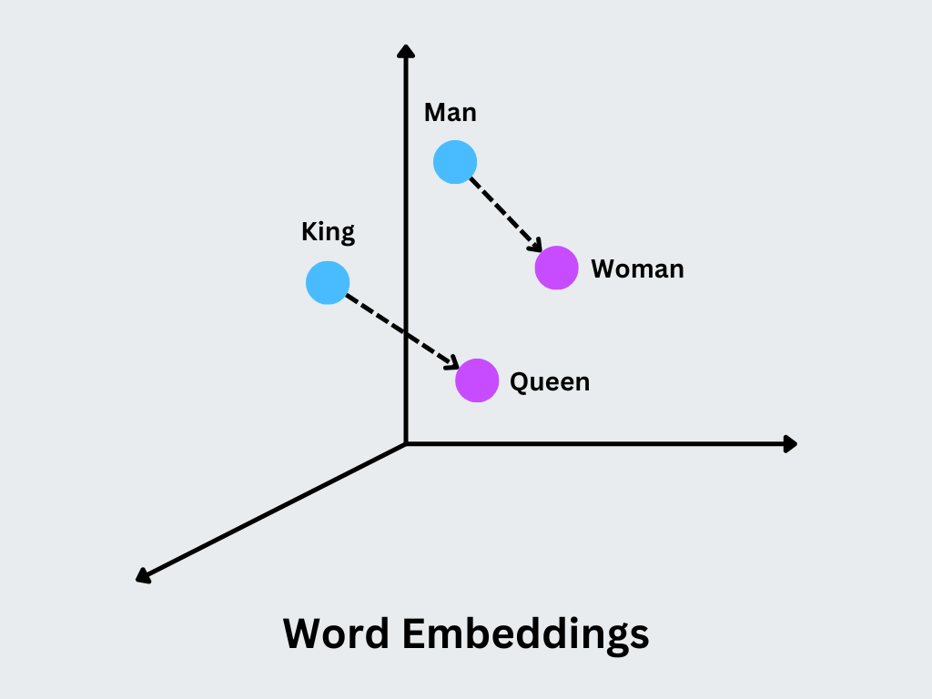
How LLMs Understand Text
LLMs can only compute with numbers!
Prompts are converted into numbers:
Tokenization:
Text is converted into a sequence of tokens (ids).
Tokens represent words, parts of words, parts of numbers, etc.
Embedding:
Tokes are converted to large vectors indicating a position in a high-dimensional space called the embedding space.
Positions in this space have meaning.
Computation is done by calculations (moving around) in the embedding space.
New words are generated from resulting vectors by learning a function that maps vectors back to tokens.
The complete response is created token-by-token (autoregessive generation). LLMs may hallucinate by creating low-probability tokens, and autoregression will amplify this issue.
Natural Language Processing (NLP)
Source: https://zilliz.com/glossary/word2vec

Slide 7
Prompts and Context
System Prompt
Example Context:
LLMs can only perform next-token prediction.
The most likely next word is predicted based on the context, which is the input window (percept) for the LLM.
The context is typically a combination of the
system prompt (general instructions you often don’t see)
more context information (documents, additional information)
the user prompt
The context information can be seen as the LLM’s memory, so it remembers things that are not in its fixed knowledge base.
The context window size is limited, and the model “forgets” everything that drops out of the window.
You are a helpful assistant who answers user questions based on the following information.
This week’s schedule:
Monday 10 AM – AI class
Wednesday 12 AM – Data Mining class
When do I need to go to the AI class?
Additional context (e.g., from a database)
User Prompt

Slide 8
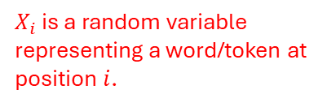


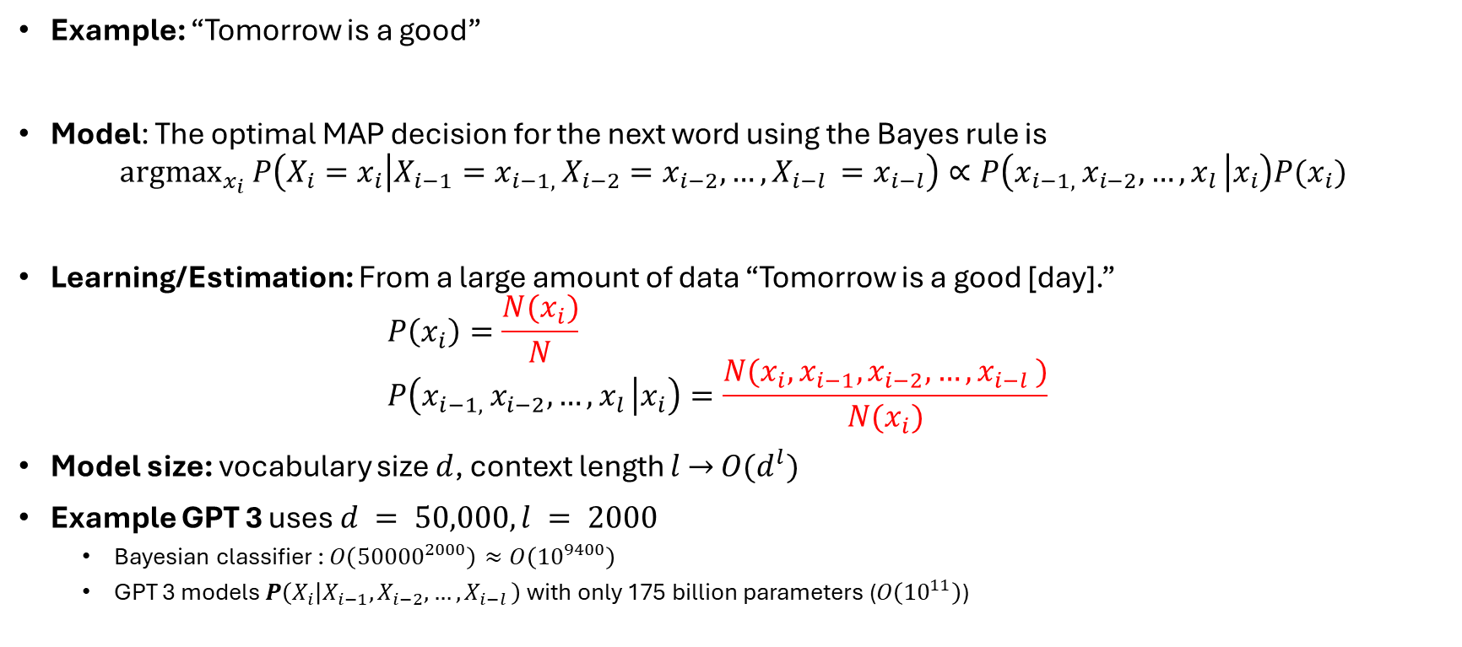





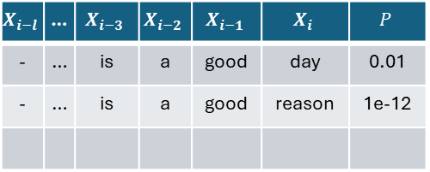
How LLMs Predict the Next Word
Context window
Predict the next word
$X_{i}$ is a random variable representing a word/token at position $i$.
Example: “Tomorrow is a good”
Model: The optimal MAP decision for the next word using the Bayes rule is ${argmax}_{x_{i}} P\left(X_{i}=x_{i} | X_{i−1}=x_{i−1, }X_{i−2}=x_{i−2}, …, X_{i−l }=x_{i−l}\right)∝P\left(x_{i−1, }x_{i−2}, …, x_{l } | x_{i}\right)P(x_{i})$
Learning/Estimation: From a large amount of data “Tomorrow is a good [day].” $P\left(x_{i}\right)=\frac{N(x_{i})}{N}$ $P\left(x_{i−1, }x_{i−2}, …, x_{l } | x_{i}\right)=\frac{N(x_{i}, x_{i−1}, x_{i−2}, …, x_{i−l })}{N(x_{i})}$
Model size: vocabulary size $d$, context length $l$ $→$ $O(d^{l})$
Example GPT 3 uses $d = 50,000, l = 2000$
Bayesian classifier : $O\left({50000}^{2000}\right)≈O\left({10}^{9400}\right)$
GPT 3 models $P\left(X_{i} | X_{i−1}, X_{i−2}, …, X_{i−l }\right)$ with only 175 billion parameters ($O\left({10}^{11}\right)$)
$$x_{i−4}$$
$$x_{i−3}$$
?
$$x_{i−2}$$
$$x_{i−1}$$
$$x_{i}$$
Mask the next word = self-supervised learning
Joint Probability as a table has all the information $P({X_{i}, X}_{i−1}, X_{i−2}, …, X_{i−l })$
$$X_{i−l}$$ | … | $$X_{i−3}$$ | $$X_{i−2}$$ | $$X_{i−1}$$ | $$X_{i}$$ | $$P$$
- | … | is | a | good | day | 0.01
- | … | is | a | good | reason | 1e-12
This does not fit in memory and we cannot estimate that many numbers!
$O(d^{l})$ rows!
State = percept
action
Tricks for compression in transformers are:
Embedding, positional encoding, and the attention mechanism.
With 16-bit floats, this needs > 350 GB RAM
next state = next percept
This is just a transition model!

Slide 9
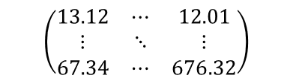




Structure of a GPT-type LLM
Predicted probabilities for next token
Vector (state)
Example
Trainable artificial neural networks
Probability for token “day”
Vectors (embedding as tensor)
classifier
$$(0, …,.63,…, 0)$$
Classifier (a soft-max layer)
$n$ transformer blocks with self-attention
$$(32432.23, …, 899.12)$$
Single embedding size vector.
Token sequence
$n$ transformer blocks with self-attention
Prompt (words)
Positional embedding
$$\left(\begin{matrix}13.12 & ⋯ & 12.01 \\ ⋮ & ⋱ & ⋮ \\ 67.34 & ⋯ & 676.32\end{matrix}\right)$$
Token by embedding size matrix
Positional embedding (a single connected layer)
Tokenizing
[18449, 382, 261, 1899]
Tokenizing
Structure of a GPT-type LLM using a decoder only transformer architecture
Today is a good

Slide 10
Using LLMs in AI

Slide 11
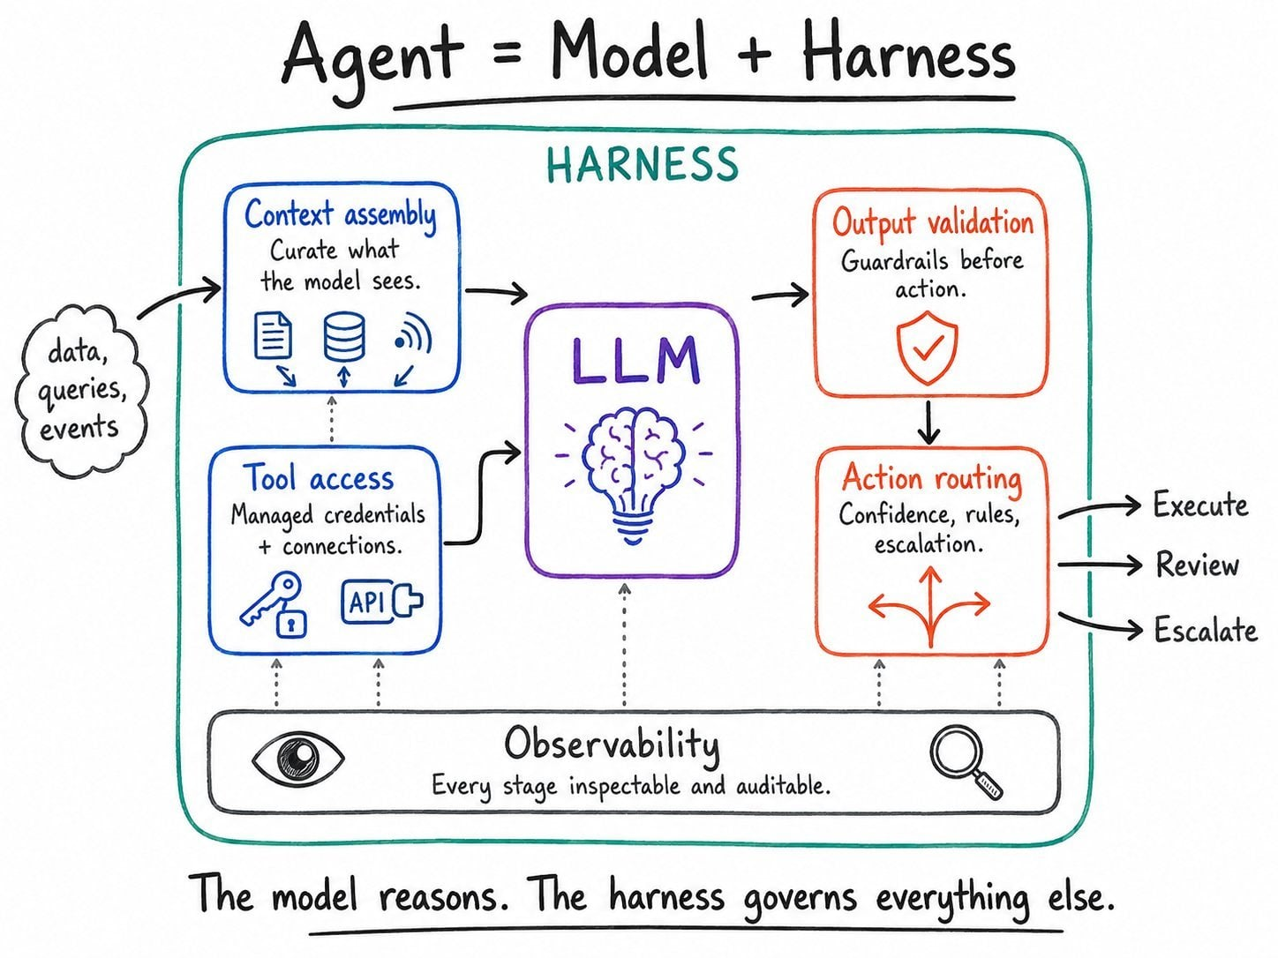
The Agent Harness
An Agent Harness transforms a raw model into an autonomous AI agent by providing:
Memory & Context Management: Manages the LLMs context windows. E.g., provides system prompts, short-term session tracking and long-term databases (like vector stores) so the AI remembers previous conversations.
Tool Access: Catch tool command, executes the tool in a safe environment, and return the results back to the model.
Loop Control & Error Recovery: Looping autonomously until the problem is solved. E.g., LLM writes broken code, the harness tests the code and tells the LLM: "This failed for X reason, try again."
Guardrails & Security: It acts as a filter to sanitize inputs before they hit the model and blocks restricted or unsafe outputs before they reach the user.
Tools: LangGraph, CrewAI, Microsoft AutoGen, …
Source: https://xmpro.com/your-ai-agent-needs-a-harness-heres-what-that-means-for-industrial-operations/

Slide 12
Prompt Engineering / Context Engineering
Design effective natural language instructions (prompts) to guide generative AI models toward desired outputs, such as text, images, or code.
Zero-shot prompt: directly instructs the model to perform a task without any additional examples.
Chain-of-thought: solve a problem as a series of intermediate steps before giving a final answer. Note: Many modern chatbots include chain-of-thought into the system prompt and call this reasoning models!
Few-Shot Prompting: Provide demonstrations in the prompt to steer the model to better performance or to create output in a desired format.
Examples:
6 times 15 minus 3 is
How much is 6 times 15 minus 3? Let's think step-by-step.
Review: Loved it! Output: Positive
Review: Hated it. Output: Negative
Review: It was good. Output:

Slide 13
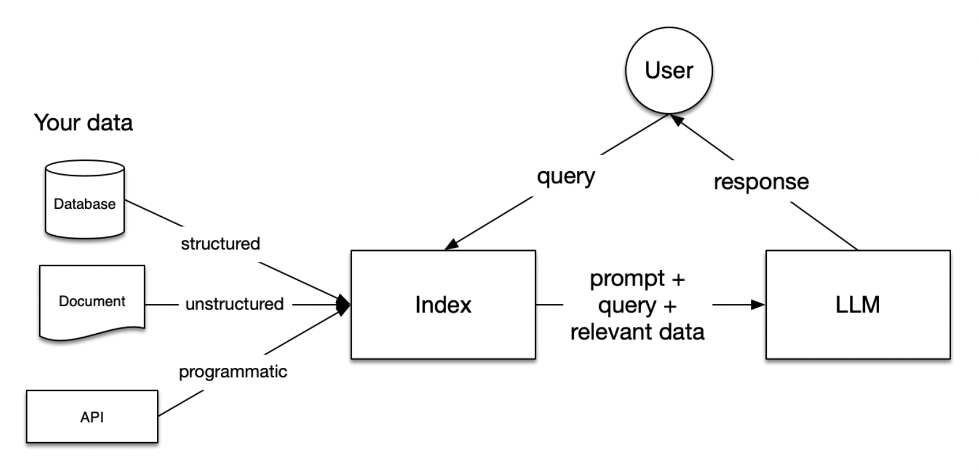
Retrieval Augmented Generation (RAG)
Issue: An LLM only knows what is in its fixed knowledge base.
RAG adds an information retrieval component to the text generator model.
Approach:
RAG takes an input and retrieves a set of relevant/supporting documents given a source (e.g., Wikipedia).
The documents are concatenated as context with the original input prompt and fed to the text generator LLM.
The LLM produces the final output.
This approach can reduce issues with hallucination and introduce information that was not in the training data.
Tools: LangChain, LambdaIndex, Flowise,…
Source: https://codingscape.com/blog/rag-101-what-is-rag-and-why-does-it-matter

Slide 14
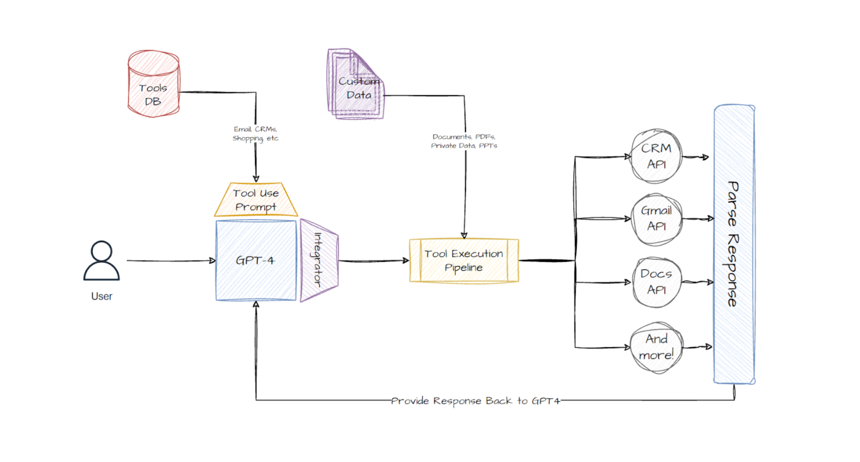
LLMs that use Tools
Enables LLMs to use tools like browsing the web, a calculator, or executing code.
Training: LLMs are finetuned using demonstrations of how the tool is correctly used.
Execution:
The LLM generates a structured output that signals a tool call. E.g.: “browser(http://…”
The tool call is intercepted by the surrounding program, and the tool is executed.
The tool’s result is returned to the LLM to create the final output.
Technology: MCP (Model Context Protocol): Open standard to connect LLMs (MCP clients) with external data sources, tools, and software applications (MCP servers).
Frameworks: LangChain, LangGraph, OpenAI Agents SDK, …
Source: https://www.mercity.ai/blog-post/guide-to-integrating-tools-and-apis-with-language-models

Slide 15
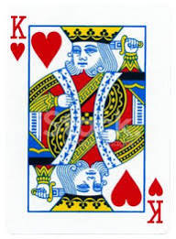
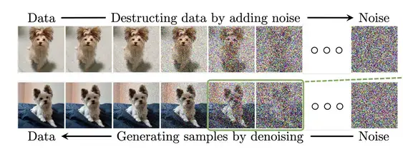
LLMs and Images
This is the king of hearts.
Image interpretation: image as the input
LLMs convert visual data into locations in the embedding space (using image encoders and multimodal alignment).
The location in the embedding space connects the image to tokens. This connection enables LLMs to describe the image.
Training: LLMs that process images are usually trained with multimodal datasets and tasks like image-text matching, predicting missing parts of an image, etc.
The general idea of learning from different types of inputs (text, video, audio, …) is called a Multimodal LLM.
Image generation: Image as the output
LLMs do not directly generate images.
The LLM is trained to generate a textual description of the desired image and then uses an external tool like a diffusion model (DALL-E, Stable Diffusion, Imagen).
Source: https://zilliz.com/glossary/word2vec
Source: https://www.superannotate.com/blog/diffusion-models

Slide 16
Agentic AI

Slide 17
Argentic AI
Definition*: Autonomous AI systems that solve complex tasks that span over long periods of time without human supervision.
Observation: LLMs are good at solving small problems, but struggle with larger, multi-step problems.
Current Approach: Break problems down into a set of specially prompted LLM calls.
The solution typically involves any or all of these:
Multiple LLM calls
LLMs can use tools (browse the web, access files, etc.) to interact with an environment.
A planner coordinates the activities of the agents: Can be a developer-defined workflow or use an LLM to plan its own.
Tools: LangChain, LangGraph, CrewAI, …
Next, we will look at several popular patterns.
*D. B. Acharya, K. Kuppan and B. Divya, "Agentic AI: Autonomous Intelligence for Complex Goals—A Comprehensive Survey," in IEEE Access, vol. 13, 2025

Slide 18
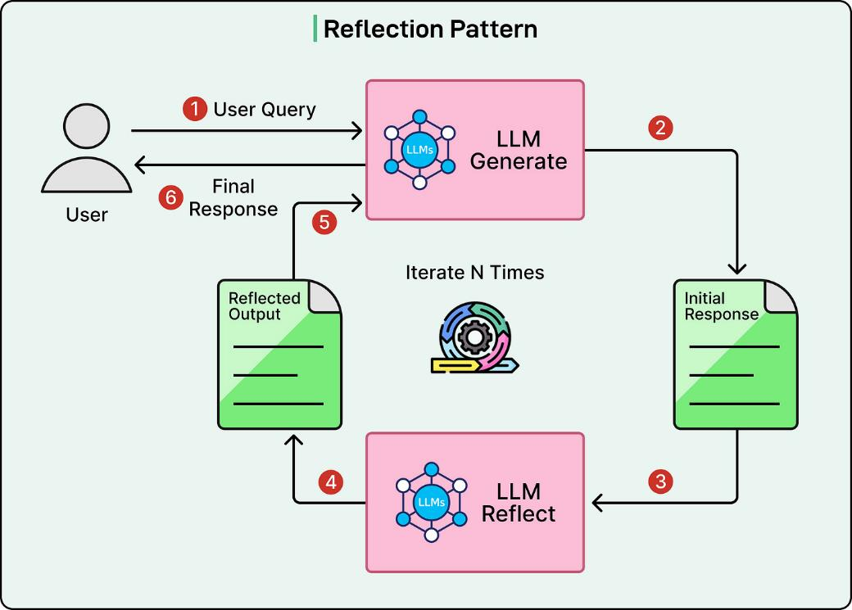
Reflection Pattern
The code that runs the LLMs is called a harness.
A generator and an evaluator agent cooperate to improve the response. This is a simple implementation of “search.”
Example:
Writing a paper and check if it needs improvements.
https://blog.bytebytego.com/p/top-ai-agentic-workflow-patterns

Slide 19
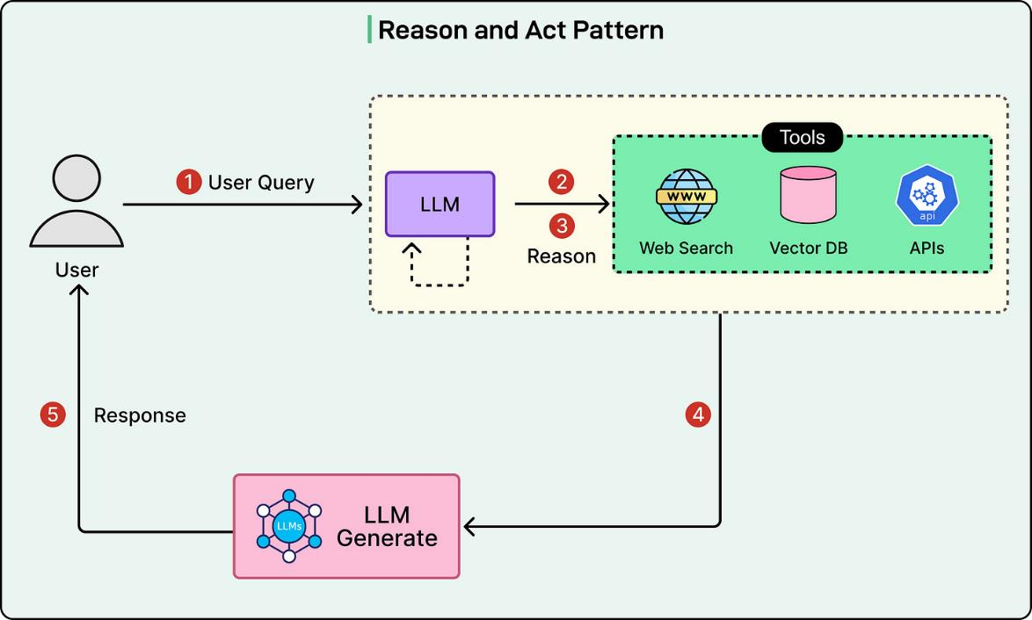

ReAct Pattern
Idea: Combine reasoning (LLM) with acting (tool calls) to perform multi-step tasks.
Example: A research agent.
Tools:
OpenClaw, etc.
Agent
Agent function is a LLM call
Persistent state stored in context
Environment
Interaction is a tool call.
https://blog.bytebytego.com/p/top-ai-agentic-workflow-patterns

Slide 20
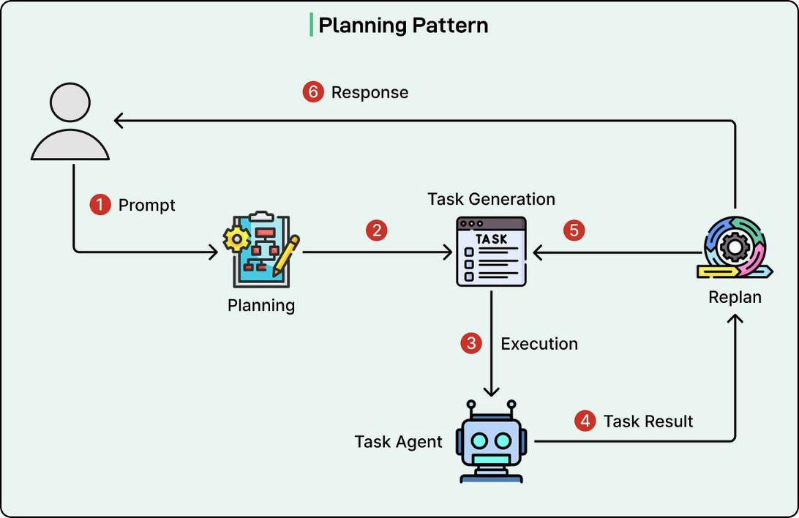
Planning Pattern
This pattern combines:
Planning (e.g., tree search) to generate a list of tasks.
Task agents (e.g., using ReAct) to execute each task
Replanning is used if the plan does not work.
Use case: For more complex tasks that need multiple steps.
https://blog.bytebytego.com/p/top-ai-agentic-workflow-patterns

Slide 21
Conclusion
LLMs are knowledge-based agents trained for the next-word prediction task.
LLMs can be fine-tuned for specific purposes (e.g., a chatbot), to understand images, and to use tools.
Prompt engineering (context engineering) is important to produce better responses from the LLM.
Retrieval Augmented Generation (RAG) can be used to include information that was not in the training data.
Agentic AI uses multiple LLM calls to deal with more complicated problems.
Some issues:
Hallucinations; the LLM does not say when it is not sure. RAG can help.
Privacy and data security when a third party hosts the LLM. Training data can be poisoned.
Safety: It is easy to avoid guardrails (i.e., jailbreak) leading to unsafe responses.
LLMs currently have no (or very little) common sense.
LLMs’ performance is influenced by small prompt changes. The results are not very dependable.
Reasoning capabilities are very limited. Agentic AI tries to mitigate this issue by focusing on smaller tasks.

