Slide 1
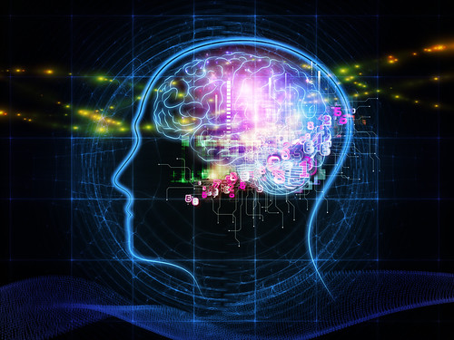


CS 5/7320
Artificial Intelligence
Knowledge-Based Agents
AIMA Chapters 7-9
Slides by Michael Hahsler
based on slides by Svetlana Lazepnik
with figures from the AIMA textbook
This work is licensed under a Creative Commons Attribution-ShareAlike 4.0 International License.
Image: "Exercise Plays Vital Role Maintaining
Brain Health" by A Health Blog
Online Material

Slide 2
Agent Types So Far
Utility-based agents
Simple reflex agents
Goal-based agents
Model-based reflex agents
We will introduce a different class of agents that relies on reasoning using knowledge.

Slide 3
Outline
Knowledge-Based Agents
Logical Agents
Large Language Models
Probabilistic Reasoning Agents

Slide 4
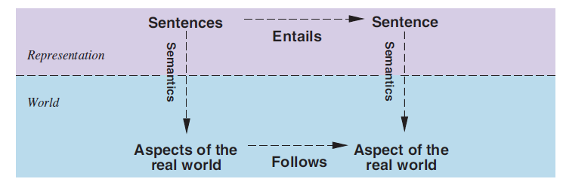
Reality vs. Knowledge Representation
Facts
Knowledge
Learning
Facts: Sentences we know to be true.
Possible worlds: all worlds/models which are consistent with the facts we know (compare with belief state).
Learning new facts reduces the number of possible worlds.
Entailment: A new sentence logically follows from what we already know.
Reasoning: The agent can reason about what will happen in the real world.

Slide 5
Knowledge-Based Agents
Knowledge base
Domain-specific content
Inference engine
Domain-independent algorithms that
find new sentences using entailment.
Knowledge base (KB) = set of facts. E.g., set of sentences in a formal language that are known to be true.
Separation between data (knowledge) and program (inference).
Declarative approach to building an agent: Define what it needs to know in its KB. Use an off-the-shelf inference engine.
The concepts of goals or utility can be incorporated into the knowledge base as facts.
Actions are based on knowledge (sentences + inferred sentences).

Slide 6
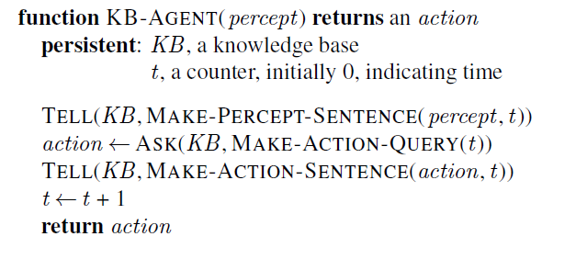
Generic Knowledge-based Agent
KB – prior knowledge
Inference engine
Learning from precepts (tell)
Ask KB for best action
Memorize percept at time t
Ask for logical action given the knowledge
Record action taken at time t

Slide 7
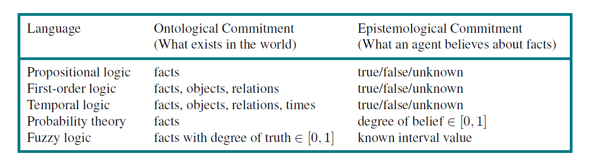
Different Languages to Represent Knowledge
+
Natural Language word patterns representing
facts, objects, relations, … ???

Slide 8
Knowledge-based Agents
Logical and Probabilistic Reasoning Agents

Slide 9
Outline
Knowledge-Based Agents
Logical Agents
Large Language Models
Probabilistic Reasoning Agents

Slide 10
Logical Agents
Facts are logical sentences that are known to be true.
Inference: Generate new sentences that are entailed by all known sentences.
Implementation: Typically using Prolog
  Declarative logic programing language.
  Runs queries over the program (= the knowledge base)
Synonyms: Symbolic AI, Expert Systems
Issues:
  Inference is computationally very expensive.
  Logic cannot deal with uncertainty.

Slide 11
Code example:
A Simple Prolog Knowledge Base
The n-Queens Problem as a Logic Problem
See Code on https://michael.hahsler.net/Introduction_to_Artificial_Intelligence/

Slide 12
Outline
Knowledge-Based Agents
Logical Agents
Large Language Models
Probabilistic Reasoning Agents

Slide 13
Probabilistic Reasoning
Replaces true/false with a probability.
This is the basis for
  Probabilistic reasoning under uncertainty
  Decision theory
  Machine Learning
We will talk about these topics a lot more

Slide 14
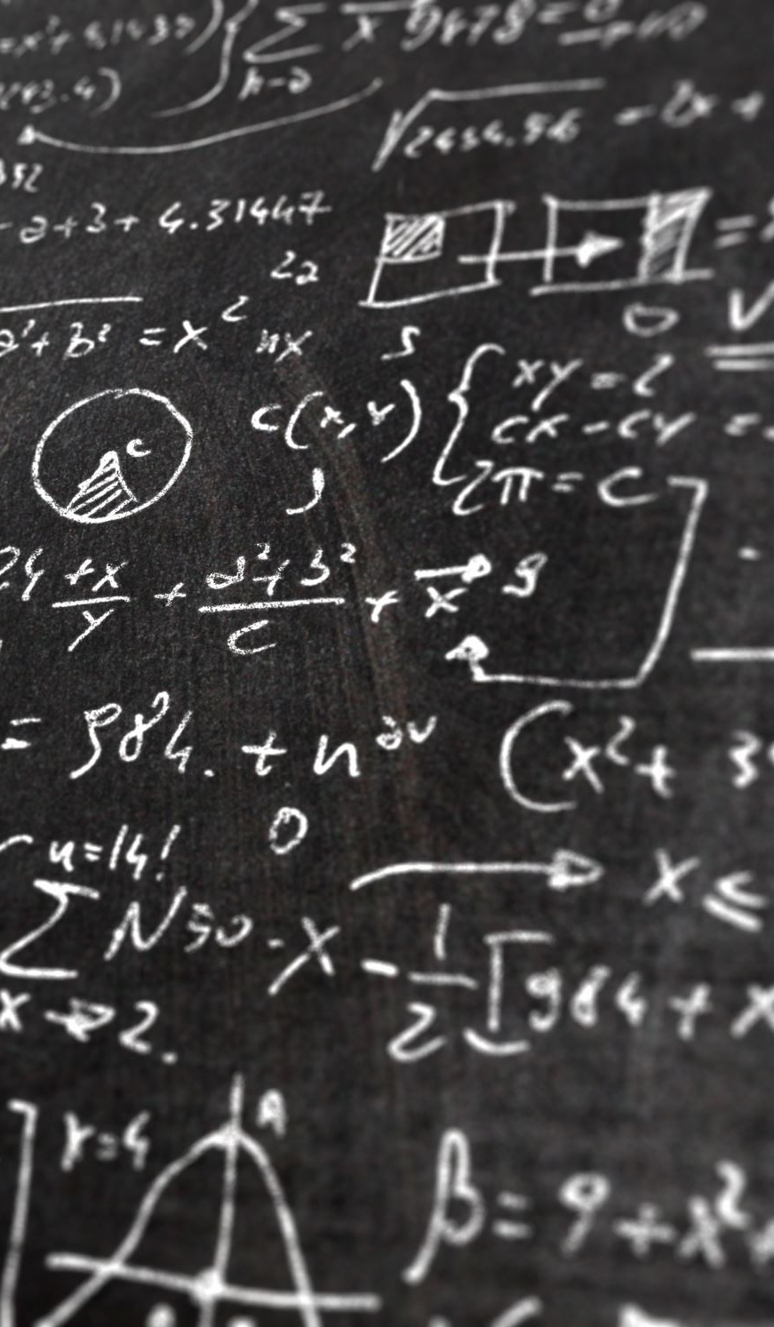
Conclusion
The clear separation between knowledge and inference engine is very useful.
Pure logic is often not flexible enough. The fullest realization of knowledge-based agents using logic was in the field of expert systems or knowledge-based systems in the 1970s and 1980s.
Pretrained Large Language Models are an interesting new application of knowledge-based agents based on natural language.
In one of the following chapters, we will talk about probability theory, the standard language to reason under uncertainty, and forms the basis of machine learning.

Slide 15
Knowledge-Based Agents using Natural Language
I am a Large Language Model
Large Language Models

Slide 16
Outline
Knowledge-Based Agents
Logical Agents
Large Language Models
Probabilistic Reasoning Agents

Slide 17
LLMs - Large Language Models
+
Natural Language word patterns representing
facts, objects, relations, … ???
Extract knowledge from large text corpora.
Store knowledge compressed as parameters in a deep neural network.

Slide 18
Using Natural Language for Knowledge Representation
Pretrained model knows words relationship, grammar, and facts stored as parameters in a network.
KB
Generates
Text
Prompts
Useful?
The user formulates a question about the real world as a natural language prompt (a sequence of tokens).
The LLM generates text using a pretrained model that represents its knowledge base.
The text (hopefully) is useful in the real world. The objective function is not clear. Maybe it is implied in the prompt?

Slide 19
LLM as a Knowledge-Based Agents
Learned word relationships, grammar, facts.
pretrained
Knowledge base
Domain-independent content (pre-training)
+
Domain-specific content (fine tuning)
Text Generator
Domain-independent algorithms
Current text generators are:
Pretrained decoder-only transformer models (e.g., GPT stands for Generative Pre-trained Transformer). The knowledge base is not updated during interactions.
Tokens are created autoregressively. One token is generated at a time based on all the previous tokens using the transformer attention mechanism.

Slide 20
LLM as a Generic Knowledge-based Agent
Prompt + already generated tokens
Next token
A chatbot repeatedly calls the agent function till the agent function returns the ‘end’ token.

Slide 21
Code example:
Large Language Models
See Code on https://michael.hahsler.net/Introduction_to_Artificial_Intelligence/

Slide 22

Many Open Questions about LLMs
Correlation is not causation: Can LLMs reason to solve problems?
Leaky data makes it hard to evaluate true reasoning performance.
Generative stochasticity leads to hallucinations: LLM makes up facts.
Autoregression is an exponentially diverging diffusion process.
The training data contains biases, nonsense, and harmful content.
Security: LLM can leak sensitive information it was trained on.
Rights laundering: Copyrighted or licensed material can be included in the training data.
Reading: [2307.04821] Amplifying Limitations, Harms and Risks of Large Language Models (arxiv.org)

Slide 23

Appendix: Logic
Details on Propositional and First-Order Logic

Slide 24
Logic to Represent Knowledge
Logic is a formal system for representing and manipulating facts (i.e., knowledge) so that true conclusions may be drawn
Syntax: rules for constructing valid sentences
E.g., x + 2 ≥ y is a valid arithmetic sentence, ≥x2y + is not
Semantics: “meaning” of sentences, or relationship between logical sentences and the real world
Specifically, semantics defines truth of sentences
E.g., x + 2 ≥ y is true in a world where x = 5
and y = 7

Slide 25
Propositional Logic

Slide 26
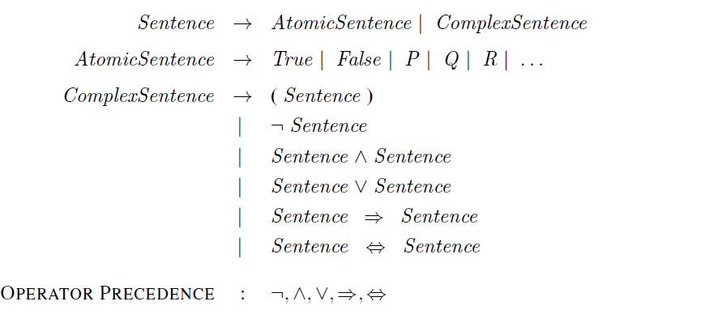
Propositional Logic:
Syntax in Backus-Naur Form
= Symbols
Negation
Conjunction
Disjunction
Implication
Biconditional

Slide 27
Validity and Satisfiability
A sentence is valid if it is true in all models/worlds
e.g., True, A ∨¬A, A ⇒ A, (A ∧ (A ⇒ B)) ⇒ B
are called tautologies and are useful to deduct new sentences.
A sentence is satisfiable if it is true in some model
e.g., A∨B, C
useful to find new facts that satisfy all current possible worlds.
A sentence is unsatisfiable if it is true in no models
e.g., A∧¬A

Slide 28
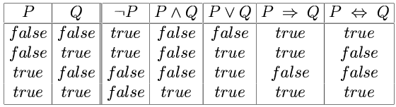
Possible Worlds, Models and Truth Tables
A model specifies a “possible world” with the true/false status of each proposition symbol in the knowledge base
E.g., P is true and Q is true
With two symbols, there are $2^{2}=4$ possible worlds/models, and they can be enumerated exhaustively using:
With two symbols, there are 2^2=4 possible worlds/models, and they can be enumerated exhaustively using:
A truth table specifies the truth value of a composite sentence for each possible assignments of truth values to its atoms. Each row is a model.
We have 3 possible worlds for $P⇒Q=true$

Slide 29
Propositional Logic: Semantics
Rules for evaluating truth with respect to a model:
¬P is true iff P is false
P ∧ Q is true iff P is true and Q is true
P ∨ Q is true iff P is true or Q is true
P ⇒ Q is true iff P is false or Q is true
Sentence
Model

Slide 30
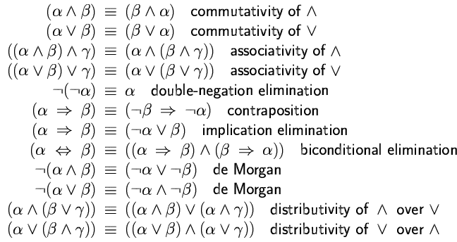
Logical Equivalence
Two sentences are logically equivalent iff (read if, and only if) they are true in same models

Slide 31
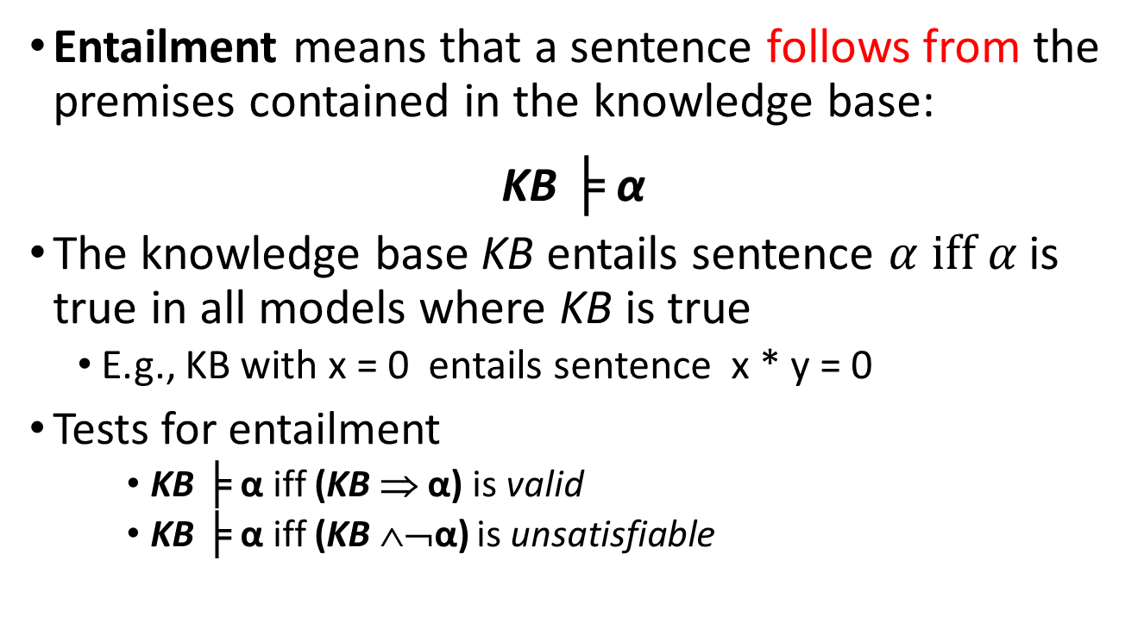
Entailment
Entailment means that a sentence follows from the premises contained in the knowledge base:
KB ╞ α
The knowledge base KB entails sentence $α \text{iff} α$is true in all models where KB is true
  E.g., KB with x = 0 entails sentence x * y = 0
Tests for entailment
    KB ╞ α iff (KB ⇒ α) is valid
    KB ╞ α iff (KB ∧¬α) is unsatisfiable
Notes:
If a╞ b, a is a stronger assertion than b (a rules out more possible worlds)

Slide 32
Inference
Logical inference: a procedure for generating sentences that follow from (ar entailed by) a knowledge base KB.
An inference procedure is sound if it derives a sentence α iff KB╞ α. I.e, it only derives true sentences.
An inference procedure is complete if it can derive all α for which KB╞ α.

Slide 33
Inference
How can we check whether a sentence α is entailed by KB?
How about we enumerate all possible models of the KB (truth assignments of all its symbols), and check that α is true in every model in which KB is true?
  This is sound: All produced answer are correct.
  This is complete: It will produce all correct answers.
  Problem: if KB contains n symbols, the truth table will be of size 2^{n}
Better idea: use inference rules, or sound procedures to generate new sentences or conclusions given the premises in the KB.
Look at the textbook for inference rules and resolution.

Slide 34
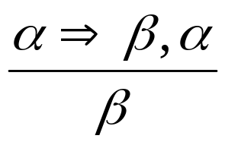
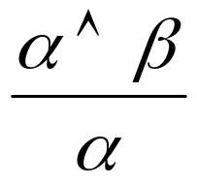
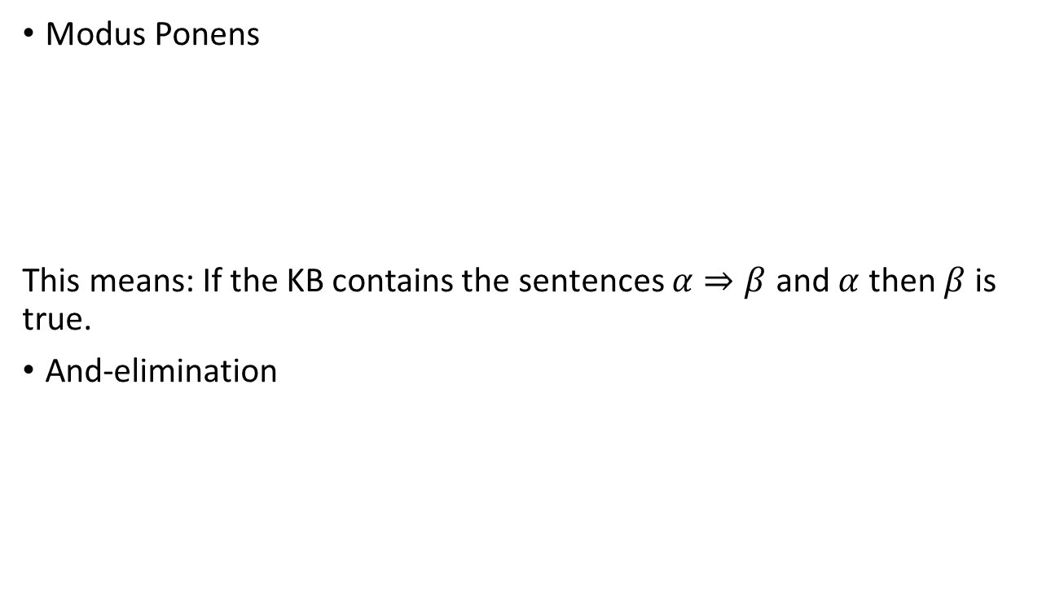
Inference Rules
Modus Ponens
This means: If the KB contains the sentences $α⇒β$ and $α$ then $β$ is true.
And-elimination
premises
conclusion

Slide 35
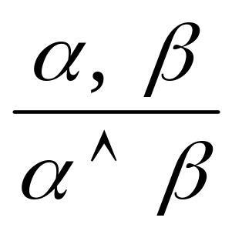
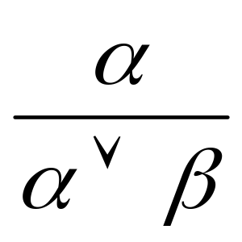
Inference Rules
And-introduction
Or-introduction

Slide 36
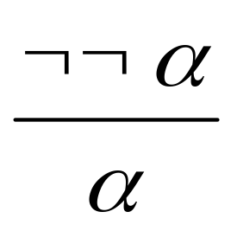
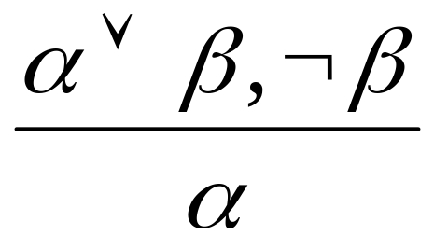
Inference Rules
Double negative elimination
Unit resolution

Slide 37
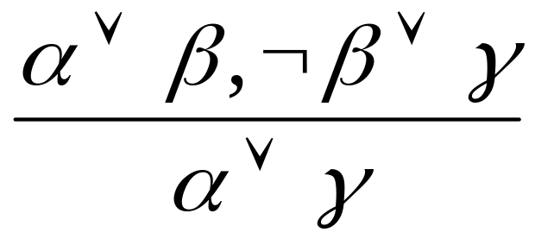
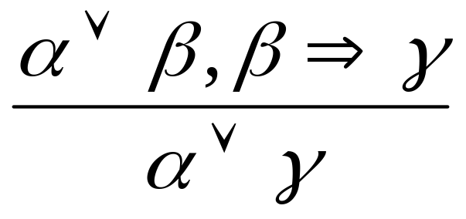
Resolution
or
Example:
  α: “The weather is dry”
  β: “The weather is rainy”
  γ: “I carry an umbrella”

Slide 38
Resolution is Complete
To prove KB╞ α, assume KB ∧ ¬ α and derive a contradiction
Rewrite KB ∧ ¬ α as a conjunction of clauses,
or disjunctions of literals
  Conjunctive normal form (CNF)
Keep applying resolution to clauses that contain complementary literals and adding resulting clauses
to the list
  If there are no new clauses to be added, then KB does not entail α
  If two clauses resolve to form an empty clause, we have a contradiction and KB╞ α

Slide 39
Complexity of Inference
Propositional inference is co-NP-complete
  Complement of the SAT problem: α ╞ β if and only if the sentence α ∧ ¬ β is unsatisfiable
  Every known inference algorithm has worst-case exponential run time complexity.
Efficient inference is only possible for restricted cases
  e.g., Horn clauses are disjunctions of literals with at most one positive literal.
Notes:
Co-NP: class of problems for which the “no” answer is easy to check, e.g., “Is this formula unsatisfiable?”

Slide 40
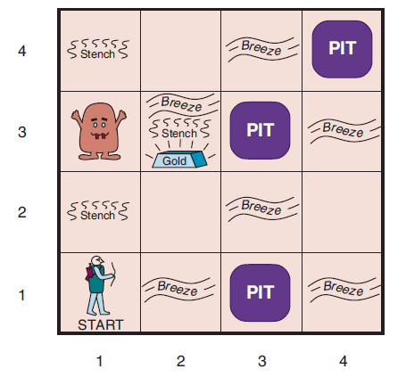
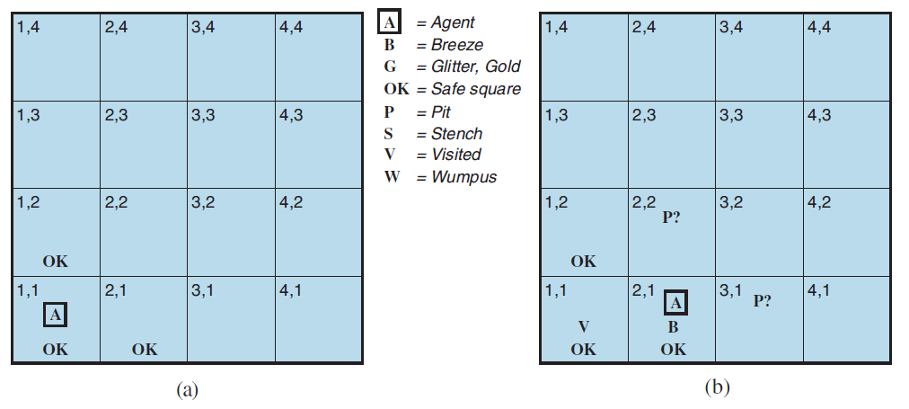
Example: Wumpus World

Slide 41
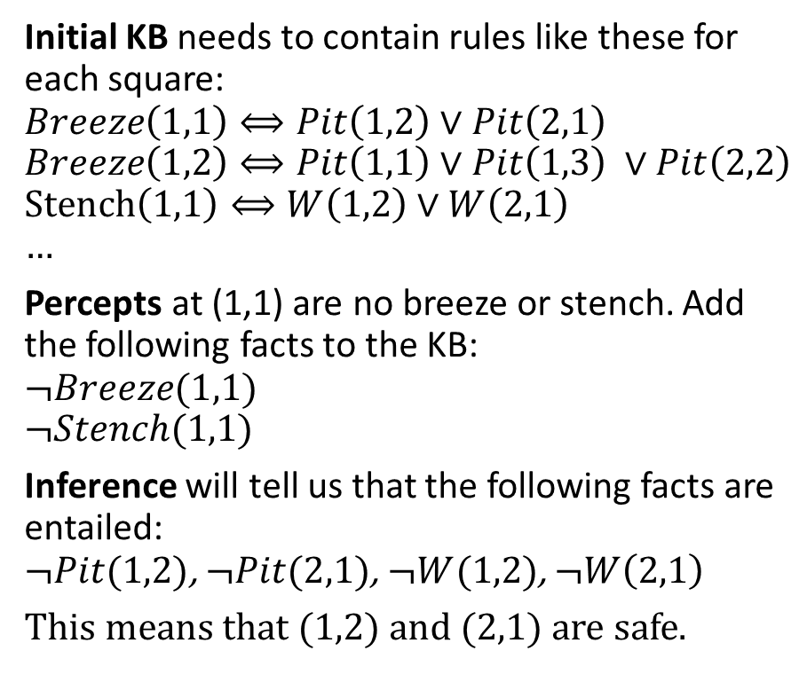
Example: Wumpus World
Initial KB needs to contain rules like these for each square:
$$Breeze\left(1,1\right)⟺Pit\left(1,2\right)∨Pit\left(2,1\right)$$
$$Breeze\left(1,2\right)⟺Pit\left(1,1\right)∨Pit\left(1,3\right) ∨Pit\left(2,2\right)$$
$$Stench\left(1,1\right)⟺W\left(1,2\right)∨W\left(2,1\right) \\ …$$
Percepts at (1,1) are no breeze or stench. Add the following facts to the KB:
$$¬Breeze(1,1)$$
$$¬Stench(1,1)$$
Inference will tell us that the following facts are entailed:
$¬Pit(1,2)$, $¬Pit(2,1)$, $¬W(1,2)$, $¬W\left(2,1\right)$
This means that (1,2) and (2,1) are safe.
We have to enumerate all possible scenarios in propositional logic! First-order logic can help.

Slide 42
Summary
Logical agents apply inference to a knowledge base to derive new information and make decisions.
Basic concepts of logic:
  syntax: formal structure of sentences
  semantics: truth of sentences in models
  entailment: necessary truth of one sentence given another
  inference: deriving sentences from other sentences
  soundness: derivations produce only entailed sentences
  completeness: derivations can produce all entailed sentences
Resolution is complete for propositional logic.
Algorithms use forward, backward chaining, are linear in time, and complete for special clauses (definite clauses).

Slide 43
Limitations of Propositional Logic
Suppose you want to say “All humans are mortal”
  In propositional logic, you would need ~6.7 billion statements of the form:
  Michael_Is_Human and Michael_Is_Mortal,
  Sarah_Is_Human and Sarah_Is_Mortal, …
Suppose you want to say “Some people can run a marathon”
  You would need a disjunction of ~6.7 billion statements:
  Michael_Can_Run_A_Marathon or … or Sarah_Can_Run_A_Marathon

Slide 44
First-Order Logic
First-order Logic adds objects and relations to the facts of propositional logic.
This addresses the issues of propositional logic, which needs to store a fact for each instance of and object individually.

Slide 45
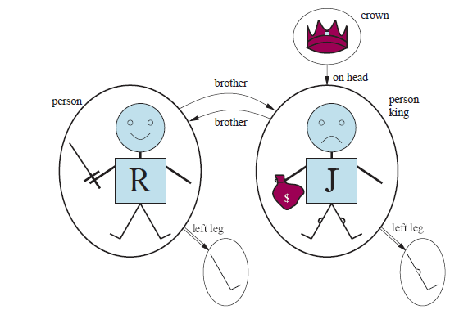
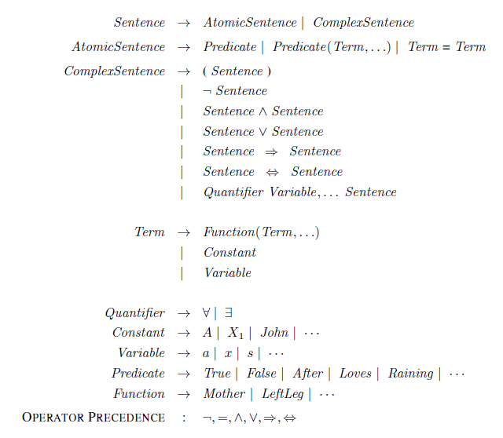
Syntax of FOL
Objects
Relations. Predicate is/returns True or False
Function returns an object

Slide 46
Universal Quantification
∀x P(x)
Example: “Everyone at SMU is smart”
  ∀x At(x,SMU) ⇒ Smart(x)
  Why not ∀x At(x,SMU) ∧ Smart(x)?
Roughly speaking, equivalent to the conjunction of all possible instantiations of the variable:
  [At(John, SMU) ⇒ Smart(John)] ∧ ...
  [At(Richard, SMU) ⇒ Smart(Richard)] ∧ ...
∀x P(x) is true in a model m iff P(x) is true with x being each possible object in the model

Slide 47
Existential Quantification
∃x P(x)
Example: “Someone at SMU is smart”
  ∃x At(x,SMU) ∧ Smart(x)
  Why not ∃x At(x,SMU) ⇒ Smart(x)?
Roughly speaking, equivalent to the disjunction of all possible instantiations:
  [At(John,SMU) ∧ Smart(John)] ∨
  [At(Richard,SMU) ∧ Smart(Richard)] ∨ …
∃x P(x) is true in a model m iff P(x) is true with x being some possible object in the model

Slide 48
Properties of Quantifiers
∀x ∀y is the same as ∀y ∀x
∃x ∃y is the same as ∃y ∃x
∃x ∀y is not the same as ∀y ∃x
  ∃x ∀y Loves(x,y)
  “There is a person who loves everyone”
  ∀y ∃x Loves(x,y)
  “Everyone is loved by at least one person”
Quantifier duality: each quantifier can be expressed using the other with the help of negation
  ∀x Likes(x,IceCream) ¬∃x ¬Likes(x,IceCream)
  ∃x Likes(x,Broccoli) ¬∀x ¬Likes(x,Broccoli)

Slide 49
Equality
Term₁ = Term₂ is true under a given model if and only if Term₁ and Term₂ refer to the same object
E.g., definition of Sibling in terms of Parent:
  ∀x,y Sibling(x,y) ⇔
  [¬(x = y) ∧ ∃m,f ¬ (m = f) ∧ Parent(m,x) ∧ Parent(f,x) ∧ Parent(m,y) ∧ Parent(f,y)]

Slide 50
Example: The Kinship Domain
Brothers are siblings
  ∀x,y Brother(x,y) ⇒ Sibling(x,y)
“Sibling” is symmetric
  ∀x,y Sibling(x,y) ⇔ Sibling(y,x)
One's mother is one's female parent
  ∀m,c (Mother(c) = m) ⇔ (Female(m) ∧ Parent(m,c))

Slide 51
Example: The Set Domain
∀s Set(s) ⇔ (s = {}) ∨ (∃x,s₂ Set(s₂) ∧ s = {x|s₂})
¬∃x,s {x|s} = {}
∀x,s x ∈ s ⇔ s = {x|s}
∀x,s x ∈ s ⇔ [ ∃y,s₂ (s = {y|s₂} ∧ (x = y ∨ x ∈ s₂))]
∀s₁,s₂ s₁ ⊆ s₂ ⇔ (∀x x ∈ s₁ ⇒ x ∈ s₂)
∀s₁,s₂ (s₁ = s₂) ⇔ (s₁ ⊆ s₂ ∧ s₂ ⊆ s₁)
∀x,s₁,s₂ x ∈ (s₁ ∩ s₂) ⇔ (x ∈ s₁ ∧ x ∈ s₂)
∀x,s₁,s₂ x ∈ (s₁ ∪ s₂) ⇔ (x ∈ s₁ ∨ x ∈ s₂)

Slide 52
Inference in FOL
Inference in FOL is complicated!
Reduction to propositional logic and then use propositional logic inference.
Directly do inference on FOL (or a subset like definite clauses)
  Unification: Combine two sentences into one.
  Forward Chaining for FOL
  Backward Chaining for FOL
  Logical programming (e.g., Prolog)

