Slide 1
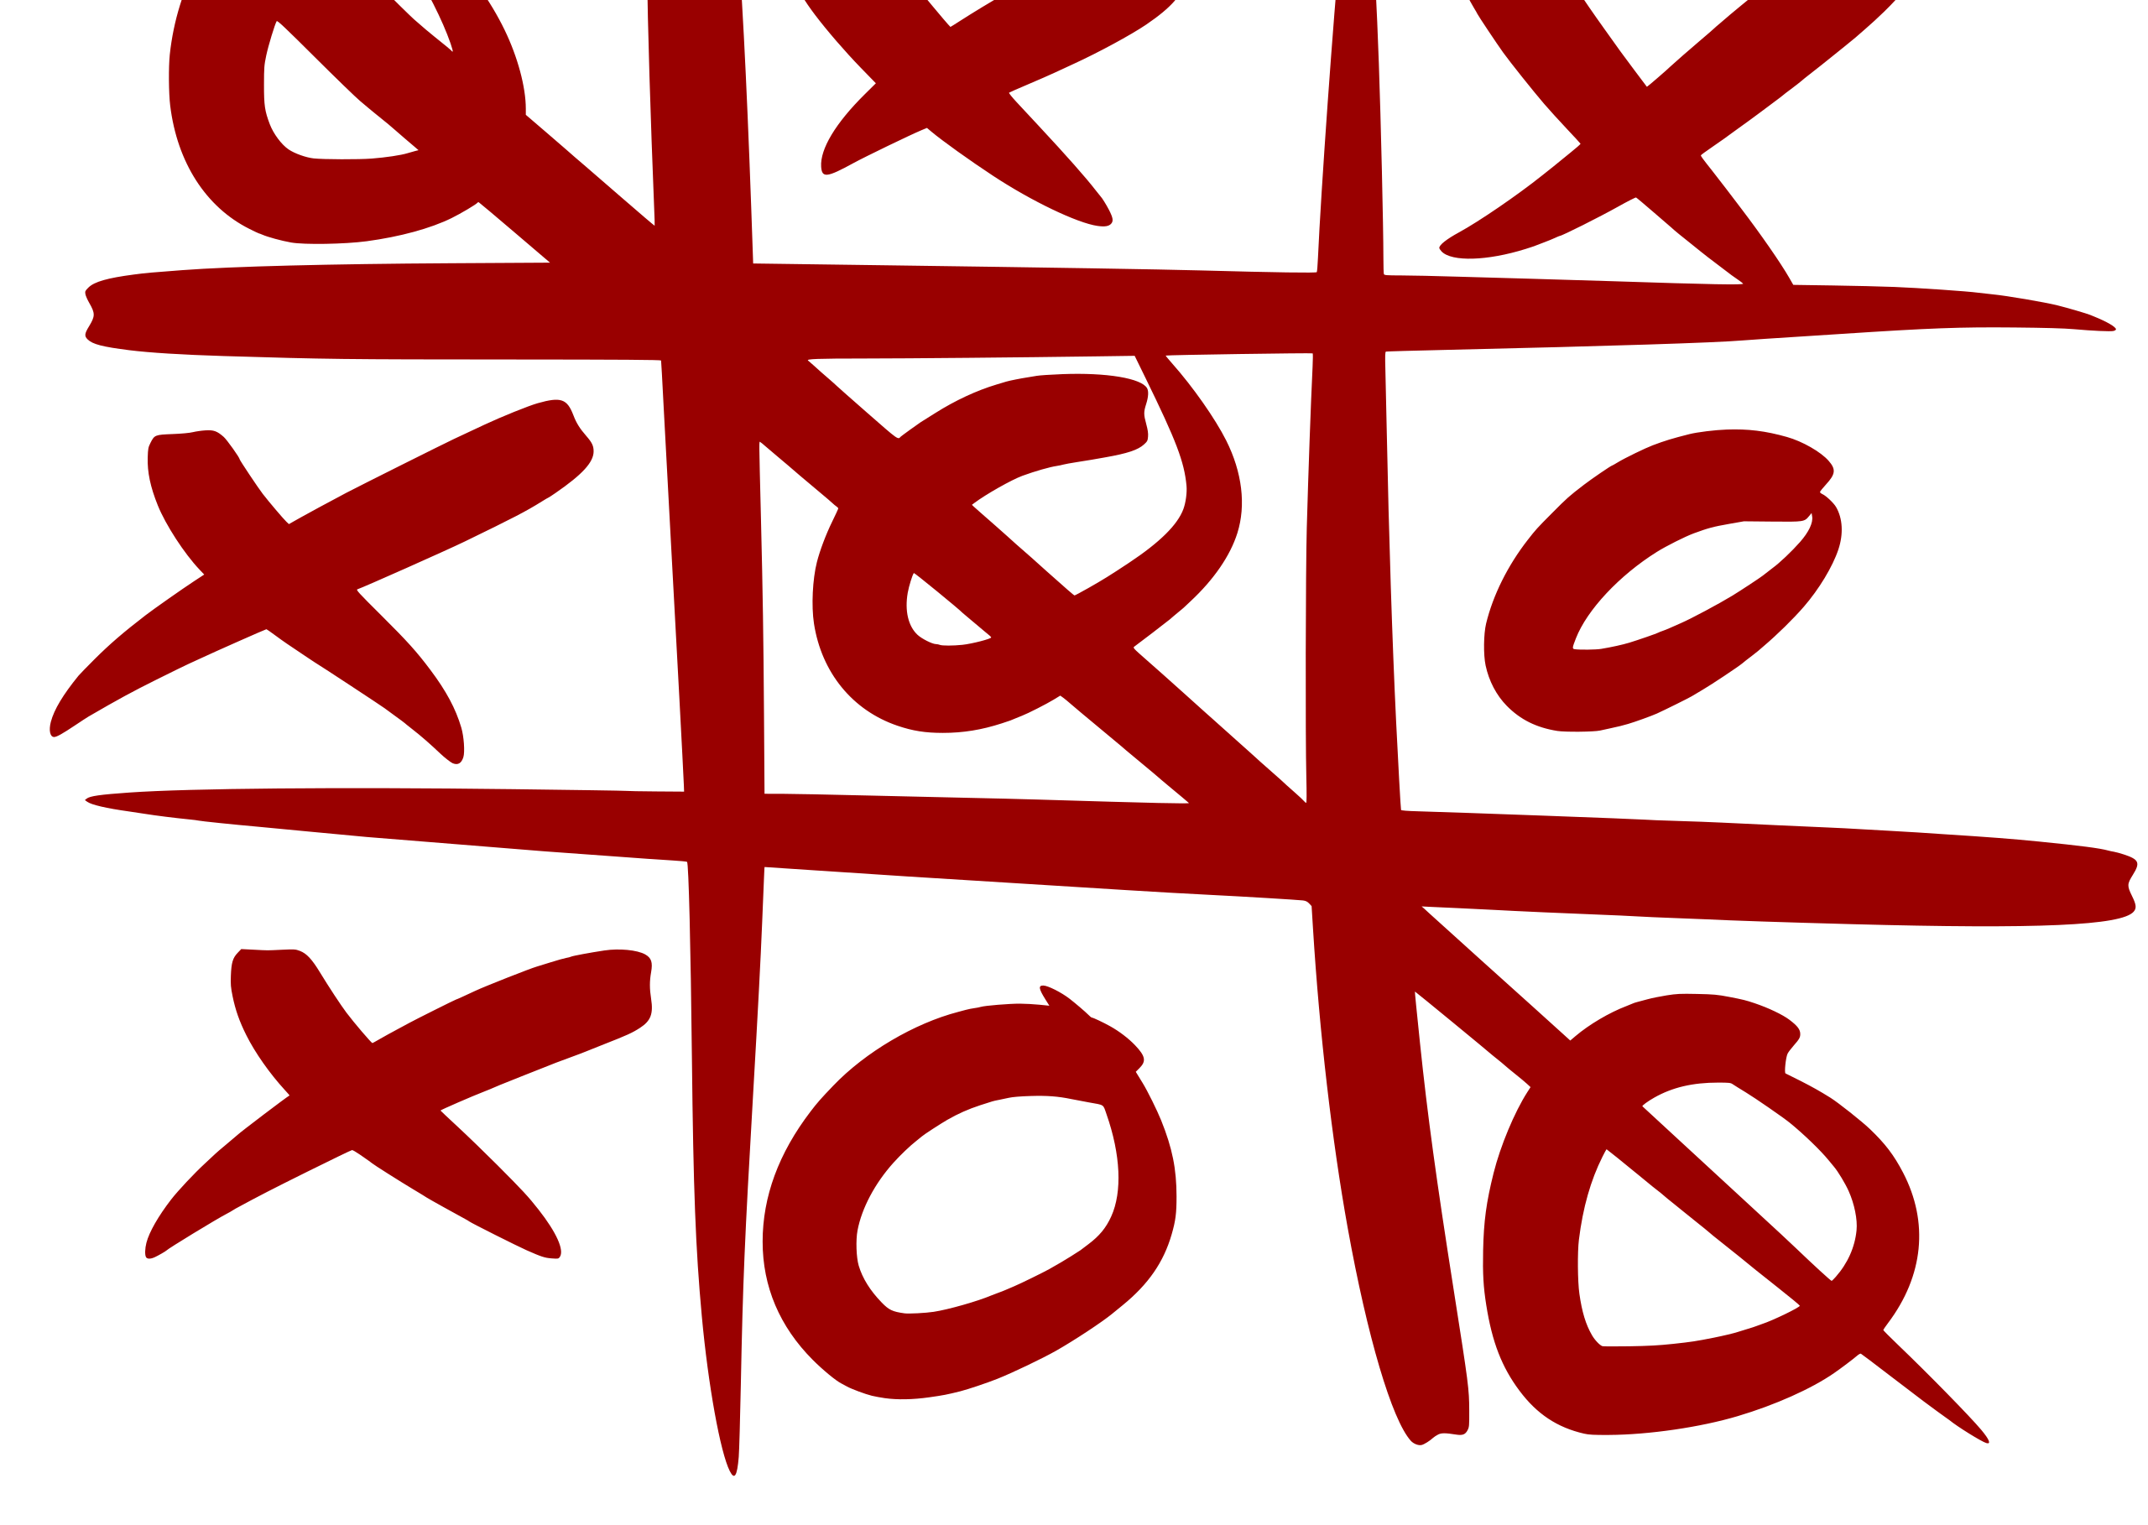
CS 5/7320 Artificial Intelligence Learning from Examples: Learning to Score a Tic-Tac-Toe board AIMA Chapter 19
Discussion
Michael Hahsler

Slide 2
Intro: Learning from Examples
What can be learned?

Slide 3
Learning from Examples
Up until now in this course:
Hand-craft algorithms to make rational/optimal or at least good decisions. Examples: Search strategies, heuristics, and constructing Bayesian networks.
Issues
We may not be able to anticipate all possible future scenarios.
We may have examples, but we do not know how to implement a solution.
Supervised Machine Learning
Uses observations: training data with the correct answers.
Learn a function (model) to map an input (e.g., state) to an output (e.g., action) representing the desired behavior.
Examples:
Use a naïve Bayesian classifier to distinguish between spam/non-spam.
Learn a playout policy to simulate games (current board -> good move)
Data
(behavior)
Algorithm chooses actions
creates
Data
(observations)
learn
Model chooses actions

Slide 4
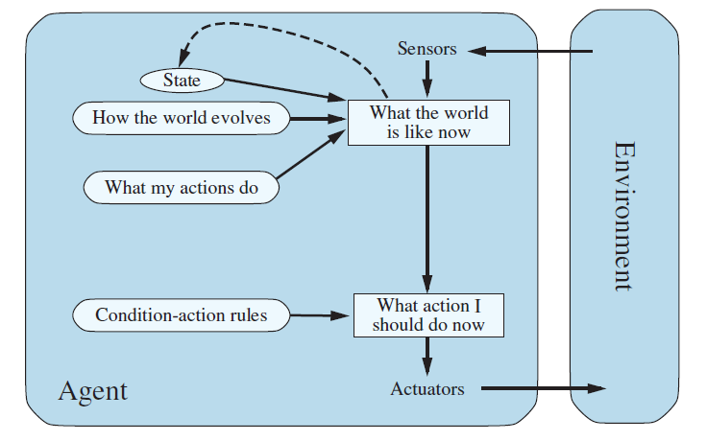




Learning Components of an Agent
We can learn many different components of an agent from examples
Example: Learning components of a model-based reflex agent
Learn the state representation
Learn a utility function
Learn the transition model
$$p$$
$$s^{′}=T(s,a)$$
$$a=f(p,s)$$
$$a$$
Learn rules

Slide 5
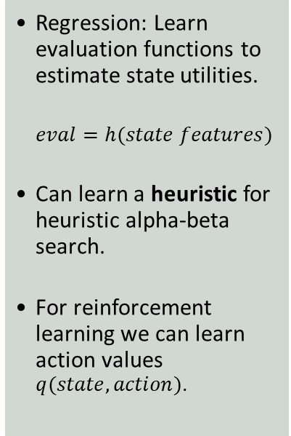
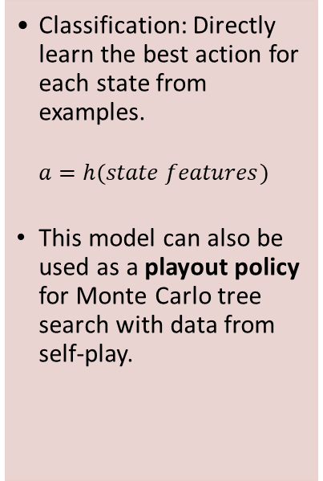
Typical Use of Supervised ML for Intelligent Agents
Learn a Policy
Learn Evaluation Functions
Learn Perception and Actuation
Compressing Tables
Classification: Directly learn the best action for each state from examples.
$$a=h(state features)$$
This model can also be used as a playout policy for Monte Carlo tree search with data from self-play.
Regression: Learn evaluation functions to estimate state utilities.
$$eval=h(state features)$$
Can learn a heuristic for heuristic alpha-beta search.
For reinforcement learning we can learn action values $q(state,action)$.
Natural language processing: Use deep learning / word embeddings / language models to understand concepts, translate between languages, or generate text.
Speech recognition: Identify the most likely sequence of words.
Vision: Object recognition in images/videos. Generate images/video.
Robotics: Learn how to move safely.
Neural networks can be used as a compact representation of tables that do not fit in memory. E.g.,
Joint and conditional probability tables
State utility tables (i.e., an evaluation function)
Q-Value tables in reinforcement learning
Bottom line: Learning a function is often more effective than hard-coding it. However, we do not always know how it performs for rare and edge cases!

Slide 6
Example: Tic-Tac-Toe
Approaches to implement/learn an evaluation function.

Slide 7


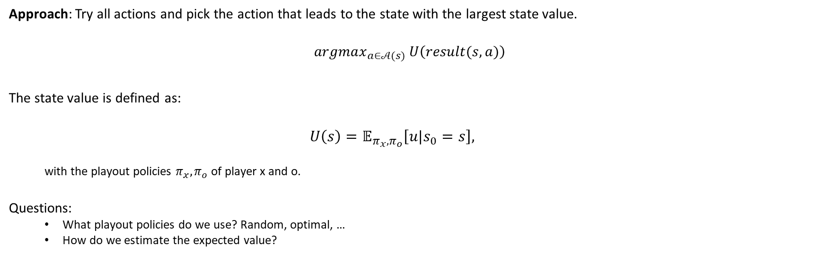
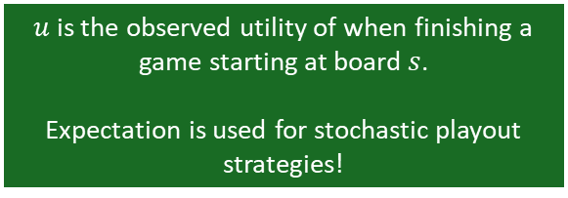
Utility of Being in a State: State Value
State $s$
$$U\left(s\right)$$
Approach: Try all actions and pick the action that leads to the state with the largest state value.
$$argmax_{a∈𝒜(s)} U\left(result(s, a)\right)$$
The state value is defined as:
$$U\left(s\right)=𝔼_{π_{x},π_{o}}\left[u|s_{0}=s\right],$$
with the playout policies $π_{x},π_{o}$ of player x and o.
Questions:
What playout policies do we use? Random, optimal, …
How do we estimate the expected value?
$u$ is the observed utility of when finishing a game starting at board $s$.
Expectation is used for stochastic playout strategies!

Slide 8
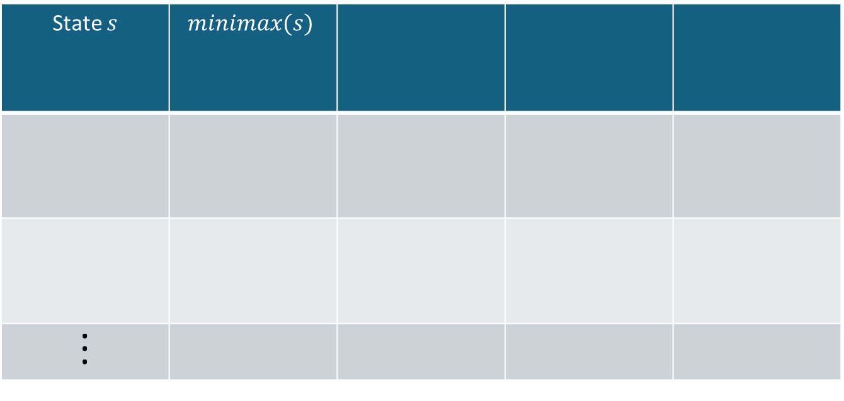


Minimax and Variations
$$U\left(s\right)=𝔼_{π_{x},π_{o}}\left[u|s_{0}=s\right]$$
Minimax replaces the expectation with optimal play!
State $s$ | $$minimax(s)$$
. . .
1
0
Playout policy $π_{x},π_{o}$
optimal play
Method
Tree search

Slide 9

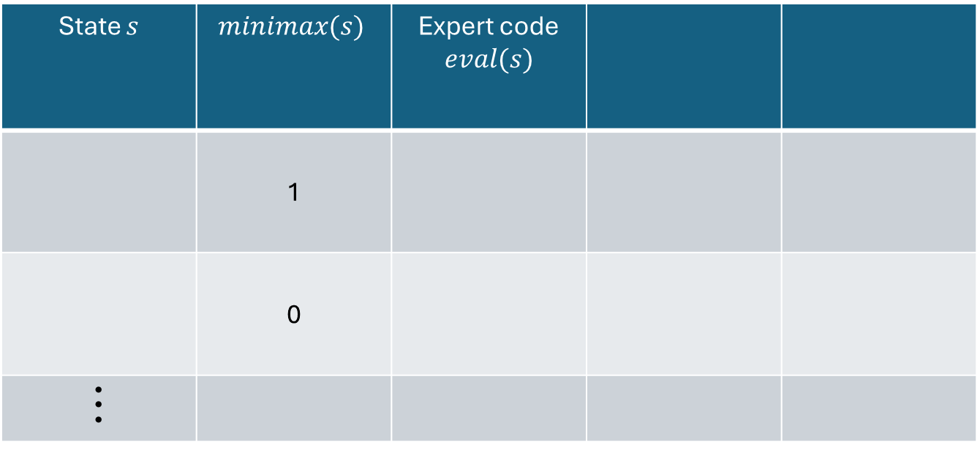

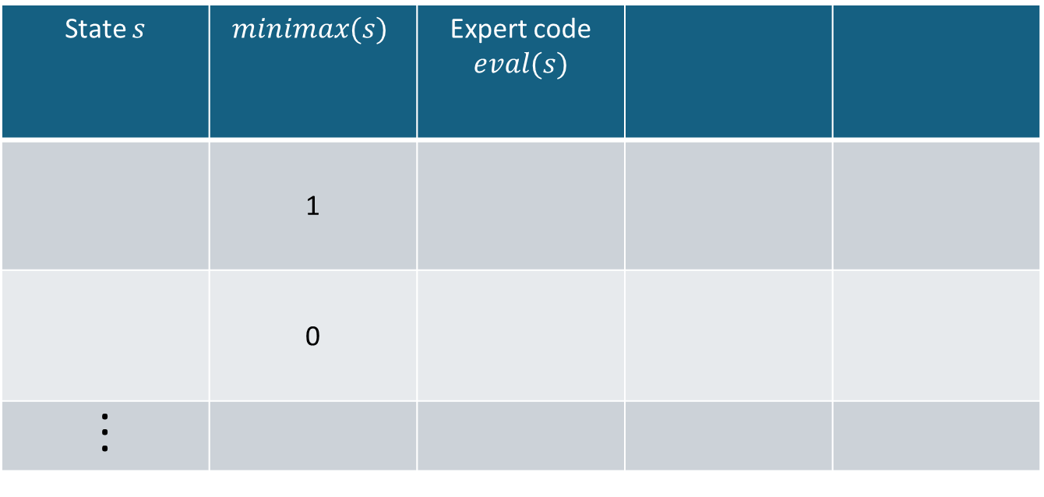
Expert Evaluation Function
$$U\left(s\right)=𝔼_{π_{x},π_{o}}\left[u|s_{0}=s\right]$$
$$≈eval(s)$$
State $s$ | $$minimax(s)$$ | Expert code $$eval(s)$$
 | 1
 | 0
. . .
State $s$ | $$minimax(s)$$ | Expert code $$eval(s)$$
 | 1
 | 0
. . .
Expert Heuristic
+.4 for each winning opportunity
-.4 for each loosing opportunity
+0.4
-0.4
Playout policy $π_{x},π_{o}$
optimal play
none
Method
Tree search
Code + cutoff search

Slide 10
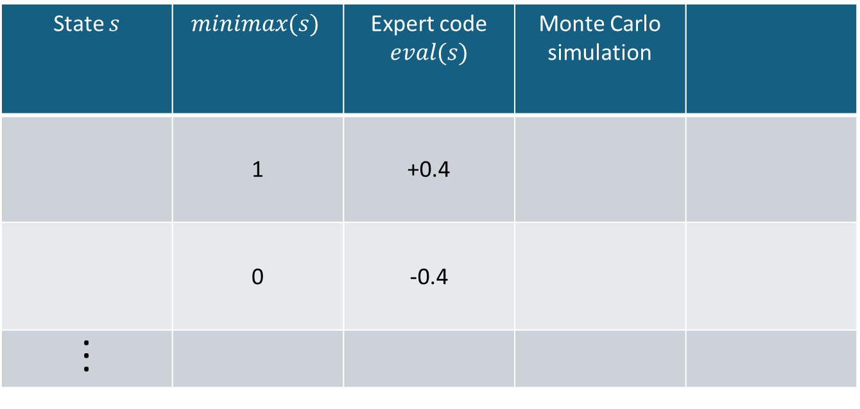



Monte Carlo Simulation
Monte Carlo Sim. $$≈\frac{1}{N}\sum_{i=1}^{N}{u_{i}|s_{0}=s }$$
$$U\left(s\right)=𝔼_{π_{x},π_{o}}\left[u|s_{0}=s\right]$$
State $s$ | $$minimax(s)$$ | Expert code $$eval(s)$$ | Monte Carlo simulation
 | 1 | +0.4
 | 0 | -0.4
. . .
0.634
-0.021
Playout policy $π_{x},π_{o}$
optimal play
none
Random or other
Method
Tree search
Code + cutoff search
Simulation

Slide 11
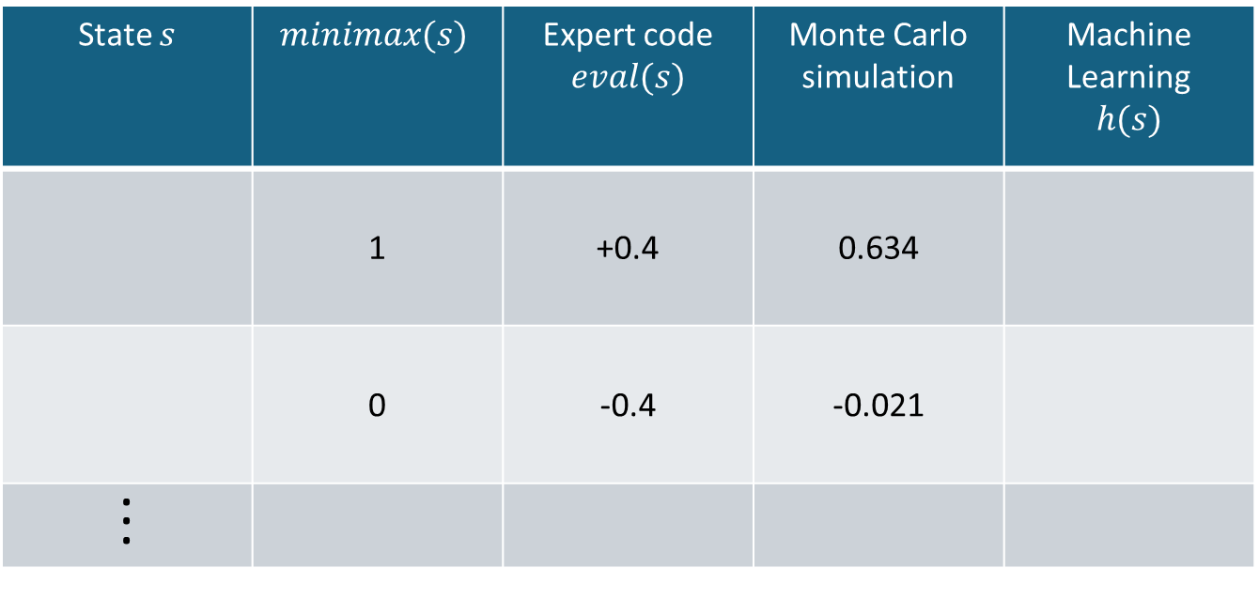


Machine Learning
$$U\left(s\right)=𝔼_{π_{x},π_{o}}\left[u|s_{0}=s\right]$$
$$≈h(s)$$
State $s$ | $$minimax(s)$$ | Expert code $$eval(s)$$ | Monte Carlo simulation | Machine Learning $$h(s)$$
 | 1 | +0.4 | 0.634
 | 0 | -0.4 | -0.021
. . .
0.325
0.042
All methods hopefully produce a consistent state order.
Playout policy $π_{x},π_{o}$
optimal play
none
Random or other
Used for simulating or training data
Method
Tree search
Code + cutoff search
Simulation
Function approximation

Slide 12
Reinforcement Learning (RL)
Tries to learn state values directly from rewards resulting from
Model-based RL: Uses a complete probabilistic model of the environment.
Model-free RL: Learns from interactions with the environment.
Online learning
Offline learning (can use supervised learning from a sampled dataset)
Machine learning for an evaluation function can be seen as a special case of model-free offline RL called (neural) fitted Q-learning with replay memory.
You can learn more by taking an RL course.

