Slide 1

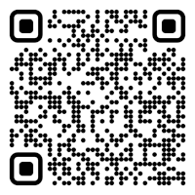

CS 5/7320 Artificial Intelligence Search with Uncertainty AIMA Chapters 4.3-4.5
Slides by Michael Hahsler with figures from the AIMA textbook
This work is licensed under a Creative Commons Attribution-ShareAlike 4.0 International License.
Online Material

Slide 2
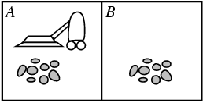
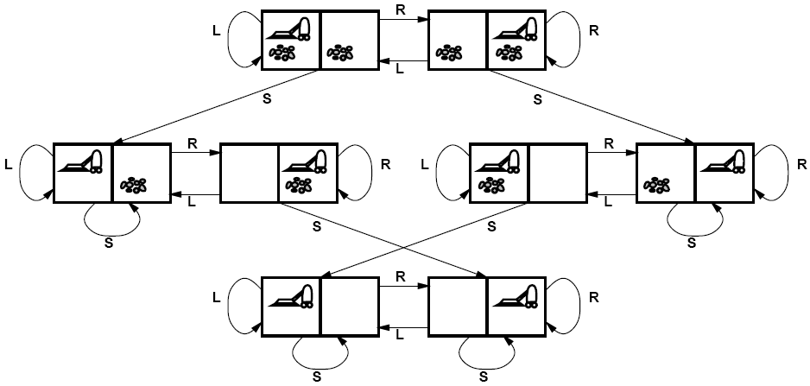
Recap: Solving Search Problems under Certainty
Full observability
No Uncertainty
Full observability: The agent always knows (=can observe) the state.
Deterministic environment with a known transition model $$Result\left(s,a\right)=s^{′}$$ The agent can predict the outcome of its actions.
Deterministic environment with a known transition model 𝑅𝑒𝑠𝑢𝑙𝑡(𝑠,𝑎)=𝑠^′ The agent can predict the outcome of its actions.
State space: A state completely describes the condition of the environment and the agent.
Initial state
Goal states
Solution: Use tree search in the planning phase to create a sequence of actions also called a plan. Then blindly execute the plan: [Suck, Right, Suck]

Slide 3
Sources and Consequence of Uncertainty
Sources: The environment may be
Not fully observable: The agent may be uncertain about its current state.
Stochastic (transition function): The agent may not be able to perfectly predict the outcome of its actions.
Consequences:
The agent needs to keep track of all the states it could be in. This set is called a belief state.
A fixed precomputed plan (sequence of actions) does not work for stochastic transition functions, but a conditional plan (also called strategy or policy) that depends on percepts is needed.

Slide 4




Types of uncertainty in the environment*
Nondeterministic Actions: Outcome of an action in a state is uncertain.
No observations: Sensorless problems.
Partially observable environments: The agent cannot directly observe the state of the environment.
Exploration: Unknown environments and online search.
* we will quantify uncertainty with probabilities later.

Slide 5

Nondeterministic Actions
Stochastic Environment (Stochastic Transition Model)

Slide 6
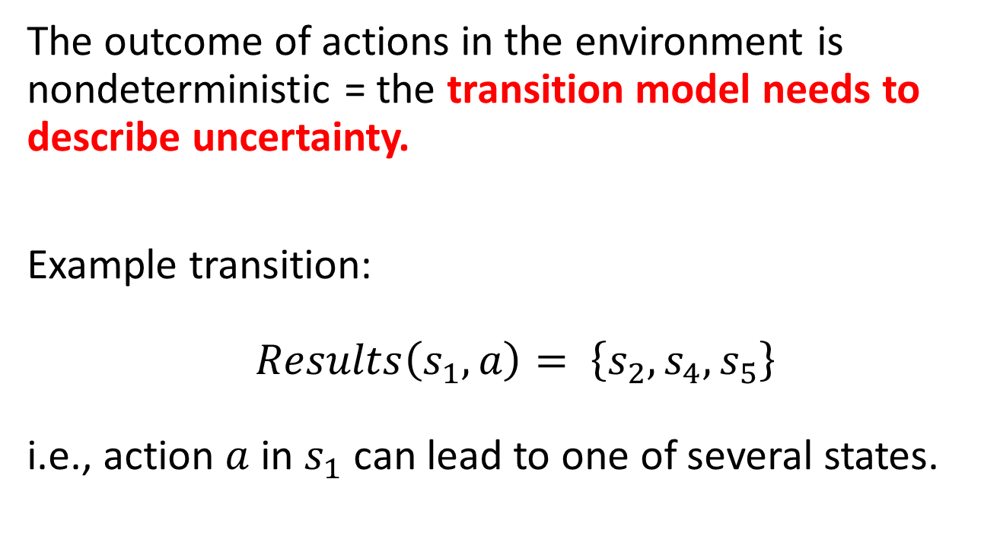
Definition: Nondeterministic Actions
The outcome of actions in the environment is nondeterministic = the transition model needs to describe uncertainty.
Example transition: $Results\left(s_{1},a\right)= \left\{s_{2},s_{4},s_{5}\right\}$ i.e., action $a$ in $s_{1}$ can lead to one of several states.
Note the ‘s’ here

Slide 7
Example: Erratic Vacuum World
Full observability
Regular fully observable, deterministic vacuum world, but the action ‘suck’ is more powerful and nondeterministic:
On a dirty square: cleans the square and sometimes cleans dirt on adjacent squares as well.
On a clean square: sometimes deposits some dirt on the square.

Slide 8
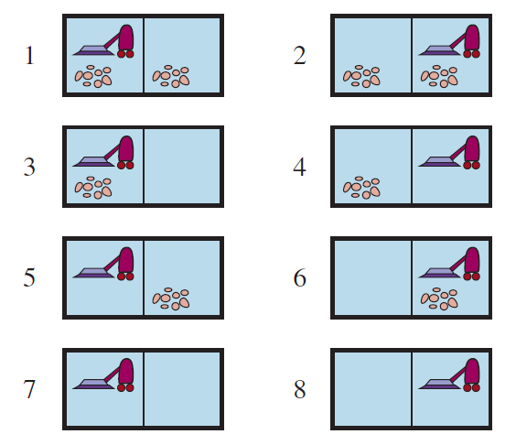

Example: Erratic Vacuum World
Full observability
Start State
$Results\left(1, Suck\right)= \left\{5, 7\right\}$
Goal states
Suck can lead to two different states! We need a conditional plan
[Suck, if State = 5 then [Right, Suck] else []]

Slide 9
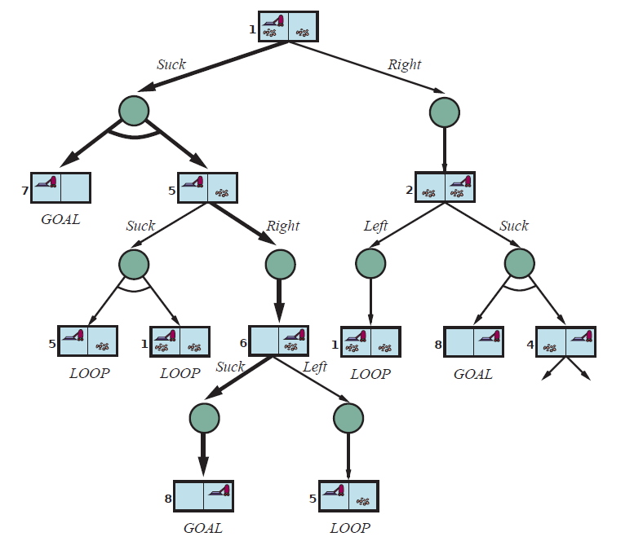


Transition Model as an AND-OR Search Tree
OR node (choose one action)
OR
AND node (all possible outcomes)
AND
…
LOOP: No need to continue search. Solution is the same as above.

Slide 10
Search the AND-OR Tree
OR node
Goal: Find a subtree with one action for each OR node and considering all outcomes of the AND nodes that has only goal leaf nodes.
Descend the tree depth-first:
OR node: trying one action at a time.
AND node: consider all outcomes and check recursively.
Ignore cycles.
Abandon a subtree if not all leaf nodes are the desired goal nodes.
Stop when the first complete subtree with only goal leaf nodes is found.
Construct the conditional plan that represents the subtree starting at the root node.
Suck
AND node
Right
…
Suck
Conditional Plan:
[Suck, if State = 5 then [Right, Suck] else []]

Slide 11
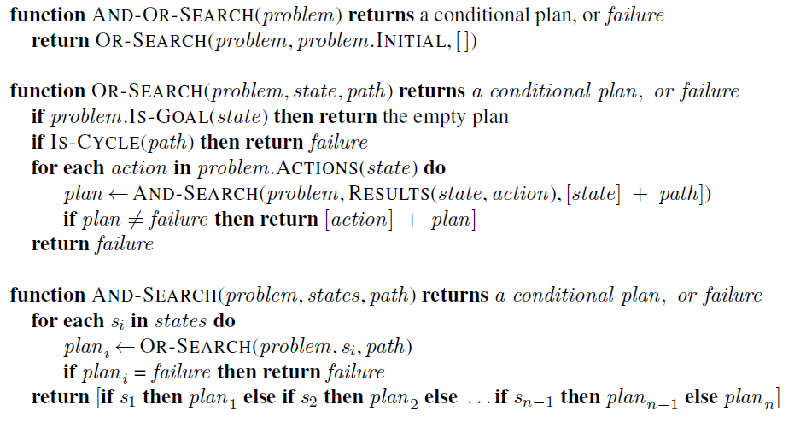
Recursive AND-OR Tree Search (DFS)
= nested If-then-else statements
path is used for cycle checking!
// don’t follow loops using path
// try all possible actions
// fail means we found no action that leads to // a goal-only subtree
// consider all possible outcomes, none can fail!
// fail if we find any non-goal subtree
Notes:
The DFS search tree is implicitly created using the call stack (recursive algorithm).
DFS is not optimal! It returns the first valid plan (subtree) that it finds.

Slide 12
An Agent using the Conditional Plan
Planning uses search to find a conditional plan that always leads to a goal state.
The conditional plan can be executed by a model-based reflex agent that uses a program counter to execute the plan and percepts for the conditions in the if-statements.
Example: After the initial action “suck”
Agent
Step
Cond. Plan
1
[Suck,
if State = 5 then
[Right,
Suck]
else
[]
]
Agent’s State
(= program counter)
2
3
Step 2
4
4b

Slide 13
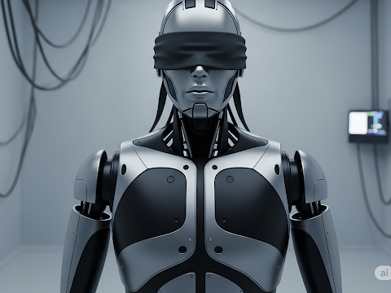
Search With No Observations
Using actions to “coerce” the world into a smaller set of known states

Slide 14
Sensorless Problems
Conformant problem: The agent has no sensors, so the environment is not observable.
Why is this useful?
Example: Doctor prescribes a broad-band antibiotic instead of performing time-consuming blood work to find a more targeted antibiotic. This saves time and money.
Basic idea: Find a solution (a plan) that works (reasonably well) from any state and then just blindly execute it.

Slide 15

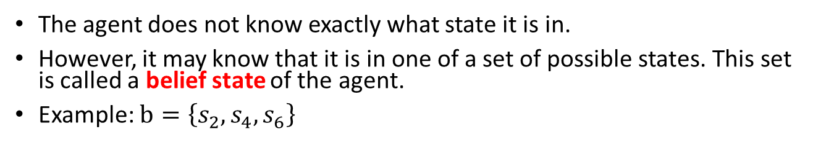

Definition: Belief State
unobservable
?
?
?
The agent does not know exactly what state it is in.
However, it may know that it is in one of a set of possible states. This set is called a belief state of the agent.
Example: $b=\left\{s_{2},s_{4},s_{6}\right\}$
$$b$$

Slide 16
Actions to Coerce the World into Known States
unobservable
?
?
?
Actions can reduce the number of possible states.
Example: Deterministic but unobservable vacuum world. The agent does not know its position or the dirt distribution.
Initial belief state {1,2,3,4,5,6,7,8}
right
Goal states

Slide 17
Actions to Coerce the World into Known States
unobservable
?
?
?
Actions can reduce the number of possible states.
Example: Deterministic but unobservable vacuum world. The agent does not know its position or the dirt distribution.
suck

Slide 18
Actions to Coerce the World into Known States
unobservable
?
?
?
Plan: The action sequence [right, suck, left, suck] coerces the world into the goal state 7. This plan works from any initial state!
Note: There are no observations, so there is no need for a conditional plan.
[right, suck, left, suck]

Slide 19
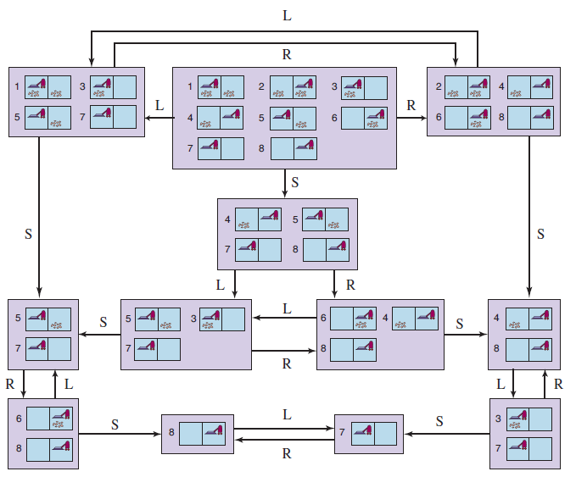
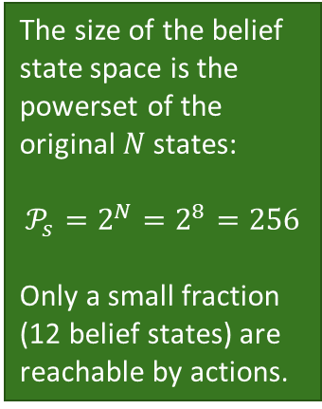
The Reachable Belief State Space
unobservable
?
?
?
The size of the belief state space is the powerset of the original $N$ states:
$$𝒫_{s}=2^{N}=2^{8}=256$$
Only a small fraction (12 belief states) are reachable by actions.
Initial belief state
No observations, so we get a solution sequence from an initial belief state:
[Right, Suck, Left, Suck]
Goal belief states

Slide 20
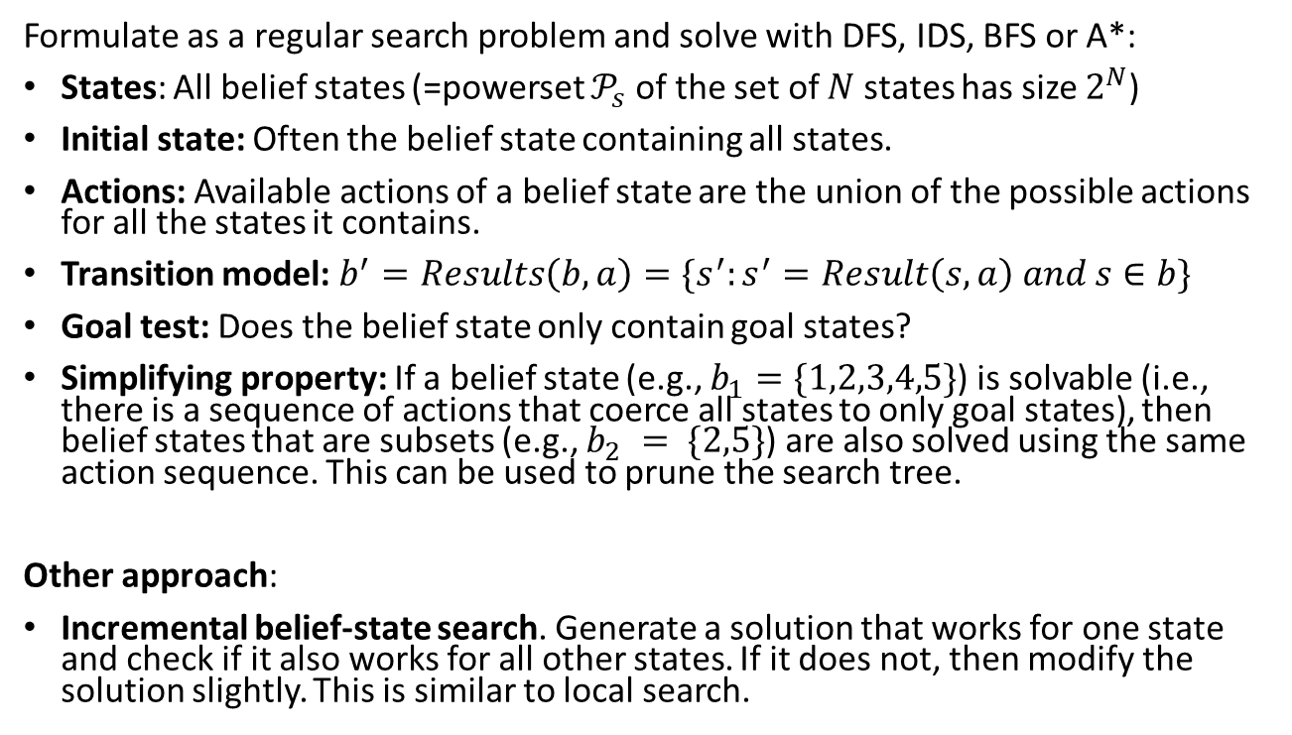
Finding a Plan
Note: State space size makes this impractical for larger problems!
Formulate as a regular search problem and solve with DFS, IDS, BFS or A*:
States: All belief states (=powerset $𝒫_{s}$ of the set of $N$ states has size $2^{N}$)
Initial state: Often the belief state containing all states.
Actions: Available actions of a belief state are the union of the possible actions for all the states it contains.
Transition model: $b^{′}=Results\left(b, a\right)=\{s^{′}:s^{′}=Result\left(s, a\right) and s∈b\}$
Goal test: Does the belief state only contain goal states?
Simplifying property: If a belief state (e.g., $b_{1}=\{1,2,3,4,5\}$) is solvable (i.e., there is a sequence of actions that coerce all states to only goal states), then belief states that are subsets (e.g., $b_{2} = \{2,5\}$) are also solved using the same action sequence. This can be used to prune the search tree.
Other approach:
Incremental belief-state search. Generate a solution that works for one state and check if it also works for all other states. If it does not, then modify the solution slightly. This is similar to local search.

Slide 21
Case Study
3m
1m
2m
x
Goal
location
The agent can move up, down right, and left.
The agent has no sensors and does not know its current location.
1. Can you navigate to the goal location? How?
2. What would you need to know about the environment?
3. What type of agent can do this?
8m
Agent
Notes:
Move 3m left and 8m up (wall stops the agent). Move 2m left and 1m down.
Dimensions of the room. Agent needs to be able to measure the distance it goes. Wall needs to stop the agent and keep it in place.
Model-based reflex agent.

Slide 22
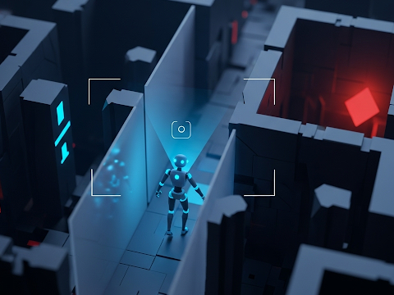
Partially Observable Environments
Using Observations to Learn About the State

Slide 23
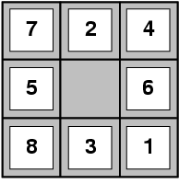
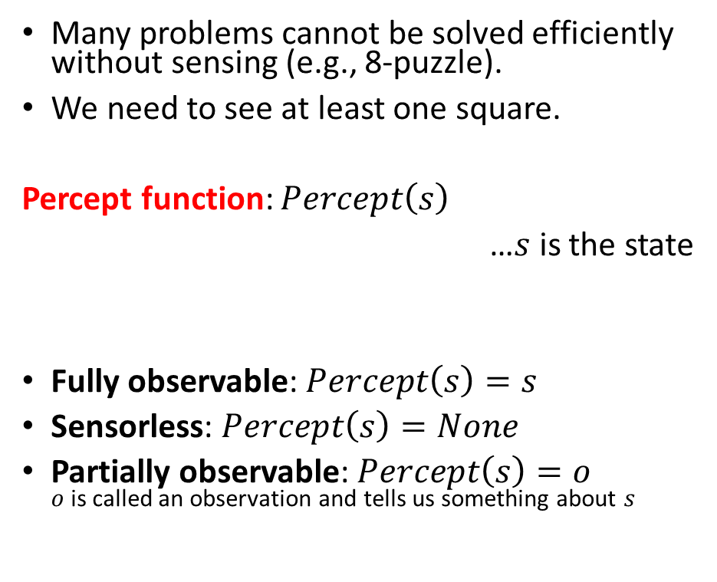
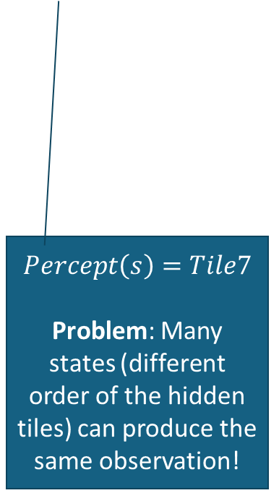
Percepts and Observability
Many problems cannot be solved efficiently without sensing (e.g., 8-puzzle).
We need to see at least one square.
Percept function: $Percept\left(s\right)$
…$s$ is the state
Fully observable: $Percept\left(s\right)=s$
Sensorless: $Percept\left(s\right)=None$
Partially observable: $Percept\left(s\right)=o$ $o$ is called an observation and tells us something about $s$
$$Percept\left(s\right)=Tile7$$
Problem: Many states (different order of the hidden tiles) can produce the same observation!

Slide 24

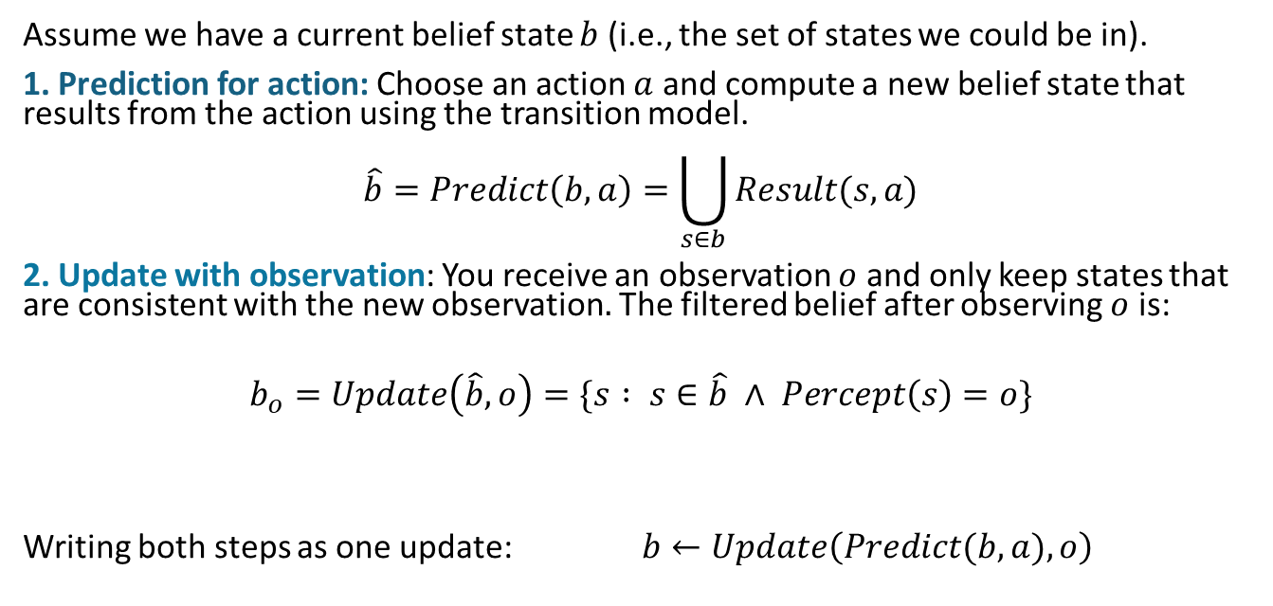
Use Observations to Learn About the State
Prediction for action $a$
Prediction for action 𝑎
Update with observation $o$
Update with observation 𝑜
$$b$$
The agents chooses an action and then receive an observation.
Idea: Observations can be used to learn about the agent’s state.
Assume we have a current belief state $b$ (i.e., the set of states we could be in).
1. Prediction for action: Choose an action $a$ and compute a new belief state that results from the action using the transition model.
$$\hat{b}=Predict\left(b,a\right)=\bigcup_{s∈b}{Result(s,a)}$$
2. Update with observation: You receive an observation $o$ and only keep states that are consistent with the new observation$.$ The filtered belief after observing $o$ is:
$$b_{o}=Update\left(\hat{b},o\right)=\{s : s∈\hat{b} ∧ Percept\left(s\right)=o\}$$
Writing both steps as one update: $b←Update\left(Predict(b,a),o\right)$

Slide 25
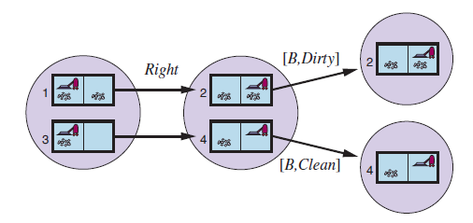
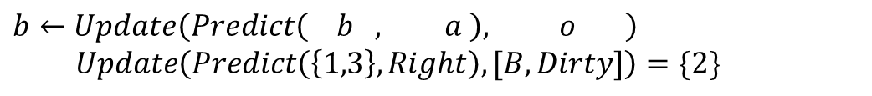
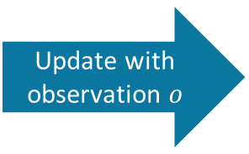
Example: Deterministic local sensing vacuum world
?
Only local dirt sensor
Prediction for action $a$
Prediction for action 𝑎
Update with observation $o$
Update with observation 𝑜
Predict for action a
Update with observation $o$
$$b$$
?
?
$$b←Update\left(Predict\left( b , a \right), o \right)$$
$$Update\left(Predict\left(\left\{1,3\right\},Right\right),[B,Dirty]\right)=\{2\}$$

Slide 26
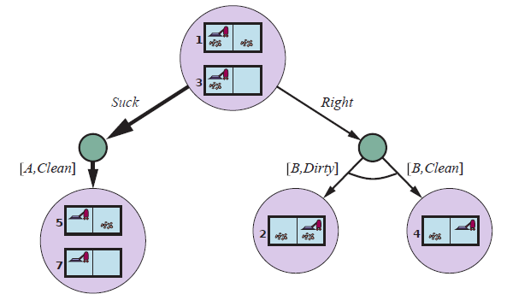
Solving Partially Observable Problems
?
Only local dirt sensor
Use an AND-OR tree of belief states to create a conditional plan.
Initial
belief state
OR
[A,Clean]
AND
[B,Dirty]
[B,Clean]
AND

Slide 27
Solving Partially Observable Problems 2
?
Only local dirt sensor
Use an AND-OR tree of belief states to create a conditional plan.
predict
Suck
Suck
OR
update
[A,Clean]
AND
[B,Dirty]
[B,Clean]
AND
Plan: [Suck, …]

Slide 28
Solving Partially Observable Problems 3
?
Only local dirt sensor
Use an AND-OR tree of belief states to create a conditional plan.
predict
OR
update
[A,Clean]
AND
[B,Dirty]
[B,Clean]
Right
AND
Right
…
Plan: [Suck, Right, …]

Slide 29
Solving Partially Observable Problems 4
?
Only local dirt sensor
Use an AND-OR tree of belief states to create a conditional plan.
predict
OR
update
[A,Clean]
AND
[B,Dirty]
[B,Clean]
AND
Suck
…
Plan: [Suck, Right, if b = {6} then Suck else []]
b = {6} is the result of the update with o = [B, Dirty]

Slide 30
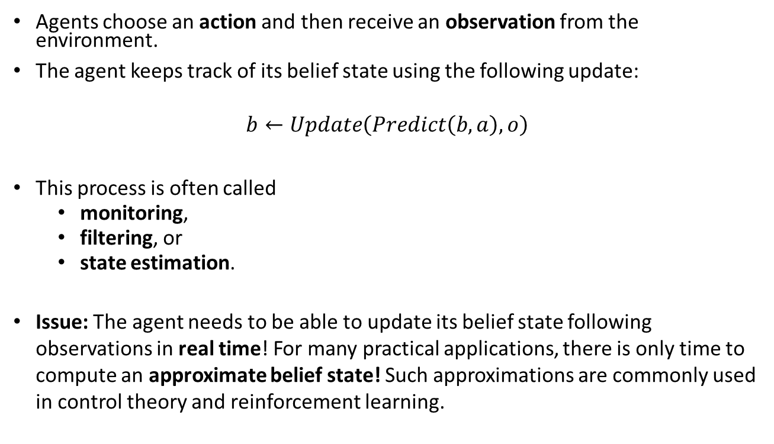
State Estimation and Approximate Belief States
Prediction for action $a$
Prediction for action 𝑎
Update with observation $o$
Update with observation 𝑜
$$b$$
Agents choose an action and then receive an observation from the environment.
The agent keeps track of its belief state using the following update:
$$b←Update\left(Predict\left(b,a\right),o\right)$$
This process is often called
monitoring,
filtering, or
state estimation.
Issue: The agent needs to be able to update its belief state following observations in real time! For many practical applications, there is only time to compute an approximate belief state! Such approximations are commonly used in control theory and reinforcement learning.

Slide 31
Environment State vs. Agent State vs. Model
The complete factored environment state description represents the true state of the world and is necessary and sufficient to apply the transition function. E.g.,
Full observability: Agent does not need to store the environment state since it is the percept. The agent may store additional information it uses to decide on the next action. E.g.,
The step in its internal “program” used to decide on the next action.
Cleaning robot: Cleaning mode vs. navigating to the charging station.
Partial observability: Agent has an agent state representing what the agent knows and uses it to decide on actions. The agent uses actions and observations to update its agent state to estimate the environment state. E.g.,
Remember prior observations that are not in the current percept: Tile A was clean at the last visit.
Estimates for unobserved fluents.
The agent’s current belief state.
Model: Is the agent’s internal knowledge about how the environment behaves. It can range from:
A simple internal variable: Cleaning mode vs. navigating to the charging station. This implicitly models the environment’s behavior that the battery will run out.
A full transition model that can predict the next state given a state and a possible action. This can be used for planning.
Information used to estimate the current state from partial observations.
Full observability
A_dirty = True
B_dirty = True
Location = A

Slide 32
Case Study: Partially Observable 8-Puzzle

Slide 33
Partially Observable 8-Puzzle
Give a problem description for this problem.
States:
Initial state:
Actions:
Transition model:
Goal test:
Percept function:
This problem can be solved using an AND-OR Tree, but is there an easier solution?
What type of agents would we use?
What algorithms can be used?
Notes:
Like the observable problem, but the percept function is Percept(s) = top-left corner tile.
Cycle all tiles through the window and remember what they are. Now it is a completely observable problem.
a) Model-based reflex agent (memory is used to keep track of hidden tiles)
B ) First a simple algorithm that moves all tiles through the window. Then use a regular search tree.

Slide 34

Exploration
Unknown Environments and Online Search

Slide 35
Recap: Offline Search
Offline search aka planning: Create a plan using the state space and the transition model before taking any action.
The plan can be
a sequence of actions, or
a conditional plan that uses observations to account for uncertainty or imperfect observability.
The agent plans using search with the known transition function to predict the consequence of actions.
Issue: In an unknown environment, we do not know the transition function.
We cannot predict outcomes of actions; therefore, we cannot plan using offline search!

Slide 36
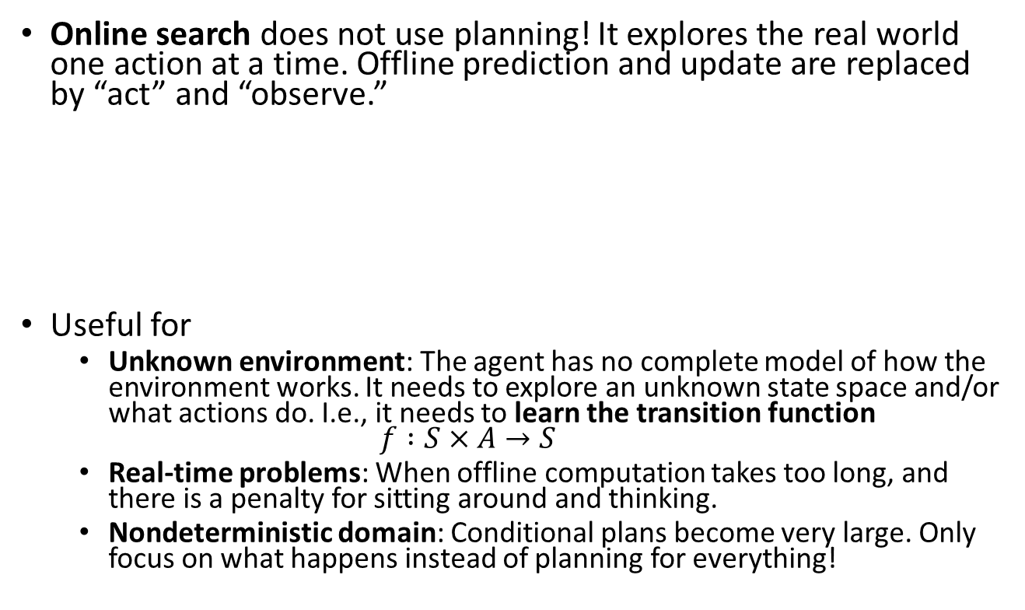
Online Search
Online search does not use planning! It explores the real world one action at a time. Offline prediction and update are replaced by “act” and “observe.”
Useful for
Unknown environment: The agent has no complete model of how the environment works. It needs to explore an unknown state space and/or what actions do. I.e., it needs to learn the transition function $f :S×A→S$
Real-time problems: When offline computation takes too long, and there is a penalty for sitting around and thinking.
Nondeterministic domain: Conditional plans become very large. Only focus on what happens instead of planning for everything!
Act
Observe
Observe
Act
Act
…

Slide 37
Design Considerations for Online Search
Knowledge: What does the agent already know about the outcome of actions? E.g.,
Does go north and then south lead to the same location?
Where are the walls in the maze?
Often a part or all of the transition function is unknown!
We need a safely explorable state space/world: There are no irreversible actions (e.g., traps, cliffs) or the agent needs to be able to avoid these actions during exploration using percepts.
Exploration order is important: Expanding nodes in local order (= close by) is more efficient if you must execute the actions to get observations: Use depth-first search with backtracking instead of BFS or A* Search.
Transition function

Slide 38
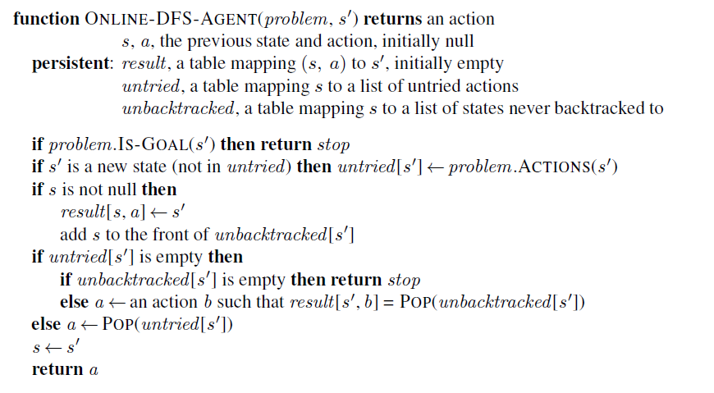
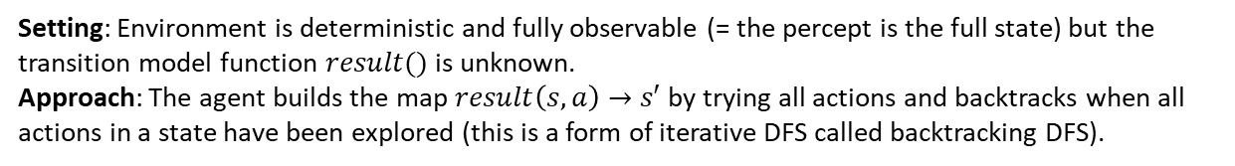
Online Search: A Model-based Reflex Agent to Learn the Transition Model
Setting: Environment is deterministic and fully observable (= the percept is the full state) but the transition model function $result()$ is unknown.
Approach: The agent builds the map $result\left(s, a\right)→s′$ by trying all actions and backtracks when all actions in a state have been explored (this is a form of iterative DFS called backtracking DFS).
Learn the result function (= transition function)
Untried is the “frontier”
a stack with the current path
Unbacktracked stores the current path
Record found transitions
Keep breadcrumbs to go back later
Use breadcrumbs to walk back

Slide 39

Case Study: DFS with Backtracking for an unknown Maze
Unbacktracked (= current path)
We don’t have a map (transition function) of the maze. We can only see adjacent squares.
We cannot plan, so we must explore by walking around!
A simple method is backtracking DFS that only stores the current path for backtracking (on a stack) to get back to untied actions when we run into a dead end (think leaving breadcrumbs or a string).
This is an iterative implementation of DFS without a reached data structure. Unbacktaced represents the currently explored path, and untried represents the frontier. DFS memory management applies.
Agent
Start
untried (~ frontier)
The transition function is unknown.

Slide 40

Important concepts that you should be able to explain and use now…
Difference between solution types:
a fixed action sequence (a plan),
a conditional plan (also called a strategy or policy), and
exploration.
What are belief states?
How actions can be used to coerce the world into known states.
How actions and observations (from percept functions) can be used to learn about the state: State estimation with repeated predict and update steps.
The use of AND-OR trees to solve small problems.
Large problems are hard!

