Slide 1
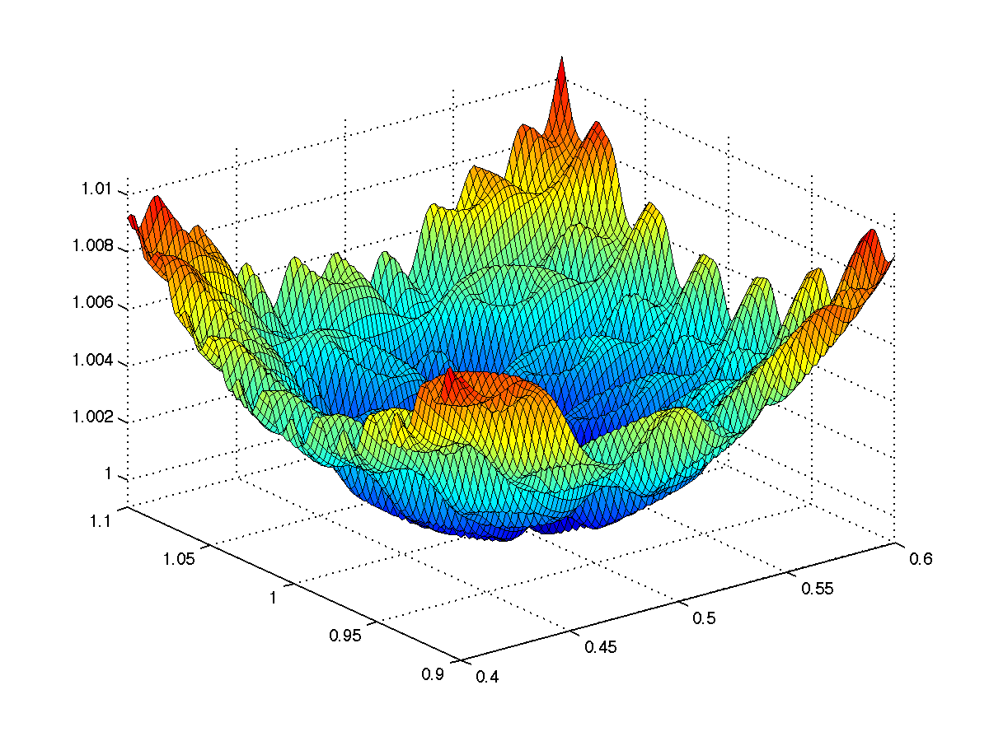


CS 5/7320 Artificial Intelligence Local Search AIMA Chapters 4.1 & 4.2
Slides by Michael Hahsler based on slides by Svetlana Lazepnik with figures from the AIMA textbook.
This work is licensed under a Creative Commons Attribution-ShareAlike 4.0 International License.
Online Material

Slide 2
Contents
What is Local Search?
Hill-Climbing Search
Simulated Annealing
Evolutionary Algorithms
Search in Continuous Spaces

Slide 3

Recap: Uninformed and Informed Search
Tries to plan the
best path
from a
given initial state
to a
given goal state.
Often comes with completeness and optimality guarantees (BFS, A* Search, IDS).
Issue: Typically have to search a large portion of the search space and therefore need a lot of time and memory.
Initial state
Goal state

Slide 4
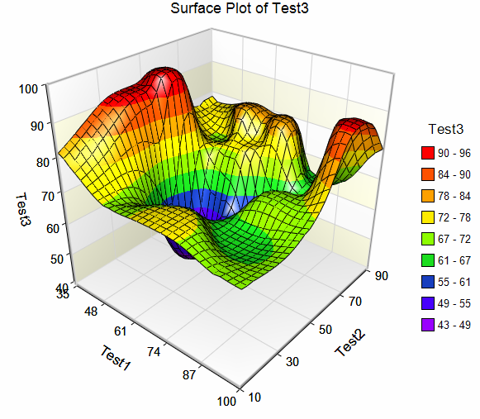
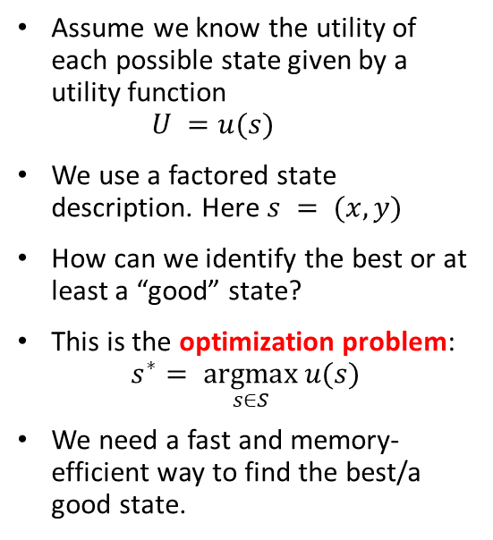
Local Search
Local improvement move from state to state
Assume we know the utility of each possible state given by a utility function $U =u(s)$
We use a factored state description. Here $s = (x, y)$
How can we identify the best or at least a “good” state?
This is the optimization problem: $s^{∗}= \underset{s∈S}{argmax}{u(s)}$
We need a fast and memory-efficient way to find the best/a good state.
x
x
Utility U
y
x
Idea:
Start with a current solution (a state) and improve the solution by moving from the current state to a “neighboring” better state (a.k.a. performing a series of local moves).

Slide 5
Main Differences to Tree Search
The goal states are unknown, but we know or can calculate the utility for each state. We want to identify a high-utility state.
Often, no explicit initial state is given, and the path to the goal and the path cost are not important.
No search tree. Just stores the current state and moves to a “better” state if possible. Needs little memory and only requires very simple code.

Slide 6
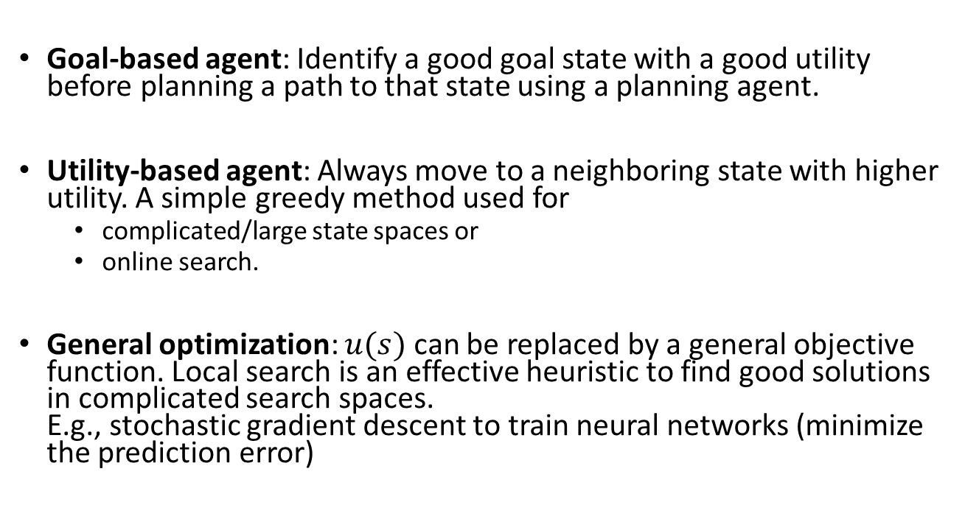
Use of Local Search in AI
Goal-based agent: Identify a good goal state with a good utility before planning a path to that state using a planning agent.
Utility-based agent: Always move to a neighboring state with higher utility. A simple greedy method used for
complicated/large state spaces or
online search.
General optimization: $u(s)$ can be replaced by a general objective function. Local search is an effective heuristic to find good solutions in complicated search spaces. E.g., stochastic gradient descent to train neural networks (minimize the prediction error)

Slide 7
Defining A Local Search Problem
State space: How large is the state space?
State representation: How do we define a factored state representation?
Objective function: What is a possible utility function given the state representation?
Local neighborhood: What states are close to each other?
Replaces the goal state
Replaces the transition function.

Slide 8



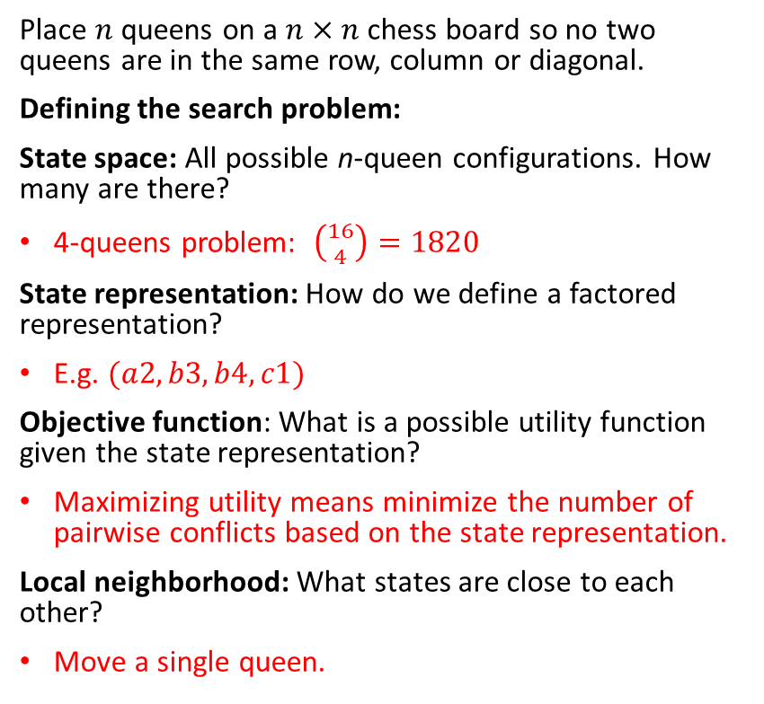
Example: n-Queens Problem
2 conflicts = utility of -2
4
3
2
1
Place $n$ queens on a $n×n$ chess board so no two queens are in the same row, column or diagonal.
Defining the search problem:
State space: All possible n-queen configurations. How many are there?
4-queens problem: $\left({16 \atop 4}\right)=1820$
State representation: How do we define a factored representation?
E.g. $(a2, b3, b4, c1)$
Objective function: What is a possible utility function given the state representation?
Maximizing utility means minimize the number of pairwise conflicts based on the state representation.
Local neighborhood: What states are close to each other?
Move a single queen.
Local move
a b c d
0 conflicts = utility of 0
Has its optimum at the goal state. Similar to a heuristic in A* search. No need to be admissible.

Slide 9
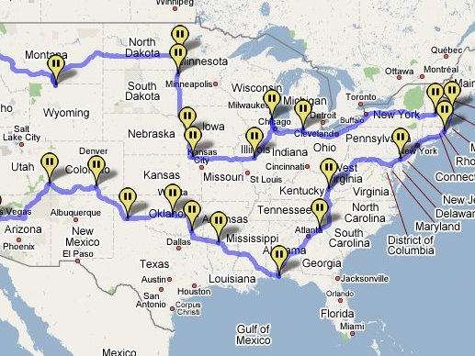
Example: Traveling salesman problem
Find the shortest tour connecting a given set of cities
State space: all possible tours (states are not individual cities!)
State representation: Order of cities in the tour.
Objective function: minimize the length of the tour.
Local neighborhood: Change the order of visiting a few cities.
Note: We have solved a different problem with uninformed/informed search! Each city was defined as a state and the path was the solution.

Slide 10
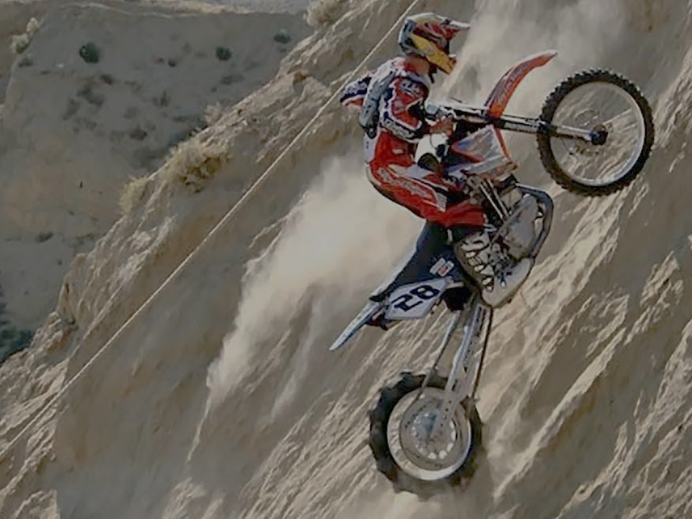
Hill-Climbing Search aka Greedy Local Search
Idea: keep a single “current” state and try to find better neighboring states.
MotorCycleUSA.com

Slide 11
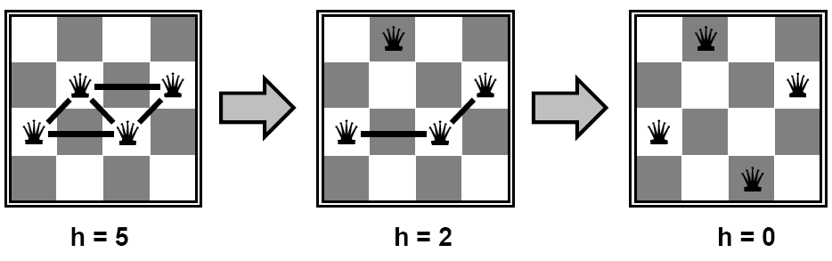
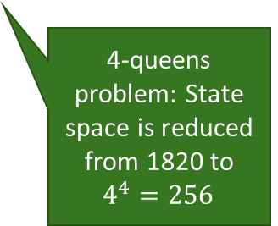
Example: n-Queens Problem
Goal: Put n queens on an n × n board with no two queens on the same row, column, or diagonal. State space: all possible n-queen configurations. We can restrict the state space: Only one queen per column.
State representation: row position of each queen in its column (e.g., 2, 3, 2, 3)
Objective function: minimize the number of pairwise conflicts.
Local neighborhood: Move one queen anywhere in its column.
Improvement strategy
Find a local neighboring state (move one queen within its column) to reduce conflicts.
4-queens problem: State space is reduced from 1820 to $4^{4}=256$
4
3
2
1

Slide 12
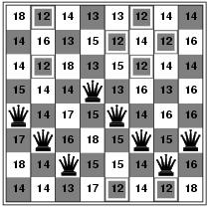

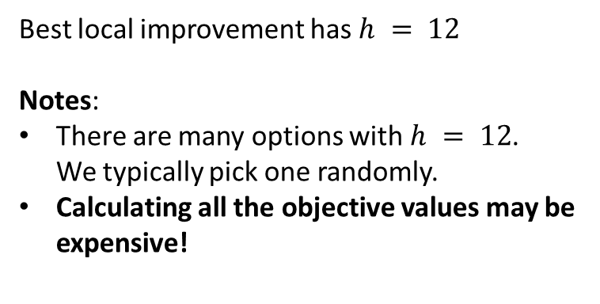
Example: n-Queens Problem 2
Find the best local move: Evaluate the objective function for all local neighbors (moving a single queen in its column while leaving the others in place).
Objective value after moving the queen in column 1 to this square
Best local improvement has $h = 12$ Notes:
There are many options with $h = 12$. We typically pick one randomly.
Calculating all the objective values may be expensive!
Current objective value: $h = 17$

Slide 13
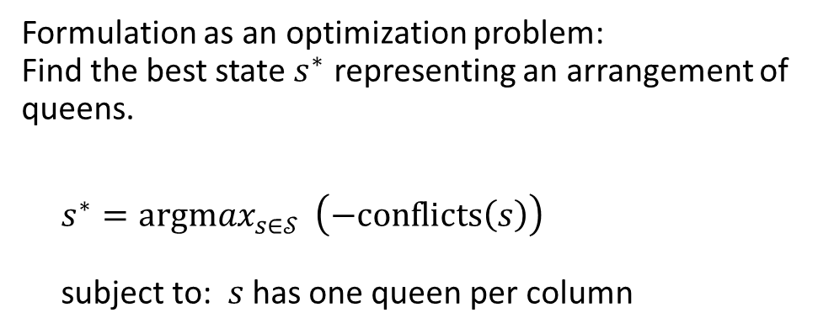
Example: n-Queens Problem 3
Formulation as an optimization problem: Find the best state $s^{∗}$ representing an arrangement of queens.
$s^{∗}={argmax}_{s∈𝒮 } \left(−conflicts\left(s\right)\right)$ subject to: $s$ has one queen per column
Remember: This makes the problem a lot easier.

Slide 14

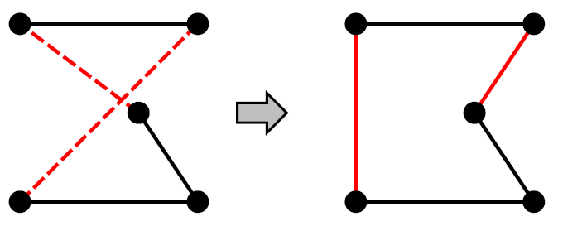
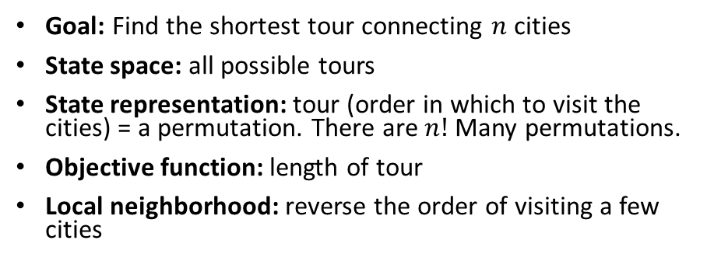
Example: Traveling Salesman Problem 2
Goal: Find the shortest tour connecting $n$ cities
State space: all possible tours
State representation: tour (order in which to visit the cities) = a permutation. There are $n!$ Many permutations.
Objective function: length of tour
Local neighborhood: reverse the order of visiting a few cities
Local move to reverse the order of cities C, E and D:
A
B
A
B
C
C
D
E
D
E
State representation (permutation):
ABDEC
ABCED

Slide 15
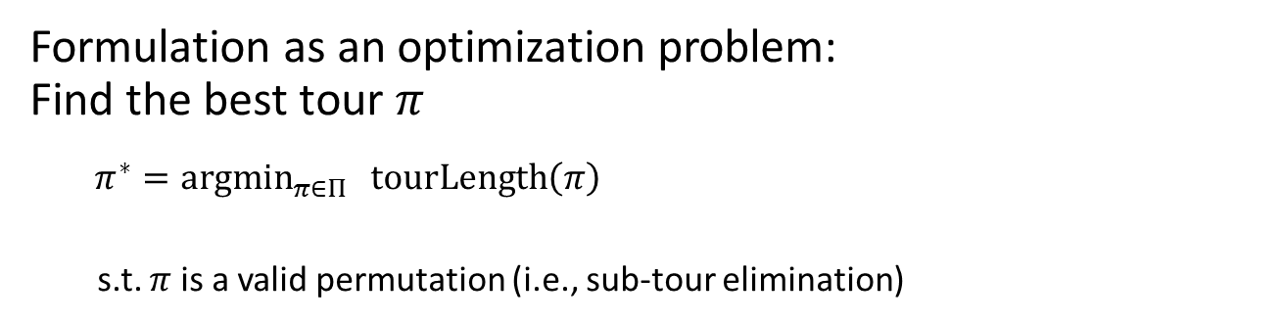
Example: Traveling Salesman Problem 3
Formulation as an optimization problem: Find the best tour $π$
${π^{∗}=argmin}_{π∈Π } tourLength\left(π\right)$
s.t. $π$ is a valid permutation (i.e., sub-tour elimination)
Local move to reverse the order of cities C, E and D:
A
B
A
B
C
C
D
E
D
E
State representation:
ABDEC
ABCED

Slide 16
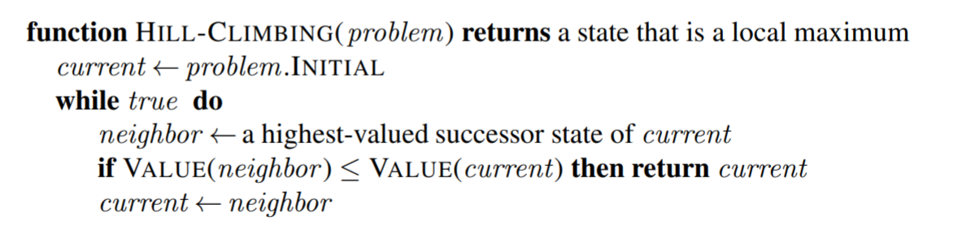
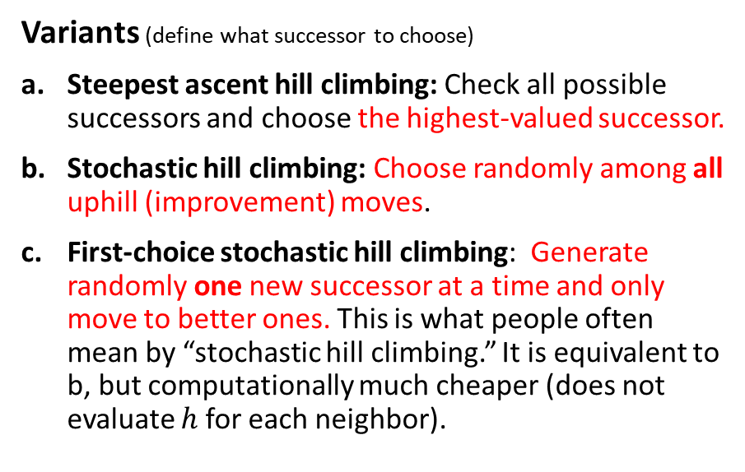

Hill-Climbing Search (Greedy Local Search)
Maximization
We often start with a random state
Use lowest-valued successor and $≥$for minimization
Variants (define what successor to choose)
Steepest ascent hill climbing: Check all possible successors and choose the highest-valued successor.
Stochastic hill climbing: Choose randomly among all uphill (improvement) moves.
First-choice stochastic hill climbing: Generate randomly one new successor at a time and only move to better ones. This is what people often mean by “stochastic hill climbing.” It is equivalent to b, but computationally much cheaper (does not evaluate $h$ for each neighbor).
Minimization
$$h = 17$$

Slide 17
Local Optima

Slide 18
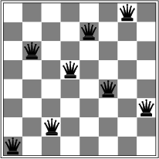
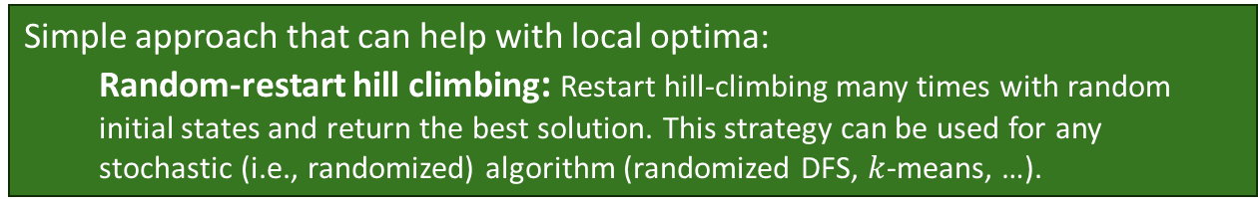

Local Optima
Hill-climbing search is greedy (like greedy best-first search) with the objective function as a typically not admissible heuristic. It only stores the current state (has no frontier data structure) and just stops at a dead end.
Is it complete/optimal?
For local search optimality and complete mean the same thing!
No – can get stuck in local optima.
Example: local optimum for the 8-queens problem. No single queen can be moved within its column to improve the objective function.
$$h = 1$$
Simple approach that can help with local optima:
Random-restart hill climbing: Restart hill-climbing many times with random initial states and return the best solution. This strategy can be used for any stochastic (i.e., randomized) algorithm (randomized DFS, $k$-means, …).

Slide 19
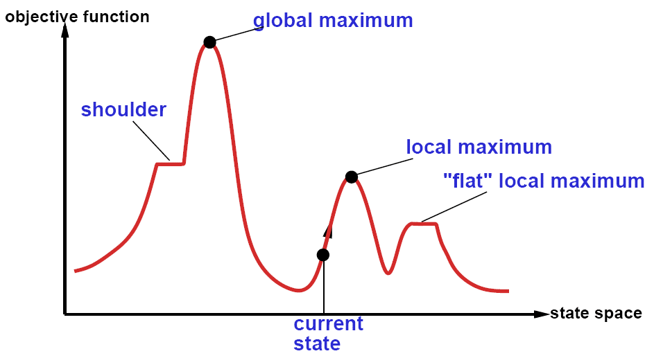


The State Space “Landscape”
Maximization
$$u\left(s\right)$$
$$s$$
Neighbors placed next to each other
How to escape local maxima?
→ Random restart hill-climbing can help.
What about “shoulders” (called “ridges” in higher-dimensional spaces)?
→ Hill-climbing that allows sideways moves and uses momentum.

Slide 20
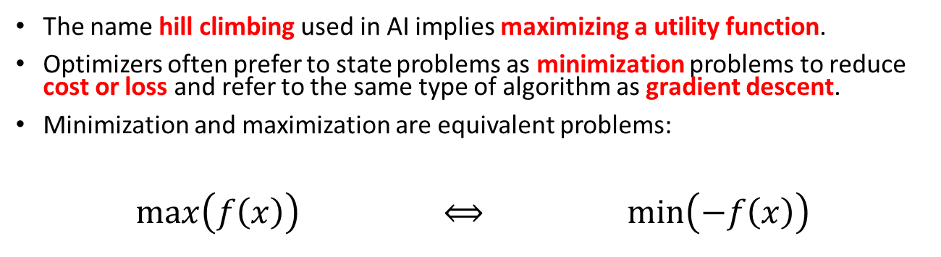
Minimization vs. Maximization
The name hill climbing used in AI implies maximizing a utility function.
Optimizers often prefer to state problems as minimization problems to reduce cost or loss and refer to the same type of algorithm as gradient descent.
Minimization and maximization are equivalent problems:
$\max\left(f\left(x\right)\right)$ $⟺$ $\min\left(−f\left(x\right)\right)$

Slide 21
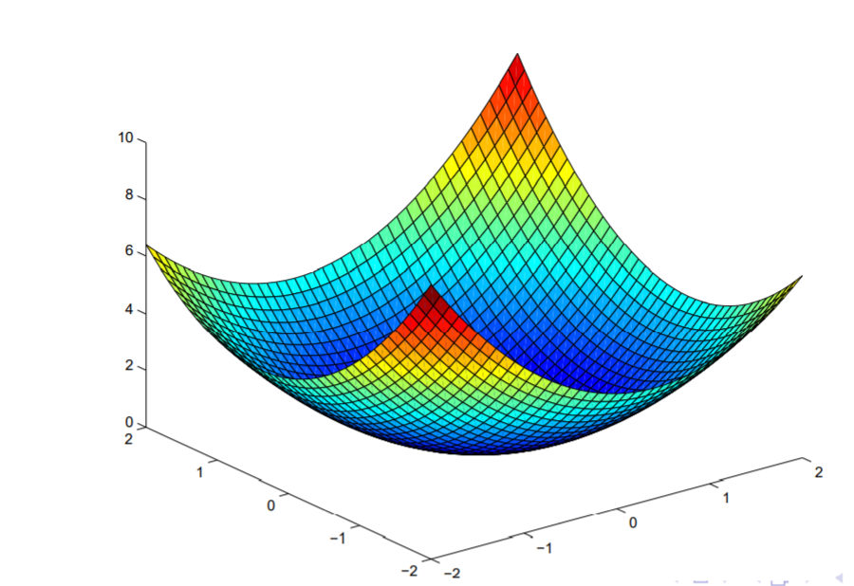
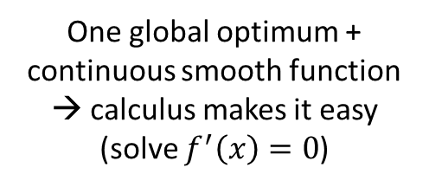
Convex vs. Non-Convex Optimization Problems
Minimization
Convex Problem
Non-convex Problem
One global optimum + continuous smooth function → calculus makes it easy (solve $f^{′}\left(x\right)=0$)
Many local optima → hard
Many AI problems are in addition discrete (the objective function is not differentiable). We often have to settle for a local optimum.

Slide 22
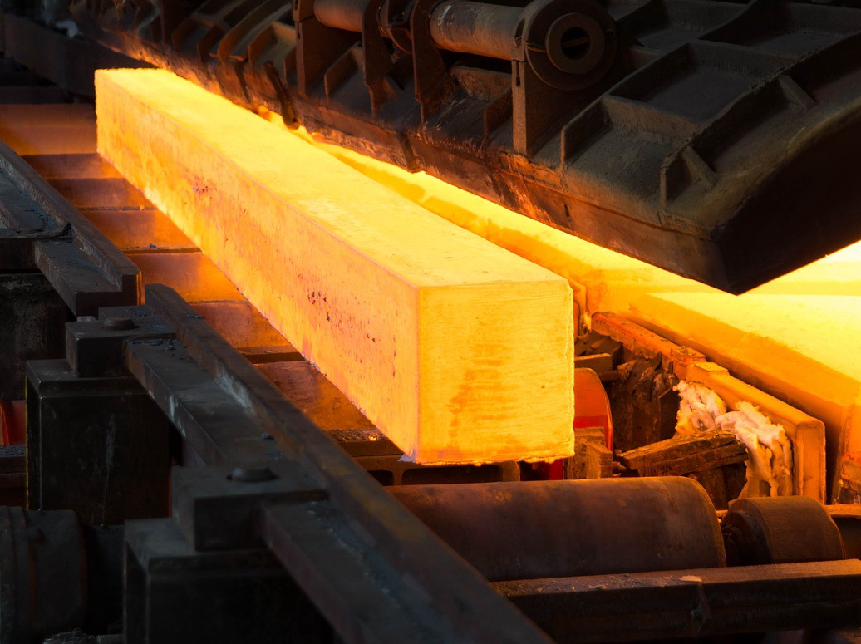
Simulated Annealing
Using heat to escape local optima…

Slide 23
Idea of Simulated Annealing
Use first-choice stochastic hill climbing + escape local minima by allowing some “bad” moves but gradually decreasing their frequency.
Inspired by the process of controlled cooling of glass or metals. Decreasing the temperature means decreasing the chance of accepting bad moves.
Minimization
Initial “bad” local move
Objective function
State space

Slide 24
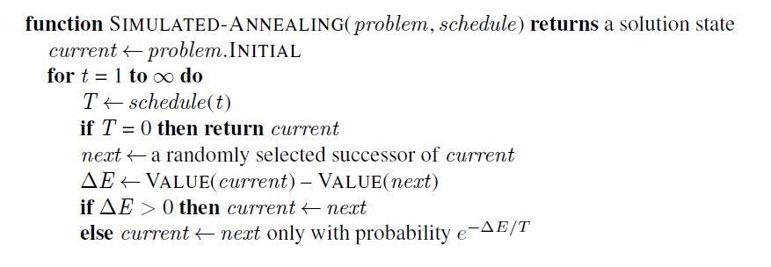
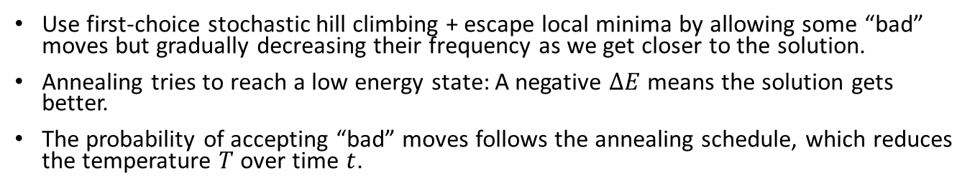

Simulated Annealing Algorithm
Use first-choice stochastic hill climbing + escape local minima by allowing some “bad” moves but gradually decreasing their frequency as we get closer to the solution.
Annealing tries to reach a low energy state: A negative $ΔE$ means the solution gets better.
The probability of accepting “bad” moves follows the annealing schedule, which reduces the temperature $T$ over time $t$.
Maximization
Typically, we start with a random state
Always accept good moves that reduce the energy.
if $ΔE≤ 0$ then
Accept “bad” moves with a probability inspired by the acceptance criterion in the Metropolis–Hastings MCMC algorithm.
Note: Use $VALUE(next) – VALUE(current)$for minimization

Slide 25
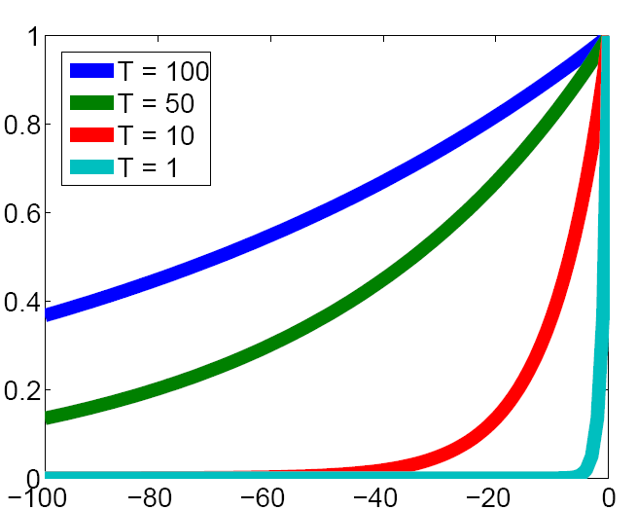
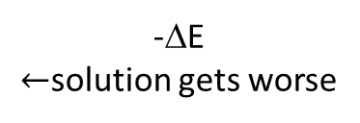
The Effect of Temperature
Convert the changes due to “bad” moves into an acceptance probability depending on the temperature. The criterion uses the negative part of the exponential function.
Prob. of accepting a worse state exp(-ΔE/T)
-ΔE $←$solution gets worse

Slide 26
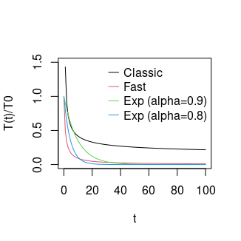
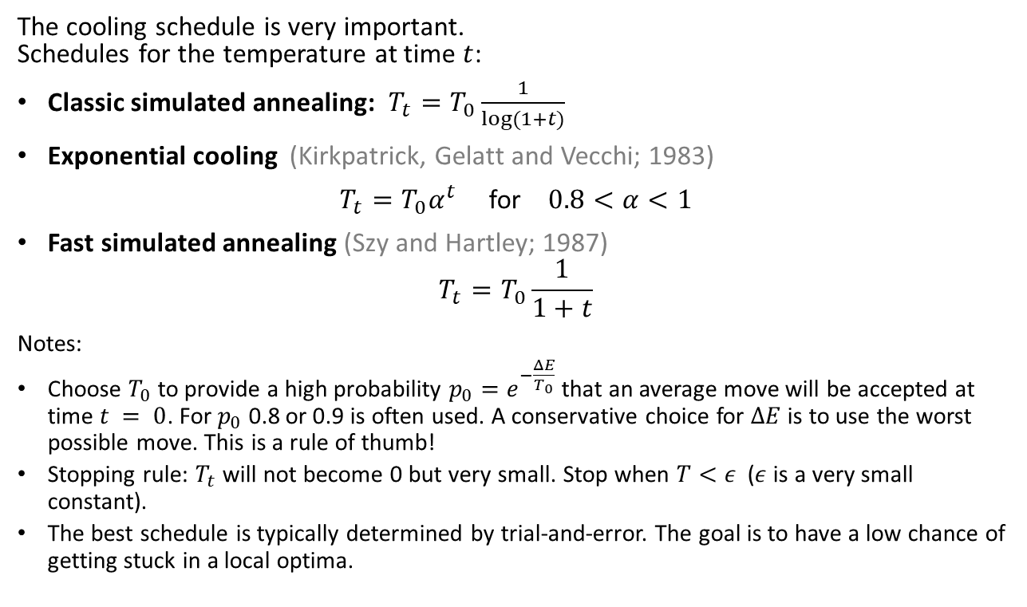
Cooling Schedule
The cooling schedule is very important. Schedules for the temperature at time $t$:
Classic simulated annealing: $T_{t}=T_{0}\frac{1}{log⁡(1+t)}$
Exponential cooling (Kirkpatrick, Gelatt and Vecchi; 1983)
$T_{t}=T_{0}α^{t}$ for $0.8<α<1$
Fast simulated annealing (Szy and Hartley; 1987)
$$T_{t}=T_{0}\frac{1}{1+t}$$
Notes:
Choose $T_{0}$ to provide a high probability $p_{0}=e^{−\frac{ΔE}{T_{0}}}$that an average move will be accepted at time $t = 0$. For $p_{0}$ 0.8 or 0.9 is often used. A conservative choice for $ΔE$is to use the worst possible move. This is a rule of thumb!
Stopping rule: $T_{t}$ will not become 0 but very small. Stop when $T<ε$ ($ε$ is a very small constant).
The best schedule is typically determined by trial-and-error. The goal is to have a low chance of getting stuck in a local optima.
This is the most popular choice!

Slide 27
Simulated Annealing Search
Guarantee
If the temperature is decreased slowly enough (using the classic cooling schedule), then simulated annealing search will find a global optimum with a probability approaching one.
However, this schedule takes too long and thus is impractical.
Practical solution
Accept suboptimal results and determine the best cooling schedule and local move need experimentally.

Slide 28
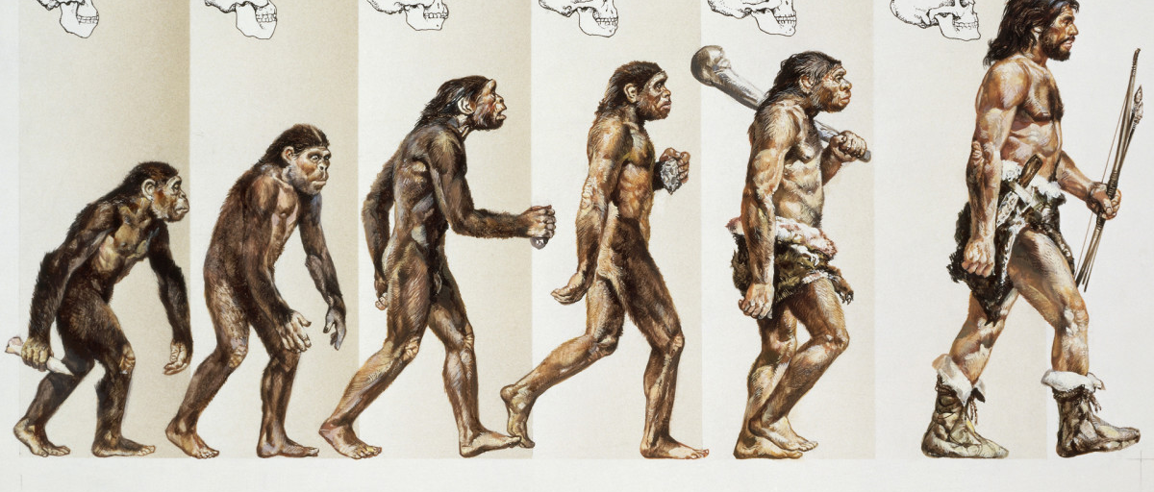
Evolutionary Algorithms
A Population-based Metaheuristics

Slide 29
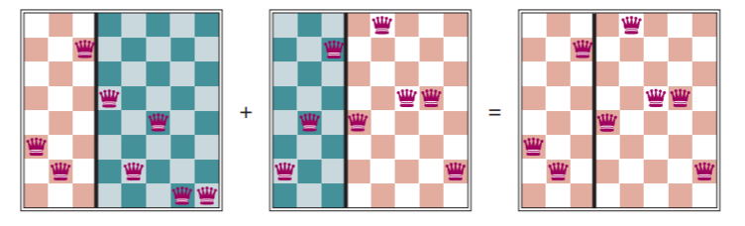
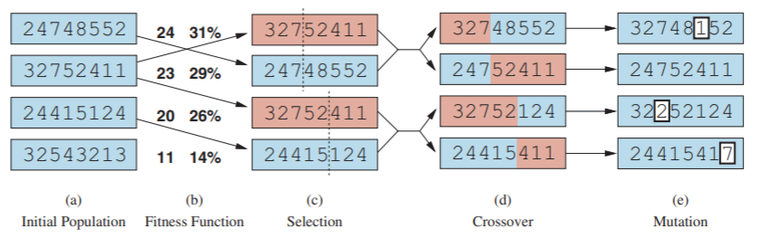
Evolutionary Algorithms / Genetic Algorithms
A metaheuristic for population-based optimization.
Uses mechanisms inspired by biological evolution (genetics):
Reproduction: Random selection with probability based on a fitness function.
Random recombination (crossover)
Random mutation
Repeated for many generations
Example: 8-queens problem
8
7
6
5
4
3
2
1
Individual = state representation as a chromosome: row of the queen in each column
next generation

Slide 30
Search in Continuous Spaces

Slide 31
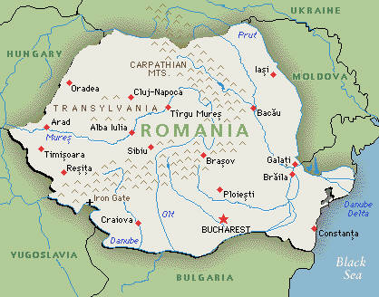
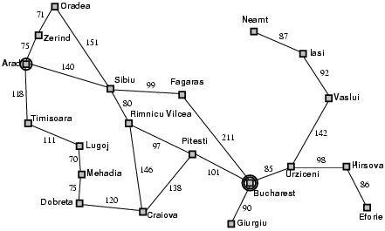


Methods: Discretization of Continuous Space
Use atomic states and create a graph as the transition function.
Use a grid with spacing of size $δ$
Note: You probably need a way finer grid!
$$δ$$
y
x

Slide 32
Example: Discretization of Continuous Space
How did we discretize this space?
Initial state
Goal state
Discretization grid

Slide 33
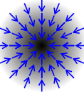





Search in Continuous Spaces: Gradient Descent
$$f(x)$$
State representation: $x= \left(x_{1},x_{2},…,x_{k}\right)$
State space size: infinite
Objective function: min $f\left(x\right)$
Local neighborhood: small changes in $x_{1},x_{2},…,x_{k}$
Gradient at point $x$: $∇f\left(x\right)= \left(\frac{∂f\left(x\right)}{∂x_{1}}, \frac{∂f\left(x\right)}{∂x_{2}}\text{, …, }\frac{∂f\left(x\right)}{∂x_{k}}\right)$ (=evaluation of the Jacobian matrix at $x$)
Find optimum by solving: $∇f\left(x\right)=0$
Gradient descent (= Steepest-ascend hill climbing for minimization) with step size $α$ (typically reduced over time)
Repeat: $x←x−α∇f\left(x\right)$
Newton-Raphson method uses the inverse of the Hessian matrix (second-order partial derivative of $f\left(x\right)$) $H_{ij}=\frac{∂^{2}f}{∂x_{i}∂x_{j}}$ as the optimal step size
Repeat: $x←x−H_{f}^{−1}(x)∇f\left(x\right)$
Note: May get stuck in a local optimum if the search space is non-convex! Use simulated annealing, momentum or other methods to escape local optima.
$$x_{1}$$
$$x_{2}$$
$$∇f\left(x\right)$$

Slide 34
Search in Continuous Spaces: Stochastic Gradient Descent
Issue: What if the mathematical formulation of the objective function is not known? We cannot find an equation for the gradient!
Idea: We may have objective function values at fixed points, called the training data. Can we approximate the gradient?
Remember: Stochastic hill climbing uses random local moves. If the training data are a random sample, then we can use some of them to approximate the gradient.
Algorithm: The resulting algorithm is called stochastic gradient descent (SGD). It is called stochastic because it uses a random sample (the training data) to decide on the next local move.
→ We will discuss search in continuous spaces with loss functions using gradient descent when we discuss parameter learning for learning from examples (machine learning).

Slide 35

Conclusion
Local search provides a fast method to find good solutions to many difficult optimization problems.
Local optima are a big issue that can be addressed with random restarts and simulated annealing.

