Slide 1
Australian residential properties analysis using python
Presented by: Python Noobs

Slide 2
contents
Hypothesis
Questions
Data Extraction – Ankita Puri
Data Cleanup and initial visualization – Snehitha Soma
Price analysis – France Guieb
Further analysis – Kritika Chaudhary
Git collaboration – Minh Phan
Postmortem

Slide 3
Hypothesis
SCOPE
Residential properties sales recorded in major cities in Australia (except Darwin and Hobart) from Sep 2018 to Jul 2020.
HYPOTHESIS
Three-bedroom properties have the highest number of properties sold from Sep 2018 to Jul 2020
NULL HYPOTHESIS
Properties with three bedrooms were not the most-sold property from Sep 2018 to Jul 2020.

Slide 4
Questions
The highest number of properties sold in terms of:
Australian city
Top 10 suburbs for Victoria
Property type (House, Townhouse, Unit)
Quarterly analysis - 2019
What does 3-BR residential property price look like in relation to the rest of the data throughout this period?
How much value does an additional BR add to a property for Victoria?

Slide 5

Extraction of Data by calling Kaggle API

Slide 6
Steps for calling Kaggle API to get Dataset
Install Kaggle Python module
Generate API token and save on local machine
Call Kaggle API to find Kaggle list of Datasets
Download the selected dataset via {Kaggle.datasets.download –d ‘datasetName’}
Read the unzipped dataset file via Pandas

Slide 7
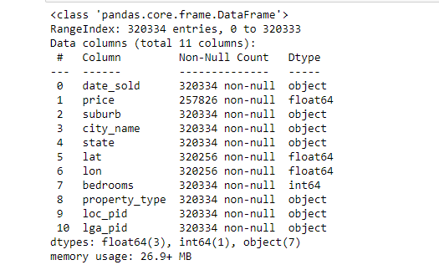
Cleanse data
Remove data have “NULL” value

Slide 8
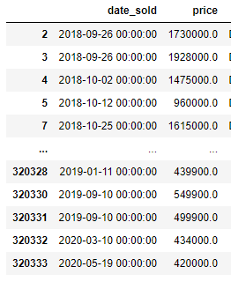
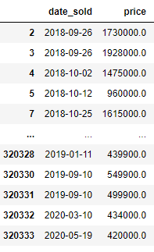
Convert date & time stamp to date

Slide 9
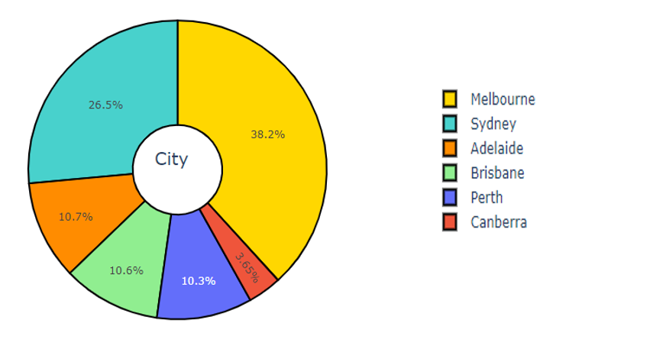
Residential properties sold in by city

Slide 10
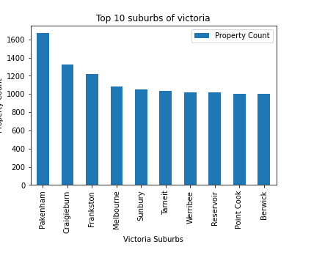
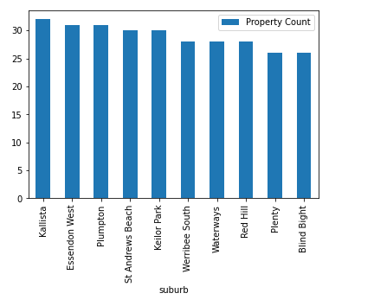
Residential properties sold in Greater Melbourne

Slide 11
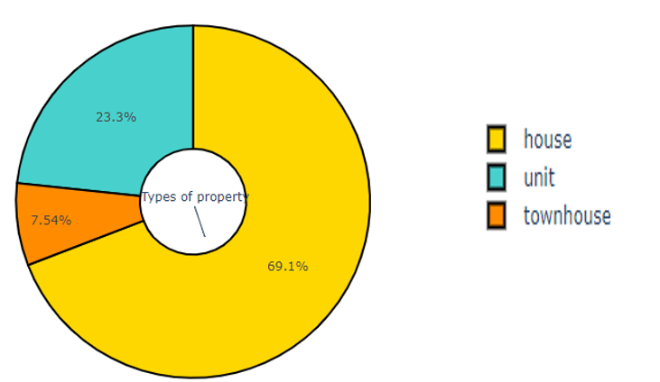
Distribution of property types

Slide 12
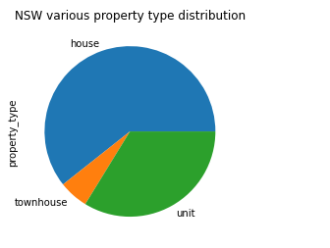
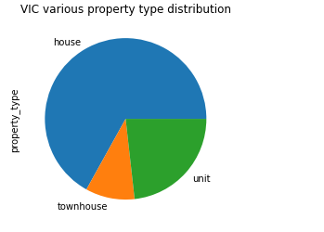
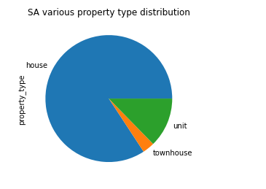
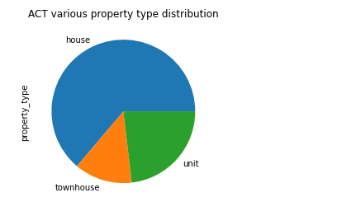
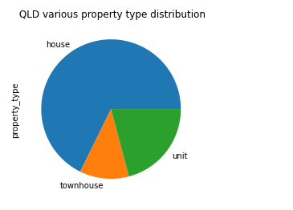
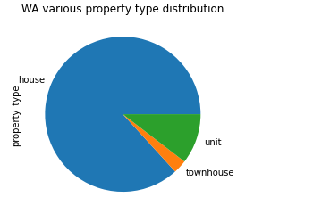
Property type distribution for all the states
Notes:
House - Pros: more space, outdoor space, more privacy and flexibility
Unit/Apartment – Pros: cheaper, more secure, low maintenance, amenities
Townhouse: more space than apartment, privacy, price

Slide 13
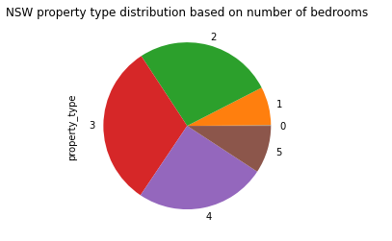
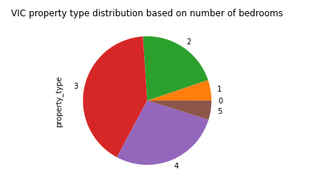
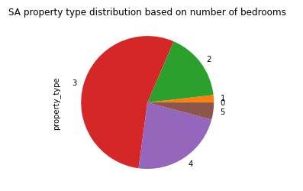
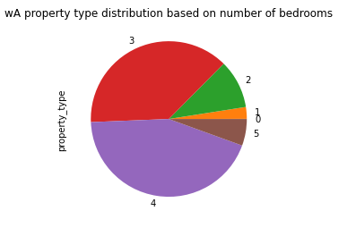
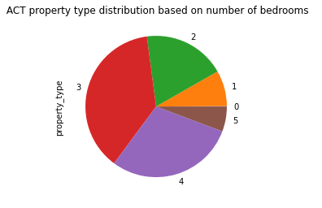
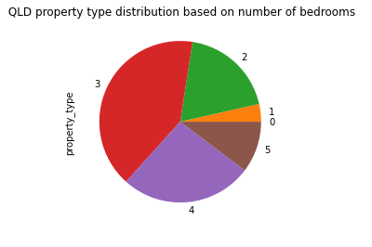
Property distribution for all the states based on number of bedrooms
Notes:
Can be used in PRICE analysis to support

Slide 14
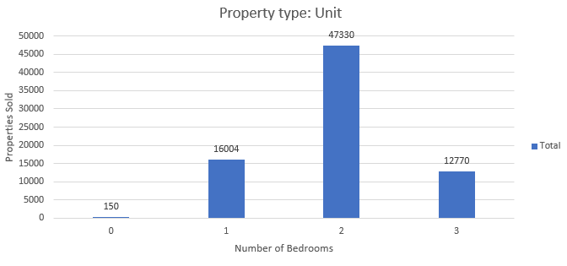
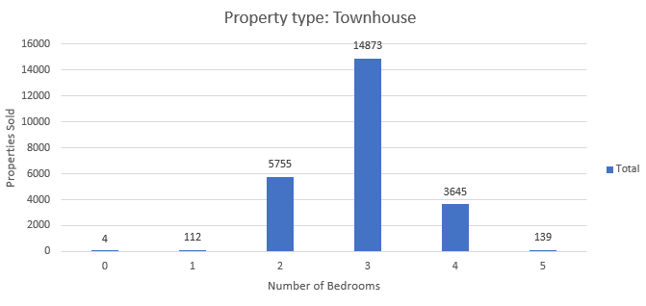
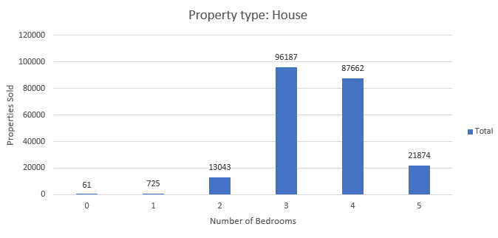
Property type vs Number of bedrooms sold:
Property types VS Number of bedrooms

Slide 15
QUARTERLY ANALYSIS FOR YEAR 2019

Slide 16
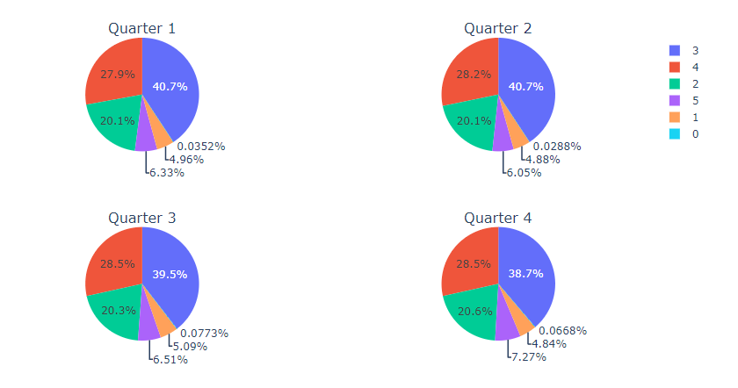
Analysis on sales with different number of bedrooms in the properties for each quarter of 2019

Slide 17
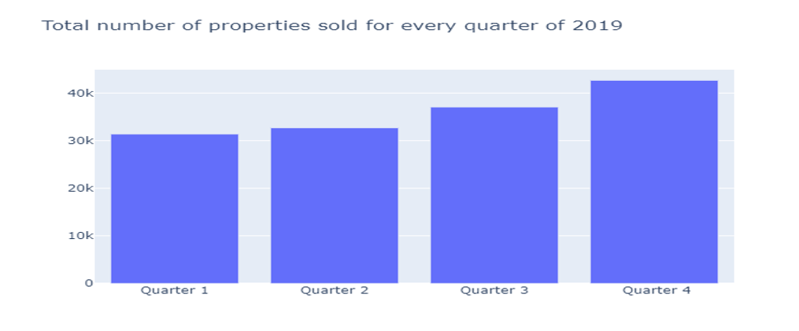
Number of properties sold in 2019
Analysis on number of properties sold for each quarter of 2019

Slide 18
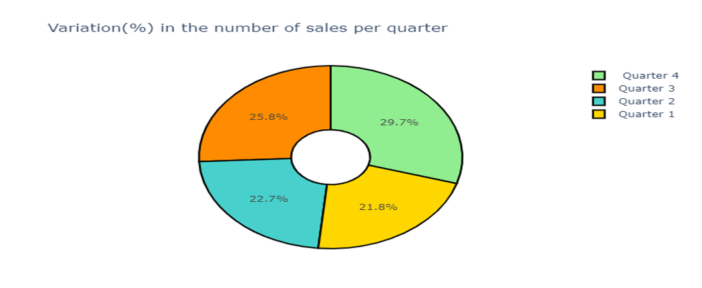
Total sales for every quarter of 2019

Slide 19
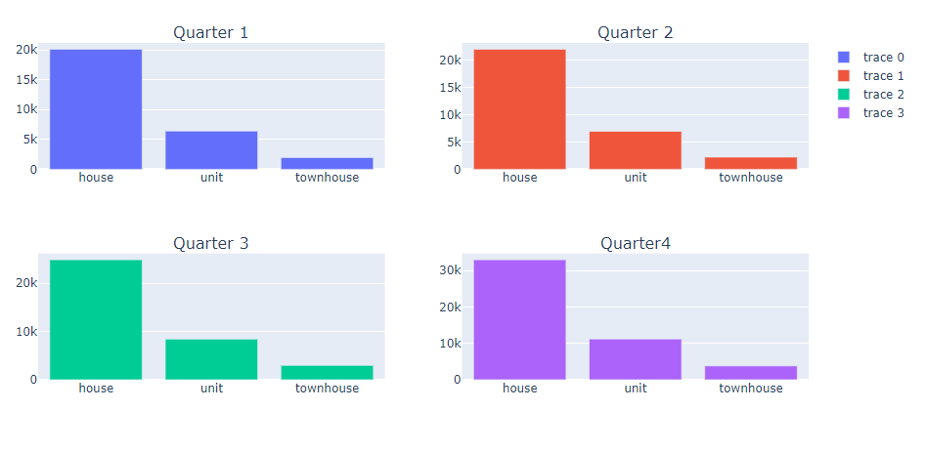
Properties type sold in 2019
Analysis on sales with different types of properties for all the quarters of 2019

Slide 20
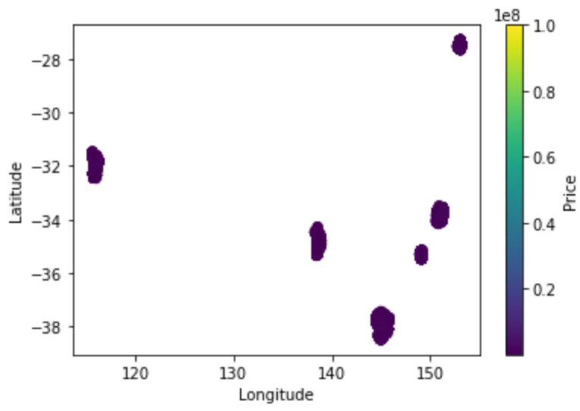
Location v Price

Slide 21
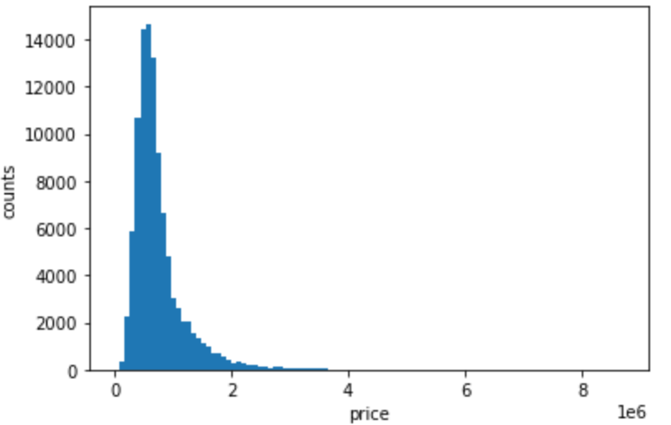
3-BR Histogram
Mean: $ 753,507
Median: $ 624,000
Mode: 0

Slide 22
Quartile calculations summary table
BR | Lower Q | Upper Q | IQR | Median | N
1 | $320,000 | $600,000 | $280,000 | $415,000 | 315
2 | $420,000 | $765,000 | $345,000 | $570,000 | 2,756
3 | $476,000 | $859,558 | $383,558 | $624,000 | 7,682
4 | $582,300 | $1,070,000 | $487,700 | $747,000 | 5,367
5 | $775,000 | $1,650,000 | $875,000 | $1,073,250 | 1,099

Slide 23
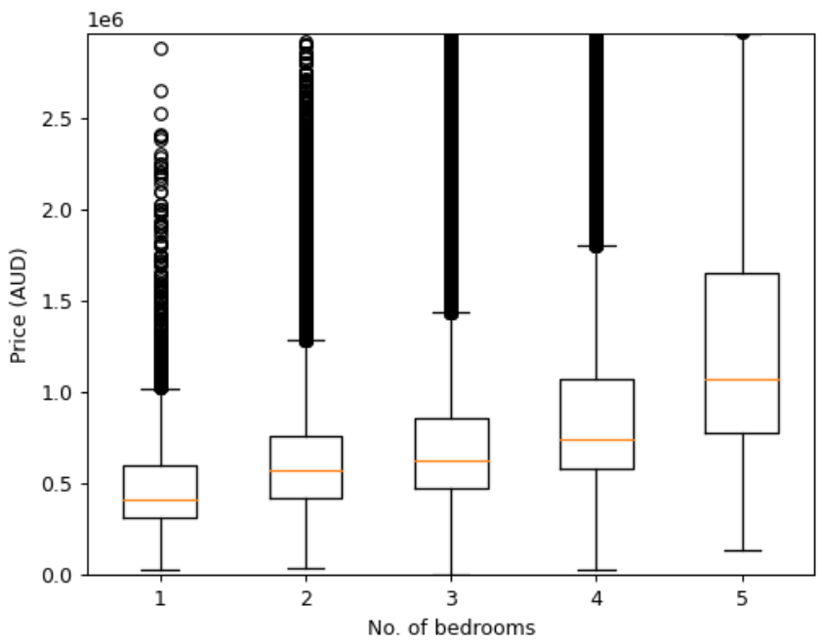
Number of BR v Price Boxplot

Slide 24
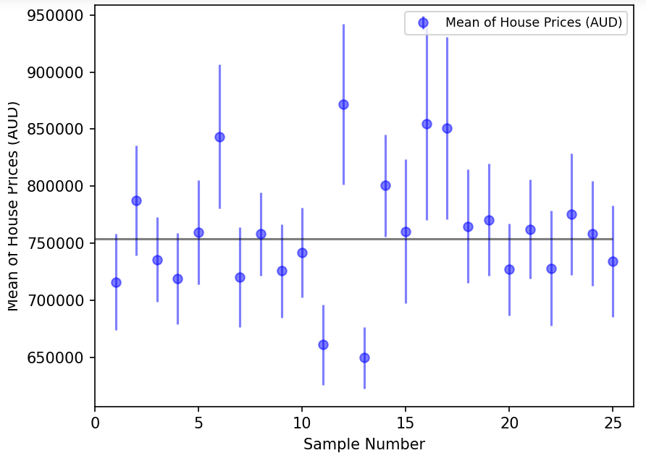
SEM on 3-BR residential properties mean

Slide 25
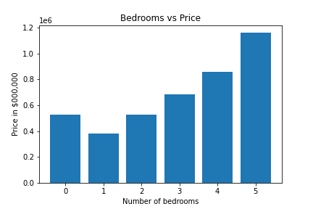
Average price of residential property with respect to number of bedrooms
Summary:
Average price of house increases with the increase in number of bedrooms.
Comparatively Average price of one bedroom is still cheaper than zero bedroom (Studio).
Moving from 4 BR to 5 BR will increase the property cost significantly.

Slide 26

Price Trend in Victoria in relation with number of BR.

Slide 27
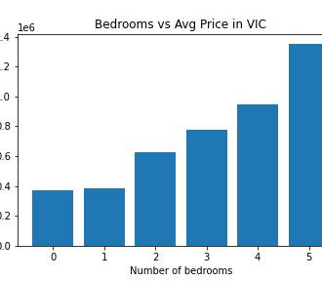
Average price of residential property with respect to number of bedrooms in VIC
Summary:
Average price of house increases with the increase in number of bedrooms.
Comparatively Average price of one bedroom is still cheaper than zero bedroom (Studio).
Moving from 4 BR to 5 BR will increase the property cost significantly.

Slide 28
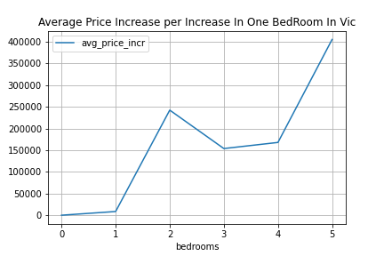
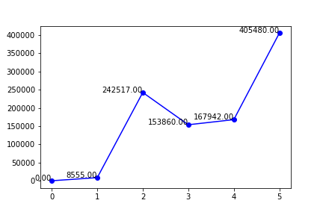
Price difference with additional BR in residential properties

Slide 29
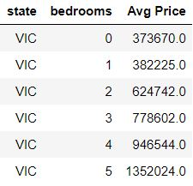
Overall analysis
Summary:
In Victoria, the avg price of a zero BR property and 1BR property are almost same.
5-BR property price increases significantly compare to 4BR and 3BR property.

Slide 30
Postmortem
Snehitha
Kritika
Data clean up and exploration
Follow up analysis on value of additional BR
Ankita
France
Minh
Extract API data from Kaggle
Analysis on price using Matplotlib
Git collaboration
Lots of ideas at the start;
Feels like driving in circles
Agreement on hypothesis
Splitting the work
Coding challenges
Final presentation
Notes:
Discuss any difficulties that arose, and how you dealt with them:
there was a lot of ideas coming in at the start as we are a bit overwhelmed by GitHub (we’ve never collaborated in GitHub before), Python (we just started learning about this weeks ago), and API and so much more.
these ideas, collectively, were scattered… we needed a hypothesis to bring focus to this project.
coming up with a hypothesis that we will agree on didn’t come easy as well. It felt like 2 steps forward and 1 step back. Perhaps it’s because at that time we were looking for real estate data online and the possibilities are endless.
it’s a bit of a chicken and egg analogy. Will it be look for real estate data first or have a specific problem to begin with i.e. residential property prices before and during the pandemic, real estate property price v location analysis… can you see where we are going with this? Not sure how other groups did it but for us, we found a data first (Kaggle) and had a look (top view approach) what’s in it and formulated our questions and eventually a problem to solve. Then we came up with a hypothesis.
It doesn’t end there. The next question was how move forward with the hypothesis and translate the tasks in Python terms and divide them among us.
Then the challenge of coding comes! Time spent on a single line of code could take hours! Lots of Googling and referring to documentation online and consultation with Tas and groupmates.
In every step or hurdle we’ve encountered, we tried our best to come up with something out of ambiguity.
What would you research next, if you had two more weeks?
If we have 2 more weeks, this wouldn’t have messed up our personal lives! Kidding aside, we would’ve added another dataset(s) to add a layer in the story we’re trying to tell. It could be Australia’s demographics i.e. info on who the buyers were and so on…

Slide 31
thank you

