Slide 1
Offline Access With RN
Tyson Kunovsky | Principal - Inspire11 Consulting

Slide 3
Offline access – questions to consider
Are we truly online? We only want to allow users to submit data if they have a connection that works.
If a user is offline, how do we save data for later use?
How do we make this work with commonly used libs redux-form?
How do we create a good developer experience?
Should we automatically try and do stuff with saved data when a user comes back online? (no for this example)

Slide 4
Stuff you will see in this talk
React Native (+ Expo)
Native Base
React Native Offline
Redux
Redux Persist
Redux Form
Recompose
Higher Order Components
Notes:
- This talk assumes a working knowledge of react native, redux, recompose, and higher order components. It is meant to be a simple explanation of how to add basic offline capabilities to any react native app.

Slide 5
Step 1 - React Native Offline

Slide 6
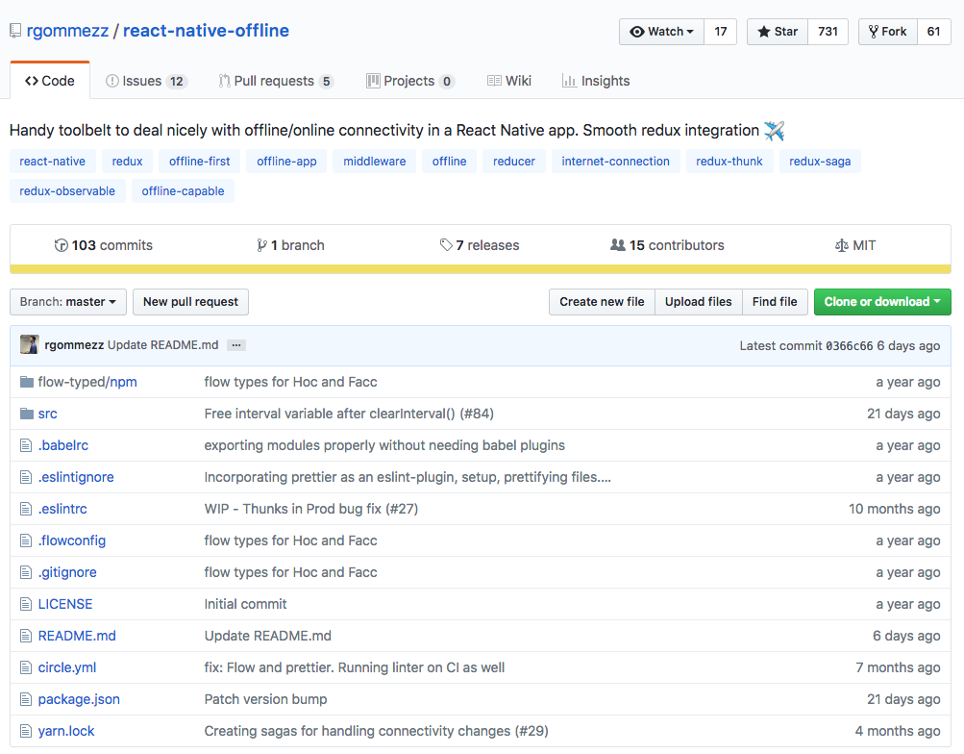
https://blog.callstack.io/your-react-native-offline-tool-belt-795abd5f0183
Notes:
React Native ships with the NetInfo module in order to detect internet connectivity. The API is pretty basic and it may be sufficient for small apps but its usage gets cumbersome as your app grows. Besides that, it only detects network connectivity and does not guarantee internet access so it can provide false positives.

Slide 7
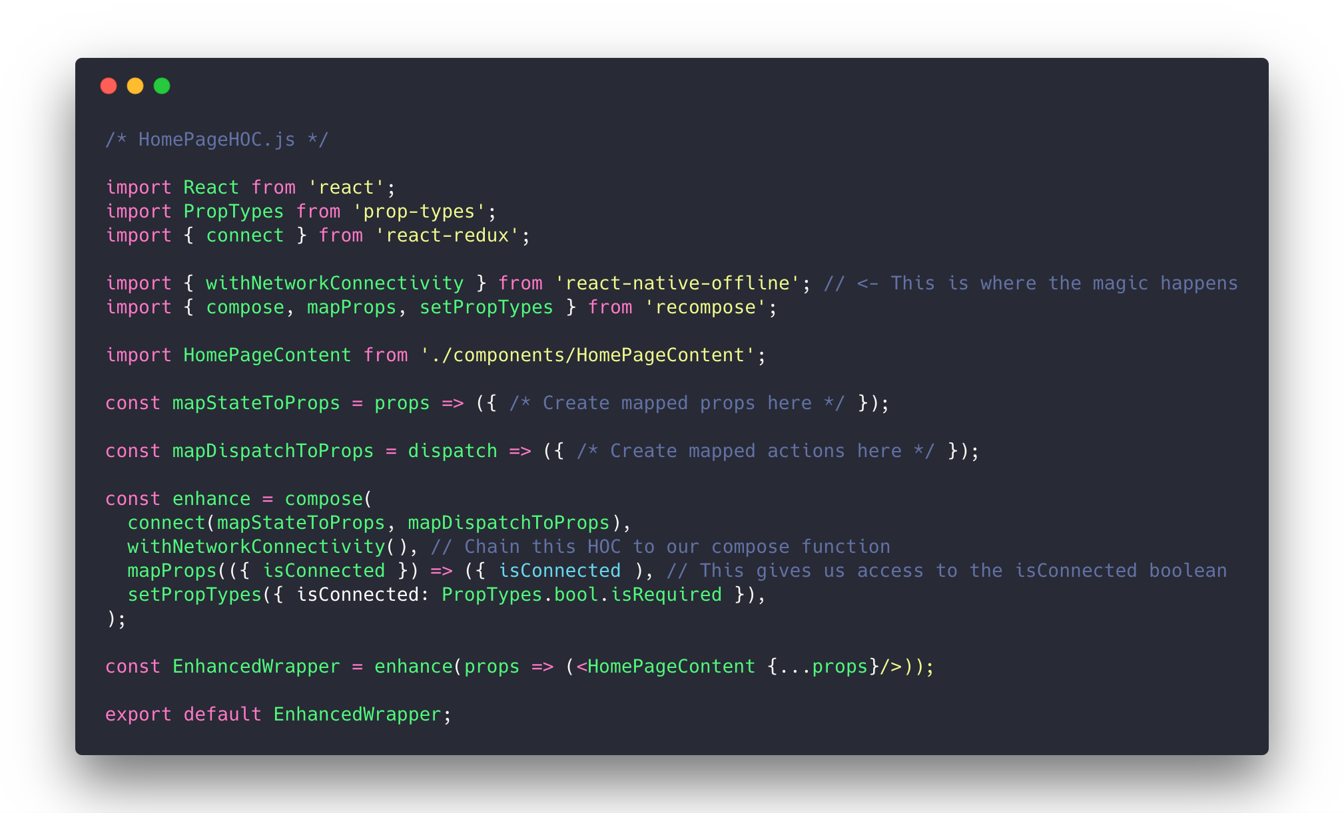

Slide 8
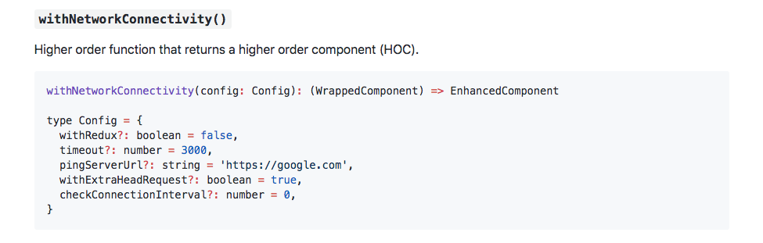
withNetworkConnectivity
https://github.com/rgommezz/react-native-offline
Notes:
withRedux: flag that indicates whether the HoC should be wired up to the Redux store. By default, this parameter is false and the HoC injects isConnected as a prop into WrappedComponent. If true provided, it won't act as a component utility and pass any prop down, but instead perform the needed actions to sync up with the store. See below Redux integration for more details.
withRedux: flag that indicates whether the HoC should be wired up to the Redux store. By default, this parameter is false and the HoC injects isConnected as a prop into WrappedComponent. If true provided, it won't act as a component utility and pass any prop down, but instead perform the needed actions to sync up with the store. See below Redux integration for more details.
timeout: amount of time (in ms) that the component should wait for the ping response. Defaults to 3s.
pingServerUrl: remote server to ping to. It defaults to https://google.com since it's probably one the most stable servers out there, but you can provide your own if needed.
withExtraHeadRequest: flag that denotes whether the extra ping check will be performed or not. Defaults to true.
checkConnectionInterval: the interval (in ms) you want to ping the server at. The default is 0, and that means it is not going to regularly check connectivity.

Slide 9
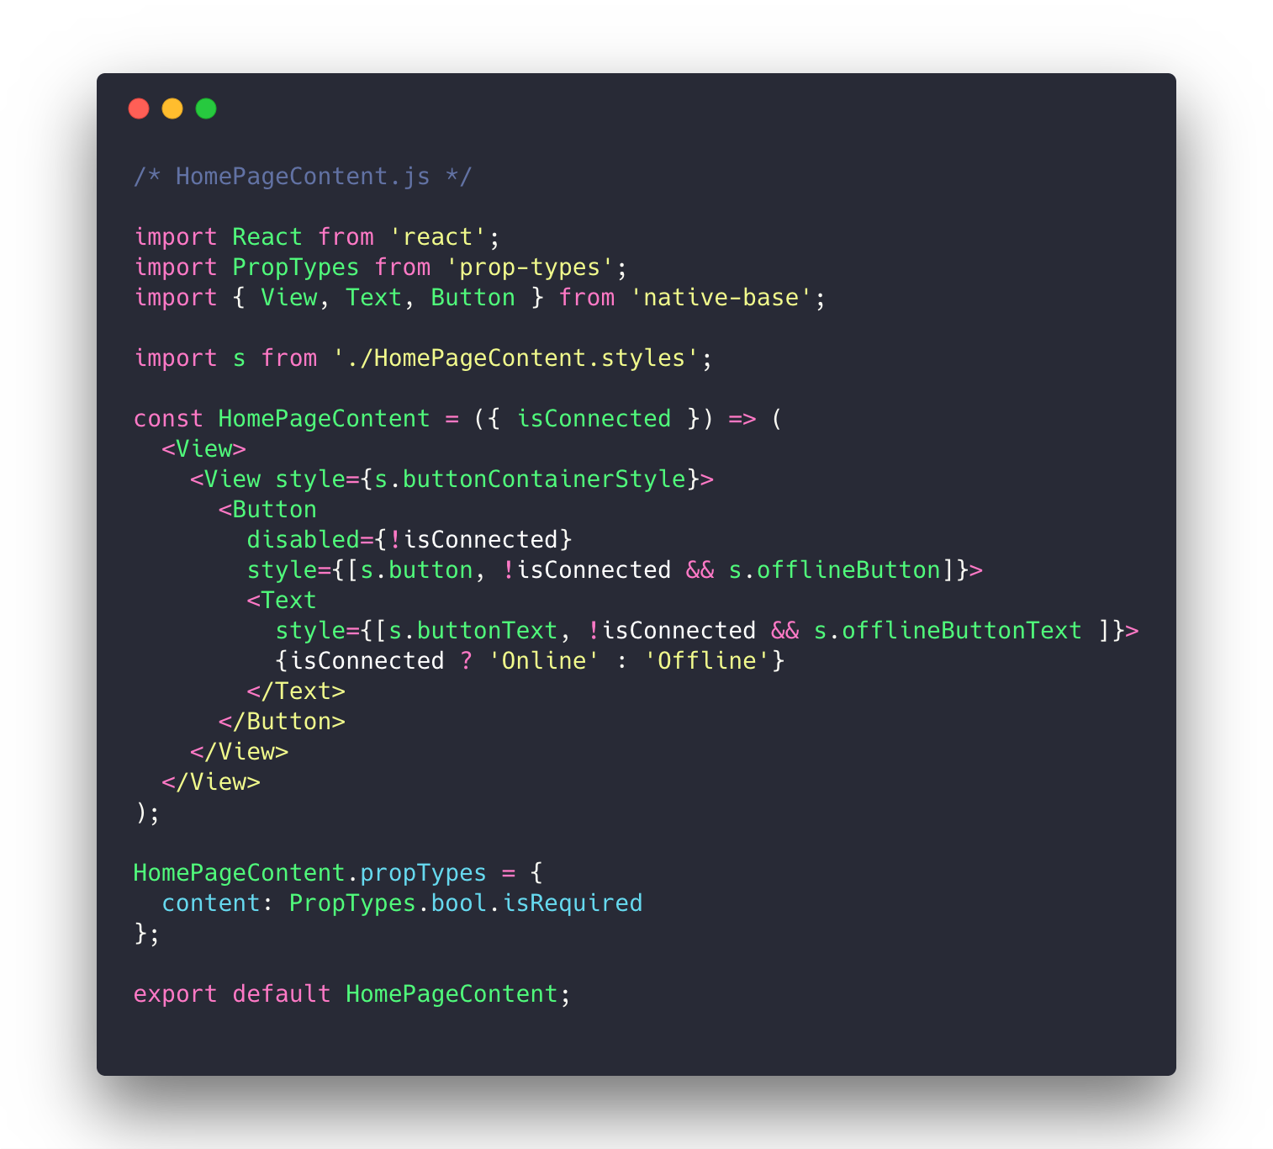

Slide 10
Step 2 - Redux Persist

Slide 11
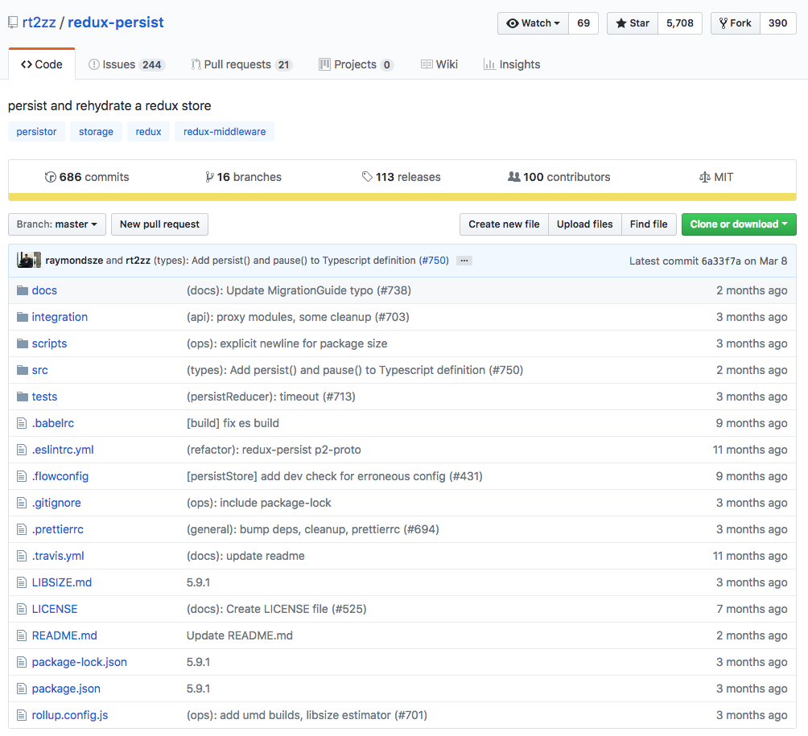
Notes:
What about saving our data?

Slide 12
How does it work?
Takes your reducer state
State reconcilers define how incoming state is merged in with initial state – make sure to choose the right one for your needs.

Slide 13
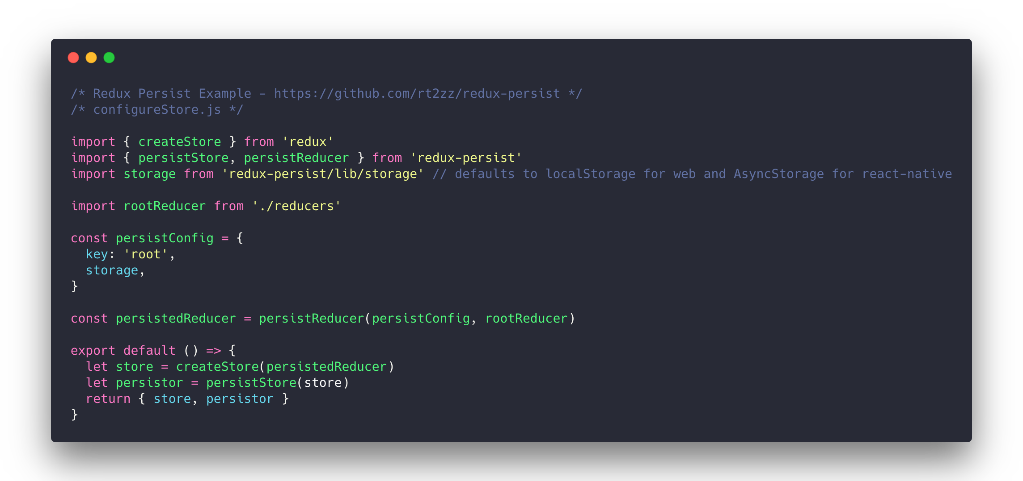

Slide 14
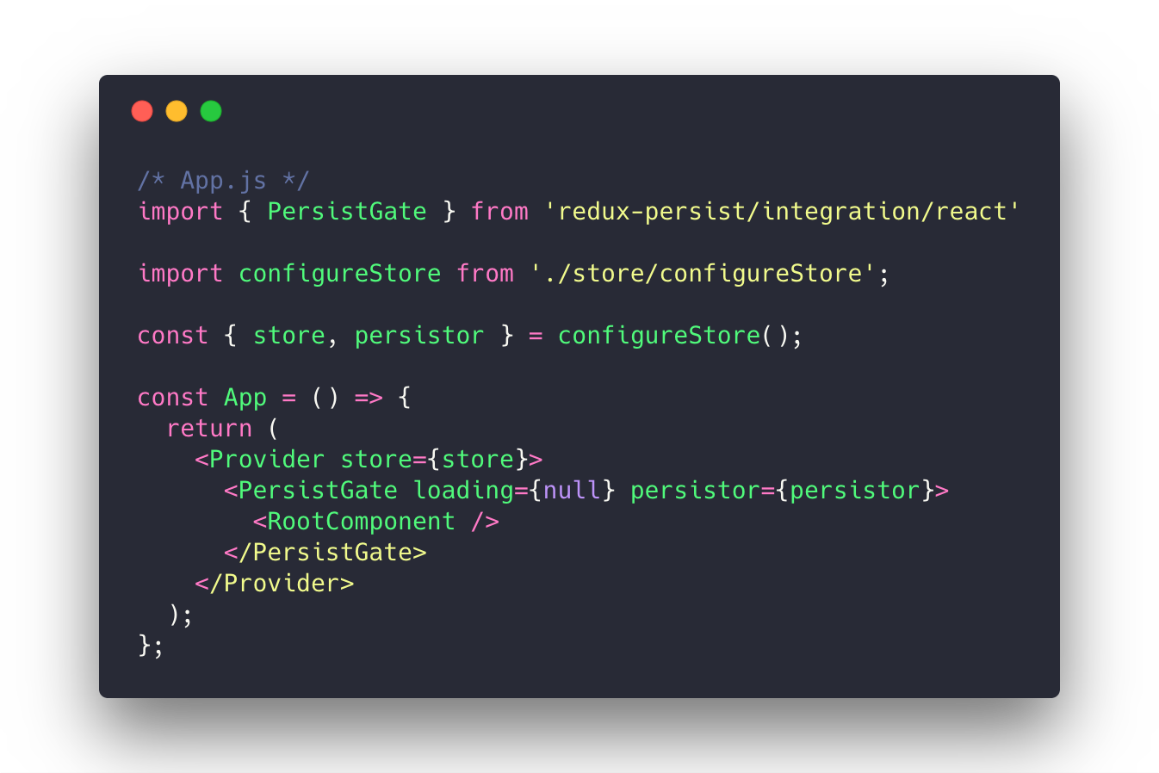

Slide 15
That’s it! (mostly)

Slide 16
Step 3 – Get it working with redux-form

Slide 17
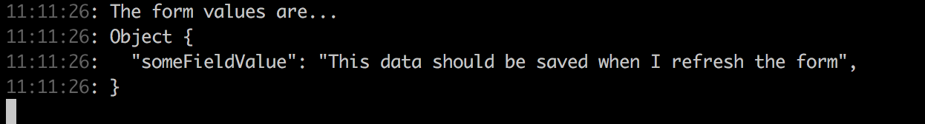
Redux Form – ensure form data saves
When we refresh the app form data is not getting hydrated properly….
Expected this:
But got this:
Notes:
Hooked this up and everything was working fine, except for the form reducers.
Turns out that the form reducer was re-initializing itself, and ignoring the values that were stored under the “form” key in AsyncStorage by redux-persist
The best way to initialize existing values into a form is to just pass an “initialValues” to that form

Slide 18
Solution
Write a transform to populate initialValues on hydrate of the app
https://github.com/rt2zz/redux-persist#transforms

Slide 19
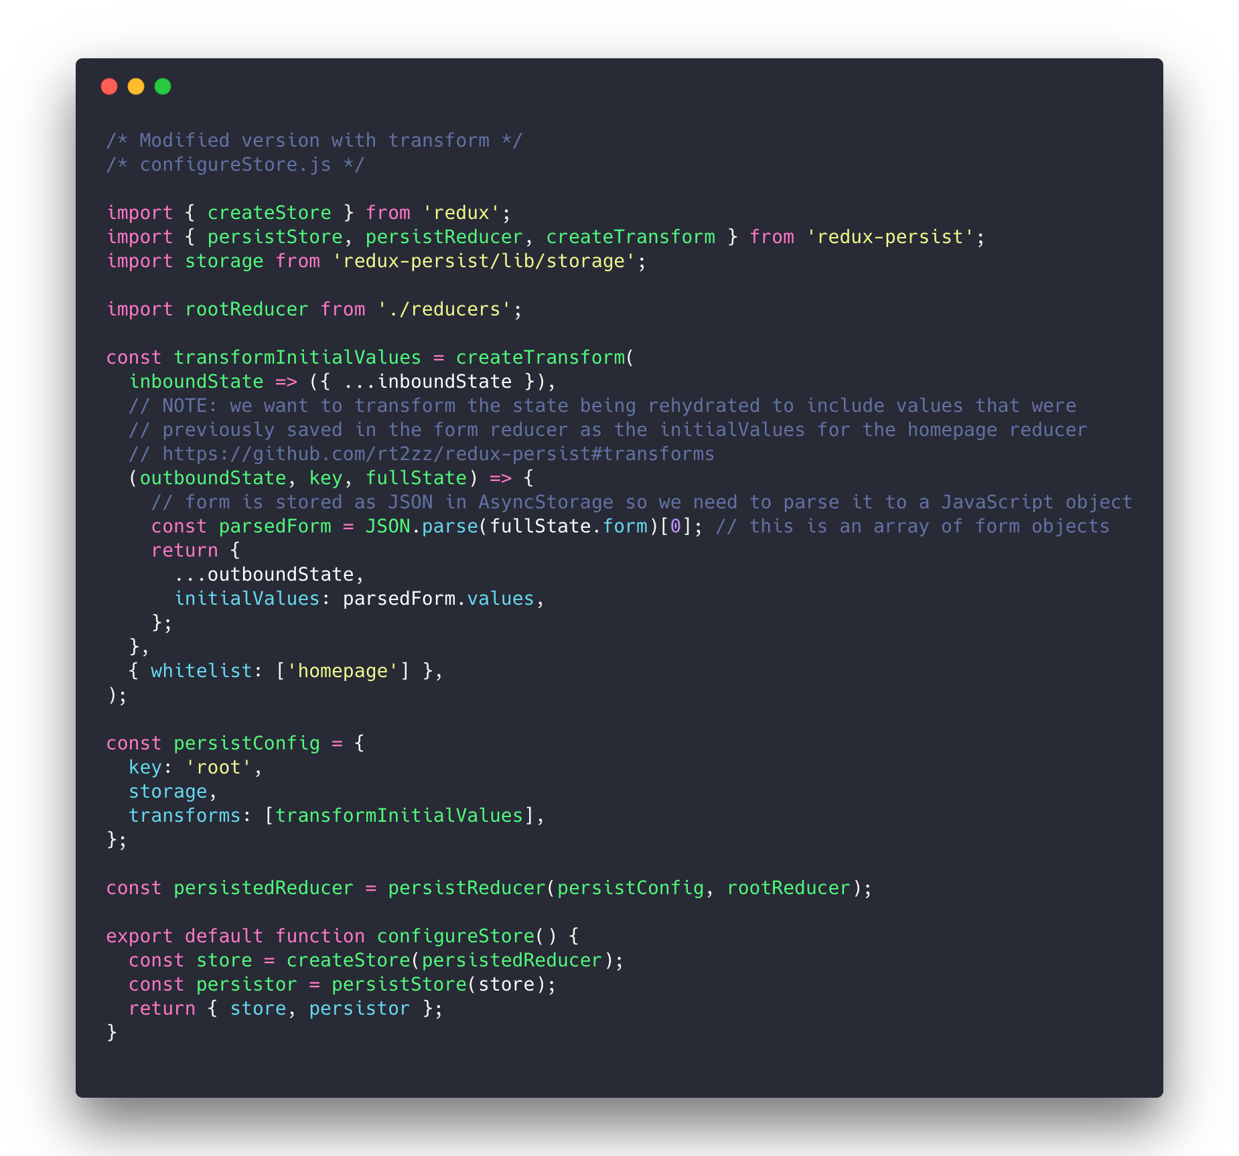
Notes:
- When the state object gets persisted, it first gets serialized with JSON.stringify()

Slide 20
Step 4 – Solid developer experience

Slide 21
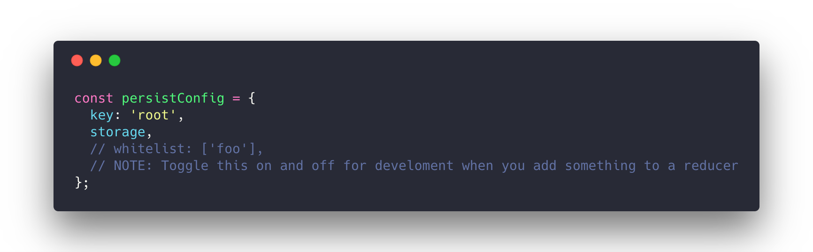
Developer Experience
Store is now being persisted between refreshed, but new values were not appearing in the reducer when we add them…

Slide 22
Limitations
Not automatically saving user’s data when they come back online
Limited by expo’s background

Slide 23
Resources
https://github.com/rt2zz/redux-persist
https://github.com/rgommezz/react-native-offline
https://blog.callstack.io/your-react-native-offline-tool-belt-795abd5f0183 <- good article on react-native-offline by its creator
https://github.com/kunovsky/reactOfflineTalk <- slides and code from this talk

