Slide 1
Offline Access With RN
Tyson Kunovsky | Principal - Inspire11 Consulting

Slide 3
Things to consider
Are we truly online?
Only allow users to submit data if they have a connection
Save data for later use
Make it work with redux-form

Slide 4
React Native Offline

Slide 5
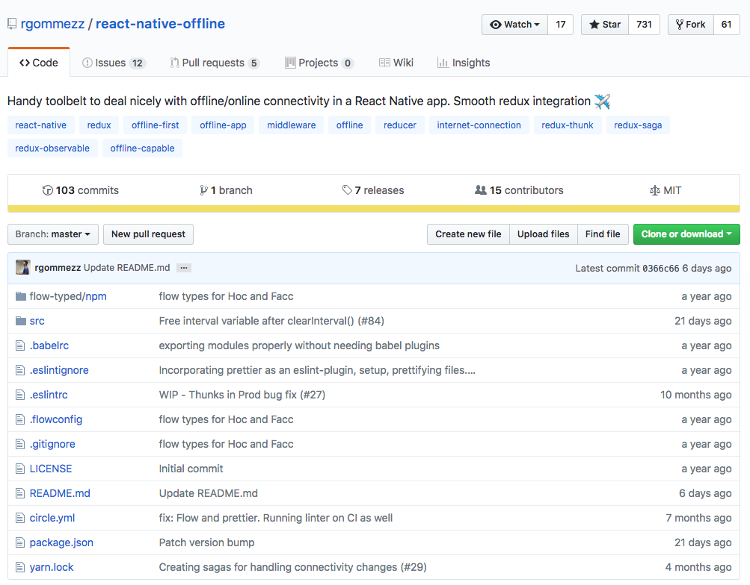
https://blog.callstack.io/your-react-native-offline-tool-belt-795abd5f0183
Notes:
React Native ships with the NetInfo module in order to detect internet connectivity. The API is pretty basic and it may be sufficient for small apps but its usage gets cumbersome as your app grows. Besides that, it only detects network connectivity and does not guarantee internet access so it can provide false positives.

Slide 6
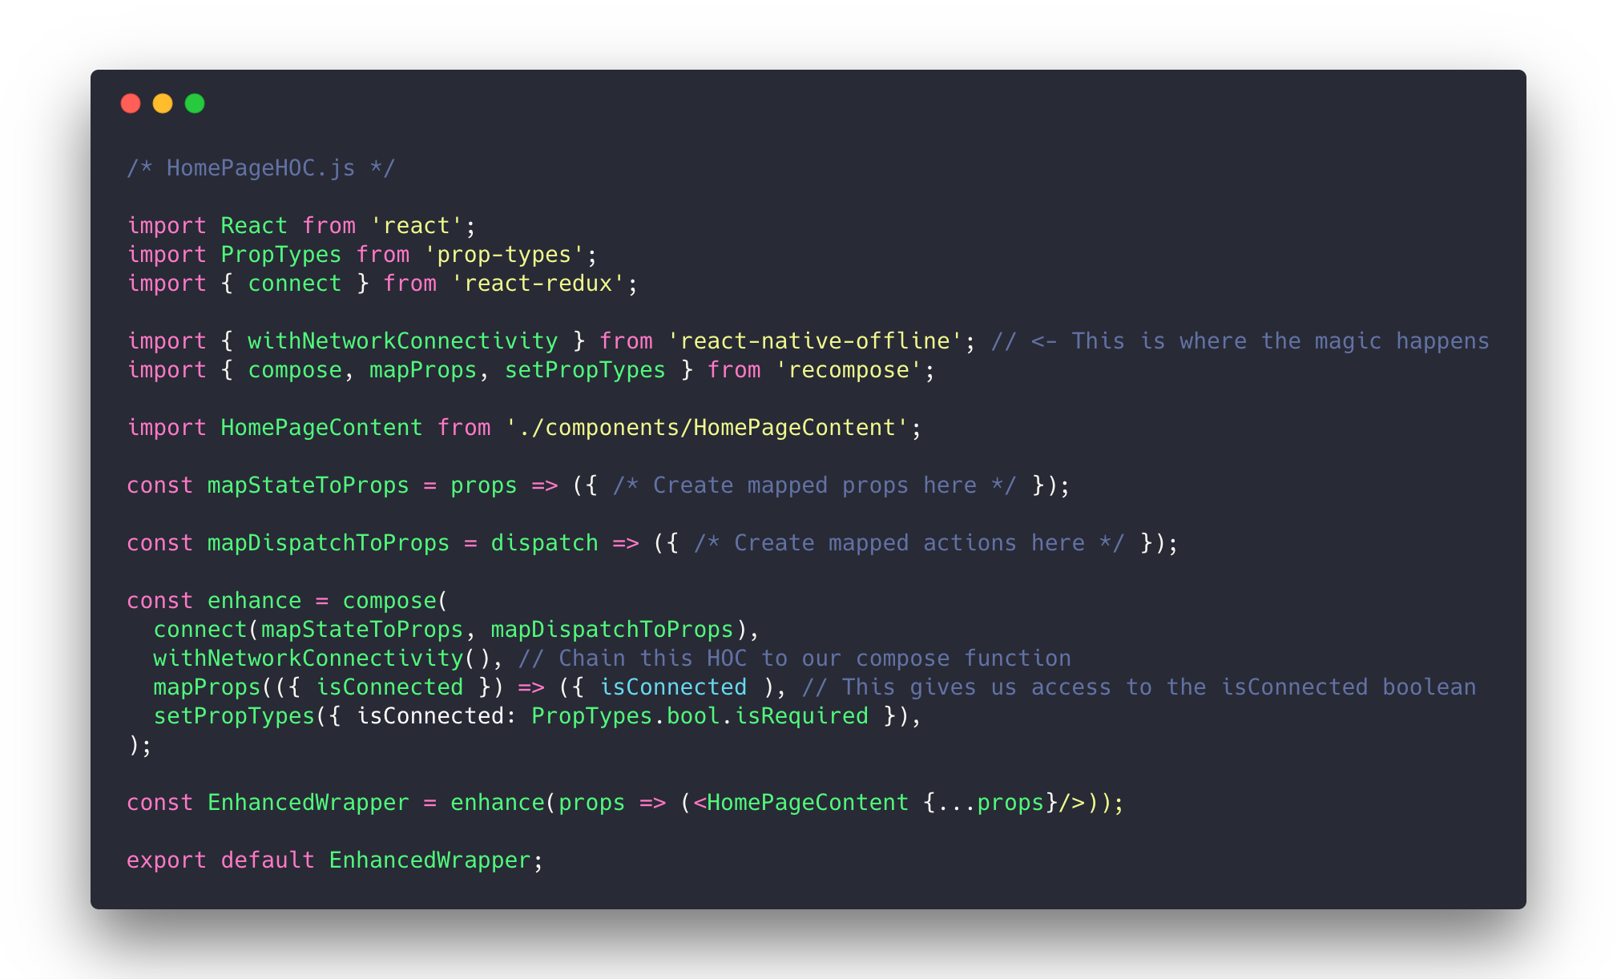

Slide 7
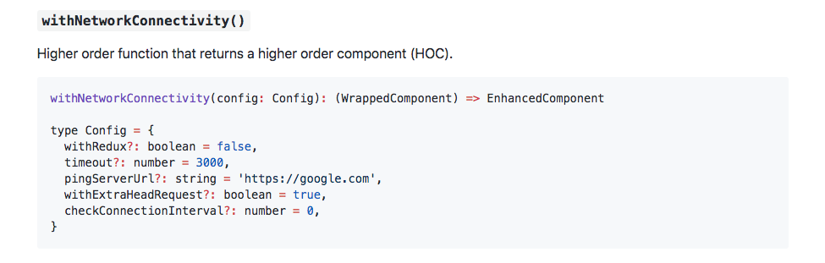
withNetworkConnectivity
https://github.com/rgommezz/react-native-offline
Notes:
withRedux: flag that indicates whether the HoC should be wired up to the Redux store. By default, this parameter is false and the HoC injects isConnected as a prop into WrappedComponent. If true provided, it won't act as a component utility and pass any prop down, but instead perform the needed actions to sync up with the store. See below Redux integration for more details.
withRedux: flag that indicates whether the HoC should be wired up to the Redux store. By default, this parameter is false and the HoC injects isConnected as a prop into WrappedComponent. If true provided, it won't act as a component utility and pass any prop down, but instead perform the needed actions to sync up with the store. See below Redux integration for more details.
timeout: amount of time (in ms) that the component should wait for the ping response. Defaults to 3s.
pingServerUrl: remote server to ping to. It defaults to https://google.com since it's probably one the most stable servers out there, but you can provide your own if needed.
withExtraHeadRequest: flag that denotes whether the extra ping check will be performed or not. Defaults to true.
checkConnectionInterval: the interval (in ms) you want to ping the server at. The default is 0, and that means it is not going to regularly check connectivity.

Slide 8
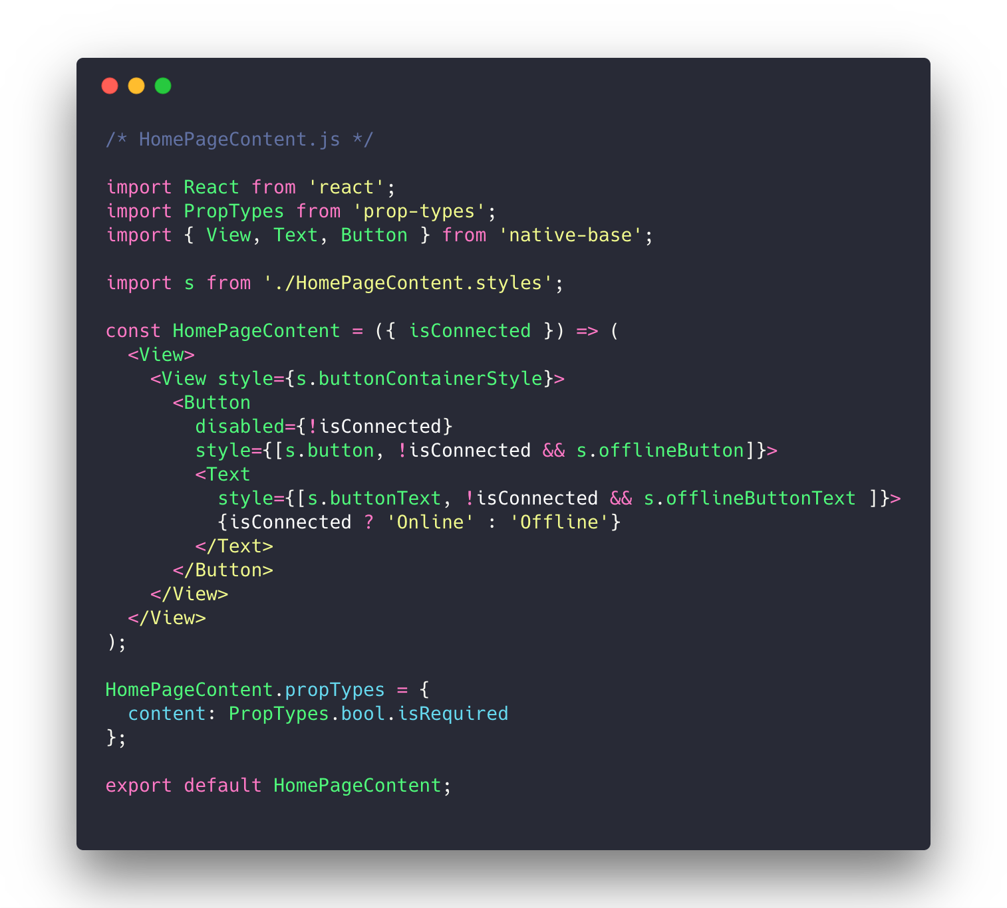

Slide 9
Redux Persist

Slide 10
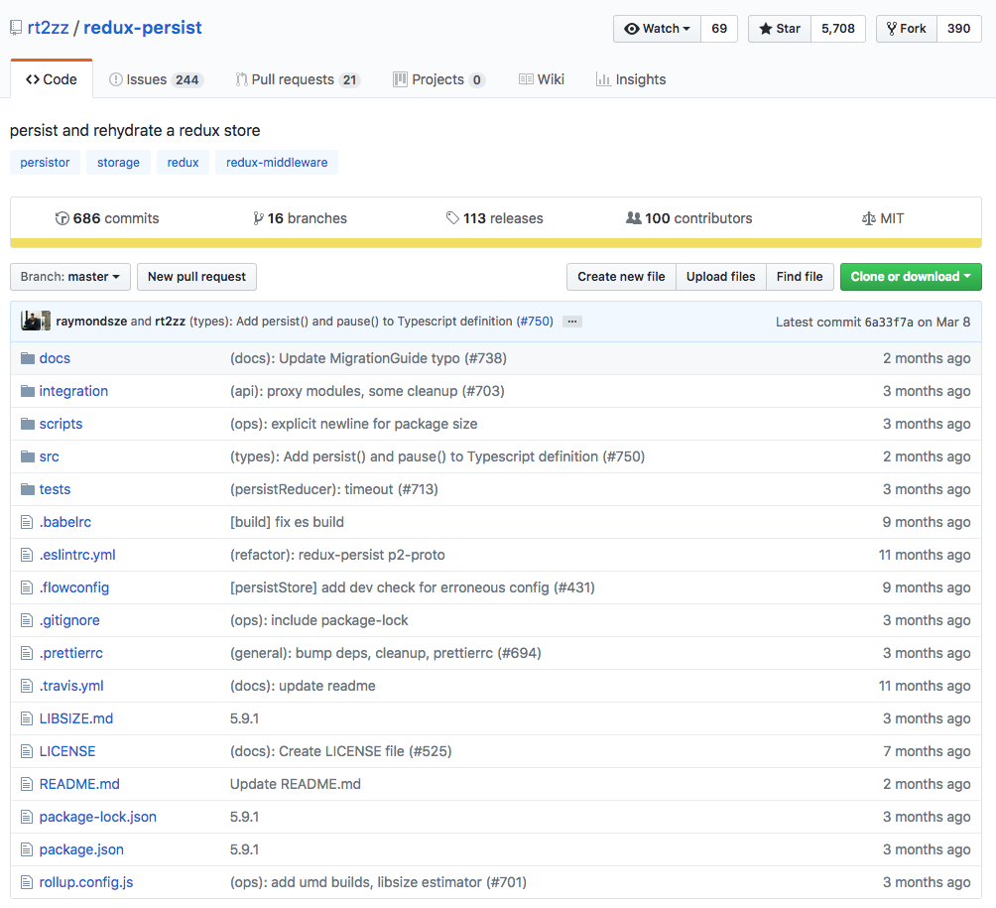
Notes:
What about saving our data?

Slide 11
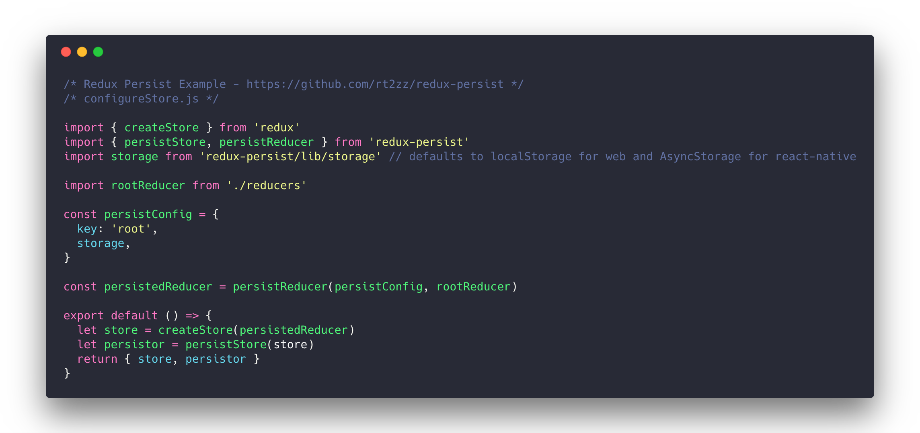

Slide 12
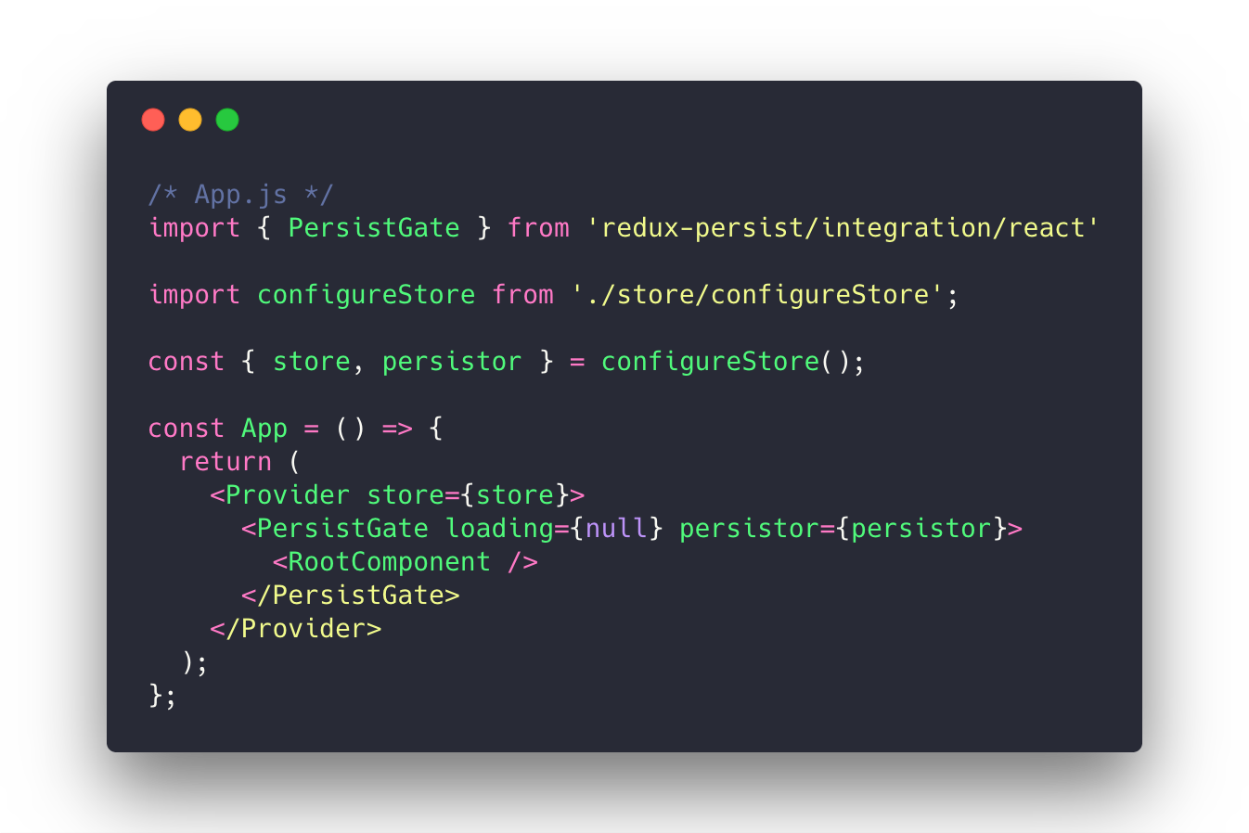

Slide 13
Challenges

Slide 14
Redux Form
Challenges of saving our data with redux form

Slide 15
Developer Experience
Persisting the store between refreshes can be annoying

Slide 16
Limitations
Persisting the store between refreshes can be annoying

Slide 17
Resources
https://blog.callstack.io/your-react-native-offline-tool-belt-795abd5f0183 <- explanation of
Add code to my Github here so people can see it!

