Slide 1
MINOR PROJECT LANE DETECTION USING IMAGE PROCESSING
Hrituparna Pathak
219302419
Manipal University Jaipur

Slide 2
TABLE OF CONTENTS
01
02
03
MOTIVATION
OBJECTIVES
METHODOLOGY

Slide 3
INTRODUCTION
Lane detection is a critical aspect of self-driving cars and autonomous vehicles, crucial for understanding driving scenes. By identifying lane positions, vehicles gain guidance to stay within their lanes and avoid straying or entering other lanes, ensuring safe navigation.

Slide 4
01
MOTIVATION

Slide 5
In the context of autonomous driving, accurate lane detection is essential for path planning and vehicle control.
A reliable lane detection system can enable autonomous vehicles to navigate complex road environments, including highways, intersections, and urban streets, with increased precision and safety.

Slide 6
02
OBJECTIVES

Slide 7
Develop and implement a lane detection algorithm capable of accurately detecting lane boundaries under various conditions such as different lighting, road markings, and weather conditions.
Explore and incorporate advanced techniques such as edge detection, Hough transform, or deep learning models to improve the robustness and accuracy of lane detection.

Slide 8
03
METHODOLOGY

Slide 9
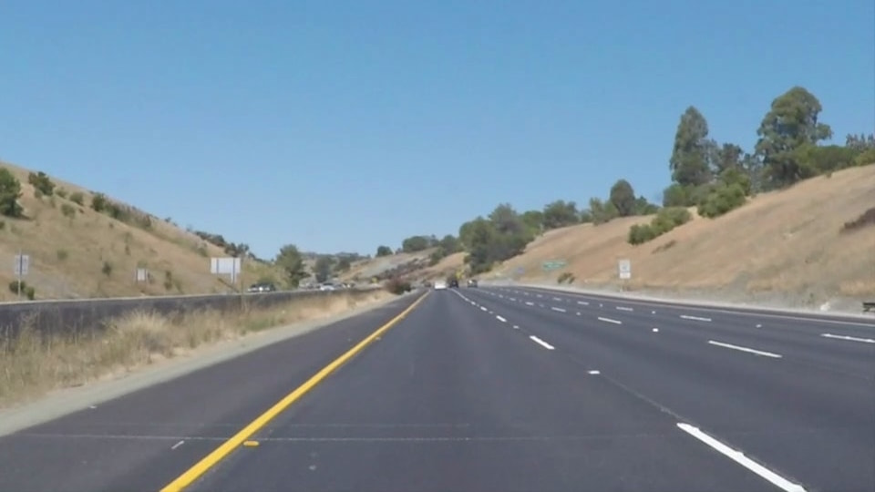
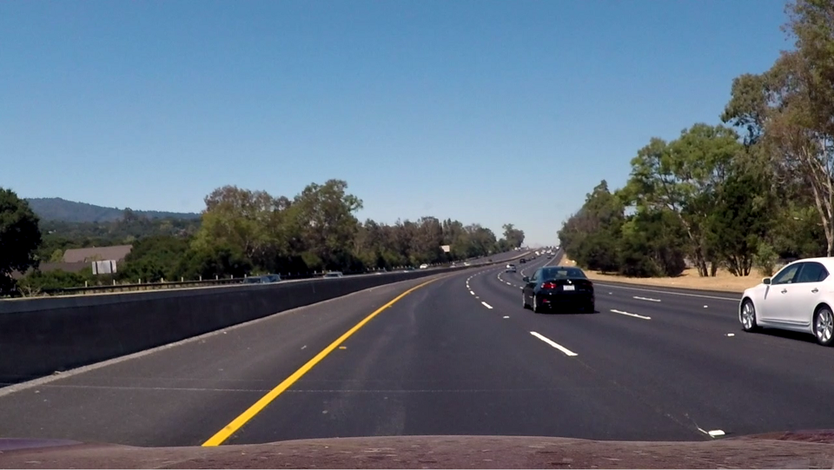
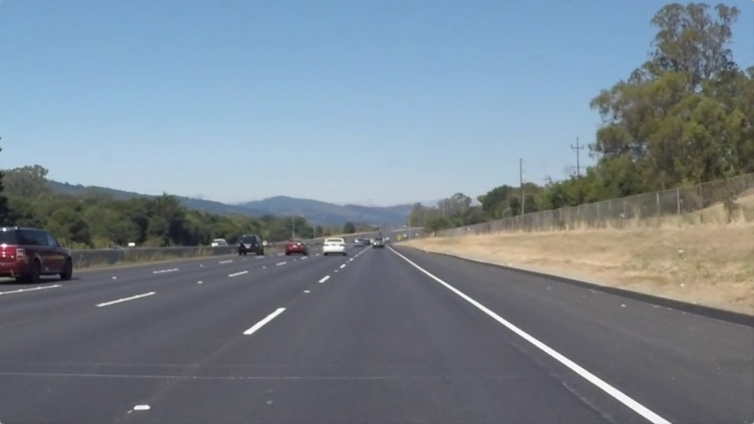
DATA COLLECTION.
I Collected Few Test Images for the Project with clear Lane Markings from different sources on the Internet.
For Example-

Slide 10
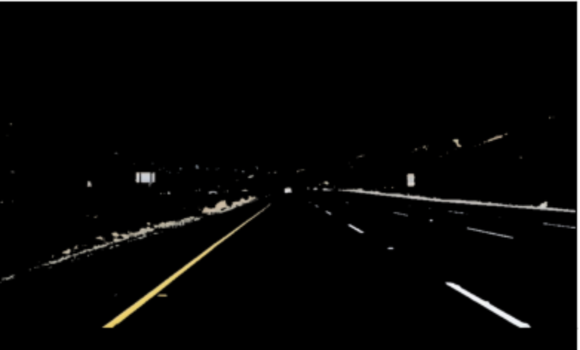
A. Color Selection
Lane lines in the test images are in white and yellow. We have chosen the most suitable color space, that clearly highlights the lane lines.
I applied color selection to the test images in the original RGB format. And tried to retain as much of the lane lines as possible, while blacking out most of the other stuff.
Figure – After applying color selection to the RGB image to blackout everything except for white and yellow lane lines.

Slide 11
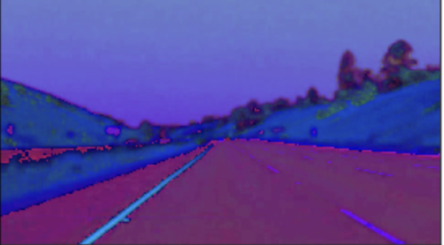
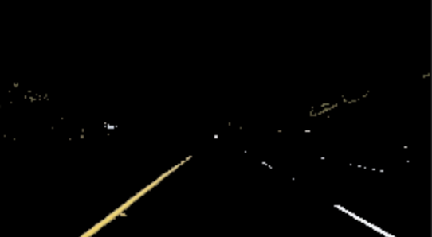
A.1. HSV color space
HSV is an alternative representation of the RGB color model. The HSV representation models the way colors mix together, with the saturation dimension resembling various shades of brightly colored paint, and the value dimension resembling the mixture of those paints with varying amounts of black or white.
Figure – After Converting RGB image to HSV.
Figure – Apply Applying color selection to the HSV images to blackout everything except for white and yellow lane lines.

Slide 12
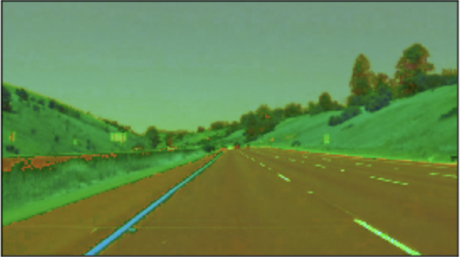
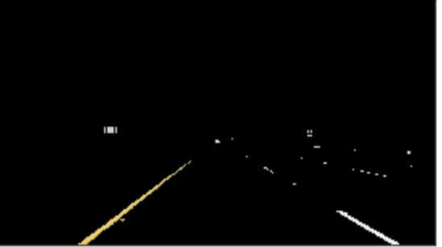
A.2. HSL color space
HSL is an alternative representation of the RGB color model. The HSL model attempts to resemble more perceptual color models such as NCS or Munsell, placing fully saturated colors around a circle at a lightness value of 1/2, where a lightness value of 0 or 1 is fully black or white, respectively.
Figure – After Converting RGB image to HSL.
Figure – Apply Applying color selection to the HSL images to blackout everything except for white and yellow lane lines.
Using HSL produces the clearest lane lines of all color spaces. We will use them for the next steps.

Slide 13
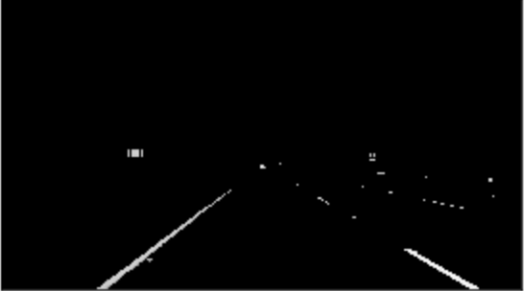
B. Canny Edge Detection
The Canny edge detection algorithm measures the intensity gradients of each pixel. So, we need to convert the images into Gray scale to detect edges
Figure – After Converting images to gray scale

Slide 14
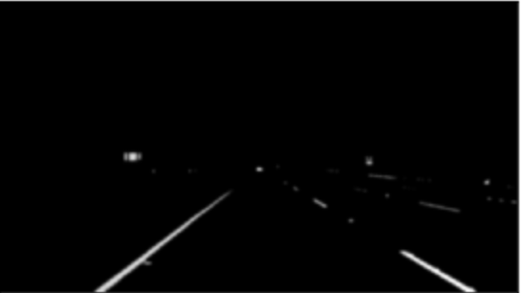
B.1. Applying Gaussian smoothing
Since all edge detection results are easily affected by image noise, it is essential to filter out the noise to prevent false detection caused by noise. To smooth the image, a Gaussian filter is applied to convolve with the image. This step will slightly smooth the image to reduce the effects of obvious noise on the edge detector.
Figure – After applying Gaussian filter to the input image.

Slide 15
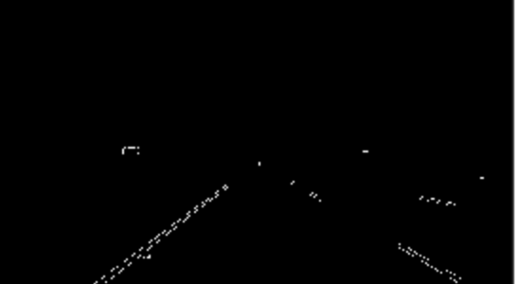
B.1. Applying Canny Edge Detection
The Process of Canny edge detection algorithm can be broken down to different steps:
Find the intensity gradients of the image
Apply non-maximum suppression to get rid of spurious response to edge detection.
Apply double threshold to determine potential edges.
Track edge by hysteresis: Finalize the detection of edges by suppressing all the other edges that are weak and not connected to strong edges.
Figure – After applying Canny Edge Detection algorithm to the input image

Slide 16
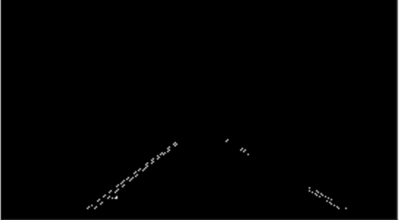
C. Region of interest
We're interested in the area facing the camera, where the lane lines are found. So, we applied region masking to cut out everything else.
Figure – After determining and cutting the region of interest in the input image.

Slide 17
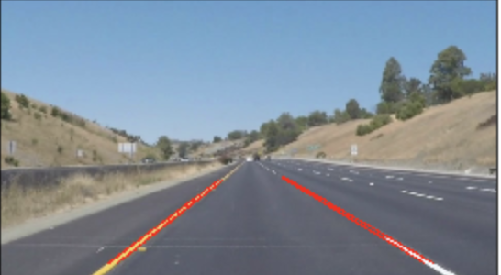
D. Hough Transform
The Hough transform is a technique which can be used to isolate features of a particular shape within an image. We used it to detected the lane lines in selected region images.
It contains the list of lines detected in the selected region. Now, we will draw these detected lines onto the original test image.
Figure – After Drawing lines onto the input image.

Slide 18
E. Drawing lines onto the input image.
We have multiple lines detected for each lane line. So We need to average all these lines and draw a single line for each lane line, also need to extrapolate the lane lines to cover the full lane line length.
We Find the slope and intercept of the left and right lanes of each image.
We Convert the slope and intercept of each line into pixel points.
We Create full length lines from pixel points.
Draw lines onto the input image.

Slide 19
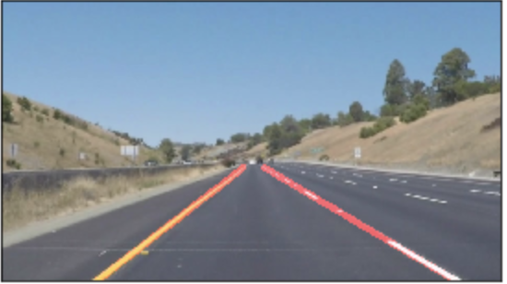
FINAL OUTPUT IMAGE

Slide 20
THE END
THANKS.

