Slide 1
Distance of two pieces in Pitch Sensitive
東条 研
孔 毅
1210022
2014-11-12

Slide 2
Contents
Basic Conception
MusicXML in Brief
Demonstration
To Do…
T

Slide 3
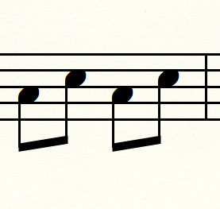
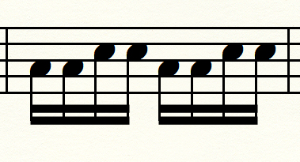
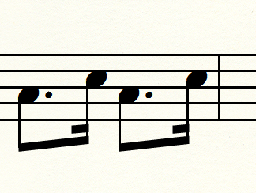
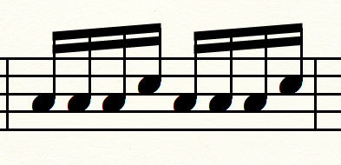
Basic Conception I
Theme
equivalence
changed
equivalence
Variation

Slide 4
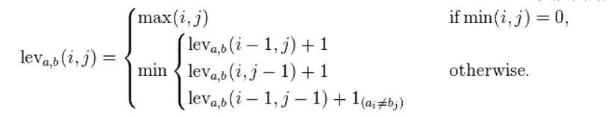
Basic Conception II
NewPitchDistance(a,b)= LevenshteinDistance(a,b) * Duration(p1,p2) * PitchDistance(p1,p2) [1]
The Levenshtein distance between two strings a, b is given by leva,b(|a|,|b|) where
Where 1(ai<>bj) is the indicator function equal to 0 when ai=bj and equal to 1 otherwise.[2]
Duration: how long time the note take in the whole measure.
Pitch Distance: 0 5 6 4 6 6 3 5 7 6 2 6 7 5 7 6 4
C Db C# D Eb D# E F Gb F# G Ab G# A Bb A# B [3]
[1] Masaki Matsubara, Keiji Hirata, Satoshi Tojo, Distance in Pitch Sensitive Time-span Tree. Copyright: @2014 Matsubara et al.
[2] http://en.wikipedia.org/wiki/Levenshtein_distance
[3] Fred Lerdahl, Tonal Pitch Space, OXFORD UNIVERSITY PRESS 2001.

Slide 5
MusicXML in Brief
<?xml version="1.0" encoding="UTF-8" standalone="no"?>
<!DOCTYPE score-partwise PUBLIC
"-//Recordare//DTD MusicXML 2.0 Partwise//EN"
"http://www.musicxml.org/dtds/partwise.dtd">
<score-partwise version="2.0">
<part-list>
<score-part id="P1">
<part-name>Theme</part-name>
</score-part>
</part-list>
<part id="P1">
<measure number="1"> <!---Begining of measure -->
<attributes>
<divisions>256</divisions>
<key>
<fifths>0</fifths> whole measure’s duration
</key>
<time>
<beats>2</beats>
<beat-type>4</beat-type>
</time>
<clef>
<sign>G</sign>
<line>2</line>
</clef>
</attributes>
<note> <!-- beginning of a note -->
<pitch>
<step>C</step> <!-- pitch information -->
<octave>4</octave>
</pitch>
<duration>256</duration> the pitch’s duration
<!-- <type>quarter</type> -->
</note>
<note>
<pitch>
<step>C</step>
<octave>4</octave>
</pitch>
<duration>256</duration>
<!-- <type>quarter</type> -->
</note>
</measure> <!---Endng of measure -->
<measure number="2">
<note>

Slide 6
Program Flow
Reading theme.xml and var.xml
Getting targets like duration, pitch information etc.
Compare each measure, dynamic splitting note to smaller group to match the other one
Use formula
NewPitchDistance(a,b)=
LevenshteinDistance(a,b) * Duration(p1,p2) * PitchDistance(p1,p2)
Calculating the value of one measure.
Add the values of all measures.
Printing out

Slide 7
Demonstration

Slide 8
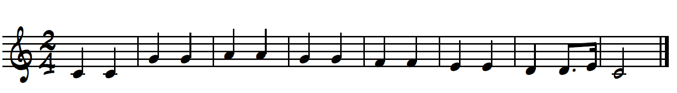

Music sample
Theme
Variation

Slide 9
To Do
Tring to find and use xml lib to deal with xml files.
Comparison and spliting function need to be improved.
Calculation the distance of different key’s variation.

