Slide 1
Comparison of Dash and Streamlit
CSCI 608
Kshiraj Kunta

Slide 2
What is Dash?
Dash is a Python framework for building interactive web applications.
Combines Flask, Plotly, and React.js.
Use Cases:
- Data visualization dashboards.
- Machine learning model interfaces.
- Monitoring tools for business analytics.

Slide 3
Key Features of Dash
Key Features:
- Highly customizable.
- Supports dynamic interactivity.
- Declarative Layouts:
Uses Python to define the structure of your web app.
- Interactivity:
Callback functions to update UI components dynamically.
- Integration with Plotly:
Create interactive visualizations effortlessly.
- Cross-Platform Compatibility:
Web apps are accessible via browsers.

Slide 4
Advantages of Using Dash
- User-Friendly:
No need to have much knowledge of HTML, CSS, or JS
- Scalable:
Suitable for small projects and enterprise-level applications.
- Extensive Community Support:
Abundant resources and documentation available.
- Open Source:
Free to use and modify.

Slide 5
What is Streamlit?
Streamlit is another Python framework for building data apps quickly.
Use Cases:
- Prototyping machine learning models.
- Creating simple interactive visualizations.

Slide 6
Key features of Streamlit
Quick Setup:
Install and run apps with minimal code.
Python Development:
No need for HTML, CSS, or JavaScript.
Built-In Widgets:
Use sliders, buttons, and other pre-built components easily.
Auto Refresh:
Automatically refreshes the app upon code changes.
Data-Centric:
Streamlined for data exploration and visualization.

Slide 7
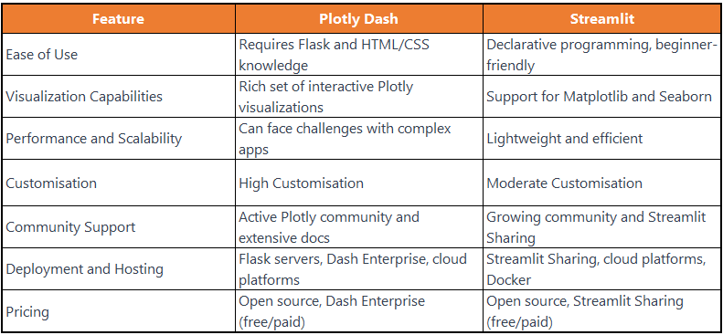
Dash vs. Streamlit

Slide 8
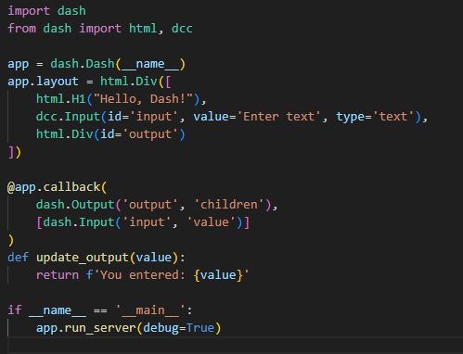
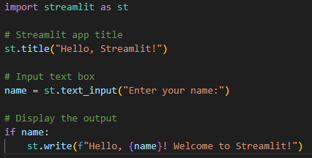
Sample Code
Dash
Streamlit

Slide 9
When to Use Dash vs. Streamlit
- Choose Dash:
For robust, production-ready applications.
When precise layout and UI customization are needed.
- Choose Streamlit:
For quick data visualization demos.
For lightweight apps with minimal coding.

Slide 10
Why Choose Dash for my Projects?
- Comprehensive Ecosystem:
Integrates well with other Python libraries.
- Scalability:
Ideal for large-scale, data-intensive applications.
- Versatility:
Suitable for a wide range of industries.
- E-Commerce Ready:
Dash enables the development of interactive and responsive e-commerce websites with dynamic product displays and user-friendly interfaces.

Slide 11
Demonstration

