Slide 1


Capstone Project Approval
UE19CS390A
Additional Info
Additional Info
Problem
Outline
Outline
Problem
Scope
Scope
Extra 1
Timeline
Deliverable
Deliverable
Intro
Use Case
Team
Team
End
Use Case
Timeline

Slide 2
Project Topic: Automated Shopping Cart
Project ID: 75
Project Guide: Prof Prajwala T.R
Team Members :
Kuntal Gorai PES2UG19C198
S V S C Santosh PES2UG19CS346
Skanda S PES2UG19CS391
Vijay Murugan A S PES2UG19CS454
Additional Info
Additional Info
Problem
Outline
Outline
Problem
Scope
Scope
Extra 1
Timeline
Deliverable
Team
Deliverable
Intro
Use Case
Team
End
Use Case
Timeline

Slide 3
Problem Statement
Scope and Feasibility study
Applications/Use cases
Expected Deliverables
Capstone (Phase-I & Phase-II) Project Timeline
Any other information
Additional Info
Additional Info
Problem
Outline
Problem
Scope
Scope
Extra 1
Timeline
Deliverable
Team
Deliverable
Intro
Use Case
Use Case
Team
Outline
End
Timeline

Slide 4
Overview
Shopping malls have become an integral part of city life and a lot of people commute to these marts to get their daily essentials and groceries.
How ever we are all forced to go through the tedious task of getting our items billed.
For some items, bar-codes and RFID tags cannot be used as they must be stuck on each of the items after weighing them individually.
Additional Info
Additional Info
Problem
Outline
Scope
Scope
Extra 1
Timeline
Deliverable
Team
Deliverable
Intro
Use Case
Team
End
Use Case
Outline
Timeline
Problem

Slide 5
Problem Statement
Standing in long queues is time consuming and tedious.
This Project aims to design a system that detects and classifies the commodities placed into the shopping cart in a systematic manner using Deep Learning techniques.
This system will add the item when placed into the cart and update the details of the items on the app, finally generating the bill.
Additional Info
Additional Info
Problem
Outline
Scope
Scope
Extra 1
Timeline
Deliverable
Team
Deliverable
Intro
Use Case
Team
End
Use Case
Outline
Timeline
Problem

Slide 6
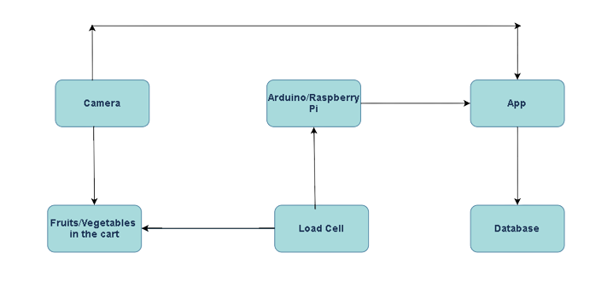
Flow Chart
Additional Info
Additional Info
Problem
Scope
Outline
Extra 1
Timeline
Deliverable
Team
Deliverable
Intro
Use Case
Team
End
Use Case
Outline
Timeline
Scope
Problem

Slide 7
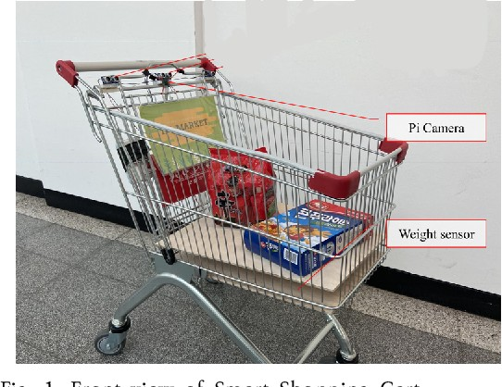
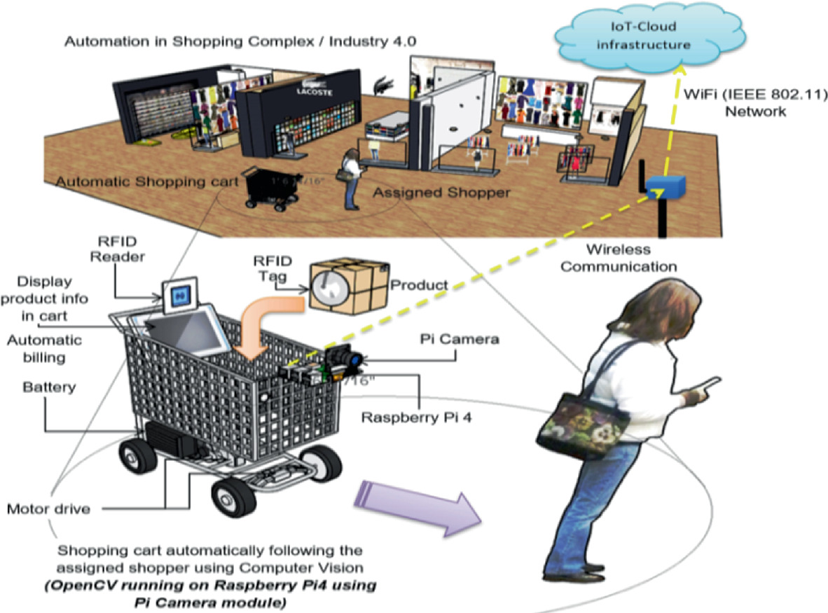
Additional Info
Additional Info
Problem
Scope
Outline
Extra 1
Timeline
Deliverable
Team
Deliverable
Intro
Use Case
Team
End
Use Case
Outline
Timeline
Scope
Problem

Slide 8
Scope
The goal of our project is to generate a bill using automated hardware as soon the user is done with their shopping.
Finding a dataset would be difficult. We plan on building our own dataset that is not biased towards any single item.
Develop a model for image classification to identify objects picked up by the customer.
Our model focuses mainly on objects like fruits and vegetables not carrying any barcode on them.
Additional Info
Additional Info
Problem
Scope
Outline
Extra 1
Timeline
Deliverable
Team
Deliverable
Intro
Use Case
Team
End
Use Case
Outline
Timeline
Scope
Problem

Slide 9
Feasibility Study
Upon referring to a few research papers in the field, YOLO(You Only Look Once), VGG19, RESNET, and ALEXNET, DenseNET are some available options, however they require a lot of computing power and optimizing them will be time-consuming because of the various parameters they come with.
Reflecting on the changes made to the cart on the app would be a tedious task.
Our model doesn’t take into consideration those items already packed having a barcode on them.
Additional Info
Additional Info
Problem
Scope
Outline
Extra 1
Timeline
Deliverable
Team
Deliverable
Intro
Use Case
Team
End
Use Case
Outline
Timeline
Scope
Problem

Slide 10
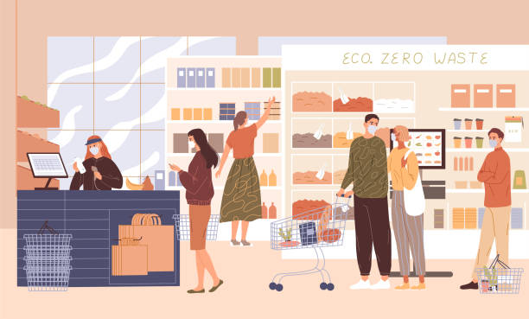
Use Cases & Application
During recent times Shopping marts are having a hard time maintaining social distancing, especially during the billing phase as it is the one choke point every customer has to pass through. Moreover, every customer takes a variable amount of time to get their items billed, causing huge queues. We aim to make this whole experience of shopping easier.
Additional Info
Additional Info
Problem
Scope
Outline
Scope
Extra 1
Timeline
Deliverable
Team
Deliverable
Intro
Use Case
Team
End
Timeline
Use Case
Outline
Problem

Slide 11
Deliverables
Capstone I Deliverables :
⮚ Problem statement
⮚ Literature Survey and Data Acquisition
⮚ Design of implementation.
⮚ Exploring architecture of hardware being used
Capstone II Deliverables :
⮚ Project Implementation
⮚ Possible ways of optimizations if necessary
⮚ Results and findings
⮚ Final Project Report / Poster Presentation
Additional Info
Additional Info
Problem
Scope
Outline
Scope
Extra 1
Timeline
Use Case
Team
Deliverable
Intro
Use Case
Team
End
Timeline
Deliverable
Outline
Problem

Slide 12
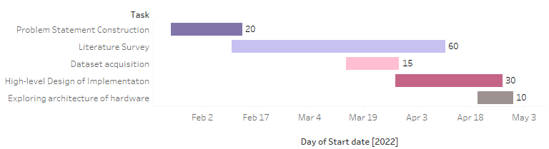
Phase 1
Additional Info
Additional Info
Problem
Scope
Outline
Scope
Extra 1
Timeline
Use Case
Team
Deliverable
Intro
Use Case
Team
End
Deliverable
Outline
Timeline
Problem

Slide 13
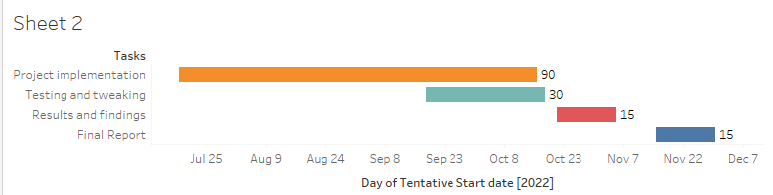
Phase 2
Additional Info
Additional Info
Problem
Scope
Outline
Scope
Extra 1
Timeline
Use Case
Team
Deliverable
Intro
Use Case
Team
End
Deliverable
Outline
Timeline
Problem

Slide 14
References used as of now
https://ieeexplore.ieee.org/abstract/document/9134378
https://ieeexplore.ieee.org/document/8697995
https://github.com/natanielruiz/android-yolo#:~:text=android%2Dyolo%20is%20the%20first,usable%20out%20of%20the%20box.&text=Then%20open%20the%20project%20on,command%20and%20selecting%20your%20device.
Additional Info
Scope
Deliverable
Use Case
Team
End
Timeline
Outline
Problem

Slide 15
THANK YOU
Additional Info
Scope
Deliverable
Team
Use Case
Team
End
Timeline
Outline
Problem

