Slide 1
UE19CS390A – Capstone Project Review #2
(Project Requirements Specification and Literature Survey)
Project Title : Automated Billing cart
Project ID : 75
Project Guide : Prajwala T.R
Project Team :
PES2U1G9CS198 Kuntal Gorai
PES2UG19CS346 S V S C Santosh
PES2UG19CS391 Skanda S
PES2UG19CS454 Vijay Murugan A S

Slide 2
Outline
Abstract
Motivation Scope of the Project
Suggestions from Review – 1
Functional and Non - Functional Requirements
Literature Survey
Capstone (Phase-I & Phase-II) Project Timeline
Conclusion
References

Slide 3
Abstract
Introduction
Shopping malls have become an integral part of city life and a lot of people commute to these marts to get their daily essentials and groceries. However, we are all forced to go through the tedious task of getting our items billed. The billing phase is the one choke point every customer has to pass through. Moreover, every customer takes a variable amount of time to get their items billed, causing huge queues. We aim to make this whole experience of shopping easier.

Slide 4
Abstract
Problem Statement
•Standing in long queues is time consuming and tedious.
•This Project aims to design a system that detects and classifies the commodities placed into the shopping cart in a systematic manner using Deep Learning techniques.
•This system will add the item when placed into the cart and update the details of the items on the app, finally generating the bill.

Slide 5
Motivation and Scope of the Project
Retail stores rely on cashiers or self-service checkout systems to process the
customers’ purchases. Since most products have barcodes that can be scanned,
the checkout time has already been minimized. However, fruits and vegetables are
commonly processed differently. The cashier or the customer need to manually
identify the class of product being bought and look for it in the system. With
that application in mind, our purpose is to present an initial approach for fruit and
vegetable classification in order to check its feasibility for such application

Slide 6
Suggestions from Review – 1
Do not try to make modifications to any of the model's architecture to introduce novelty as novelty automatically falls into picture
Think about how payment is processed

Slide 7
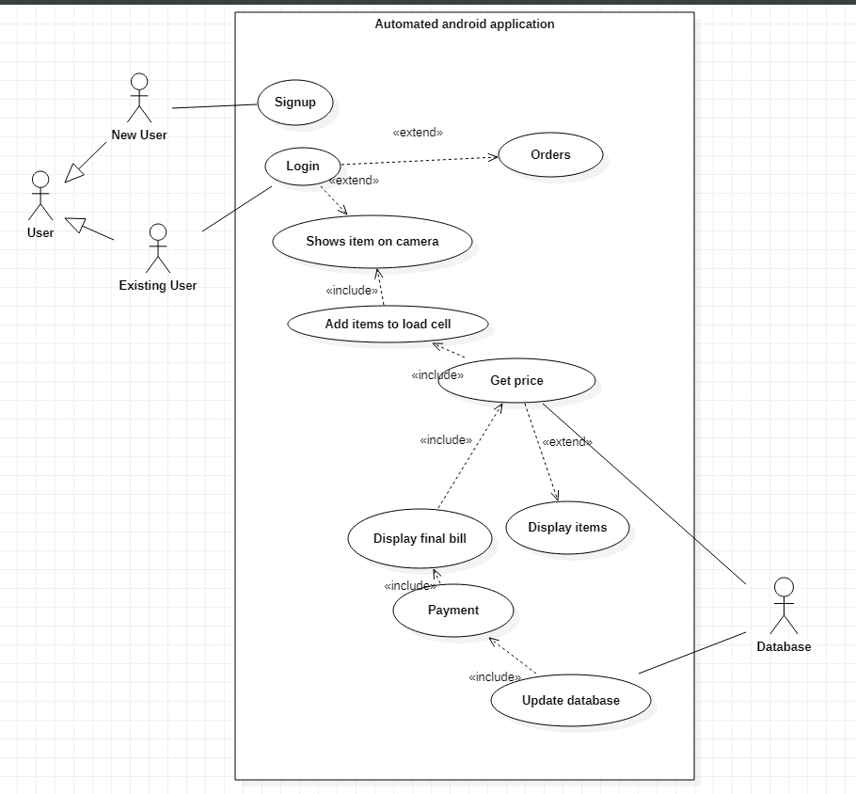
User Classes and Characteristics

Slide 8
Constraints / Dependencies / Assumptions / Risks
CONSTRAINTS
A customer shows a cheaper product and places the expensive product into the cart i.e., fooling the system.
Actual weight being different from the weight measured by the load cell.
DEPENDENCIES
Keras, TensorFlow, OpenCV, DarkFlow
ASSUMPTIONS
A customer should have android phone which is compatible with the requirements of our app.
Payment is handled by third party interface like Razor Pay, or in-built wallets
RISKS
The app crashing.
Failure of Hardware Resources

Slide 9
Functional Requirements
Ability of the system to classify the items shown by the user accurately.
Authenticating the user whenever necessary.
Upon items added to the cart, the load-cell will work accurately, and the weight will be reflected on app.
The app is robust and is always connected to the Arduino when in use.

Slide 10
Non - Functional Requirements
Ability of model to perform classification of item within 3 seconds.
Ability to deploy the trained model in resource deficit devices for making classification of products.
Ensure user-friendliness in the app.

Slide 11
Literature Survey
Paper 1: Machine Learning Models
Paper Details | Objective of paper, Techniques/Methods | Advantages | Limitations
Fruit Classification for Retail Stores Using Deep Learning Jose Luis Rojas-Aranda(B), Jose Ignacio Nunez-Varela, J. C. Cuevas-Tello, and Gabriela Rangel-Ramirez Source of Paper: Springer Date of Publication: 17 June 2020 | Objective: Classify fruits based on images and additional features MobileNetV2 by Keras Train By TensorFlow Additional Input Features Custom Dataset Transfer Learning Replace Dense Layer RMS Prop Optimizer Batch Normizalition K Means used for Colour Accuracy obtained: 95% for images without plastic bags and 93% for with | Plastic Bags considered Data Augmentation Computationally inexpensive Small dataset Improvised technique | Varieties not considered Constant Background 3 Types only Ensamble C

Slide 12
Literature Survey
Paper 2: Machine Learning Models
Paper Details | Objective of paper, Techniques/Methods | Advantages | Limitations
A Hierarchical Grocery Store Image Dataset with Visual and Semantic Labels Marcus Klasson, Cheng Zhang, Hedvig Kjellstrom Source of Paper: Arxiv / Research Gate Date of Publication: January2020 | Objective: Help Visually impaired people with grocery detection in supermarkets. Custom Dataset Both Generative and Discriminative. Multi view deep generative model Linear Classifier Pretrained CNN Choose Feature Sufficient Power SVM SVM + DenseNet Accuracy Obtained: 85% | Small Dataset Real life images | High Computational Resources Lot of Time

Slide 13
Literature Survey
Paper 4: App Development
Paper Details | Objective of paper, Techniques/Methods | Advantages | Limitations
Android Application for Grocery Ordering System Shubham B Dubey1, Gaurav M Kadam2, Omkar Angane3 Source: https://www.irjet.net Date of Publication: 04 Apr 2021 | Objective: To develop an interactive, user-friendly application for people to shop groceries online. Android Studio JUnit 4 Espresso Test Recorder User-friendly GUI for ordering groceries. Signup/Login Browse through the products and choose. Payment Section. | The app performed efficiently with no errors. The application did not crash at any point in time. The app was able to control the smart shopping cart without any delays. Based on the commands received, the shopping cart was able to move in the preferred directions. There is 100% success rate in each direction of the motion control. The app saves users a lot of time. | This application is not developed for iOS. The UID of all the items must be scanned.

Slide 14
Paper 3: Deployment of Machine Learning Models
Literature Survey
Paper Details | Objective of paper, Techniques/Methods | Advantages | Limitations
Deployment of Deep Learning Models on Resource-Deficient Devices for Object Detection Ameema Zaina , Dabeeruddin Syed Department of Electrical & Computer Engineering Texas A&M University College Station, Texas, U.S.A. Source of paper: IEEE Date of publication: 11 May 2020 | Objective: Faster deployment of deep learning model in resource deficient devices like mobile. 1. The weights of the trained model (high equipped device) - protobuf file(mobile device compatible). 2. Trained model - tiny yolo v2. 3. The dataset - VOC dataset. 4. Darknet with CUDA, dark flow and OpenCV 5. Image recognition model on android (TensorFlow).It performs three functions – TensorFlow Classify, Tenser Flow Stylize and TensorFlow Detect. 6. TenserFlow Detect- shared object(.so) file and .jar file 7. The .so file and .jar file - bazel. 8. Deployed in real time. | The device detects objects in real time, and it does not require any access to the internet. The object detection model was able to detect and classify object in mobile device within fraction of seconds. | Generation of protobuf file is quite challenging. Incompatibilities with versions of python and OpenCV Moving a huge neural network to mobile device sand making device understand the deep layers of network. Developing model on less resources(e.g., without a GPU) Object detection when mobile device move at higher speed Object detection under low illumination.

Slide 15
Literature Survey
Paper 5: IoT Hardware
Paper Details | Objective of paper, Techniques/Methods | Advantages | Limitations
Automatic Load Detector Design to Determine the Strength of Pedestrian Bridges Using Load Cell Sensor Based on Arduino Source: https://doi.org/10.35882/ijeeemi.v4i1.3 Date of publication: February 2022 | Objective: To develop a system that can test both static and dynamic loads using load cells. Load cell hx711 Arduino UNO LCD screen | The system was able to measure the weights dynamically. The system measures weight in real-time and displays it on the LCD screen. | The system was measured to give outputs with up to 8.5% error, which is not negligible.

Slide 16
Literature Survey
Hypothesis | Points supporting Hypothesis | Points against Hypothesis | Alternate Hypothesis
Use of DenseNet/ Alex NET as our main model | Accuracy achieved is very very high compared to any other CNN comparable | Needs very large data sets for performing well Computational Resources needed are very high | Use of Data Augmentation techniques Use of MobileNet V2
Deployment of model developed onto cloud | No need to worry about the computational resources available on the users device | Need to have continuous network connection to send requests onto cloud | Deploy model onto users device integrated with app as a protobuf file

Slide 17
Summary of Literature Survey
Develop a model using MobileNet v2 training it completely on our devices and for prediction can be used on user’s device for classifying and generating the bill
Convert the pretrained model into a mobile device compatible file i.e. protobuf file which is achieved using Dark Flow and OpenCV.
Once converted we pass this file to our android studio package where we use Tensor flow module to predict images.
Make use of android studio to develop a fully working application whose flow is from login/ signup to the payment section with several intermediate steps to generate a bill.
We can make use of a loadcell to calculate weight of the groceries added to the cart and is monitored continuously by the Arduino connected to the device.

Slide 18
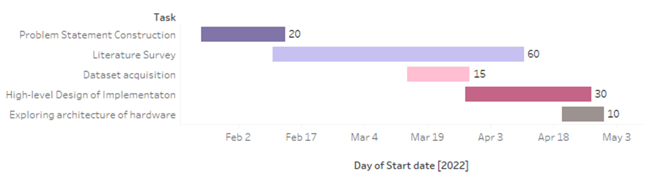
Capstone (Phase-I & Phase-II) Project Timeline
Phase 1
The work is distributed equally amongst ourselves for each task in the first phase.

Slide 19
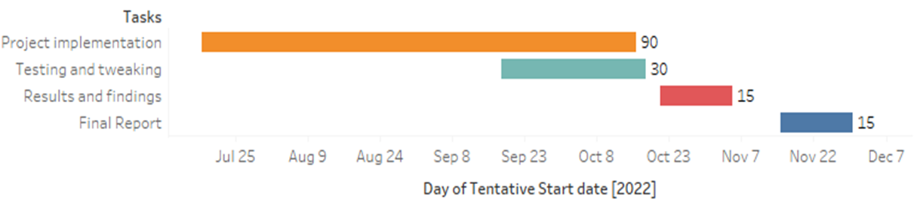
Capstone (Phase-I & Phase-II) Project Timeline
Phase 2
Skanda and Vijay will be dealing with the image classification using deep learning techniques.
Kuntal and Santosh will be handling the app development part.
The IOT implementation will be handled by all four with equal distribution.

Slide 20
References
https://ieeexplore.ieee.org/abstract/document/9089651
https://www.irjet.net/archives/V8/i4/IRJET-V8I4678.pdf
https://arxiv.org/pdf/1901.00711.pdf
https://link.springer.com/chapter/10.1007/978-3-030-49076-8_1

Slide 21
Thank You

