Slide 1
UE19CS390A – Project Phase – 1
End Semester Assessment
Project Title : Automated Billing Cart
Project ID : 75
Project Guide : Prof. Prajwala T R
Project Team :
PES2UG19CS198 Kuntal Gorai
PES2UG19CS346 S V S C Santosh
PES2UG19CS391 Skanda S
PES2UG19CS454 Vijay Murgan A S

Slide 2
Agenda
Introduction and Motivation
Problem Statement
Abstract and Scope
Literature Survey / Existing System
Suggestions from Review – 3
Requirements Specification
Design Approach
Design Constraints, Assumptions & Dependencies
Proposed System / Approach
Architecture
Design Description
Project Progress
References

Slide 3
Introduction and Motivation
Shopping malls have become an integral part of city life and a lot of people commute to these marts to get their daily essentials and groceries.
However, we are all forced to go through the tedious task of getting our items billed.
For some items, bar-codes and RFID tags cannot be used as they must be stuck on each of the items after weighing them individually.

Slide 4
Problem Statement
Standing in long queues is time-consuming and tedious.
This Project aims to design a system that detects and classifies the commodities placed into the shopping cart in a systematic manner using Deep Learning techniques.
This system will add the item when placed into the cart and update the details of the items on the app, finally generating the bill.

Slide 5
Abstract
Shopping malls are visited by a large number of people every day, and this causes huge queues for billing. To avoid this systems such as bar codes and RFID tags have been used to reduce billing times. This system has shown a reduction in billing times, but the problem prevails. We use an image classification model trained on a custom dataset to classify and bill grocery items like fruits and vegetables as and when they are added to the cart such that the final bill can be generated at the click of a button and hence eliminates billing time.

Slide 6
Scope
Retail stores rely on cashiers or self-service checkout systems to process the customers’ purchases. Since most products have barcodes that can be scanned, the checkout time has already been minimized.
However, fruits and vegetables are commonly processed differently. The cashier or the customer needs to manually identify the class of product being bought and look for it in the system.
With that application in mind, our purpose is to present an initial approach for fruit and vegetable classification in order to check its feasibility for such application.

Slide 7
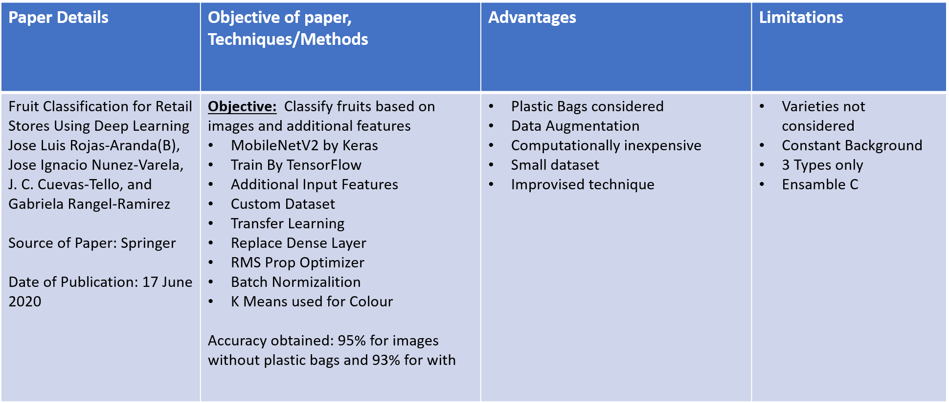
Literature Survey/Existing System
Paper 1: Machine Learning Models

Slide 8
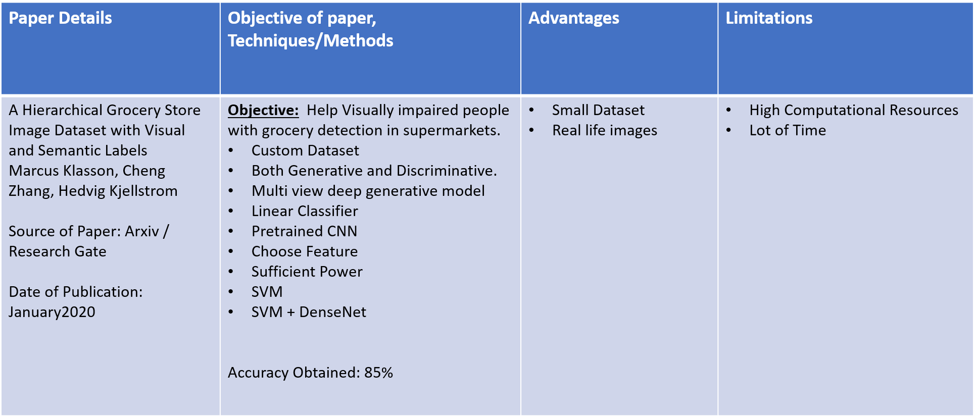
Literature Survey/Existing System
Paper 2: Machine Learning Models

Slide 9
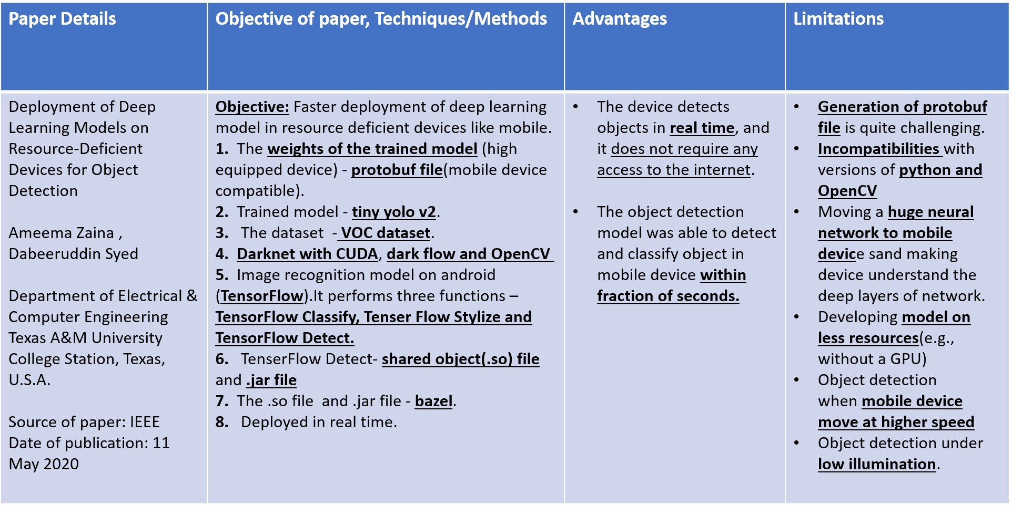
Literature Survey
Paper 3: Deployment of Machine Learning Models

Slide 10
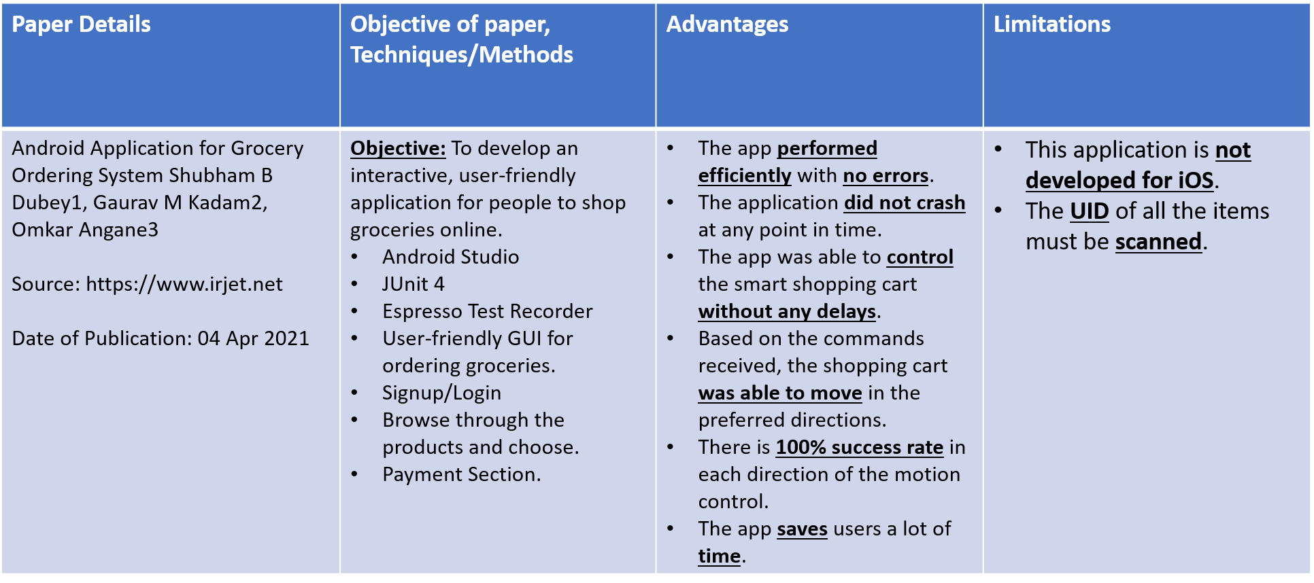
Literature Survey
Paper 4: App Development

Slide 11
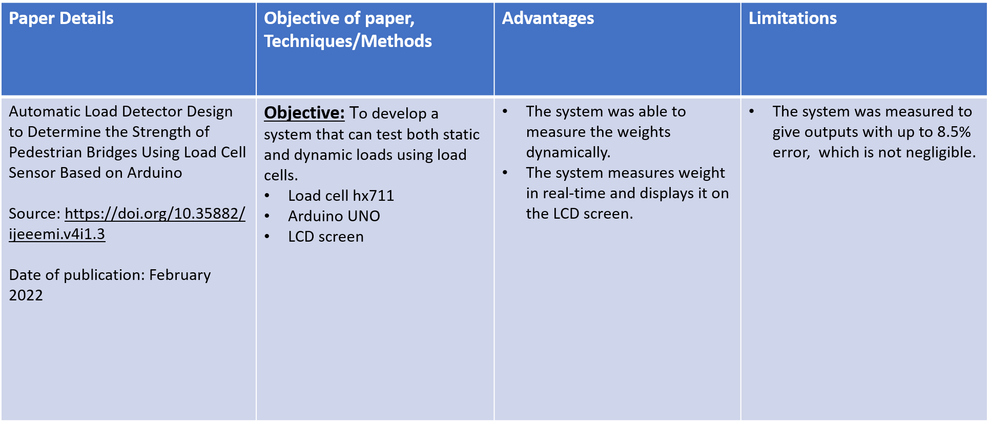
Literature Survey
Paper 5: IoT Hardware

Slide 12
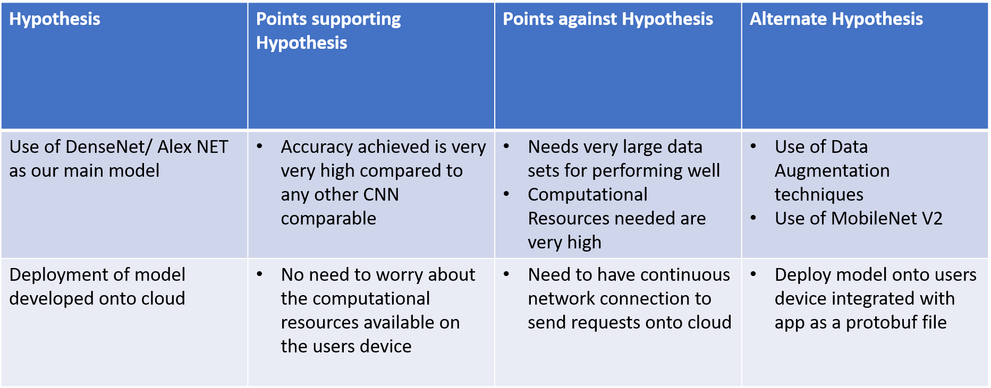
Literature Survey

Slide 13
Existing System
Existing systems mainly use RFID tags and barcodes to bill items. With this in place, it is not feasible to tag individual pieces of fruits and vegetables every time new stock arrives.
It is simply too tedious and time-consuming, and in extreme cases can cost the business.

Slide 14
Suggestions from Review - 3
Pilot project:
We were suggested to start this off as a pilot project to reduce complications in the product. We plan to move ahead with this in mind.
Dataset:
So far, we have created a custom dataset of fruits and images, with each class having a minimum of 600 images and a maximum of 1,500 images.

Slide 15
Design Approach
We will have a camera that feeds the input image to the model that then classifies it. This classification data is used to pull the cost of the item from the database. The data from the Arduino board connected to the load cell is then used to calculate the item’s final cost. This is then entered into the bill. The user may delete this entry at any time to remove the item from the cart. The problems that may arise are: if multiple items are held in front of the camera, they may get misclassified, the load cell may be inaccurate at weighing the items, or the app may malfunction.

Slide 16
Requirements Specification
Android devices must have internet hardware and support HTTP protocols.
The camera on the phone must be functional.
A load cell to measure the weight of the item being placed on the cart
Arduino board for communication between the android app and the load cell
Use MobileNetV2 with transfer learning for real-time grocery classification since it has less trainable parameters and uses fewer computational resources.
Android Studio to develop the application that supports all Android devices version 8.0 and above.
DarkFlow with OpenCV and Cython for the generation of the protobuf file.

Slide 17
Design Constraints, Assumptions & Dependencies
DESIGN CONSTRAINTS
The mobile device must be connected to the Arduino board at all times
DEPENDENCIES
Keras, TensorFlow, OpenCV, DarkFlow
ASSUMPTIONS
A customer should have an Android phone that is compatible with our app's requirements.
Payment is handled by a third-party interfaces like Razor Pay, or in-built wallets

Slide 18

Design Details
Novelty(What is unique about this idea?) :-All previous projects implemented made use of RFID tags which are attached to every item. Also, items like fruits and vegetables don’t always have an RFID tag that is considered in our project.
Innovativeness(What is new about our implementation?) :- Integrating transfer learning using MobileNetV2 in Android Studio with integration from continuous value from Arduino giving weights.

Slide 19
Design Details
Security (How well is our projected protected to ensure privacy):- Making use of Encryption and Decryption techniques to ensure the privacy of the user is protected. Only the admin of the Super Market would be able to modify the weights, price, and other necessary details of that supermarket. In the case Of payments, the use of already existing third-party service would deal with the total security of payments.
Reusability(How well can this application be used for other purposes):- The concept of using transfer learning enables us to reuse the model developed for any other classification task which could easily enable our app to solve any classification problem easily.

Slide 20


Design Details
Reliability(How does the proposed model perform consistently well?):- To ensure optimum reliability, we aim to construct a model with high precision and low latency.
Performance(How well does the proposed model execute a function?):- We aim to train the model to be able to classify the provided item in 3-4 seconds with an accuracy of at least 90%.

Slide 21
Proposed System / Approach
The proposed system will have the following features:
1. An efficient deep learning model which can classify the items with very minimal error and faster classification. We aim to use transfer learning with MobileNetV2, which makes it lightweight, enabling it to run on resource-deficient devices.
2. An android app that can perform functionalities like classifying the items placed in front of the camera, adding items to a cart, removing items from the cart, and paying the bill for items added to the cart.

Slide 22
Proposed System / Approach
3. A load cell acts as a weight sensor and helps customers estimate the weight of the item they are trying to add to their cart.
4. An Arduino board to send the weights detected by the load cell with the android app.
5. Finally, a cloud backend - for which we plan to employ AWS, which will serve as a database to store the details about the items like cost, quantity, and description available in the supermarket, the order history consisting of orders that the customer had bought at the store

Slide 23
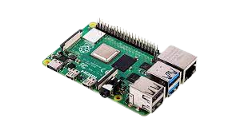
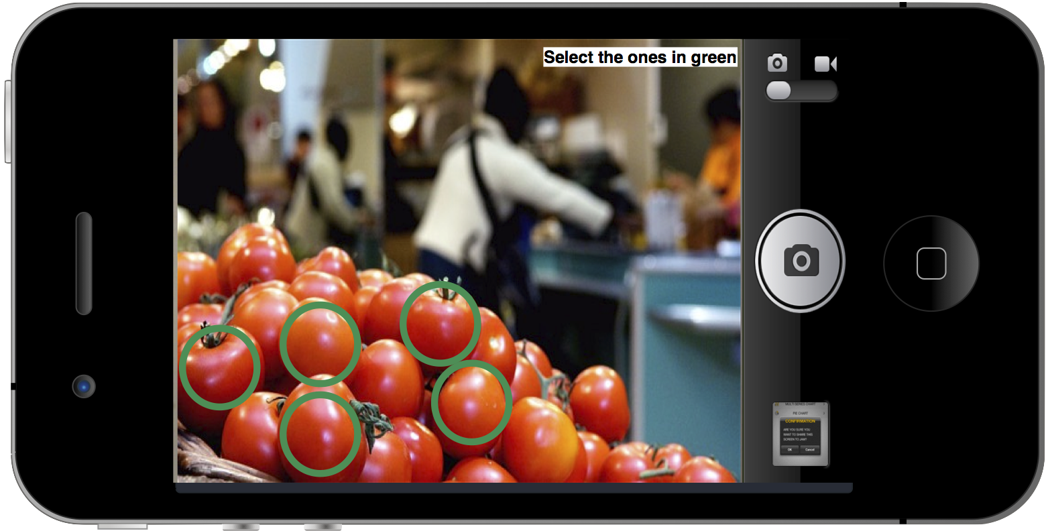


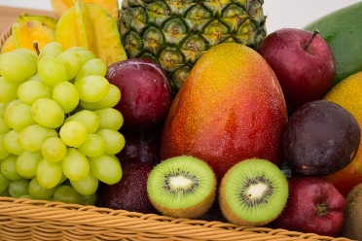
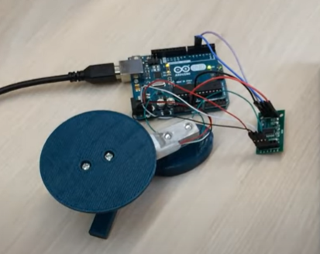
Architecture
Camera
Database
Arduino/Raspberry Pi
App
Items in the cart
Load Cell

Slide 24
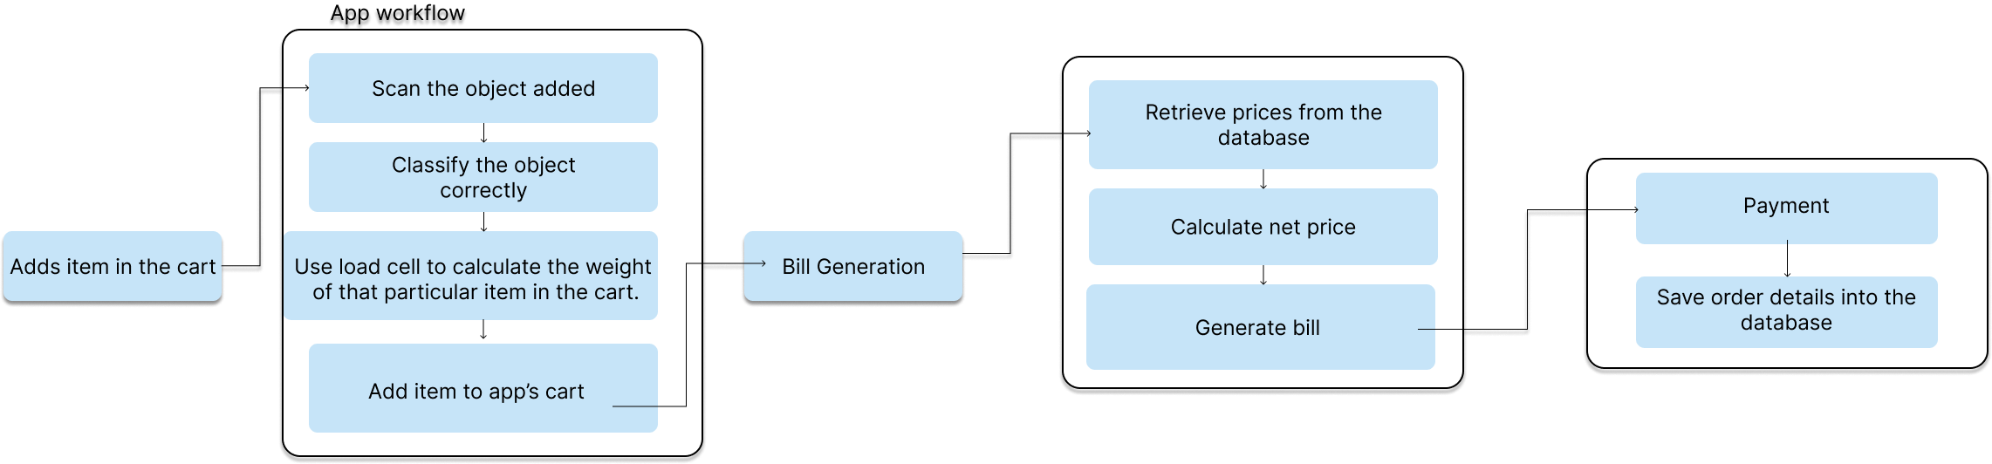
Workflow

Slide 25
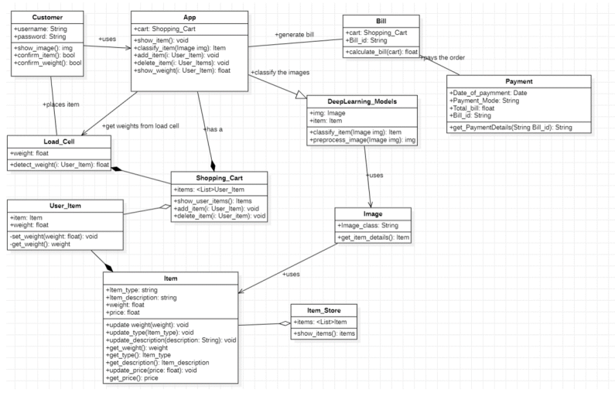
Design Description (if applicable)
Master class diagram

Slide 26
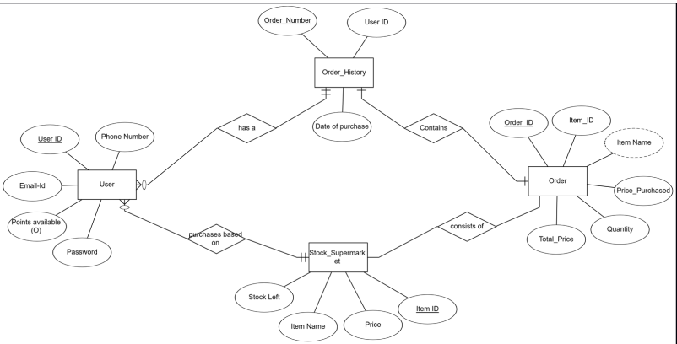
Design Description (if applicable)
ER Diagram

Slide 27
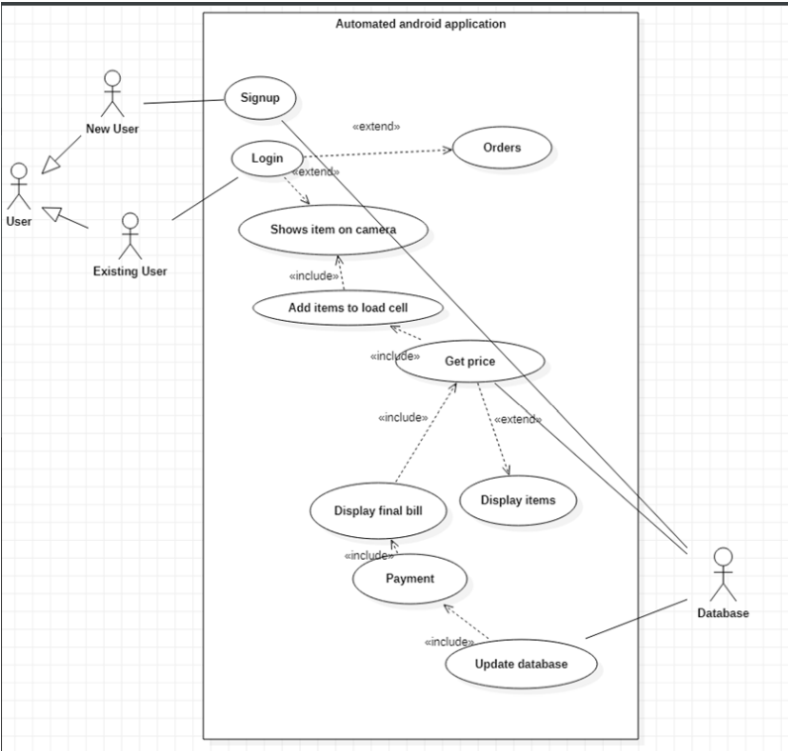
Design Description (if applicable)
Use Case Diagrams

Slide 28
Design Description (if applicable)
Report Layouts
1. Introduction
1.1Purpose
1.2Target Audience
2. Design Implementation
2.1Functional Dependencies
2.2 Function Description Table
3. System Documentation
3.1 Overview
3.2 Technical Architecture (Training, Testing)
3.3 Business Architecture
4. Support Documentation
5. User Documentation
6.References
Name | Version | Actors | Pre conditions | During | Post condition | Exception | Additional notes

Slide 29
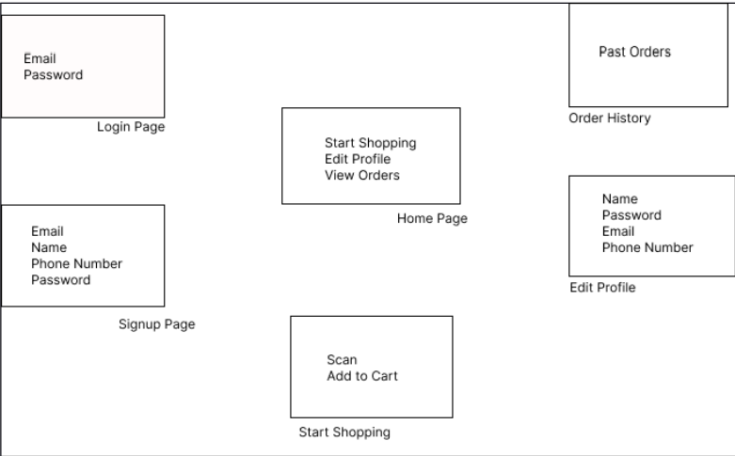
Design Description (if applicable)
External Layouts

Slide 30

Project Progress
Started Building Our Dataset by extending already existing dataset.
Tried Implementing Transfer Learning using MobileNetV2 and VGG16 for binary and multi-class classification.
Determine the Problem statement.
High-Level Design.

Slide 31
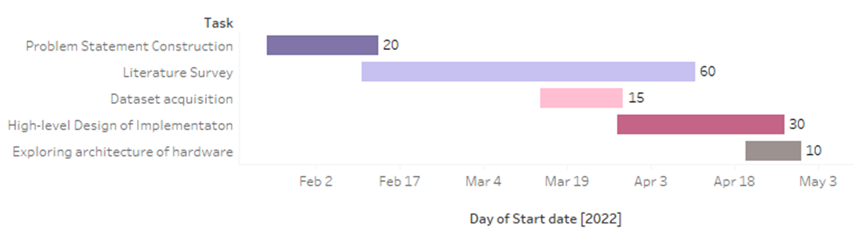
Capstone (Phase-I & Phase-II) Project Timeline
Phase 1
The work is distributed equally amongst ourselves for each task in the first phase.

Slide 32
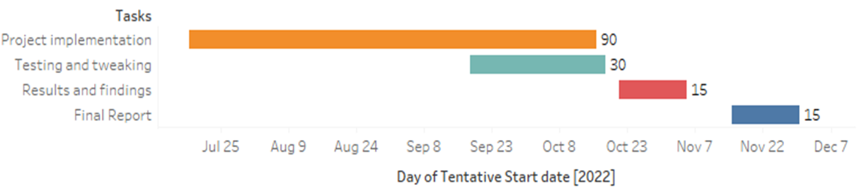
Capstone (Phase-I & Phase-II) Project Timeline
Phase 2
Skanda and Vijay will be dealing with the image classification using deep learning techniques.
Kuntal and Santosh will be handling the app development part.
The IOT implementation will be handled by all four with equal distribution.

Slide 33
Conclusion
The conclusions of the Capstone Project Phase – 1 are the following:
Designing and understanding the Problem Statement.
Understanding the Project Deliverables.
System Requirement Specifications Completed
Product Requirement Specifications Completed
Literature Survey based on past Research papers and getting an idea of the way in which, we can start off with our project.
Scraping images from different website to build a dataset for training the model.
Implemented code based on our model for classification task to understand its working.
Constructed High Level Design for our project.
We put together a proper design for the implementation of our solution.

Slide 34
References
Deployment of Deep Learning Models on Resource-Deficient Devices for Object Detection by Ameema Zainab, Dabeeruddin Syed. Link: https://ieeexplore.ieee.org/abstract/document/9089651
Android Application for Grocery Ordering System by Shubham B Dubey, Gaurav MKadam, OmkarAngane Link: https://www.irjet.net/archives/V8/i4/IRJET-V8I4678.pdf
A Hierarchical Grocery Store Image Dataset with Visual and Semantic Label by Marcus Klasson, Cheng Zhang, Hedvig Kjellstrom. Link : https://arxiv.org/pdf/1901.00711.pdf
Fruit Classification for Retail Stores Using Deep Learning by Jose Luis Rojas-Aranda, Jose Ignacio Nunez-Varela, J. C. Cuevas-Tello, Gabriela Rangel-Ramirez Link: https://link.springer.com/chapter/10.1007/978-3-030-49076-8_1
Cross Validation Voting for Improving CNN Classification in Grocery Products by Jamie Duque Domingo , Roberto Medina Aparicio, and Luis Miguel Gonzalez Rodrigo Link: https://ieeexplore.ieee.org/document/9715066

Slide 35
Thank You

