Slide 1


POST OPERATIVE PATIENT DATA
GROUP NUMBER. : 7&8
Alekhya Bulusu
Sushma Alimineti
Amulya Kuntala
Nagaphani Musunuri

Slide 2
Background :
Post operative care refers to any of your needs after a surgery. This could include cleaning the cuts , pain medication ,dressing cuts, eating or monitoring while sleeping .It is important that it’s done right in order for your body to recover properly.
Objective :
To predict the discharge decision based on the attributes given using python programming.
Path :
A data set is considered to predict the discharge decision based on the attributes. The data is analyzed using machine learning algorithms, one of which is logistic regression.

Slide 3
A glimpse of the patient data
L-CORE = Patient’s internal
temperature
L-SURF = Patient’s surface
temperature
L-O2 = Oxygen saturation
L-BP = Last measurement of
BP
SURF-STBL = Stability of patient’s surface temp.
CORE-STBL= Stability of patient’s core temp.
BP-STBL= Stability of patient’s BP.
INDEX | L-CORE | L-SURF | L-O2 | L-BP | SURF-STBL | CORE-STBL | BP-STBL | COMFORT | decision ADM-DECS
0 | mid | low | excellent | mid | stable | stable | stable | 15 | A
1 | mid | high | excellent | high | stable | stable | stable | 10 | S
2 | high | low | excellent | high | stable | stable | mod-stable | 10 | A
3 | mid | low | good | high | stable | unstable | mod-stable | 15 | A
4 | mid | mid | excellent | high | stable | stable | stable | 10 | A

Slide 4

Data and data quality check :
The given data contains 9 attributes & 90 observations.
Output variables : Discharge Decision.
The remaining 8 attributes are input variables.
The characteristic of attributes are categorical.
The missing values are in COMFORT column and are in row 46,48 & 70.

Slide 5
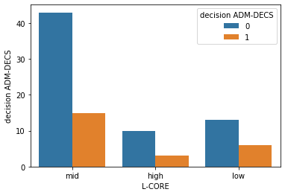
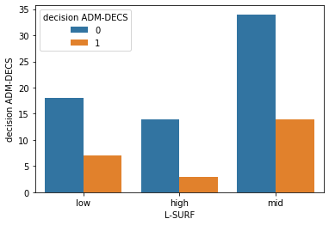
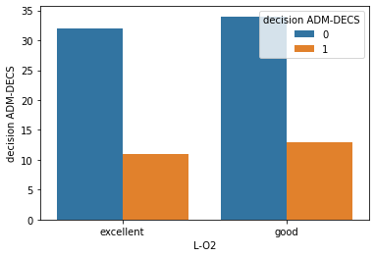
Eda insights
The missing values in our data are replaced by mode.
To analyze the data we created different plots.

Slide 6
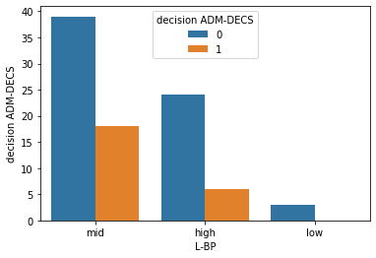
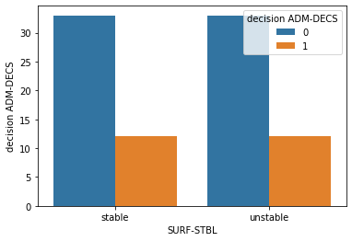
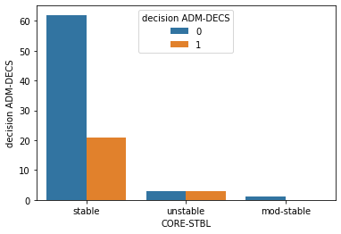
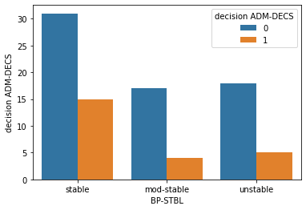

Slide 7
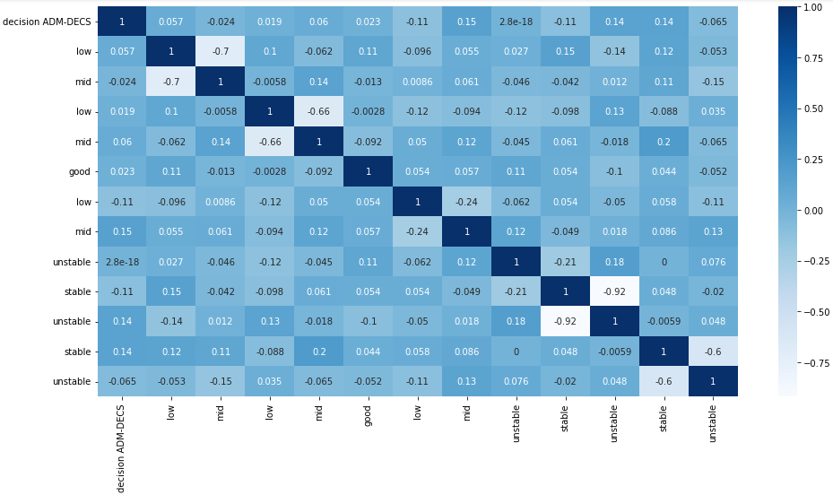
HEATMAP :
Heat map is the graphical representation of correlation matrix representing correlation between different variables.
Correlation ranges from -1 to 1. So, all the values in the heat map also are ranging from -1 to 1.
If the value is positive then there is positive correlation between the attributes. If value is negative then there is negative correlation and if the value is 0 there is no correlation i.e. the 2 attributes are independent.

Slide 8

Algorithms:
Depending on the response, the output variable is a categorical, so we use logistic regression.
Logistic regression is a machine learning classification algorithm that is used to predict the probability of a categorical dependent variable.
In this case, the dependent variable is a binary variable that contains data code as 0 & 1.
We use train and test split method to get best accuracy value.

Slide 9
SPLIT SIZE BETWEEN TRAIN AND TEST | ACCURACY
TRAIN:50% , TEST:50% | 75%
TRAIN:75% , TEST:25% | 61%
TRAIN:67% , TEST:33% | 70%
TRAIN:80% , TEST:20% | 83%
Here we took 4 splits with different test and train percentages. As
we can observe from the table above, we obtain best accuracy when split size between train and test is 80% and 20% respectively. Hence we obtain the best result at train:80% and test 20%.

Slide 10
Model statistics:
Accuracy:
It is the proportion of correct predictions over total predictions.
Code for finding accuracy:
from sklearn.metrics import accuracy_score
accuracy_score(y_test,predictions)
Output: 83% accuracy
 | PRECISION | RECALL | F1-SCORE | SUPPORT
0 | 0.88 | 0.93 | 0.90 | 15
1 | 0.50 | 0.33 | 0.40 | 3
ACCURACY |  |  | 0.83 | 18
MACRO AVG | 0.69 | 0.63 | 0.65 | 18
WEIGHTED AVG | 0.81 | 0.83 | 0.82 | 18

Slide 11

Summary:
Logistic regression is used to explain the relationship between target variable and one or more independent variables which may be numerical, categorical or ratio level.
The classification task of the data is to determine where the patients in a post operative recovery state should be send to next, because hypothermia is significant concern after surgery.

Slide 12
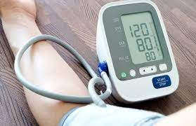
RECOMMENDATIONS:
Based on the promising results, we conclude with the following recommendations for future work on risk and warning scores for post operative patient deterioration detection as follows :
Continuous monitoring
Feature extraction
Physiological modelling
Personal health data, Lab data
Combine pre, intra & post-operative data
Temporal behavior

Slide 13
Appendix:
Codes for logistic regression :
from sklearn.linear_model import LogisticRegression
predictions=logreg.predict(X_test)
from sklearn.metrics import classification_report
classification_report(y_test,predictions)
Confusion Matrix : It describes the performance of a classification model on a set of test data for which the true values are known.
Code : from sklearn.metrics import confusion_matrix
z=confusion_matrix(y_test,predictions)
Output :
array([[14, 1],
[ 2, 1]])

Slide 14
References:
Github link:
Alekhya Bulusu: https://github.com/alekhyabulusu/unp.project-.git
Sushma Alimineti:
Amulya Kuntala:
Nagaphani Musunuri: https://github.com/phanimusunuri1234/UNP_Assignment/blob/main/unp.ipynb

Slide 15


