Slide 1
Omni Mart Retail Exploratory Data Analysis
Data Thinkers
#CHALLENGE 01
Members:
Manish Kumar Roy
Arnab Mandal
Kuntal Khan
Sujit Paul
THE MANHATTAN PROJECT

Slide 2
Data Thinkers
Members:
Manish Kumar Roy
Arnab Mandal
Kuntal Khan
Sujit Paul
#CHALLENGE 01
THE MANHATTAN PROJECT
1. Customer Age Distribution
Majority of customers are in the 18–25 age group, showing a younger customer base.
Another smaller peak is visible around 40–50 years, indicating a secondary age group of middle-aged customers.
Very few customers are above 60, meaning older demographics are underrepresented.
Insight: Marketing and product strategies should primarily target young adults (18–25), but also keep offerings for middle-aged customers (40–50).

Slide 3
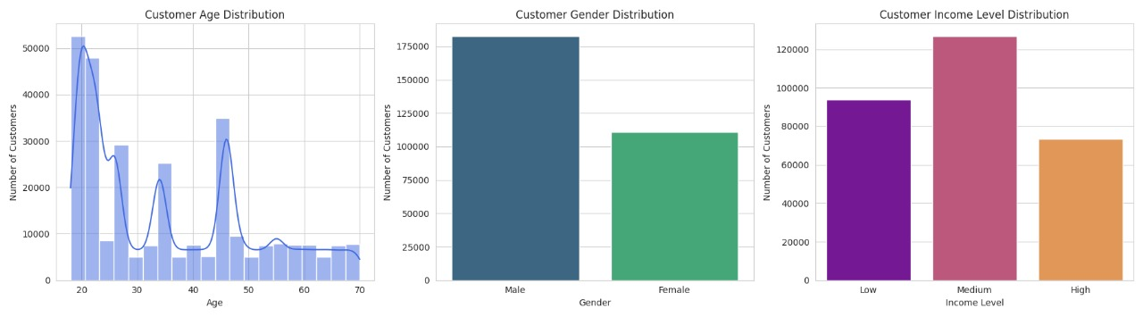
1. Customer Age Distribution
Majority of customers are in the 18–25 age group, showing a younger customer base.
Another smaller peak is visible around 40–50 years, indicating a secondary age group of middle-aged customers.
Very few customers are above 60, meaning older demographics are underrepresented.
Insight: Marketing and product strategies should primarily target young adults (18–25), but also keep offerings for middle-aged customers (40–50).
Customer Gender Distribution:
Males dominate the dataset (~175,000) compared to females (~110,000).
There is a clear gender imbalance.
Insight:
Campaigns targeting women may help in balancing customer acquisition.
Alternatively, male-focused products/services might already be driving the customer base.

Slide 4
Customer Gender Distribution:
Males dominate the dataset (~175,000) compared to females (~110,000).
There is a clear gender imbalance.
Insight:
Campaigns targeting women may help in balancing customer acquisition.
Alternatively, male-focused products/services might already be driving the customer base.
Customer Income Level Distribution
Medium-income customers form the largest group (~125,000).
Low-income customers are significant (~95,000).
High-income customers are fewer (~75,000).
Insight:
Products and services should be priced and designed for the medium-income segment, with some budget-friendly options for low-income groups.
High-income group is smaller but could be targeted for premium offerings.

Slide 5
Insight:
Products and services should be priced and designed for the medium-income segment, with some budget-friendly options for low-income groups.
High-income group is smaller but could be targeted for premium offerings.
Customer Income Level Distribution
Medium-income customers form the largest group (~125,000).
Low-income customers are significant (~95,000).
High-income customers are fewer (~75,000).
Insight:
Overall sales remain stable around 32.5M – 34.5M, with no major long-term growth or decline trend.
Peaks observed in April 2023 and September 2023, both crossing ~34.3M — these could indicate seasonal or promotional sales boosts.
Sharp dips are noticeable in May 2023, July 2023, October 2023, and March 2024 — especially March 2024, which shows the lowest sales (~32.25M).
Sales show a cyclical up-and-down pattern, suggesting possible external factors (festivals, offers, or demand cycles) influencing customer purchases
Key Takeaway:
The company has a stable sales base but should investigate reasons behind sharp dips (like May, July, and March) and try to replicate strategies that led to sales peaks (April & September).

Slide 6
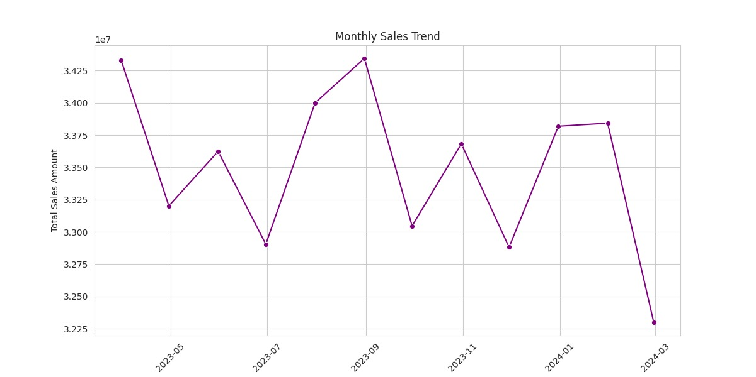
Insight:
Overall sales remain stable around 32.5M – 34.5M, with no major long-term growth or decline trend.
Peaks observed in April 2023 and September 2023, both crossing ~34.3M — these could indicate seasonal or promotional sales boosts.
Sharp dips are noticeable in May 2023, July 2023, October 2023, and March 2024 — especially March 2024, which shows the lowest sales (~32.25M).
Sales show a cyclical up-and-down pattern, suggesting possible external factors (festivals, offers, or demand cycles) influencing customer purchases.
Key Takeaway:
The company has a stable sales base but should investigate reasons behind sharp dips (like May, July, and March) and try to replicate strategies that led to sales peaks (April & September).
Insight:
USA leads significantly with the highest sales (~125M), almost 50% higher than the next country.
UK is the second largest market (~85M), showing strong performance but still far behind the USA.
Germany (~70M) is the third in line, contributing a solid share but notably less than UK and USA.
Australia (~60M) and Canada (~60M) have nearly equal sales, being the lowest contributors among the five countries.
There is a large gap between USA and other countries, indicating USA is the dominant market
Key Takeaway:
The USA should remain the primary focus market, but there’s strong potential to expand in the UK and Germany.
Australia and Canada are underperforming markets and may need localized strategies, promotions, or partnerships to boost sales.

Slide 7
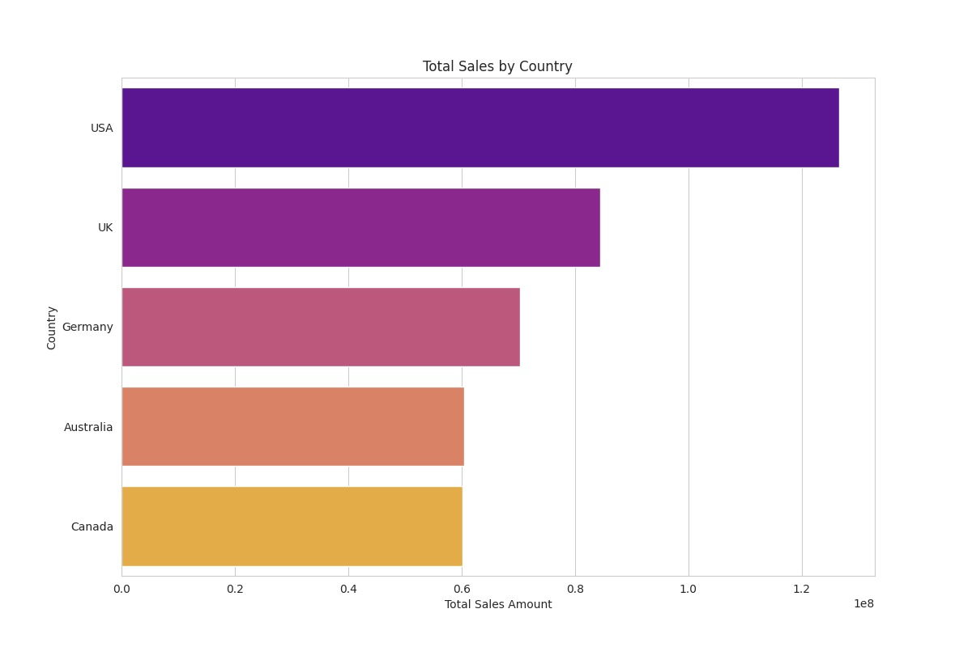
Insight:
USA leads significantly with the highest sales (~125M), almost 50% higher than the next country.
UK is the second largest market (~85M), showing strong performance but still far behind the USA.
Germany (~70M) is the third in line, contributing a solid share but notably less than UK and USA.
Australia (~60M) and Canada (~60M) have nearly equal sales, being the lowest contributors among the five countries.
There is a large gap between USA and other countries, indicating USA is the dominant market
Key Takeaway:
The USA should remain the primary focus market, but there’s strong potential to expand in the UK and Germany.
Australia and Canada are underperforming markets and may need localized strategies, promotions, or partnerships to boost sales.
Insight:
Customer segmentation (Regular vs Premium vs New) does not strongly affect per-transaction
Insight:
Income level is not a strong differentiator for per-transaction spending. All groups spend similarly, suggesting pricing or product range appeals equally to all income levels.
Key Takeaway:
The business may need to rethink Premium offerings, since premium customers are not spending more than others.
Opportunities exist to design targeted promotions to encourage higher per-transaction spending in Premium and High-income groups

Slide 8
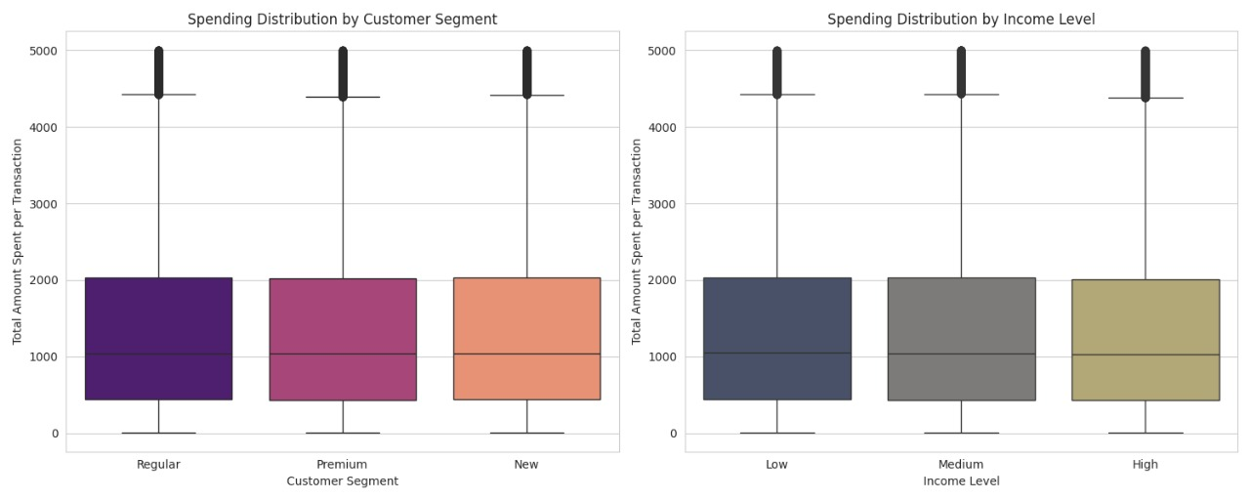
Insight:
Customer segmentation (Regular vs Premium vs New) does not strongly affect per-transaction
Insight:
Income level is not a strong differentiator for per-transaction spending. All groups spend similarly, suggesting pricing or product range appeals equally to all income levels.
Key Takeaway:
The business may need to rethink Premium offerings, since premium customers are not spending more than others.
Opportunities exist to design targeted promotions to encourage higher per-transaction spending in Premium and High-income groups.
Insight:
Electronics is the most popular category (~69,000 purchases), indicating strong customer demand for tech products.
Grocery follows closely (~65,000 purchases), showing that everyday essentials are also a major sales driver.
Clothing, Books, and Home Decor have similar purchase volumes (~52,000–53,000 each), indicating balanced customer interest in lifestyle categories.
Key Takeaway:
Electronics and Grocery are the core revenue generators.
Clothing, Books, and Home Decor are secondary contributors, but still significant.
Strategies could focus on bundling lifestyle products with Electronics or Grocery to boost cross-category sales.

Slide 9
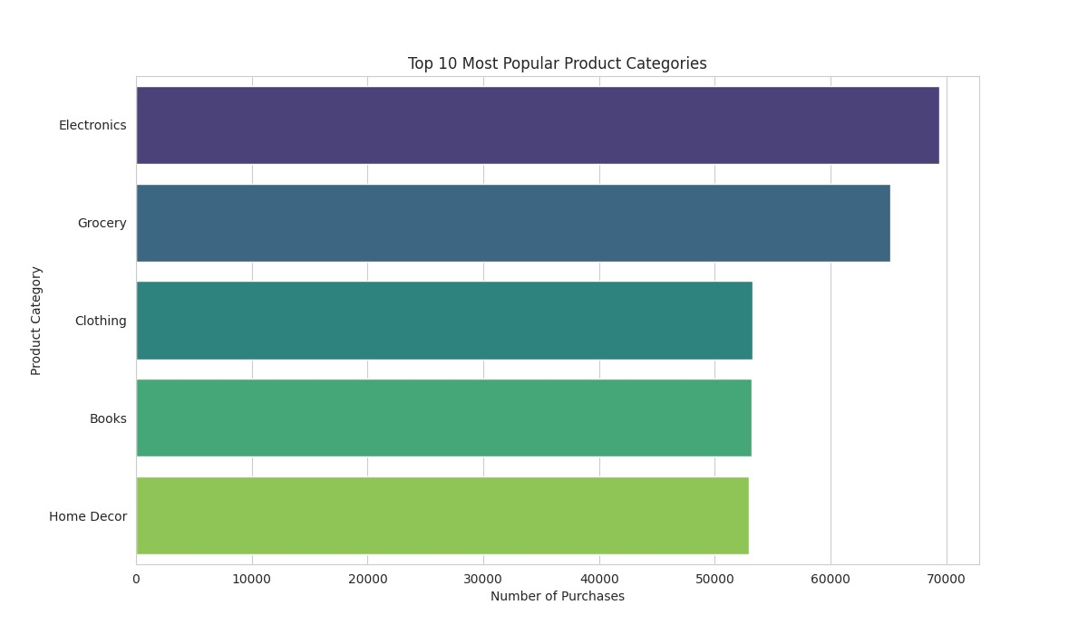
Key Takeaway:
Electronics and Grocery are the core revenue generators.
Clothing, Books, and Home Decor are secondary contributors, but still significant.
Strategies could focus on bundling lifestyle products with Electronics or Grocery to boost cross-category sales.
Insight:
Electronics is the most popular category (~69,000 purchases), indicating strong customer demand for tech products.
Grocery follows closely (~65,000 purchases), showing that everyday essentials are also a major sales driver.
Clothing, Books, and Home Decor have similar purchase volumes (~52,000–53,000 each), indicating balanced customer interest in lifestyle categories.
Insight:
Volatility observed – Growth rates fluctuate frequently between positive and negative, showing unstable sales performance.
Key Takeaway:
Sales are unstable and highly seasonal/volatile.
The business needs better forecasting, promotions, or customer retention strategies to reduce sudden declines.
Final observation – The last month shows the steepest decline (-4.5%), which is a warning sign for business sustainability.
Pattern – Growth alternates between positive and negative frequently, meaning no consistent upward trend is established.

Slide 10
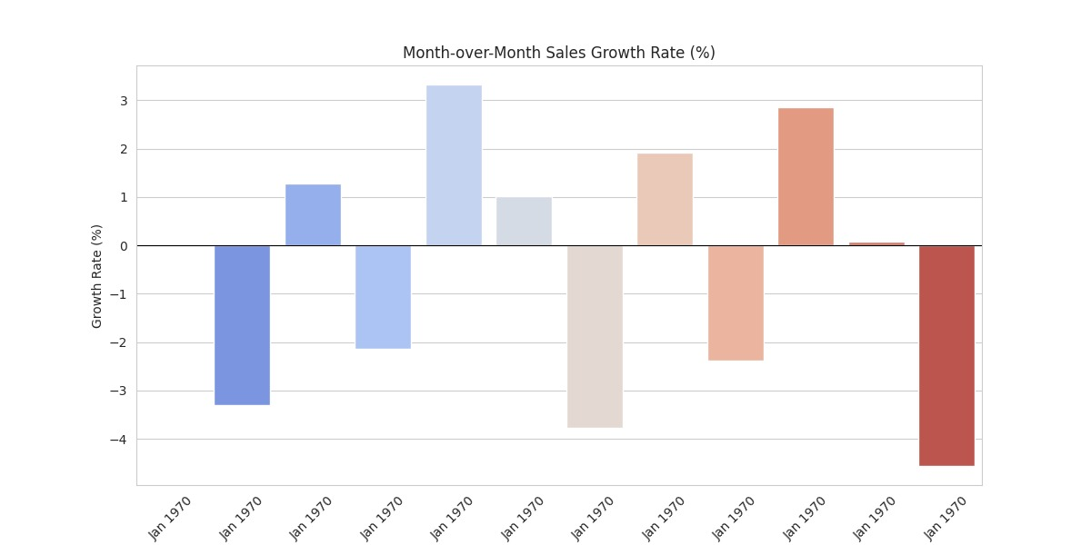
Insight:
Volatility observed – Growth rates fluctuate frequently between positive and negative, showing unstable sales performance.
Final observation – The last month shows the steepest decline (-4.5%), which is a warning sign for business sustainability.
Pattern – Growth alternates between positive and negative frequently, meaning no consistent upward trend is established.
Key Takeaway:
Sales are unstable and highly seasonal/volatile.
The business needs better forecasting, promotions, or customer retention strategies to reduce sudden declines.
Thank You

Slide 11
Thank You

