Slide 1
Loan Risk Analysis and Prediction System
DET Mini Project Presentation

Slide 2
Project Objective
Analyze a real loan dataset and identify default-related patterns
Apply preprocessing, ETL, association mining, classification, and clustering
Present insights using charts, reports, and a prediction module

Slide 3
Dataset Exploration
Dataset: lending_club_loan_two.csv
Rows: 396,030 and selected features: 24
Explored numerical, categorical, and time-related fields
Key risk indicators: loan amount, income, DTI, loan status, grade

Slide 4
Data Preprocessing
Handled missing values and removed unnecessary columns
Clipped outliers using IQR-based limits
Transformed date fields into issue year, issue month, and credit history years
Created engineered features: default_flag and default_stage

Slide 5
Unit III Concepts and Algorithm
Association rule mining finds relationships among borrower features
Support measures frequency, confidence measures reliability, and lift measures strength
Apriori algorithm was used after converting continuous values into buckets

Slide 6
Unit IV Concepts and Algorithms
Supervised learning predicts default using labeled data
Unsupervised learning groups borrowers without target labels
Algorithms used: Logistic Regression, Decision Tree, Random Forest, and K-Means

Slide 7
Supervised Learning Results
Model | Accuracy | F1 Score
Logistic Regression | 0.8056 | 0.0876
Decision Tree | 0.8017 | 0.1476
Random Forest | 0.8047 | 0.0358

Slide 8
Unsupervised Learning Results
Cluster | Records | Avg Default Flag
low_risk | 64,794 | 0.0000
medium_risk | 32,769 | 0.0354
high_risk | 22,437 | 0.9997

Slide 9
Visualization Tools and Techniques
Tools used: Python, Matplotlib, and Seaborn
Charts created: risk distribution, cluster scatter plot, association rules, and model comparison
Visualizations support analysis, reporting, and presentation clarity

Slide 10
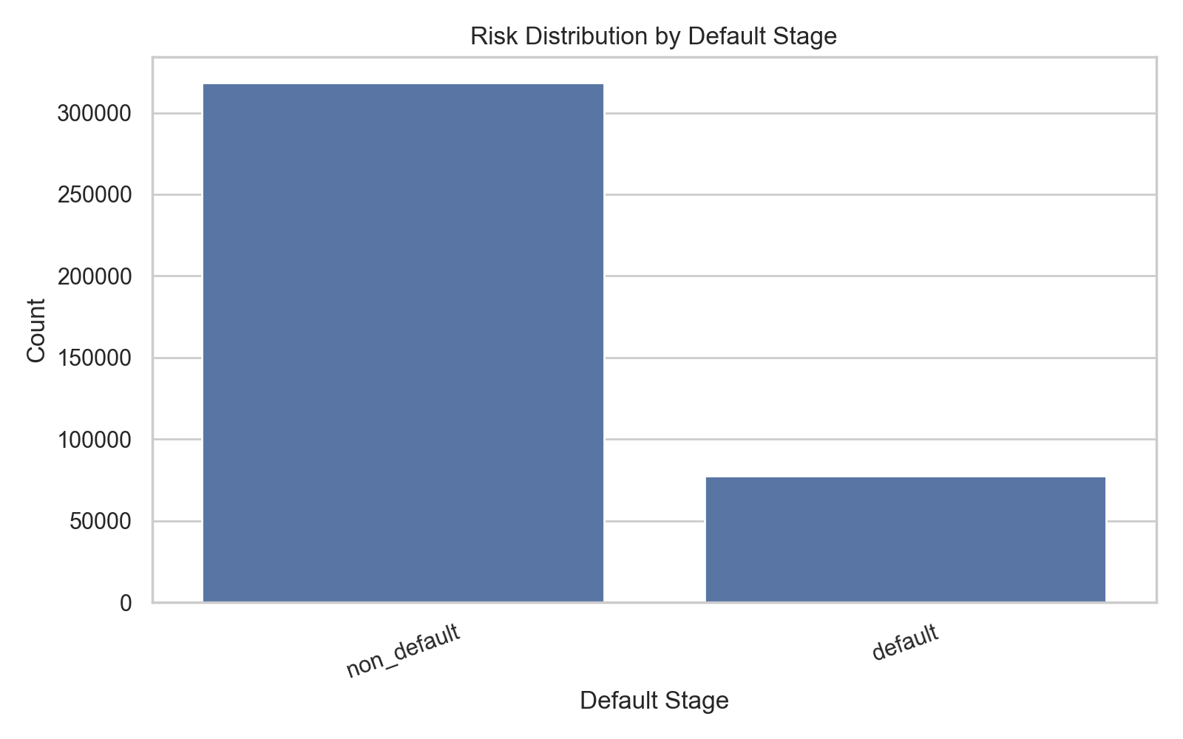
Risk Distribution
Borrower status distribution from the processed dataset

Slide 11
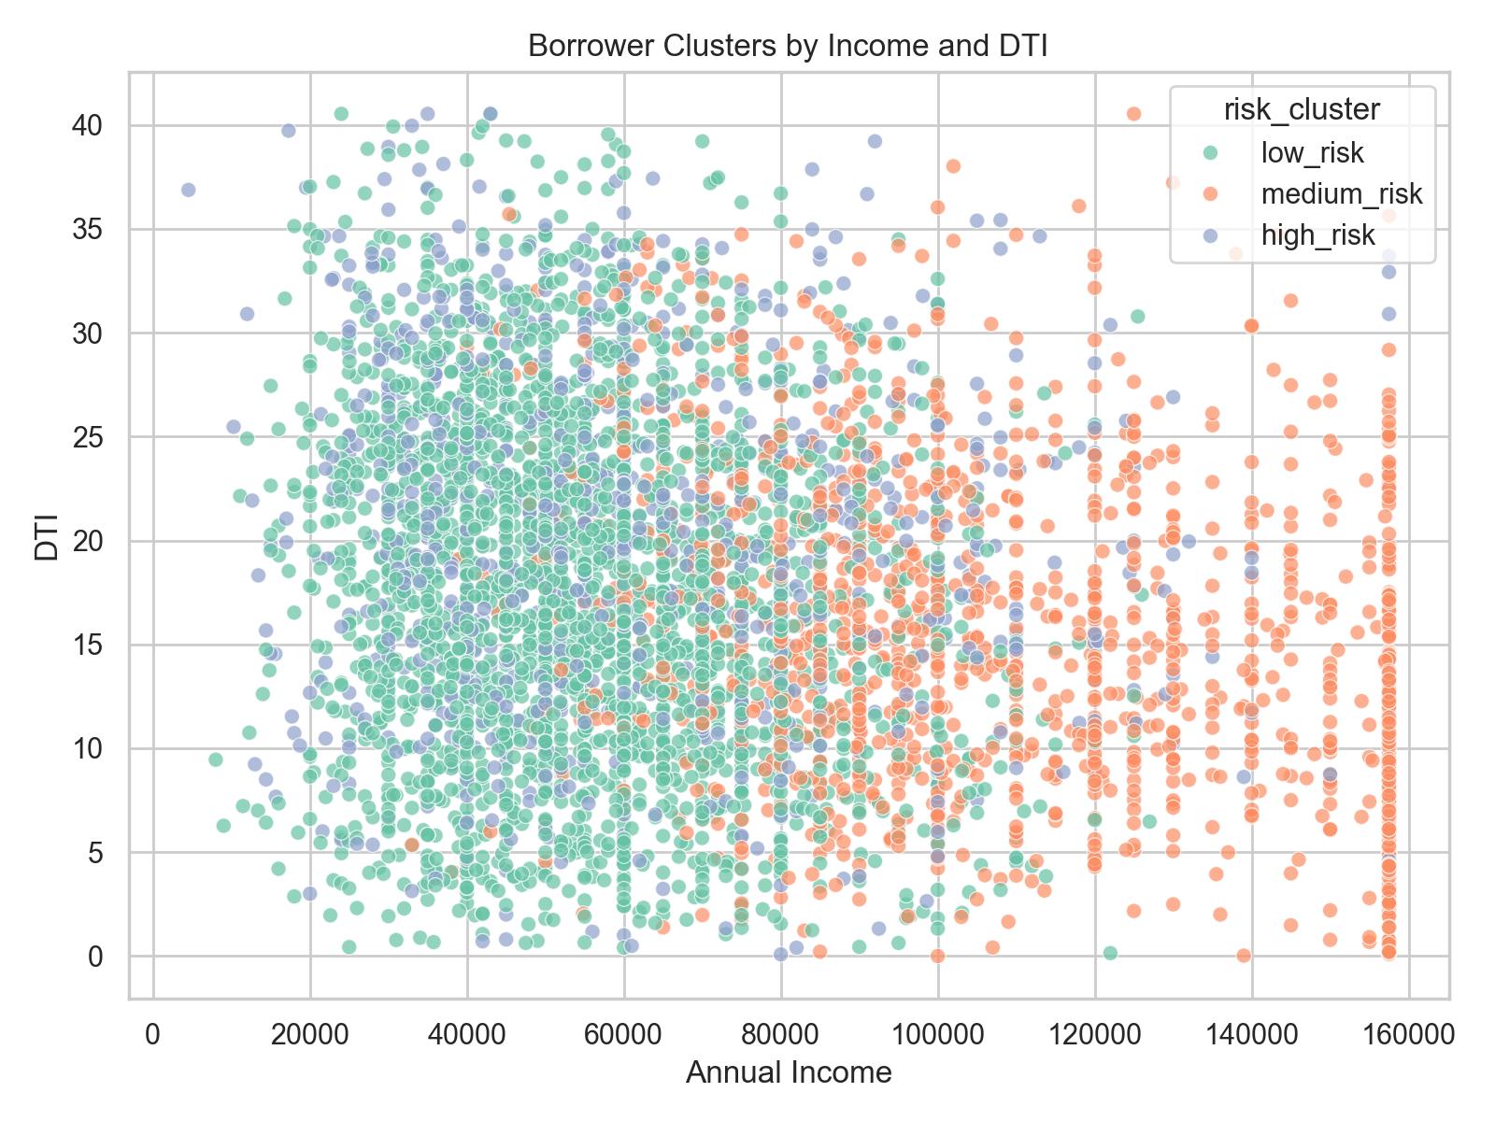
Cluster Visualization
K-Means borrower clusters by income and DTI

Slide 12
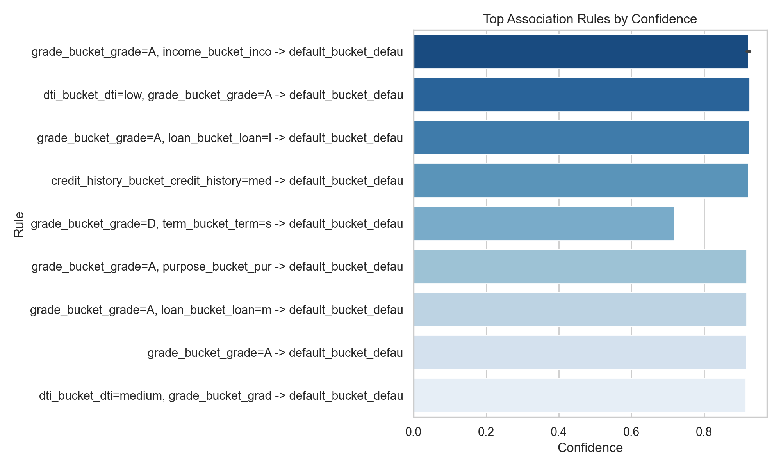
Association Rules
Top association rules ranked by confidence

Slide 13
System Implementation
Built a prediction module for default probability estimation
Added stage classification, interest recommendation, and what-if simulation
Demo output: default probability 0.081, non_default stage, low_risk cluster

Slide 14
Architecture Flow
Dataset
Preprocessing
ETL
Warehouse
Association Mining
Classification
Clustering
Visualization
System Output

Slide 15
Conclusion
The project covers DET syllabus Units I-IV in one workflow
It combines preprocessing, ETL, association mining, ML models, clustering, and visualization
The final system demonstrates practical loan risk prediction and analysis

