Slide 1

Data Hiding: Image Steganography
Submitted By:
Atit Kunwar, 191508
Utsab Maharjan, 191549
Sagar Nemkul, 191535

Slide 2
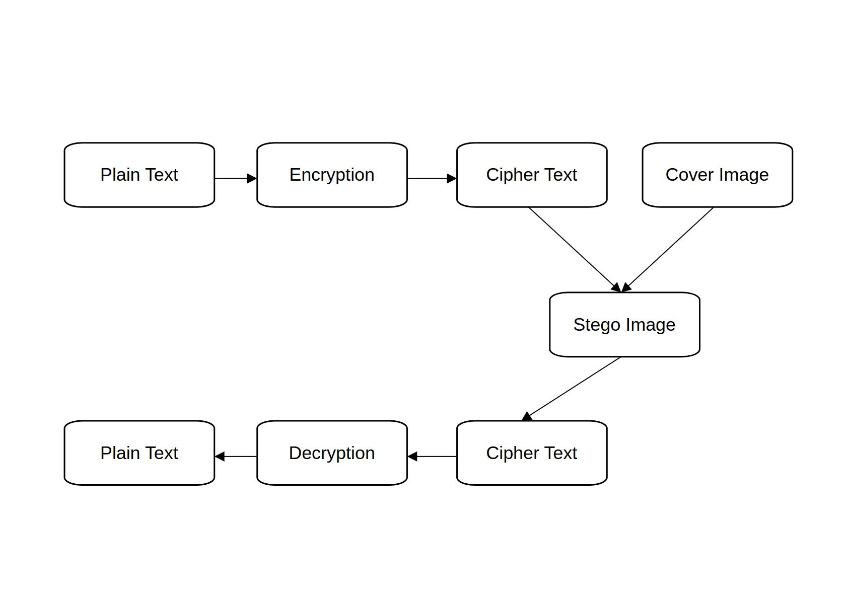
INTRODUCTION
Image steganography is technique of hiding data within image
Cryptography is the art of transforming data into cipher text
Goal is to hide secret data that is undetectable by any observer
Steganography differs from cryptography
Data are embedded in digital image, audio or video files
1

Slide 3
PROBLEM OF STATEMENT
Unethical use of steganography
How can a message be send secretly to the destination ?
Selecting the best algorithm for data security
Adjusting quality of image unnoticeable to Human Vision
Changed size of an image while steganography
2

Slide 4
PROJECT OBJECTIVES
Limit unauthorized access
Maintain Security while sharing data
To encrypt the secret data
3

Slide 5
SCOPE AND IMPORTANCE
Secure confidential information
Confidential data are converted to cipher text
Conceal the data in an image
Reveal hidden message using symmetric key
Limit unauthorized access
4

Slide 6
LITERATURE REVIEW
Steganography is used in conjunction with cryptography to hide secret information
In ancient Greece, messages were written in head and made them grow hair, send to the receiver and shave off hair to see secret message
During world war II invisible ink was used
5

Slide 7
METHODOLOGY
Used Incremental Software Process Model.
Each module consist analysis, design, coding, testing and documentation
Submodule adds a function to the previous release.
Each process continues until the complete system is achieved.
6

Slide 8
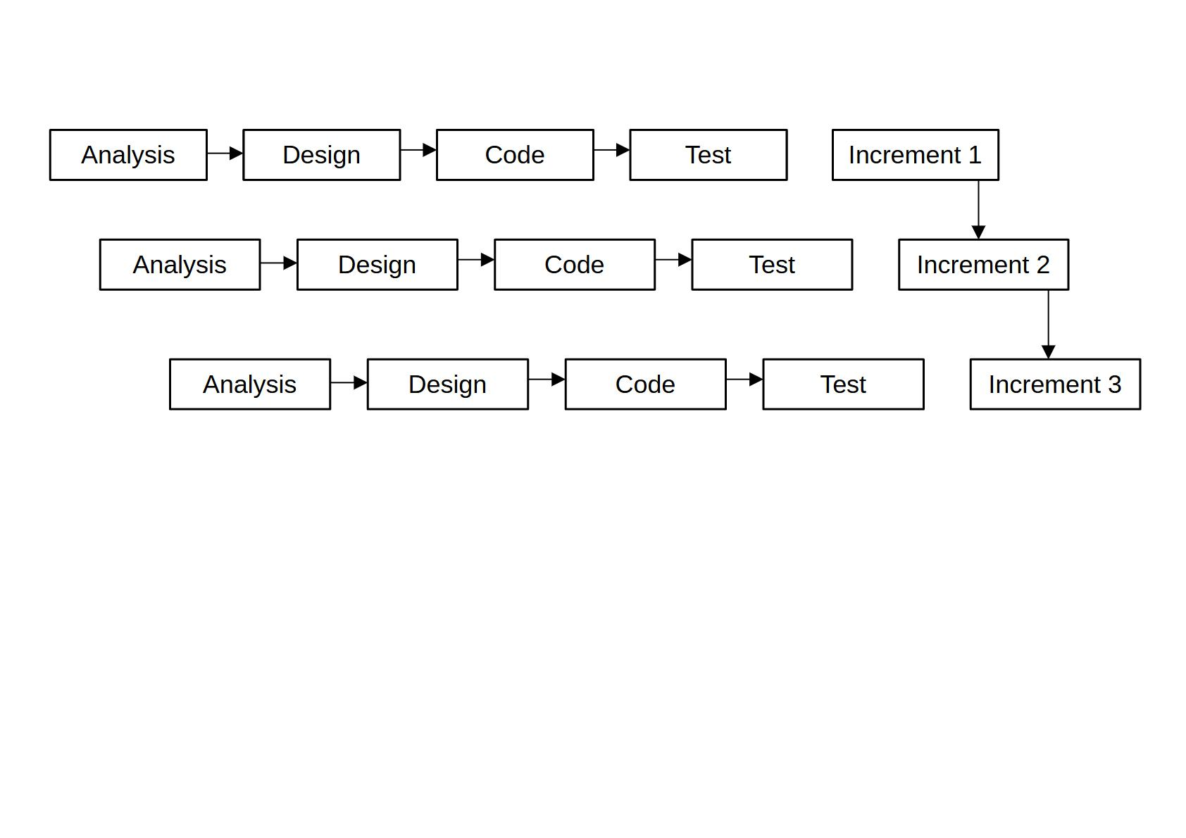
INCREMENTAL LIFE CYCLE
7

Slide 9
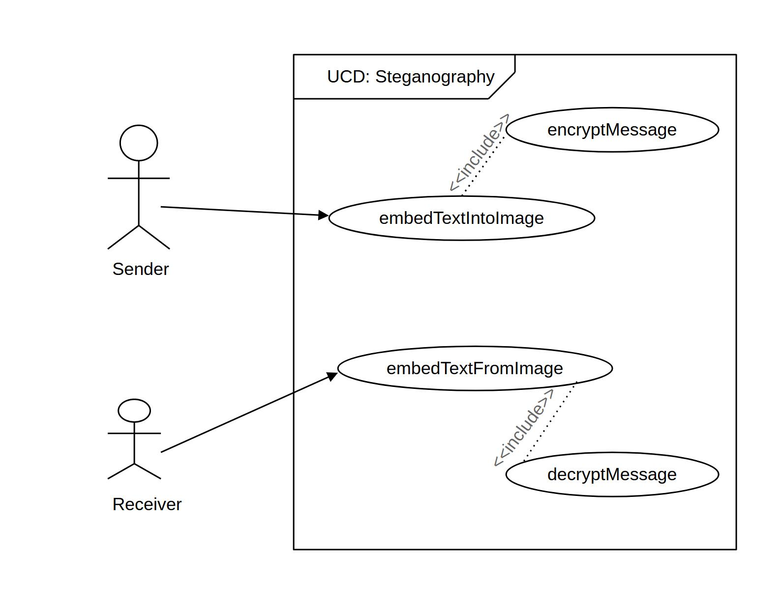
USE CASE DIAGRAM
8

Slide 10
chittra
9

Slide 11
SCOPE AND IMPORTANCE
•To hide data in an image
•Extract the secret message
10

Slide 12
SCOPE AND IMPORTANCE
•To hide data in an image
•Extract the secret message
11

Slide 13
SCOPE AND IMPORTANCE
•To hide data in an image
•Extract the secret message
12

